Slide 1
Running AliEn from CVMFS
Predrag Buncic
Miguel Martinez Pedreira

Slide 2
Installation
First step is installing CVMFS
Fetch the cvmfs repository information and install
rpm -Uvh http://cvmrepo.web.cern.ch/cvmrepo/yum/cvmfs/EL/6/`uname -i`/cvmfs-release-2-3.el6.noarch.rpm
yum install cvmfs cvmfs-init-scripts cvmfs-auto-setup
Specific versions can be used (like cvmfs-keys-1.4-1)
Edit (create if it does not exist) the file: /etc/cvmfs/default.local
CVMFS_REPOSITORIES=alice.cern.ch,atlas.cern.ch,atlas-condb.cern.ch,atlas-nightlies.cern.ch
CVMFS_HTTP_PROXY=http://ca-proxy.cern.ch:3128
Obtain the proxy in: http://cernvm.cern.ch/config/proxy.cgi

Slide 3
Installation
Run the config setup to configure autofs to use CVMFS
cvmfs_config setup
Verify with cvmfs_config chksetup -> OK and /cvmfs/<repo> mounted
If you want to take new changes done in the filesystem
cvmfs-talk remount
Set your AliEn environment as usual:
Certificates under .alien/globus
Env variables in .alien/Environment if needed
e.g. ALIEN_ORGANISATION=ALICE
If restarting services, better remove .alien/httpd folder

Slide 4
Run it
Prepare and set the AliEn environment for CVMFS
. /cvmfs/alice.cern.ch/etc/login.sh
alienv enter AliEn
You should receive a new input and be ‘inside’ CVMFS, start the services as usual
We have set a VoBox with running jobs, using CVMFS packages, succesful results
LDAP for packman: method = CVMFS
SLC6 with type FORK
Issue with the closeSE and APISCONFIG v1.1x
GCLIENT_SERVER_LIST ok, alien_CLOSE_SE=ALICE::CERN::Castor2

Slide 5
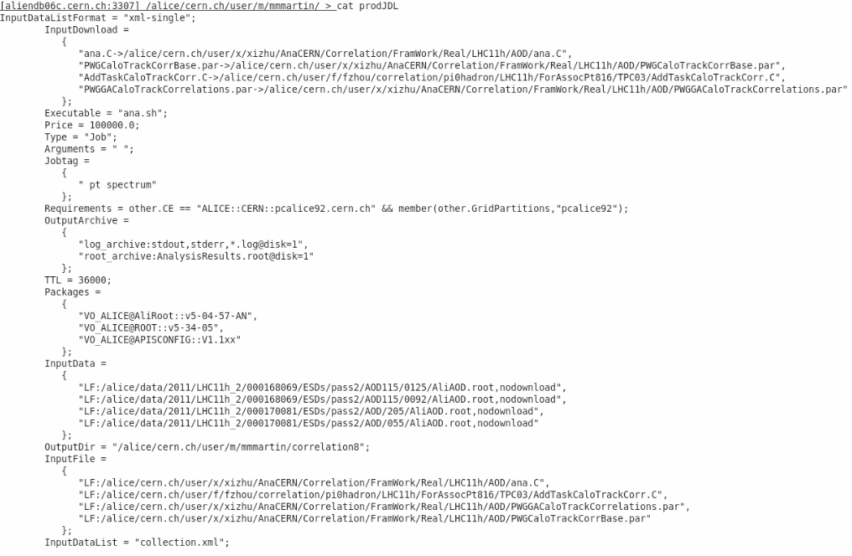

Slide 6
