Slide 1
CWG7
(reconstruction)
R.Shahoyan, 12/06/2013

Slide 2
New ITS
No principal decision on the readout type yet,
different readout schemes are in study:
  simultaneous snapshot of sensor matrix
  upon the trigger (not considered here since
  event data is already isolated)
  sequential readout (rolling shutter)
row N
row k+1
row k
row 1
J
row in readout at cycle J
readout direction
J+1
Collision happens during readout of row k at cycle J
⇒ hits on rows k+1:N will be read at cycle J,
hits on rows 1:k at cycle J+1
row (k) is inefficient during readout
Case of single row Rolling Shutter
N rows of sensor read out sequentially, single row is read in time τ, full cycle in T = Nτ
(N ~ 600-700, τ ~ 30 ns ⇒ T ~ 20 ns)
Cycles are indexed, the start time of each cycle is known precisely
Need 2 cycles to cover hits of single collision
Collision time (σ_{t}~25ns << T) is known from trigger
⇒ ~ T effective integration time (for the pile-up…)

Slide 3
Continuous readout with Rolling Shutter (case of single row RS)
Alternative ways of data extraction from the
detector upon the trigger signal:
  Continuous raw data: all cycles are read out
  w/o interruption, reconstruction is responsible
  for isolating the triggered collision
  using the trigger flag (time) as a reference.
  Only time frame relevant for trigger goes to
  raw data (smallest data size: preferred option?):
  cycle J (rows k+1:N) + cycle J+1 (rows 1:k)
    No problem of event separation(?): minimal time-frame covering triggered event is defined in DAQ
    But: need special handling for the case of 2nd trigger whose data overlaps with 1st one
      store in the 2nd event data of J(m+1:N)⊕J+1(1:k) already stored for 1st event
      ⇒ events are still isolated in the raw data
      ⇒ at high int. rate (almost every cycle is triggered) overhead of
      overlapping time frames may exceed the gain from reading only triggered cycles
      store 2nd event data starting from last row stored for 1st event: J+1 (row k+1)
      ⇒ no overhead in raw data from events overlap
      ⇒ events are not isolated: reconstruction needs to do this
      ⇒ At high rates (always in p-p ?) both continuous and “triggered frames” raw data contains the same information, just format ⇒ handling by reconstruction is different
m
k
J J+1 J+2 time/cycle
trig1
trig2

Slide 4
Possible reconstruction schemes
Clusterization: Need to define:
  cluster format
  container: access level: layer, cycle, “row “ (e.g. in-cycle time slice)
  handling of clusters split between 2 cycles
  Reconstruction: two extreme options
  Short time-frames, reconstruction has clusters for cycles J, J+1 only
  Find tracks fully covered by these cycles
  IF continuous raw data or “triggered frames” merged together
  Discard cycle J; if needed, suppresses used clusters of cycle J+1
  Fetch clusters of cycle J+2
  Repeat procedure
  ⇒ CPU-time overhead from considering collisions only partially covered by the fetched cycles as background hits (increases combinatorics to test, but its tracks will be discarded: they will be reconstructed at next step)
  ⇒ No memory overhead from keeping in scope large amount of clusters data
  Large time-frames: reconstruction has access to clusters for “unlimited” amount of cycles.
  Tracks are built with local check on cluster’s time slice compatibility;
  ⇒ No overhead on discarding incomplete track candidates to consider them again at next step
  ⇒ Overhead on storing/accessing many clusters by reconstruction
  Algorithms: most probably track finding will rely on ITS standalone traking;
  At the moment CA is prime candidate (CBM CA code is being adapted/assessed)

Slide 5
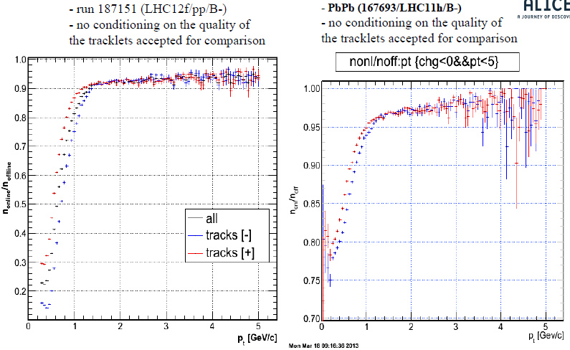
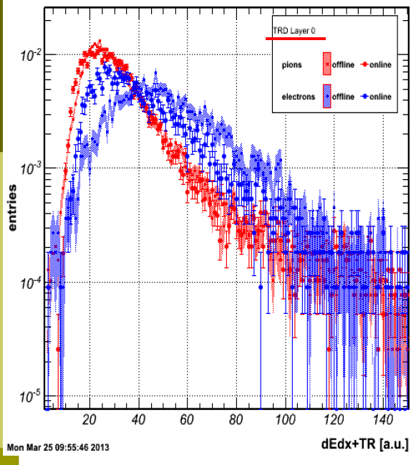
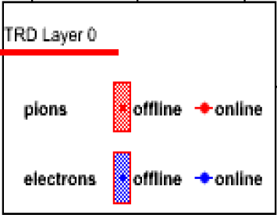
TRD
Online reconstruction
Current offline reconstruction is based on
offline tracklets.
Idea is to use the online tracklets built in FEE.
Main question: quality of the online tracklets
(speed vs TRD triggering capabilities)
The efficiency of building the online tracklets is
satisfactory (>90% wrt offline for Pt>1.5GeV)
The position resolution is also good but the
angular resolution is significantly worse:
  will not affect tracking capabilites
  will affect PID (need more study)
  Organization of the work still to be discussed within the TRD
  Possible improvement for Run2 (offline)
  Include TRD data into track kinematics update
  (larger lever arm ⇒ improved momentum resolution)
  Need better calibration/alignment.
  Work on global calibration/alignment framework to
  (re)start in July/August
A.Bercuci
pp
PbPb
online/offline
online/offline
pp

Slide 6
L.Aphecetche
MUON
Goal for run3: have fully online reconstruction for Run3
As much as possible for Run2; If full online reco is impossible, then do online preclustering,
store in hltESDTree to finish processing offline (much faster)
Current HLT code does not allow for full track reconstruction (but can be used as a starting point)
  simplified clustering
  Station within the dipole is not used
  trigger information used (will not be available in Run3)
Organizational difficulties: not much expertise in HLT (need training),
some people who worked before for HLT Muon are not in Muon anymore.
Even for the offline code some critical parts (clustering) was written by person who quit Alice
Currently assessing CPU/memory consumption. CPU hotspots identified (in p-Pb):
~80% of time: clusterization, 20% : tracking/matching to trigger
tracking dominated (~64%) by B-field queries (field map access can be optimized)
Short-term plans: once profiling CPU/profiling is done, investigate speed-up solutions
for pre-clustering.

