Slide 1
Fourth LHC Splices Review
Quality Assurance Review
Review of actions from 3 last reviews
NB : 8 non-closed ones from 1st review
5 non-closed ones from 2nd review
18 actions from third review

Slide 2
Review I: II.2 3) p5/14 : Hot spot calculations.
Include in the integrated system surveys the temperature limits of the various components of each circuit. Perform the calculations to determine the maximum temperatures for the components in the different circuits. Check to see that there is an appropriate margin for the maximum temperature of the circuit components and that the overall risk are balanced between voltage and temperature.
2nd Review: Work in progress. This analysis should be completed, at least for the more critical elements, before LS1 to be able to profit from anything that is learned from the analysis.
3rd Review: In the second review, we recommended that this analysis should be completed, at least for the more critical elements, before LS1 to be able to profit from anything that is learned from the analysis. Models now exist that enable these calculations to be done; however nothing specific regarding the balancing of temperature and voltage limits was presented at this review. => Open
Not part of this review, probably still open

Slide 3
Review I: II.3 3) p7/14 : Multiple samples to get experience
Make multiple samples/trials of critical steps, as part of a qualification plan to be developed, to get a statistically significant basis for assessing the risks of there being any important imperfections in the machine after installation
2nd Review : Have done multiple tests on many variants of the splice repair components. Once the design is completed, a statistically significant number of samples of the final design still need to be tested
3rd Review: In the second review, we commented that a statistically significant number of samples of the final design still need to be tested. Large number of splice test for database purpose has not yet been demonstrated. => Open
More was done, now sufficient return from production so probably to be closed

Slide 4
Review I: II.4 4) p9/14 : Contingency and extra resources
The planning needs to take account of the possibility of unforeseen developments that will slow down or disrupt the orderly work flow. For example, a larger number of splices than the currently estimated 15% may be required to be remade, or problems with the machining of the copper stabilizer could arise. Include schedule contingency into the baseline and ensure that additional resources are available to able to maintain the schedule.
2nd Review: Little progress since last year
3rd Review: The manpower and budget contingency are minimum. The number of special intervention teams may not be sufficient. => Open
Not formally part of this review, 3rd review’s comment probably still valid => Open

Slide 5
Review I: II.5 4) p11/14 : Tooling calibration plan
A verification and calibration plan for the special tooling should be drawn up and implemented to assure a constant quality of the work throughout the production
2nd Review: Nothing presented at this review.
3rd Review: All the special tooling developed for the main bus-bar splices are well developed and tested. However, little was presented to us regarding a QA program for the tooling itself, i.e.procedures and standards which would verify the proper functioning of the special tooling, including both the tools used to do the repair work and the tools used to verify the quality of the work. => Open
See presentations from this review

Slide 6
Review I: II.6 1) p12/14 : Alternative scenario with unforeseen issues
Study alternate scenarios in view of optimizing the utilization of the critical resources that will certainly be limited (in terms of qualification and experience). Study unforeseen/unexpected scenarios
2nd Review: No evidence that this has started
3rd Review: A well planned schedule including allocation of resources in time and space has been developed. This plan seems adequately optimized. => Closed
Study unforeseen/unexpected scenarios.
Nothing was presented regarding any risk analysis. => Open
Not formally part of this review, as many contingency as possible has been included
List of competent staff not involved in SMACC has been defined

Slide 7
Review I: II.6 2) p12/14 : Risk analysis
CERN should insure that enough resources are allocated to ensure that the risk assessment and subsequent risk analysis can be executed on the planned time scale
2nd Review: Excellent work was done on the screening exercise, but it is important that the recommendations that result be implemented. It should be the goal to complete the critical ones before LS1
3rd Review: This has been done for all required consolidation activities except for the DFBA repairs where both the design of the repairs and the tooling and procedures are still being developed. => Open
See presentations from this review

Slide 8
Review I: II.7 3) p14/14 : Actual operating voltages
Determine the actual operating voltages to judge required hipot levels
2nd Review: In progress, but new hipot voltages have not been formally established.
3rd Review: A new set of hipot test voltages has been proposed following a systematic analysis of the operating voltages. However, the previous specification (LHC-PM-ES-0001 rev. 2.0) has not yet been updated and therefore the previous test voltages remain the official ones. => Open
See ELQA presentation at this review
Review I: II.7 5) p14/14 : Simultaneous hipots of different buses
Consider simultaneous hipots of different buses to test bus-to bus withstand capability without going to needlessly high hipot stresses
2nd Review: This technique seems not to have been considered as part of the re-evaluation of hipot voltages. It should still be considered.
3rd Review: The evaluation of bus-to-bus and coil to heater voltages has been included in the development of new hipot test voltages, but the hipot voltage specification (LHC-PM-ES-0001 rev. 2.0) has not yet been updated. => Open
See ELQA presentation at this review

Slide 9
Review II: 4 II.1 p4/11 : Procedures for training
Write detailed manufacturing procedures and QA procedures within the next few months in order to be used for the training of the crews.
3rd Review: Most if not all procedures have been written, a number are released, others being at the approval stage. Most notably, the assembly and QC procedures for the DFBA repairs are still under development, and these need to be completed soon to ensure adequate time for checking them and then using them to train the repair personnel. => Open
See presentations at this review and DFBA review, probably to be closed

Slide 10
Review II: 6 II.2.2 p4/11 : Consolidated QC plan, clarify criteria
Consolidate the QC plan, in particular on how to implement the plans and procedures and some of the qualification criteria which have not yet been clarified.
3rd Review: The QC plan appears to be complete and well detailed, including criteria. A QA plan for interconnects has been established which covers all aspects: sequence of activities, QC’s,calibration of tools, training and audits of personnel and procedures, maintenance, traceability, etc…Still to be addressed or detailed : a clear list of responsible personnel for the different levels of NC management. => Open
See presentations at this review, probably to be closed

Slide 11
Review II: 9 II.3.3 p6/11 : Consolidate DFBA splices
Apply shunts to the 13 kA splices in all DFBAs, including the most difficult circuits Repair these joint up to the same standards and based on the same designs as in the magnet to magnet interconnect. Splice repairs should be done by the same crew that repairs the magnet to magnet interconnects.
3rd Review: Work is in progress (see comments and recommendations in DFBs section), but it should be the goal to complete all the tasks before LS1. => Open
See presentations at this review and DFBA review: probably to be closed

Slide 12
Review II: 11 II.3.3 p6/11 : Study methods to lower risks for specific DFBAs
Investigate methods and/or procedures that would lower the risk of repair of the two DFBAs that require re-location to perform the work.
3rd Review: Ongoing. For DFBAP an external Cu bypass cable is proposed and for DFBAK a in situ solution is being studied without disconnecting the HCM. => Open
See presentation at this review, probably to be closed

Slide 13
Review II: II.4 p7/11 : Address the recommendations that remain open from the previous review before the next review.
3rd Review: Of the 17 recommendations from the 1st review that were open as of the 2nd review, 9 are considered by us to be closed and 8 to remain open (including II.6.1, part of which is closed). Of the 17 recommendations from the 2nd review (not counting this one), we consider 13 to be closed and 4 to remain open. => Open

Slide 14
Review III: 1 The knowledge accumulated in the written procedures should be transfer through the training courses to the new operators.
See presentation at this review,
Formal training course and certificate given to the operators
Probably to be closed
Review III: 2 Supervisors and activity managers should take care of the good execution of the procedures in all their details especially when the routine will be installed.
See presentations at this review and visit to the LHC tunnel

Slide 15
Review III: 3 The management of both expected and “unknown” non-conformities and the flowchart for the decision should be detailed and the right level of approval (experts, activity manager, project leader, etc..) defined before the start of the work in April 2013.
See QA presentation at this review,
Probably to be closed
Review III: 4 Define the procedures and approvals for the case that “some acceptance criteria may be modified following the experience of the first LHC sector”.
See QA presentation at this review,
Probably to be closed

Slide 16
Review III: 5 Open joints and make R8/R16 measurements of splices previously measured during 2009 as early in the shutdown as possible. Compare the current values with those from before the physics run and reconsider the 5 μΩ criterion if any significant changes are observed.
See ELQC presentation at this review,
Planned and on-going
Review III: 6 Finalize the design and the choice of the final solutions for the special DFBs by the end of January 2013.
See DFBA presentation at this review,
Probably to be closed

Slide 17
Review III: 7 Re-evaluate the proposed solution for the DFBAP of the copper bypass cable and present the analysis at a subsequent review prior to making a final decision.
See DFBA presentation at this review and the DFBA review,
Probably to be closed
Review III: 8 Complete the validation, qualification and tests of the DFBA repair solutions and procedures by the end of January 2013.
See DFBA presentation at this review and the DFBA review,
Probably to be closed

Slide 18
Review III: 9 Develop a detailed schedule for the DFBA repairs, including the sequence of operations, their durations and the required resources by the end of January 2013.
See DFBA presentation at this review and the DFBA review,
Was done
Under revision with recent experience from DFBAK (L6)
Review III: 10 Finalize procedures, QC plans and other documentation for the DFBA repairs before mid-February 2013.
See DFBA presentation at this review and the DFBA review,

Slide 19
Review III: 11 Conduct a final design and production readiness review for the DFBA repairs no later than mid-February 2013.
DFBA review was conducted in February 2013
Probably to be closed
Review III: 12 Revised bolting material and procedure for bolted contact in the quadrupole diode should be qualified and finalized before February 2013 that allows two month lead time for training the operators before LS1.
See presentation at this review
Probably to be closed

Slide 20
Review III: 13 Resource-loaded schedule for production and testing of the diode stack should be planned as soon as possible in order to dispatch the work to technicians.
Not part of this review
Review III: 14 Perform a risk analysis considering all the things that can go wrong, and develop mitigation strategies to deal with each, should it occur, prior to the start of the LS1 work in the tunnel
Contingency was put in the schedule
As early start as possible philosophy applied
Inventory of trained immediately efficient staff was drawn

Slide 21
Review III: 15 Put in place a plan to develop and increase the number of highly experienced staff and supervisors over the course of the shutdown, the number of whom seems to set the limit on the rate of work.
Inventory of trained immediately efficient staff was drawn
Probably still open, obsolete ?
Review III: 16 Develop a list of “scope contingency” items among the tasks planned during LS1; that is, work which is less essential to complete during LS1 which could be dropped in order to allow the essential work to be completed on schedule. Although this review committee is charged to look only at the SMACC Project, we believe that this recommendation should apply globally to the work done by CERN during LS1.
Critical choice of activities to be included was done
Any further modification is srutinized carefully by CERN management
Probably still open, obsolete ?

Slide 22
Review III: 17 Keep a strong focus on safety and quality as higher priority than schedule and to the extent possible, shield those doing the work from stress due to schedule pressure, in order to guard against the risk of mistakes being made or shortcuts being taken due to schedule pressure.
So far OK
Continuous ? To be reinforced ?
Review III: 18 Identify, before the start of the shutdown, the individuals and groups that will be responsible to make judgments on non-routine non-conformities to ensure both that the required expertise exists and that there are enough experts that decisions can be made in a timely way without undue stress on the experts.
See presentations at this review
Probably to be closed

Slide 23
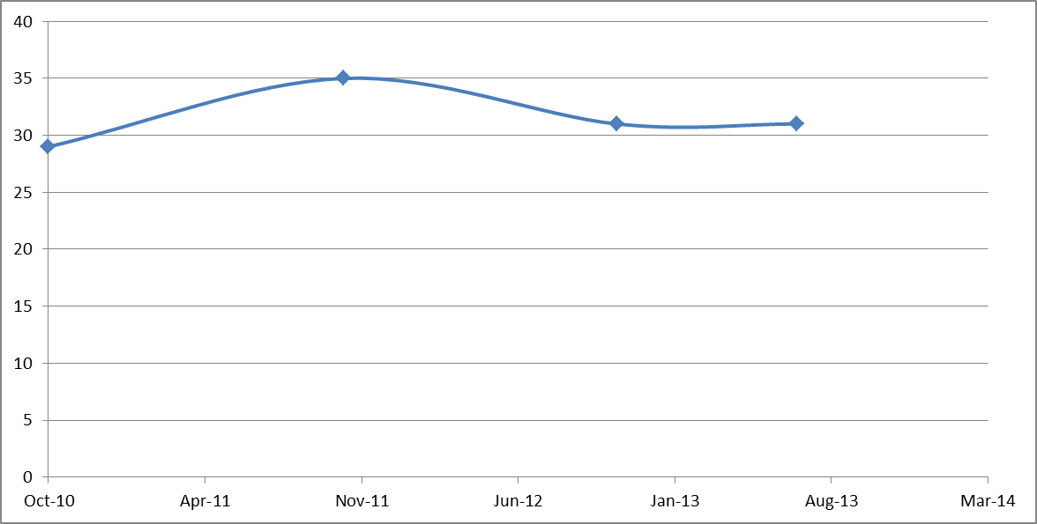
Review Date | Rev 1 Oct-10 | Rev 2 Nov-11 | Rev 3 Nov-12 | Rev 4 July-13
1 | 29 | 17 (12) | 8 (9)
2 |  | 18 | 5 (13)
3 |  |  | 18
4
TOT open | 29 | 35 (12) | 31 (22)
?

