Slide 1
Fourth LHC Splices Review
Quality Assurance Review
Introduction
Why this 4th review ?
Committee, mandate
Questions to the reviewers
  Overall Quality Assurance Aspects
  Specific questions
  Follow-up
Programme of the review

Slide 2
Why this ?
Fourth LHC Splices Review
Quality Assurance Review
General mandate
To review CERN’s plans and consolidation actions concerning the superconducting splices in the LHC machine for 7 TeV operation
Specifically:
To work in close liaison with the CERN Splices Task Force,
To consider all splices over complete circuits, within and between equipment.
To ensure “best practice” knowledge existing in world Laboratories and Industries has been duly considered.
To ensure that an integrated, systems approach is being followed, covering both electrical and mechanical issues, neighboring systems, operations, …

Slide 3
Why this ?
Fourth LHC Splices Review
Review 1 to assess:
  the design for the consolidation of the main 13 kA interconnection splices
  the plans for the work organization, quality control, resources, schedules
  the status and risk analysis of all superconducting splices in LHC.
Review 2 to assess:
  the final design for the consolidation of the main 13 kA interconnection splices
  the status and risk analysis of all superconducting splices in LHC
  the quality control procedures and plans
  the update of the plans for the work organization, quality control, resources, schedules
October 2010
Report form the first LHC Splices Review: “Although the design is well beyond the conceptual stage, it is not yet a final design, and this review cannot be considered a final design review. Therefore, although the conceptual design appears to be good, the committee cannot fully assess the soundness of the design until it is final. Another review, when the design is final, or nearly so, may be advised.”
November 2011
Report form the second LHC Splices Review:
“The Task Force has made substantial progress in developing designs for repairing the main 13 kA bus splices, in planning for the long shutdown…and in assessing other risks that could compromise the integrity of any of the many superconducting circuits in the LHC..
The main features of the dipole bus are a double shunt and an insulating cover. The design of the shunts and the techniques for soldering them across the joints are well done and have been fully tested under an array of conditions. This appears to meet all requirements.

Slide 4
Why this ?
Fourth LHC Splices Review
Report form the second LHC Splices Review:
“The insulating cover design is still evolving…This is a clever design which provides the required functionality in the presence of non-negligible splice-to-splice dimensional variations. However, the precise implementation of this scheme still needs to be developed… the design of this crucial element is not yet final, and we are unable to determine that it meets the requirements.”
“At the first review, we recommended that a double shunt be applied to the quadrupole bus.The Task Force has tried a number of possible ways of implementing this recommendation, but has not found any that are satisfactory. However, there have been several other mitigations, which if properly implemented would tend to reduce the risk to the quadrupole bus splices. These include a plan to reduce the dump time constant from 37 sec to 20 sec, a better defined set of criteria for deciding which joints need to be remade before applying the shunt, and the development of what we hope will turn out to be an insulating box that provides robust mechanical support which will limit the stresses in the soldered joints. We believe that if all three of these are fully implemented, then the single shunt design would represent a reasonable level of risk relative to other scenarios..”
“A task force has performed a comprehensive survey/screening of all superconducting circuits in the LHC … recommendations have been presented, and most are being acted upon … it will be equally important for CERN to apply the resources necessary to address the recommendations in a timely fashion...”
“It has just been decided that the 13 kA splices inside all of the DFBAs shall also be repaired… The design work has not begun yet, and therefore we cannot comment…”
“… although the overall planning looks reasonable, many of the details still need to be filled in…”

Slide 5
Why this ?
Fourth LHC Splices Review
Review 3 to assess:
  the readiness for the shutdown intervention: specifications, procedures, quality control methodologies, qualifications, resources, schedule
  the remaining pending design issues
November 2012
Report form the third LHC Splices Review:
We believe that the Superconducting Magnets And Circuits Consolidation (SMACC) team is ready (or nearly so) on almost all aspects required for the work during LS1, and we expect that the remaining preparations will be successfully put in place in time for the start of work in April.
“One area of concern is the DFBA splice repairs. We recommend that CERN conduct a final design and production readiness review of the DFBA repairs no later than mid-February.”
“Schedule and resources appear to be adequate, but with little margin”
“Keep a strong focus on safety and quality as higher priority than schedule and to the extent possible, shield those doing the work from stress due to schedule pressure, in order to guard against the risk of mistakes being made or shortcuts being taken due to schedule pressure”
“The approach to QA/QC taken by the SMACC team, to work towards continuous improvement of quality by examining trends in addition to simply identifying and correcting non-conformities, is commendable”

Slide 6
Why this ?
Fourth LHC Splices Review
Report form the third LHC Splices Review:
“It is important to test how the current management with WISh can handle the schedule deviation associated with non-conformities.”
“Although the schedule appears to include some contingency, the contingency for manpower … is minimum. One should take in to account the events such as
  A larger number of splice remade (more than 15%)
  Problems with the machining of the copper stabilizer
  A larger number of M-flange replacement (requires full splice remade)”
“Decision making procedures for unknown non-conformities are not well presented.”
“«some acceptance criteria may be modified following the experience of the first LHC sector» The procedure for such critical decision is not well defined.”
“The conditions related to the use of a single shunt for the quadrupole bus are satisfactorily met provided the established criteria for deciding when to re-make a joint are rigorously applied.”
“Revised bolting material and procedure for bolted contact in the quadrupole diode should be qualified and finalized before February 2013 that allows two month lead time for training the operators before LS1.”
“The rate at which the work can be accomplished is ultimately limited by the number of highly experienced staff who can be trusted to lead and perform critical activities and the number of supervisors available to work in the tunnel.”

Slide 7
Why this ?
Fourth LHC Splices Review
Report form the third LHC Splices Review on DFBA aspects
“One area of concern is the DFBA splice repairs. We recommend that CERN conduct a final design and production readiness review of the DFBA repairs no later than mid-February.”
“Finalize the design and the choice of the final solutions for the special DFBs by the end of
January 2013.”
“Complete the validation, qualification and tests of the DFBA repair solutions and procedures by the end of January 2013.”
“Finalize procedures, QC plans and other documentation for the DFBA repairs before mid-
February 2013.”
“Re-evaluate the proposed solution for the DFBAP of the copper bypass cable and present the analysis at a subsequent review prior to making a final decision.”
“Conduct a final design and production readiness review for the DFBA repairs no later than mid-February 2013.”

Slide 8
Why this ?
Fourth LHC Splices Review
February 2013
Review of the Design and Production Readiness of the DFBA Splice Consolidation:
  The main objective of this review was to assess the readiness of the consolidation actions envisaged for the DFBA splices as well as the lyras in the shuffling modules. Particular attention was devoted to the DFBAK and DFBAP, for which the disconnection from the continuous cryostat had been considered necessary.
Report form the DFBA Splices Consolidation Review: (EDMS 1276910)
“The procedures as well as the quality control of the mechanical interventions and the splice consolidation were discussed in length.”
“While the preparation of the consolidation actions … (i.e. mechanical interventions and splice consolidation) appeared well matured, the Panel identified a few areas where further work is needed:
* the splice consolidation (where the soldering procedures remain to be verified to be inline with the state of the art)
* the consolidation of the lyras (where a study of the forces in play, the integration, the layout is needed) as well as to further training of the operators for the insertion of the constrains
“The Panel also recommends that adaptive solutions are applied to strongly non-conform splices limiting the redoing of the splice anew only when strictly necessary”
“For the DFBAP consolidation, the long global bypass solution should be abandoned now and the resources redeployed to develop an extended Plan A (e.g. prepare for non conformities).”
“Before the summer, a quality audit must be organized to check the work is progressing according to procedures and plan of the DFBA Splice Consolidation project.”
“With the reserves described above, the Panel acknowledges that the team is ready for the consolidation of the DFBAs.”
“The DFBA splice consolidation must be included in the next review of the SMACC Project that should take place in summer 2013, after completion of the first sector.”

Slide 9
Why this ?
Fourth LHC Splices Review
Review 4 and committee
Review 4 to perform a Quality Audit to assess (R Ostojic):
  whether the status of LHC corresponds to what was expected
  if implementation actions correspond to the plan
July 2013
Purpose:
  to review the quality of the consolidation activities of the LHC superconducting circuits and magnets (SMACC)
  to analyse the trends, and to consider any changes in the procedures that may be required following the consolidation of the first sector(s).
The Review committee:
George Ganetis / BNL
Chen-yu Gung : ITER
Howard Pfeffer / Fermilab
Alain Poncet / CERN
Jim Strait / Fermilab : Chairperson
Pierre Vedrine / CEA Saclay
Some changes in the review committee:
  Toru Ogitsu / KEK and H Ten Kate (CERN) cannot attend

Slide 10
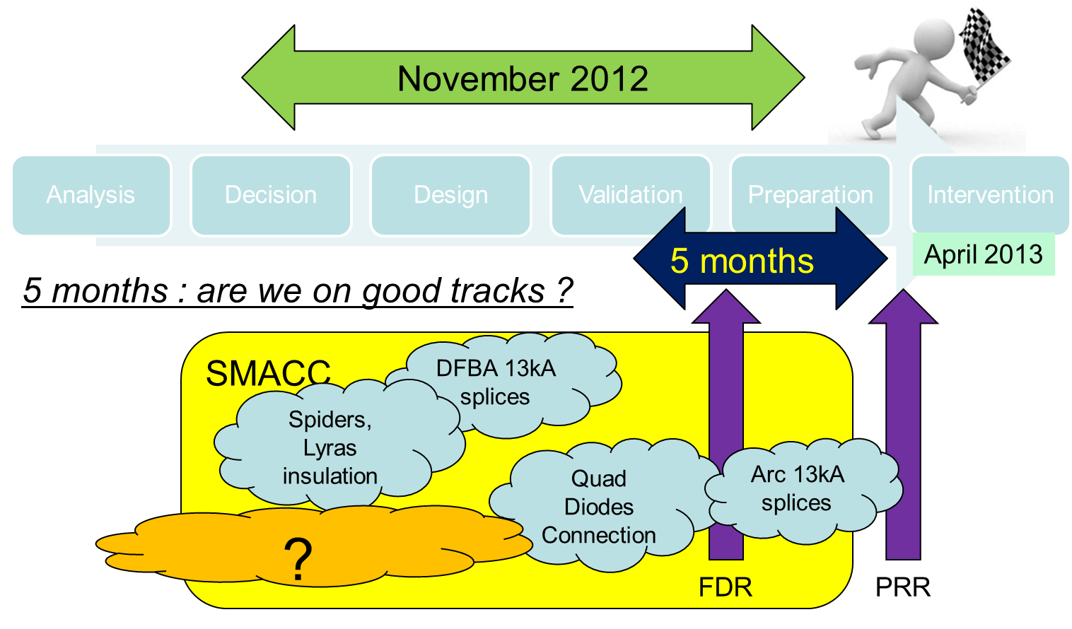
Fourth LHC Splices Review
Quality Assurance Review
Where are we today ?
Today
Powering Tests
Start of intervention
End of SMACC
Warm-up
Closure of 1st sector
July 2014
August-October 2013
08.04.2013: First opening of IC Now: > 55%
24.04.2013: First shunt installation Now: > 15%
08.05.2013: First M line welding Now: ≈ 3%

Slide 11
Fourth LHC Splices Review
Questions to reviewers (1/3)
Overall Quality Assurance Aspects
Is the previously defined and approved baseline correctly implemented ?
Are modifications/adaptations triggered by the worksite experience correctly managed and justified?
Are there critical activities / teams especially QA-QC ones for which resources should be reinforced ?
Is the decision line for NC management clear and adequate ?
Is the daily/weekly QA follow-up adequate, allowing to reach the required (safety), quality (and production) SMACC objectives ?
What can be improved (realistically) ? What should be the priorities ?

Slide 12
Fourth LHC Splices Review
Questions to reviewers (2/3)
Specific questions
More splices have to be redone, mainly for geometrical reasons. The present strategy is to undo and redo splices according to the validated procedure. Would you recommend to develop an alternative procedure, able to cope with larger geometry defects ?
Are there (EL)QC that could be skipped ? (R_8 after Cu machining,….)
Is the frequency of ELQA test (daily) adequate ? Could it be safely reduced?
Comment on the damaged cable in sector 56? Can you comment on an intervention strategy ?
What is your feedback on the Review of the Design and Production Readiness of the DFBA Splice Consolidation ?
Some technical aspects to be watched closely:
  DFBA, Consolidation of the diodes, Insulation system modification, shortening of the long RQF/RQD busbar segments (Pts 1&5),…
  NB: CSCM out of scope

Slide 13
Fourth LHC Splices Review
Follow-up
Have the recommendations from last reviews been correctly implemented and followed-up?
Do you see a 5th review useful to compile lessons learnt / prepare LHC (re)commissioning tests ? When ?
Do you see an (internal) organisation review useful ?
At the end of the first sector (Sept-Oct 2013)?
Do you have proposals for improvements ?
NB: * The SMACC projects ends technically sector by sector, with the pressure tests (and the possible ensuing corrective actions)
* Time and resources are limited
* Do not hesitate to ask for clarifications, demonstrations

Slide 14
Fourth LHC Splices Review
Programme of the review (1/4)
  Monday 22 July
  09:00 01:00 Committee training for tunnel tour
  10:00 03:00 Committee tunnel tour
  16:00 01:30 Committee preparation session
  Tuesday 23 July
  08:30 01:00 Introduction – Status – Overview of SMACC QA
  09:50 02:00 Status of production activities and internal QC
  14:00 04:00 QC of consolidation activities
  Wednesday 24 July
  08:30 00:30 Committee closed session
  09:00 03:00 Response to reviewers questions, discussion
  14:00 Committee closed session
  17:00 Preliminary conclusions J. Strait

Slide 15
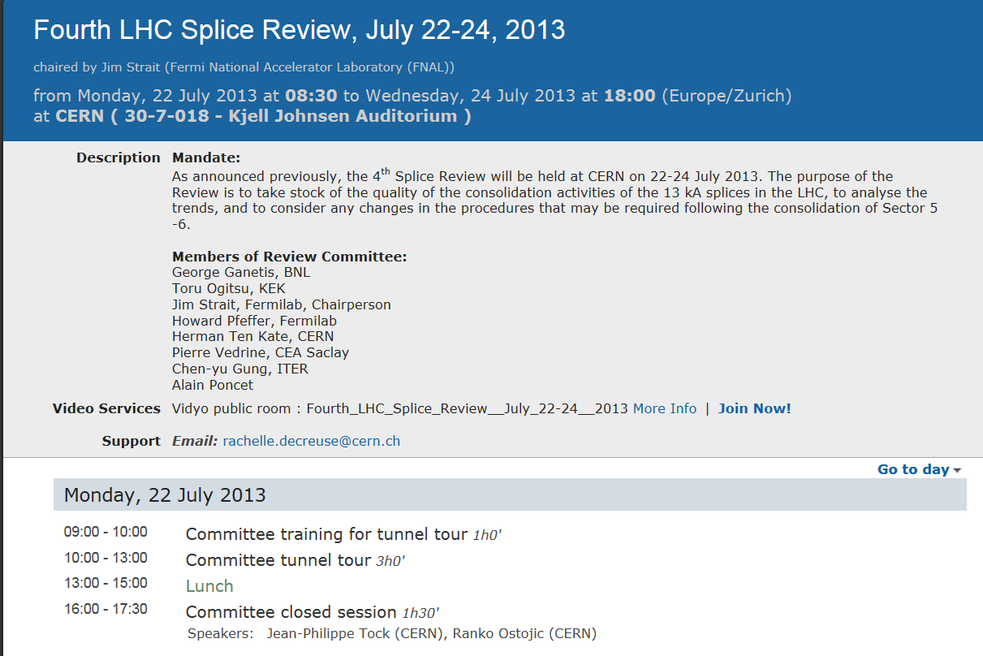
Fourth LHC Splices Review
Programme of the review (2/4)

Slide 16


Fourth LHC Splices Review
Programme of the review (3/4)

Slide 17
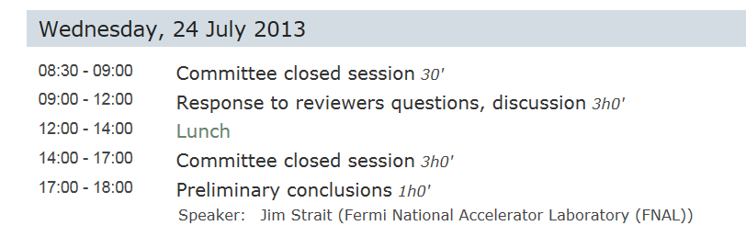
Programme of the review (4/4)

Slide 18


Fourth LHC Splices Review
Thank you for accepting this charge and being here
We are here to answer your questions
The three first reviews were useful and recommendations relevant :
          “The management of both expected and “unknown” non-conformities and the flowchart for the decision should be detailed and the right level of approval (experts, activity manager, project leader, etc..) defined before the start of the work in April 2013.”
          “The planning needs to take account of the possibility of unforeseen developments that will slow down or disrupt the orderly work flow. For example, a larger number of splices than the currently estimated 15% may be required to be remade, or problems with the machining of the copper stabilizer could arise. Include schedule contingency into the baseline and ensure that additional resources are available to able to maintain the schedule”
          ...

Slide 19
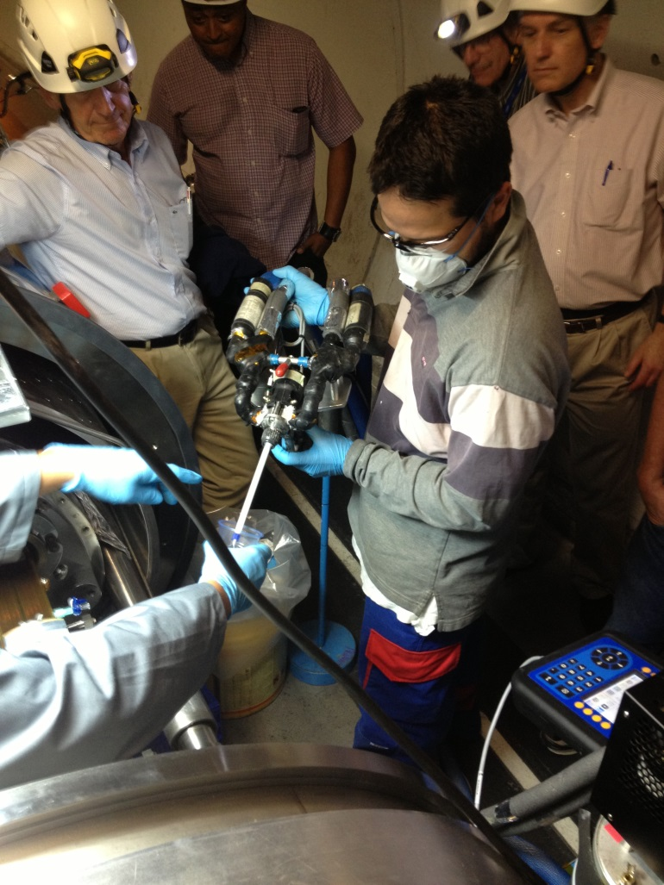
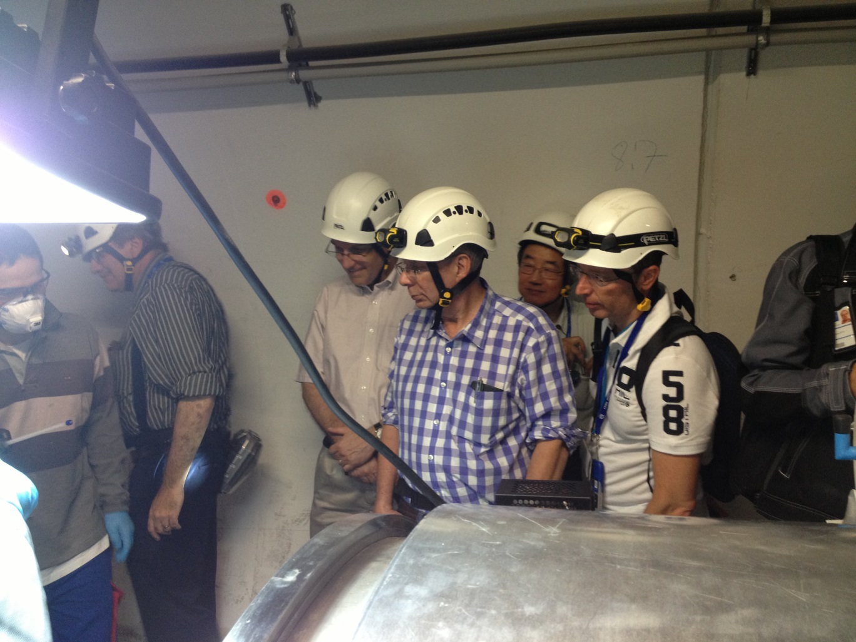
Fourth LHC Splices Review

