Slide 1
Overview of SMACC-QA
Recall of SMACC-QA organization
Tuning the procedures
Main results from the QC teams
Auditors findings
Ranko Ostojic
23 July 2013

Slide 2
Long Shutdown 1
F. Bordry
SMACC: J-Ph. Tock
Quality Assurance
R. Ostojic
Open/Close IC & DN200
A. Musso
Main arc splices consolidation
F. Savary
Electrical QC: C Scheuerlein
- Welding QC: JM Dalin
Beam vacuum QC: C Garion
Open/close IC QC: D Bodart
QA support
Opening/ Closure of IC
Partial and complete
W bellows & ther. shields
Installation of DN200
Sleeves cutting
Splice de/resoldering
BB surfacing
Shunt installation
TIG welding
S. Atieh
Special interventions
N. Bourcey
ELQA
K. Dahlerup
Leak Tests
P. Cruikshank
- Orbital & manual
Cryomagnets exchange
Connect. Cryostat cons.
PIMs
Specific issues
Heavy NC
DFBA
A. Perin
Continuity
HV test
Beam lines
Cryogenics lines
Insulation vacuum
Splices and BB
Coordination, Support and Infrastructure
M. Pojer
Radiation protection
Safety
Access
Coordination with
Survey, Instrumentation, Transport, LS1 planning, QPS, cryogenics,…
Test teams on a chain of IC
Reporting tools

Slide 3
SMACC-QA Organization
Production Inspections
Actor: Operators and supervisors
Level: Interconnection
Documents: IP for each activity
CERN Audit
Actor: Team of experienced CERN staff
Level: All
Documents: IPs, TPs, CERN rules
Quality Control
Actor: QC team
Level: Interconnection, Subsector
Documents: TP for each QC activity
QA Team
Actor: QA team
Level: All
Documents: IPs, TPs
Actions:
Review and decision on NCs and border-line cases
Follow-up of audits and production quality trends
Follow-up and timely completion of test reports and MTF entries

Slide 4
QC Team Leaders
ICIT
D. Bodart
C. Garion
ELQC
Ch. Scheuerlein
WELD
J-M. Dalin
ELQA
K. Dahlerup-Petersen
VAC
P. Cruikshank

Slide 5
SMACC-QA Team
Splice Consolidation Team Leader and Internal-QC Leader
F. Savary
R. Principe
Quality Control Team Leaders
D. Bodart
C. Garion
Ch. Scheuerlein
J-M. Dalin
K. Dahlerup-P
P. Cruikshank
QA Support
S. Feher
R. Ostojic
M. Struik
SMACC Project Leader
and Coordination
J-P. Tock
M. Pojer

Slide 6
Experts
ELQC
S. Atieh
F. Bertinelli
A. Verweij
WELD
J-P. Brachet
G. Favre
ICIT
A. Musso
V. Parma
ELQA
S. Le Naour
R. Mompo
VAC
N. Kos
R. Kersevan

Slide 7
CERN Auditors
G. Favre
S. Feher
P. Galbraith
M. Lamont
S. Mathot
R. Ostojic
M. Struik
H. Ten Kate
D. Tommasini
L. Williams

Slide 8
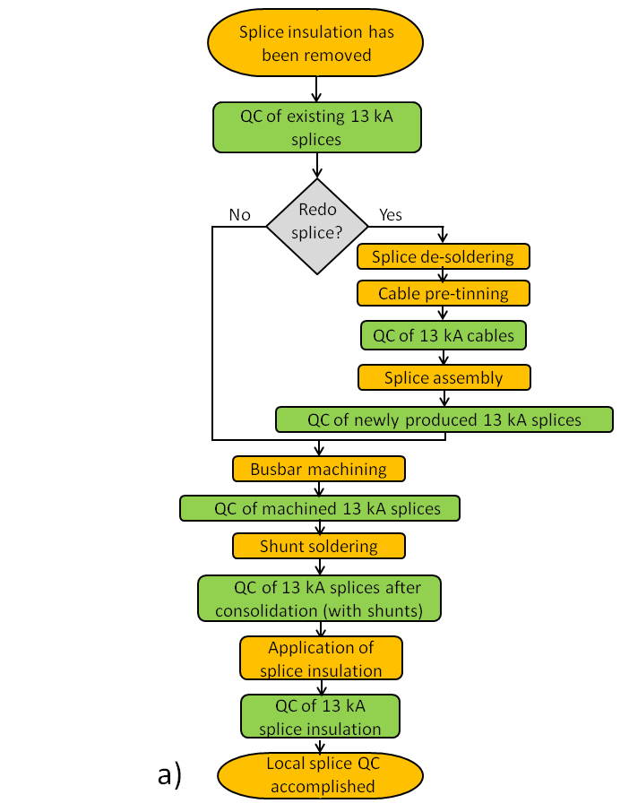
Typical SMACC Workflow
Typically:
  “Production step n” paired with “QC step n”
The two activities performed by independent teams.
Coordination of activities through WISH.
Management of NCR through MTF.

Slide 9
Decision Line
NCR opened in MTF
QA Team
Decision by Consensus
No
Difficult case
Decision by RO and JPhT
Yes
Actions and NCR Closure
Very high impact case
Decision by F. Bordry

Slide 10
Informing and Reporting
Use of MTF tools:
  retrieval and analysis of NCRs,
  notification lists for informing relevant teams on creation and status of critical NCRs.
Regular SMACC-QA Team meetings, every Tuesday and Thursday.
Regular reporting to LSC on production quality trends and nature and statistics of NCRs.

Slide 11
Tuning the procedures
The QC activities are based on a set of procedures (LHC-QBBI-TP), which are well understood and their methods thoroughly validated in workshop conditions.
The teams are reacting to the inspection results from the tunnel “on-line”, and the experience gained is used to streamline the procedures and adjust the acceptance criteria.

Slide 12
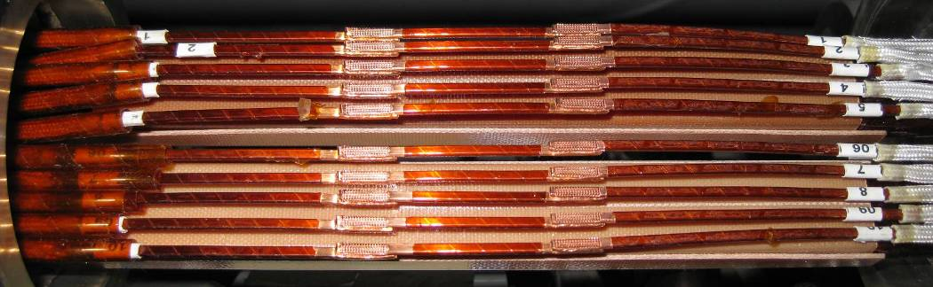
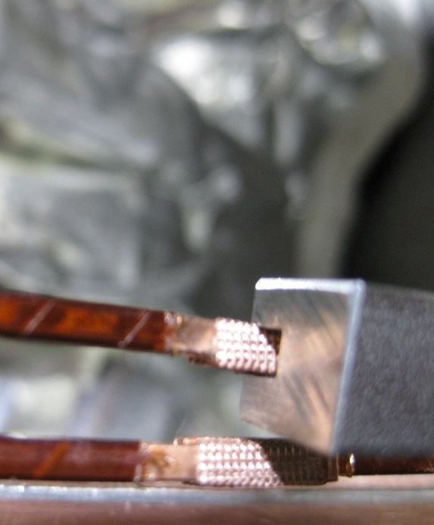
Inspection of ultrasound welding
Change of ultrasound welding machine settings from CP=0.6 to 0.8 in 2009.
Gauge used for inspection has 3.1 mm width and is too small for CP=0.8.
Based on measurements of recently produced welds, gauge width increased to 3.4 mm.
New version of the inspection procedure (LHC-QBBI-TP-0003) released.

Slide 13
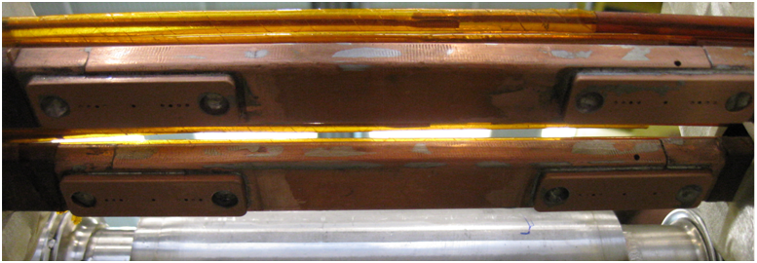
Inspection of the shunts
Visual inspection of the top and bottom shunts modified (criterion of continuity of fillets suppressed)
New version of the procedure released (LHC-QBBI-TP-0007).

Slide 14
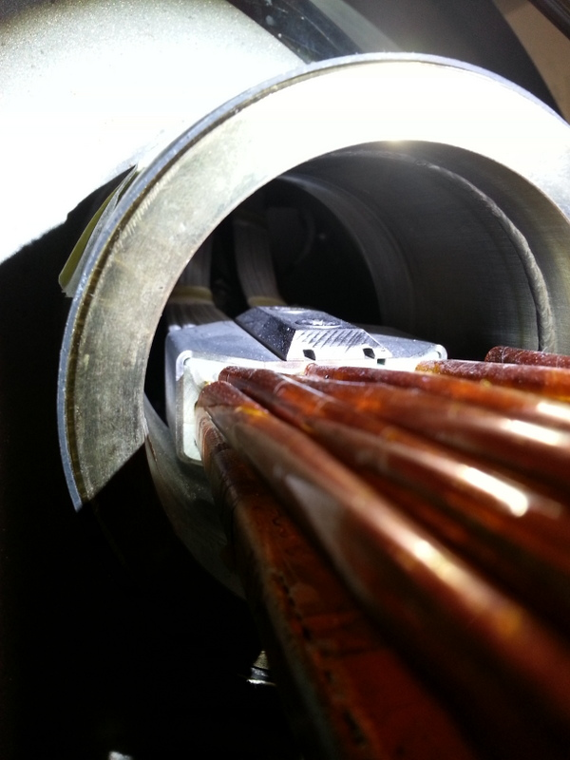
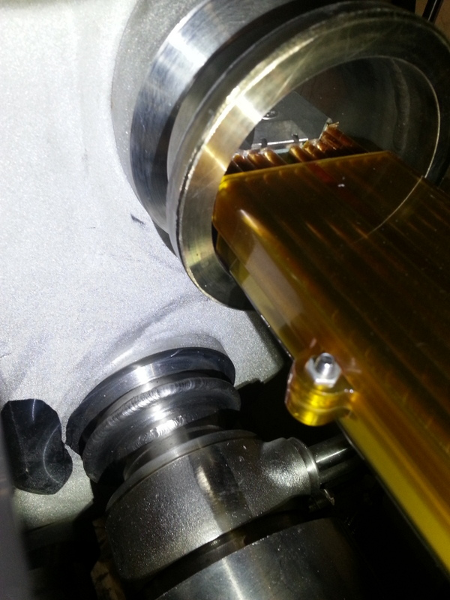
Insulation boxes
The problem
About 35% of busbars outside position tolerance.
Clearance box/M-flange insufficient to avoid box damage during welding.

Slide 15
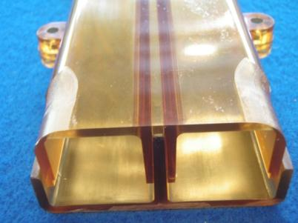
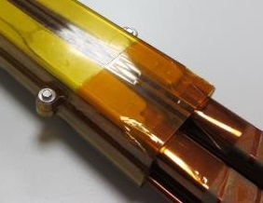
Insulation boxes
Modification of baseline
The standard box is modified to have rounded corners at the extremities (wall thickness reduced from 3 mm to 1.3 mm). Polyimide layers added to cover the extremities.
The assembly procedure (LHC-QBBI-TP-0024) updated and released.

Slide 16
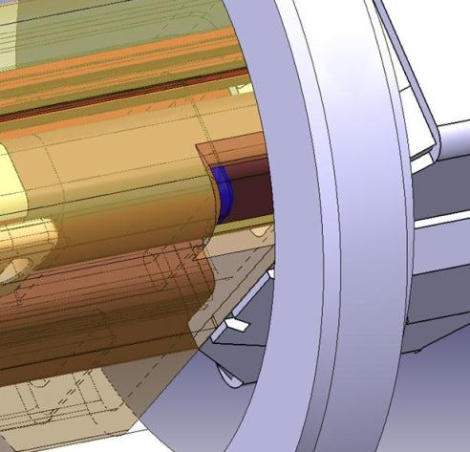
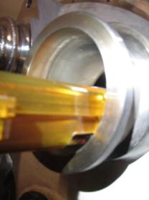
Insulation boxes
The standard repair
In case of interference:
Corners cut back so that the box cover is outside M-flanges.
U-pieces recovered from the existing insulation, reinstalled on busbars (mechanically protect the busbars and improve electrical insulation).

Slide 17
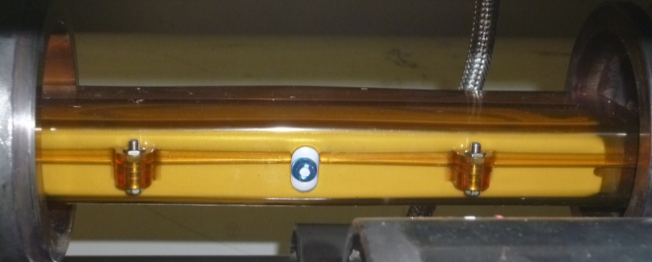
Insulation boxes
Inspection procedure
The inspection procedure (LHC-QBBI-TP-0008) updated and released.
The procedure defines the role of the LMF-QC and ELQC teams in the inspection process at different times, when visual aspect of the boxes differs due to presence of Eccobond filling.

Slide 18
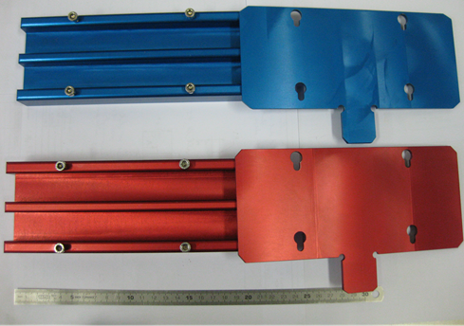
Revisiting geometrical acceptance criteria
Global alignment gauge
Geometrical constraints of the insulation box were reanalyzed.
The dimensions of the global gauges are confirmed.

Slide 19
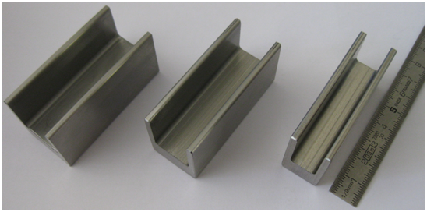
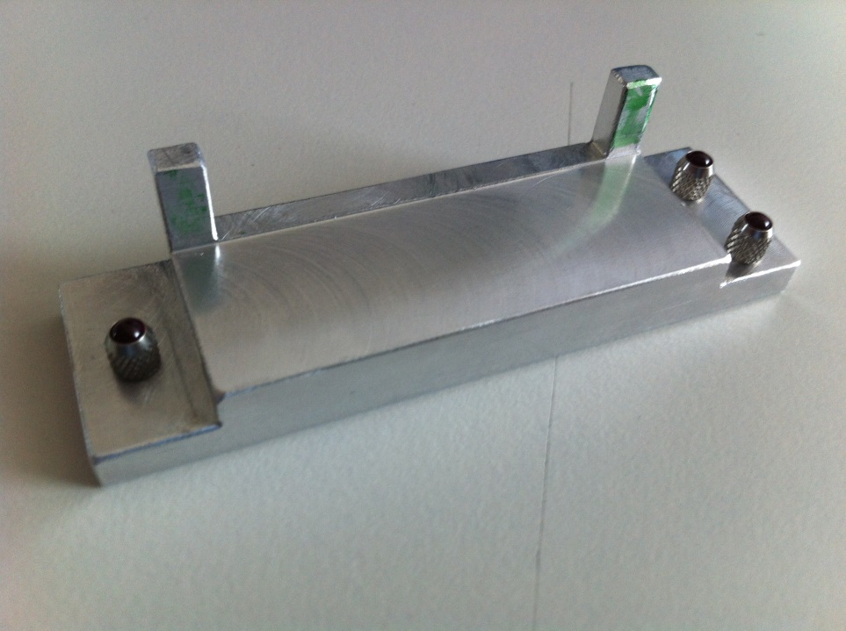
Revisiting geometrical acceptance criteria
Height gauge
A new type of gauge for checking the bottom surface of the busbars was tried out but with negative result.
The dimensions of the present C-gauges are confirmed.

Slide 20
Main results from the QC teams

Slide 21
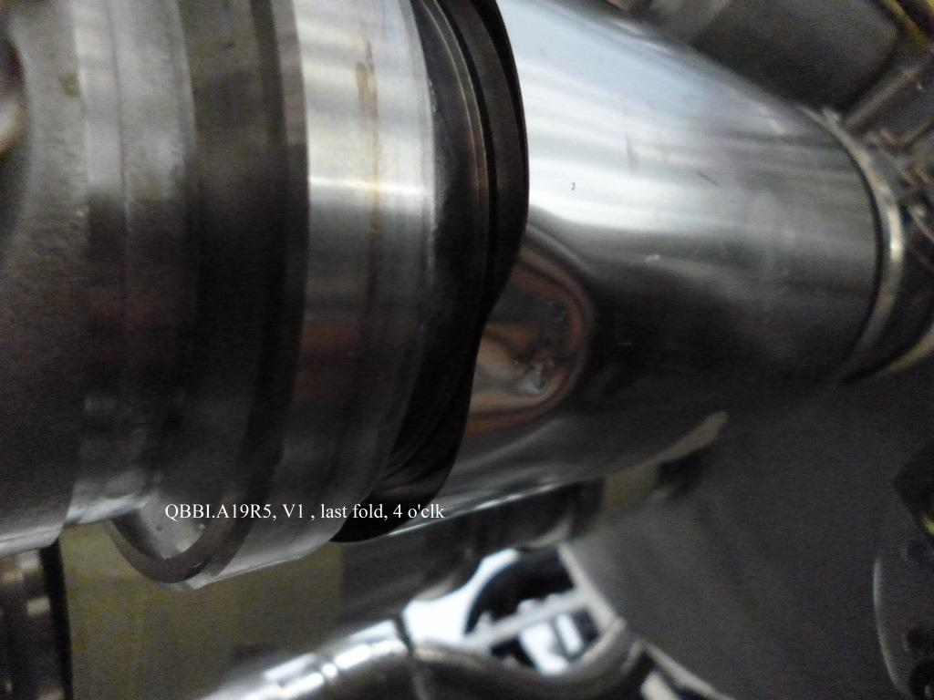
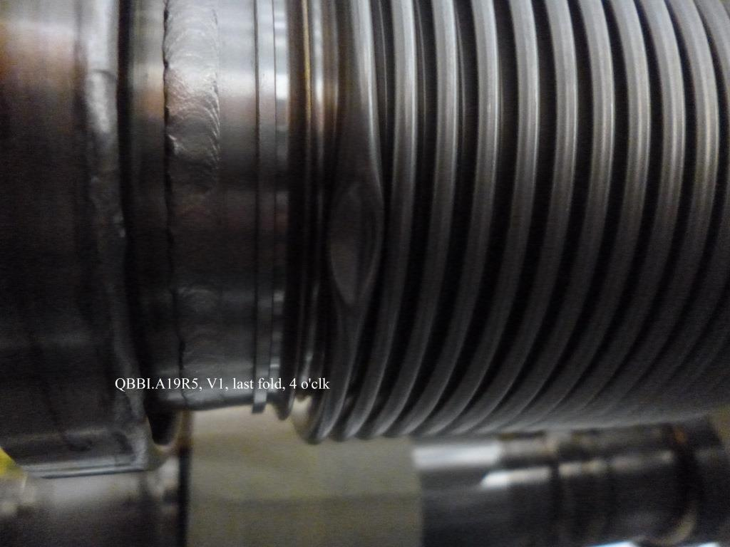
ICIT: cases of equipment damage
  Equipment damage from the initial LHC installation confirmed or discovered in several sectors.
  During LS1:
    Certain number of PIMs and nested bellows were damaged during M-line cutting.
    Temperature sensor wires broken during MQ diode consolidation.
    Additional protections ordered and installed.

Slide 22
ELQC
A large number of inspections have been performed covering all steps of the 13 kA splice consolidation “train”. In general:
  A high number of defective splices needs to be repaired:
    In S56, 25% of the splices had to be redone, 20% due to geometrical defects.
    In S67, 30% of the splices are defective, 13% due to electrical defects (R8).
    Exploratory inspections were done in S78 and S81: 25-30% of defective splices may be expected in other sectors.
  The quality of all repair and consolidation steps is satisfactory, similar to that obtained in the workshop and during 2008/09 campaign.
  ELQC is an essential element of SMACC-QA and all steps need to be maintained in the remaining sectors. (Possible suppression of one inspection step for newly made splices to be discussed during the Review).
Heavily damaged SC cable was found in a quadrupole segment with an R_{cold} outlier. All other segments of this type are being inspected before the repair is decided.

Slide 23
Statistics
QC of existing splices
Sector 5-6
Final
Inspected splices |  | 1272 | %
Conform |  | 956 | 75.2
Non-conform |  | 316 | 24.8
 | R8 | 30 | 2.4
 | Splice alignment | 57 | 4.5
 | Splice height | 178 | 14.0
 | Deformed lip | 15 | 1.8
 | Splice width | 6 | 0.5
 | Flange exchange | 22 | 1.7
Geometrical defects
20.8%

Slide 24
Statistics
QC of existing splices
Sector 6-7
Final
Inspected splices |  | 1266 | %
Conform |  | 890 | 70.3
Non-conform |  | 376 | 29.7
 | R8 | 170 | 13.5
 | Splice alignment | 66 | 5.2
 | Splice height | 116 | 9.1
 | Deformed lip | 14 | 1.1
 | Assembly | 10 | 0.8
Geometrical defects
15.4%

Slide 25
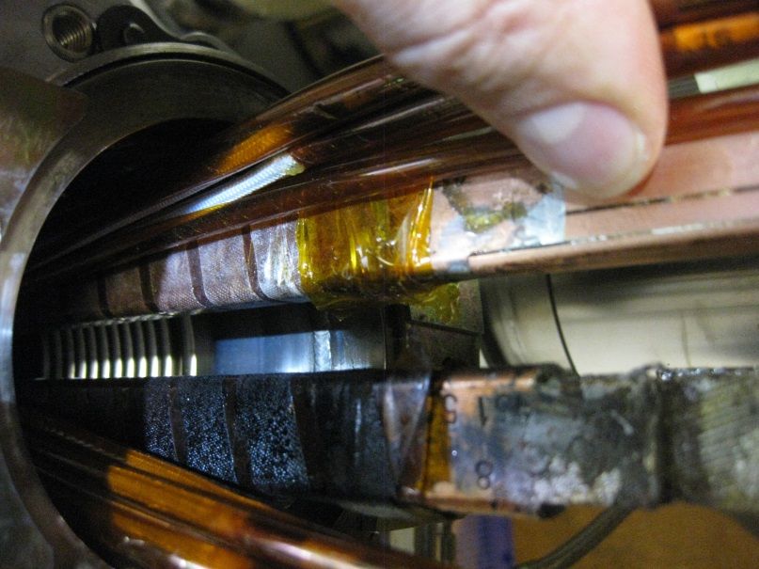
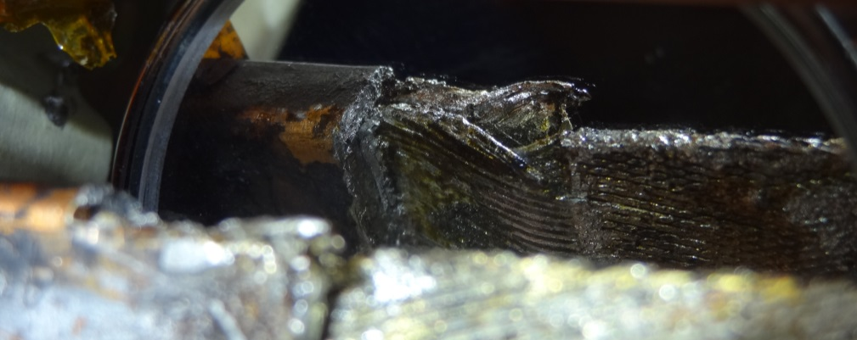
Case of heavily damaged SC cable
Heavily damaged cable was found in a M2-int of QBBI.A21L6, part of a segment with an R_{cold} outlier, with clear signs of a busbar and cable overheating.
A campaign has been launched to open all other segments with R_{cold} outliers, to verify if similar damage occurred.
All splices in these segments are blocked until a full picture of possible damage is available and a strategy of repair is decided.

Slide 26
ELQA, WELD, VAC
ELQA
ELQA tests performed every afternoon. Frequent disruptions due to poorly insulated clamps. High humidity in the tunnel a concern.
  Up to now, only “technological” shorts.
Frequency of ELQA tests?
  Questioned but maintained on daily basis; to be discussed during the Review.
WELD
M-line welding picking up. Excellent quality.
DN200 weld well advanced. Inspections show very good quality with a few NCs easily repaired.
VAC
M-leak checks about to start in the first vacuum subsector.

Slide 27
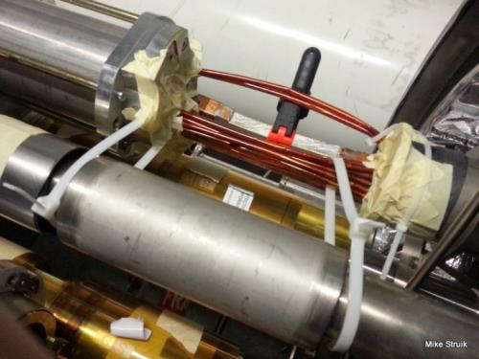
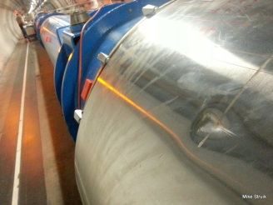
Auditor findings -1
Is the force applied in a controlled way?
W-bellows checked?
Protective cover replaced?

Slide 28
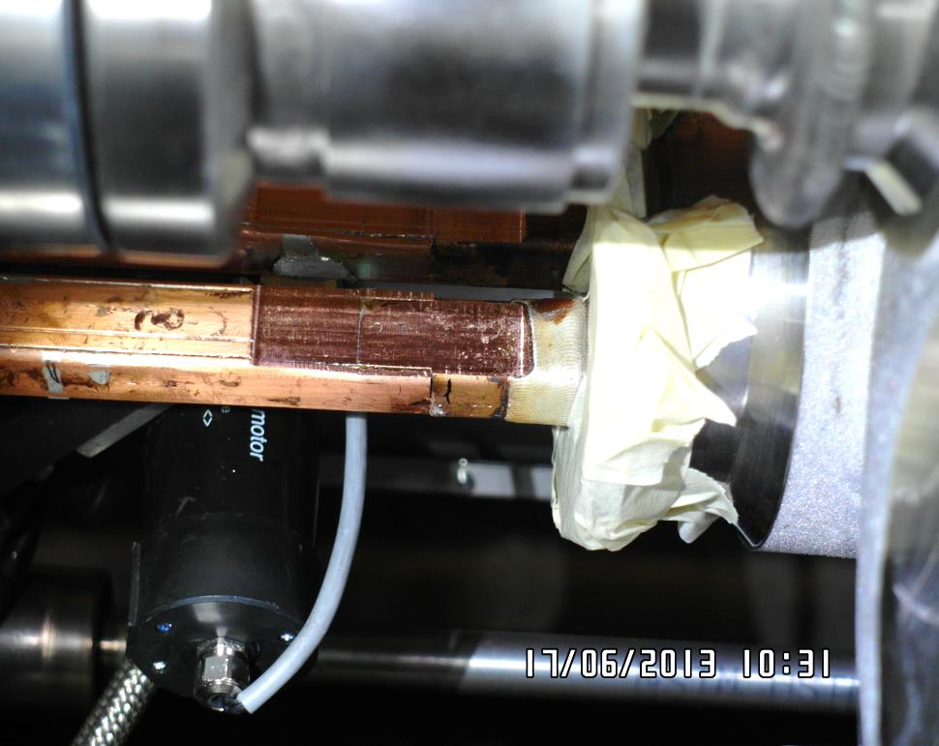
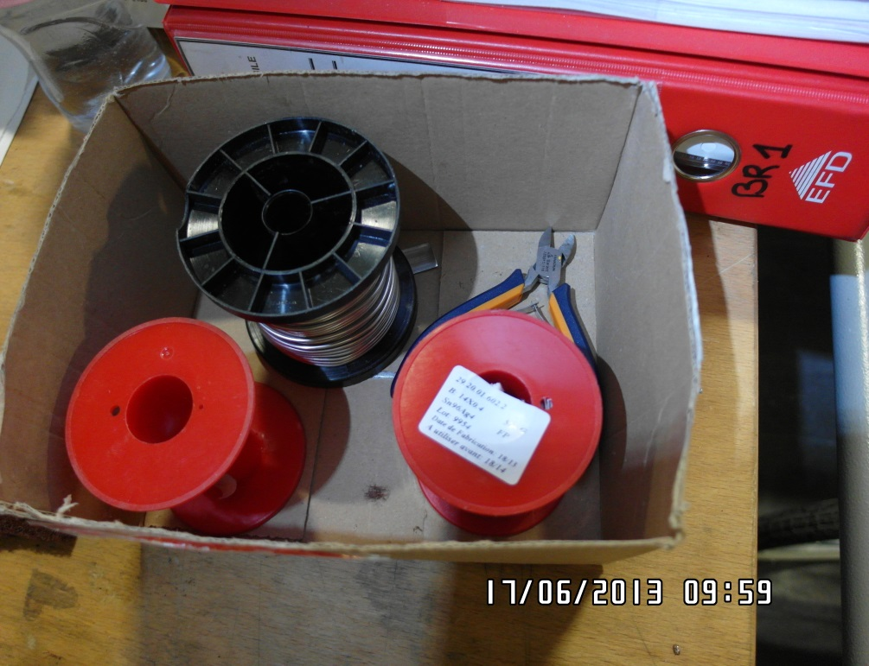
Auditor findings - 2
Cleanliness of surfaces is a standing concern
Traces of glue and Kapton on machined surfaces and machining tools.
Efficiency of cleaning (oxidization, glue) before soldering?
Traceability of solder?

Slide 29
Summary – 1
The QA for SMACC relies on the production teams, on the QC team, and the team of CERN auditors.
  All elements of the QA organisation are fully operational.
The teams are reacting to the production and inspection results essentially “on-line”. Feedback from the tunnel is used to streamline the inspection procedures and acceptance criteria.
  A significant number of QC steps have been performed with existing/updated procedures.

Slide 30
Summary – 2
A significant number of splices have to be redone, dominated by the geometrical defects.
  In S56, 25% of the splices were redone, 20% due to geometrical defects.
  In S67, 30% of the splices are defective, 13% due to electrical defects (R8).
  A similar number of defective splices is expected in other sectors.
Heavily damaged SC cable was found in a quadrupole segment with an R_{cold} outlier. All other segments of this type are being inspected and an appropriate strategy of repair is being discussed.
Protection of IC components and cleanliness during work remain a major concern.

Slide 31
Back-up
Initiating and management of NCRs

Slide 32
Basics of NC Management
LHC QA Plan – basis for all projects in the A&T sector, including SMACC.
The principles of non-conformities management given in QAP301 – “Handling of Non-conforming Equipment”.
Two classes of non-conformities:
  CRITICAL: have an impact on performance, durability, interchangeability, health or safety, interface to other LHC systems,
  NON-CRITICAL: all the others.
Project engineer decides on whether a non-conformity is critical or non-critical. Approves the non-critical NCs.
Critical non-conformities require approval of project engineer + project management.

Slide 33
…Within SMACC-QA …
“Project Management”
“Project Engineers”
(≡)
(≡)
F. Savary
R. Principe
Ch. Scheuerlein
J-M. Dalin
D. Bodart
C. Garion
K. Dahlerup-P
P. Cruikshank
Ch. Scheuerlein
J-M. Dalin
D. Bodart
C. Garion
K. Dahlerup-P
P. Cruikshank
Experts
S. Feher
R. Ostojic
M. Struik
J-P. Tock
M. Pojer

Slide 34
Production Step n
Production step n
Standard IP
Internal-QC
Non-Standard IP
(Validated repair)
NOK
NOK
OK
Internal-QC
Traveler in MTF
OK
Traveler
Internal-QC/QC
Non-critical NC
(“Use-As-Is”)
Go
Critical NC
WISH
NCR opened in MTF
QC step n

Slide 35
Quality Control step n
QC step n
NCR opened in MTF
Standard TP
Test Report in MTF
Critical NC
QA Team Decision
Test Report
Experts
OK
or Non-Critical NC
(“Use-As-Is”)
Action
Production team
QC team
QA Support
Action, Documentation Complete
SMACC
Coordination
Go
WISH
OK
Close NCR in MTF
Production step n+1

Slide 36
Decision Line
NCR opened in MTF
QA Team
Decision by Consensus
No
Difficult case
Decision by RO and JPhT
Yes
Actions and NCR Closure
Very high impact case
Decision by F. Bordry

Slide 37
Statistics
Critical NCRs
SMACC
22 July 2013
 | Open | Closed
LMF train Internal QC | - | 4
ICIT | 5 | 6
ELQC | 15 | 59
WELD | - | 1
ELQA | - | 1
VAC | 34 | 41

