Slide 1
Fourth LHC Splice Review Geneva – 22 to 24 July 2013
The Splice Consolidation Train
F. Savary with contributions from M. Duret, L. Grand-Clément, F. Lackner, H. Prin, R. Principe, S. Triquet, and many others

Slide 2
Outline
Organization
Communication channels
Production work plans
The train QA structure
Consolidation work flows
Production rates and trends
QA indicators
Data logs vs nominal working conditions
How do we master quality?
Major issues
How to deal with them?
Impact on work and procedures
Quadrupole diodes
Conclusions

Slide 3
Organization & work flows

Slide 4
Communication channels
LS1 Committee
SMACC Meeting
SMACC Project Leader
SMACC QA
CSI
Meetings
2 / Week
Meetings
3 / Week
Splices consolidation train
QA
Production

Slide 5

Production work plans
Splices consolidation train H. Prin & F. Lackner
Production
☞ WORK PLANS
Remove insulation
2
1
M-Line Cutting
4
3
Re-soldering
De-soldering
Shunt
6
5
Copper machining
Quadrupole diodes
8
7
Install insulation

Slide 6

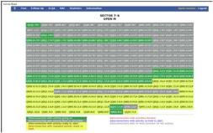
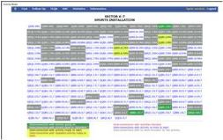
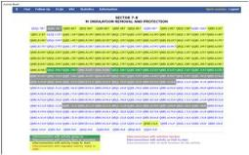
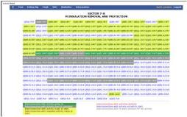
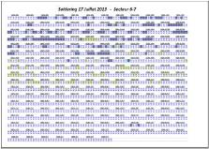
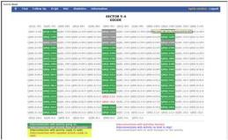
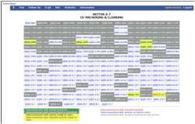
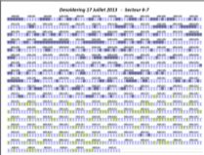
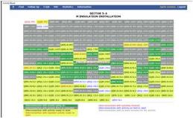
Production work plans
Via email every evening after ELQA validation tests
General message and specific ones to provide guidelines, and insist on important points / priorities
To all “opérateurs responsables”, the two “chefs de chantier” and the LMF mechanical and logistics services
With copy to LMF QA and CSI Office Leader
Dashboards per activity per ongoing sector
Printed on site and distributed in the morning

Slide 7
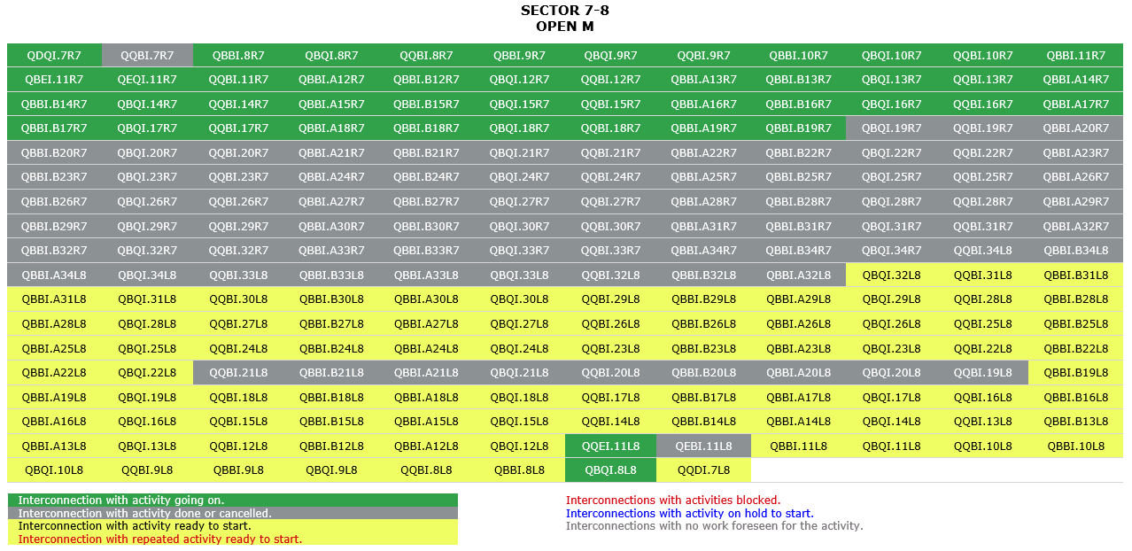
Work plan – Open M
Ongoing activity
Done or cancelled
Ready to start

Slide 8
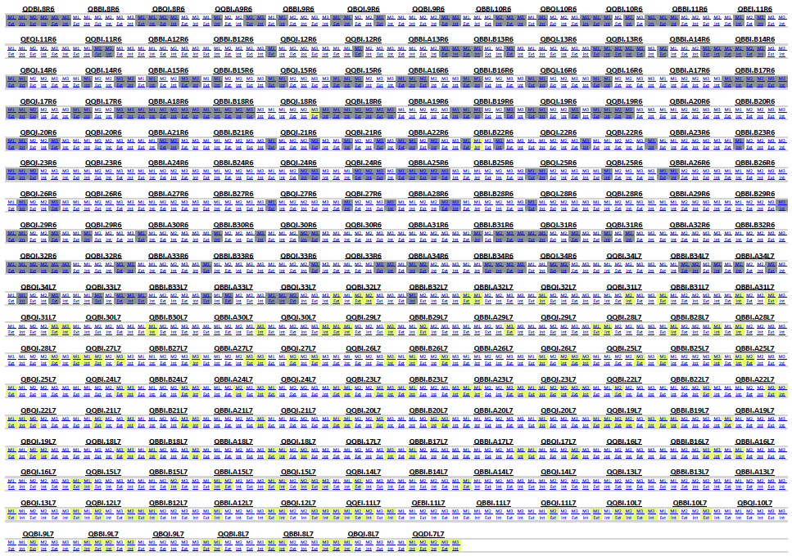
Work plan – De-soldering, 1

Slide 9
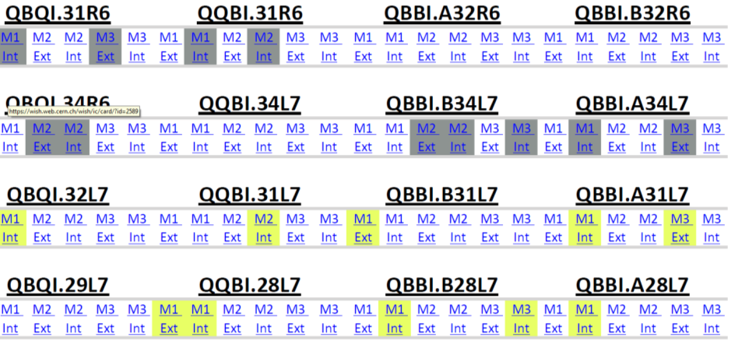
Work plan – De-soldering, 2

Slide 10
Train QA Structure
[Resp.] R. Principe
Barely sufficient
[QC1] Becle S.
[QC3] Berthet R.
[QC2] Housiaux O.
[Data recording] Menu S.
Ensure procedures are respected
Detect ncr’s at early stage, and issue ncr’s documentation
Provide support as needed
Collect data from loggers
DFS
MTF-EDMS

Slide 11

M-Line cutting – St16 Work Flow
Daily Work Plan
M-Line Cutting
Measuring position | Result
M1 - X0-Left | 8.55 mm
M1 - X4-Left | 8.33 mm
M1 - X8-Left | 8.48 mm
M1 - X0-Right | 8.91 mm
M1 - X4-Right | 8.43 mm
M1 - X8-Right | 8.76 mm
… | …
Flange Lip ok
☑
Data entered in WISH
NO
M-Flange to be replaced
CSI to initiate step

Slide 12
St16 – Follow up file

Slide 13
M1 Ext. De-soldering – St21 WF
Daily Work Plan (following ELQC test results)
Wish records
De-soldering machine id.
Operators id. and date
Stabilization machine id. (resistive heating)
Data entered in WISH
De-soldering
Sc cable status and bb extremities ok
☑
EDMS records
Temperature profiles (de-soldering and stabilization)
Exact time of the cycle
General remarks
Number of cycles
Data entered in EDMS
NO
Inform SMACC and QA about NCR’s (e.g., sc cable damaged)

Slide 14
De-soldering follow up files
To find it in the data logger!
Up to 2

Slide 15
De-soldering follow up files

Slide 16
Production Rates & Trends

Slide 17
Open M
Target rate 53 IC’s / Week
Achieved av. rate 39 IC’s / Week
13 weeks

Slide 18
M De-solder & cable stabilization
Achieved av. rate 41 splices / Week
There seems to be a limit here
Insufficient capacity!

Slide 19
QA indicators

Slide 20
Splice soldering – Nom. process
LHC-QBBI-IP-0013 (released in EDMS):
The splice parts are put together with a clamping vise with a force of 23 kN
Induction heating is used
Sn-Ag 96/4, melting point 221°C
Temperature control probe set to 250°C
The heating process stops automatically after 2 min
Cooling of the clamping vise is initiated manually by the operator, @ 100°C
Melting T Sn-Ag 221°C
Phase 2: Plateau @ 250 °C for 2 min.
Stop heating
Phase 1: Ramp up
Start cooling of clamping vise
Temperature monitoring probe

Slide 21
Soldering statistics S56
Till July 10th, 2013
 | Done | % | To do | % | Total | Anomalies | %
M1 ext | 78 | 100 | 0 | 0 | 78 | 4 | 5.12
M1 int | 91 | 100 | 0 | 0 | 91 | 6 | 6.59
M2 ext | 33 | 94.28 | 2 | 5.71 | 35 | 0 | 0
M2 int | 37 | 97.36 | 1 | 2.63 | 38 | 0 | 0
M3 ext | 50 | 98.03 | 1 | 1.96 | 51 | 2 | 4
M3 int | 48 | 94.11 | 3 | 5.88 | 51 | 2 | 4.16
Total | 337 | 97.96 | 7 | 2.03 | 344 | 14 | 4.15

Slide 22
Soldering – typical anomalies
‘Anomalies’ means T profile outside allowable range
400°C
230°C

Slide 23
Classification of anomalies
There are, to date, 14 deviations from nominal conditions, outside allowable range
Classification
M1 line: 10 (71%)
Insufficient temperature: 11 (78%)
NB: QBQI.18L6 = low temperature
Excessive temperature and/or process interruption: 3 (21%)
Cycle duration: 1 (0.7%)

Slide 24
Resolution of anomalies
Insufficient temperature
Overall, 3% of the splices redone
In most cases, due to the utilization of damaged temperature monitoring probes (made of Inconel). The melting is verified by witness filler, which is put in contact with the outside surface of the splice
The temperature monitoring probes were replaced, and will be replaced systematically after several cycles (following inspection)
Accasionally, the temperature monitoring probes were not installed correctly. To avoid this, we have organized refresher courses
Excessive temperature, or interruption of the process
Overall, 0.8% of the splices redone
Due to bad positioning of the temperature control probe. To avoid this, we have organized refresher courses
For the few occurrences: LMF to redo the splice, and the cable will be checked by ELQC (e.g. for excessive T)

Slide 25
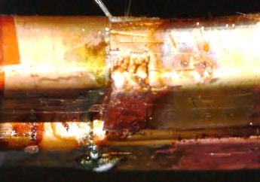
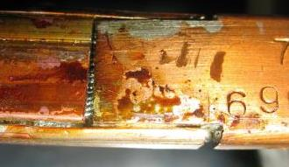
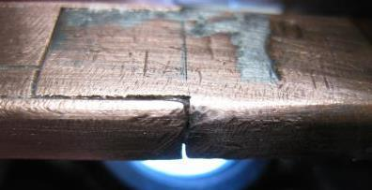
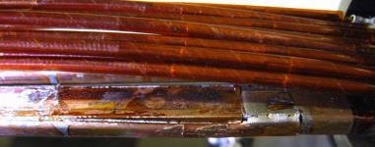
Catalog of defect (the past …)

Slide 26
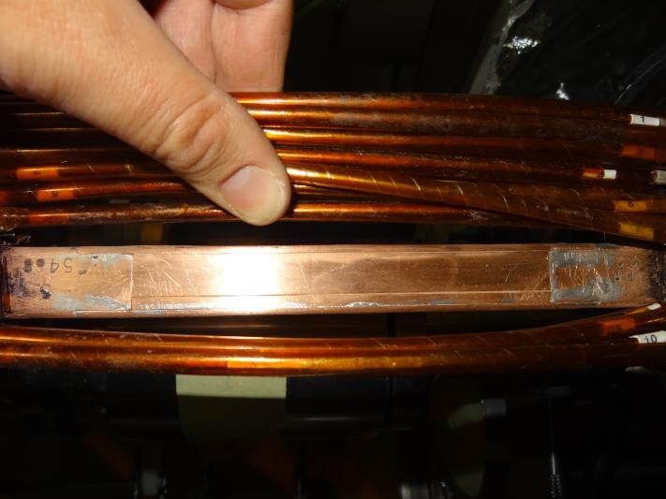
Today quality (e.g. QBQI.25L6)

Slide 27
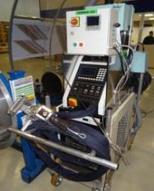
Splice de-soldering – Nom. process
LHC-QBBI-IP-0022 released in EDMS
Induction heating is used (260 °C)
Heating till melting, and U/cover can be removed

Slide 28
De-soldering statistics S56
Till July 16, 2013
 | Done | % | To do | % | Total | Anomalies | %
M1 ext | 79 | 100 | 0 | 0 | 79 | 25 | 31.64
M1 int | 92 | 100 | 0 | 0 | 92 | 25 | 27.17
M2 ext | 34 | 100 | 0 | 0 | 34 | 10 | 29.41
M2 int | 39 | 100 | 0 | 0 | 39 | 10 | 25.64
M3 ext | 52 | 100 | 0 | 0 | 52 | 10 | 19.23
M3 int | 53 | 98.14 | 1 | 1.85 | 54 | 10 | 18.51
Total | 349 | 99.71 | 1 | 0.28 | 350 | 90 | 25.71

Slide 29
De-soldering T curves
T lower than expected

Slide 30
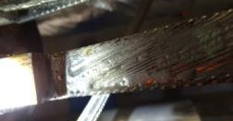
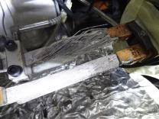
De-soldering
Categories of defects after de-soldering in S56

Slide 31
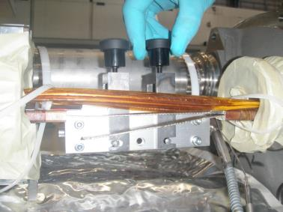
Cable stabilization
LHC-QBBI-IP-0015 released in EDMS
Resistive heating is used
Plateau of 3-4 min @ 240°C

Slide 32
Stabilization statistics S56
Till July 16, 2013
 | Done | % | To do | % | Total | Anomalies | % | Thermal | % | Other | %
M1 ext | 79 | 100 | 0 | 0 | 79 | 4 | 5.1 | 3 | 75 | 1 | 25
M1 int | 92 | 100 | 0 | 0 | 92 | 4 | 4.3 | 2 | 50 | 2 | 50
M2 ext | 34 | 100 | 0 | 0 | 34 | 3 | 8.8 | 2 | 66.6 | 1 | 33.3
M2 int | 39 | 100 | 0 | 0 | 39 | 8 | 20.5 | 0 | 0 | 8 | 100
M3 ext | 52 | 100 | 0 | 0 | 52 | 2 | 3.8 | 1 | 50 | 1 | 50
M3 int | 53 | 98.14 | 1 | 1.85 | 54 | 3 | 5.6 | 0 | 0 | 3 | 100
Total | 349 | 99.7 | 1 | 0.28 | 350 | 24 | 6.8 | 8 | 33.3 | 16 | 66.6

Slide 33
Stabilization (‘thermal’ anomalies)
260°C
220°C

Slide 34
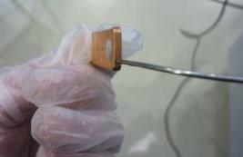
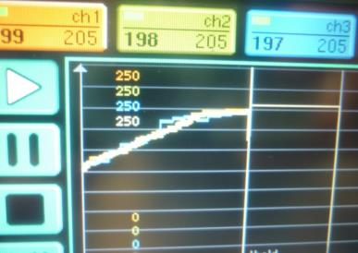
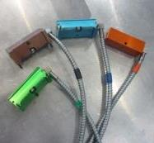
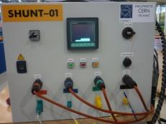


Shunt soldering – Nom. process
LHC-QBBI-IP-0021 released in EDMS
Resistive heating is used
Sn-Pb 60/40, melting point 188°C
Ramp up to 205 °C in ~5 min, then plateau for 2.5 min

Slide 35
Shunt soldering statistics S56
 | Done | % | To do | % | Total | Anomalies | % | Th. | % | Other | %
M1 | 222 | 97.79 | 5 | 2.2 | 227 | 2 | 0.9 | 2 | 100 | 0 | 0
M2 | 222 | 97.79 | 5 | 2.2 | 227 | 2 | 0.9 | 1 | 50 | 1 | 50
M3-ext | 222 | 97.79 | 5 | 2.2 | 227 | 4 | 1.8 | 4 | 100 | 0 | 0
M3-int | 222 | 97.79 | 5 | 2.2 | 227 | 3 | 1.35 | 2 | 66.66 | 1 | 33.33
Total | 222 | 97.79 | 5 | 2.2 | 227 | 11 | 4.95 | 10 | 90.9 | 2 | 18.18

Slide 36
Shunt soldering

Slide 37
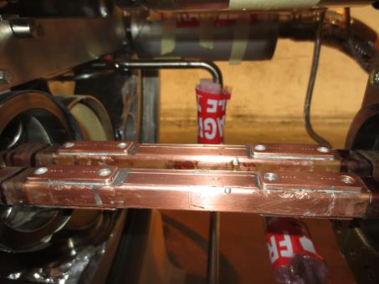
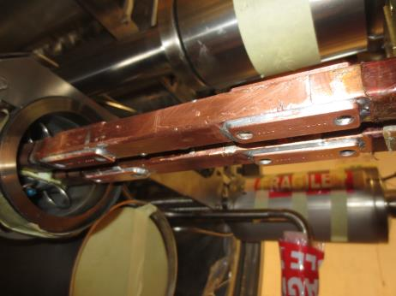
Example of shunted splices
QBQI.25L6

Slide 38
Major issues / difficulties

Slide 39



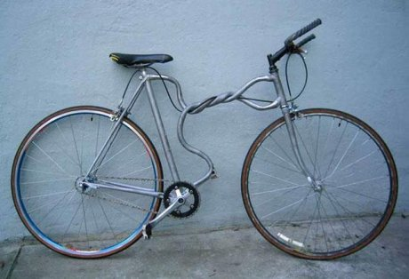
Not everything is perfect!

Slide 40

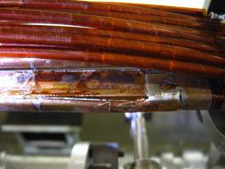
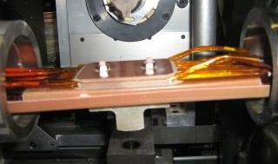
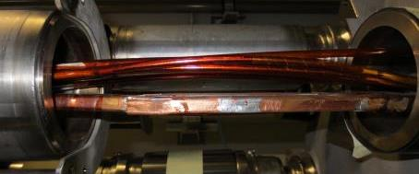
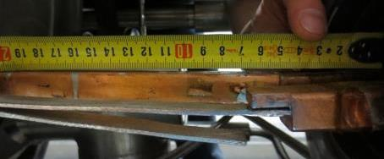
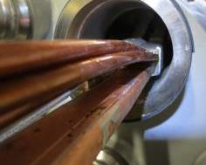
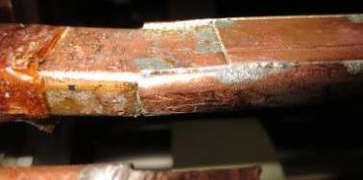
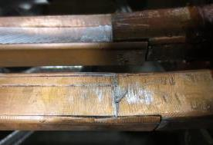
Museum of horrors …

Slide 41
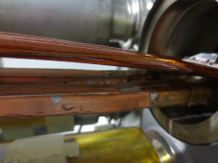

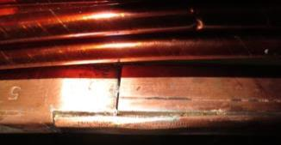

… implying some adjustments
Defects exceeding the tolerance limits, especially impacting on the installation of the insulation box, and requiring modifications of the insulation system
Main impacts:
Need to develop adequate solutions
Additional work to carry out tests and mock-up assemblies, to validate the proposed solutions
Modify some of the procedures and repeat the approval process
Production rate affected during the first months, and impact on the welding activity
Expansion of the train to treat conforming cases, and increased production times due to the logistics effort
Step in copper joint
Bending deformation
Gaps in copper joint

Slide 42

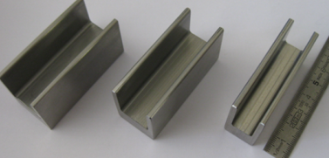
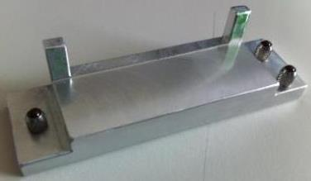
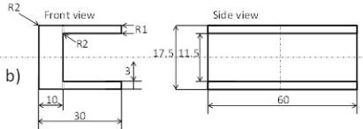
Local gauge …

Slide 43
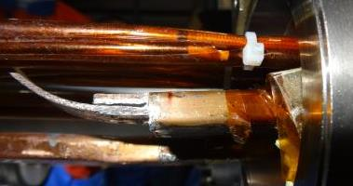
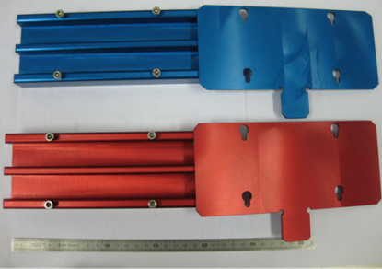
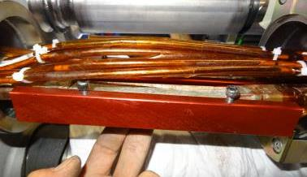
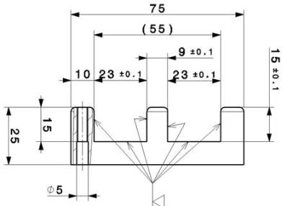
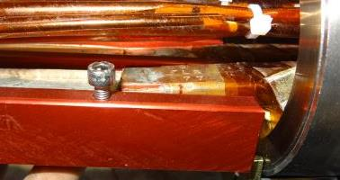
… and global gauge
21
+1
0

Slide 44
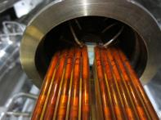
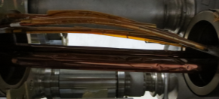
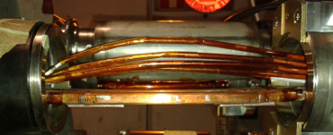
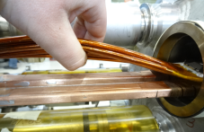
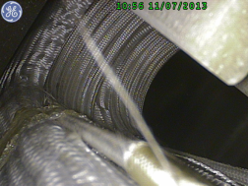



Spool cables
Good case
Lines M1 & M2
Too long
Do not fit into the combs of the new insulation system
Some of them will have to be cut, shortened, and re-welded

Slide 45




Capture tooling
The amount of capture tooling did not match the actual needs due to unexpected expansion of the train
We started with 500 items
We have manufactured additional 1200 (simple)
Are mounted after M-lines are cut-opened, and are removed in the end, after resin injection

Slide 46


Insulation system …
Quadrupole splices
… Had to be revised to cope with the non-conforming radial position of the bus bars in the M-Flange
V_{RESIN}= 50 ml / splice
Dipole splices
Injection hose
V_{RESIN}= 58 ml / splice

Slide 47




Optimizing injection parameters
In order to
Avoid over pressure during injection (risk of bursting the tubes)
Avoid excessive temperature (< 50˚C @ any time of the process)
Ensure shunt covering (min. of 50% required in the shunt region)
Avoid lack of transversal filling (min. of 2 x 20 mm on either side of the screws)
Avoid injecting excessive amount of resin (risk of higher stresses on the screws)
Lack of Eccobond
Over injection
Lack of Eccobond

Slide 48



Quad. bus bars
 | Parameter | Nominal | Tolerance limit
Bus Bar with Insulation | H_{POS.} | 26.1 | 27.6
 | V_{POS.} | 15.1 | 16.1
 | RGAP_{BB-Flange} | 10.9 | 9.1
Insulation Box standard | RGAP_{Box-Flange} | 3.8 | 2
Insulation box modified | RGAP_{Box-Flange} | 5.4 | 3.6
[-1;+1]
[-1.5;+0]
[-0;+1.5]

Slide 49

Dipole bus bars
 | Parameter | Nominal | Tolerance limit
Bus Bar with Insulation | H_{POS.} | 26.1 | 27.6
 | V_{POS.} | 8.1 | 9.1
 | RGAP_{BB-Flange} | 13.4 | 11.7
Insulation box standard | Bot RGAP_{Box-Flange} | 7.1 | 5.4
 | Top RGAP_{Box-Flange} | 3.6 | 1.9
Insulation box modified | Bot RGAP_{Box-Flange} | 8.2 | 6.5
 | Top RGAP_{Box-Flange} | 5.2 | 3.5
[-1;+1]
[-1.5;+0]
[-0;+1.5]

Slide 50

Measurements, RGAP_{BB-Flange}
Av. RGAP quad’s: 9.9 mm
Av. RGAP dip’s: 12.5 mm
73 IC’s were checked in S67, from QBBI.8R6 to QBBI.B31R6
2 RGAP measured for the quadrupole BB, and 2 / 4 for the dipoles
For the quadrupole BB, 80 out of 206, i.e. 39%, of the measuring points are below 9.1 mm, i.e. outside the specified tolerance, and 17, i.e. 8% would not allow the installation of the standard box for which a minimum gap of 7.1 mm is needed
For the modified box (see next slides), a gap of 5.5 mm will be sufficient

Slide 51








Solution – New baseline
Wall thickness reduced from 3 mm to 1.3 mm @ both ends
Two layers of 70 µm polyimide tape @ both ends
To protect the box against severe damage during welding of M-lines in case of contact, especially sticking with the flange

Slide 52








When there is interference …
Glue the VP310 U profile on the bus bar insulation with Araldite, then continue with the standard process, i.e. apply the 50 µm polyimide foil around the bus bar, and finally the filling pocket, and the insulation box. VP310 is an additional mechanical/thermal and electrical insulation

Slide 53
Fall back solution
De-solder, reshape the bus bar ends, and re-solder

Slide 54



Update of the procedures, 1
Splice soldering (LHC‐QBBI‐IP‐0013)
2 min plateau @ 250°C, instead of 15 s @ 240°C
Cu machining
Harmonization of the criteria between LMF QA and ELQC (0.15 mm flatness and measurement procedure)
Shunt soldering
Solder fillet and aspect of the reservoir
New version for the following procedures
LHC‐QBBI‐IP‐0024 (Insulating box installation)
LHC‐QBBI‐IP‐0028 (Eccobond injection procedure)

Slide 55
Update of the procedures, 2
Visual inspection of the insulation system after injection, according to test procedure edms 1240302 to verify that:
Eccobond® fills a large volume of the box
The locking screws are in good contact between top and bottom box parts
There are no visible crack
The insulation box is correctly positioned with respect to the M-line flanges
The spool cables are correctly positioned
The insulation box satisfies the dimensional tolerances

Slide 56

Diodes … … of the quadrupole magnets only

Slide 57

Consolidation highlights

Slide 58


Diode consolidation – St57
Daily Work Plan
Cut-open the diode box
Take pictures
Do electrical checks
El. Checks ok
☑
NO
El. check of int. contacts ok
☑
NO
NO
R BB to HS > 2µΩ
R diode to HS < 15µΩ
NO
YES
YES
NCR
Redo the bad contact
NCR
NCR
Diode stack substitution
DFS
MTF & EDMS
Consolidation work
Electrical checks

Slide 59
Measurement procedure
For the internal contacts
The sum of internal contact resistances + the resistance of bus bars is measured
Then, individual contact resistances are calculated
HS to diode
Bus bar to HS
U1 $=$ I x (Rbb1 + Rc_bb_hs1 + Rhs1 + Rc_d_hs1)
U1
U2
U2 $=$ I x (Rbb2 + Rc_bb_hs2 + Rhs2 + Rc_d_hs2)

Slide 60
Diode to HS + HS to BB

Slide 61
Diode BB to connection plate

Slide 62
Magnet BB to connect. plate

Slide 63
Overall status
Sector 5-6 :
47/47 Opened
47/47 Measured
10/47 Consolided
Sector 6-7 :
51/51 Opened
51/51 Measured
Sector 7-8 :
51/51 Opened
51/51 Measured
Sector 8-1 :
11/47 Opened

Slide 64
BB to connection plate contacts

Slide 65



NCR QBQI.25R6 and QBQI.34R7
Insulation sleeve not at the right position

Slide 66
Conclusions
Train organization working fine
Overall very good quality of the work carried out; very few failures
Overall quality of the existing splices lower than expected, i.e. more splices to redo, which appears to be a bottle neck
Issues with the installation of the insulation system, which needed to be adapted, due to imperfect position of the bus bars in the M-flanges
Learning curve phase almost over, acceptance criteria were revised, and the procedures updated accordingly
Train QA too busy
Consolidation of the quadrupole diodes under control, working fine

Slide 67
With warm thanks to:
The splice consolidation train (production and QA)
M. Duret, F. Lackner, H. Prin, R. Principe, and S. Triquet
J.-M. Hubert and A. Aijaz (PAEC), P. Martins, L. Favier, K. Chaouki, M. Dumas, C. Lopez, M. Pozzobon, L. Grand-Clément, P. Canard, R. Faes, and numerous FSU’s
S. Menu, A. Ulbricht, and H. Monari
The CSI team, M. Pojer and friends
The SMACC QA team, R. Ostojic, C. Scheuerlein and friends
EN-MME
The welding experts, S. Atieh and friends
The material scientists, S. Sgobba and friends
The mechanical instrumentation engineers, M. Guinchard and friends
The SMACC ELQA team, K. Dahlerup-Petersen, G. D’angelo, and friends
The Project Leader and the TE Management for their continuous support
And I have certainly forgotten many others, a thousand apologies!

Slide 68
Spare slides

Slide 69
Insulation removal and inspection – St18
Daily Work Plan
Insulation removal
General status of the interconnect ok
Data entered in WISH
Records
Compression tool & machine id
Operators id. and date
☑
NO
Inform SMACC and QA about NCs (e.g., spool damaged)

Slide 70
St18 – follow-up files

Slide 71
St18 – follow-up files

Slide 72
M1 Ext Soldering – St24
Wish records
Soldering machine id.
Operators id. and date
Lot #. for U and wedge
Lot #. for SnAg
# of extra cycles
Daily Work Plan (following ELQC test results)
Data entered in WISH
Soldering
BB geometry and general status OK
☑
EDMS records
Temperature profiles
Exact time of the cycle
General remarks
Number of cycles
Data entered in EDMS
NO
Inform SMACC and QA about NCs (e.g. high T during soldering)
Re-do splice soldering, re-heat the splice, or “use as is”

Slide 73
Soldering follow up files p. 1/2

Slide 74
Soldering follow up files p. 2/2

Slide 75
Cu Machining & Cleaning – St46
Daily Work Plan (following ELQC test results)
Wish records
Operators id.
Date
Data entered in WISH
Cu machining
Data entered in EDMS
EDMS records
NCs
Flatness and position (vs. flange) ok
☑
NO
Paper copy
Follow up files
Exact machining position
General remarks
Inform SMACC and QA about NCs (e.g., excess machining)
Fix by further machining or “use as is”

Slide 76

Cu machining follow up files

Slide 77
Shunts installation – St48
Daily Work Plan (following ELQC test results)
Wish records
Shunt sold. machine id.
Operators id. and date, et.
Shunt lot number
Extra cycles if any
Shunt installation
Data entered in WISH
Position and quality of Sn-Pb solder ok
☑
EDMS records
Thermal cycles per shunt
Exact date and time
NO
Data entered in EDMS
Inform SMACC and QA about NCs
Re-do shunt soldering

Slide 78
Shunt installation follow up files
To find it in the data logger!

Slide 79
M insulation installation – St54
Daily Work Plan (following ELQC test results)
Wish records
Compression tool machine id.
Injection machine id.
Operators id. and date, et.
Eccobond lot number
Insulation box lot
Data entered in WISH
Insulation
Box position, Eccobond distribution and general status ok
☑
EDMS records
Eccobond injected volume
Exact date and duration of the injection cycle
Data entered in EDMS
NO
Inform SMACC and QA about NCs (i.e, bad positioning of the bb vs. flange)
Redo ins. box installation (i.e., VP310)

Slide 80
Installation of the box follow up files

Slide 81
Eccobond injection follow up files

Slide 82
Procedures status
Chap. | Sub-activity | EDMS | Baseline | Status
3.2 | Découpe soudure manchettes M | 1227123 | LHC-QBBI-IP-0023 | Released
 | Training course | 1261495
3.2.1 | Fiche d'instruction pour certification CE | 1234983
3.2.2 | Risk assesment form OHS-0-0-5 | 1234987
3.2.3 | Safety form | 1234992
4.1 | Capture soufflet M | 1198420 | LHC-QBBI-IP-0014 | Released
 | Training course | 1233270
4.1.1 | Fiche d'instruction pour certification CE | 1210645
4.1.2 | Risk assesment form OHS-0-0-5 | 1210638
4.1.3 | Safety form | 1210651
4.2 | Dépose isolation interconnexion | 1198424 | LHC-QBBI-IP-0011 | Released
 | Training course | 1235008
6.1 | Débrasage par induction U/plat de fermeture | 1218408 | LHC-QBBI-IP-0022 | Released
 | Training course | 1242596
6.2 | Stabilisation câble supraconducteur | 1218412 | LHC-QBBI-IP-0015 | Released
 | Training course | 1235753
8.1 | Brasage par induction U/plat de fermeture | 1218410 | LHC-QBBI-IP-0013 | Released
 | Training course | 1235010
 | Critères Contrôle Qualité Interconnexions 12 kA | 1171359
10 | Usinage cuivre avant brasage des shunts | 1227125 | LHC-QBBI-IP-0025 | Released
11.1 | Brasage des shunts sur les busbars | 1224166 | LHC-QBBI-IP-0021 | Released
 | Training course | 1242600
11.2 | Débrasage des shunts sur les busbars | 1224636 | LHC-QBBI-IP-0020 | Released
 | Training course | 1242602
13.1 | Montage boitier isolation busbar | 1227124 | LHC-QBBI-IP-0024 | Released
 | Training course | 1242604
13.2 | Démontage capture soufflet M | 1218413 | LHC-QBBI-IP-0019 | Released
 | Training course | 1242606
13.3 | Injection Eccobond |  | LHC-QBBI-IP-0028 | Under approval LHC

Slide 83
Other procedures
Interconnexion DFBA PG-BB-PIG-TAIL | 1265665 | LHC-DFBA-IP-0004 | Released
Interconnexion DFBA SHM-HCM | 1265664 | LHC-DFBA-IP-0003 | Released
Plan Assurance Qualité | 1251404 |  | Released
Audits internes LS1 | 1261449 |  | Released
Formation-personnel-LS1 | 1261468 |  | Released
Gestion des approvisionnements LS1 | 1261472 |  | Released
Gestion des défauts et des NC LS1 | 1261475 |  | Released
Gestion des déchéts générés en LS1 | 1272591 |  | Released
Gestion des données LS1 | 1272593 |  | Released
Gestion du parc-machines LS1 | 1272595 |  | Released
Contrôle qualité LMF pour LS1 | 1272597 |  | Released

Slide 84
Insulation removal / M protection
Achieved rate 33 IC’s / Week

Slide 85
M Solder
Achieved rate 36 splices / Week

Slide 86
Cu machining & cleaning
Achieved rate 23 IC’s / Week

Slide 87
Shunts installation
Achieved rate 21 IC’s / Week

Slide 88
M insulation installation
Achieved rate 9 IC’s / Week

Slide 89
NCR’s on diodes
QBQI.14R5 and QBQI.16R5
High internal contact resistance detected by indirect measurement (13µΩ instead 5 max)
Diode had to be partially removed from its cylinder
Direct measurements have confirmed the high value
Decision by the Diode Working Group to «use-as-is»
About the three sectors measured
17 diode stacks out of 149 have at least one value above 7 µΩ
9 at least one value above 10 µΩ
2 at least one value above 15 µΩ
Include QBQI.16R5, QBQI.31R6 has to be measured by direct procedure

Slide 90



NC QBQI.( 30L8 / 25L8)
Insulation piece was almost in the right position ... but
Diode blocks the piece rotating
Special tool is designing
Or using diode extraction
Step «Diode reparation check» done on 6/6/2005

Slide 91

NC QBQI.30R7
Insulation piece without holes
Cold mass 008
«Prototype»

Slide 92


Measurement procedure, LS1
Contacts has to be computed
Heat sink / diode
R contact bb,hs + R contact d,hs

