Slide 1
Fourth LHC Splice Review
22-24 November 2013
Special interventions
Status of production and QC
Nicolas Bourcey TE-MSC-MDT

Slide 2
Outline
Work organisation
Sector 5-6: lessons and improvements
Status of special activities
Status of magnets replacement
QC
Traceability
Still to do and conclusion

Slide 3
Work Organisation
Interventions prior to the train:
PIM consolidations
Special opening (ELQA, leaks, RQ busbars segment shortening, early opening for splice analysis, Q7-DFBA M sleeves opening…)
Magnets exchange
Interventions in parallel of the train:
Fixed urgent NCR raised during train consolidations

Slide 4
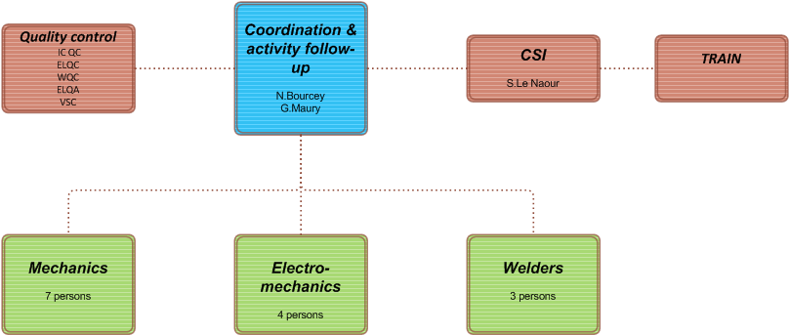
Team (16 persons)
3 month of training in surface before LS1 on mock-ups in building 180.

Slide 5
Sector 5-6
6 interventions planned before start of LS1 (PIM consolidations, 3 leaks, ELQA)….
More than 40 interventions done!
Flange replacements (10)
Corrective action: partial cutting
Cut of flanges for busbars machining (18)
Corrective action: tooling re-design
Cutting mark on flange weld
Corrective action: modify tooling
PIM damaged (5)
Corrective action: add protections
Q7-DFBA M sleeves opening (train machine doesn’t fit)
SIT intervene in 23% of the IC of the sector.

Slide 6
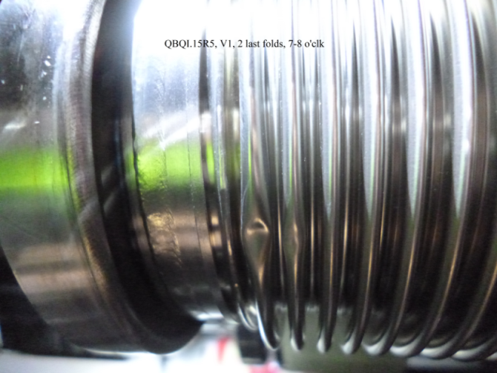
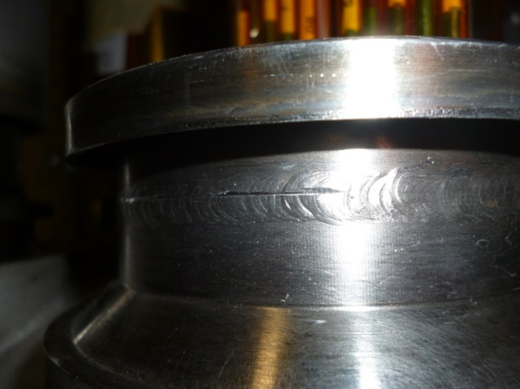
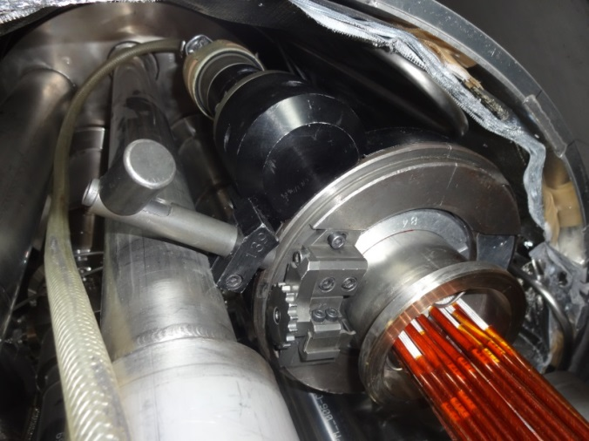
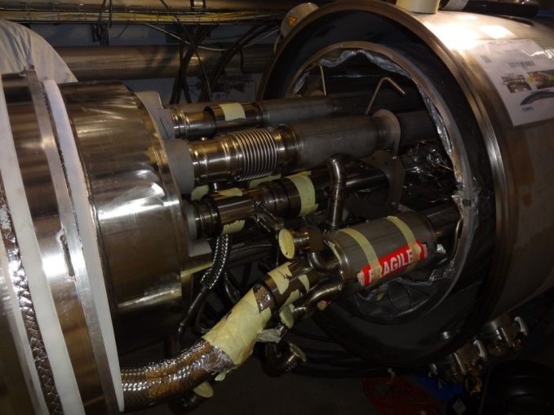
Sector 5-6: lessons and improvements
PIM damaged
Mark during cutting
M flange cutting
Only 7 interventions in sector 6-7 up to now!
Corrective actions applied in sector 5-6 improve the quality.
Q9 M-N pipes cutting

Slide 7
Status of special interventions
PIM
Only 2 PIM found broken during ball test (1-2 and 8-1) instead of 14 expected.
5 PIM damaged during SMACC (5-6).
Leaks
3 old leaks repaired in 5-6 (2 M flange and 1 M2N flexible)
1 old leak repaired in 7-8 (M2N flexible)
Sector | 5-6 | 6-7 | 7-8 | 8-1 | 1-2 | 2-3 | 3-4 | 4-5 | Total
Magnets | 0/0 | 0/0 | 8/8 | 0/0 | 24/24 | 8/12 | 0/16 | 0/8 | 40/68
NCR + preventive | 10/10 | 2/2 | 6/12 | 5/7 | 2/2 | 0/4 | 0/2 | 6/6 | 31/45

Slide 8
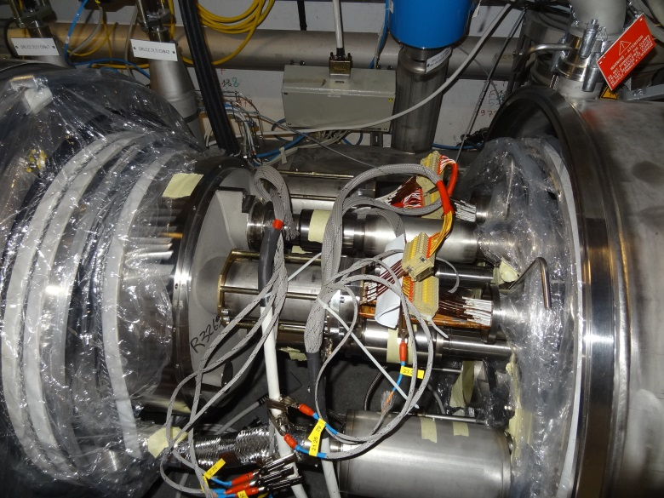
Status of special interventions
Early opening of M line sleeves and removal of insulation
Opening for ELQA instrumentation
Sector | 5-6 | 6-7 | 7-8 | 8-1 | 1-2 | 2-3 | 3-4 | 4-5 | Total
ELQA tests | 3/3 | 3/3 | 3/3 | 3/3 | 3/3 | 3/3 | 3/3 | 3/3 | 24/24
Splice analysis | 0/0 | 0/0 | 5/5 | 4/4 | 8/8 | 22/22 | 0/11 | 5/5 | 44/55
Electrical NC | 0/0 | 0/0 | 4/4 | 4/4 | 1/1 | 0/0 | 0/0 | 0/0 | 9/9
77/88 M sleeves opened prior to the train

Slide 9
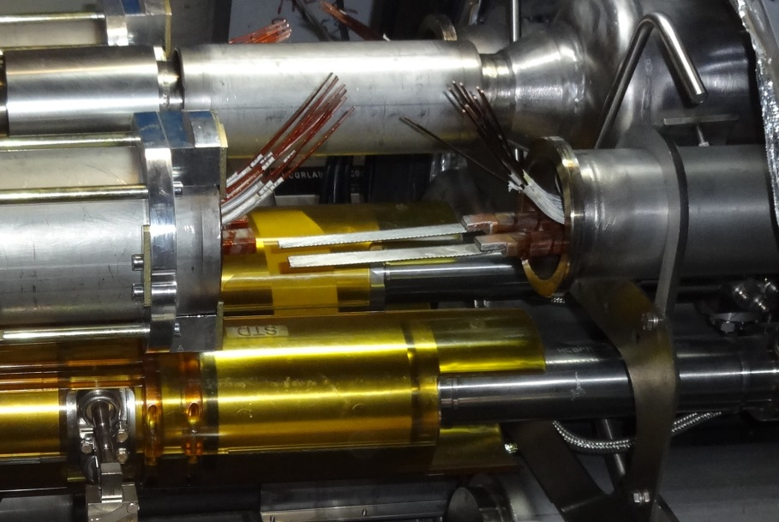
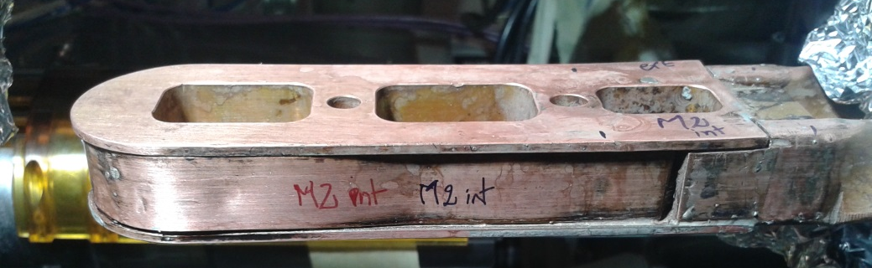
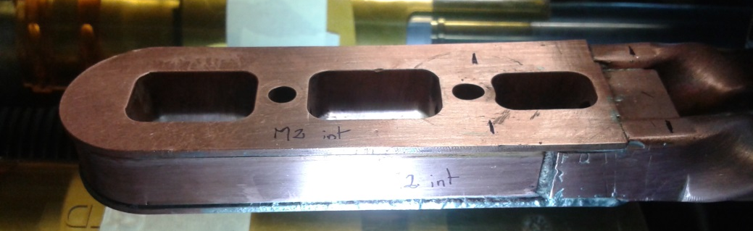
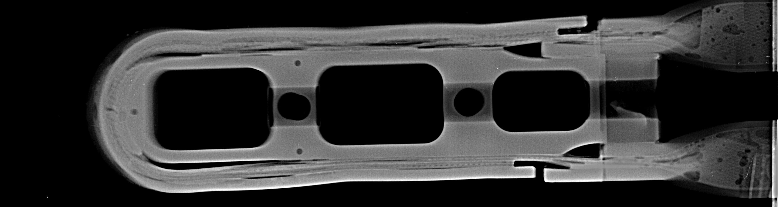
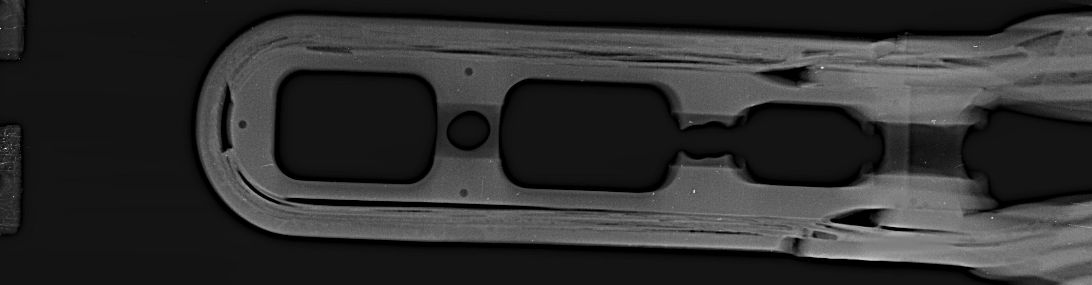
Status of special interventions
RQ busbars segment shortening at point 1 and 5
4 IC’s opened, desoldering and cutting of busbars done.
QEQI.11R5: soldering of the short-circuit. M1 ok but NCR on M2 (cable initially too long and external copper wedge too soft). (D.Etiembre / G.Bachmann)
Before repairing
After repairing
Courtesy of S. Le Naour

Slide 10
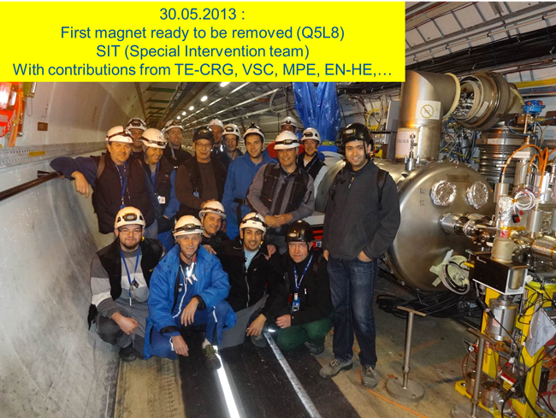
Status of magnet exchange
14/18 magnets removed (last transport foreseen 09/08)
12 installed (last transport foreseen 15/08)
Reconnection of all magnets foreseen before end of the year

Slide 11
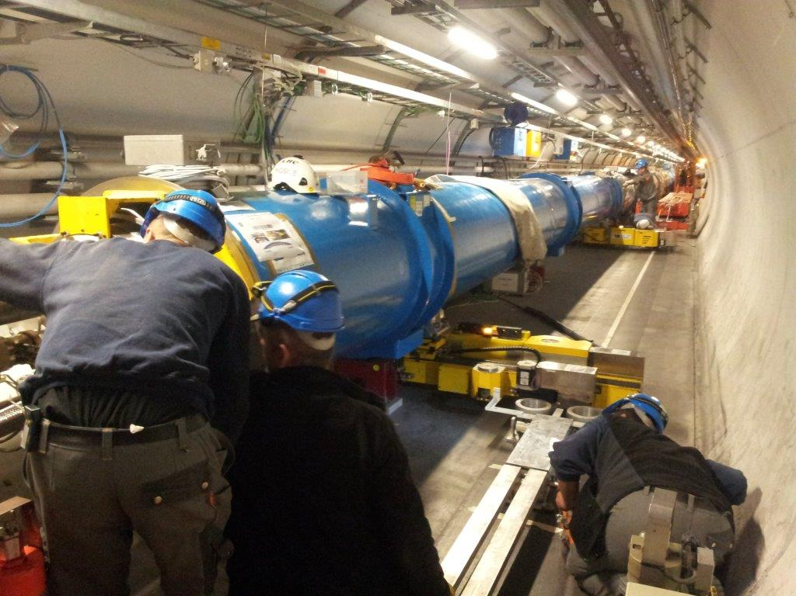
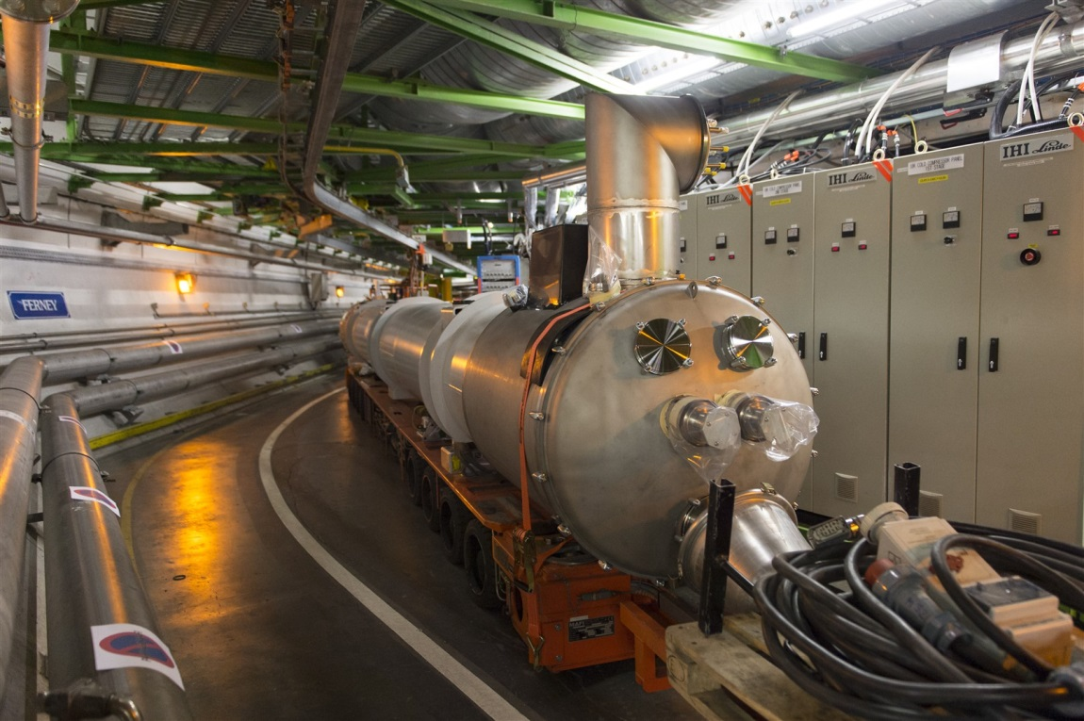
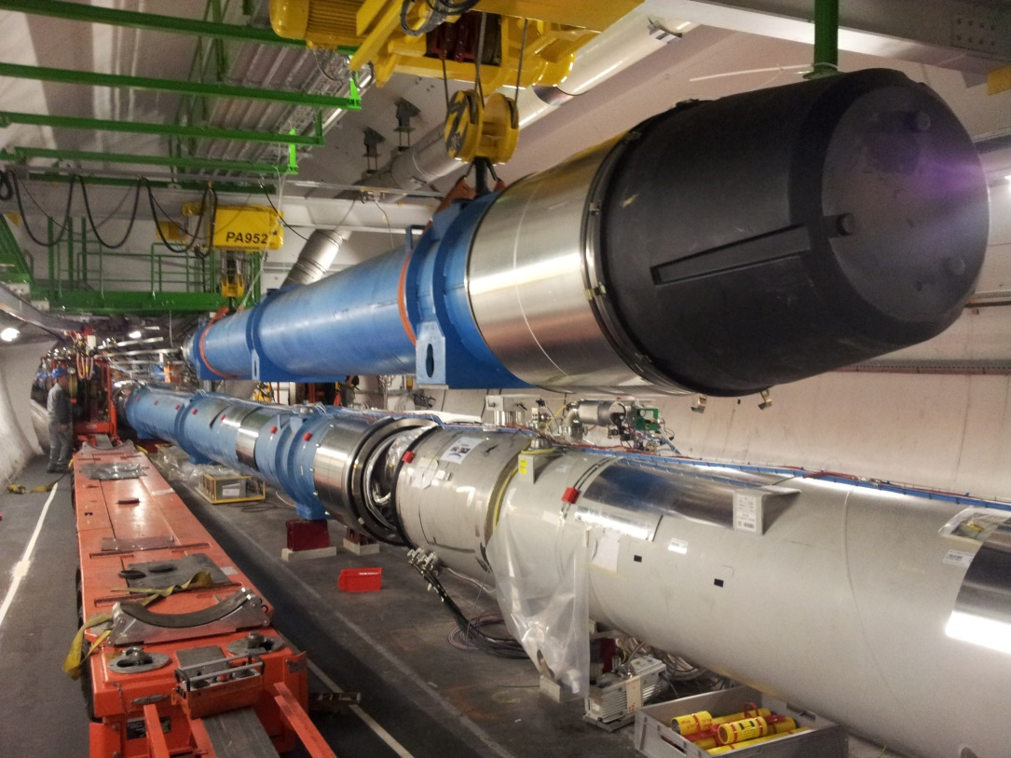
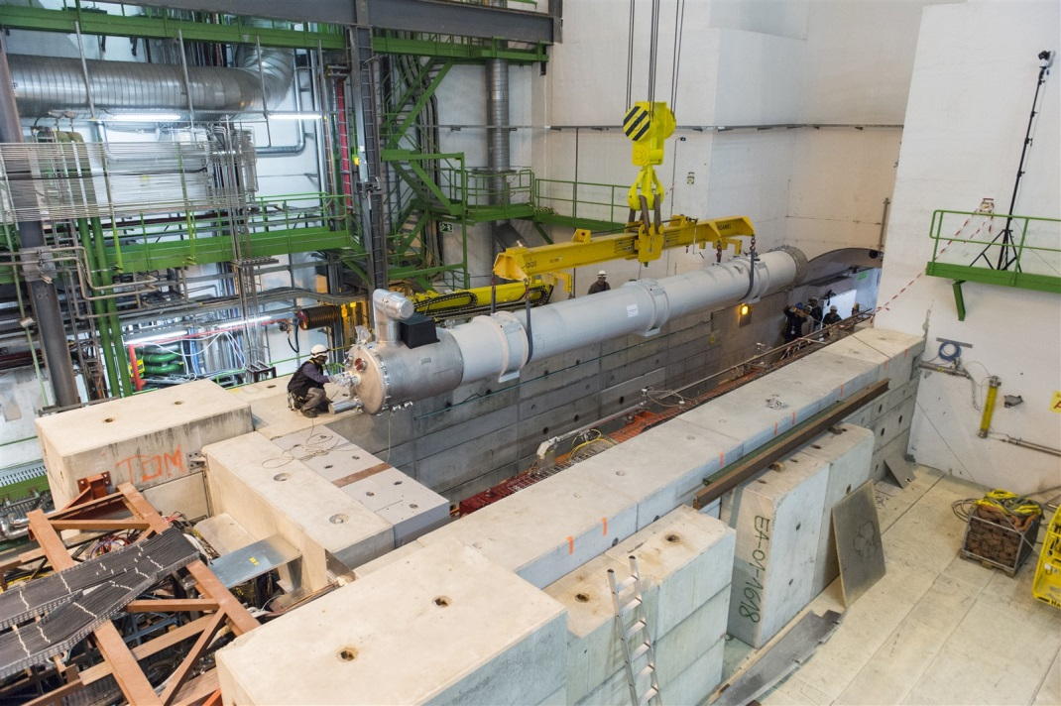
Some pictures of cryomagnets transport
Thanks to EN-HE colleagues

Slide 12
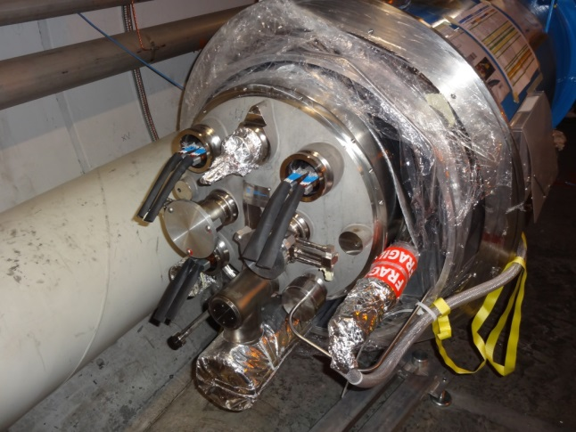
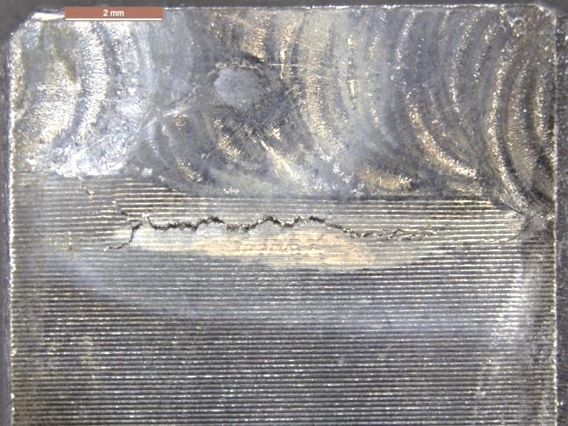
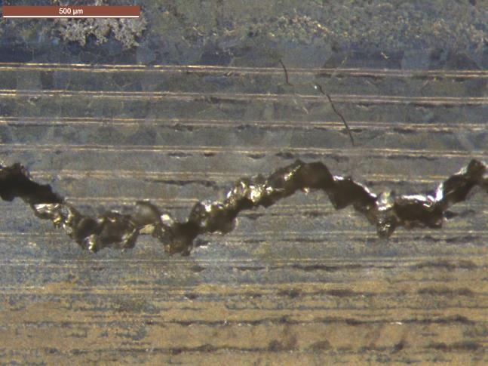
QC: Welding
Welders qualification (automatic and manual welding)
Internal QC
Visual inspection
Endoscopy
Parameters recording for automatic welding
External QC
Visual inspection 100% (WQC)
Radio on butt weld 100% (WQC)
Leak tests (VSC)
Systematic change of M
line flanges
1 NCR detected by radio: crack due to copper particles (leak test ok).
Corrective action: modification of the shielding tooling from copper to stainless steel (see EDMS report 1301475 of A.Gerardin).
Courtesy of A.Gerardin

Slide 13
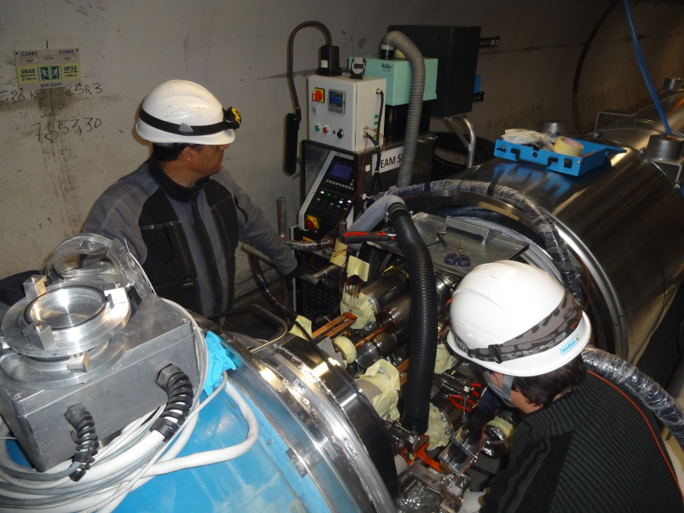
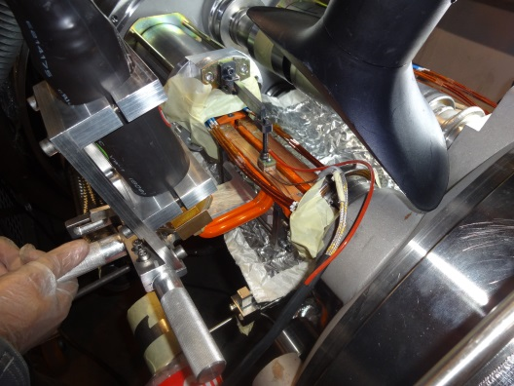
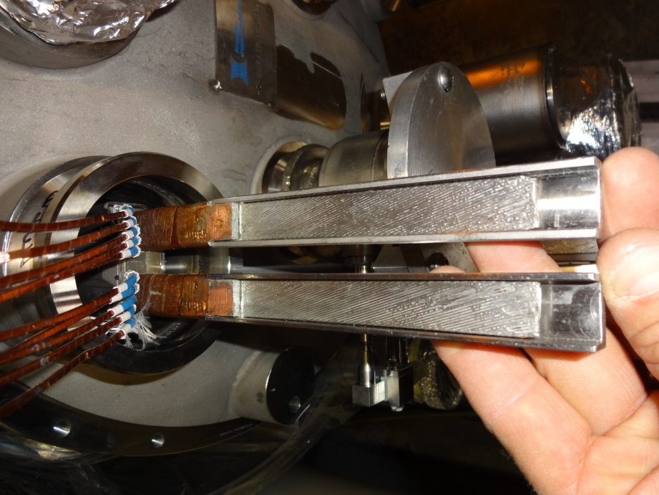
QC: Desoldering and stabilisation
Internal QC
Same procedure than train
Visual inspection
Gauges
Process data recording
Traceability of data in MTF
External QC
Visual inspection (ELQC)
SIT never do soldering of 13KA busbars.

Slide 14
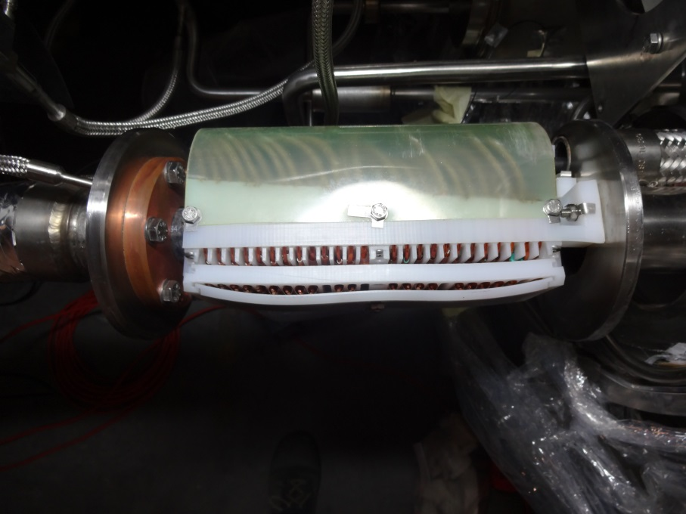
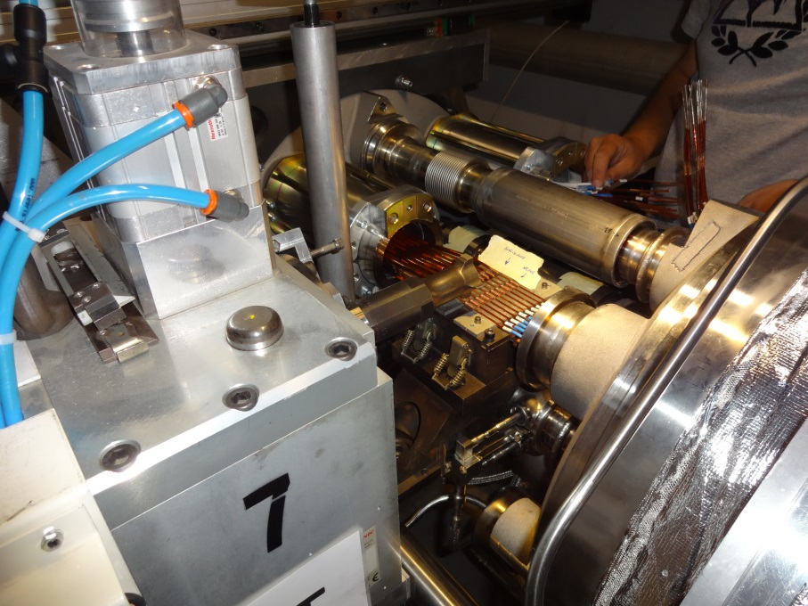
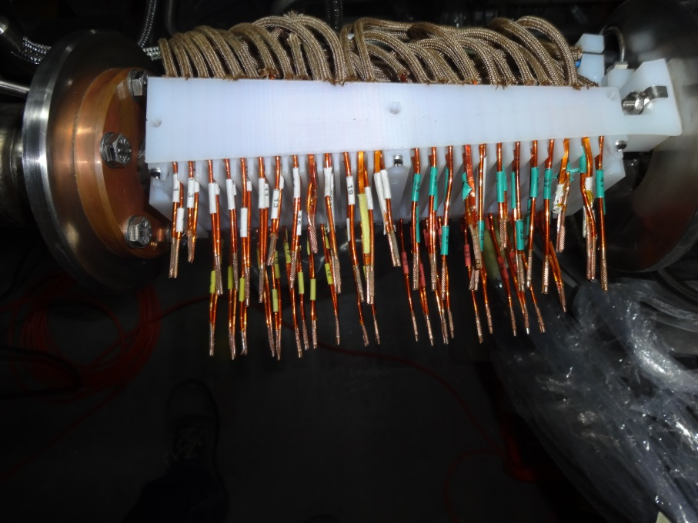
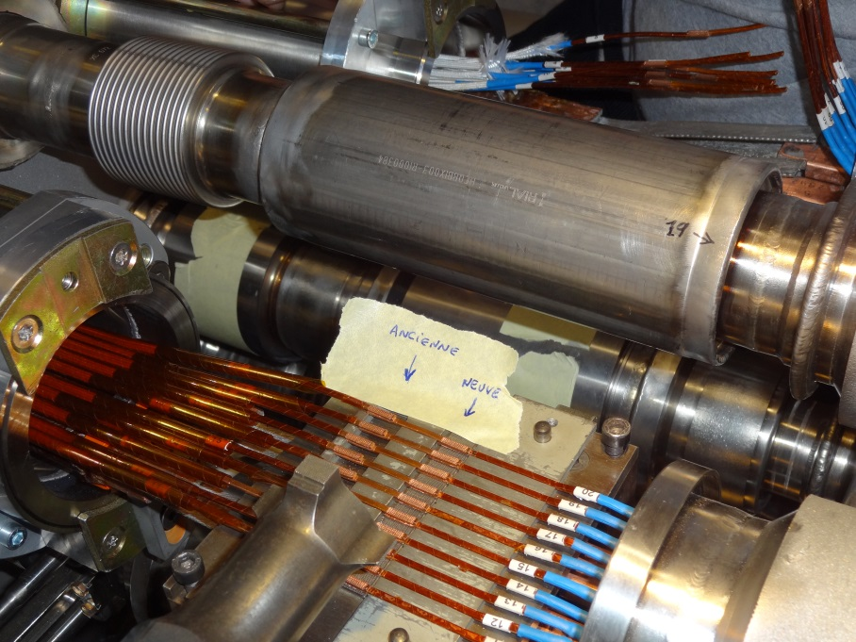
QC: US welding
US welding of line N
US welding of spools

Slide 15
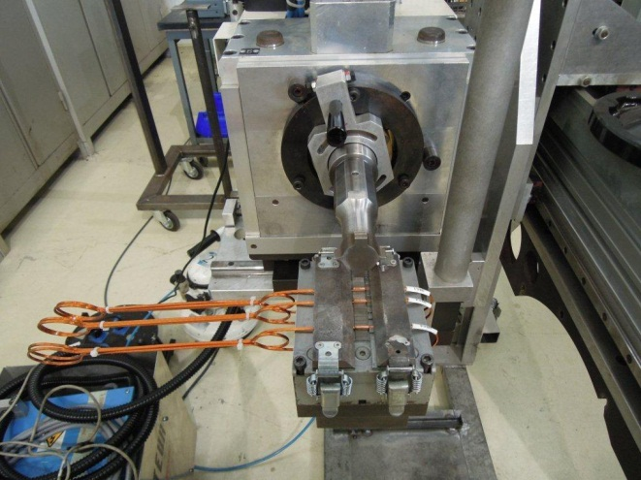
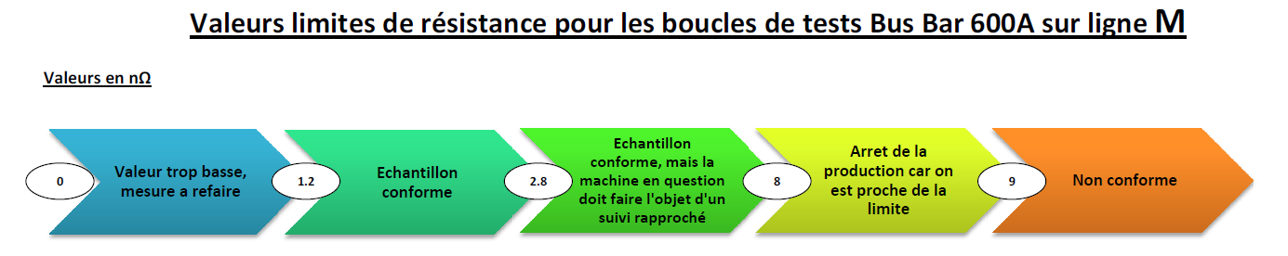
QC: US welding
Qualification of welding machines before LS1 and after each transport. Production of standard samples for cold Rc measurements (cryolab) and tensile test (EN-MME).
Same welding program than 2009 production.
Same criteria than during the installation.

Slide 16
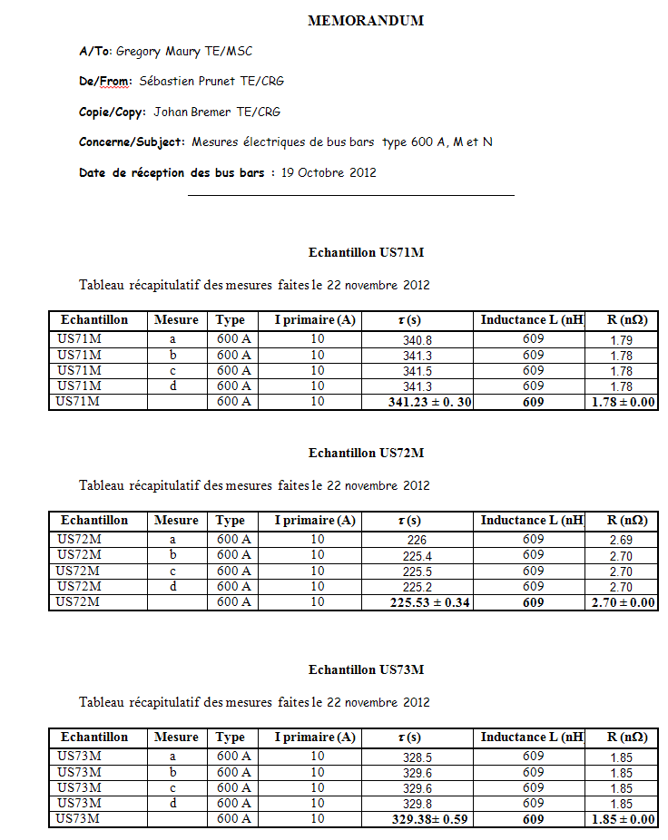
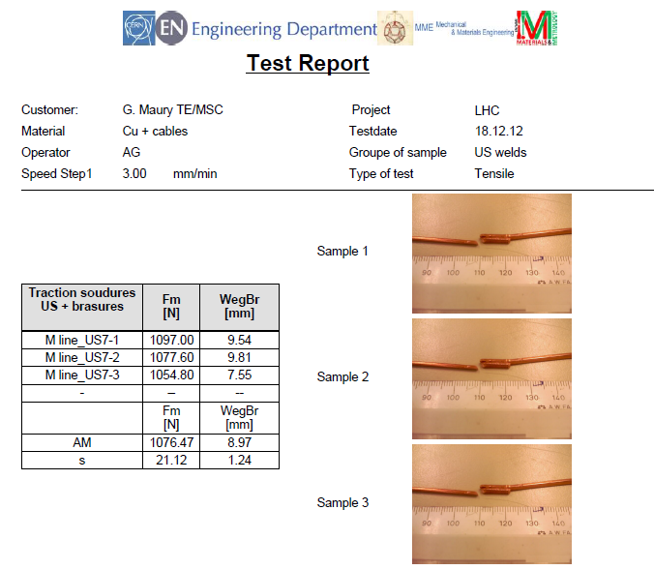
QC: US welding
Example of reports for machine qualification

Slide 17
QC: US welding
> 0.5 mm non-conform
Internal QC
production of samples just before soldering to warm-up the machine
Visual inspection, gauges
External QC
Visual inspection by ELQC team N line EDMS #1223920
M line EDMS #1223924
Electrical tests by ELQA team after completion of a sector
Alignment
1 mm ± 0.5
Excess length
Gauge

Slide 18
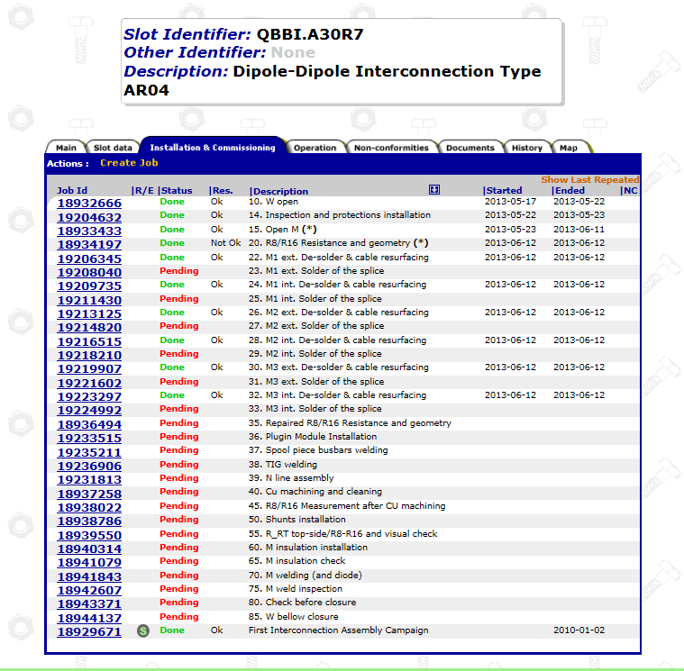
Traceability
New step created in MTF to register process data.
All activities done by SIT are registered in excel files

Slide 19
Still to do and conclusion
Still to do:
Magnets replacement will finish before end of 2013. 3 weeks of delay on the planning.
Connection cryostat: 6/16 inspected ok. Still 2 to repair.
Line Y repair
Triplets copper braid
SAM level gauges
Follow train NCR
SIT is able to follow the needs and we expect to free resources for major NCR last quarter of 2013.

Slide 20
Acknowledgement S.Le Naour, G.Maury, J.P.Tock, and all teams who work with us.
Thank you for your attention.

