Slide 1
ITA activities for CERN:
LHC & SLCH

Slide 2
OUTLINE
  1. ITA general overview
  2. ITA Activities at CERN
  3. LHC – Activities
  4. SLCH - Activities
  5. ITA facilities
  6. Workshop

Slide 3
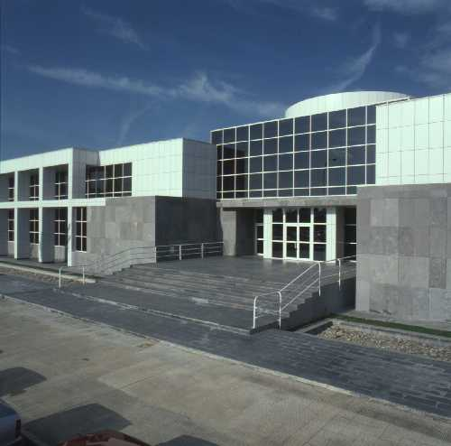
1. ITA
The Instituto Tecnológico de Aragón (ITA) is a non-profit Technology Centre
  Zaragoza, Spain.
ITA main objective is:
  to promote competitiveness in the industrial sector
  to support the growth of business and technological sectors by means of the development, acquisition, adaptation, transfer and diffusion of innovative technologies in a multi-agent collaborative framework

Slide 4
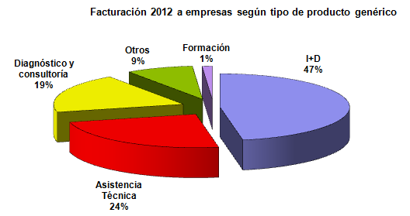
1.1 ITA: Staff & Budget
Tech Centre created in 1985
Facilities with more than 15.000 m2
220 people
Aprox. 1100 custmers/ year
Investment in facilities: 1.5 Meuro / Year al budget: 14 Meuro
Staff qualification. year 2012
54%
7%
20%
PhD’s
19%
Doctors
Superior technicians
Intermediate technicians
Assistance staff

Slide 5
1.2 Organization

Slide 6
2. ITA activities for CERN
Since more than 6 years ITA is collaborating with CERN within CMS experiment (TK subsystem)
Our activities have been focused on :
  Electromagnetic compatibility issues
  Power supply distribution issues
Notes:
Leer..

Slide 7
2. ITA activities for CERN
These activities are part of the R&D project for CMS upgrades
  CERN R&D Working line
    EMC immunity studies for CMS TK upgrade - 9.04
  National research program
    I+D en Detectores para Futuros Colisionadores: FPA2010-22163-C02-01 (Ip: I.Vila) 2011- 2013
    I+D en detectores y estudios fenomenológicos para el colisionador Lineal Internacional : FPA2007 – 66387 (Ip: I Vila) - (2007-2010)
Notes:
Leer..

Slide 8
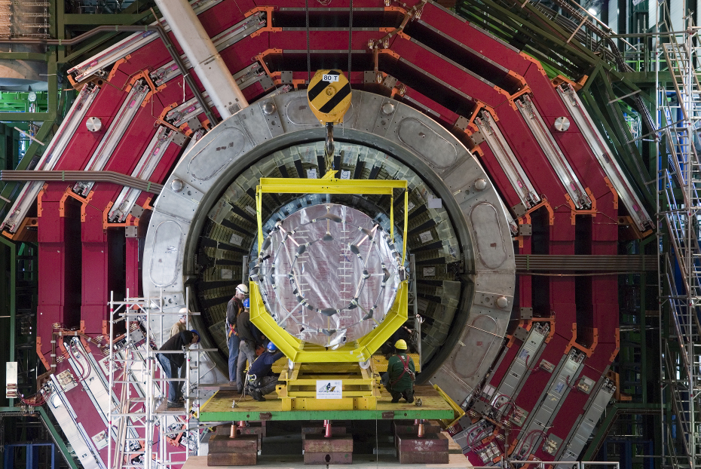
2. ITA activities for CERN
Muon Chambers
Iron Yoke
Electromagnetic
Calorimeter (ECAL)
Hadron
Calorimeter (HCAL)
Superconducting Solenoid
Tracker
Overall diameter: 20 mts / Overall length : 25 mts / Total weight: 13000 Tn
Notes:
The detector is divided in several sub-detectors that are located in different layers.
The goal of the CMS experiment is to identify particles and measure their energy using sensitive devices (detectors). The detectors produce electrical signal that are processed by a group of electronics devices called front end electronic (FEE).
One of the most important sub-detector of CMS is the Tracker System (pasar transparecnia)

Slide 9
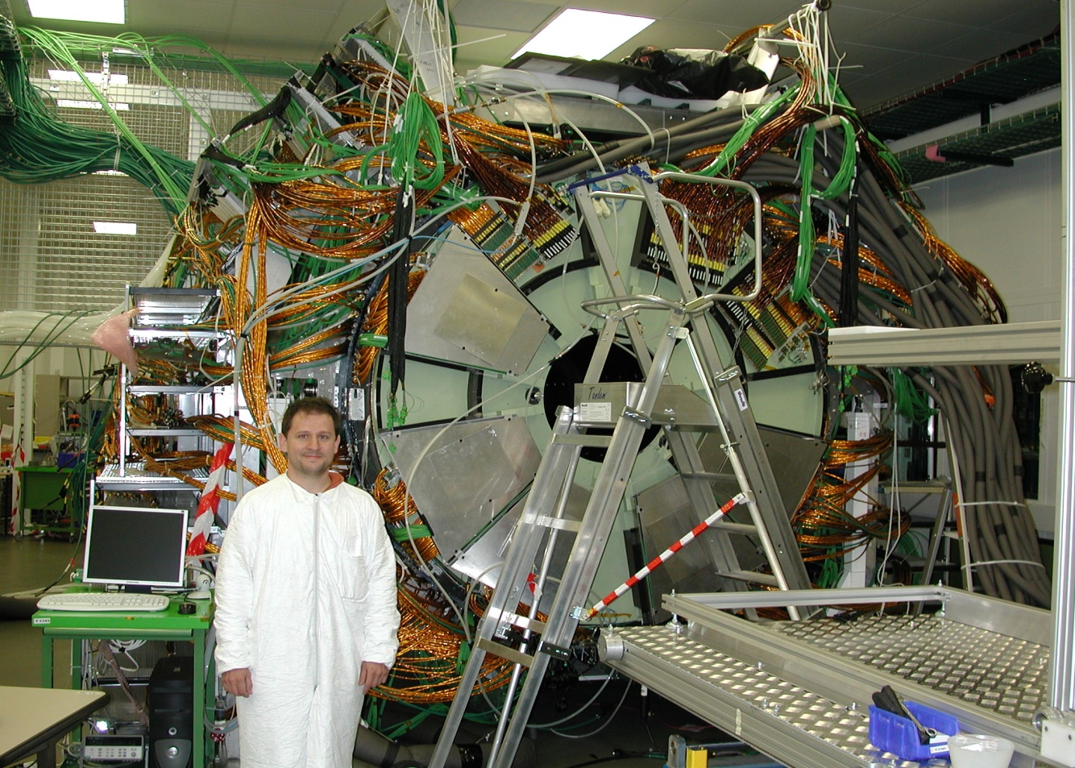
2. ITA activities for CERN
CMS Tracker - Subdetector

Slide 10
2. ITA activities for CERN
ITA has collaborated actively with the CMS community.
  FERMILAB
  RTWH Aachen
  CERN groups: Electronics Section - PH?
  Spanish groups:
    IMB-CNM
    IFCA
During 2009 ITA was a member of CMS power task force
  SLHC baseline design
Since 2011 ITA is officially a collaboration member of CMS experiments
  ITA is the only Aragon institute involved in SLHC project

Slide 11
2. ITA activities for CERN
These activities may be divided in two periods
ITA activities for LHC :
  EMC analysis on previous CMS systems and new designs.
  SLHC preparation
ITA activities for SLHC :
  EMC studies for CMS tracker upgrade project - SLHC

Slide 12
3. ITA activities for CMS - LHC
ITA activities has been focused on the analysis of old experiment designs:
  FEE characterization old TRACKER:
    Coupling Mechanisms
  Weak points characterization of old FEE:
    Impact for Upgrades designs
  Evaluation of new powering schemes
    Based on CMS-LHC experience

Slide 13
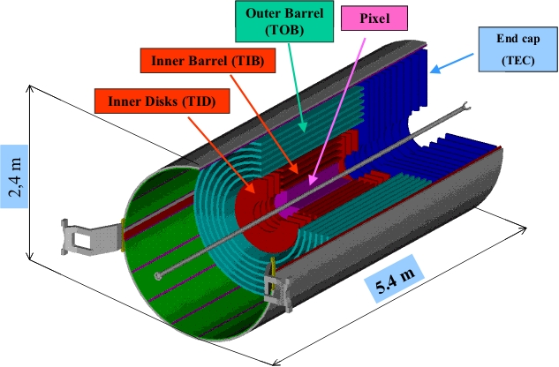
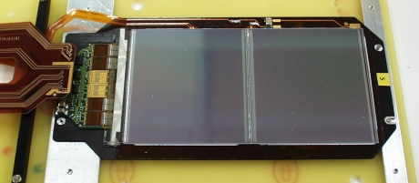
3. ITA activities for CMS – LHC: Coupling Mech.
Tracker detector
Tracker Module
(13884 units)
Silicon sensor
(512 channels)
FEE
( Hybrid - 4 APVs)
Carbon fiber
frame
Notes:
It is located in the collision region.
The Silicon Tracker measures the track of particles after collision. (As a picture describing the trajectories of particles after collisions). Each of the is divided in different regions (barrels, disk , end caps..)
The silicon tracking system is made of several base units called “modules”. Each module consists of three main elements:
• Single or double side silicon micro-strip sensors.
• Mechanical support (Carbon fibre frame).
• Readout front-end electronics (Hybrid circuit) (most important component APV25)
The tracker FEE electronics has an specific characteristics ..

Slide 14
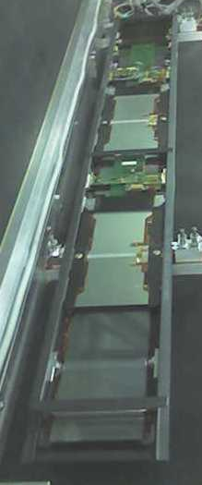
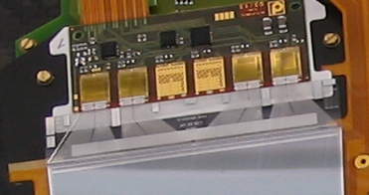
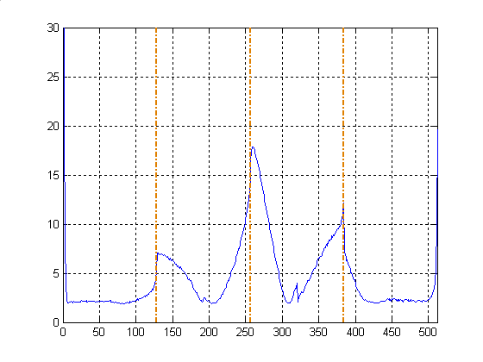
3.1 ITA activities for CMS – LHC: Coupling Mech.
Near field radiated noise was the main noise source of Tracker system but it was not clear its coupling path
  Radiated noise generated by CM or DM currents
    Noise currents on power network
A detailed study based on simulation and real measurements were developed to characterize the coupling mechanism.
  Close to the Sensor & Pitch adapter area

Slide 15
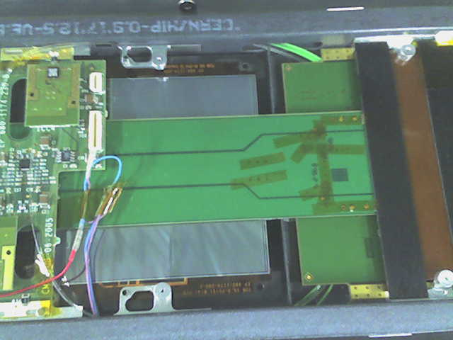
3.1 ITA activities for CMS – LHC: Coupling Mech.
A
By
B
C
D
E
Before processing
After processing

Slide 16
3.1 ITA activities for CMS – LHC: Coupling Mech
A detailed analysis of signal circuit of FEE was carried out
  A gap was found between sensor and FEE.
    This area makes the input circuit susceptible to magnetic field perpendicular to the sensor (By).
Analysis was carried out mixing
  FEM – COMSOL
  TL – Models (MATLAB)
  Signal processing tecniques
CF cross piece
APVi
By
wd
(Sensor-Kapton)
Backplane
e=0.6mm
CF legs

Slide 17
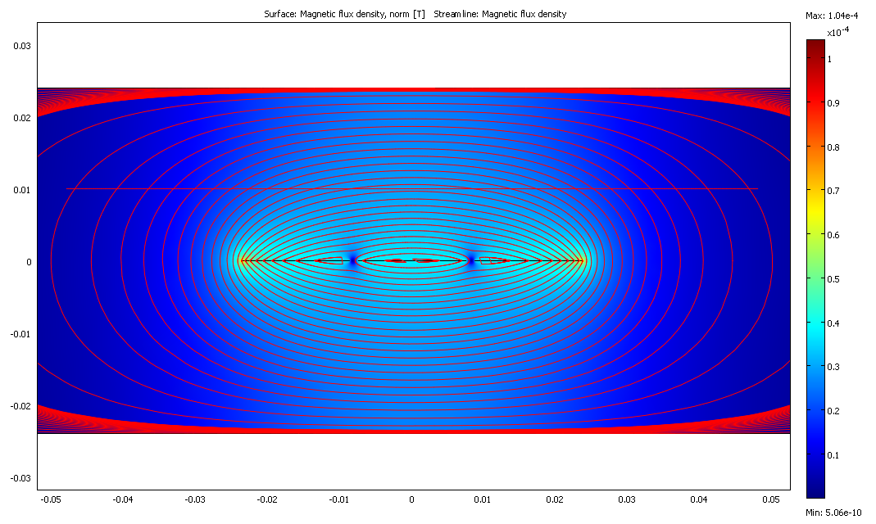
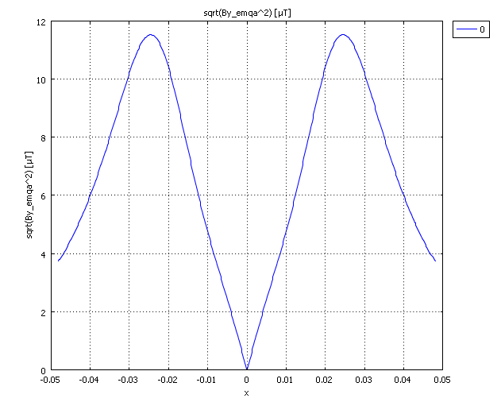
3.1 ITA activities for CMS – LHC: Coupling Mech
FEM model
[By]
MATLAB signal processing
Before processing
After processing

Slide 18
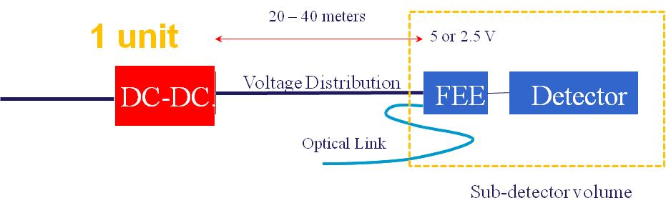
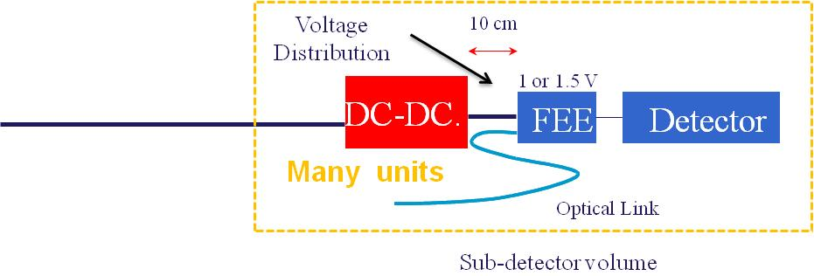
4. ITA activities for CMS Upgrade- SLHC
Today
Phase II- Upgrade
New FEE requirements forces to install DC-DC converters close to FEE (inside sub-detector modules). – More 8000
  High current demanded by each power channel
However DC-DC converters are a very noisy source
ITA R&D has been focused on :
  To define preliminary rules to ensure the integration of main components (Detector, FEE, Power network and DC-DC )
  To define design strategies that allow increasing the immunity of the Detector-FEE unit.

Slide 19
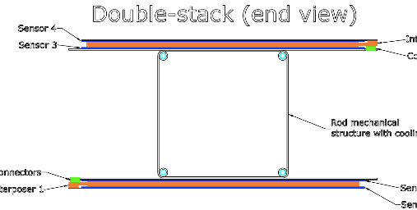
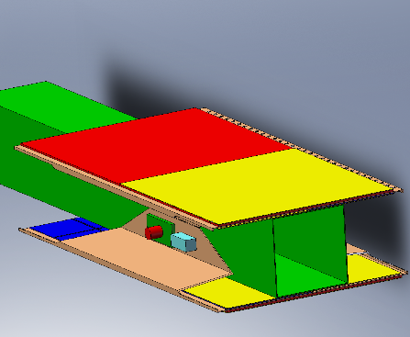
4. ITA activities for CMS Upgrade- SLHC
There are several layout proposal for system layout . Prop 2
DC-DC
  M. Jonhson´s Talk
  CMS upgrade WS 2009

Slide 20
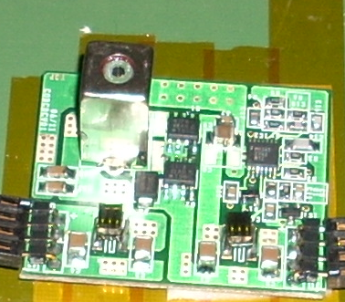
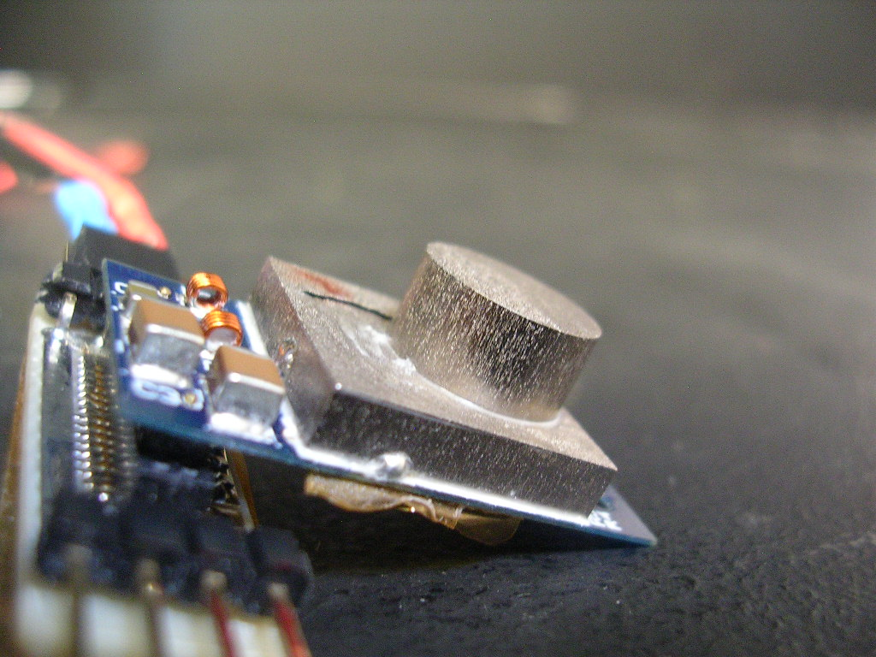
4.1 ITA activities for SLHC: PS Impedances
The aim of this study is to define and characterize the impedances connected to the DC-DC power converter
  It defines the noise (conducted and radiated) levels emitted by the DC-DC power converters AT SYSTEM LEVEL
Impedance effects on noise emissions has been studied by simulations and real measurements
  ITA converter (Commercial components) – (5A)
  Aachen converter (ASICs CERN –AMIS2) – (3A)

Slide 21
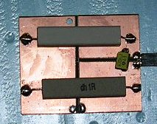
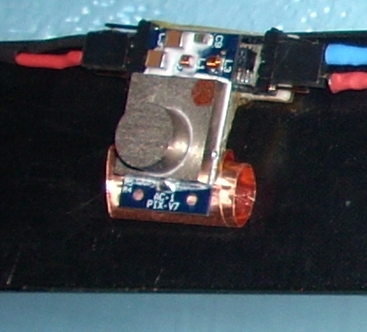
4.1 ITA activities for SLHC: PS Impedances
The low impedance connected to the input and output of DC-DC converters increases the noise level
  Load filter capacitor - DM
  Carbon fiber – CM
Real measurement
Simulation

Slide 22
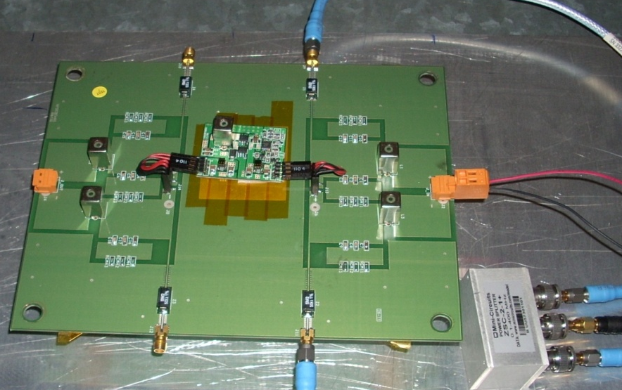
4.1 ITA activities for SLHC: PS Impedances
A set up has been developed to estimate noise emissions in real scenario – System Level
  Low impedance at the input and at the output

Slide 23
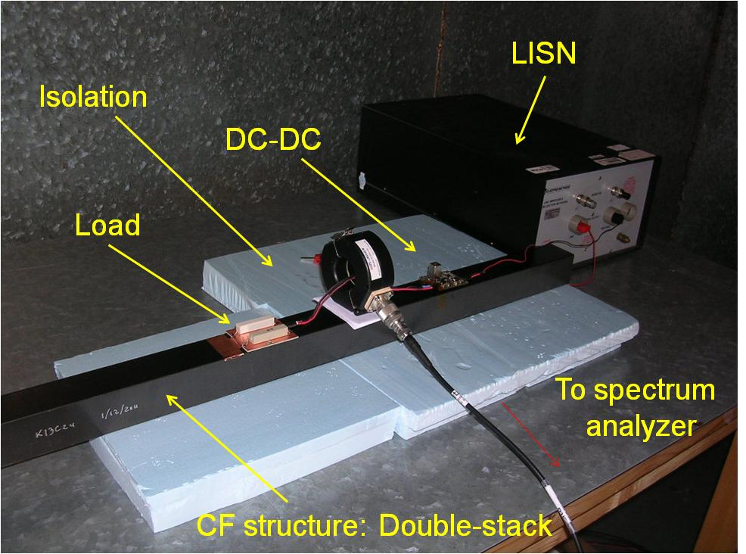
4.1 ITA activities for SLHC: PS Impedances
Three prototypes of Rod structure of Tracker PT layer have been sent to ITA from FERMILAB
A small prototype of the power network has been developed
  Conducted emissions were measured

Slide 24
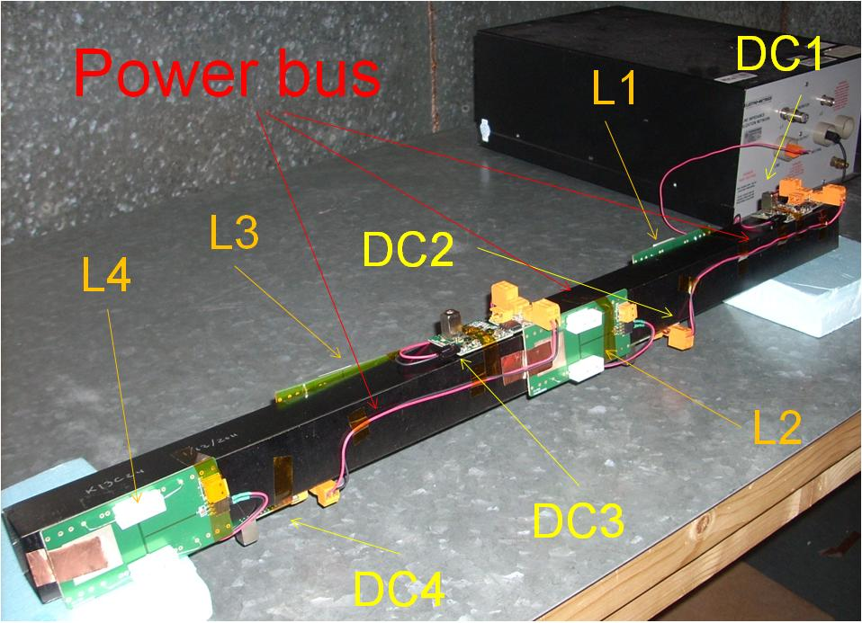
4.2 ITA activities for SLHC: Noise propagation PN
Noise levels in a power network based on DC-DC converter were measured too
  A small prototype of the power network has been prepared to measure the conducted emission on the PT layers.
    4 DC-DC converters (ITA type) & Resistive loads
Several measurements have been performed
  CM & DM at output of each unit
  CM & DM on the power bus

Slide 25
4.2 ITA activities for SLHC: Noise propagation PN
1DC-DC
4 DC-DC
OUTPUT
INPUT

Slide 26
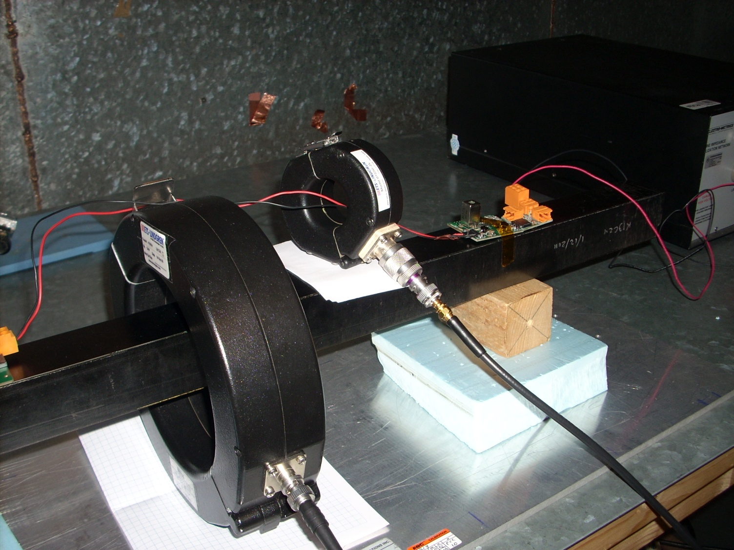
4.2 ITA activities for SLHC: Noise propagation PN
CF conductivity - OK .
It will be used as a detector ground
  CM & Noise currents through the CF structure

Slide 27
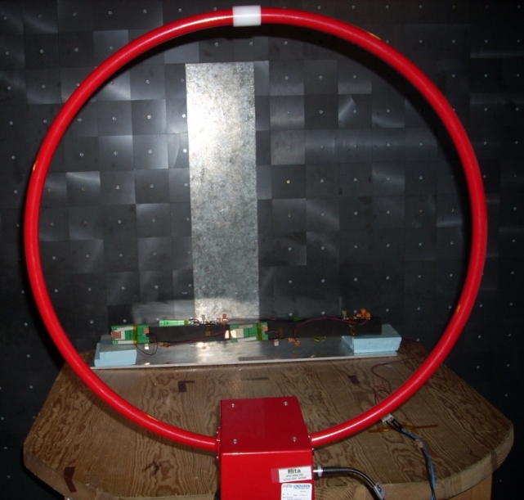
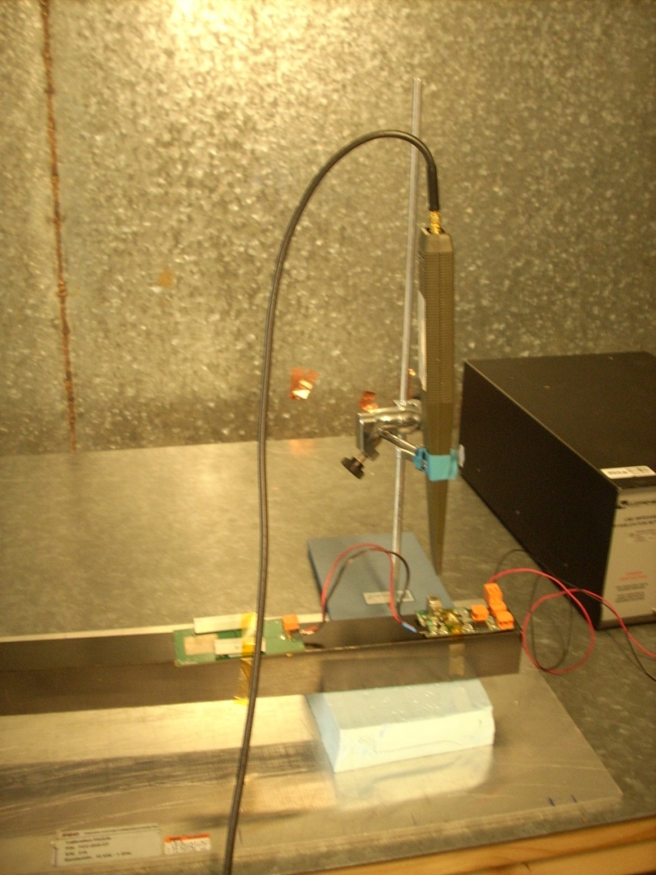
4.3 ITA activities for SLHC: Radiation effects PN
A similar procedure has been followed to measured the radiated noise emission of a power network based on DC-DC converters.
  1 & 4 DC-DC converters
    ITA type
  Resistive loads
Several measurements have been performed
  Near field noise emissions
  Far field noise emissions

Slide 28
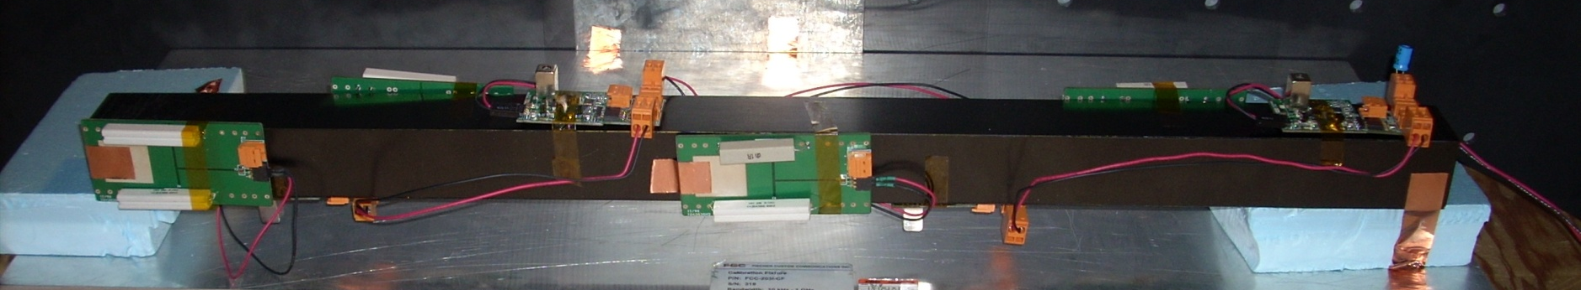
4.3 ITA activities for SLHC: Radiation effects PN
4 DC-DC converters have been placed on the rod .
P6
P4
P3
P2
P1
P5

Slide 29
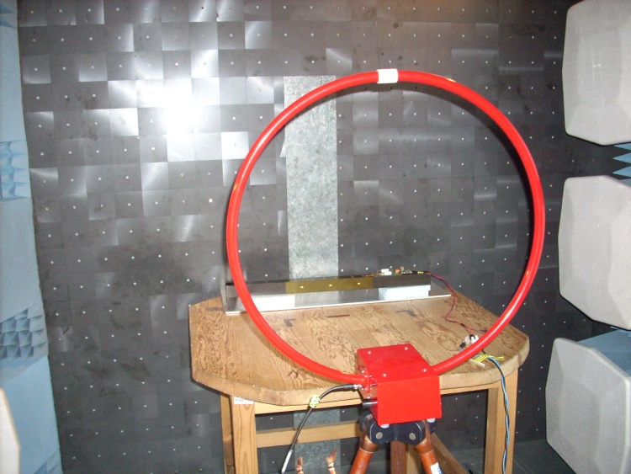
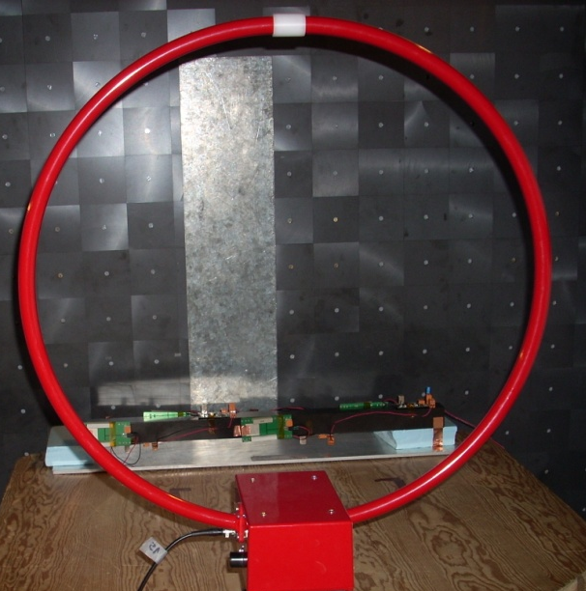
4.3 ITA activities for SLHC: Radiation effects PN
The test set-up was placed inside a semi-anechoic chamber
1 DC-DC
2 Gnd
4 DC-DC

Slide 30
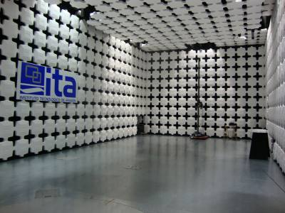
5. ITA Facilities
EMC - Facilities
  Faraday cage
  Semi-anechoic chambers
    3m / 10 m
  Spectrum analyzers/receiver up to 26GHz
  Current probes & Antennas
  Surge & Burst & ESD generators
  Amplifiers (10kHz-6GHz)
  RF generator
Power Electronic Lab -Facilities
  Boards designs
  Power supplies (up 25kW)
  Programming controllers
  Test climatic chamber

Slide 31
6. Workshop
These activities are not the only ones focused on big scientific facilities
ITA is involved on other 2 projects:
  Belle II experiment - PXD DEPFET
    First EMC studies in a pixel detector
    R&D collaboration: Max Planck Institute of Munich
  International Linear Collider –FTD
    ITA is in charge of the power pulsing system for ILC-FTD
    R&D collaboration : IMB,IFCA ,IFIC, CIEMAT,…
Many of these studies has been carried out in parallel with other studies for industries and companies
  We transfer most of the technology developed in this projects

Slide 32
6. Workshop
Next Wednesday at Paraninfo ITA organizes a special workshop entitled:
“Desarrollo Tecnológico y Oportunidades de Negocio Surgidas en Grandes Instalaciones Científicas”

Slide 33
6. Workshop
16:00 - 16:10 Apertura y bienvenida (Salvador Domingo, Director del Instituto Tecnológico de Aragón).
16:10 – 16:50: Del CERN a la Sociedad: Inventando para ti (Dr. I.Vila, Instituto Física de Cantabria - CSIC).
16:50 – 17:20 Alibava systems: experiencia en comercialización de electrónica para sensores de partículas (Dr. Manuel Lozano, Instituto Microelectrónica de Barcelona - CSIC).
17:20 – 17:45: Café y visita a la exposición
17:45 – 18:15: Desarrollo tecnológico en la industria y grandes experimentos científicos. ¿Dos mundos aislados? (Dr. Fernando Arteche, Instituto Tecnológico de Aragón)

Slide 34
6. Workshop
18:15 – 18:40: Enterprise Europe Network – La red europea de cooperación tecnológica entre empresas (Ignacio Hernández, Instituto Tecnológico de Aragón).
18:40 – 19:00: El ICMA y el desarrollo de instrumentación científica avanzada para grandes instalaciones científicas (Instituto de Ciencia de Materiales de Aragón - ICMA).
19:00 – 19:30: Mesa redonda: La transferencia de tecnología entre grandes instalaciones y la sociedad. Moderador: (Miguel Ángel Pérez, Instituto Tecnológico de Aragón).
19:30 – Clausura

