Slide 1
Technology for People
Vienna University of Technology
September 8th, 2014
Welcome
8th International Workshop
on the CKM Unitarity Triangle (CKM2014)
Univ.Prof. Dipl.-Ing. Dr. Johannes Fröhlich
Vice Rector for Research

Slide 2
History
1815: Founded as „k. k. polytechnisches Institut"
1865: First reform
restructuring, implementation of faculties, concentration on technological disciplines
1872: Renamed to „k. k. Technische Hochschule" (TH)
new organisational statute (lasts until 1945)
1902: First doctorates awarded
1919: Admission for women
1975: Renamed to „Technische Universität Wien" (TUW)
1999: Implementation of University Act ´93
2004: Autonomy through University Act ´02
2015: 200 Years Anniversary

Slide 3
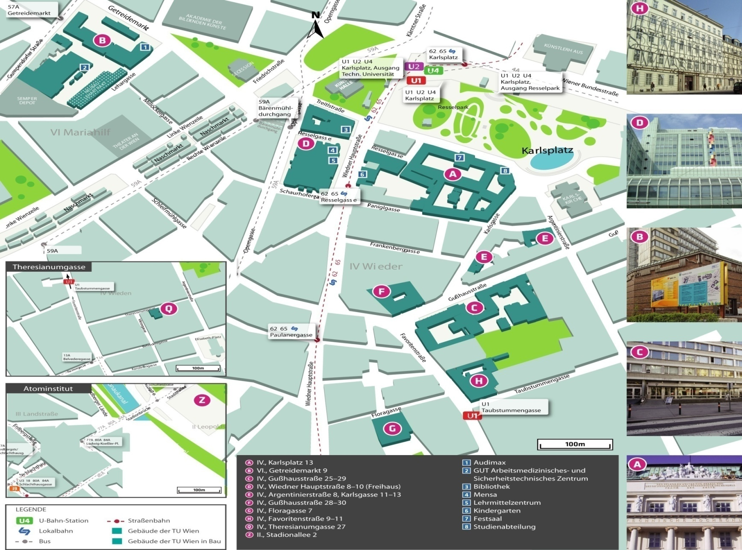
Location

Slide 4
Facts & Figures
Finances
ca. 215 Mio. € | global budget (from federal funds)
ca. 81 Mio. € | third party funds
63 Mio. € | third party funds**
Staff
3.367 | scientific staff
thereof 140 | professors
1.174 | non-scientific (administrative & technical) staff
4.541 | total staff
Students
ca. 27.000
thereof 24,6% | foreigners
thereof 25,5% | women
Graduations
ca. 2.200 | first and second degrees, Bologna System
thereof | 900 BSc, 460 MSc, 520 Diploma Engineer, 260 PhD

Slide 5
Organisation
Faculties
8 Faculties | Bachelor + Master Programmes | Institutes
Architecture and Planning | 2 + 3 | 6
Civil Engineering | 1 + 3 | 8
Electrical Engineering and Information Technology | 1 + 5 | 9
Informatics | 4 + 11 | 7
Mechanical and Industrial Engineering | 2 + 2 | 9
Mathematics and Geoinformation | 5 + 9 | 7
Physics | 1 + 2 | 4
Technical Chemistry | 1 + 5 | 4
(interdisciplinary programs) | 1 + 3 | -
Total | 19 + 43 | 54

Slide 6
TU-Research Matrix: Research Focal Areas and Research Fields
in bold: with connex to Physics at TUW
Computational Science and Engineering | Quantum Physics and Quantum Technologies | Materials and Matter | Information and Communication Technology | Energy and Environment | Additional Fields of Research
Computational Materials Science | Photonics | Surfaces and Interfaces | Computational Intelligence | Energy Active Settlements and Infrastructures | Development and advancement of the architectural arts
Computational Fluid Dynamics | Quantum Metrology | Materials Characterization | Computer Engineering | Sustainable and Low Emission Mobility | The European City – between self-organisation und controllabililty
Computational System Design | Quantum Modeling and Simulation | Bulk Metallic Phases | Cognitive and Adaptive Automation and Robotics | Climate Neutral Renewable and Conventianal Energy Supply Systems | Fundamental Mathematics Research
Mathematical and Algorithmic Foundations | Nano-electronics | Non-metallic Materials | Distributed and Parallel Systems | Environmental Monitoring | Mathematical Methods in Economics
Computer Science Foundations | Design and Engineering of Quantum Systems | Composites | Media Informatics and Visual Computing | Efficient Utilisation of Resources
Modeling and Simulation | Quantum Many-body Systems | Biomaterials | Business Informatics | Sustainable Technologies and Products
Risk Based Design |  | Special and Engineering Materials | Telecommunication
 |  | Structure-Property-Relationship | Sensor Systems

Slide 7
TUW-Activities/Synergies for „Particle Physics“
in the context of Strategies/Collaboration/Infrastructure:
*) OeAW-HEPHY/TU Wien research activities for LHC
*) Institute of Atomic and Subatomic Physics (“Atominstitut”):
- TRIGA nuclear reactor as core neutron research facility – 50 years anniversary in 2012
- implementation of a working group in collaboration with HEPHY on dark matter, parallel appointment of new HEPHY director Prof. Schieck as Professor for Particle Physics at TU Wien
- construction of the PERC instrument for neutron decay studies , funded within the Priority Programme "Precision experiments in particle- and astrophysics with cold and ultracold neutrons" of the German Research Foundation
*) Austrian Science Fund granted PhD School “Particles and Interactions“: to combine the expertise on properties and interactions of elementary particles and hadronic matter. Partners of TUW: University of Vienna, and two institutes of the Austrian Academy of Sciences (HEPHY – High Energy Physics Institute and SMI – Stefan Meyer Institute)

Slide 8
Development Plan TU 2013+ Mission
Innovation
Research
Teaching

