Slide 1
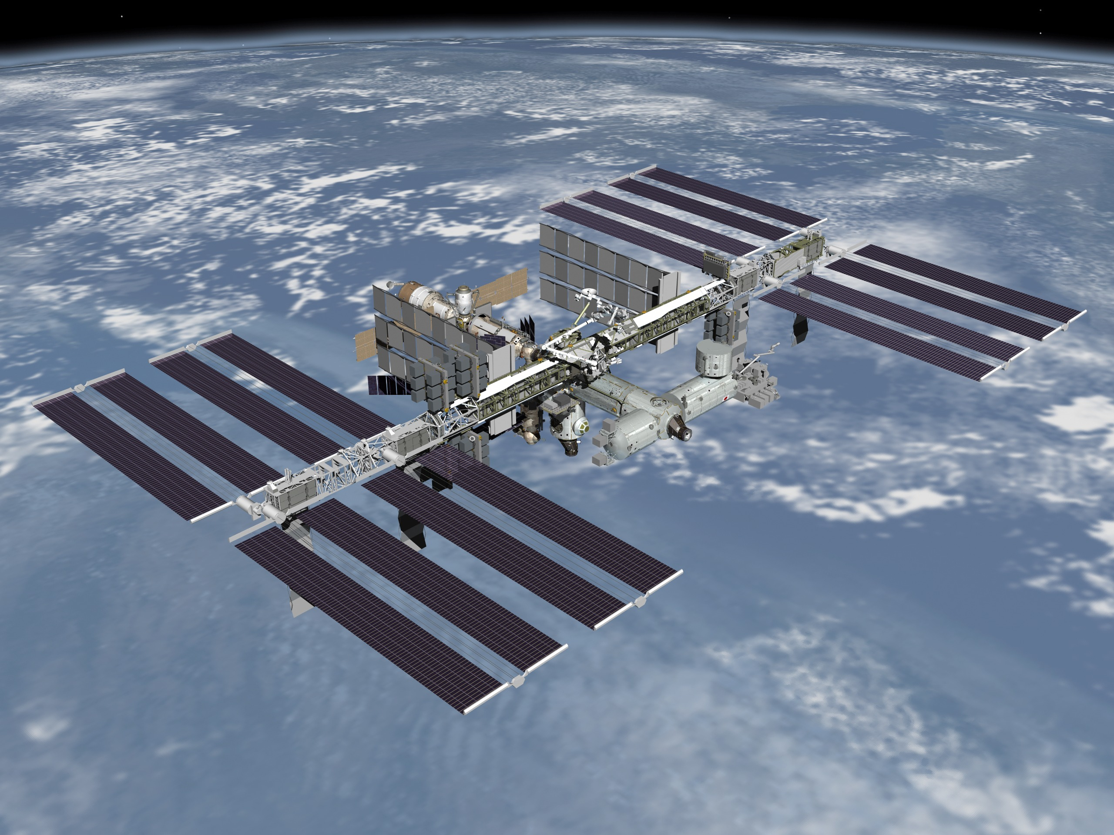
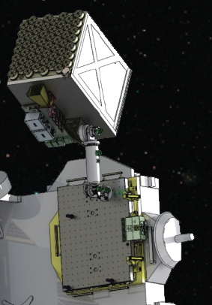
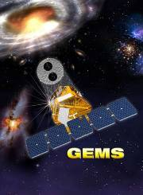
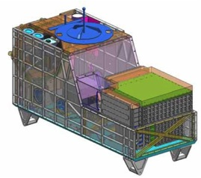
Modeling of the Background Rate for the Next Generation of Space-based Experiments
GOAL:
Determine the background rate due to cosmogenic and terrestrial background outside the regions of high flux of trapped particles.
Determine duty cycle imposed by high background and trapped radiation.
John Krizmanic
CRESST/USRA/NASA/GSFC
NICER
CALET

Slide 2
The Problem
The next generation of space-based X-ray and Cosmic-ray experiments are designed for unprecedented signal sensitivity → high background rejection.
The magnitude of the background must be determined as well as mitigation strategies developed, both in the choice of instrument design and signal processing capability.
Simulation packages (GEANT) can be used to accurately determine the impact of background radiation if the spectra of all backgrounds are known (and the Fermi team has developed an extensive set of background models (Mizuno et al., ApJ 614)).
Outline:
Overview of methodology.
Discussion of background flux models.
Example of radiation background for NICER → would be appropriate for CGBM.
Application for CALET.
Highlights of recent SPENVIS workshop (Brussels May 22 – 24, 2013).

Slide 3
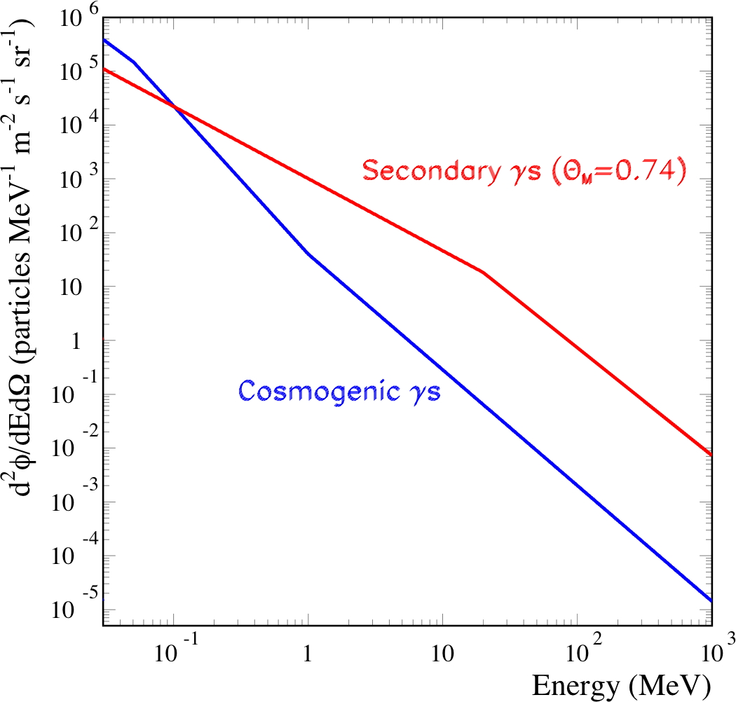
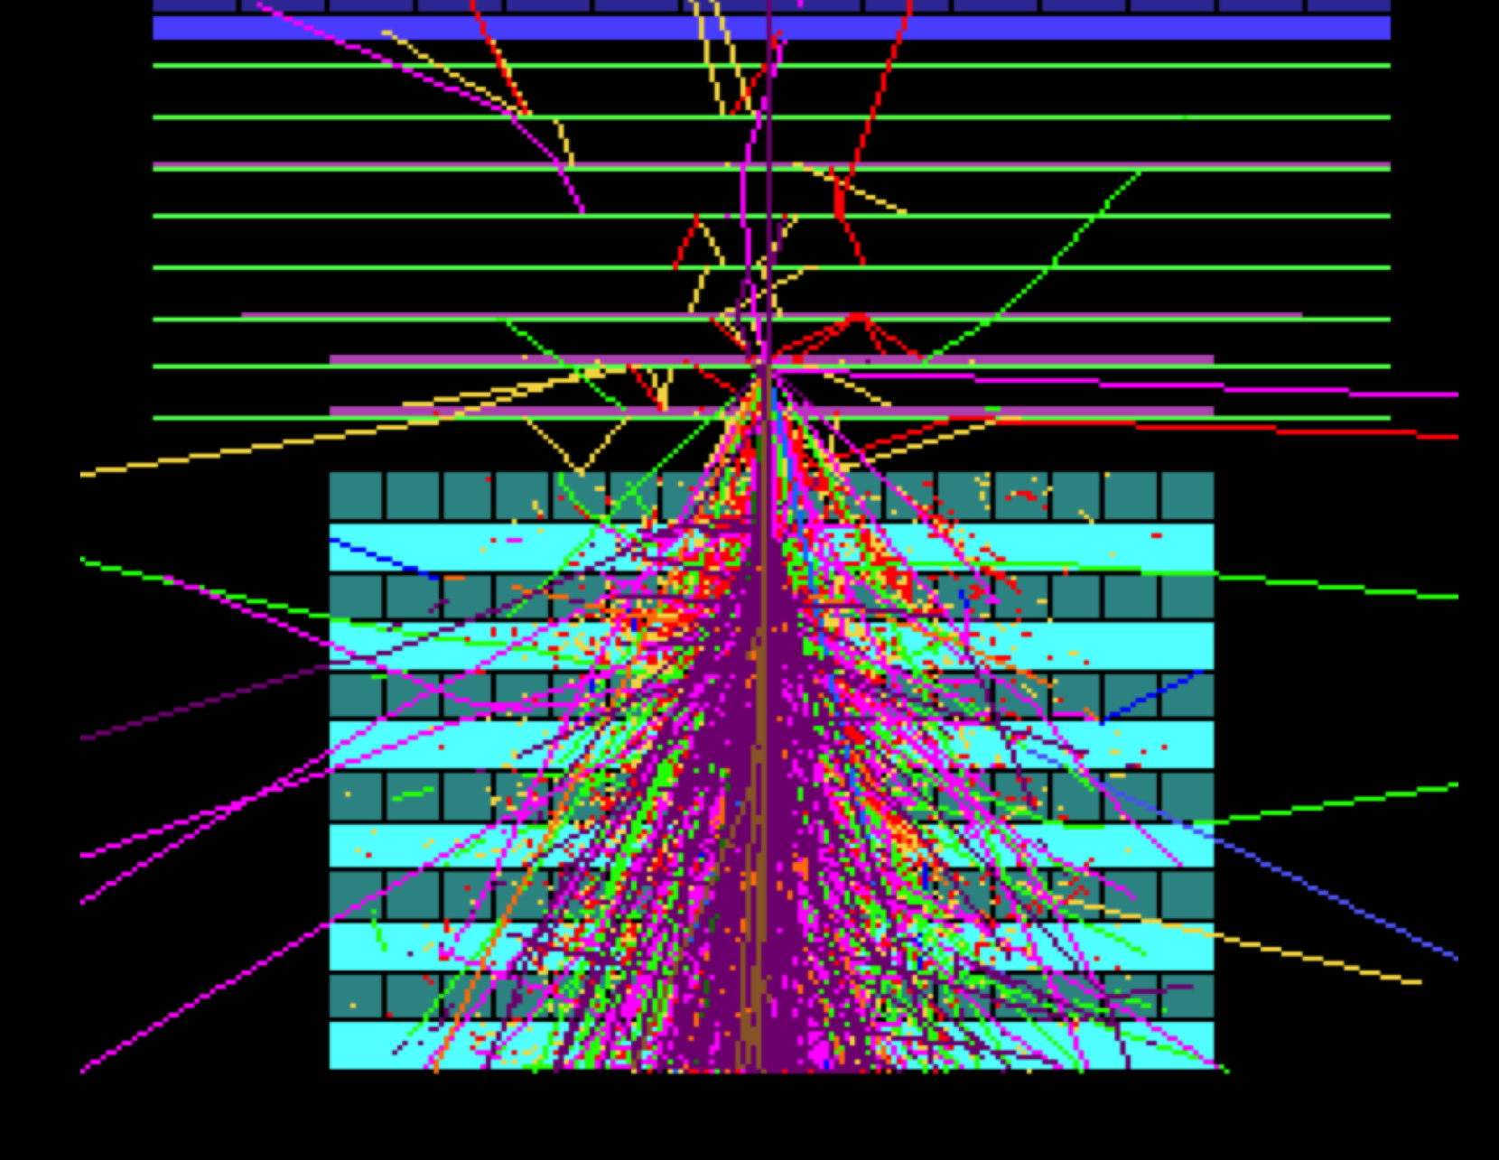
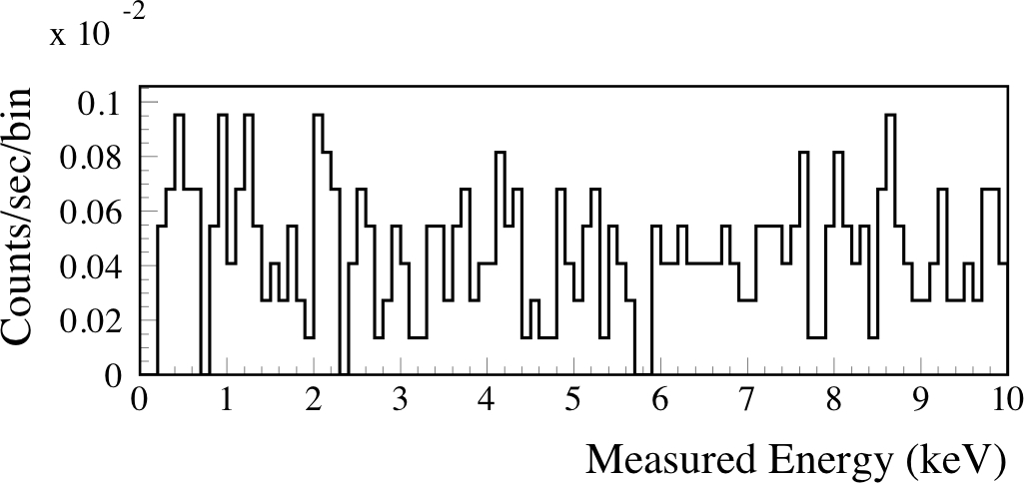
Background Flux Modeling
Instrument Modeling
Predicted Background Rate
Flux
Experiments in orbit are irradiated by multiple sources:
  Cosmic Ray Primaries: protons, helium, e±, heavy nuclei.
  Diffuse X-ray and Gamma-ray background.
  Atmospheric ‘Backsplash’ and trapped particles: protons, photons, e±, neutrons.
  High values of trapped-particle flux preclude science operation:
    Duty cycle decreased.
    Depending on the flux level, may require putting instrument in a safe mode.
Fluxes and spectra depend on orbit parameters (altitude and geomagnetic latitude) and solar activity (Solar Modulation Factor)
Fluxes and spectra sampled by radiation-sensitive detectors also depends on surrounding material, which acts as both a shield and a target.

Slide 4
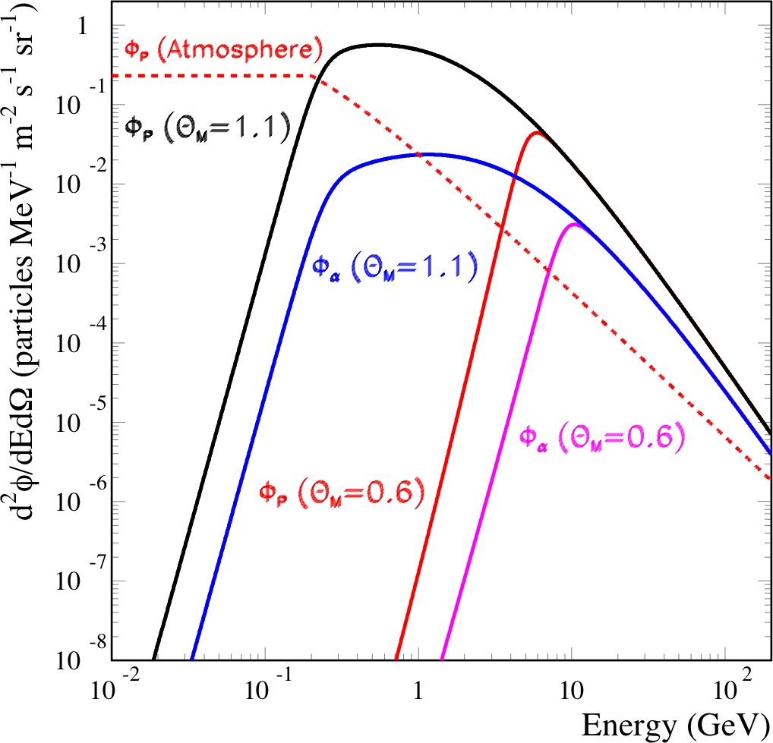
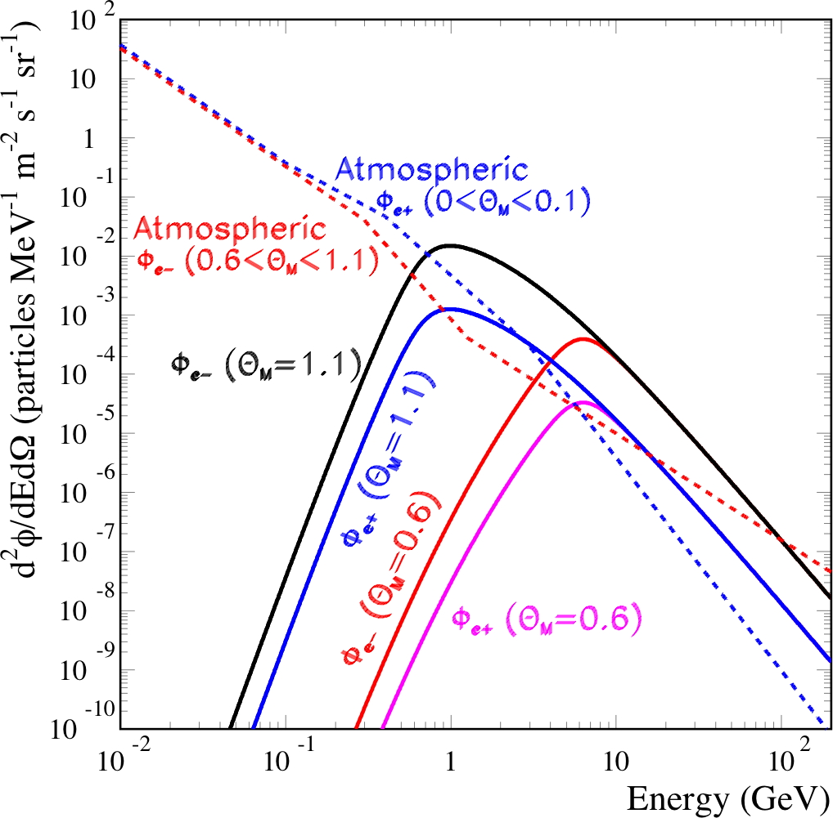
Background Radiation Models
based upon Mizuno et al., ApJ 614 (2004) & Fermi updates and are data driven.
includes dependence on geomagnetic latitude, extended to lower energy for some.
considers background sources outside of regions of high fluxes of trapped particles.
these spectra can then be used in GEANT to generate background event files.
the definition of the event generating surface and the integral flux defines an event rate.
event selection criteria can then be applied to minimizing the background rate while maximizing the signal acceptance, requires a instrument response model.

Slide 5
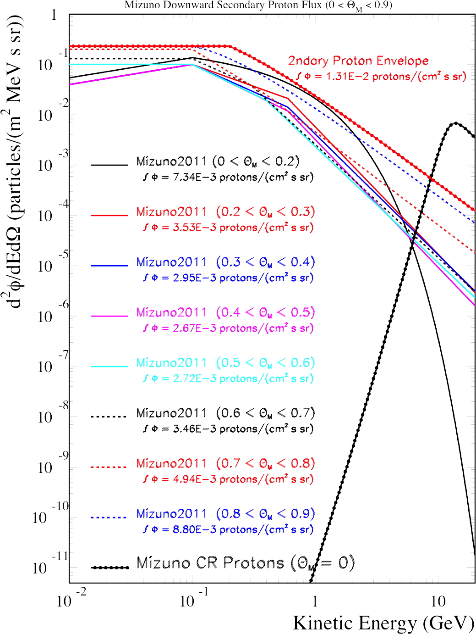
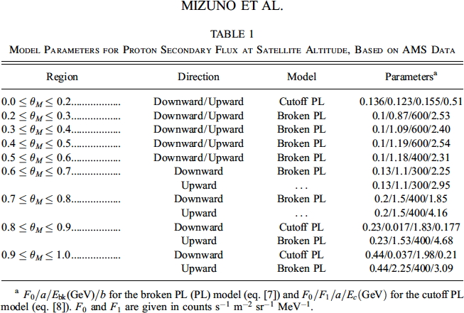
Secondary Proton Model
Similar geomagnetic-dependent models for 2ndary e⁻, e⁺, γ, n
Secondary Proton Flux is a function of geomagnetic location (& up ≠ down at high θ_{M})
Integral flux goes from 2.7 → 8.8 (rel units).
Spectral shapes rather similar.
Define envelope function to throw MC events, then need to scale by relative flux in appropriate bands of geomagnetic latitude.

Slide 6
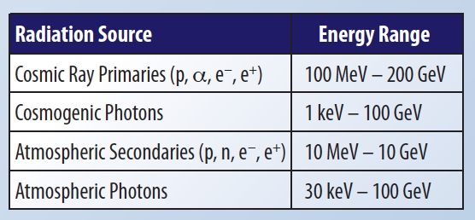
Energy Range of Fermi Background Models
Fermi-based background flux models extrapolation to low-energies (Fermi interested in > 10 MeV).
⬅
Need to extend flux models to lower energies (CGBM) and higher energies (CCAL):
where input spectrum × instrument response → 0 signal
Electron CSDA range in Al:
100 keV: 70 um; 1 MeV: 2 mm; 10 MeV: 2.2 cm
7 keV – 1 MeV range

Slide 7
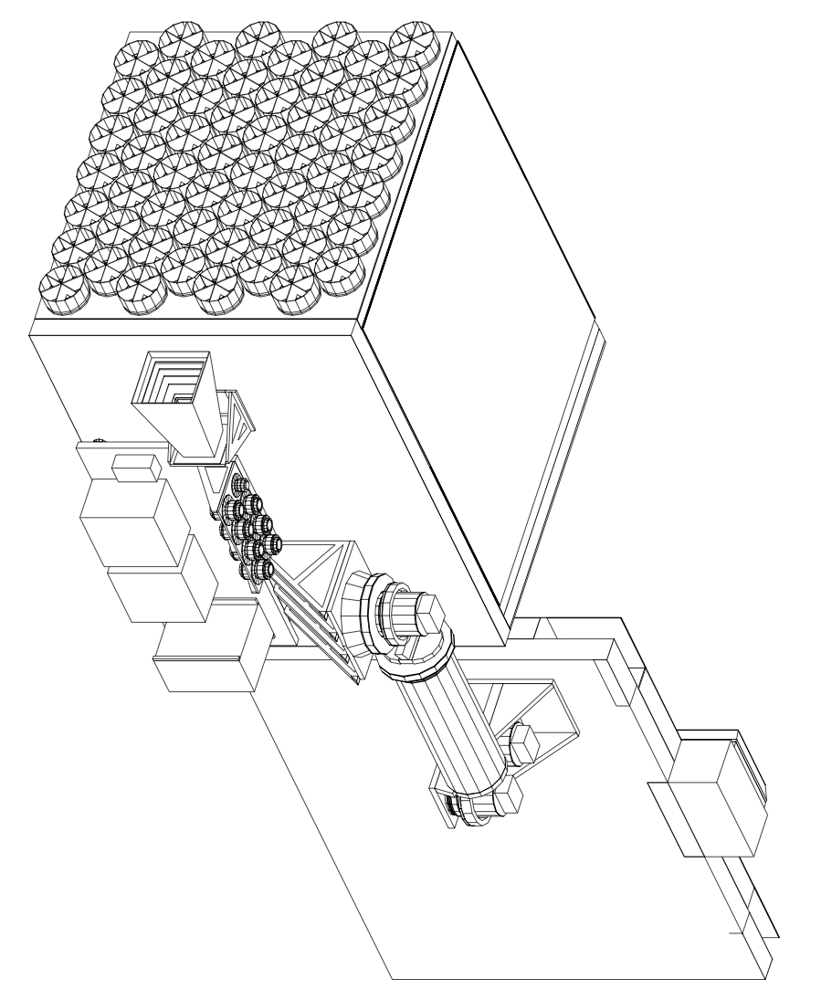
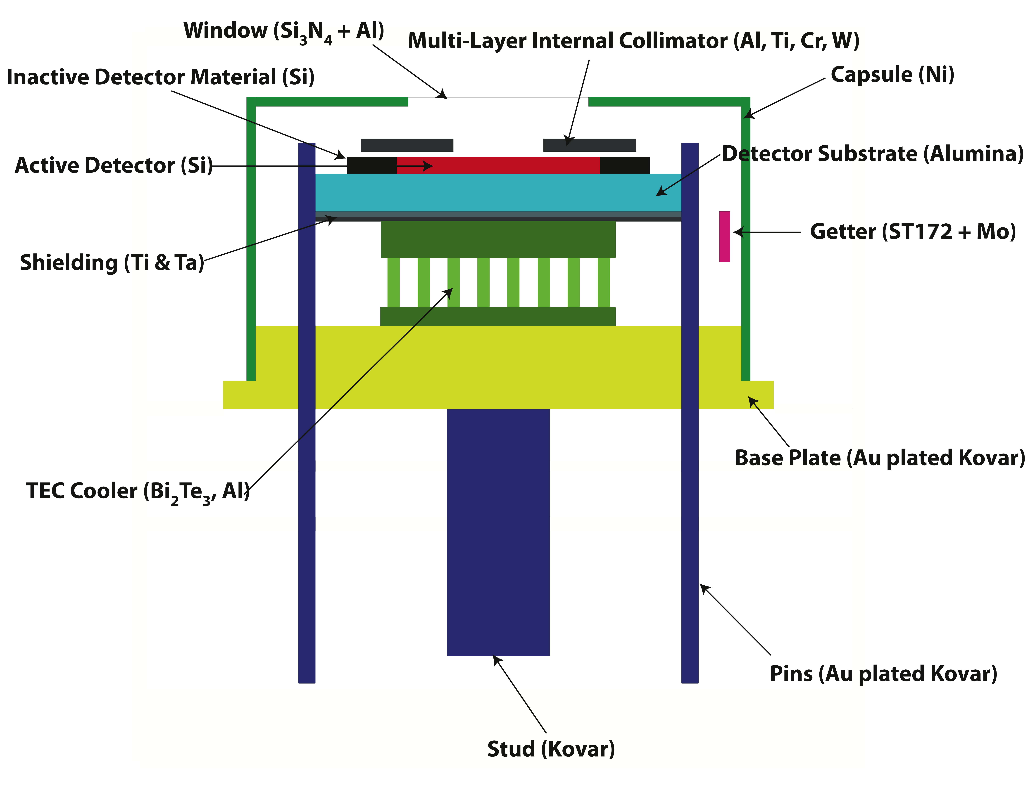
The Neutron star Interior Composition ExploreR (NICER)
Measuring neutron star radii via phase resolved X-ray spectroscopy
200 eV – 10 keV
Developed by Steve Sturner @ GSFC
  MGEANT mass model based upon CAD instrument model.
  Materials in model match that in instrument, i.e. alloys vs pure Al (X-ray fluorescence).
  Care taken to model detector housing & materials.
1.1 m
Short shields
1.7 cm

Slide 8
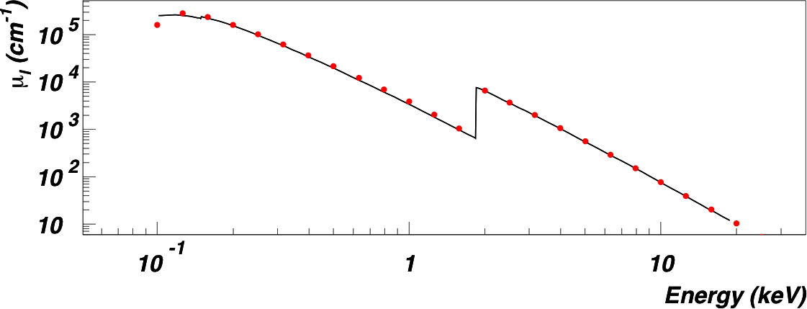
MGEANT Modeling
We are using MGEANT, which is based upon GEANT3, but with improvements:
  MGEANT uses GLECS: an extension program for the GEANT3 simulation package that incorporates improved physics into the simulation of Compton and Rayleigh scattering.
  In GLECS, the total cross sections for an element are interpolated from the Evaluated Photon Data Library (EPDL [2]) tables. These data include electron binding effects and are valid from 10 eV to 100 GeV.
  MGEANT used for TGRS on WIND, GRIS, and SPI on Integral.
  “We have successfully used MGEANT with the lower energy bounds set as low as 200 eV.” – MGEANT Manual.
  For GEMS ¼ atm DME polarimeter, comparison to GEANT4 simulations and laboratory data show excellent agreement (NIM paper currently being written).
Curves: NIST XCOM values
Red Points: σ-sampling > 200 eV
Blue Points: σ-sampling > 1 keV
μ_{l} = ρ σ_{Tot} /(uA), u ≈ 1.66 × 10⁻²⁴ g
Comparison of silicon linear attenuation coefficient (dots) to NIST values.

Slide 9
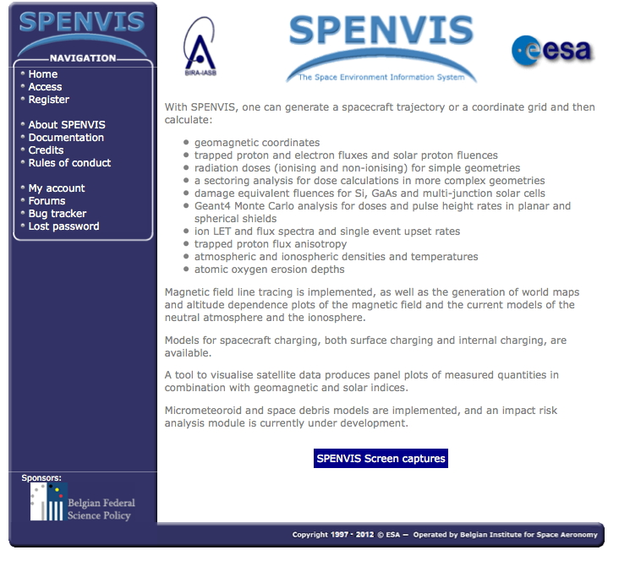
http://www.spenvis.oma.be/

Slide 10
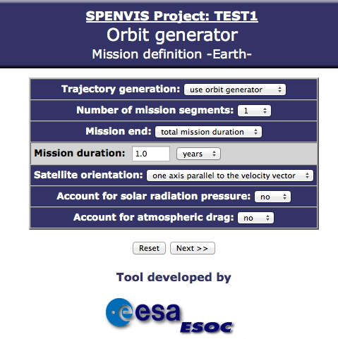
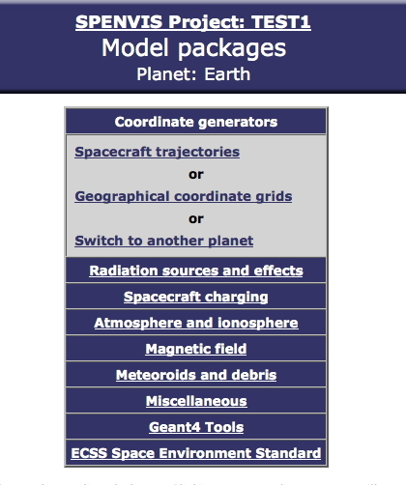
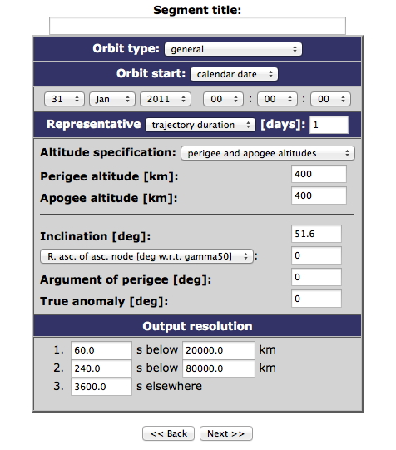
Orbit Analysis via SPENVIS
Data file with equal time-spaced orbit parameters: altitude, long, lat, L, timetag, etc.

Slide 11
SPENVIS use I: Defining geomagnetic orbit fraction
Using the ‘Coordinate generators/Spacecraft trajectories’ tool the orbit position parameters (latitude & longitude) can be generated in equal time spacing based on altitude (400 km), inclination (51.6°), and duration (30 days).
Assuming a location of the Earth’s magnetic north pole (λ_{P}=85.9,φ_{P} =147.0) the geomagnetic latitude (Λ) for a given orbit (λ,φ) can be calculated:
GeoMagnetic Latitude Bin (radians) | Fraction of Orbit within Bin | Running Total
0 – 0.1 | 0.082 | 0.082
0.1 – 0.2 | 0.083 | 0.165
0.2 – 0.3 | 0.084 | 0.249
0.3 – 0.4 | 0.086 | 0.335
0.4 – 0.5 | 0.089 | 0.424
0.5 – 0.6 | 0.095 | 0.519
0.6 – 0.7 | 0.107 | 0.626
0.7 – 0.8 | 0.134 | 0.76
0.8 – 0.9 | 0.173 | 0.933
0.9 – 1.0 | 0.067 | 1
ISS Orbit fraction versus Geomagnetic Latitude obtained from Spenvis Analysis
The geomagnetic latitude fractions can be thus calculated and be used to determine the background rate vs geomagnetic latitude.

Slide 12
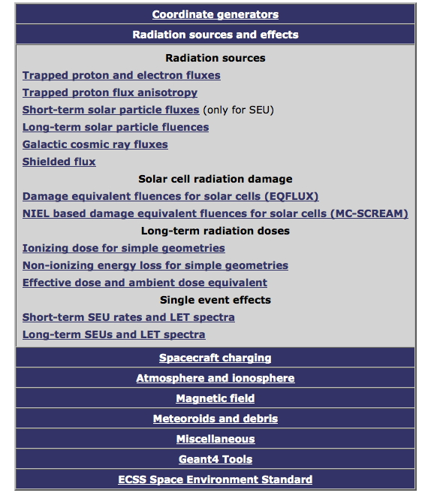
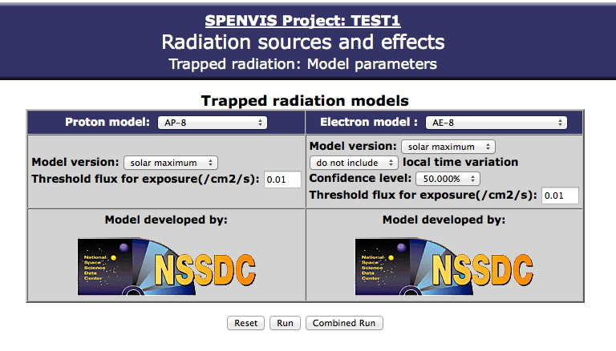
Trapped Particle Distributions via SPENVIS
Data file of integral isotropic fluxes for each mission defined orbit location:
  AE8: 40 keV → 7 MeV (30 bins)
  AP8: 100 keV → 400 MeV (29 bins)
  Lowest flux bit: 1 Hz/cm²
  NOTE: AE9 & AP9 models supercede AE8 & AP8
H – U; ISO 15390; CREME96 (86)

Slide 13
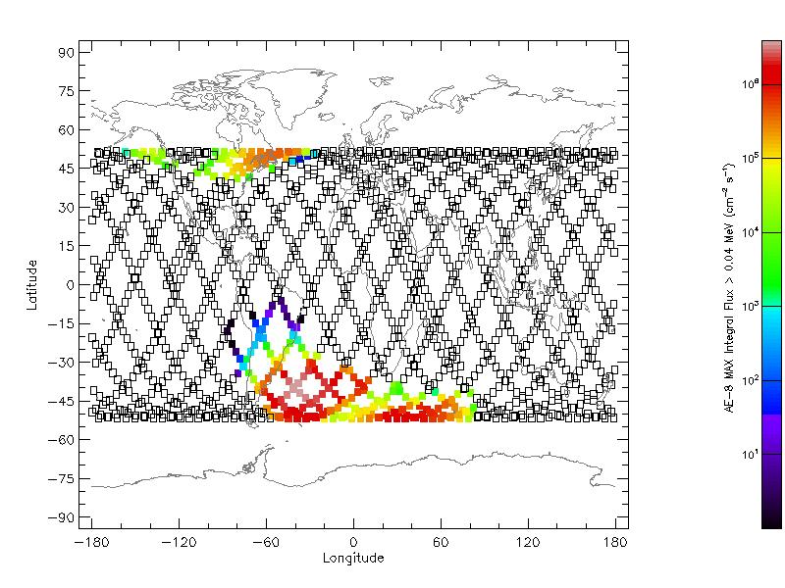
SPENVIS use II: Excluding regions of high flux of trapped particles
Using the ‘Radiation sources and effects /Trapped proton and electron fluxes’ tool, the integral flux vs energy of trapped electron (AE8) and protons (AP8) can get generated as a function of the orbit position parameters (latitude & longitude).
Selection of a maximum integral flux vs position can then be used to exclude regions of the orbit where trapped flux is too high to allow science operation → duty cycle.
Note: ROSAT (53° inc, 580 km) was able to operate in upper high flux region.
AE8 (SolarMax) map of integral electron flux (E_{Elec}≥ 40 keV) for 1 day ISS orbit.

Slide 14
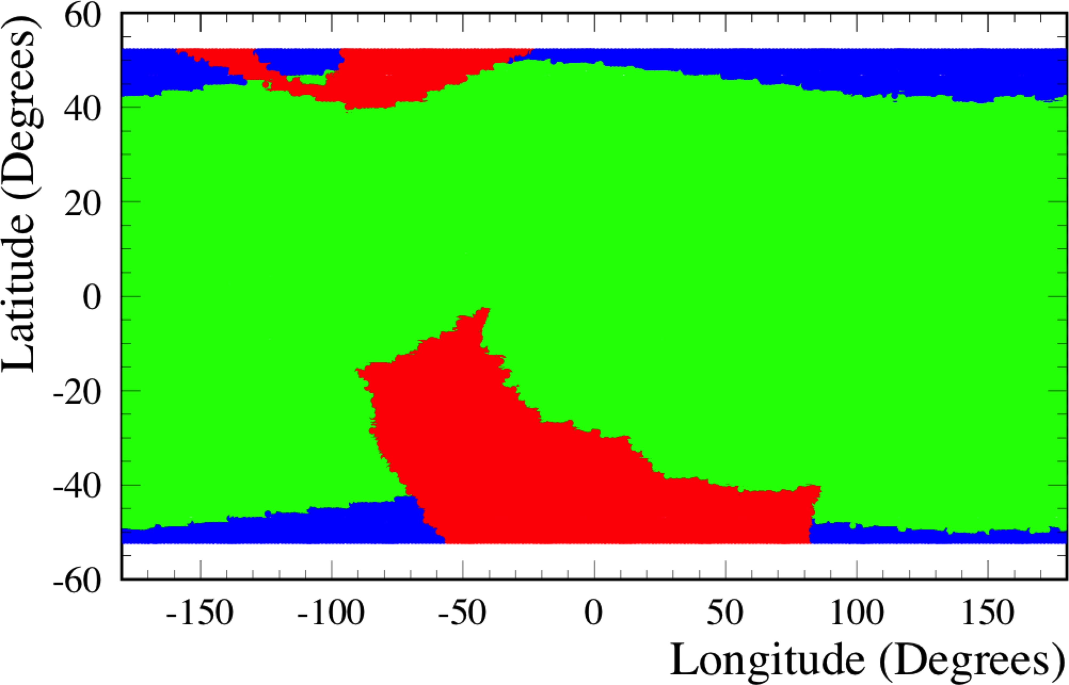
Duty Cycle Determination
Using the results of the NICER background modeling (outside of regions of high trapped particle: electrons > 1 Hz/cm² above 40 keV; protons > 1 Hz/cm² above 100 keV) and excluding the trapped particle flux regions → duty cycle.
Legend
Green: backgound < 0.01 cts/s/keV
66% of ISS orbit
Blue: background ≥ 0.01 cts/s/keV
17% of ISS orbit
Red: trapped particle flux > 1 Hz/cm²
17% of ISS orbit

Slide 15
Background Rate vs GeoMag Lat
GeoMagnetic Latitude Bin (radians) | Fraction of Orbit within Bin | Orbit Running Total | Background Rate within Bin (CPS) (0.2 keV ≤ E_{DEP} ≤ 2 keV) Goal: < 0.02 CPS | Background Rate within Bin (CPS) (2 keV ≤ E_{DEP} ≤ 10 keV) Goal: < 0.08 CPS
0 – 0.1 | 0.082 | 0.082 | 1.35E-2 | 4.98E-2
0.1 – 0.2 | 0.083 | 0.165 | 1.36E-2 | 5.01E-2
0.2 – 0.3 | 0.084 | 0.249 | 1.37E-2 | 5.03E-2
0.3 – 0.4 | 0.086 | 0.335 | 1.39E-2 | 5.14E-2
0.4 – 0.5 | 0.089 | 0.424 | 1.45E-2 | 5.41E-2
0.5 – 0.6 | 0.095 | 0.519 | 1.45E-2 | 5.40E-2
0.6 – 0.7 | 0.107 | 0.626 | 1.70E-2 | 6.48E-2
0.7 – 0.8 | 0.134 | 0.760 | 1.83E-2 | 7.15E-2
0.8 – 0.9 | 0.173 | 0.933 | 2.14E-2 | 8.59E-2
0.9 – 1.0 | 0.067 | 1 | 2.76E-2 | 1.14E-1

Slide 16
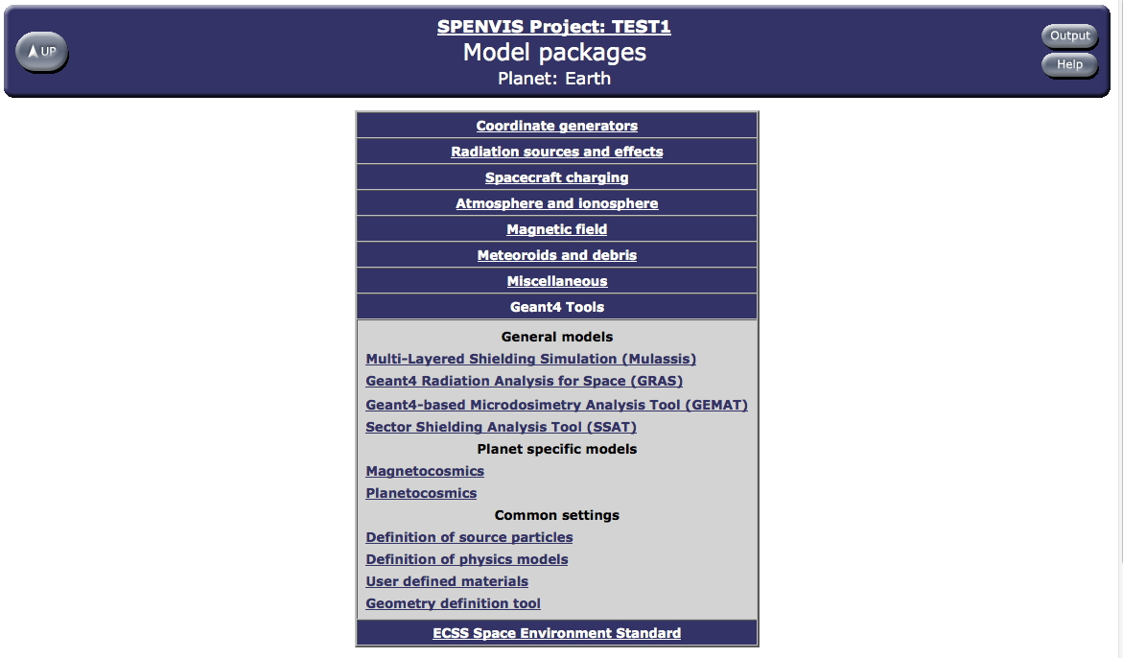
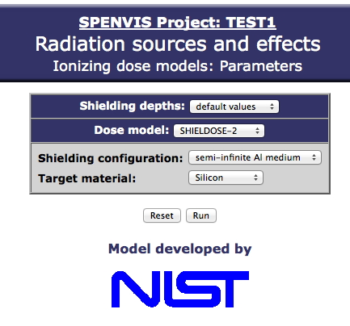
Dosimetry in SPENVIS
Single Event Upset rates at the ASIC level
GEANT4-based 3-dim calculations based upon GDML
Geantino-based analysis to get shielding profiles vs location & angle
Standard spectral definitions: monoE, PowerLaw,
User input

Slide 17
CALET-related Items of Interest
New trapped radiation models AE9, AP9, and SPM (Space Plasma)
  Claimed to be significant upgrade of AE8 and AP8
  Differential spectra reported now point-by-point (as well as integral spectra).
  Onmidirectional versus directional options
  Lowest flux but now 0.1 Hz/cm² (factor of 10 better)
  Details in Space Science Reviews (Mar 2013), ~6 months to get into SPENVIS
CALET-related
  AE9 and AP9 can be used to now better quantify the event rate in the instrument in areas of high flux of trapped particles.
  Can be used to coordinate trapped particle flux maps to those measured by MAXI (would be more straight-forward to analyze since do not need to know MAXI’s instrument response function to get effective particle rate).
  Can use GEANT4-related dosimetry tools to predict mission dose rates anyway in CALET if we have an accurate GDML file (flight design in the near future).
  JFK is working on getting improved atmospheric secondary e⁻, e⁺, and proton flux models based upon AE9, AP9, and related work → helpful for CGBM background studies.

Slide 18
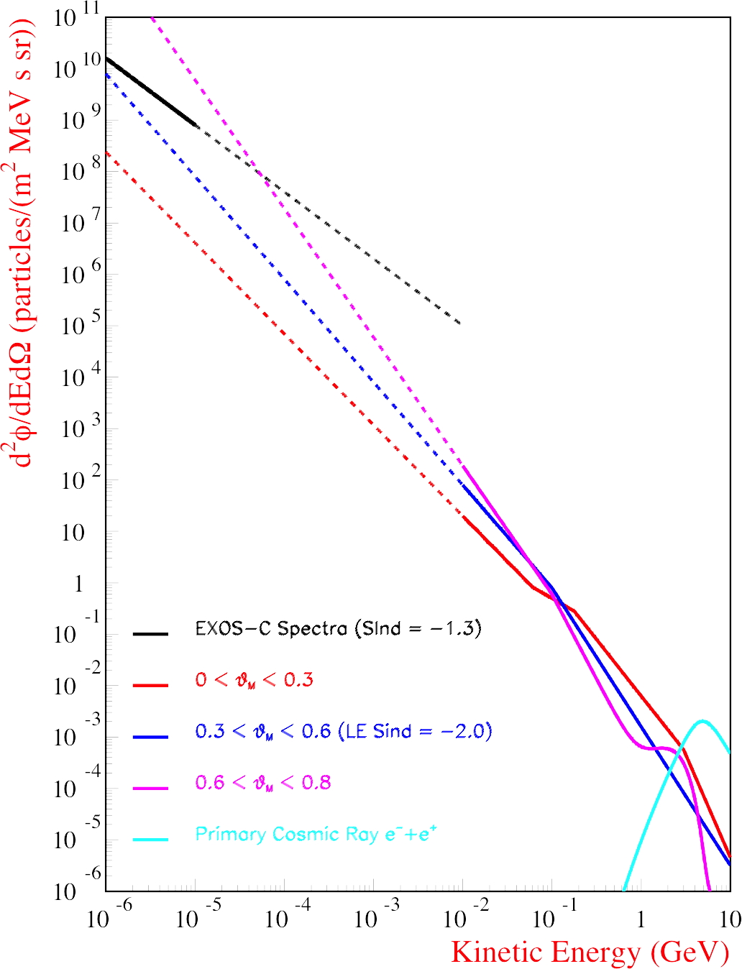
Flux Extrapolation to Low-E
Atmospheric ‘secondary’ e⁺ e⁻
Outside regions of high flux of trapped particles.
Spectra defined by AMS-01 measurements with E > 100 MeV, but with extrapolation to 10 MeV.
Extrapolation to 10 keV yields wide range of flux values.
Background rate prediction thus vary over a wide range.
?????
★
AMS-01 Data
Estimate scaling low flux bit of AE8max model of 1 Hz/cm² in a 0.04 – 0.1 MeV energy bin.
→ Naïve extrapolations to lower E overpredicts the background.

Slide 19
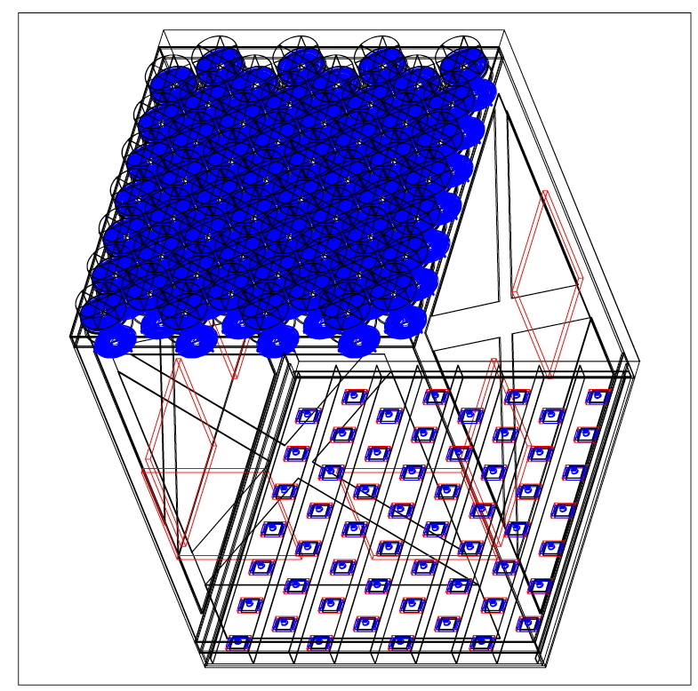
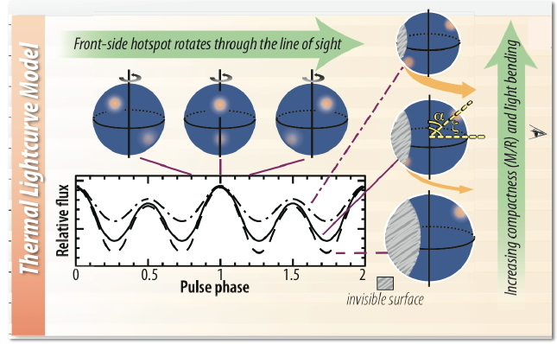
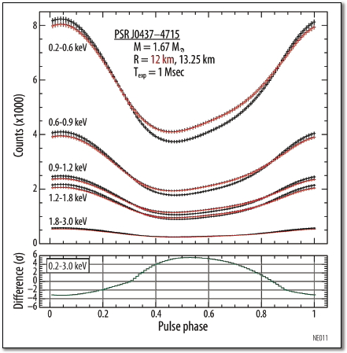
The Neutron star Interior Composition ExploreR (NICER)
Simplified MGEANT model
NICER is an array of 56 individual telescopes, each with grazing-incident optics and a silicon drift detector with a ~1.1 m separation.
X-ray signal energy range: 200 eV – 10 keV
NICER will measure radii of neutron stars, which reveals the interior composition.

