Slide 1
ISS data telemetry system and plan of ground system in JAXA
Created by Shiro Ueno (ISAS/JAXA)
Edited by Yoichi Asaoka (Waseda, CALET/JAXA)
May 30, 2013, CALET TIM@CERN

Slide 2
Interpretation of DPAP Rev.A confirmed at TIM
This raw data flow is not described in DPAP Rev.A.
JAXA and Waseda has agreed that Waseda monitors the CALET status by using the raw data.
JAXA Tsukuba
Space Center
Waseda University: CALET Data Processing Data
Science and technical publications
CALET
ground system
packet
by
packet
CGBM
Quick-
look
Analysis
Software
Raw data
Raw
data
Quick Look
for monitoring
the CALET status
CGBM QL results to GCN & Atel, and on CALET web page
stored
Archive open to whom
contribute to HW work?
(Level 0 data; discussion between agencies)
Level 0 data
file
Level 0 Data file (CAL+CGBM+HK etc.)
file
by file
Level 1 Data files
(CGBM)
stored
Archive open to
CALET Science team
(Level 1 data;
in Japan, US, Italy)
Level 1 Data files
(CAL)
stored
Level 2 Data files
(CGBM)
stored
Archive open to
CALET science team & guest investigators
(L2; Japan, US, Italy)
Level 2 Data files
(CAL)
papers
stored
Level 3 Data files
(CGBM)
stored
Archive open to
public
(Level 3 data & higher;
in Japan, US, Italy)
Level 3 Data files
(CAL)
stored
papers

Slide 3



Who is who in the development of the CALET ground system @JAXA
Italy
Japan
U.S.A
ASI
JAXA
NASA
Technical Support
Hardware Development
HV Power Supply (FM)
CHD (EM)
Human Spaceflight Mission Directorate,
Space Environment Utilization Center
Technical Support
ISS Downlink Resources
CALET Project
JEM Exposed-facility
Experiment Group
Project Manager:
********
Group Leader:
********
with full-time members
Including
********
Dr. Shimizu
with visiting members
including
Prof. Torii
Prof. Tamura
Dr. Asaoka
He supports
CALET Project
in international
communication.
In the development of the
JAXA Ground System,
one member is the manager
of the JAXA ground system
(official contact
point between JAXA and the
ground-system contractor.).
with full-time members
including
Mr. Honda (from IHI
Aerospace temporarily
transferred to JAXA.)
Belonging to both the JAXA CALET project team and Waseda university.
(Technical Lead)
CALET Science Team
Japan Team
- Waseda University (Prof Torii, Dr Asaoka ……)
- JAXA, ISAS, ISS Science Project Office (Dr Ueno, ……)
- and more
US Team
Italy Team
Science Data Handling
Science Analysis
Science Publication
PI from Japan;
Co-Pis from US & Italy.
He supports the design of the CALET ground system, because the CALET project has no member familiar with the ISS-related data process and transfer.

Slide 4
Organization Chart (Note: Based on Ueno’s observation; to be verified with the CALET Project)
 | Organization chart for the CALET ground system (Development Phase) | Organization chart for the CALET ground system (Operation Phase)
CALET Ground System @UOA (UOA is the JEM User Operation Area at JAXA Tsukuba Space Center)
CALET Ground System @Waseda University
The chain of command
Supported by
other members
of the CALET
Project including
Prof. Torii, Prof. Tamura, Dr Shimizu
Project Manager
May or may not be the same as
in the development phase.
CALET ground system manager;
(Contact
for contractor)
Dr. Asaoka
(Technical
lead; Contact
for CALET science team)
Supported by
CALET science team members including
Dr. Ueno,
Dr Tomida
The chain of command
Prof. Torii
(CALET PI;
Leader at Waseda)
Requirement is
imposed by
JAXA CALET project
May or may not be the same as
in the development phase.
Dr. Asaoka
(CALET ground system manager; Technical
lead; Contact for CALET science team)
Supported by
CALET science team

Slide 5
The development schedule of Tsukuba side is:
April 2013: Design started with contractor;
July 2013: Design review with contractor.
Dec 2013–Jan 2014: I/F test between JAXA and Waseda.
March 2014: Completion of the development of the Tsukuba Ground System.
JAXA Tsukuba
Space Center
Waseda University: CALET Data Processing Data
Science and technical publications
Data latency < 10 sec
CALET
ground system
packet
by
packet
CGBM
Quick-
look
Analysis
Software
Raw data
Raw
data
Quick Look
for monitoring
the CALET status
CGBM QL results to GCN & Atel, and on CALET web page
stored
Archive open to whom
contribute to HW work?
(Level 0 data; discussion between agencies)
Level 0 data
file
Level 0 Data file (CAL+CGBM+HK etc.)
file
by file
Level 1 Data files
(CGBM)
stored
Archive open to
CALET Science team
(Level 1 data;
in Japan, US, Italy)
Level 1 Data files
(CAL)
stored
Current files
are closed
every one hour(TBD).
Level 2 Data files
(CGBM)
stored
Archive open to
CALET science team & guest investigators
(L2; Japan, US, Italy)
Level 2 Data files
(CAL)
papers
stored
Level 3 Data files
(CGBM)
stored
Archive open to
public
(Level 3 data & higher;
in Japan, US, Italy)
Level 3 Data files
(CAL)
stored
papers

Slide 6
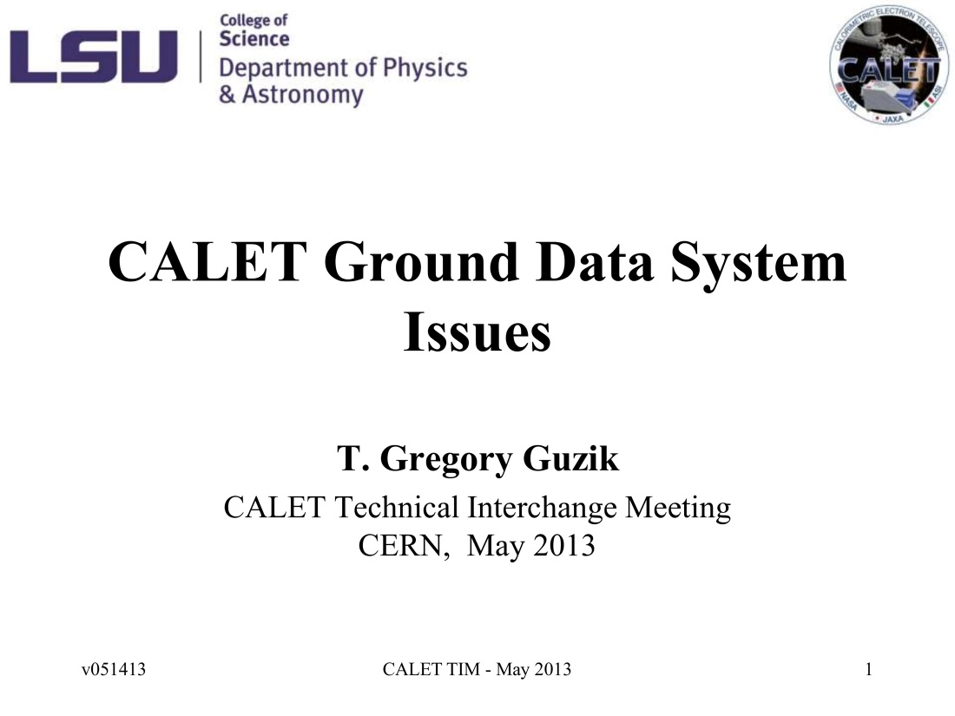
CALET Ground Data System Issues
Greg-san’s presentation Page 1 of 12
The cover page of Greg-san’s presentation.
Thank you for preparing this start point of our discussion, Greg-san.

Slide 7
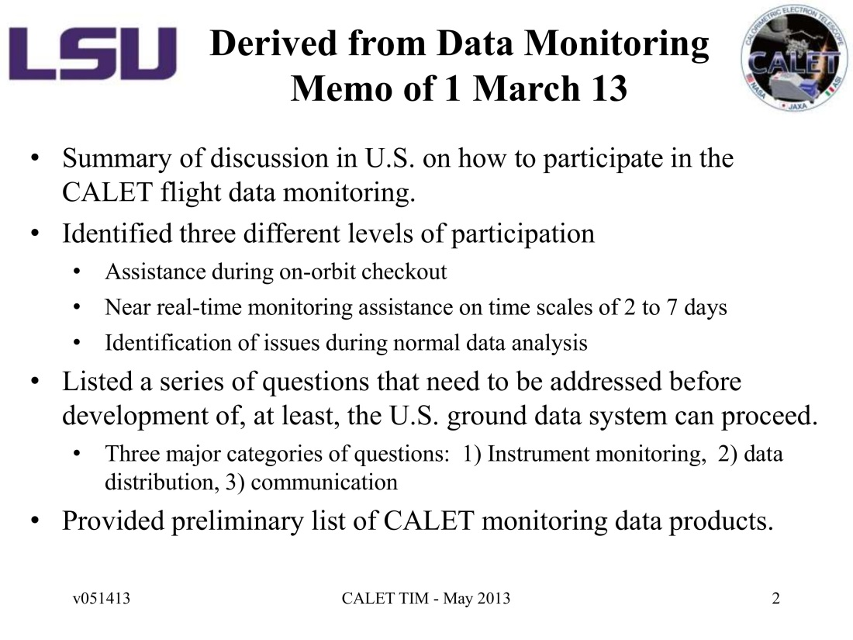
Outline of Greg-san’s Presentation
Greg-san’s presentation Page 2 of 12
Skipped

Slide 8
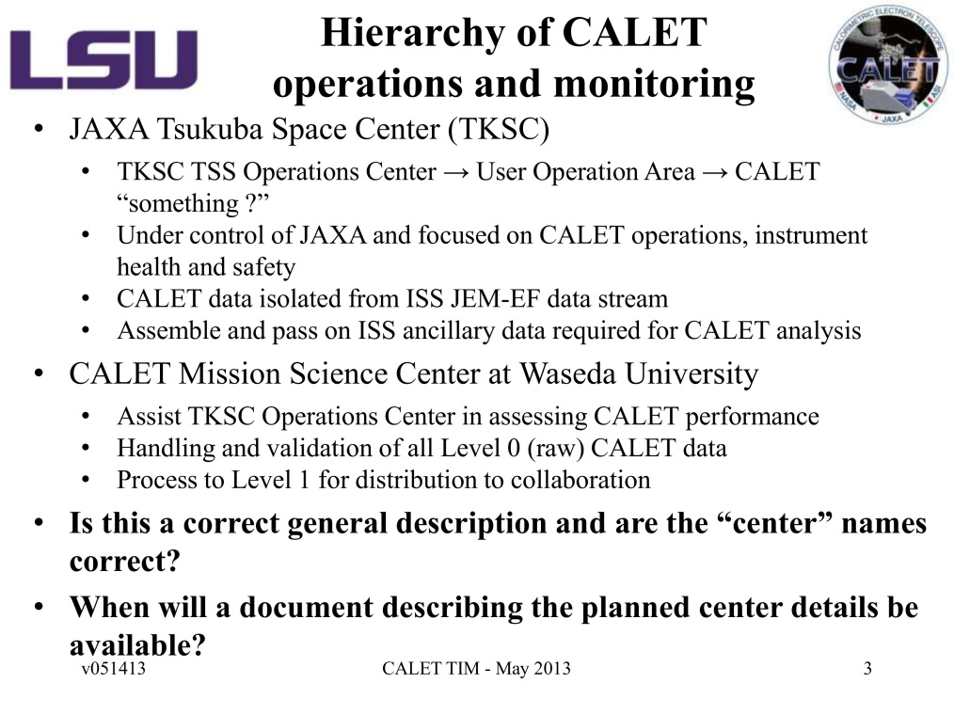
Hierarchy of CALET operations and monitoring
Greg-san’s presentation Page 3 of 12
Is this a correct general description and
are the “center” names correct?
Proper place & system names on Tsukuba side are:
JAXA TKSC (Tsukuba Space Center)
SSIPC(Space Station Integration and Promotion Center)
UOA (User Operation Area)
OCS
(Operation Control System)
CALET Ground System (TBD)
2. When will a document describing the planned
center details be available?
The development schedule of Tsukuba side is:
April 2013: Design started with contractor;
July 2013: Design review with contractor.
Dec 2013–Jan 2014: I/Ftest between JAXA and Waseda.
March 2014: Completion of the Tsukuba Ground System.
Proper “center” names on both Tsukuba and Wasda sides:
1) Not defined in DPAP.
2) Asked by Greg-san and consulted by Mitchell-san,
a series of email messages were exchanged between
JAXA and Wasda in September 2011
with the final message from Torii-sensei proposing
COC (CALET Operation Center at Tsukuba) and
WCSC (Waseda CALET Operation Center (TBD)).
These have not been officially approved.
Correction based on
Prof. Torii’s comment

Slide 9
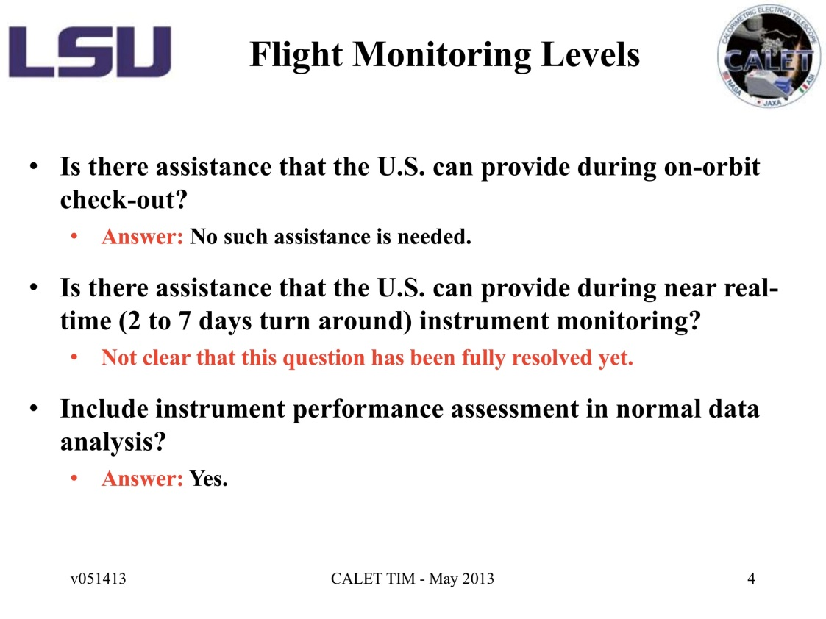
Flight Monitoring Levels
Greg-san’s presentation Page 4 of 12
Is there assistance that the U.S. can
provide during on-orbit checkout?
Torii-san’s answer:
No such assistance is needed.
2. Is there assistance that the U.S. can
provide during near real-time (2 to 7
days turn around) instrument monitoring?
@TIM: Need further discussion.
3. Include instrument performance assessment in normal data analysis?
Torii-san’s answer:
Yes.

Slide 10
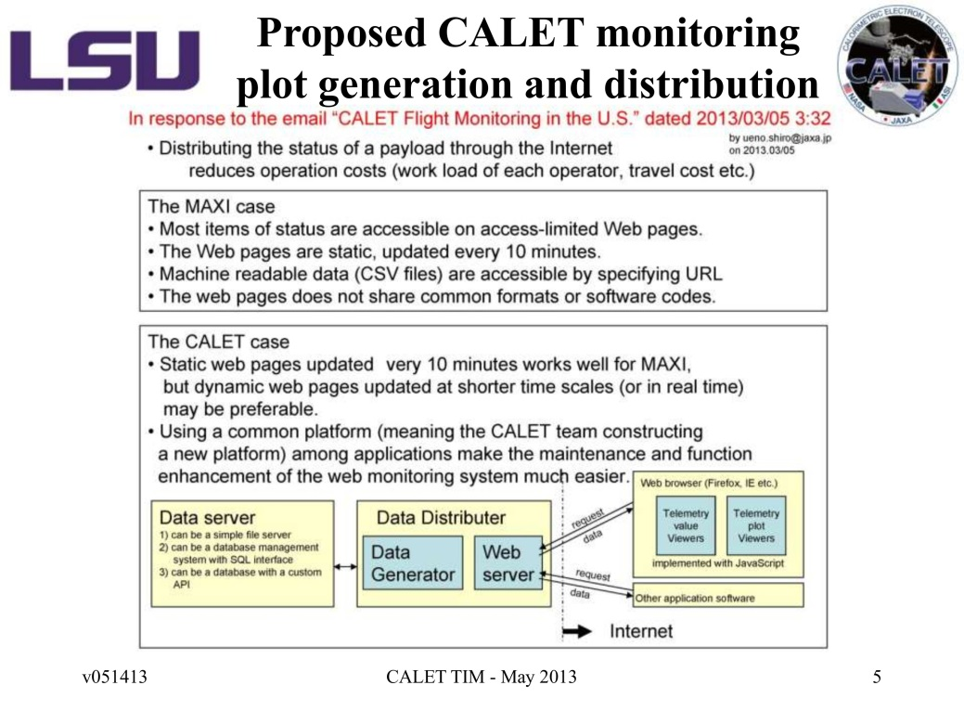
“Proposed” CALET monitoring plot generation and distribution
Greg-san’s presentation Page 5 of 12
I (Ueno) made and sent this slide
to the CALET domestic mailing list
to help the Japanese members
discuss what sort of CALET Monitoring
in the U.S. will possible and prepare
a response to Greg-san.
Since I did not express the intention clearly,
this slide was unexpectedly distributed
as it is to the CALET international mailing list. This slide was just Ueno’s personal opinion based on MAXI’s Lessons Leaned.
Waseda University just distributes Level 1 data files;
The international team conducts their near-real-time (2 to 7 days turn around) instrument monitoring by using the Level 1 data files.

Slide 11
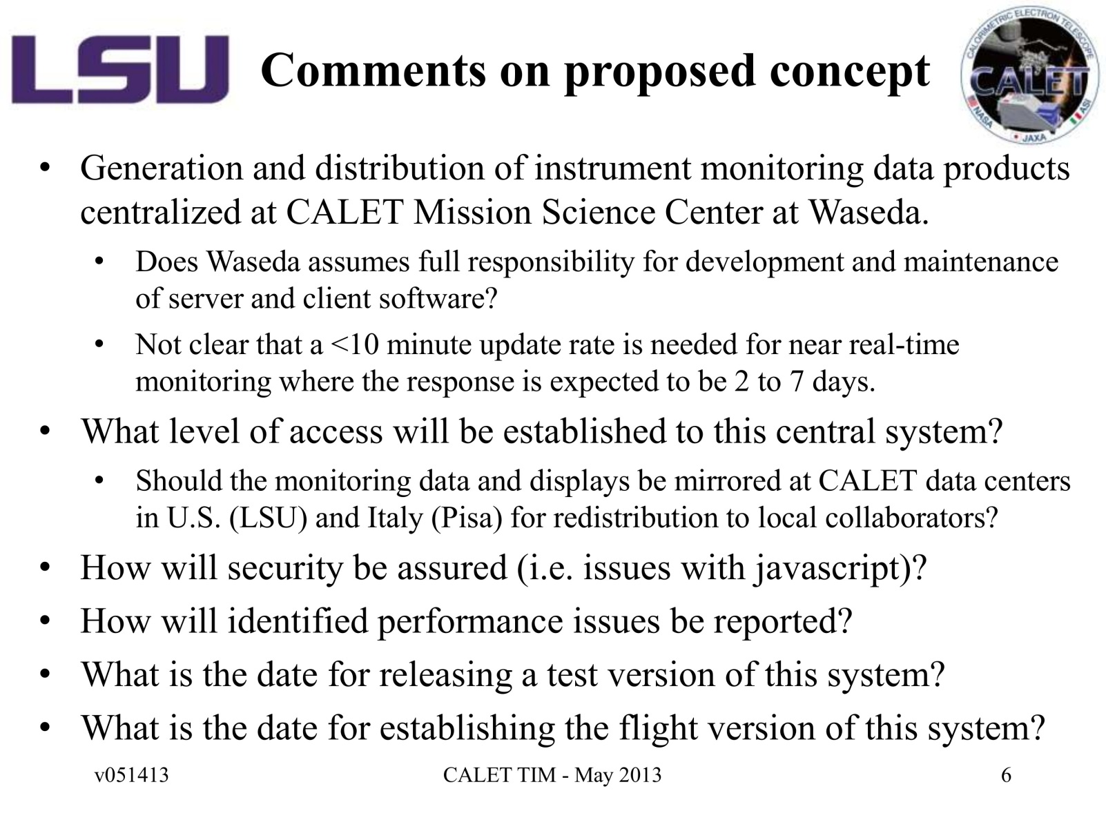
Comments on “Proposed” concept
Please see previous slide. Let me skip this slide without answering the obsolete questions.
Greg-san’s presentation Page 6 of 12

Slide 12
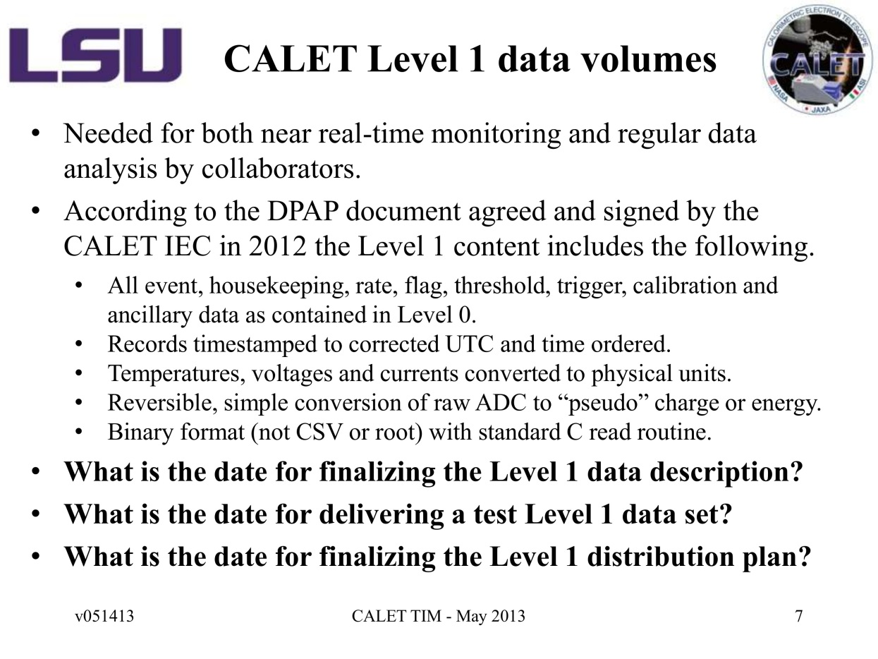
CALET Level 1 data volumes
Greg-san’s presentation Page 7 of 12
What is the date for finalizing the Level 1
data description?
2. What is the date for delivering a test
Level 1 data set?
3. What is the date for finalizing
the Level 1 distribution plan?
(Consequence of TIM) Data Handling and Analysis team will work together to finalize the Level 1 description.
(Asaoka added)

Slide 13
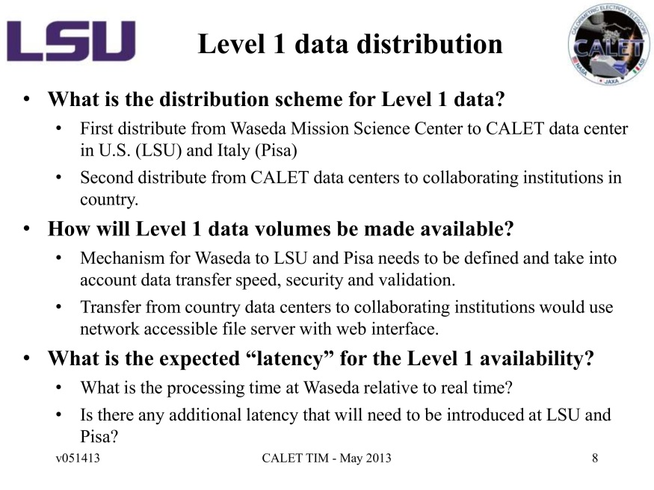
Level 1 data distribution
Greg-san’s presentation Page 8 of 12
What is the distribution scheme for Level 1 data?
+ First distribute from Waseda Mission Science
Center to CALET data center in U.S. (LSU) and
Italy (Pisa)
+ Second distribute from CALET data centers
to collaborating institutions in country?
2. How will Level 1 data volumes be made
available?
+ Mechanism for Waseda to LSU and Pisa needs
to be defined and take into account data
transfer speed, security and validation.
Not yet defined. We may learn from the Level 0
data transfer mechanism from JAXA to Waseda,
which is still to be designed but will use
SSH tunneling for security and send check-sum
files and file-transferring log files together
with Level 0 data files for validation.
+ Transfer from country data centers to
collaborating institutions would use network
accessible file server with Web interface.
Data distribution logs are necessary for both of
Waseda to US/Italy distribution and distribution
within country. (Torii).
3. What is expected “latency” for the Level 1
available?
+ What is the processing time at Waseda relative to
real time?
We cannot specify the latency for the initial
phase of the ground system operation.
For the stable operation phase,
the goal of the latency should be answered by
the Waseda team.
+ Is there any additional latency that will needed
to be introduced at LSU and Pisa?
Data-gap compensation’s time scales could
affect the data latency.

Slide 14
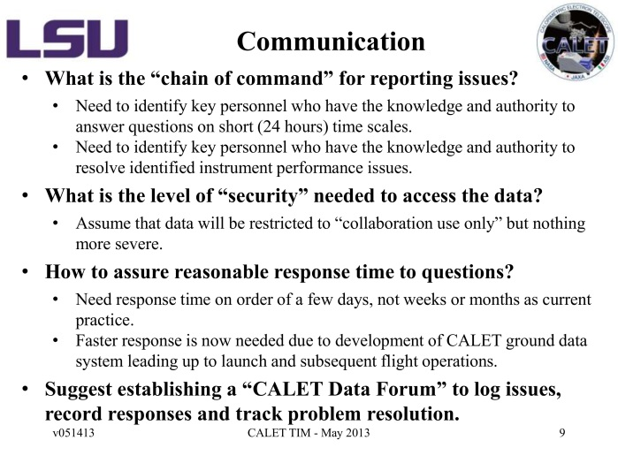
Communication
Greg-san’s presentation Page 9 of 12
1. What is the “chain of command” for reporting issue?
1.1 Need to identify key personnel who have the knowledge
and authority to answer question on short (24 hours) time scales.
1.2 Need to identify key personnel who have the knowledge
and authority to resolve identified instrument performance issues.
2. What is the level of “security” needed to access the data?
2.1 Assume that data will be restricted to “collaboration use only”
but nothing more severe.
3. How to assure reasonable response time to questions?
3.1 Need response time on order of a few days, not weeks or months
as current practice.
3.2 Faster response is now needed due to development of CALET ground
data system leading up to launch and subsequent flight operations.
4. Suggest establishing a “CALET Data Forum” to log issues,
record responses and track problem resolution.
In following slides, we address these questions and suggestion one bye one.

Slide 15
Communication
(From Greg-san’s presentation Page 9 of 12)
1. What is the “chain of command” for reporting issue?
1.1 Need to identify key personnel who have the knowledge
and authority to answer question on short (24 hours) time scales.
1.2 Need to identify key personnel who have the knowledge
and authority to resolve identified instrument performance issues.
Response from Ueno:
I have shown the “chain of command” for the ground system development
in Slide 4 of this presentation.
We can register and contact key personnel of each specific subject
If we use an issue (or bug, or action item) tracking web application
such as Redmine, Trac, or Bugzilla.
(Also see Ueno’s response to Greg-san’s suggestion on establishing a “CALET Data Forum”. )
Discussion@TIM:
Action(s):

Slide 16
Communication
(From Greg-san’s presentation Page 9 of 12)
2. What is the level of “security” needed to access the data?
2.1 Assume that data will be restricted to “collaboration use only”
but nothing more severe.
Response from Ueno:
I think that Greg-san’s assumption is correct.
No specific “security” requirement will be imposed by the JAXA CALET project
as far as the access control in DPAP (page 22 of 32) is realized using a proper authentication method.
A specific “security” requirement will be imposed by Waseda University.
Discussion@TIM:
Action(s):
1) Confirm it with the CALET project (assignee: Asaoka&Ueno; by 15 June 2013)

Slide 17
Communication
(From Greg-san’s presentation Page 9 of 12)
3. How to assure reasonable response time to questions?
3.1 Need response time on order of a few days, not weeks or months
as current practice.
3.2 Faster response is now needed due to development of CALET ground
data system leading up to launch and subsequent flight operations.
Response from Ueno:
Quick response depend on both people and technology.
People: Ask individuals to improve their attitude if needed ☺.
Technology: Issue (or bug, or action item) tracking systems such as Redmine, Trac, and Bugzilla, will help us to receive quick responses.
Issue tracking systems usually have a function, called “whining”, which automatically sends an issue list via email to each action assignee at a regular interval or when any registered issue has been left unattended for too long.
Discussion@TIM:
Action(s):

Slide 18
Communication
(From Greg-san’s presentation Page 9 of 12)
4. Suggest establishing a “CALET Data Forum” to log issues,
record responses and track problem resolution.
Response from Ueno:
Tool | Good at | Not good at | Comments
Online Chat | Real-time discussion by multiple people; making quick decision making | Summarizing information | Ex. The MAXI internal alert web page has a built-in online chat.
Forum | Non-real-time free discussion; asking trivial questions (FAQ) | Tracking the status, action deadline, and assignee of issue | Ueno recommends this for CALET.
Wiki | Presenting the latest snapshot of information in a hierarchical structure |  | Ueno strongly recommends this for CALET.
Issue tracking system | Tracking the status, action deadline, and assignee of issue |  | Ueno strongly recommends this for CALET.
Ueno recommends Revision Control System (for documents & software codes) such as subversion.
Note: Installs are one-time tasks, but the user registration task and the data backup task are not.

Slide 19
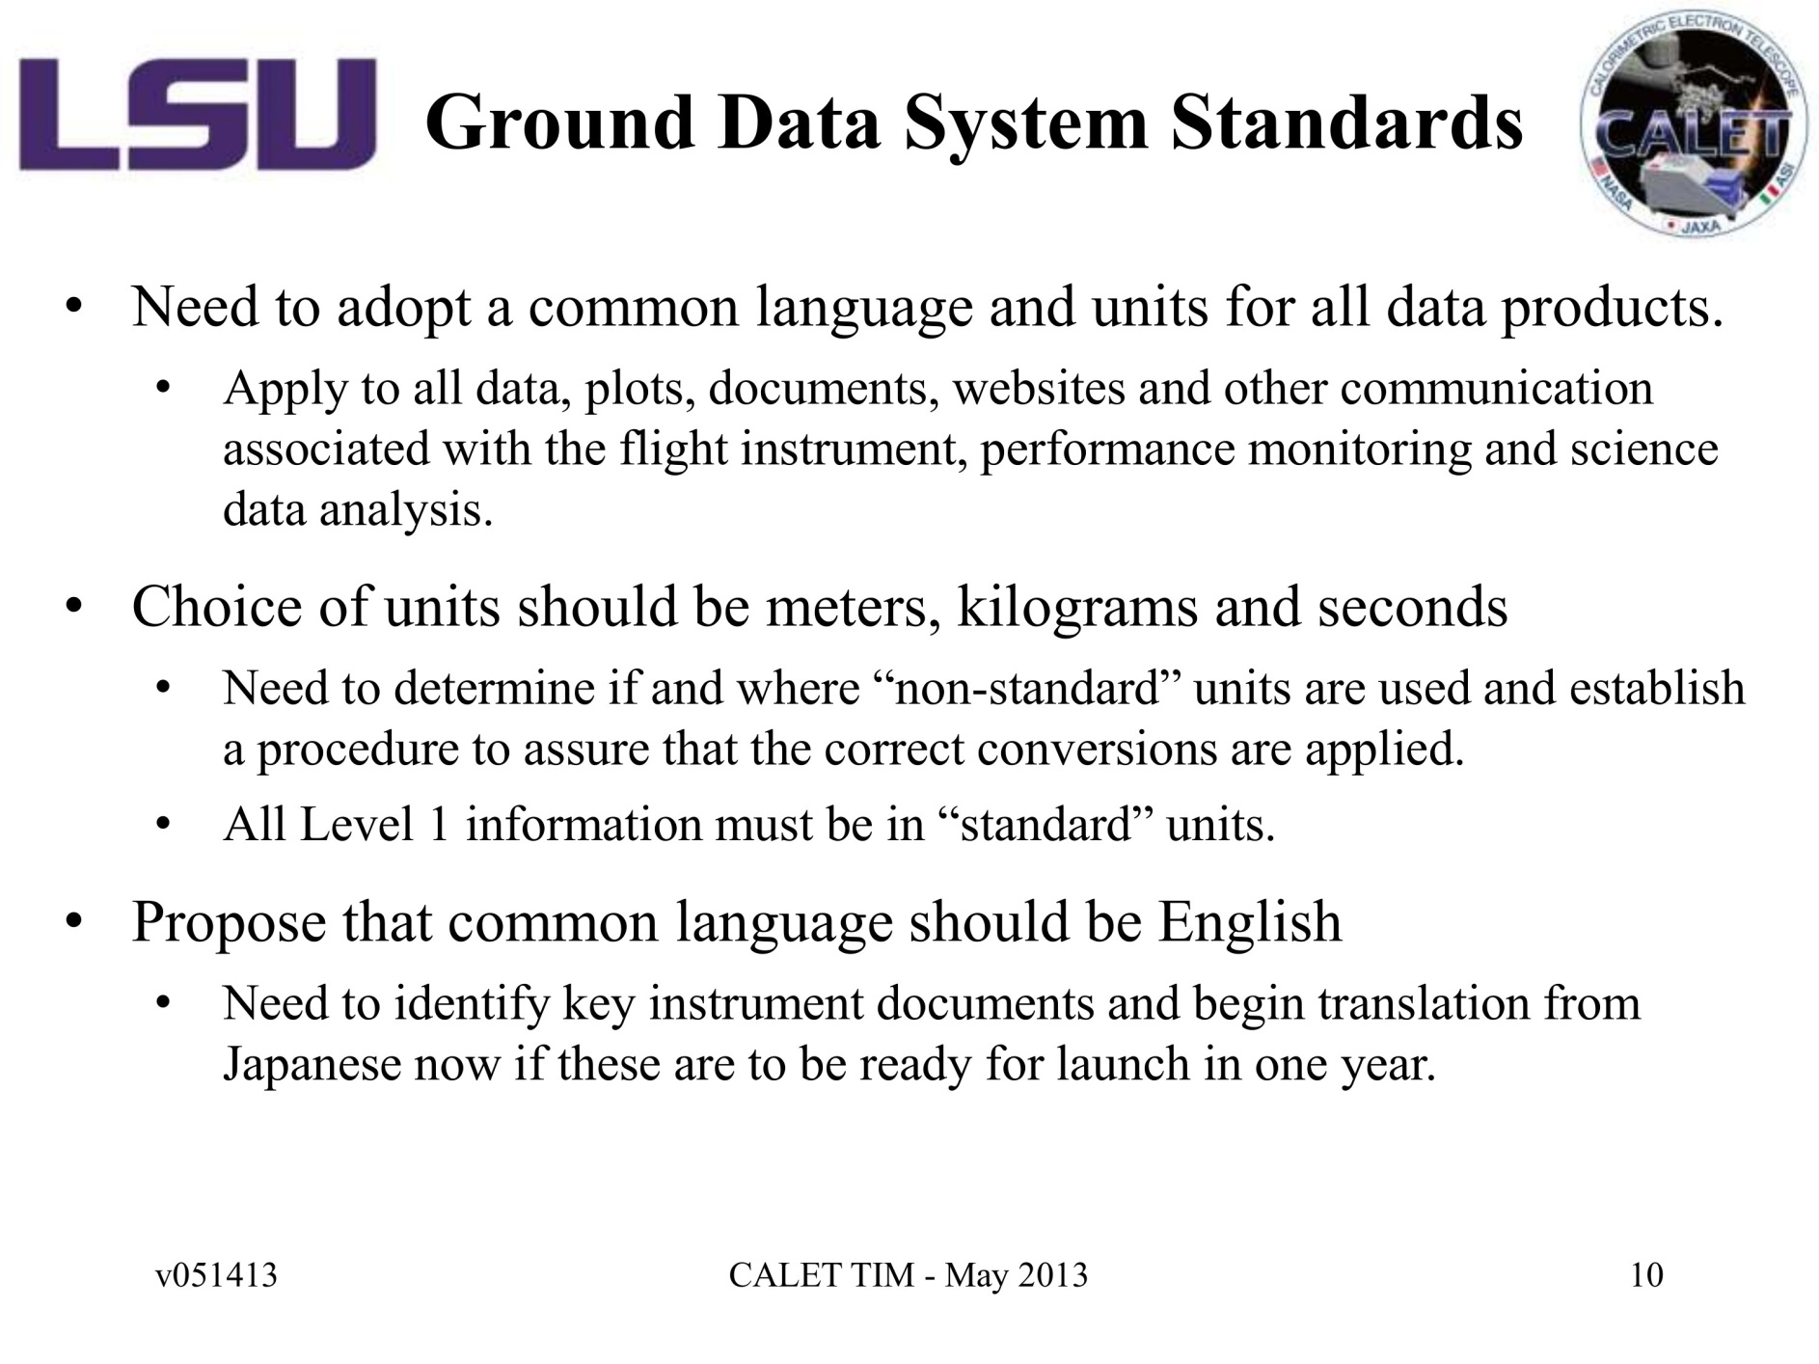
Ground Data System Standards
Greg-san’s presentation Page 10 of 12
Common nomenclature in English for the CALET mission
should be defined and listed with their meanings (Ueno).

Slide 20
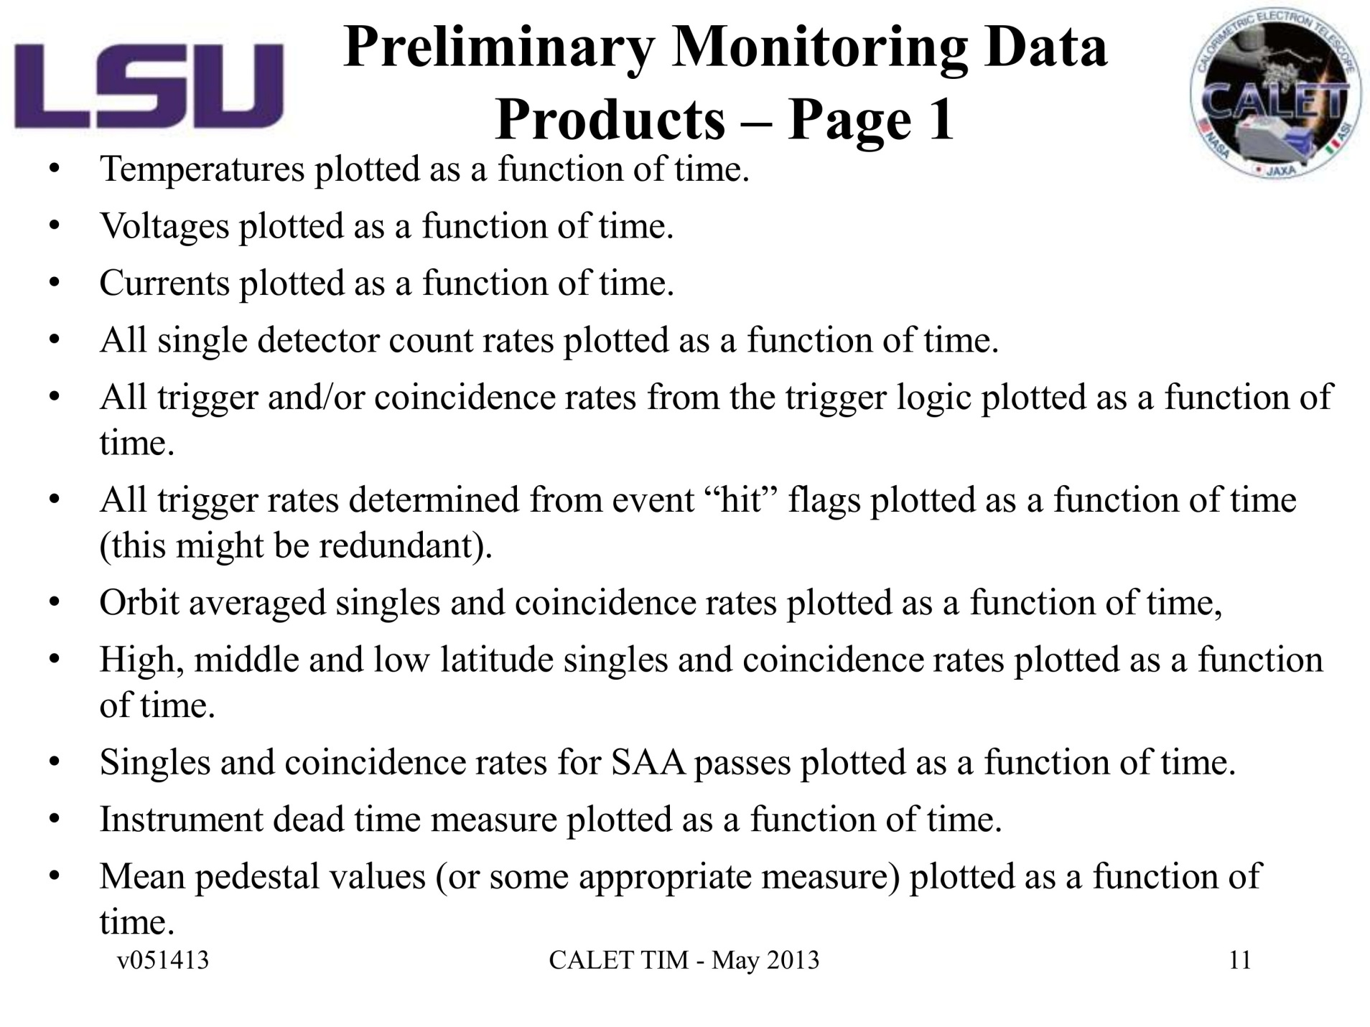
Preliminary Monitoring Data Products – Page 1
Greg-san’s presentation Page 11 of 12
Japan, the U.S., and Italy may have to use
a common CALET-specific definition of the SAA region?

Slide 21
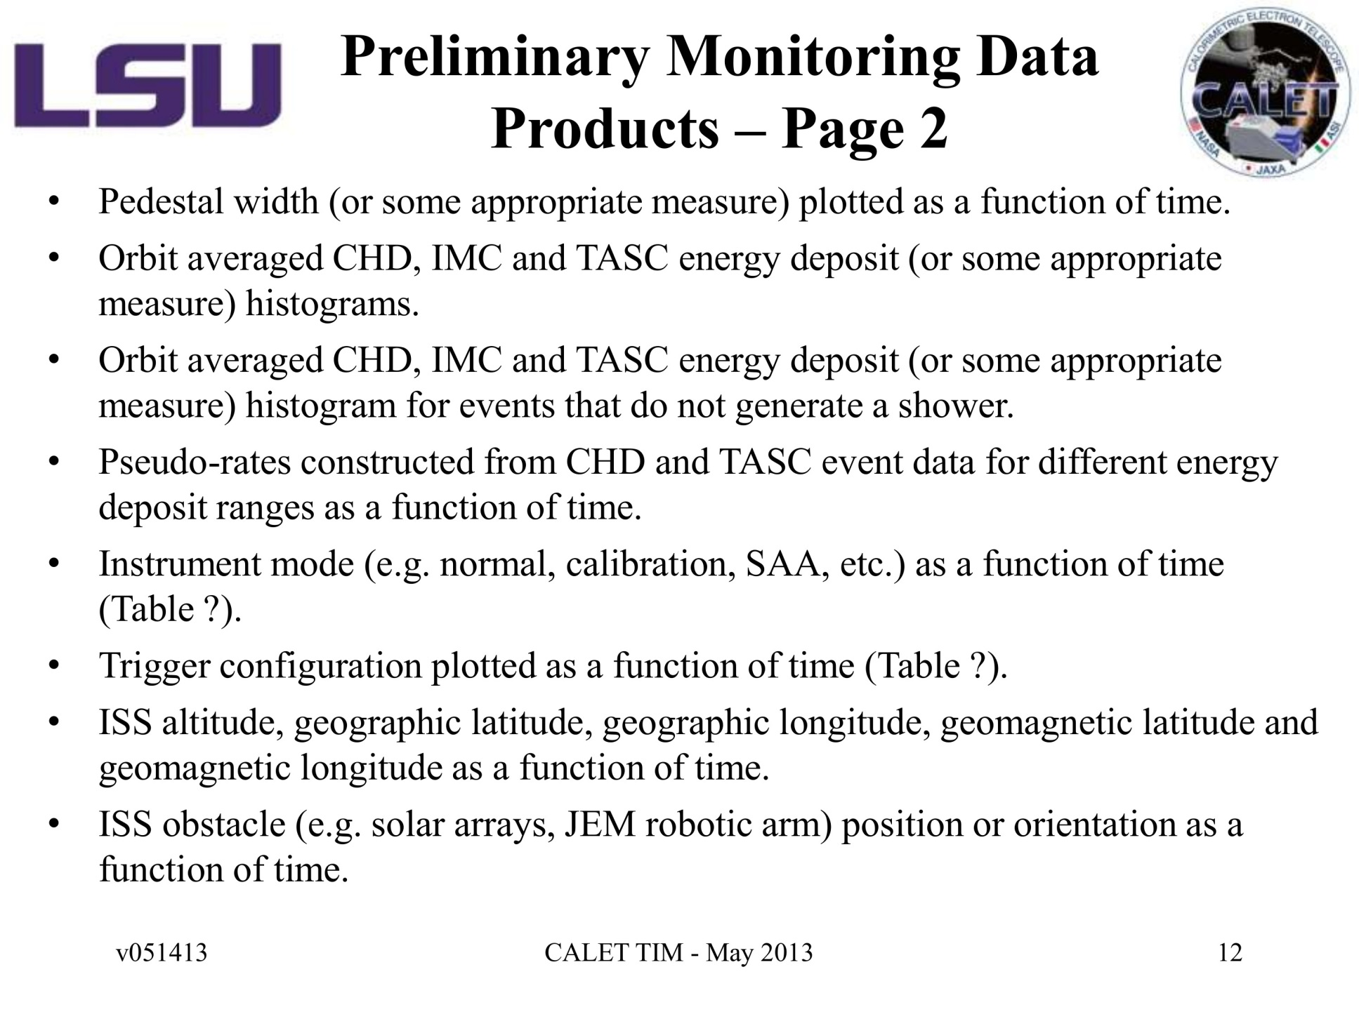
Preliminary Monitoring Data Products – Page 2
Auxiliary
Ancillary
Greg-san’s presentation Page 12 of 12
The ISS ancillary data (distributed on ISS and collected by CALET) include the ISS position
in a Cartesian coordinate system.
The ISS ancillary data does not include the JEM robotic arm information.

