Slide 1
Epics Configuration of
CALET CAD Model
May 29, 2013
Kenji YOSHIDA

Slide 2
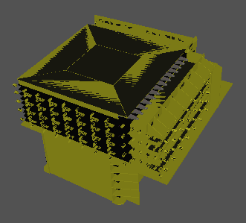
Epics Config of CALET CAD model
--- Outer Appearance ---

Slide 3
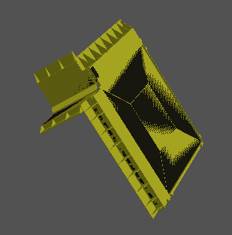
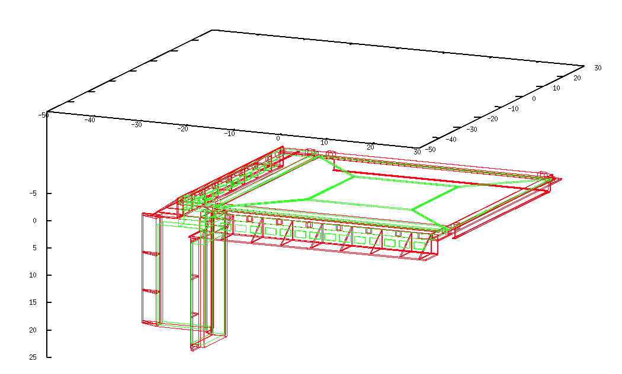
EPICS Config: Top panel, corner panel
Top panel, corner cover: Al alloy 7075

Slide 4
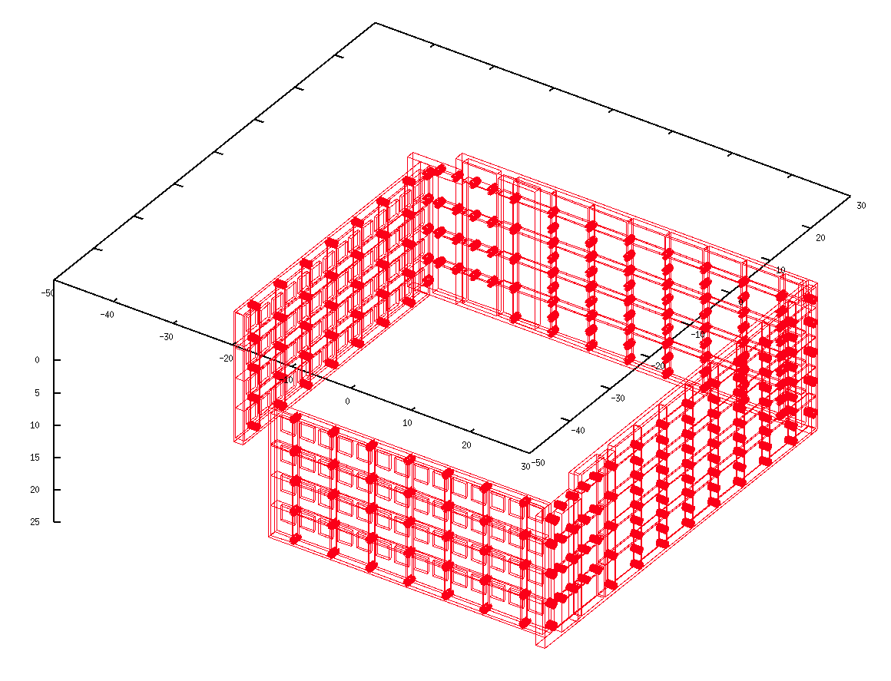

EPICS Config: side panel, back panel of IMC
Side panel, back panel: Al alloy 7075

Slide 5
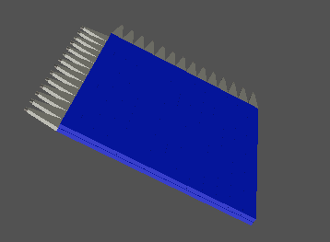
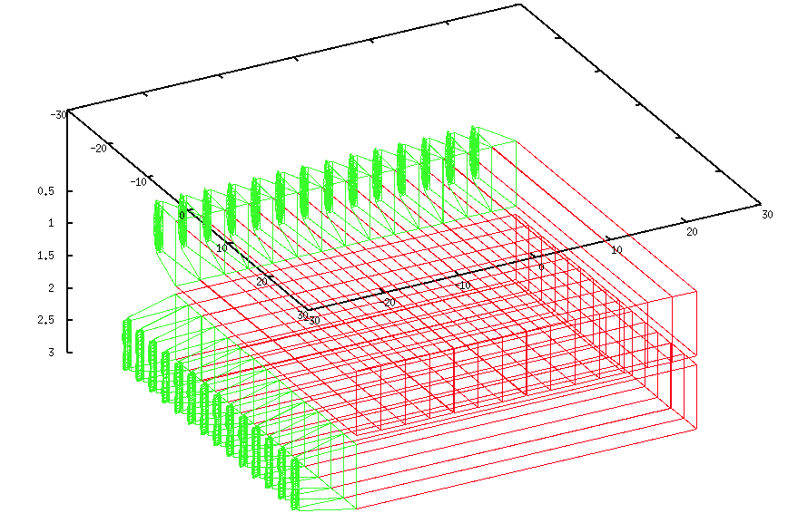
EPICS Config: CHD detector

Slide 6
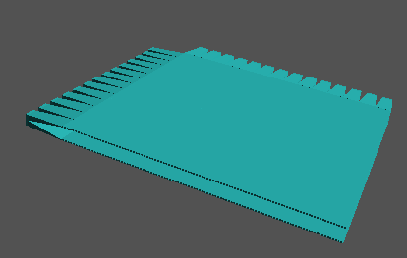
EPICS Config:
IMC 1 x-y layer

Slide 7

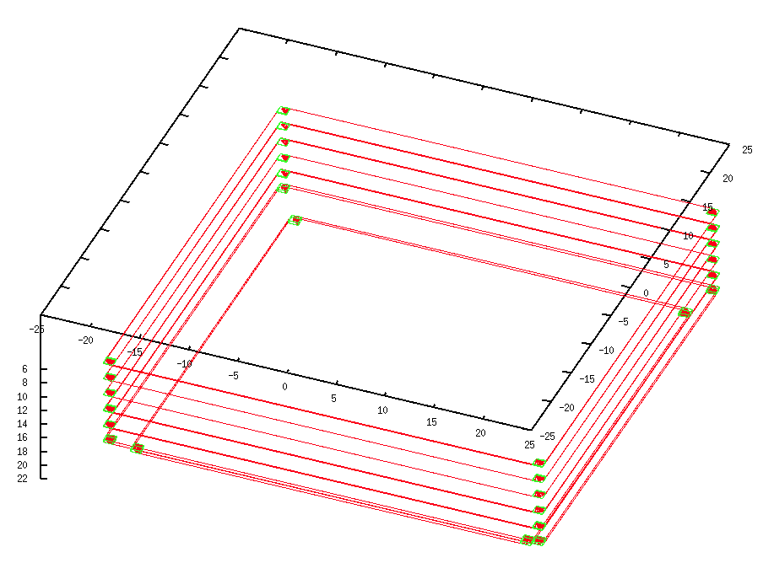
EPICS Config: Tungsten plates

Slide 8
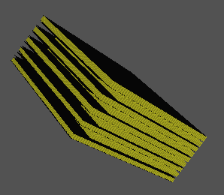
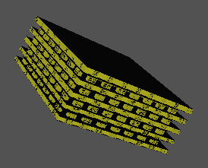
EPICS Config: Honeycomb panel
Honeycomb panel: Al

Slide 9

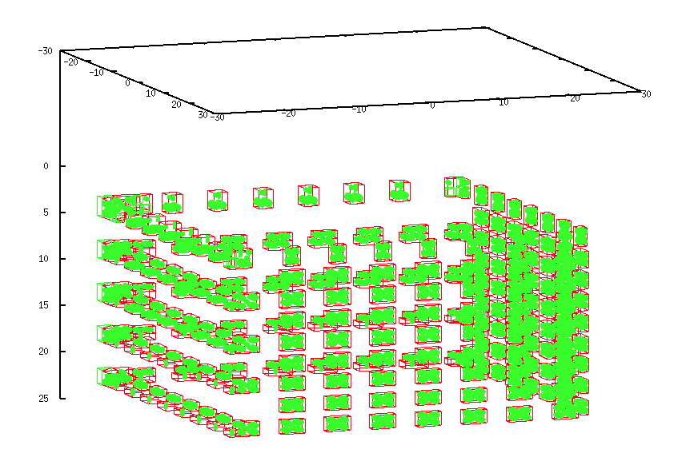
EPICS Config: Honeycomb Insert
Insert in Honeycomb panel: Al alloy 2024

Slide 10

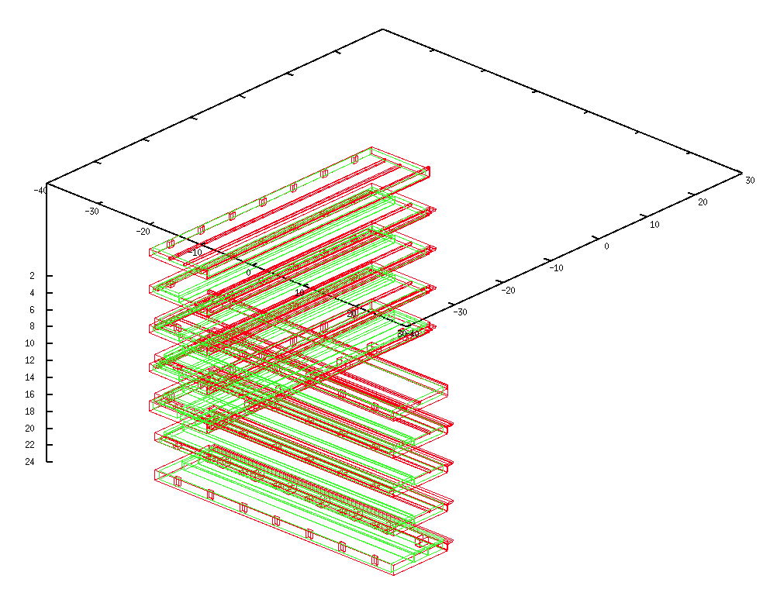
PMT plates
PMT plate: Al alloy 7075

Slide 11
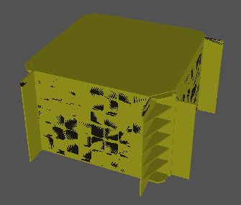
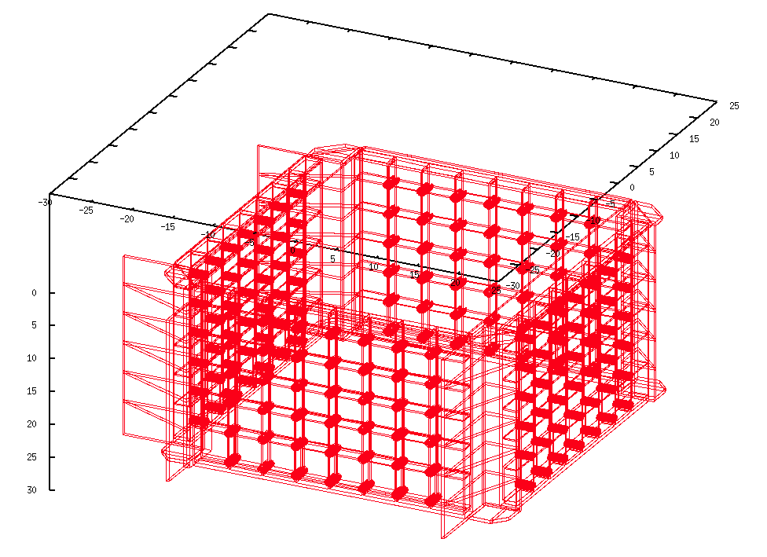
EPICS Config: TASC Panels
TASC panels: Al alloy 7075

Slide 12

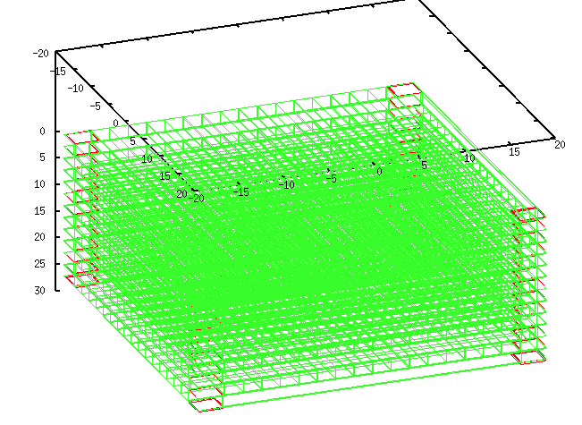
EPICS Config: CFRP Holder

Slide 13
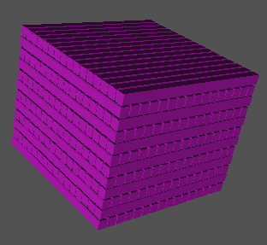
EPICS Config: TASC PWO

Slide 14
Status of CALET-CAL CAD model
To be beta version
  To check the CAD model in the Japan M&S group
To be distributed by the end of June

