Slide 1


Current status of the CALET Gamma-ray Burst Monitor (CGBM)
Kazu Yamaoka
STE lab., Nagoya University

Slide 2
Outline
1. CALET mission and CGBM
2. CGBM hardware component
3. Bread Board Model (BBM)
of Sensors and electronics
4. Schedule
5. Summary

Slide 3
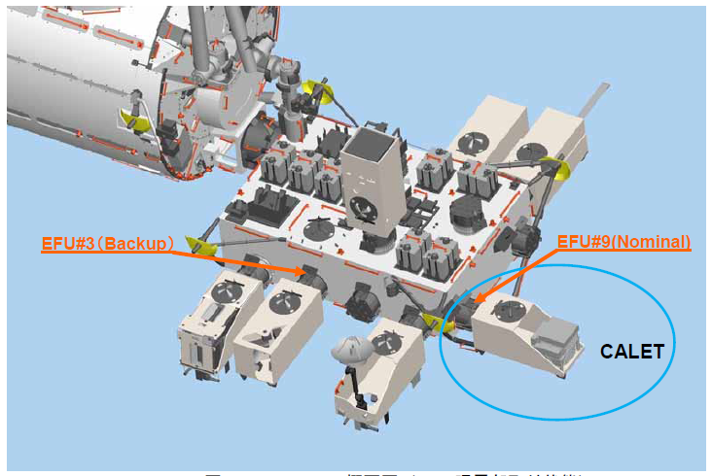
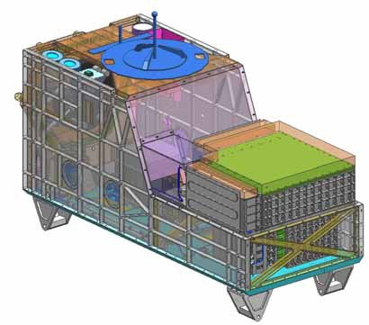
CALET mission and CGBM
CALET(CAlorimetric Electron Telescope)
  Launch by H-IIB/HTV(H-II Transfer Vehicle)
  in summer 2014
  Attached to Kibo on the ISS.
  JAXA(Japan), NASA(US), ASI(Italy)
  Currently In the development phase of PFM
Calorimeter (CAL)
  Electrons:1 GeV – 20 TeV
  Gamma-rays:10 GeV – 10 TeV
  Protons, Heavy ions: a few10 GeV–1000 TeV
Gamma-ray Burst Monitor (CGBM)
  Energy range: 7 keV – 20 MeV
  Hard X-ray Monitor (HXM): 7 keV – 1 MeV
  Soft Gamma-ray Monitor (SGM): 100 keV – 20 MeV
SGM
HXM
CAL

Slide 4
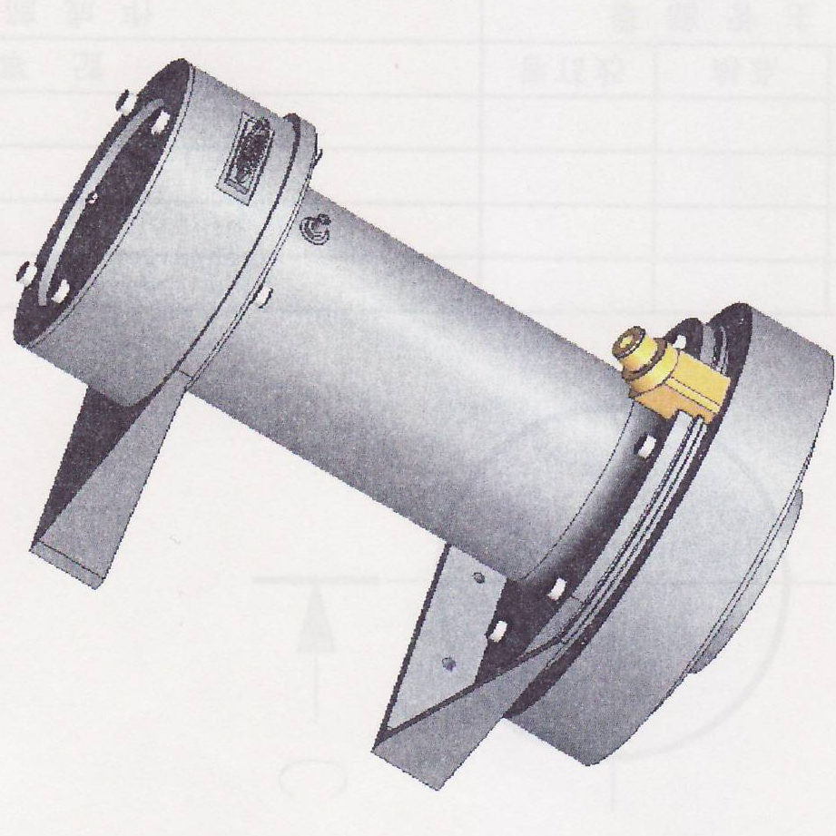
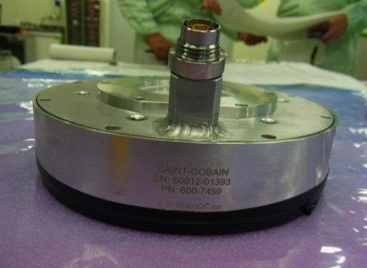
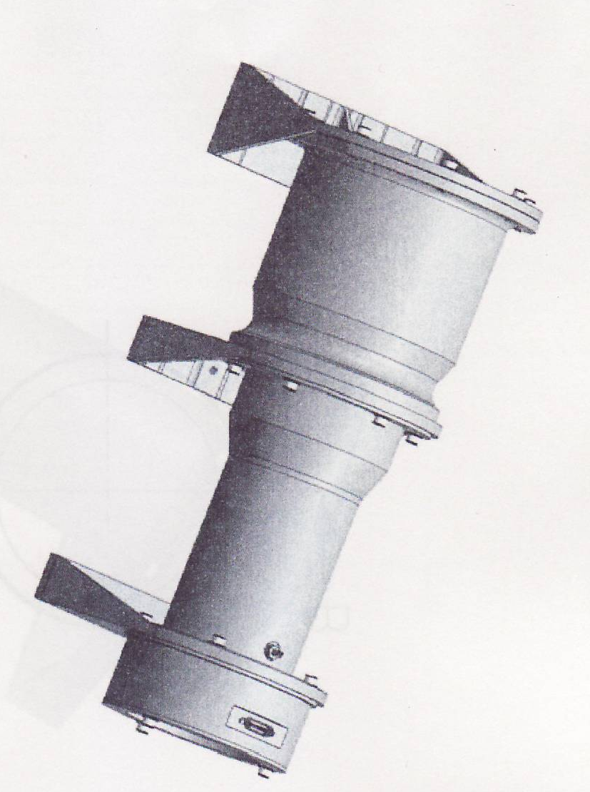
CGBM hardware components
  Sensors
  two Hard X-ray Monitor（HXM)
    LaBr₃(Ce) (φ66 mm x 0.5 inches)
    + PMT R6232-05
    LaBr₃ is not used for gamma-ray
    celestial observations.
    Bleeder circuit, Charge sensitive amplifiers
  One Soft Gamma-ray Monitor(SGM)
    BGO (φ4 inches x 3 inches)
    + PMT R6233-20
  Electronics (GBM E-box)
    Process signals from 3 sensors.
    Pulse-height analysis, Accumulation of event-by-event
    data with high time resolution when GRB occurs
HXM
SGM

Slide 5
Summary of CGBM performance
CGBM | HXM | SGM
Detector | LaBr₃(Ce)＋PMT | BGO +PMT
Size and geometry | Φ6.6cm x 1.27cm t | Φ10.2cm x 7.6cm t
Number | 2 | 1
Energy range (Goal) | ~7 keV – 1 MeV (3 keV to 3 MeV) | ~100 keV – 20 MeV (30 keV to 30 MeV)
Geometrical Area (cm²) | 68 cm² (for two) | 81 cm²
Energy resolution | ~4%@662 keV | ~15%@662 keV
GRB Localization | No position capabilities by CGBM itself。Localization by interplanetary network (IPN).
Field of View | ~60 deg. (~π str.) | ~4π str.
Time resolution | GRB trigger： 62.5 us (event-by-event data) Nominal: 1/8 s and 4 s (monitor data)

Slide 6
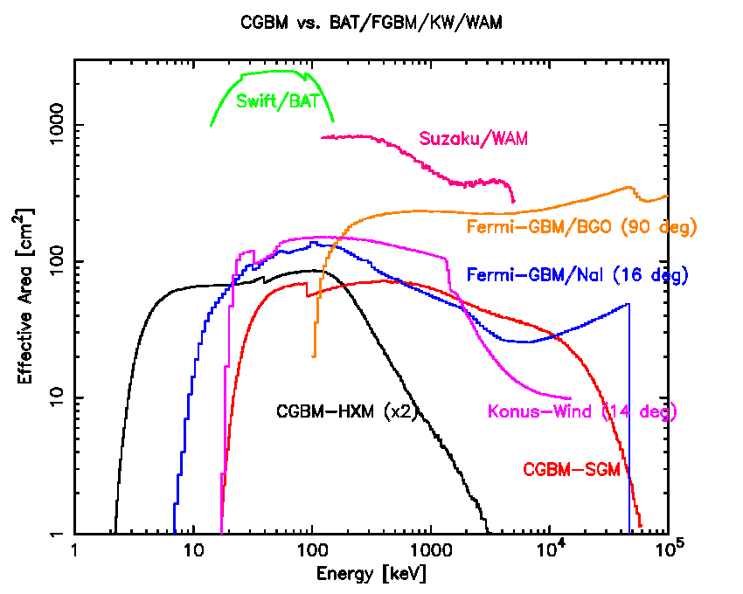
Comparison of the CGBM effective area with other GRB detectors
Sensitive to X-rays below 10 keV !

Slide 7
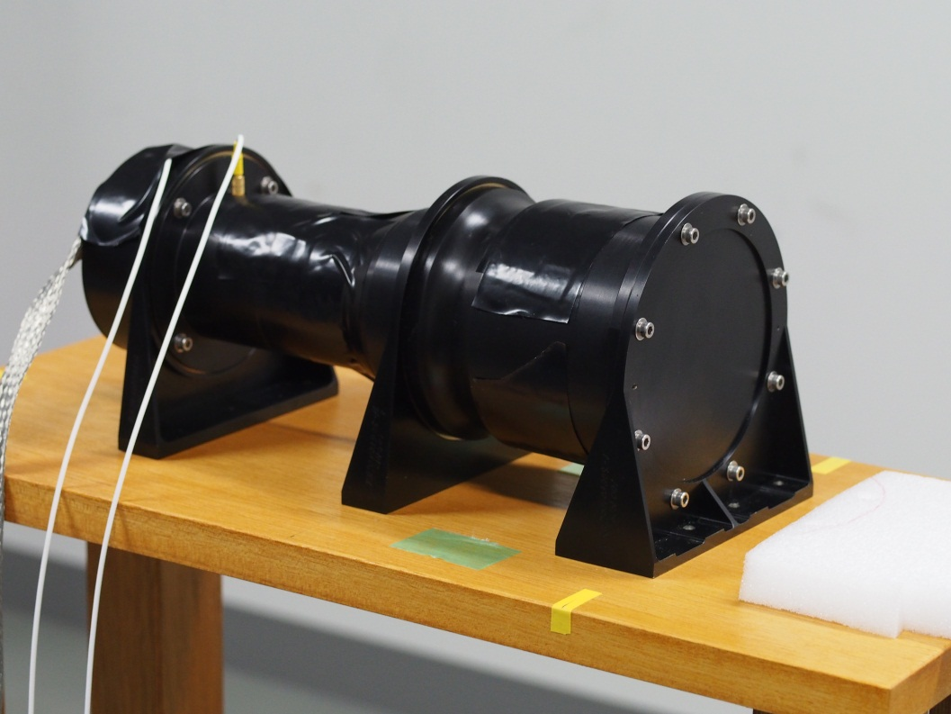
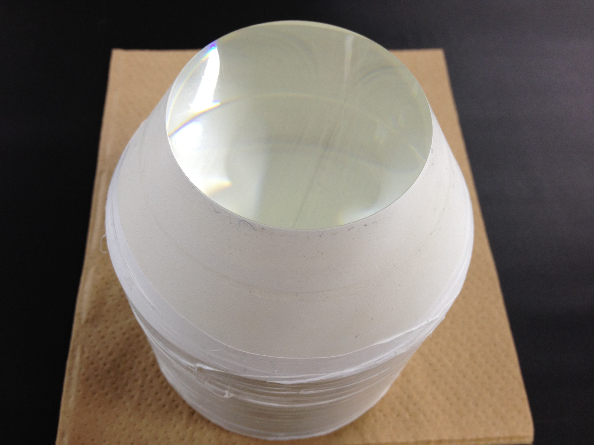
Bread-board model (BBM) of SGM sensors
Fabrication by the IHI aerospace
BGO and light guide are almost the same as PFM.
The housing shape is equivalent to PFM.
A bleeder is installed, but a CSA is not.
Install
BGO＋light guide (OKEN Co Ltd)

Slide 8
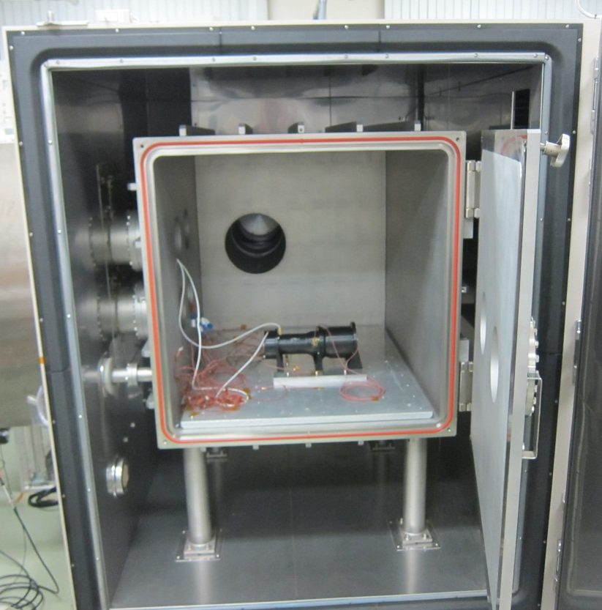
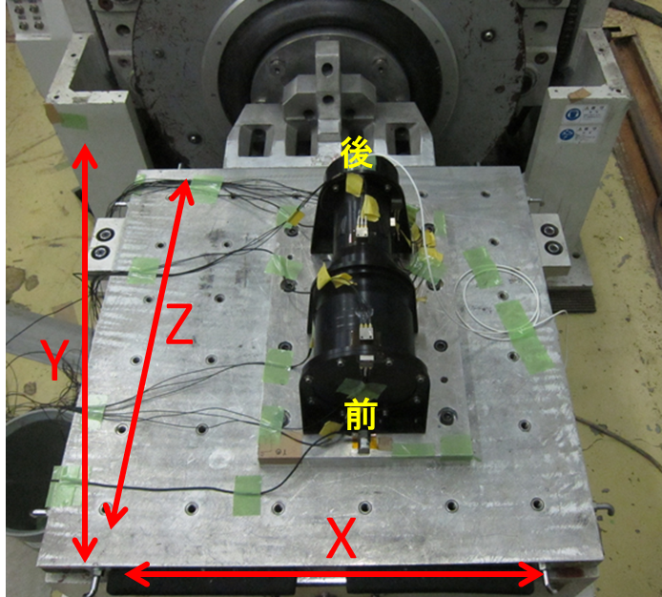
Environment test of SGM-BBM sensors
①Jan. 9-10, 2013 Vibration test @IMV at Sagamihara
sine sweep, random 19.8 Grms
②Jan. 12-16, 2013 Thermal vacuum test＠thermal vacuum chamber at ISAS/JAXA,
Range: -30～45 ℃ Variation rate ：12℃ per hour

Slide 9
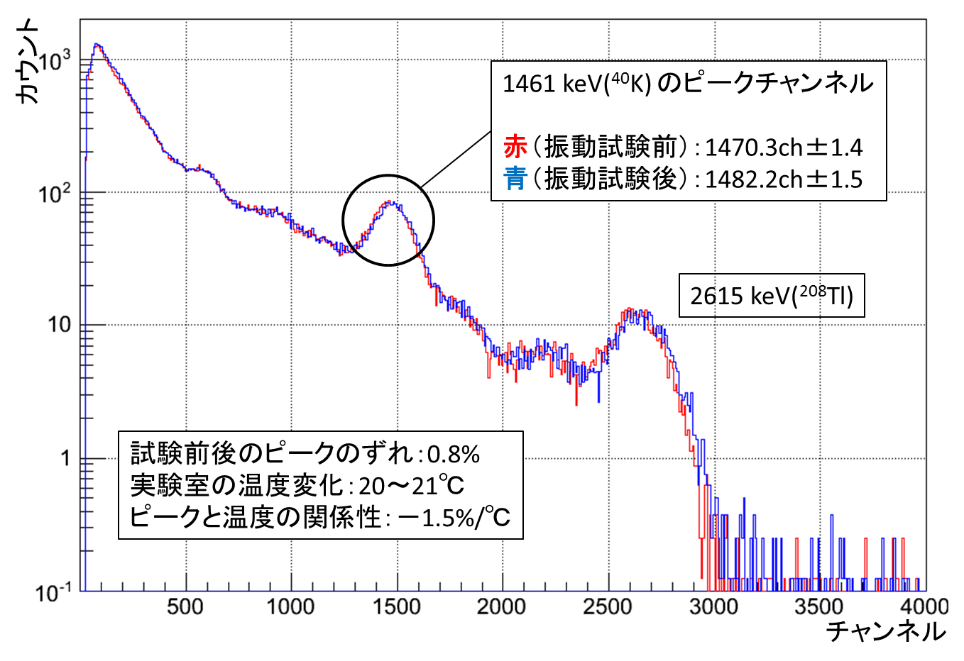
Performance verification before and after the environment test
Always monitor the natural background (especially for 1461 keV line from⁴⁰K) for checking the detector conditions.
Furthermore, we resolved the detector and checked inside crystals, then we cannot find any cracks in the BGO crystal by eyes. → Both tests have been passed !

Slide 10
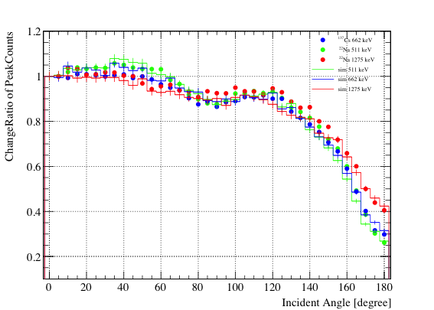
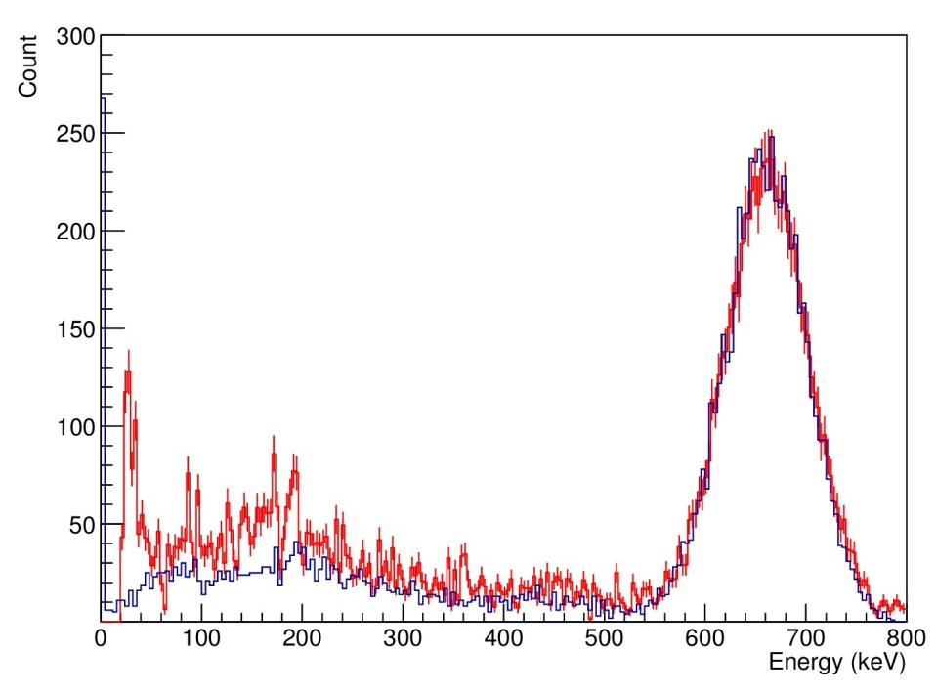
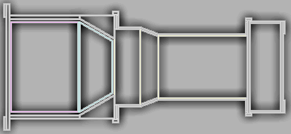
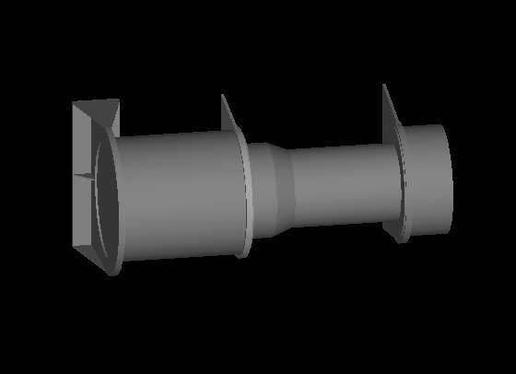
Toward the construction of detector response
We need to construct detector response functions for any energies and incident angles with GEANT 4. We are now comparing experiment and simulations. → Pre-flight calibration will be planned on July 2013.
Angular dependence of photo-peak count rates
Simulation geometry
keV
662 keV
1274 keV
662 keV spectrum
90°
Experiment
Simulation
0°
180°

Slide 11
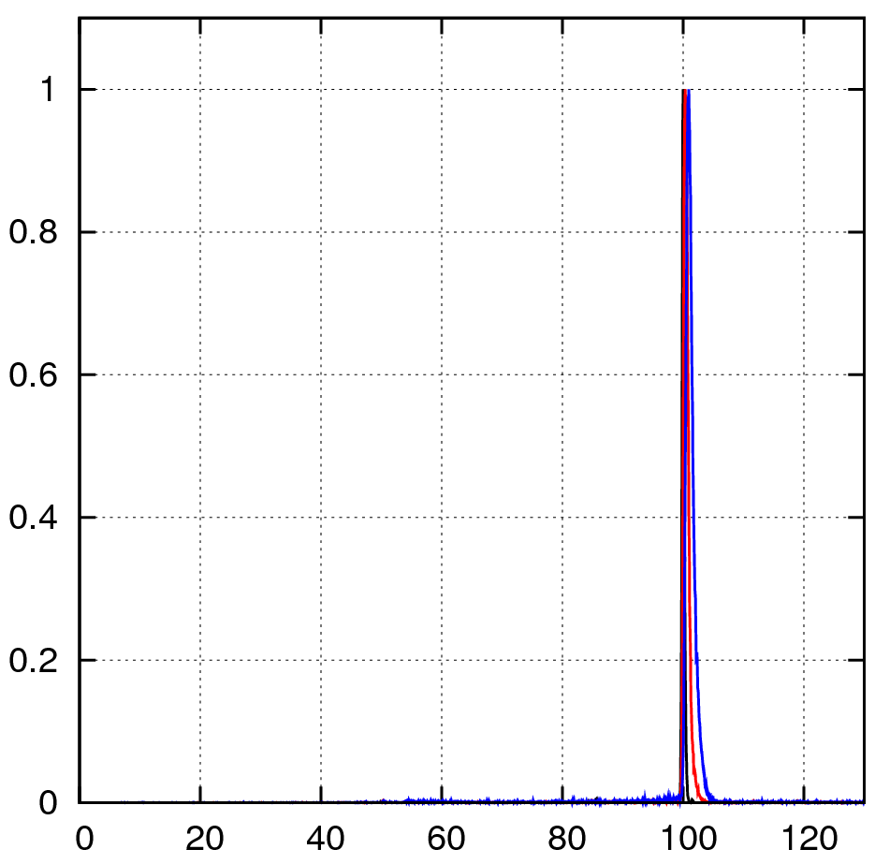
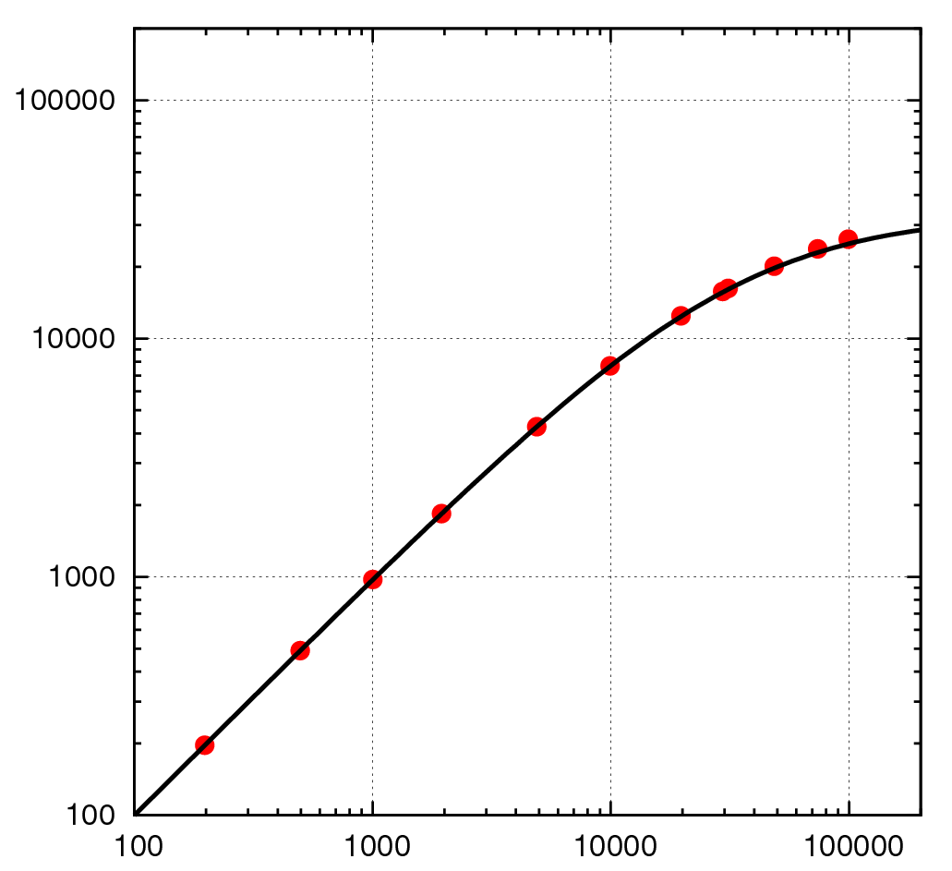
High counting tolerance test to the E-box BBM
Random pulse input up to ~10 kHz as expected in previous intense GRBs.
Incident rate dependence of outputted rate
Random pulsar spectrum with monochromatic pulse height
Outputted rate
Normalized count
1 kHz
10 kHz
20 kHz
No significant degradation
Almost the same as predicted
エネルギー [keV]
Input rate

Slide 12
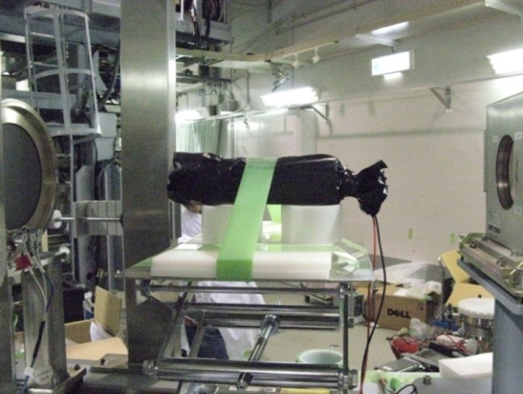
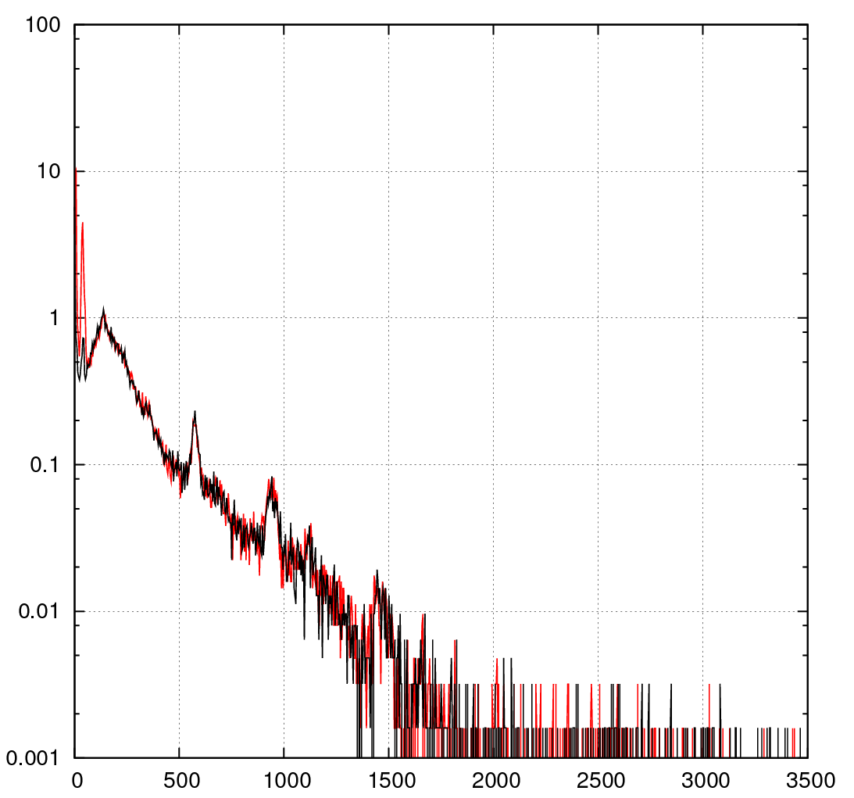
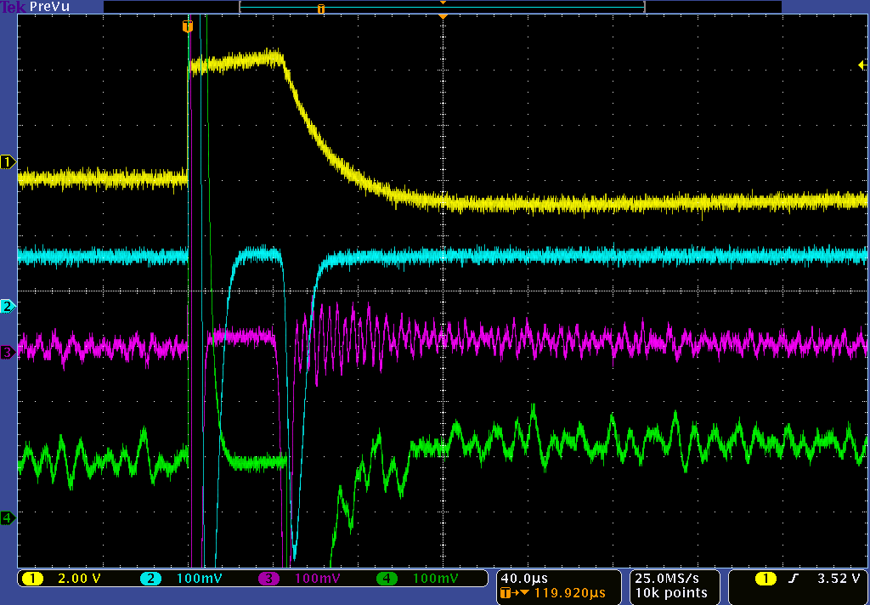
Proton irradiation test to the BBM equivalent circuit
Perform proton beam irradiation test (kinetic energy 70 and 200 MeV) at Wakasa-wan energy research center to simulate the ISS environment.
No problems in recovery of signal within about 60 us.
BG spectra with /without beams
Proton（70MeV）
Beam ON
Beam OFF
Preamp out
60us
Low gain
LD comparator
High gain

Slide 13
CGBM Schedule
June-July: Verification test of PFM by IA and MPC
End of July 2013:
Pre-flight calibration for CGBM PFM alone
at JAXA Tsukuba Space Center
Oct.-Nov. 2013:
Gamma-ray irradiation test to the BBM in the 5-30 MeV rage
at New-Subaru beam-line.
Jan. 2014:
Irradiation test to the CGBM PFM after the CALET integration.

Slide 14
Summary
The CALET gamma-ray burst monitor (CGBM) is the 2nd scientific instrument to support a gamma-ray burst observation in the GeV-TeV range with CAL.
Test of Bread-board model (BBM)
  Sensors Vibration and thermal vacuum test has been passed safely.
  Electronics No significant degradation under a high counting rate and proton irradiation.
The PFM of sensors and E-box are now being built, and will be tested on June and July. The pre-flight calibration of CGBM is planned on end of July.

Slide 15
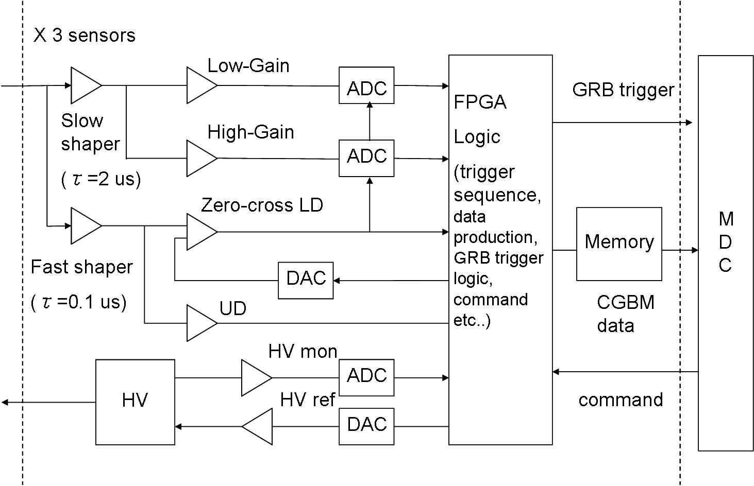
CGBM E-box
  processes signals from 3 CGBM sensors
  Analog part: amplifiers with a wide dynamic range, peak detection circuit, LD and UDs
  Digital part: ADC, FPGA (e.g. GRB trigger system) ,
  10-Mbyte Memory (GRB data accumulation)
  High Voltage (SITAEL S9099)
E-box
Mission Data
Controller (MDC)
Sensors

Slide 16
Comparison with CGRO/EGRET, AGILE/GRID,
And Fermi/LAT
 | Energy | Effective Area (cm²) | FOV | Angular resolution (68%) | Deadtime
CGRO /EGRET | 20 MeV-30 GeV | 1500 | ~0.5 str. | 5.5 deg.@100 MeV 1.3 deg @1 GeV 0.5 deg @10 GeV | ～100 msec
AGILE /GRID | 30 MeV - 50 GeV | 540 | ~2.5 str. | 4.7 deg @100 MeV 0.6 deg @1 GeV 0.2 deg @10 GeV | ～200 us
Fermi /LAT | 20 MeV - 300 GeV | ~3000 @100 MeV ~7000 @1 GeV ~8000 @10 GeV | ~2.4 str. | 3.5 deg @ 100 MeV 0.5 deg @ 1 GeV 0.1 deg @ 10 GeV | ~27 us
CALET /CAL | 1 GeV – 10 TeV | ~600 | ~ 2 str. | 2.5 deg @ 1 GeV 0.4 deg @ 10 GeV 0.2 deg @ 100 GeV | ~1.8 ms

