Slide 1
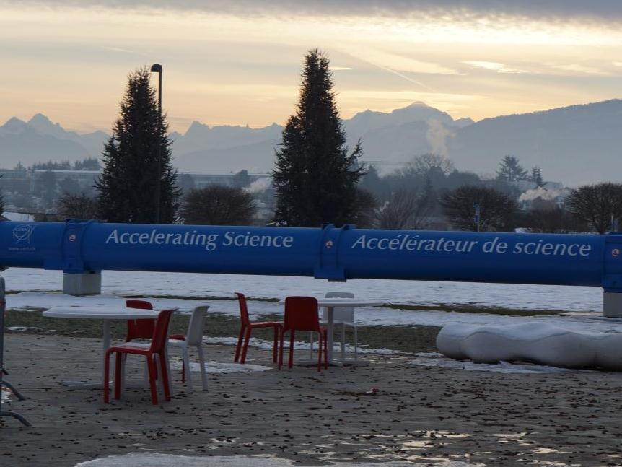

Outline of the beam test in 2012
Outline of the beam test in 2012
Kanagawa Univ., Waseda Univ.^{A}，Yokohama National Unvi.^{B}，Tokyo Univ. ICRR^{C}，JAXA/SEUC^{D}，Siena Univ/INFN^{E}，Florence Univ./INFN^{F}，Rome Univ. Tor Vegata/INFN^{G}，
Pisa Univ.^{H}，NASA/GSFC^{I}，Washington Univ.-St.Louis^{J}
T.Tamura，S.Torii^{A}，K.Kasahara^{A}，S.Ozawa^{A}，T.Kotani^{A}，Y.Nakagawa^{A}，Y.Ueyama^{A}，
T.Niita^{A}，M.Nakamura^{A}，R.Katahira^{A}，S.Kaneko^{A}，Y.Katayose^{B}，Y.Akaike^{C}，清水雄輝^{D}，P.S.Marrocchesi^{E}，P.Maestro^{E}，G.Bigongiari^{E}，S.Bonechi^{E}，P.Brogi^{E}，O. Adriani^{F}，N. Mori^{F}，S.Oleksandr^{F}，R.Sarvoli^{G}，L.Marcelli^{G}，V.Di Felice^{G}，F.Palma^{G}，A.Basti^{H}，S.Tolaini^{H}，A.Orsini^{H}，J.W.Mitchell^{I}，B.Rauch^{J}
Kanagawa Univ., Waseda Univ.^{A}，Yokohama National Unvi.^{B}，Tokyo Univ. ICRR^{C}，JAXA/SEUC^{D}，Siena Univ/INFN^{E}，Florence Univ./INFN^{F}，Rome Univ. Tor Vegata/INFN^{G}，
Pisa Univ.^{H}，NASA/GSFC^{I}，Washington Univ.-St.Louis^{J}
T.Tamura，S.Torii^{A}，K.Kasahara^{A}，S.Ozawa^{A}，T.Kotani^{A}，Y.Nakagawa^{A}，Y.Ueyama^{A}，
T.Niita^{A}，M.Nakamura^{A}，R.Katahira^{A}，S.Kaneko^{A}，Y.Katayose^{B}，Y.Akaike^{C}，清水雄輝^{D}，P.S.Marrocchesi^{E}，P.Maestro^{E}，G.Bigongiari^{E}，S.Bonechi^{E}，P.Brogi^{E}，O. Adriani^{F}，N. Mori^{F}，S.Oleksandr^{F}，R.Sarvoli^{G}，L.Marcelli^{G}，V.Di Felice^{G}，F.Palma^{G}，A.Basti^{H}，S.Tolaini^{H}，A.Orsini^{H}，J.W.Mitchell^{I}，B.Rauch^{J}

Slide 2
Development of CALET
BBM
(Bread Board Model)
（EM）
(Engineering Model)
PFM
(Proto-Flight Model)
FM
(Flight Model)
STM
(Structure Thermal Model)
BBM：Bread Board Model
to verify a structure or electronics tentatively
PFM：Proto-Flight Model
Equivalent to flight model
The CALET PFM become FM After AT
STM：Structure Thermal Model
to verify a design of structure and temperature
(structure, material, device arrangement, mass, heat)
EM：Engineering Model
to verify mechanical and electrical function and
characteristics on mass, size, power etc.

Slide 3
BBM／STM
BBM
  Structure
    IMC（1/4： X 2 layers, Y 2 layers）
    TASC（1/4： X 2 layers, Y 2 layers）
  Electronics
    VA chip readout（～10/112）
    IMC-FEC（1/8： X 2 layers）
    TASC-PMT-FEC（1/1: X 1st layer）
    TASC-APD/PD-FEC（1/11： Y 1st layer）
STM
  Structure
    CHD（all layers：X 1 layer, Y 1 layer）
      SciBar X 3 bars, Y 3 bars, Plastic（mass dummy）
    IMC（all layers：X 8 layers、Y 8 layers）
      All SciFi + support structure (sub-slate)
    TASC（all layers：X 6 layers, Y 6 layers）
      CFRP support structure, several PWOs, brass（mass dummy）
⇒ EM Assembled with BBM（electronics） and STM（structure）

Slide 4
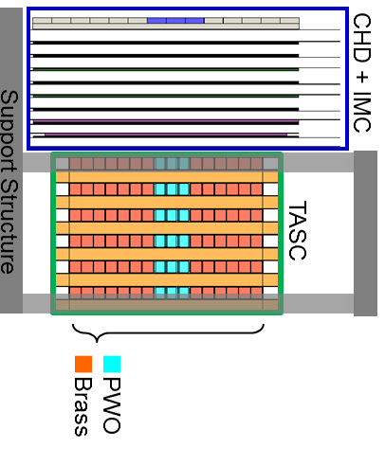

Engineering Model
Detector Configuration
 |  | PFM/FM | EM
CHD | SciBar | X:14x1 + Y:14x1 (28) | X:3x1 + Y:3x1 (6)
 | PMT | X:14x1 + Y:14x1 (28) | X:3x1 + Y:3x1 (6)
IMC | SciFi | X:448x8 + Y:448x8 (7168) | X:448x8 + Y:448x8 (7168) X:256x8 + Y:256x8 (4096)
 | MaPMT | X:14x4 + Y:14x4 (112) | X:8x4 + Y:8x4 (64)
TASC | PWO | X:16x6 + Y:16x6 (192) | X:3x6 + Y:3x6 (36)
 | Brass | － | X:13x6 + Y13x6 (156)
 | PMT | X:16x1 (16) | X:3x1 (3)
 | APD/PD | X:16x5 + Y:16x6 (176) | X:3x5 + Y:3x6 (33)
EM built up with BBM and STM

Slide 5
Engineering Model
Electronics
BBM
  VA-readout
  IMC-FEC
  TASC-PMT-FEC
  TASC-APD/PD-FEC
Other electronics
  VME computer for DAQ system
  VME modules （Scaler, I/O register, Charge ADC）
  NIM modules for the trigger logic
  CAMAC modules （Peak hold ADC）
  FEC for bCALET（IMC, TASC）
  Test circuit （CHD）
FEC’s were read out by a VME LVDS I/F

Slide 6
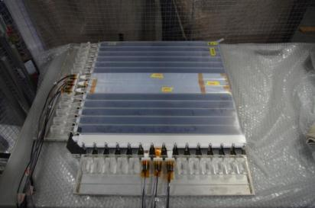
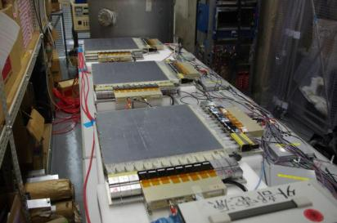
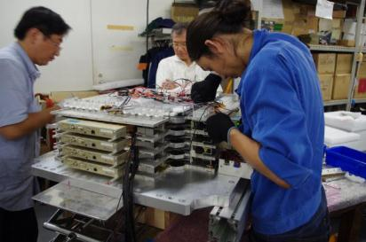
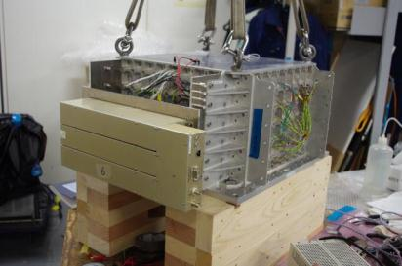
Assembling
CHD (STM)
IMC (STM)
CHD/IMC（STM)
TASC (STM)

Slide 7
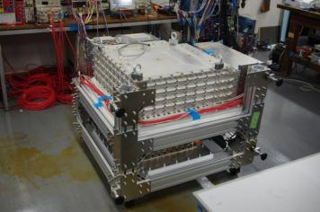
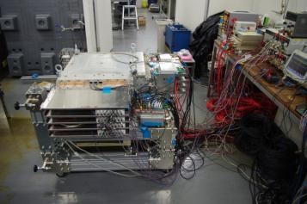
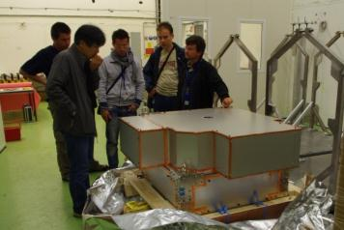
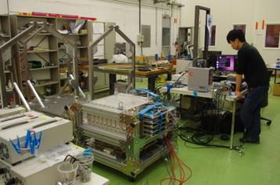
Detector Test
@Waseda
@CERN-SPS

Slide 8
Objectives of Beam Test
  to verify the function of BBM-FEC
    Detection of 1 MIP
    Generation of trigger
    DAQ from IMC and TASC
  to verify the performance of CALET
  （comparison with MC simulation）
    Trigger efficiency
    Angular resolution
    Energy resolution
    Electron/Proton separation
    Charge resolution of CHD

Slide 9
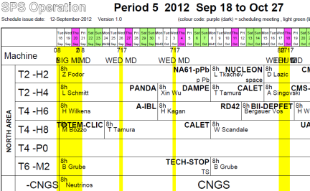

Beam Schedule 2012
Machine time
  2 weeks (Sep.24-Oct.8) @ H8
  1 week (Oct.8-Oct.15) @ H4
Data
AMS/Pamela/Auger/Explorer/Antares/Fermi/
LISA/Nestor/IceCube/Mice/Meg/T2K/Katrin/
WArP/HESS/Magic/ArDM/CREAM/Belle II/CBM/
Panda/CTA-PP/Planck/CALET/Borexino
（Feb. 2012）
⇒ Machine time available more than one week
H8
  muon: (898k) 180 GeV/c
  electron: (1,318k) 10, 20, 30, 50, 80, 100, 150, 200 GeV/c
  proton: (2,156k) 400 GeV/c
H4
  muon: (575k) 150 GeV/c
  electron: (547k) 10, 150, 200, 250, 290 GeV/c
  proton: (1,297k) 30, 100 GeV/c

Slide 10
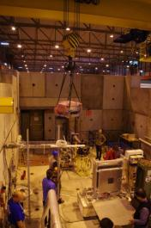
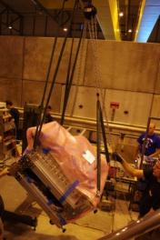
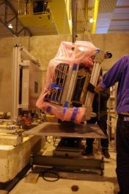
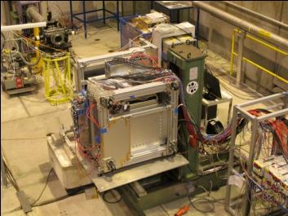
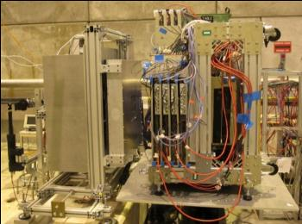
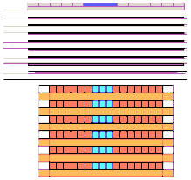
Installation at H8
beam pipe
CALET
EM
Si detector
(Trk.+SIA)
beam
pipe
CALET-EM
moving
table
moving table
Si detector
(Trk.+SIA)
CHD
+IMC
Si detector
(Trk.+SIA)
CHD + IMC
TASC
TASC
Trig.
Scin.
Trigger Scinti.
■PWO
■Brass
Beam
Support Structure
Moving Table

Slide 11
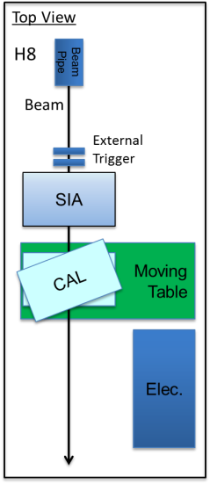
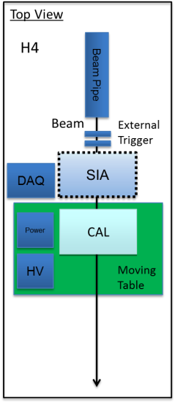
Test Conditions
Detectors Configuration
  Beam angle
    0 deg. / 20.7 deg. @H8
    0 deg. @H4
  with / without SIA @H4
    to study unknown mass
    in the upstream of beam line
CAL
20.7 deg

Slide 12
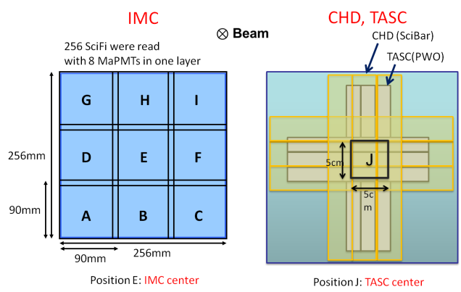
Test Conditions
Beam position (setting with moving table)
  Muon: whole IMC (position: A～I)
  Electron, Proton: center of TASC (position: J)

Slide 13
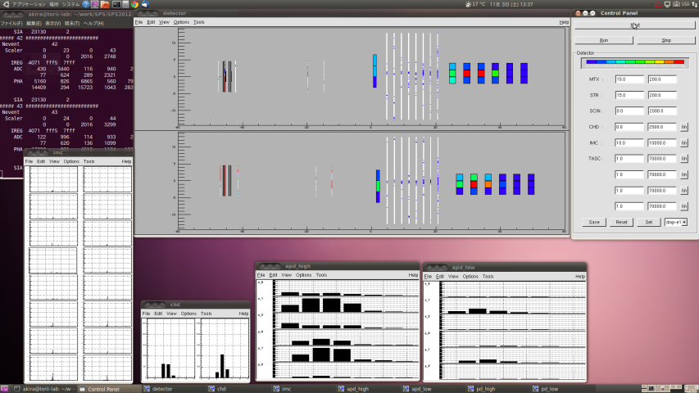
Electron 290GeV Pos.J run833
Detector
IMC
CHD
TASC
X
IMC
X
Y
Y
TASC(APD High)
TASC(APD Low)
CHD
X
X
X
Y
Y
Y

Slide 14
Summary
The CALET EM was assembled with the STM and BBM.
Beam tests with the CALET EM were done at CERN-SPS in Sep.-Oct. 2012.
Total collected data: muons 1.47M, electrons 1.86M , protons 3.45M.
Analyses => Akaike/Niita
Ion beam run carried in Jan.-Feb. 2013

Slide 15
Backup charts

Slide 16
Beam Tests for CALET at CERN-SPS
2009 Readout of BGO, PWO
  （IMC+）TASC Lead（18 r.l.）＋BGO, PWO (one crystal each)
2010 CALET prototypeⅠ
  IMC 32 SciFis×8 layers （X-direction）
  TASC 2 PWOs×8 layers （X-direction）
2011 CALET prototypeⅡ
  CHD 4 SciBars （X-direction）
  IMC 32 SciFis ×8 layers （X-direction）
  TASC 3 PWOs ×12 layers （X-direction）
2012 CALET STM/BBM Model

Slide 17
Machine time:
  2 weeks (Sep.24-Oct.8) @ H8
  1 week (Oct.8-Oct.15) @ H4
Beam
  H8 (refer to Appendix A for more detail)
    muon: 180 GeV/c (897.5 k)
    e: 10, 20, 30, 50, 80, 100, 150, 200 GeV/c (1,317.8 k)
    p: 400 GeV (2,156 k)
  H4 (refer to Appendix B for more detail)
    muon: 150 GeV/c (575 k)
    e: 10, 150, 200, 250, 290 GeV/c (546.8 k)
    p: 30, 100 GeV/c (1,297.1 k)
Conditions
  beam position (refer to Appendix C)
    muon: whole (position: A～I)
    e, p: center of TASC (position: J)
  beam angle (p.4)
    0 deg. / 20.8 deg. @H8
    0 deg. @H4
  with / without SIA @H4 (p.5)
    to study unknown mass in the upstream of beam line

Slide 18
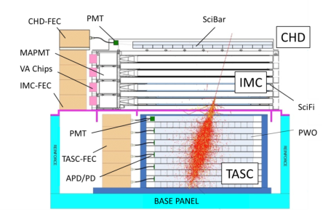
CAL Trigger
Discri. Signals for Trigger
CHD
  X-dir: Sum of 14 PMT×1: S/H
  Y-dir: Sum of 14 PMT×1: S/H
IMC
  X-dir: Sum of 14 Last Dynodes of MaPMT （SciFi 2 layers）×4: S/L/H
  Y-dir: Sum of 14 Last Dynodes of MaPMT （SciFi 2 layers）×4: S/L/H
TASC
  Top （X-dir） Sum of 16 PMT×1: S/L/H
Triggers
Single (Track)
Electron/Gamma-ray Shower
  Low Energy
  High Energy
Heavy Nuclei
  Low Energy
  High Energy

Slide 19
CAL Trigger
Electron/Gamma-ray
Single Trigger
Low Energy Trigger > 1 GeV
High Energy Trigger > 10 GeV
“Single Track”
CHD Single LD .
CHD Single LD
CHD Single LD
CHD
1 MIP
1 MIP
1 MIP
―
Single LD .
Low LD
High LD
IMC
＞He
Low
High
1 MIP
＞He (TBD)
1 MIP
―
Low
High
TASC
（Page00）
（Page01）
Heavy Nuclei
（Page00）
（Page01）
Heavy
Single
Trigger
Ultra
Heavy
Trigger
Heavy Low Trigger
Heavy High Trigger
CHD Heavy LD
CHD Heavy LD
CHD Heavy LD .
Heavy (P.00)
Z≧10 (P.01)
Heavy (P.00)
Z≧10 (P.01)
CHD
Heavy
Z≧10
Single LD .
Low LD
High LD
IMC
＞He
1 MIP
Low
High
＞He (TBD)
1 MIP
―
Low
High
TASC

Slide 20

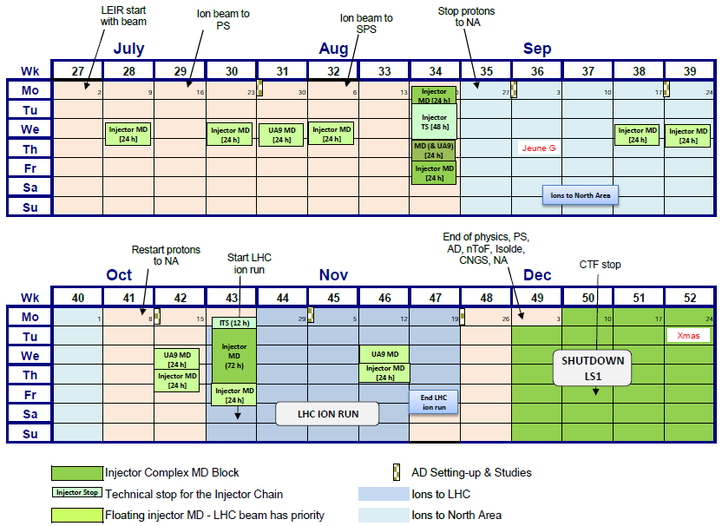
Beam Schedule 2012

Slide 21

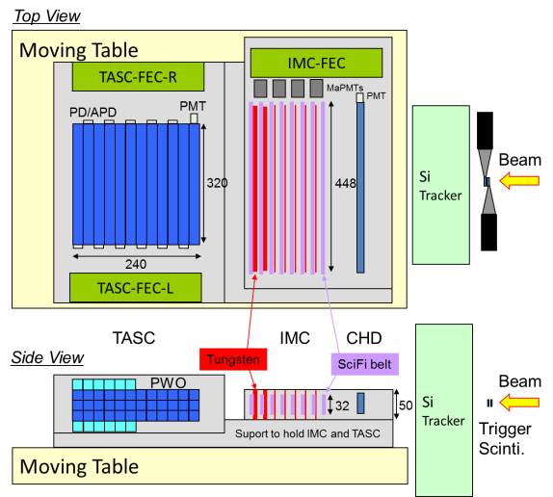
CALET prototype (2011)
・トリガーシンチレータ
・シリコンストリップ検出器 （0.7 μm間隔）
XY 90 mm幅 ×4層
・CHD
X 4本（32㎜幅）
・IMC
X 32㎜幅ベルト8層
・TASC
X 3本×12層
・可動テーブル
（コントロール室で操作）

Slide 22
Data statistics taken at H8
muon (180 GeV/c)
electron
(Position J)
protron (400 GeV/c)
(Position J)
Position | Total #
A | 21,000
B | 90,700
C | 0
D | 10,000
E (Center) | 575,800
F | 100,000
G | 0
H | 100,000
I | 0
Energy (GeV/c) | Total Event Num. | Purity (%)
10 | 95,000 | 63
20 | 109,500 | 60
30 | 60,000 | 94
50 | 65,000 | 88
50 (low rate) | 67,000 | 79
100 | 122,000 | 80
150 | 250,000 | 20
200 | 400,000 | 12
200 (low rate) | 149,300 | 12
Beam file | Total #
H8A.799 | 1,845,400
H8A.950 | 310,600

Slide 23
Data statistics taken at H4
muon (150 GeV/c)
electron
(Position J)
protron
(Position J)
Position | Total #
A | 57,500
B | 50,000
C | 50,000
D | 50,000
E (Cent.) | 105,000
F | 50,800
G | 61,700
H | 50,000
I | 100,000
Energy (GeV/c) | Total Event Num. | Purity (%)
10 | 50,000 *1
150 | 112,600 | 91
200 | 190,900 *2 | 90
250 | 93,900 | 93
290 | 100,000 | 93
Energy | Total #
30 | 675,300 *3
100 | 621,800
*3 including 124k events w/o SIA
*1 including 50k events w/o SIA
*2 including 57k events w/o SIA

Slide 24
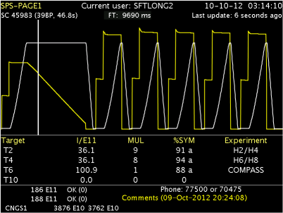
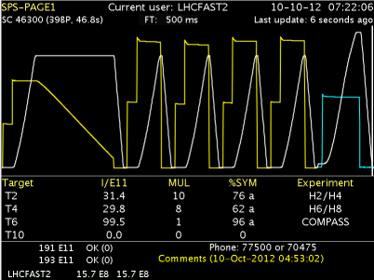
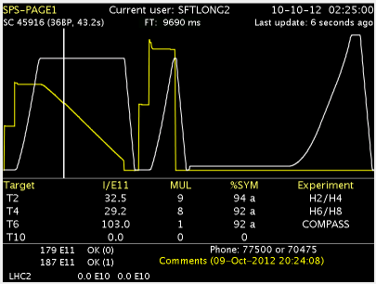
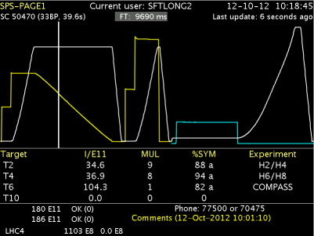
Beam cycles

Slide 25
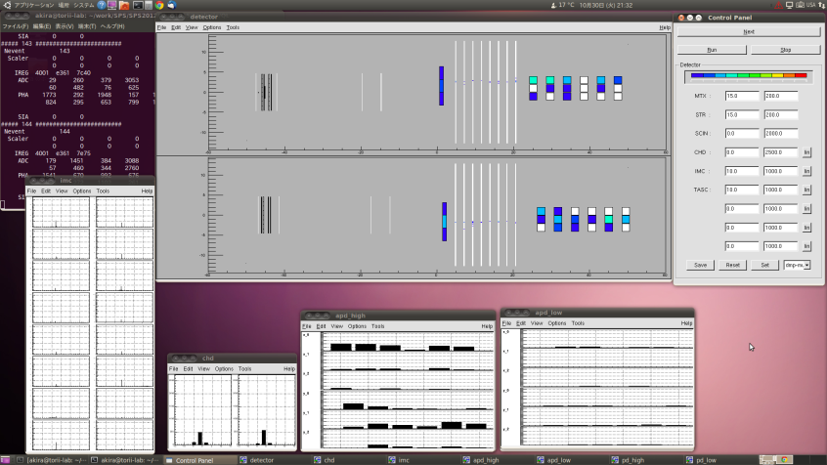
Muon 150GeV Pos.E run134
Detector
IMC
CHD
TASC
X
X
Y
Y
X
X
X
Y
Y
Y
IMC
CHD
TASC(APD High)
TASC(APD Low)

Slide 26
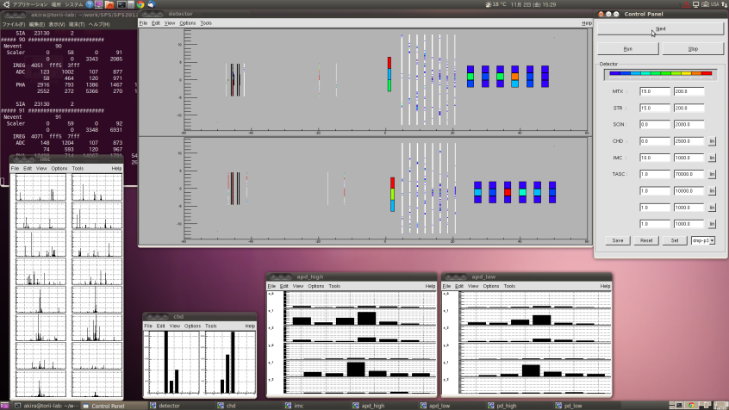
Proton 400GeV Pos.J run437
Detector
IMC
CHD
TASC
X
X
Y
Y
X
X
X
Y
Y
Y
IMC
CHD
TASC(APD High)
TASC(APD Low)
⇒ 29aBF6 金子 「高エネルギートリガーシステム」
⇒ 29aBF7 村田 「粒子識別性能実証」
⇒ 29aBF8 片平 「エネルギー測定性能」
⇒ 29aBF9 小澤 「重粒子検出性能」

