Slide 1
Outline of the ion test in 2013
Tadahisa TAMURA for Beam Testing Team
2013.5.28

Slide 2
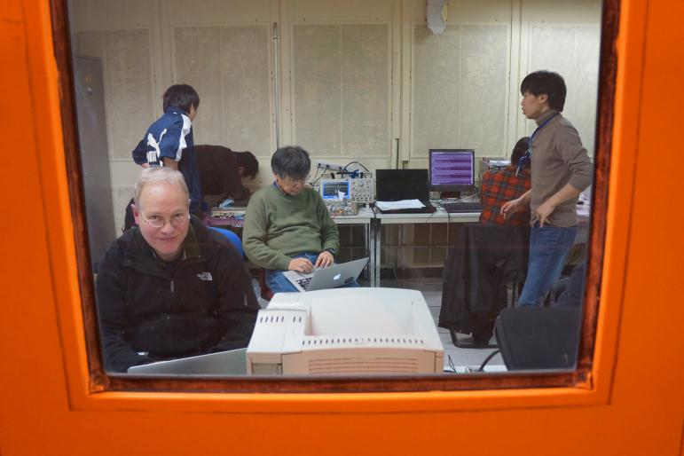
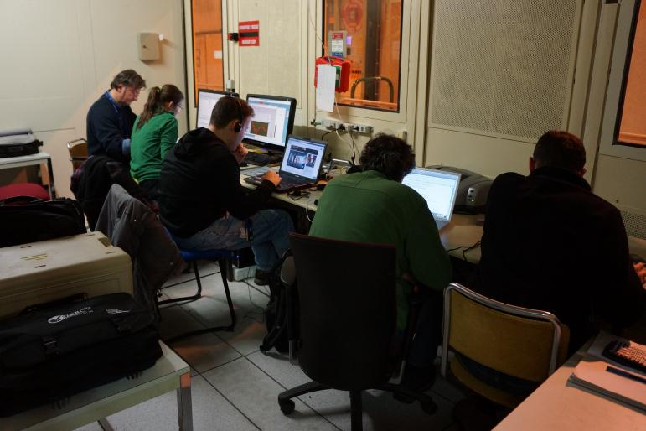
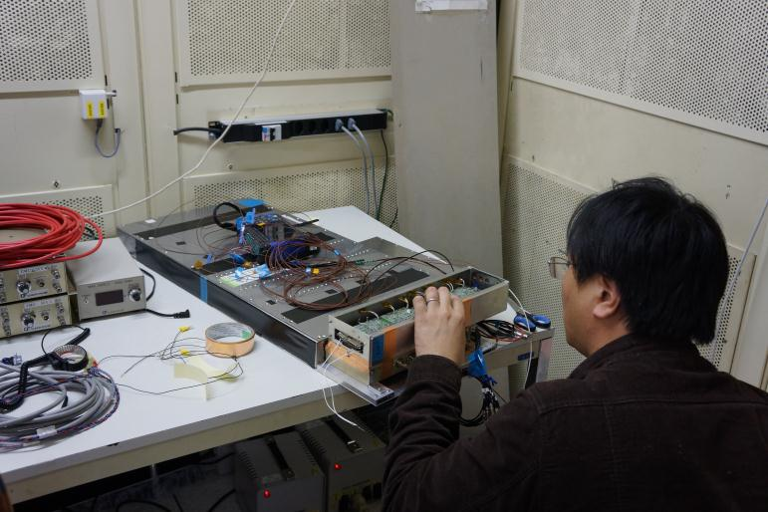
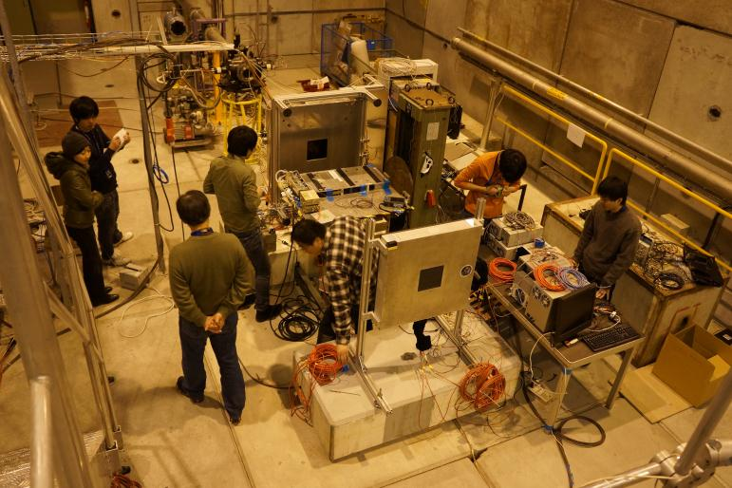
Ion beam test at H8
Control rooms for the H8 beam line
JC-detector
Si Tracker
beam pipe
moving table
BBM3
IC-CHD
H8 beam area

Slide 3
Schematic drawing of Detectors and DAQ System
ion beam at H8
control room (barrack)
Ext. Trigger
Scintillators + PMT’s
NIM
Visual
Scaler
PC
Discri./Coinc.
/Gate Gen.
/Level Adapt. etc.
JC
HV
IC
VME
Trigger
CPU, Lupo, I/O-Reg.,
Scaler, PH-ADC,
Charge-ADC
Si Trk
Si Trk
DAQ
JC-detector
CHD SciBar
(2 bars)
PMT
FEC
BBM3
(TASC-X1)
LVDS I/F
PMT
FEC
IMC SciFi
(1 belt)
bCALET
MaPMT
FEC
TASC PWO
(2 crystals)
PMT
Test circuit
DC
Power
HV (bCALET)
APD/PD
Oscilloscope
IT CHD
(3+3)
HV (CP)

Slide 4
Ion Beam Test at H8
Fragments (A/Z~2) from Pb (82,208) of 30 GeV/u
Schedule
  Jan.24-27
    Si Tracker + IC-CHD
    JC apparatuses were delayed one day to arrive at CERN.
    Trouble shooting of JC-DAQ
      BBM3 had been modified after October.
      VME Modules were unstable (due to the VME crate ?).
  Jan.27-Feb.4
    JC-CHD+SciFi+PWO + IC-CHD
    Si Tracker + JC-CHD+SciFi+PWO + IC-CHD
  Feb.4-6
    Oscar’s run

Slide 5
Data Statistics
CHD ID | BBM3 input ch | HV [V] | Event number
 |  |  | w/o Si Tracker | with Si Tracker
0 | 5 ⁽¹⁾ | 450⁽²⁾ | 2.5 M | 1 M
1 | 12⁽³⁾⁽⁵⁾ | 410⁽²⁾ | 0.7 M
 |  | 360⁽⁴⁾ | 28 k
 | 3⁽³⁾ | 360⁽⁴⁾ | 1.7 M | 1 M
Gain of amplifiers of ch5 was the same as flight model.
PMT output current was 480 fC for 1 MIP (nominal value of flight model).
Gains of amplifiers of the other channels were 4.4 times higher than flight model.
PMT output current was reduced by about 1/3.
Lower 4 (or more) bits of ADC were invalid.

Slide 7
Data Acquisition diagram
CHD-PMT
PWO-PMT
Adaptor
BOX
BBM-I/F
V-LUPO
BBM
TASC-X1
MaPMT
IMC-FEC
/₃
DP
APD/PD
PreAMP
(HIC test)
/₂
Slow
Shaper
/₄
PH-ADC
/₈
Input Reg.
HV (2ch x2, 1ch x1)
Trigger
G.G.
Latch
S1
Div
Disc.
Coin.
G.G.
Scaler
S2
Div
Disc.
Coin.
G.G.
HV
Output Reg.
Clock
Ped Run mode
CHD-IT
/₆
/₈
Delay
~150ns
/₈
QDC
V965A
Tracker
VME-CPU
USB
VME bus

Slide 8
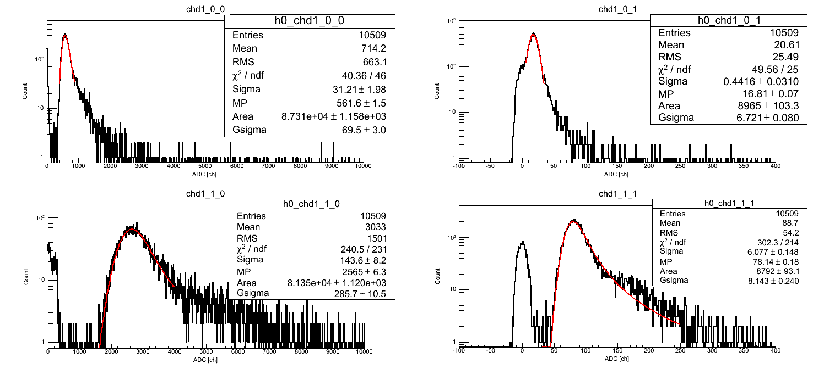
PMT gain calibration with proton
CHD#0 BBM ch5 HV-450V (High gain)
CHD#0 BBM ch5 HV-450V (Low gain)
1MIP=562ch
1MIP=16.8ch
(480 fC/MIP)
CHD#1 BBM ch12 HV-410V (High gain)
CHD#1 BBM ch12 HV-410V (Low gain)
1MIP=2570ch
1MIP=78ch
(480 fC/MIP)
Energy deposit of Fe (Z=26) is equivalent to 480MIPs.
Energy deposit of Zr (Z=40) is equivalent to 1033MIPs.
Maximum range of low gain is 810pC (=1687 MIPs).
(Maximum range of high gain is 27pC (=56 MIPs).)

Slide 9
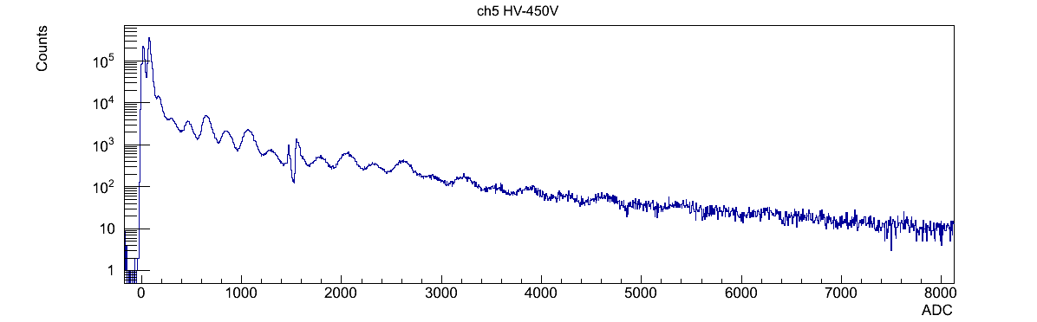
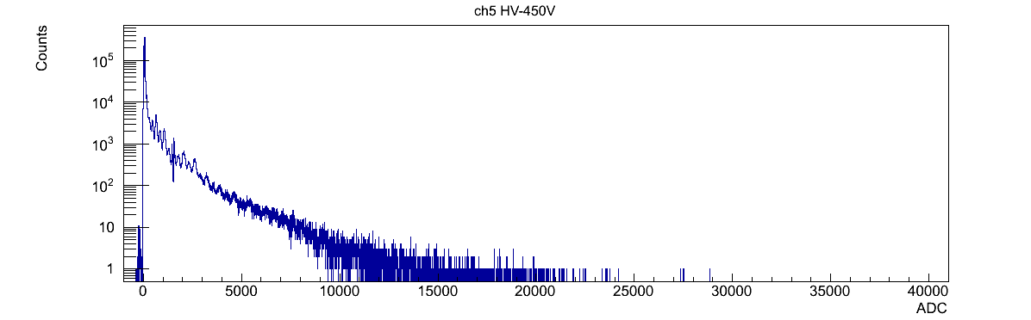
Fragments (A/Z=2, 30GeV/u)
CHD#0 BBM ch5 HV-450V (Low gain)
He
C
O
Si

Slide 10
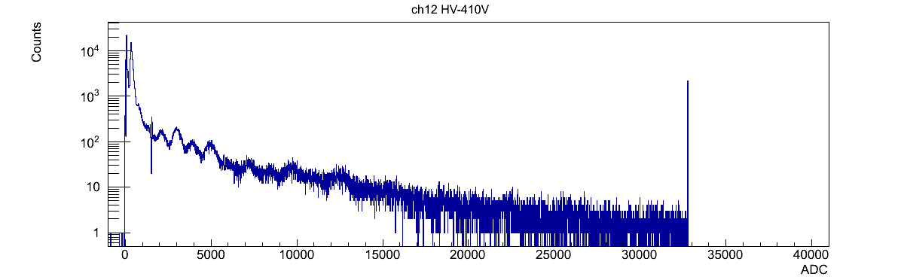
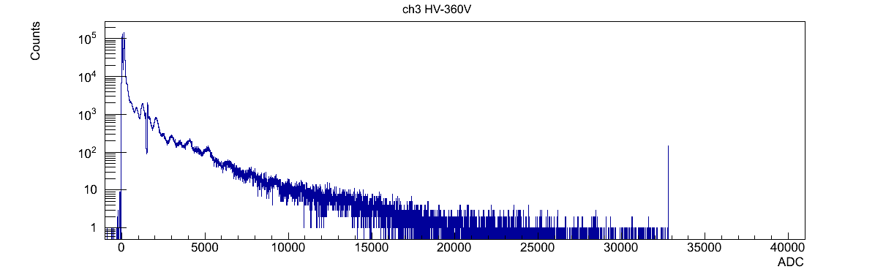
Fragments (A/Z=2, 30GeV/u)
CHD#1 BBM ch12 HV-410V (Low gain)
He
C
O
Si
He
CHD#1 BBM ch3 HV-360V (Low gain)
C
O
x 1/2.5
Si

Slide 11
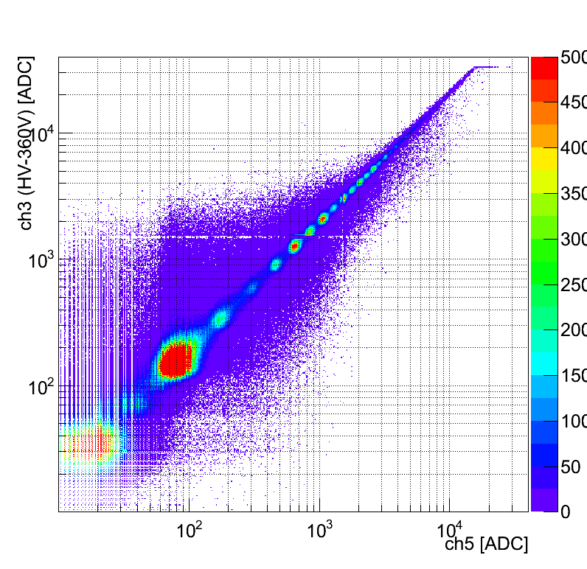
Correlation between two CHDs
C
He
D(p)

Slide 12
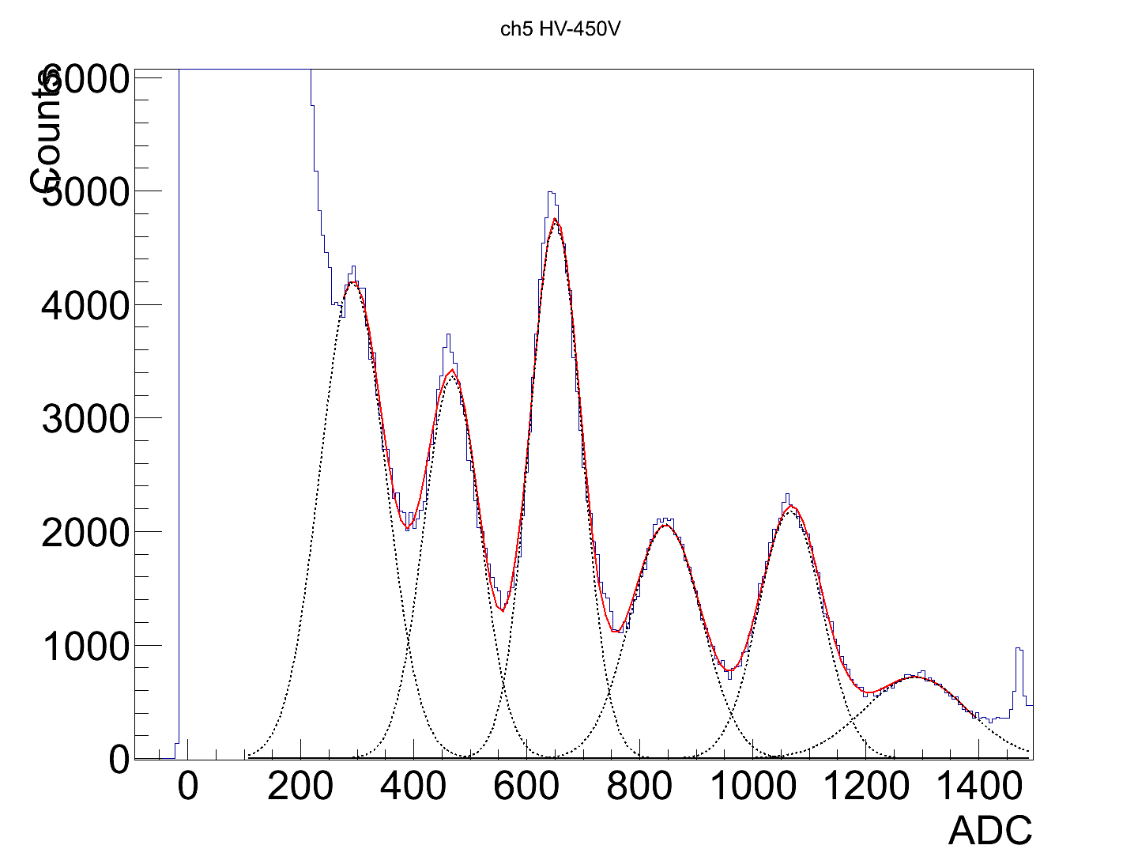
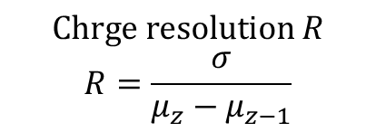
Charge resolution around Z~6
CHD#0 BBM ch5 HV-450V (Low gain)
$$Chrge resolution R$$
$$R=\frac{σ}{μ_{z}−μ_{z−1}}$$
C
Be
Preliminary
B
 | Mean μ [ADC] | St.Dev. σ [ADC] | Charge Res. R [e]
Be | 291.8 | 58.6 | -
B | 467.9 | 49.8 | 0.28
C | 650.7 | 46.2 | 0.25
N | 845.6 | 63.1 | 0.32
O | 1066.7 | 56.4 | 0.26
N
O

Slide 13
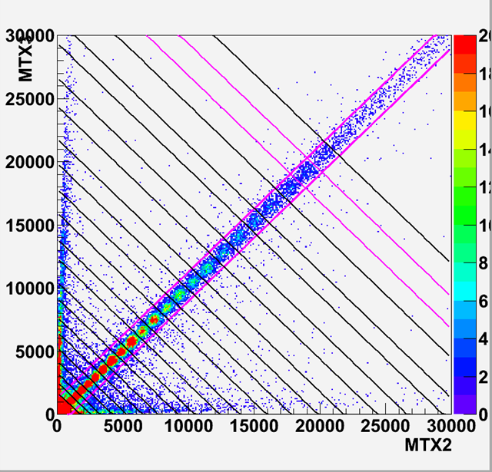
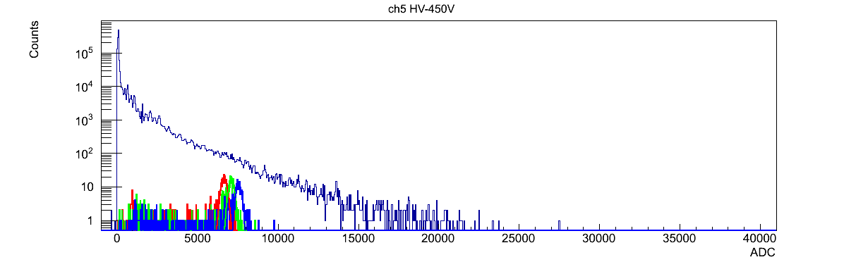
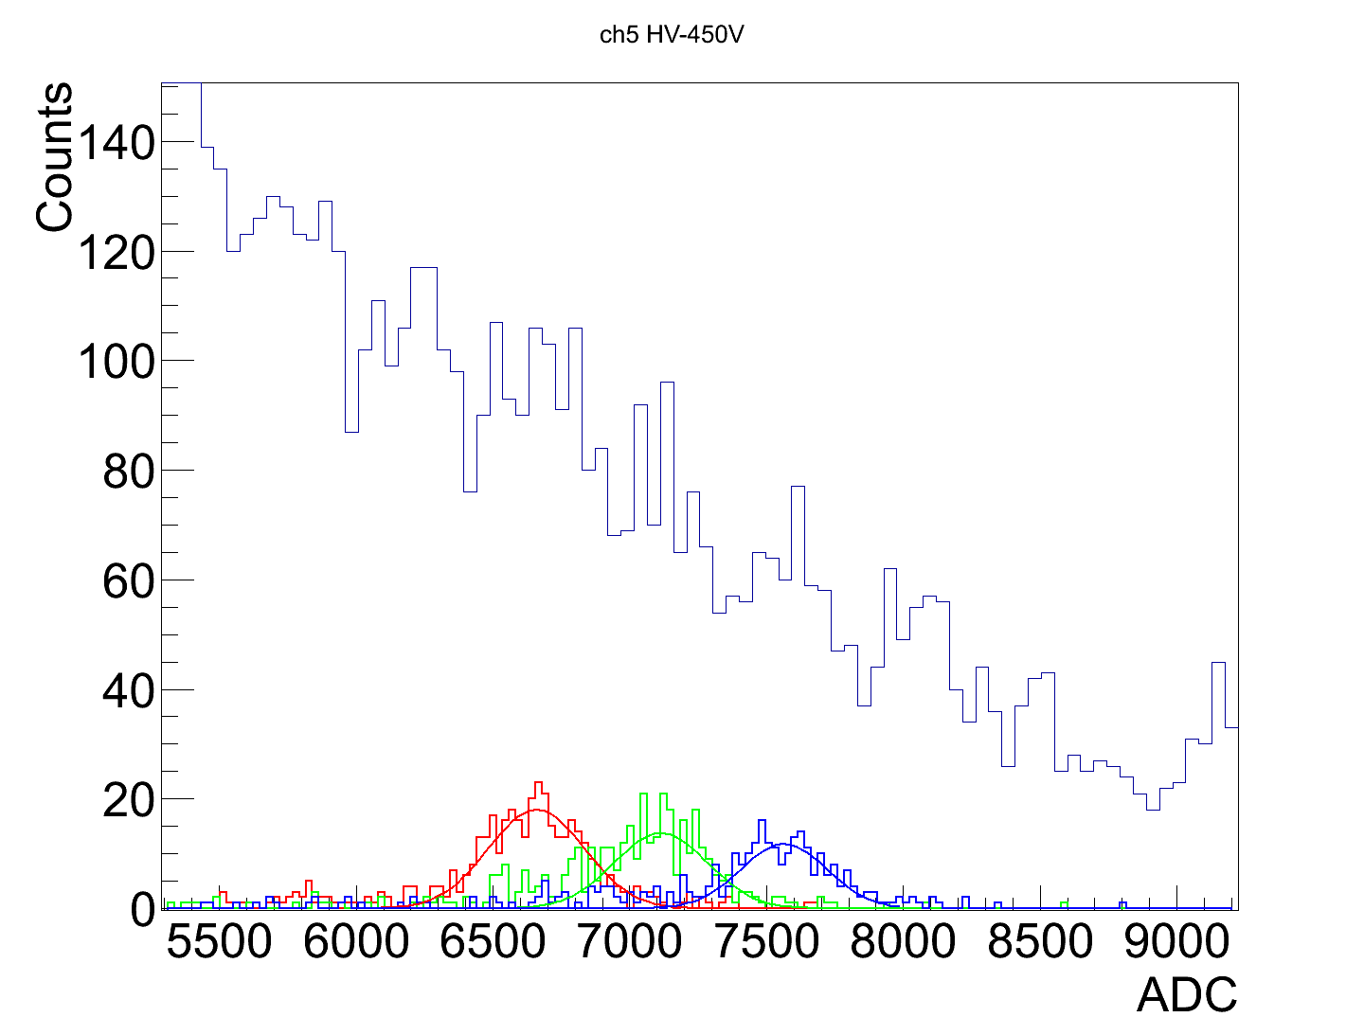
Charge resolution around z~26
Particle selection with Si detector
CHD#0 BBM ch5 HV-450V (Low gain)
Fe
Selected by Si detector
（Mn, Fe, Co）
Preliminary
(enlarged)
 | Mean μ [ADC] | St.Dev. σ [ADC] | Charge Res. R [e]
Mn | 6658.5 | 175.9 | -
Fe | 7113.0 | 171.6 | 0.38
Co | 7563.8 | 158.0 | 0.35
Mn
Fe
Co

