Slide 1

ICRC Paper Analysis:
CALET Positron Fraction and
CALET UH Prediction
Brian Flint Rauch
Washington University
CALET TIM – CERN May 29, 2013

Slide 2

CALET Positron/Electron Measurements Using the Geomagnetic Field
Previous results presented at APS and COSPAR in 2012
AMS-02 surprised us by publishing – utilized their positron fraction spectrum in analysis
Included low energy trigger

Slide 3
Vertical Cutoff Rigidities
Bilinear interpolation of 5° latitude × 15° longitude grid at 450 km altitude
by Smart & Shea AdSpR, 44, 1107 to 1° pitch

Slide 4
Geomagnetic Latitudes
Converting vertical cutoff rigidities to geomagnetic latitude using Störmer theory.
In GV, where λ is geomagnetic latitude.

Slide 5
Determining Geomagnetic Latitude Exposure
ISS Orbit Fraction
Geomagnetic Orbit Fraction
East-West Geometry Factor
Use ISS orbit fractional latitude residence time to derive fractional geomagnetic latitude residence time
Model differential geometry factor of CALET for East-West angle
Notes:
----- Meeting Notes (3/29/12 11:17) -----
mention that CALET is limited in pointing up and cannot reach the high energies of Fermi

Slide 6
Critical Momentum Dependence on East-West Angle and Geomagnetic Latitude from Störmer Theory
Positrons
Electrons

Slide 7
Electron and Positron Fluxes
Positrons
Electrons
Used PAMELA e⁻ and e⁺ fluxes because they cover the range of CALET’s sensitivity
Now using positron flux derived from PAMELA e⁻ flux and AMS-02 e⁺ fraction

Slide 8
Electron and Positron Fluxes Used in Analysis
Fluxes × E³
PAMELA e⁻ flux used
e⁺ flux was derived from PAMELA e⁻ flux and e⁺ fraction
Now e⁺ flux derived from PAMELA e⁻ flux and AMS-02 e⁺ fraction

Slide 9
Apply CALET Energy Resolution and Sensitivity to Electron and Positron Fluxes
CALET Energy Resolution
CALET Detection Efficiency
Low Energy Detection Efficiency
The energy resolution and sensitivity for CALET limit its ability to distinguish the energy bands where electrons and or positrons are screened
Now using low energy trigger detection efficiency – which I should undo

Slide 10
Comparison With Previous Results
Positrons
Electrons
Total separable e⁺ and e⁻ fluxes multiplied by detection efficiency
Observable window narrowed using energy resolution at both bounds

Slide 11
Comparison With Previous Results
Positrons
Electrons
e+ binning according to AMS-02 e⁺ fraction - results scaled to 5 year exposure
e⁻ binning according to PAMELA e⁻ - results scaled to 5 year exposure

Slide 12
CALET Measurement of Ultra-Heavy Cosmic Rays
SS abundances from K. Lodders, ApJ 591, 1220 (2003)

Slide 13
GCRS Abundances Compared to
Solar System Before UH
Meyer, et al. ApJ, 487, 182 (1997)
Ellison, et al. ApJ, 487, 197 (1997)
  preferential of dust elements in dust grains
  volatile elements have mass (A) dependent acceleration
Refractory elements T_{C 50%}< 1200 K
HEAO-3-C2 data for ~2GeV/nuc
  Englemann et al. A&A 233, 96 (1990)
Solar System (SS) abundances
  Lodders ApJ 591, 1220 (2003)

Slide 14
GCRS Abundances Compared to
Solar System With TIGER UH
Adding TIGER UH GCR data ruins the volatility modeling ordering for SS source material
TIGER data for 2001 & 2003 flights
  Rauch, et al. ApJ 697, 2083 (2009)
But ACE-CRIS isotope results show excess ²²Ne and ⁵⁸Fe explained as outflow from WR stars
  Binns, et al. ApJ, 634, 351 (2005)

Slide 15
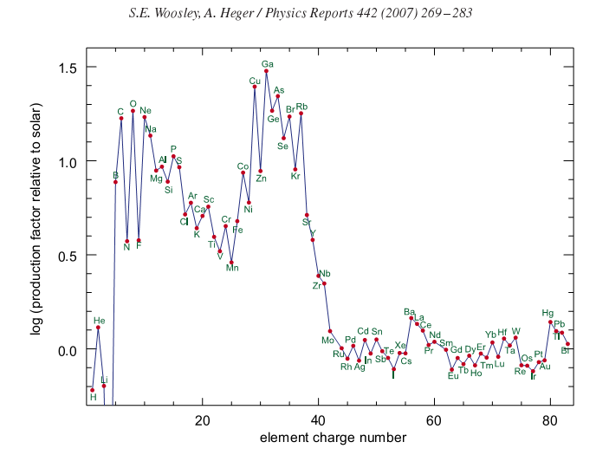
GCRS Abundances Compared to Source Mixture Model
Comparing Measured GCRS with a mixture model of ~80% SS and ~20% massive star outflow (MSO) material
  Woosley & Heger Phys. Rep., 442, 269 (2007)

Slide 16
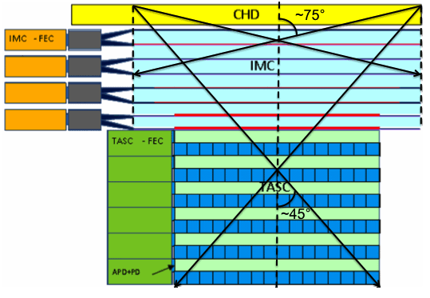
Improved Collecting Power for Higher Energy Events
TIGER data for scintillators similar to those used in CALET
Above a C1 threshold of ~5000 (~600 MeV/nucleon) Fe-peak resolution does not vary with energy
Charge determinations of UH GCRs can be made with scintillator signals alone
Passage through the CHD and the top four fiber layers in the IMC gives a larger geometry factor, 0.40 m²-sr, than for the total instrument, 0.12 m²-sr

Slide 17
ISS Orbit Vertical Cutoff Rigidities
Geomagnetic vertical cutoff rigidities at 450 km in 15◦ longitude by 5◦ latitude bins from Smart & Shea AdSpR, 44, 1107-1123 (2009)
Dashed white lines are ₂₆Fe cutoff at 600 MeV/nucleon
Orbit residence time based on an ISS inclination of 51.6° weighted for time in latitude bins and evenly sampling longitude bins

Slide 18
Instrument Limits
Differential geometry factor as a function of incidence angle with ¼ reduction beyond 45 due to obstruction on one side
Flux reduction due to interactions within CHD
Maximum measurable charge for signal processing chain – current expectation is up to Z~40

Slide 19
Expected CALET UH-GCR Measurement
Based on assumption that East-West angle effect on rigidity cutoff averages out to roughly the same as the vertical rigidity cutoff

Slide 20
Critical Momentum of Nuclei
Work in Progress
Critical Momentum Dependence on East-West Angle and Geomagnetic Latitude from Störmer Theory
In GeV/c where λ is geomagnetic latitude and γ is the East-West angle

Slide 21
Determining Geomagnetic Latitude Exposure
ISS Orbit Fraction
Geomagnetic Orbit Fraction
East-West Geometry Factor
Use ISS orbit fractional latitude residence time to derive fractional geomagnetic latitude residence time
Model differential geometry factor of CALET for East-West angle

Slide 22
Evaluate Integral Flux Spectra Over Allowed Energies
At each rigidity step evaluate integrals for each element at critical energy
Evaluate integral spectra element by element due to memory limitations

Slide 23
Conclusions
CALET should obtain ~5x the statistics of TIGER (~1xTIGER/year)
Roughly comparable statistics from 2012-2013 Super-TIGER flight
CALET measurements will require simpler corrections for nuclear interactions being above the atmosphere

