Slide 1

ISOLDE Technical Report
ISCC Meeting 9th July 2013
Richard Catherall, EN-STI

Slide 2
Outline
Hall Activities
  Infrastructure
Target Area Activities
  Shielding
  Robot upgrade
  Accumulated collective dose
  Hot cell progress
The ISOLDE machine
  RFQ Cooler
  REX (and TSR)
  RILIS
  Target development
Medicis
News from EN-STI-RBS
  Labs
  Test stand
Design Study Progress

Slide 3
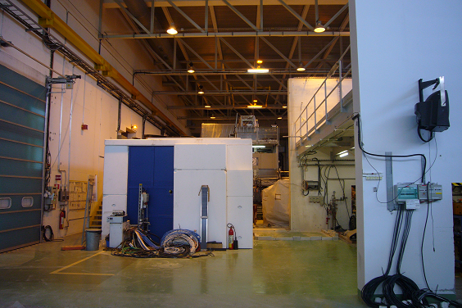
ISOLDE Hall
Cutting of the wall now done
  After removal of MINIBALL, cables etc

Slide 4
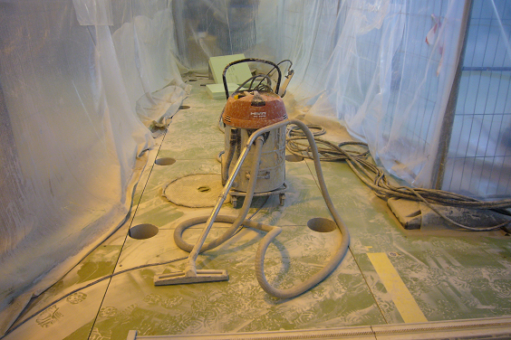
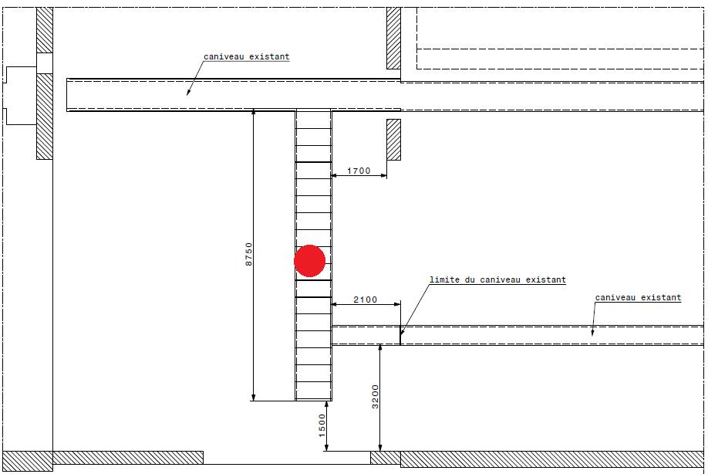
ISOLDE Hall
Cutting of the service trench now in progress
  Protected but still a dust problem

Slide 5
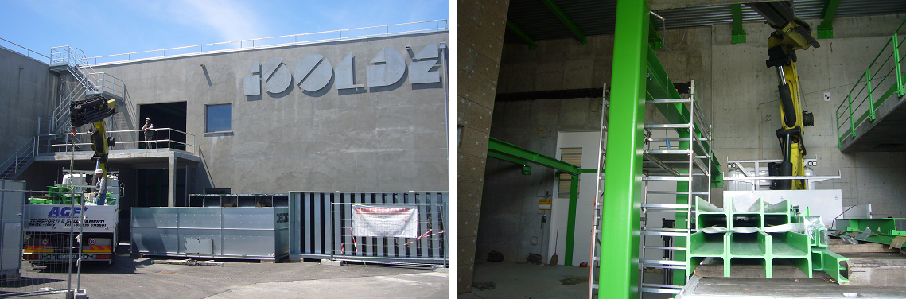
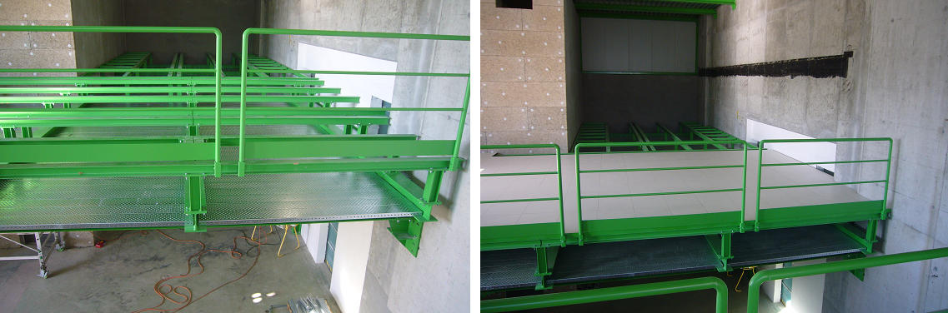
Building 199: CV
Metallic structures in place
  2nd floor inside the building

Slide 6
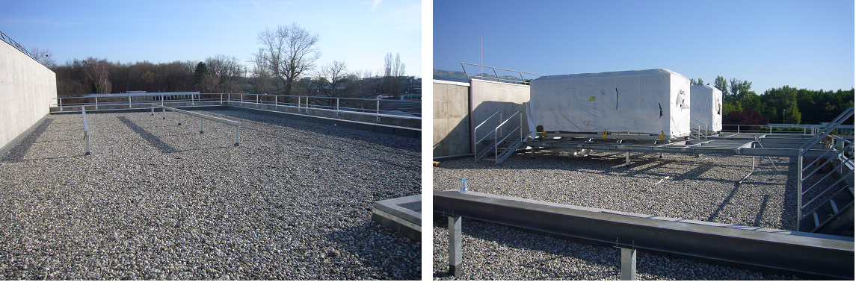
Building 199: CV
Installation of support structure and chillers put in place on roof.
before
after

Slide 7
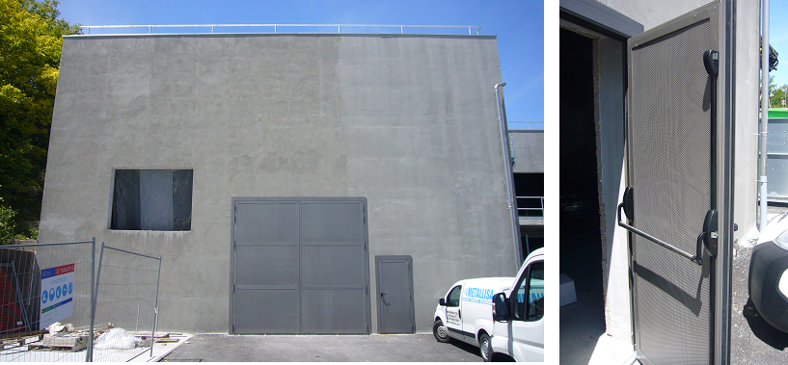
Building 198: Compressor building
Installation of sound-proofing doors done

Slide 8
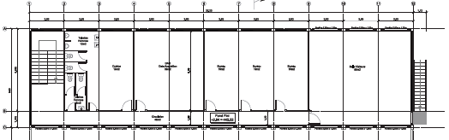
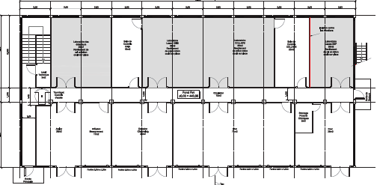
Building 508
Demolition to start soon
Tremendous effort by everyone to remove everything from building 507 and 115
To be finished by the end of October

Slide 9
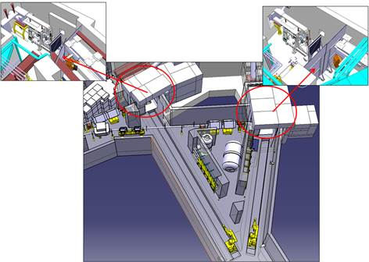
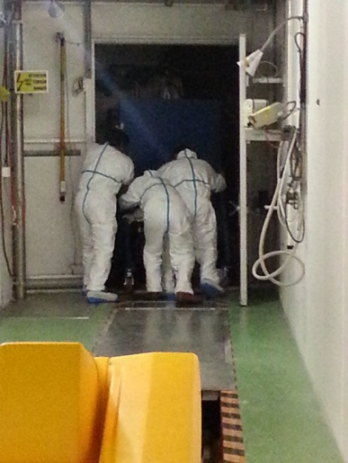
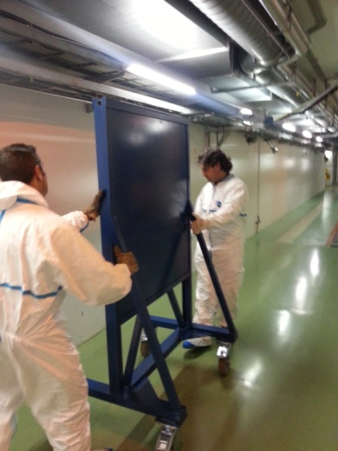
Target Area
Installation of first layer of shielding

Slide 10
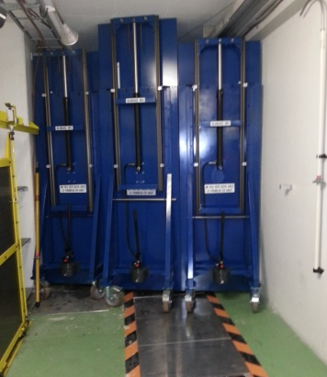
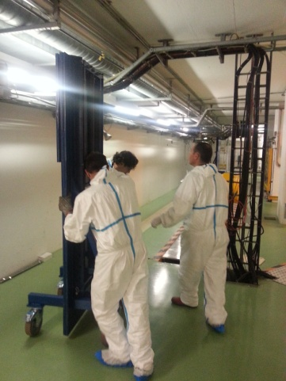
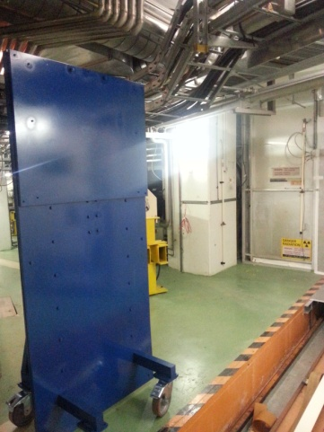
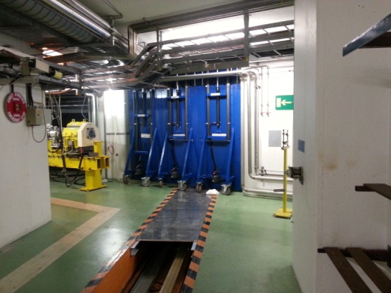
Target Area
Installation of second layer of lead shielding in front of faraday cage.
Shielding not as effective as first estimated
  Re-evaluation of WDP planning required
  Further measures put in place

Slide 11
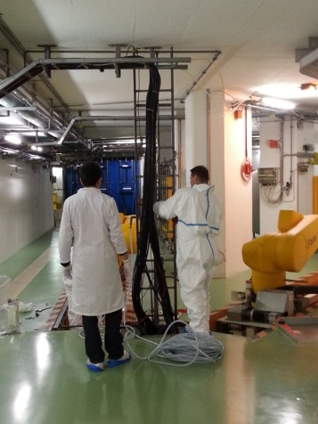
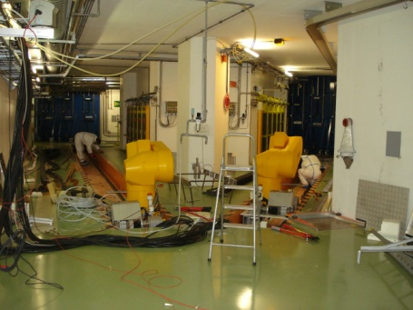
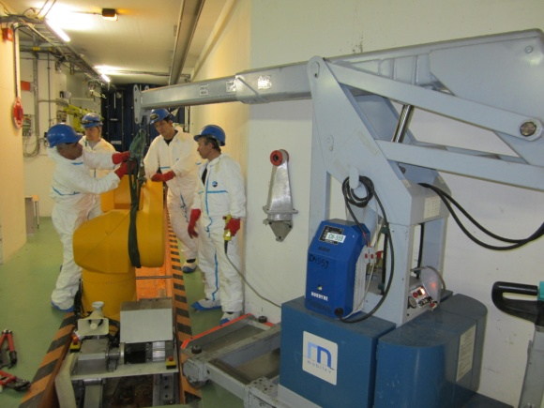
Target Area
Removal of robots and infrastructure
  Cables, cable trays, rails etc
Trench covers to be put in place after cleaning
  This week

Slide 12
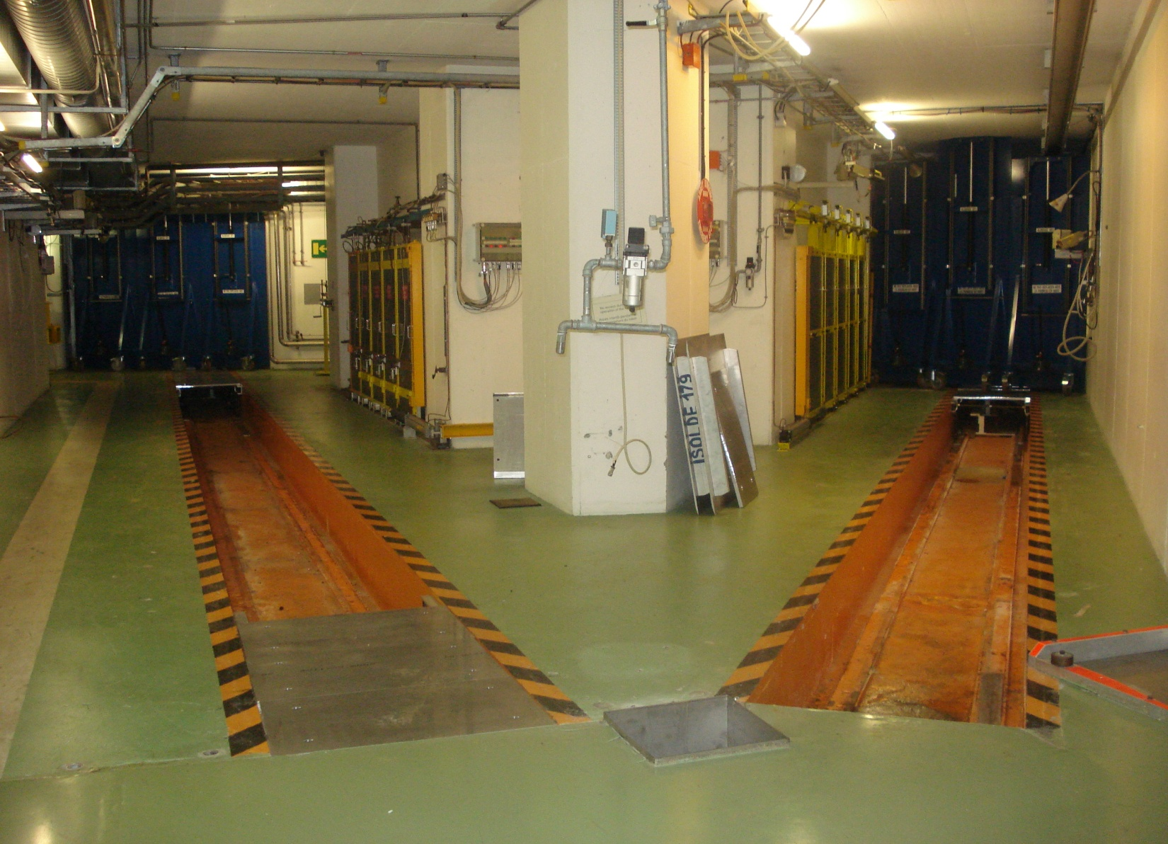
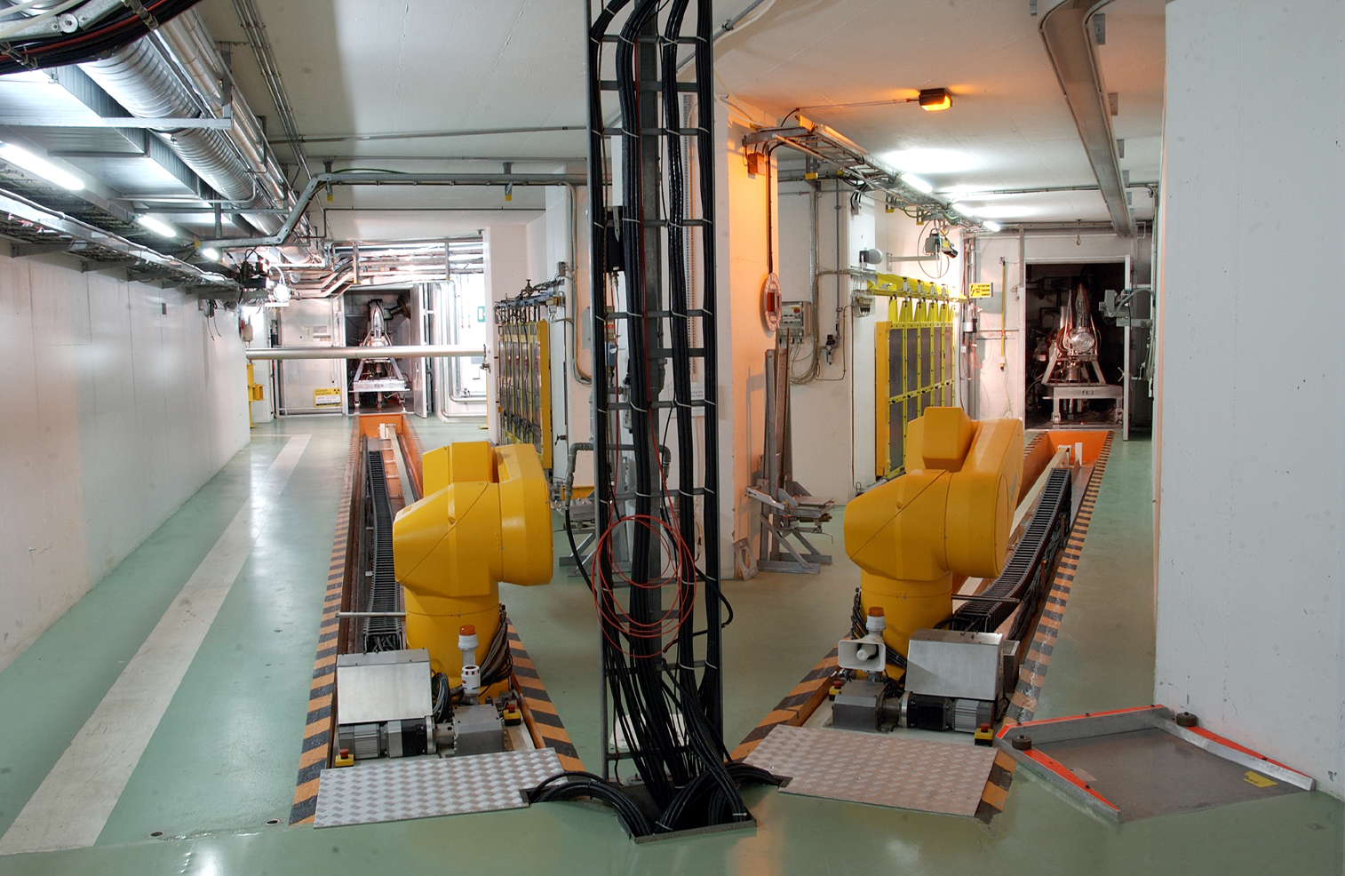
Now you see them
Now you don’t

Slide 13
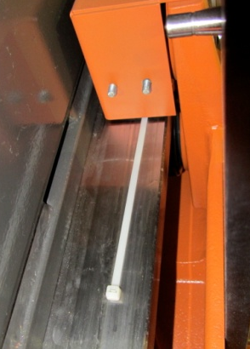
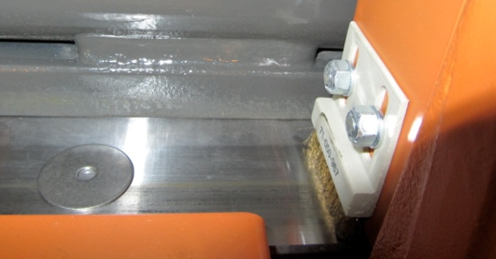
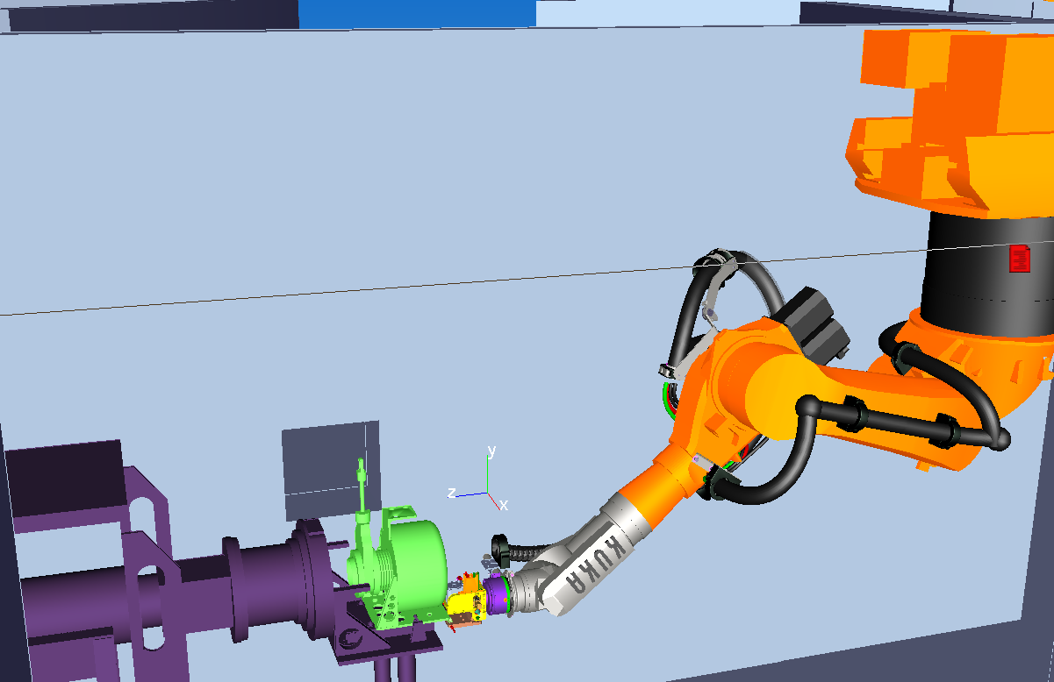
Robot upgrade
Many failure scenarios being addressed on the test bench in B. 927
  Motor failures
  Obstacles on rails etc.
New gripper
New exchange point
Tests on bigger targets
  PbBi target module
  LIST targets etc
Shelf upgrade on-going
Redundant micro-switches for target position
Kuka Sim Pro
  Programming of cycles that can be loaded into real robots

Slide 14
Suivi des débits de dose
Phase 1: installation des blindages
Phase II: démantèlement des robots
Phase III: modification des services
Phase IV: installation des robots
Phase V: test des robots
Dose collective cumulée
1234 uSv
Dose collective totale estimée
1648 uSv
Dose collective cumulée
483 uSv
Dose collective totale estimée
1547 uSv
Dose collective cumulée
0 uSv
Dose collective totale estimée
2313 uSv
Dose collective cumulée
0 uSv
Dose collective totale estimée
2905 uSv
Dose collective cumulée
0 uSv
Dose collective totale estimée
1609 uSv

Slide 15
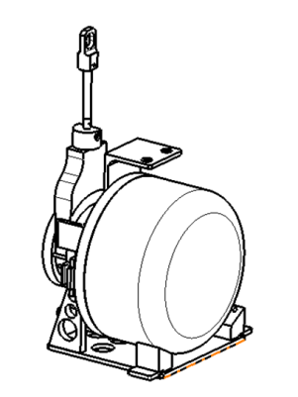
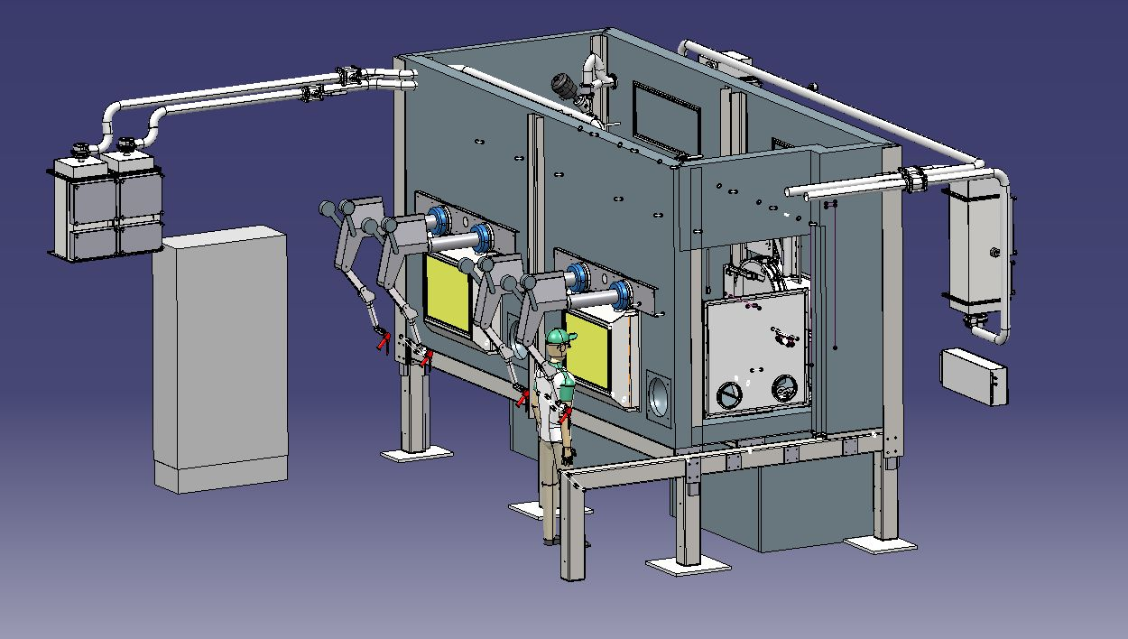
Alpha Gamma Hot Cell
Dismantling of irradiated ISOLDE target units:
Separation of materials
Controlled oxidation of Uranium-oxide (most used target material)
Project time line:
Contract awarded to Isotope Technologies Dresden (ITD) in March 2013
Final design presentation July 2013
Installation March 2014

Slide 16
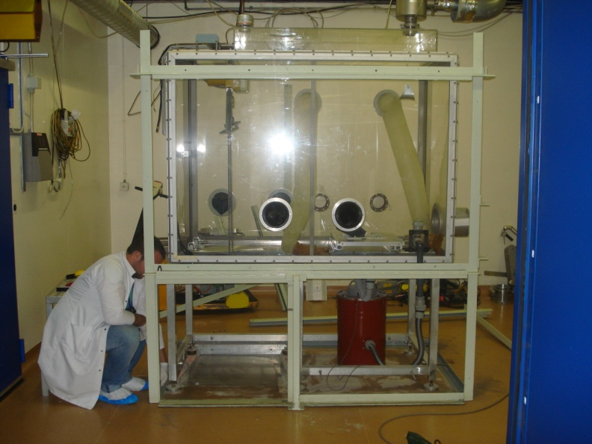
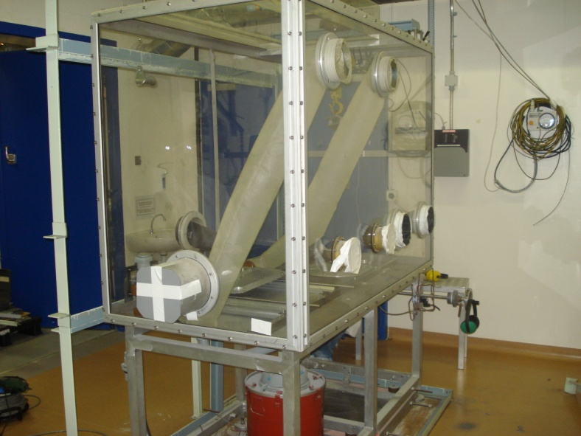
Old Hot Cell

Slide 17
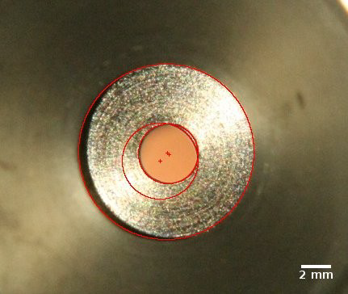
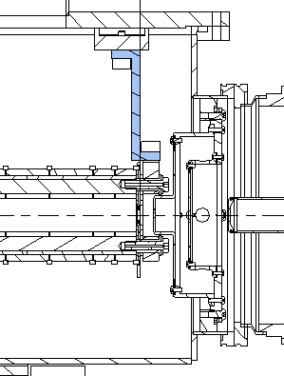
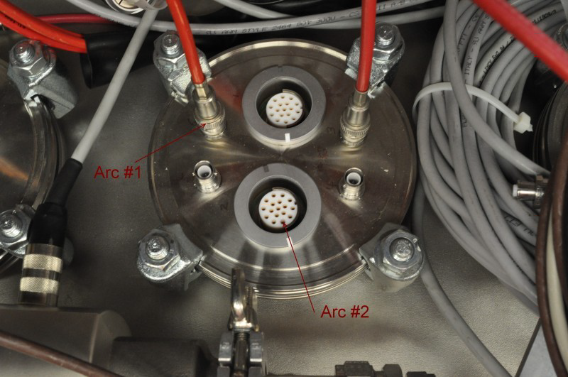
RFQ Cooler Alignment
Re-alignment
The old supports have been replaced with pieces allowing position adjustment
The mis-alignment was measured
(shown, extraction mis-alignment of
0.75mm)
2. Re-wiring
ISCOOL will be re-wired to separate high and low voltage lines, in order to avoid discharges

Slide 18
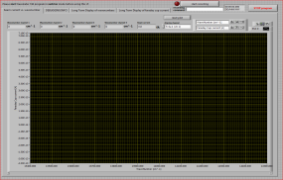
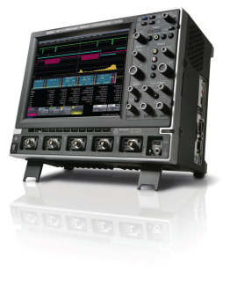
RILIS at off-line mass separator
A simplified laser system is installed at the off-line ISOLDE mass separator – capable to produce Ga ion beams for testing RILIS cavities
pA – meter
Faraday cup and
MCP detector
on movable holder
λ – meter
Vertical deflector
Nd:YAG
Ti:Sa
SHG/THG/FHG
RILIS Ti:Sa Laser System
Delay generator
Behlke switch
10 kHz Master clock
DC
V-source
Nd:YAG

Slide 19
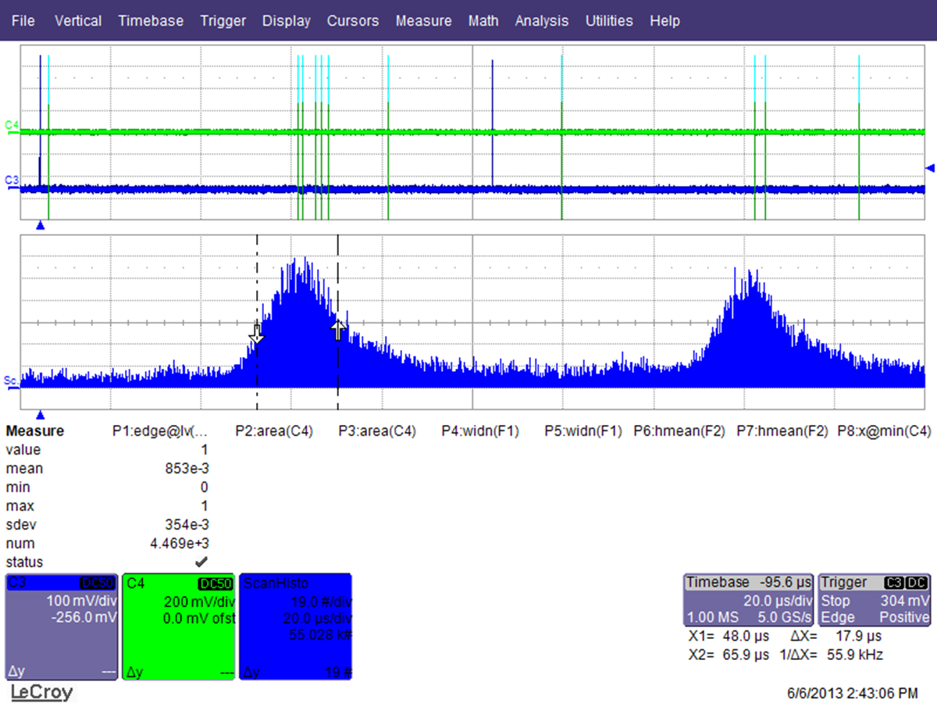
Time structure of laser ionized beam
MCP measurement,
3 pA beam scattered on the Faraday cup
Gate = 5 μs
FC measurement,
42 nA beam sliced by 5 μs gate

Slide 20
RILIS room extension
Required by safety
Existing laser room + SAS
28 m²
RILIS
Side effects:
Some rearrangement on EBIS platform will be needed
Limitation on future EBIS extension
254 cm
REX EBIS
320 cm
6 m²
IS COOLER
100 cm
Extended part (SAS)
  Work by external contractor is planned for July

Slide 21

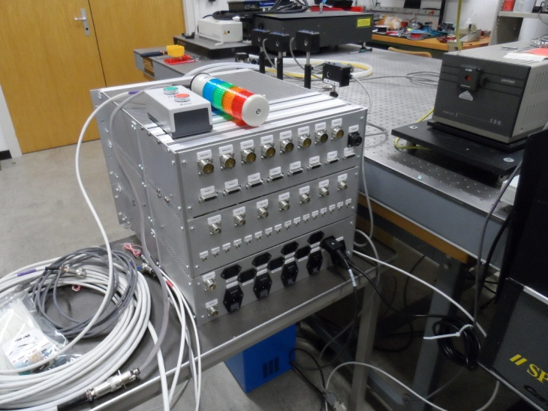
RILIS machine protection
  Hardware to control multiple laser interlocks and shutters are assembled by STI-ECE
  Testing has started

Slide 22
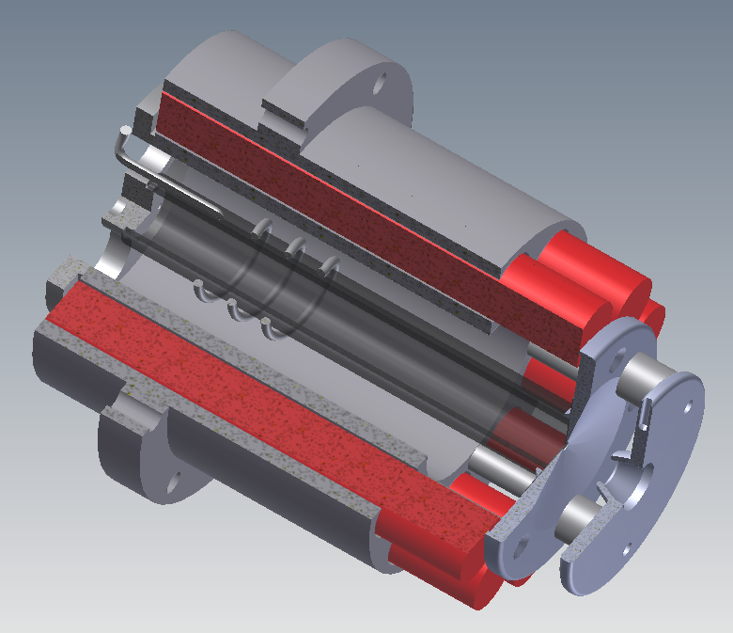
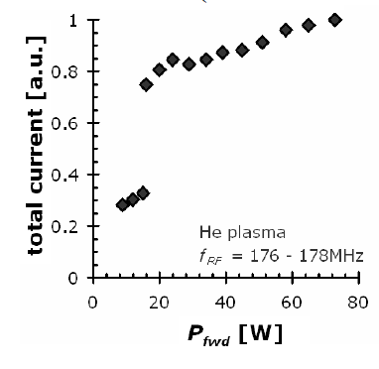
Helicon source
RF antenna
P_{fwd} ≤ 250 W
f_{RF} = 0.01 – 400 MHz
Axial magnetic field for Helicon mode generation
Plasma electrode
Tungsten, Ø = 0.9 mm
Gas feed
N
¹⁰CO
¹¹CO
¹⁵CO
¹⁶CO
Developed by the TISD group for the production of CO⁺ and CO₂⁺ , N₂⁺, and noble gas beams;
First online operation 2011/09, upgraded system tested 2012/11;
Strong gain achieved on ¹⁰CO and ¹¹CO;
Measurements of short-lived carbon isotopes difficult due to instrumental issues.
Plasma chamber
SiO_{2,} Ø = 12 mm, l = 100 mm
S
Two-stage extraction system for improved ion beam quality
U_{el} = 0 – 3 kV
Capacitive → inductive transition
M. Kronberger et al., EMIS proc.

Slide 23
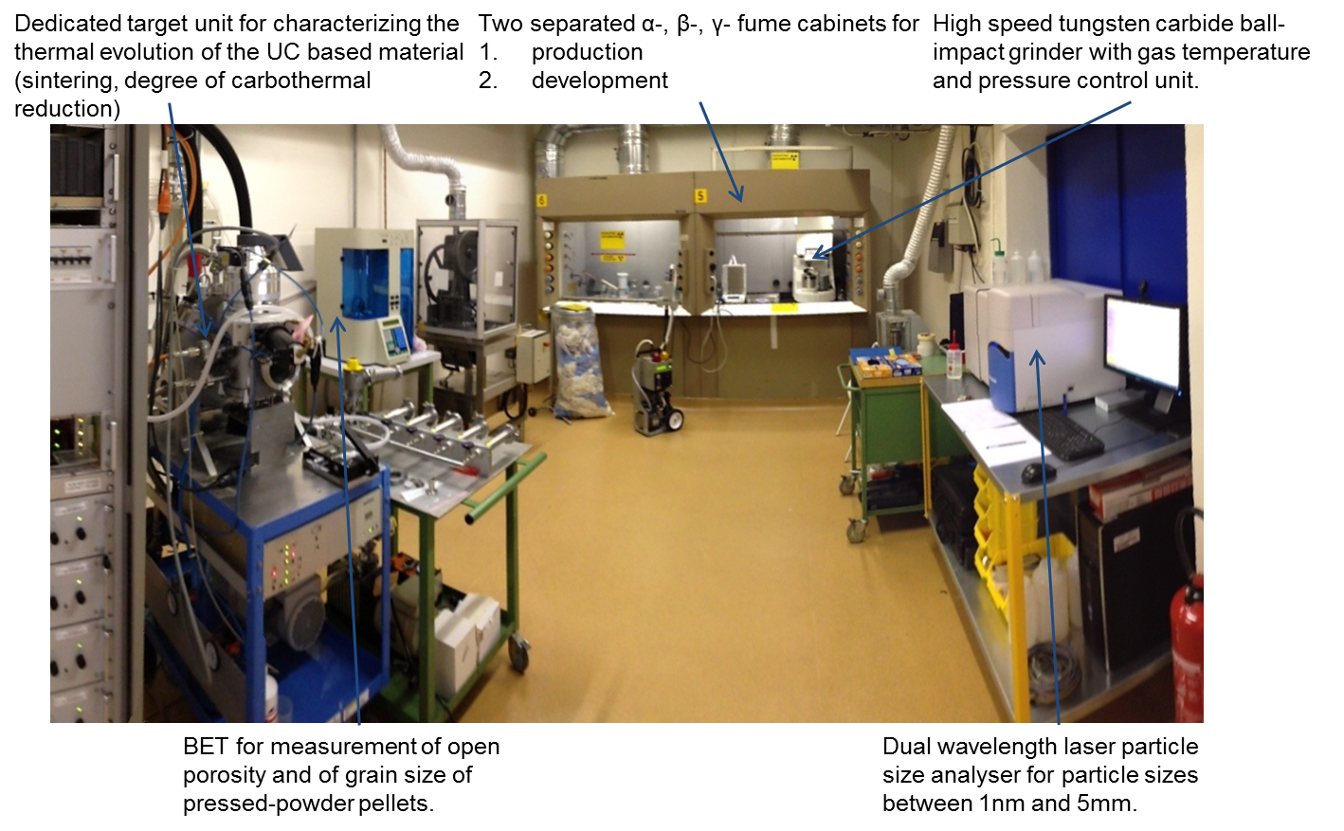
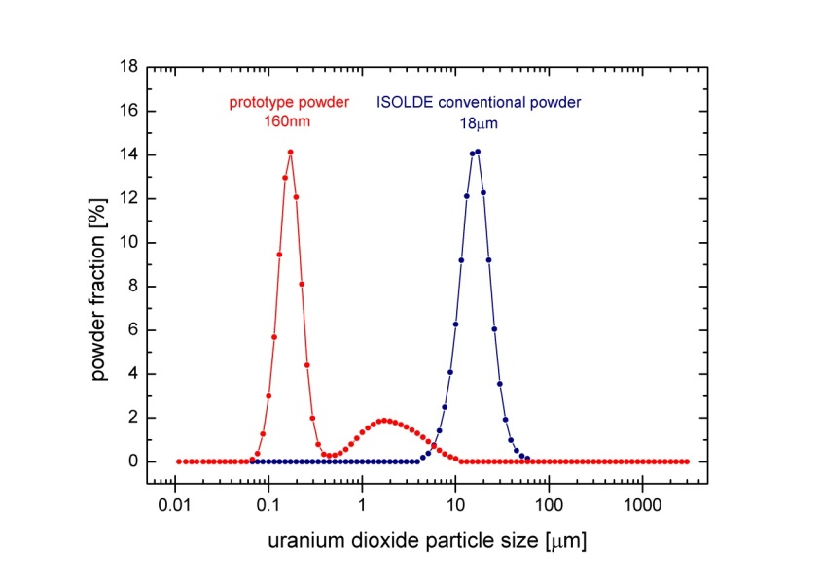
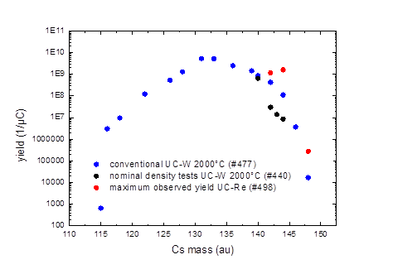

UCx from CNT+Nano UO2
11Be: 5.3x10⁷ 1/µC, database: 7x10⁶ 1/µC (2x10⁷ 1/µC after RILIS upgrade)
Record yields for Cs
Structure seems widely conserved over time and temperature
A. Gottberg et al., ActILab

Slide 24
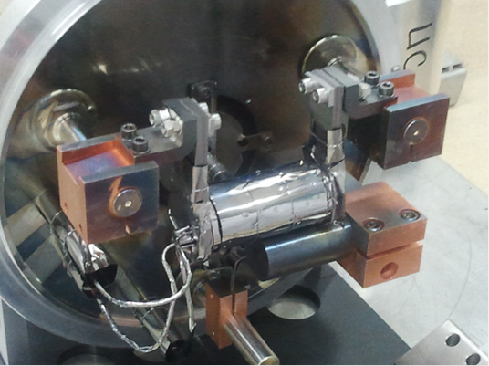
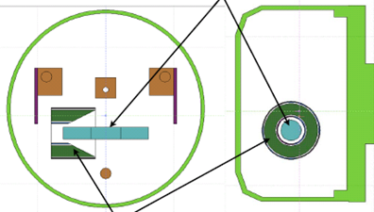
Neutron converter – phase II
Concept: R. Luis et al, EPJ A 2012
Onboard for phase II:
S. Cimmino et al.,
@ TRIUMF in 2014
Phase I tested at ISOLDE
T. Mendonca et al.,
to be subm. to NIM B

Slide 25

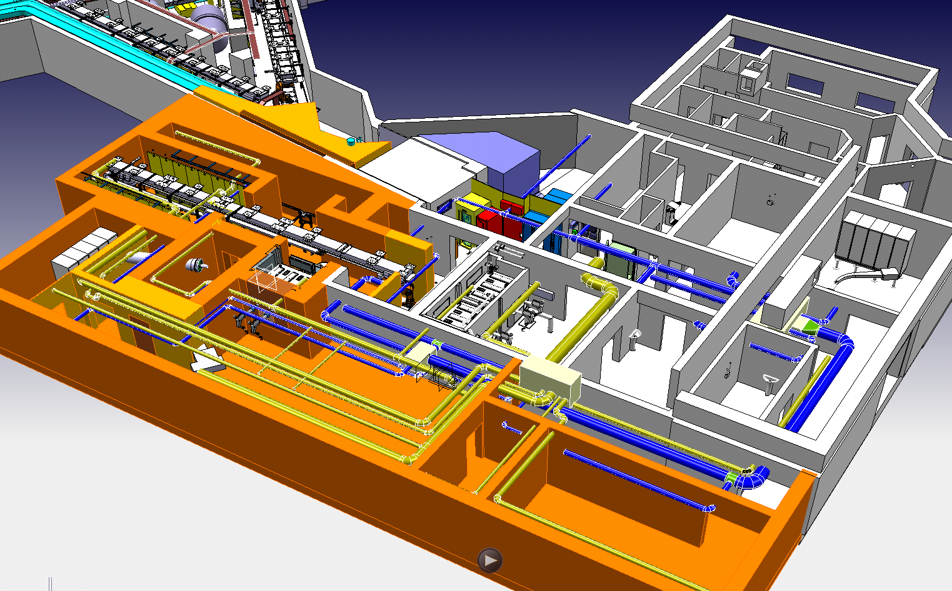
Favorable internal safety review end of June
Ground work to start beginning of July
Catia 3D preliminary view:
by Vincent Barozier

Slide 26
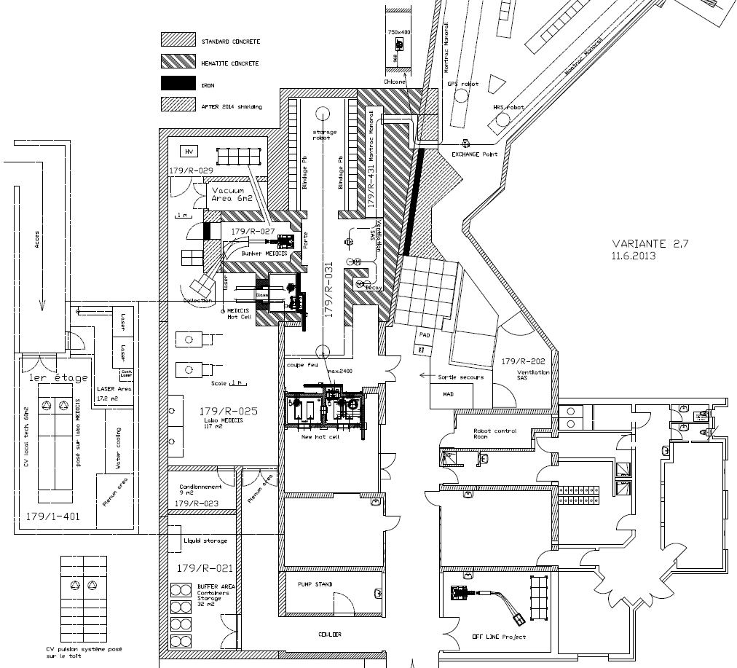
Target Storage and services
Buffer area
MEDICIS Lab
Ventilation CV
New buildings
Layout :

Slide 27
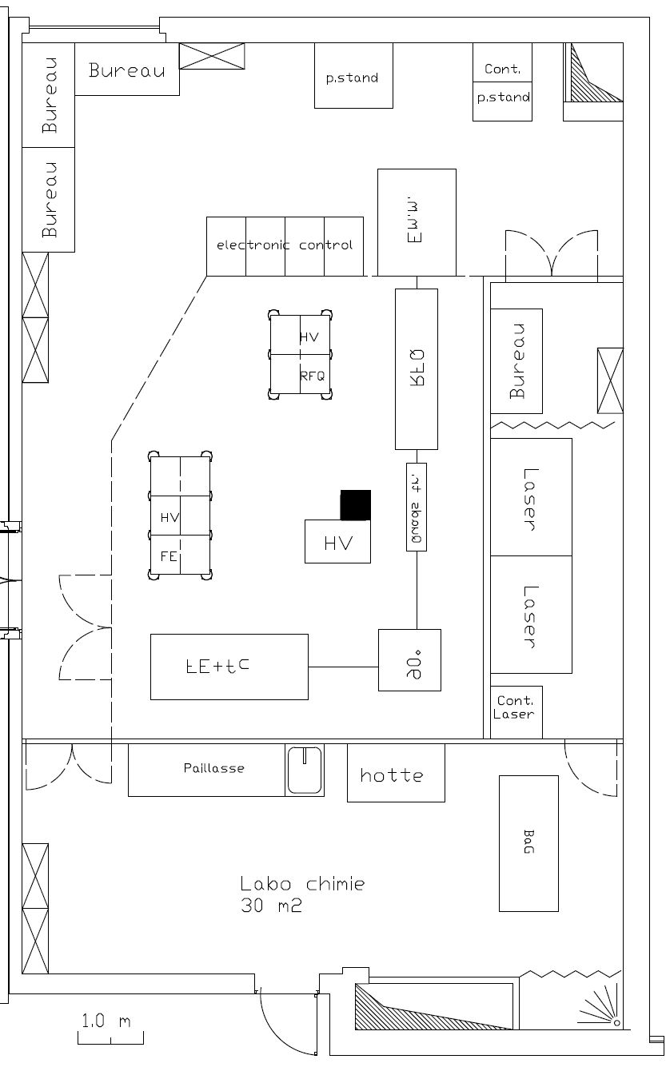
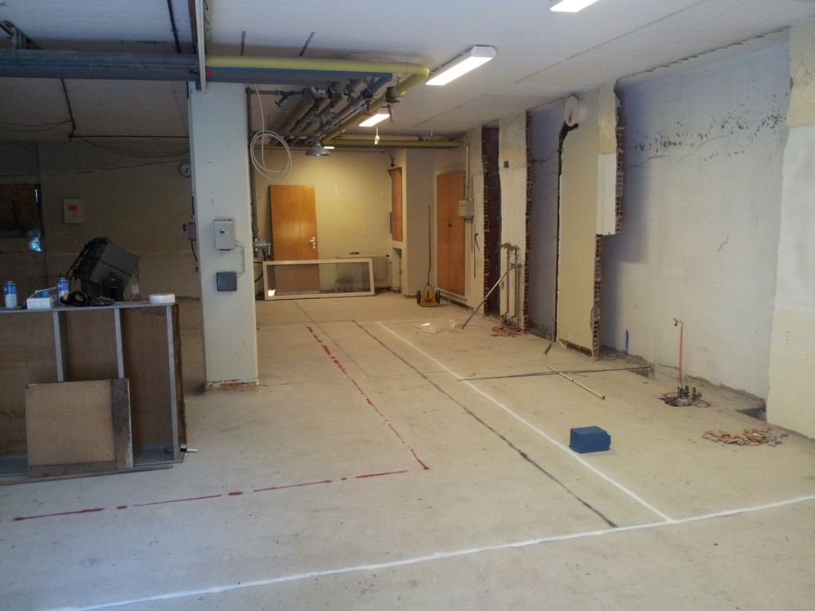
Lab refurbishment
Class c lab declassified as radioactive lab Class C
Transformation for off-line separator, laser lab and chemical lab
No longer need B. 275

Slide 28
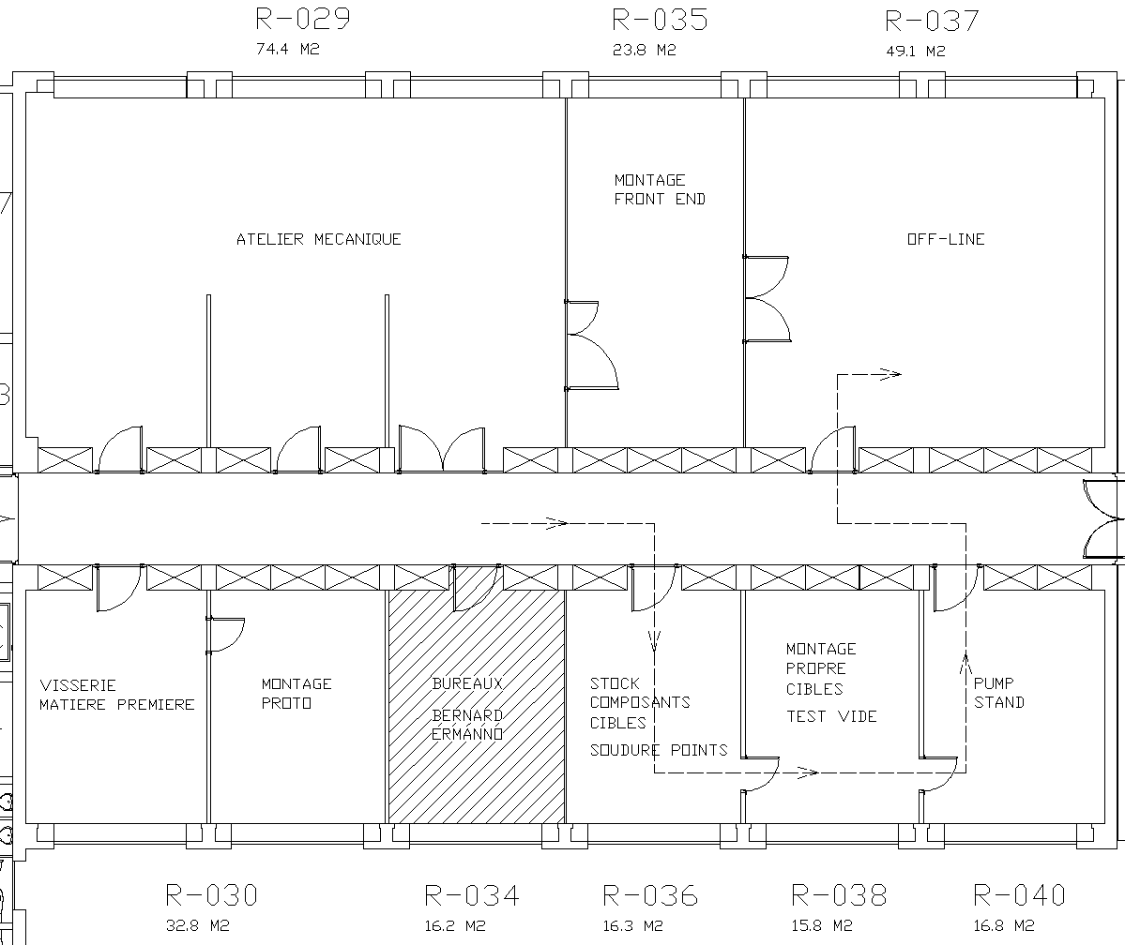
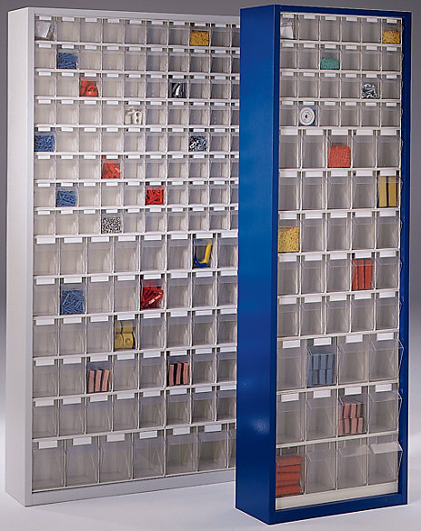
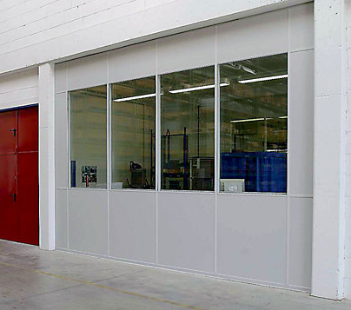
Labo 3-R modifications

Slide 29
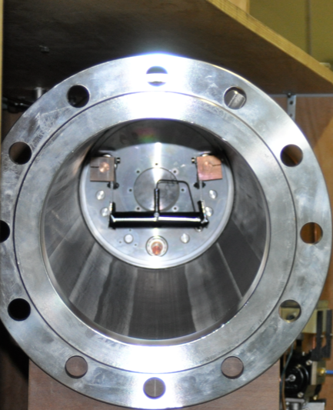

Water leak test bench
Objective: understand the consequences of a water leak in a hot target
Water leak occurred on past but on cold target.
Risk analysis on “pressure cooker” effect
Water leak on container
Target position
Front-end volume
Water cooling for target

Slide 30



Water leak test bench
Thermal shock breaks the container
Water reacts with Tantalum (container and target material)
  2 Ta + 5 H₂O = Ta₂O₅ + 5 H₂
Production of H₂ proportional to exchange surface between tantalum and water
Water condenses on cold surfaces of Front-end
Pressure increase due to the production of H₂.
→ Objective: remove water circuit from target
Test 1
Test 2: 2 tantalum rolls –> H2 > 5l
Test 3: 8 tantalum rolls –> H2> 20l
H₂< 1 liter

Slide 31
Design Study progress
Ventilation
  User requirement document under approval
    Covers all aspects of ventilation requirements
    Compatible with Medicis Project
Double extraction electrode system
  Under test on the off-line separator
New RFQ Cooler
  All parts ordered and assembly started
HT
  Belke switch test stand operational

Slide 32


New FE’s under construction
One to be used as a test stand for the design study
  To validate RFQ operation
The other as a spare/off-line FE for UC target testing in B. 179 (Class A labs)

Slide 33



EBIS upgrade
The electron gun is the most critical item for the charge breeder upgrade
Building up 3D e-beam
simulation experience
Left. BNL EBIS test stand. Suitable for HEC² tests and operational.
Right. HEC² electron gun pre-assembled at CERN.
* High Energy Current Compression (HEC²)
gun produced at CERN
* First gun tests foreseen at BNL test EBIS
summer 2013
* TSR@iSOLDE integration study on-going
* CERN groups in the process of giving feedback
* Report to be submitted beginning of September
TSR@ISOLDE

Slide 34

HRS Beam Dump

Slide 35
Beam Dumps
Following a thermo-mechanical analysis:
  The present situation seems critical for the HRS dump
  An upgrade of the beam intensity at 1.4 GeV would lead to a failure of the material if no active cooling is added
  An upgrade of the beam intensity and energy to 2.0 GeV would lead to a failure of the material
But it gets worse...

Slide 36

Soil Samples

Slide 37
Soil samples: results
Echantillon | Nuclide | A Total (Bq/g) | A Total (Bq/kg) | LE (Bq/kg) | Multiple LE
S10 Profondeur carotte 4.55 - 4.70 m Masse échantillon 1.31 kg | Be-7 | 2.36E-01 | 2.36E+02 | 4.00E+05 | 5.90E-04
 | Na-22 | 6.81E-01 | 6.81E+02 | 3.00E+03 | 2.27E-01
 | Sc-46 | 4.27E-02 | 4.27E+01 | 7.00E+03 | 6.10E-03
 | Mn-54 | 2.90E-01 | 2.90E+02 | 1.00E+04 | 2.90E-02
 | Co-60 | 4.25E-02 | 4.25E+01 | 1.00E+03 | 4.25E-02
 | Y-88 | 1.75E-03 | 1.75E+00 | 8.00E+03 | 2.19E-04
 | Cs-134 | 9.79E-03 | 9.79E+00 | 5.00E+02 | 1.96E-02
 | Eu-152 | 4.50E-02 | 4.50E+01 | 7.00E+03 | 6.43E-03
 |  |  |  | Somme | 3.31E-01
BTY IS3 Profondeur carotte 4.95 - 5.10 m Masse échantillon 1.535 kg | Be-7 | 1.95E-01 | 1.95E+02 | 4.00E+05 | 4.88E-04
 | Na-22 | 5.78E-01 | 5.78E+02 | 3.00E+03 | 1.93E-01
 | Sc-46 | 3.47E-02 | 3.47E+01 | 7.00E+03 | 4.96E-03
 | Mn-54 | 2.74E-01 | 2.74E+02 | 1.00E+04 | 2.74E-02
 | Co-57 | 3.81E-03 | 3.81E+00 | 5.00E+04 | 7.62E-05
 | Co-60 | 3.94E-02 | 3.94E+01 | 1.00E+03 | 3.94E-02
 | Y-88 | 1.61E-03 | 1.61E+00 | 8.00E+03 | 2.01E-04
 | Cs-134 | 8.68E-03 | 8.68E+00 | 5.00E+02 | 1.74E-02
 | Eu-152 | 3.88E-02 | 3.88E+01 | 7.00E+03 | 5.54E-03
 |  |  |  | Somme | 2.88E-01

Slide 38
Beam dumps: Status
An endoscopy will be performed in the beginning of 2014.
Based on the Booster beam dump design, a design for a water cooled copper block to be placed in front of the existing beam dump has been launched
Fluka simulations on dose rates resulting from the above have been launched
  Improvements include: size, collimators, further shielding
Awaiting a reply from RP on their position concerning soil activation.

Slide 39
Thank you for your attention
The HIE-ISOLDE workshop will be held on the
  28th & 29th November 2013

