Slide 1
HIE-ISOLDE Project
Status Report
67th ISCC Meeting
CERN, 9 July 2013
Yacine.Kadi@cern.ch
Project Organization
Budget 2013-2016
Main Highlights & Issues
Outlook

Slide 2
Project Organization
Nominations:
  Walter Venturini Delsolaro (BE/RF) = > DPL
  EMC coordinator ?
Quality Assurance Plan:
  Hardware Baseline in place (EDMS) and now Operational
  Product Breakdown Structure finalized => equipment and document numbering
  Configuration Management => EN/MEF
  Follow-up of budget and work progress reporting => EVM set-up
  Technical Specs handled by CERN Project Office
Documentation:
  HIE-ISOLDE website under re-construction => help of CATHI fellows
  EDMS => more then 600 documents produced
  HIE-ISOLDE project notes => 22 accessible through CDS
Safety File:
  Descriptive Part of the Safety File has been checked and will be circulated for approval
  Hazard Inventory section and the Demonstrative Part are currently being checked.
  Operation Part and the Feedback Part are being drafted

Slide 3
Budget 2013-2016
Summary of the request for funding from CERN approved in the MTP2013
Evolution of the Cost-to-Completion:
  CtC 2010 = 35.3 MCHF
  CtC 2011 = 35.7 MCHF
  CtC 2012 = 36.5 MCHF approved (38.3 MCHF requested)
  CtC 2013 = 38.7 MCHF requested

Slide 4
Spending Profile

Slide 5
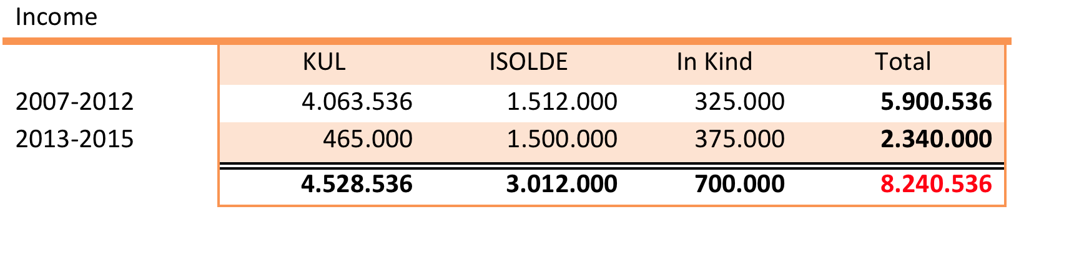
Cost: External Funding Phase 1
1.097.162
4.506.838
(*) to be considered additional expenses on salaries of 6.0 MCHF (2011-2014) already covered by EU-FP7-ITN Marie-Curie program: CATHI
The missing income of 0.7 MCHF => loan from CERN

Slide 6

HIGHLIGHTS: Procurement
Civil Engineering => metallic structures (bldg 170, 198 and 199)
CV and EL Systems => installation work on-going until Q1 2014
Copper forgings => all high-beta cavities + 5 options (15 for 2013)
Cavity substrate => 5 for 2013, 15 + 5 options (2014-2015) => 2 pre-series by EN/MME
SC solenoid => 4 high-beta cryomodules + 2 options (first 2 by March 2014)
      Cavity Alignment system design and fabrication => CATE , 2 cryomodules
      Clean room at SM18 => to be delivered in August 2013
      Beam Instrumentation => contract negotiation for the short boxes
Invitation for Tenders
      Cryogenic Distribution System (September FC) => launched
      CM1 and CM2 vacuum + He vessels (Price Enquiry) => launched via CERN,
      Quadrupole & Dipole magnets with associated power supplies and supports
Market surveys
      HEBT lines (vacuum system, long instrumentation boxes, inter-cryomodule supports, etc…) => in progress

Slide 7
HIGHLIGHTS: Procurement
Already engaged for Phase-2 (10 MeV/u):
      High-beta cavities => (45+16kCHF)*10 = 610 kCHF
      SC solenoids => (85 kCHF * 2) = 170 kCHF
      Beam Instrumentation => (45 kCHF * 4) = 180 kCHF

Slide 8
HIGHLIGHTS: Technical Advances
HEBT activities => Integration and EMC issues being checked
Design Study for the Intensity Upgrade well underway
      Target + Front-end (FE8 and 9)
      Offline separator test bench
      HVAC + Cooling => nuclearization
      Charge Breeder => assembly of electron gun, test at BNL (US)
      Technical Workshop Nov. 28-29, 2013
SRF activities
      Cavity tests (more substrate, improved sputtering, procurement, etc…)
      Cavity ancillaries (RF coupler and tuner)
      LLRF (prototype, integration, etc…)
      RF controls and interlocks
Installation Coordination and Co-activity Planning

Slide 9
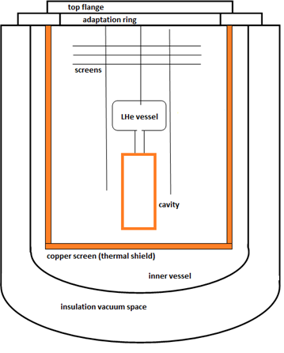
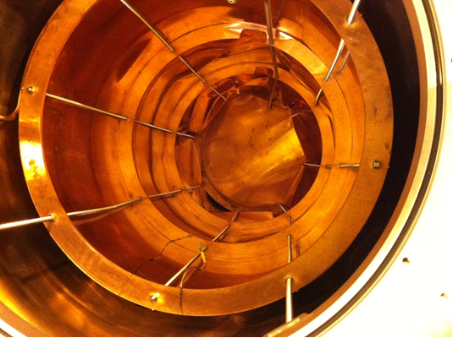
Collapse of test cryostat in SM18
Insulation vacuum space was at atmospheric pressure when inner vessel was pumped
Inner vessel did not withstand the external pressure and collapsed
Copper screen and stainless steel threaded bars were deformed
Cavity and insert remained untouched
(Likely) time of the event: sometime during first pump down, 27 April 2013

Slide 10
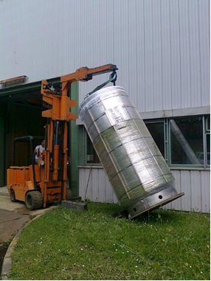
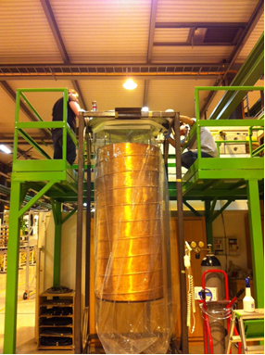
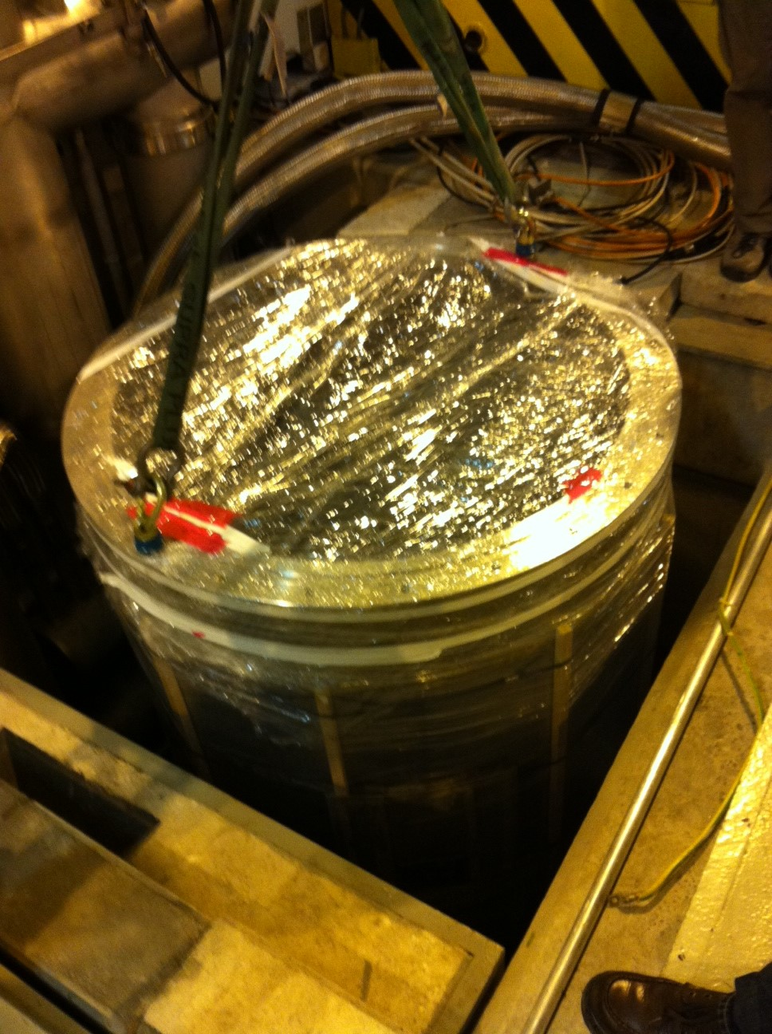
Recovery test cryostat
Decisions
  Use a spare cryostat and the old copper screen
  Install a vacuum gauge and a pumping port on the insulation vacuum space of the spare cryostat
Timetable
  Friday 2 May 2013: Leak test of shield circuit→ OK (!); Removal of clean area roof and floor platform, cleaning tests of spare cryostat
  Monday 6 May: Removal of damaged cryostat and shield, checks and preparation of spare shield
  Tuesday 7 May: Transport and cleaning of spare cryostat, drying overnight
  Wednesday 8 May: cryostat back in hall, installation of Pirani gauge and pumping port, installation of cryostat in pit, pumdown of vacuum space
  Friday 10 May: leak test, reinstallation of clean area, conditioning
  Monday 13 May: Installation of cavity insert (kept clean in meanwhile), pumpdown
  Tuesday 13 May: leak detection, commissioning of cryogenics. Recovery.

Slide 11
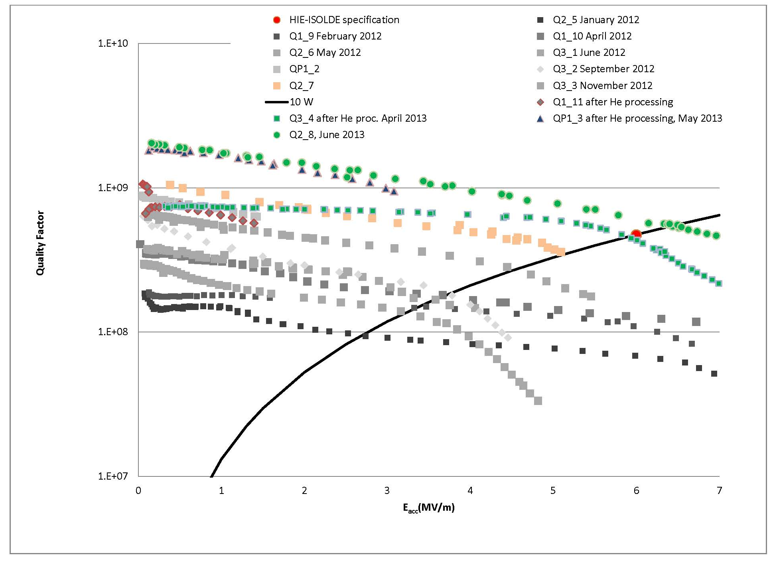
Cavity tests

Slide 12
HIGHLIGHTS: Issues
Design of prototype Diagnostic Box
  AVS delivered Faraday Cup which was tested at REX-ISOLDE
  Body of the DB was being tested (particule contamination and degassing) when it Failed => need to re-design mechanical part
  Additional Resources needed to develop the electronics for acquisition and motor control but also for the mechanical design => under review within BE/BI
  MS => in stand by (7 short and 13 long DBs)
Integration issues (building 170):
  Advance on tunnel/shielding design and integration
  Cable routing

Slide 13
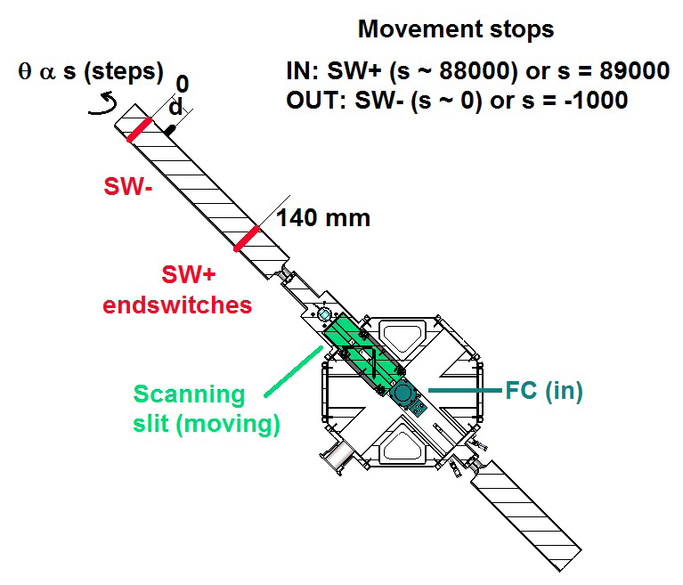
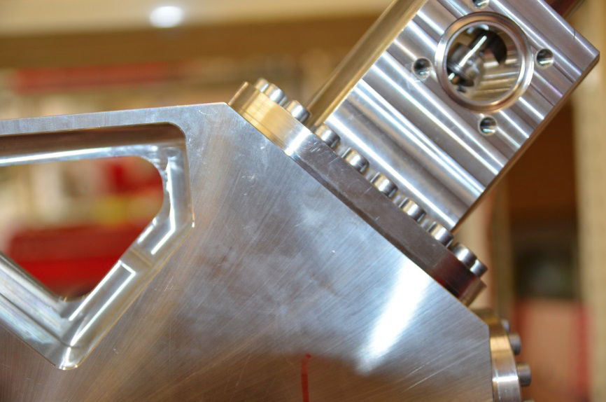
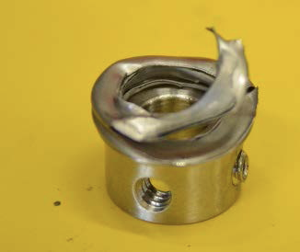
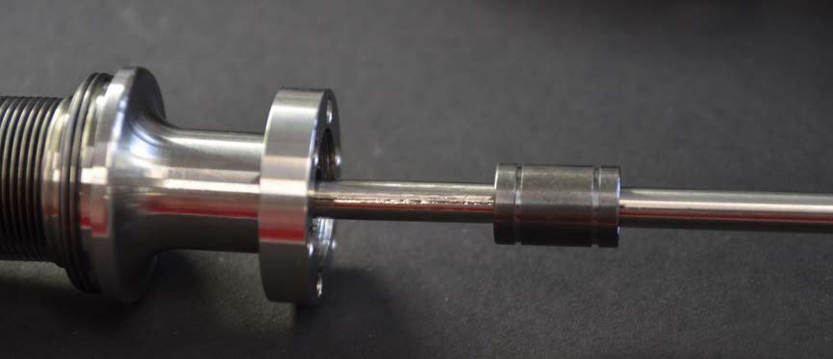
Failure of the prototype short DB
History log of the experimental test done with the HIE DB:
– 20 August 2012: Installation of HIE DB in REX-ISOLDE Hall
– From 20 August 2012 to 5 February 2013: Experimental measurements with stable beams (A/q = 4 and A/q = 3.5); mainly Faraday cup test but also beam profile measurement including movement of the scanning slit (during this period, about 100 IN-OUT scans of the scanning slit were performed).
– 8-9 April 2013: Tests of the scanning slit software, approx. 350 IN-OUT cycles.
– 10-15 April 2013: Stress test of the scanning slit mechanism (run of 1340)
Total number of IN-OUT cycles of the scanning slit mechanism: approx. 1800.
HIE-BDB-TN-0001 (edms# 1284254)

Slide 14
HIGHLIGHTS: Issues
Design of prototype Diagnostic Box
  AVS delivered Faraday Cup which was tested at REX-ISOLDE
  Body of the DB was being tested (particule contamination and degassing) when it Failed => need to redesign mechanical part
  Additional Resources needed to develop the electronics for acquisition and motor control but also for the mechanical design => under review within BE/BI
  MS => in stand by (7 short and 13 long DBs)
Integration issues (building 170):
  Advance on tunnel/shielding design and integration => blocs ordered
  Cable routing => ongoing finalizing all DICs

Slide 15
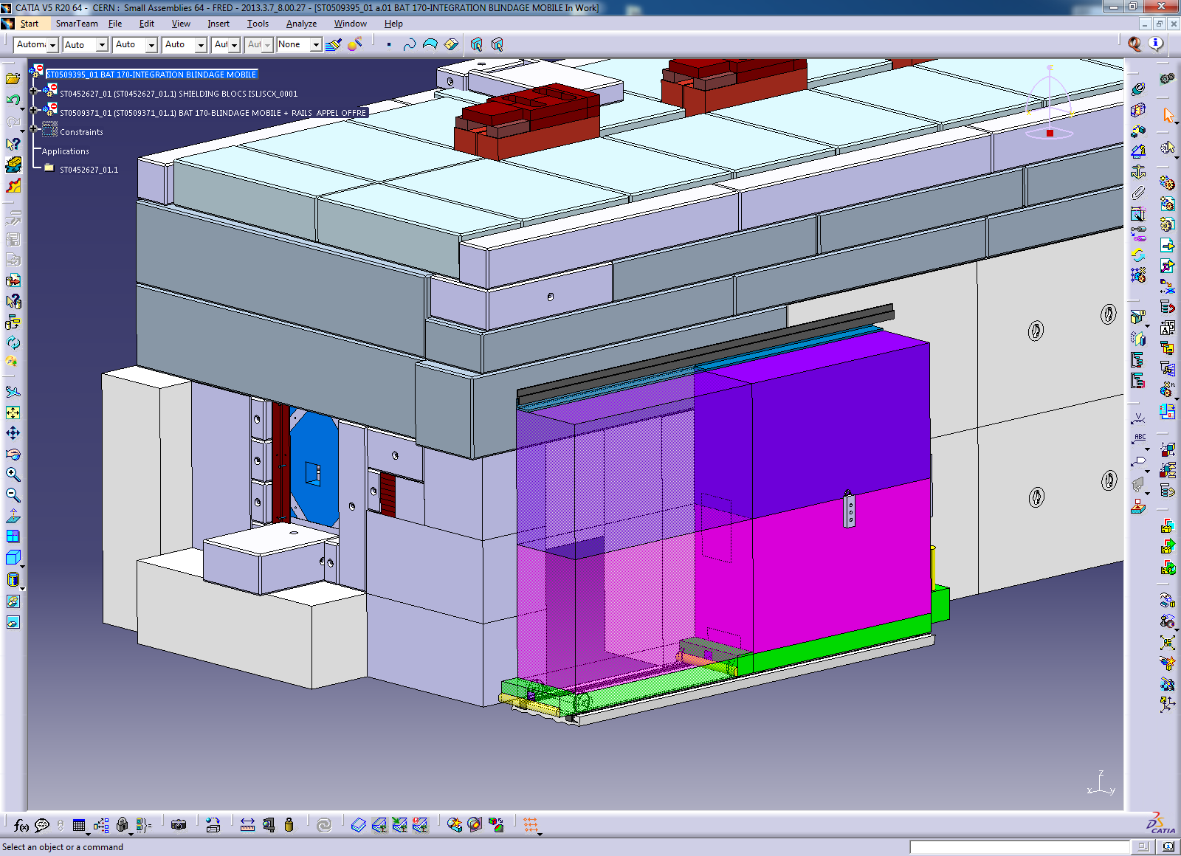
Shielding of HIE SC Linac (EN/HE)

Slide 16
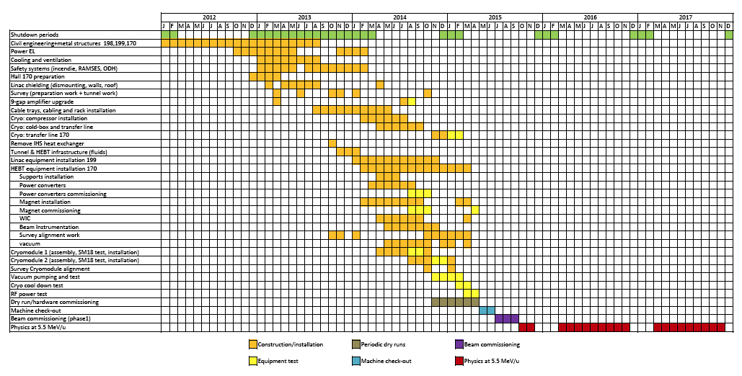
Project Schedule
EDMS No. 1143510 (April 2013 ver.14)

Slide 17
Conclusions
The strategic decision to refurbish the ALEPH cryo-plant will bring an additional delay of about 6 months => already integrated
The identified additional cost of 2.557.000 CHF to cover Material, Personnel and R&D have been included in the MTP2013 and approved by Council (June 2013).
Re-deployment & allocation of extra resources approved:
  cryo-module → (in total 5 man years)
  refurbishment of the ALEPH cryo-plant → (in total 8.3 man years)
  Electronics for Beam diagnostic boxes
However it should be considered that in case extra resources related to:
  beam instrumentation (in total 4 man years)
  are not made available, as requested, further delays will apply.
  operation budget prepared and submitted for approval.
Reviews for 2013:
  Cost and Schedule together with Risk Assessment => early November
  Safety Review => early November
  HIE-ISOLDE Technical Workshop => 28-29 November

Slide 18
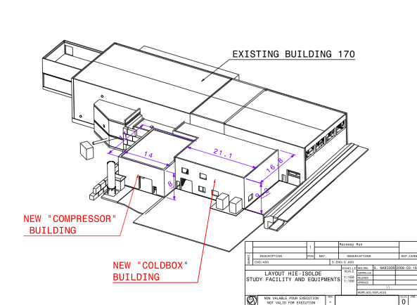
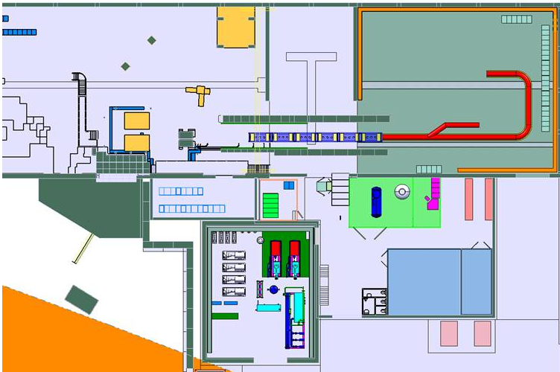
Thank you
HIE-ISOLDE web site -> http://hie-isolde.web.cern.ch/hie-isolde/
CATHI-ITN web site -> https://espace.cern.ch/Marie-Curie-CATHI/default.aspx

