Slide 1

Power requirementS for the LHC harmonic cavities with the full-detuning scheme
P. Baudrenghien, T. Mastoridis, CERN BE-RF
2nd LHC Harmonic Cavity meeting, May 27th ,2013

Slide 2
Content
Beam-Cavity-TX interaction formula
ACS system with fixed klystron phase and resulting beam phase modulation
Resulting power requirements for the harmonic system
Case study 1: Bunch shortening mode
Case study 2: Bunch lengthening mode
Conclusions

Slide 3
BEAM-CAVITY-TX interaction
(Joachim’s bible [1])

Slide 4
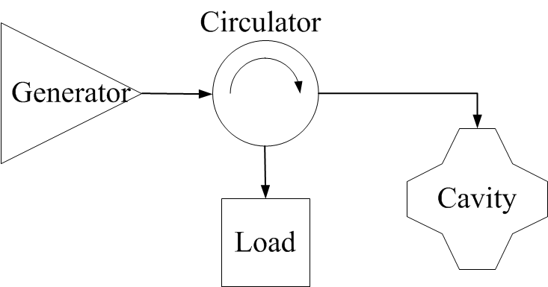
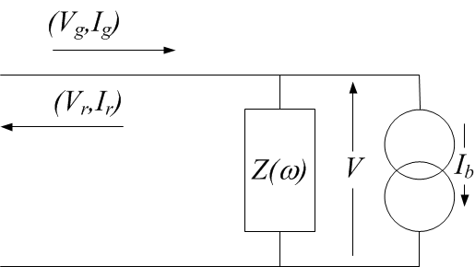
Consider a cavity linked to its generator via a circulator, waveguide and coupler
The TX forward current, cavity voltage and beam current are phasors at the RF frequency with a modulation slow compared to an RF period
Equivalent circuit diagram with incident and reflected waves transformed to the cavity gap impedance

Slide 5
We can derive a simple relation between I_{g}, V, I_{b} and the cavity detuning Δω [1]
The modulation in beam current I_{b}(t) is imposed by the filling pattern: presence of small gaps for kicker rise time, plus a 3.2 μs minimum gap for the beam dump kicker
So far we have operated the LHC RF for full compensation of the transient beam loading in the ACS cavities:
When proposed in 2007, the power requirement for the harmonic cavities assumed fixed voltage in both ACS and harmonic cavities [2]. After optimization of Q_{L}, the required power is then simply proportional to voltage and peak RF component of beam current, formula used in the first proposal

Slide 6
THE ACS (fundamental) system and the beam phase modulation

Slide 7
Beam phase modulation
Back to the ACS cavities. We now assume that the modulus of the voltage is kept constant but its phase is allowed to vary in response to the transient beam loading
The beam follows the voltage phase modulation. We take the situation in physics: 180 degrees stable phase
with i_{b}(t) a scalar representing the beam current modulation
The smoother will null the phase modulation of the generator current
with i_{g}(t) a scalar representing the (hopefully small) required modulation of the generator current phase. Note that we choose the real axis as aligned to the generator current

Slide 8
Now using (2),(3),(4) in the equation (1), we get the beam phase modulation resulting from operating the ACS cavities with a fixed-phase drive
with
the component of beam current at the fundamental RF frequency,
and the optimal (full) detuning
In 1991 Boussard [3] had derived a simplified formula valid in the limiting case σT_{rev}<<1

Slide 9
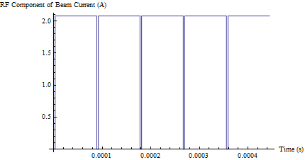
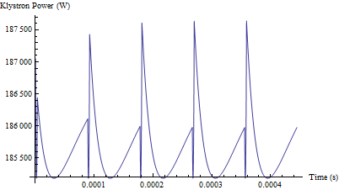
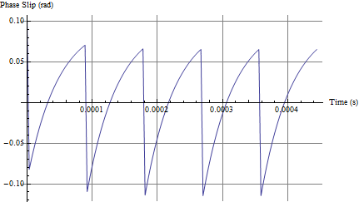
The following figures consider the HighLumi case: 2808 bunches, 2.2E11 p/bunch, 1.11 A DC, cos² longitudinal bunch profile, 1 ns base length, bunching factor 0.9, 2 MV/cavity, Q_{L}=60000, R/Q =45 Ω. The cavity is at the optimum detuning (-9039 Hz). We consider the 3.2 μs long abort gap only.
Top left: Component i_{b}(t) of beam current at 400 MHz. 3.2 μs long abort gap.
Top right: Klystron power, almost independent of beam current
Bottom left: Phase modulation at 400 MHz. We get 0.180 rad pk-pk (10.3 degrees) at 400 MHz equal to 72 ps pk-pk.

Slide 10
The harmonic system

Slide 11
We now consider the harmonic cavities at frequency ω₁= n ω
The bunch phase is defined by the Master ACS system (4). The beam current at the frequency of the harmonic cavities is
with i_{b,1}(t) a scalar representing the beam current modulation at the harmonic frequency. Given the bunch length and resulting bunching factor, it will be significantly smaller than i_{b}(t)
The harmonic cavity voltage must be locked to the fundamental RF
with φ₁ a constant phase offset between fundamental and harmonic systems. This parameter will be different for Bunch Lengthening and Bunch Shortening modes.

Slide 12
Let us consider the RF-beam phase
For the fundamental we have
For the harmonic system
We have bunch shortening when the two gradients add, i.e. when the two arguments are equal. Bunch lengthening corresponds to opposite gradients, i.e. when the two arguments differ by π

Slide 13
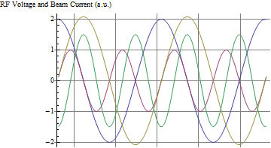
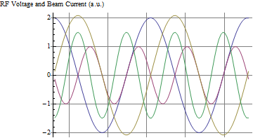
Possible buckets in BS mode: the beam current peaks on the zero crossing, negative slope of both fundamental and harmonic RF
Possible buckets in BL mode: the beam current peaks on the zero crossing, negative slope of fundamental and positive slope of the harmonic RF
Real parts of the fundamental (blue) and harmonic (red) voltages given by equations (2) and (21), plus real parts of the component of beam current at fundamental (yellow) and harmonic (green). Harmonic at twice fundamental frequency (n=2).
Left: Bunch shortening mode (φ1 = -π/2)
Right: Bunch lengthening mode (φ1 = π/2)
Assumes a positive bunching factor at the harmonic frequency.

Slide 14
We now apply Joachim’s formula to the harmonic cavity in order to derive the required generator current
With I_{b1}(t) following the phase modulation φ(t) imposed by the fundamental cavities (4),(5) and V₁(t) locked to the fundamental system (6) at optimal detuning Δω₀, we get, after some calculations
the minus sign in BS mode, the plus sign in BL mode. Δω₁ is the detuning of the harmonic cavity, and

Slide 15
We now want to minimize the peak modulus of I_{g1}(t) over a turn
Real-valued term. Independent of beam.
This term makes a small excursion, symmetric around zero, in both beam and no-beam segment
This term toggles between beam and no-beam segment.
In BL mode it will be large (+ sign). In BS mode it can be made small by choosing
The cavity tune can be chosen to minimize peak generator current. After some calculations we get

Slide 16
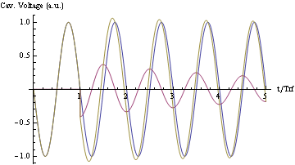
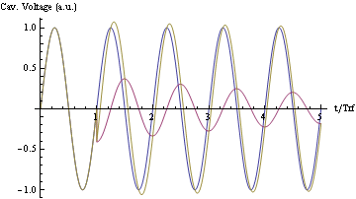
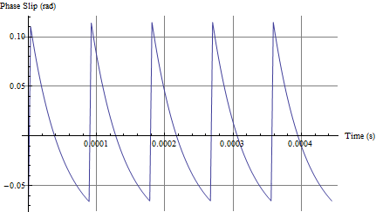
Left: Beam induced voltage caused by a bunch passage at 180 degree stable phase. Generator driven voltage in blue, bunch induced voltage in red, total voltage in yellow. The bunch causes a positive phase shift (phase advance). Right: Idem with a bunch passage at 0 degree stable phase resulting in a negative phase shift (phase lag).
Left: Phase modulation caused by abort gap in a cavity at 180 degree stable phase, with fixed klystron drive. Right: idem with 0 degree stable phase.
In BS mode, both systems have 180 degree stable phase. The beam phase modulation produces a voltage transient that “helps” the harmonic cavity track the voltage of the fundamental cavity -> required power is reduced
In BL mode, the beam phase modulation with the 0 degree stable phase in the harmonic system produces a voltage slip opposite to the desired RF phase modulation imposed by the ACS system -> much larger power required

Slide 17
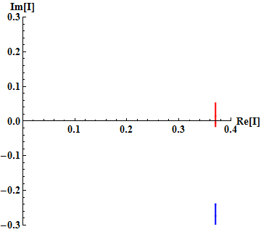
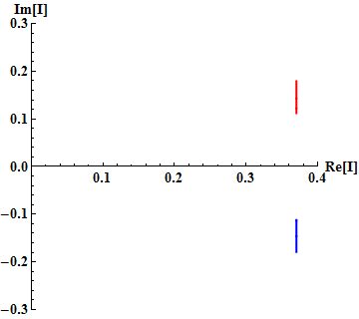
In both modes, the detuning must be chosen to minimize the peak generator current
The amplitude of the vector is proportional to the klystron current. Beam-on segment in red, beam-off segment in blue. The figure on the right corresponds to the optimal detuning (-15.4 kHz), minimizing the peak klystron current. On the left the detuning (-13 kHz) is almost perfect for the beam segment but will make the klystron power significantly larger in the no-beam segment.

Slide 18
We now optimize the main coupling to minimize generator peak power
We get
Power needed with half-detuning scheme
Small for high Q_{L}
BS mode: minus sign
A good design selects (8)
A large loaded Q_{L1} is favorable (7)
The required power can be much smaller than with half detuning scheme
BL mode: plus sign
A good design selects a large Δω_{01,} that is large (R/Q)₁ and low voltage per cavity
A small loaded Q_{L1} is favorable
The required power will always be larger than with the half detuning scheme

Slide 19
CASE STUDY 1
Bunch shortening mode, 800 MHz cavity

Slide 20
Beam and fundamental cavity parameters: 3.2 μs long abort gap, 1.11 A DC , 1 ns Cosine square line density bunch, 2 MV per ACS cavity (16 MV total)
2 A RF component of beam current at 400 MHz and 1.44 A at 800 MHz
Assuming 8 MV total at 800 MHz, and 45 Ω (R/Q)₁, the beam phase modulation matches the harmonic cavity perfect for
We get 1.44 MV ideal voltage per harmonic cavity. I consider 1.6 MV/cavity (5 cavities total)
The absolute minimal required power is 55 kW with a Q_{L1,opt}=260000. Much reduced from the 300 kW (1/8 V₁ I_{b,pk1}) required without beam phase modulation
Let us use a Q_{L1}=100000 instead to make beam loading compensation easier when deviating from the 1 ns bunch length

Slide 21
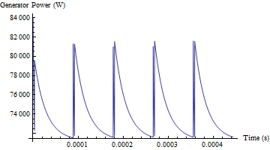
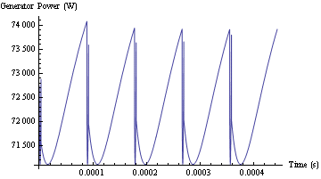
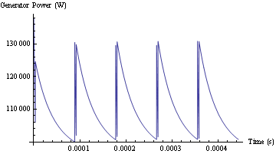
0.8 ns, 74 kW peak
1 ns, 82 kW peak
1.6 MV/cav, Q_{L1}=100000
Top left: Generator power with the 1 ns bunch length
Top right: Idem with 0.8 ns bunch length
Bottom right: Idem with 1.4 ns bunch length
1.4 ns, 130 kW peak
In BS mode, phase modulation significantly reduces the needed RF power if the cavity parameters (R/Q and V) are selected properly
The scheme is not very sensitive to bunch length

Slide 22
CASE STUDY 2
Bunch lengthening mode, 800 MHz cavity

Slide 23
Beam and fundamental cavity parameters as before
To minimize the required power we want to maximize Δω₀₁, that is a large (R/Q)₁ and low voltage per cavity (8)
With 90 Ω (R/Q)₁, and 1 MV per cavity (8 cavities total), the absolute minimal required power is 260 kW with Q_{L1}=11000
Alternatively, with 45 Ω (R/Q)₁ we need 330 kW with an optimal Q_{L1}=17000
Without modulation, we would need 190 kW per cavity (1/8 V₁ I_{b,pk1})

Slide 24
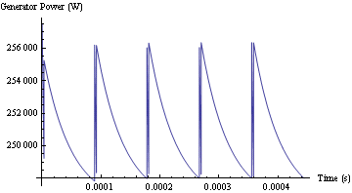
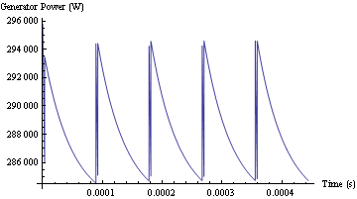
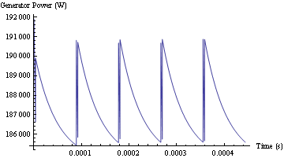
1 ns, 256 kW peak
0.8 ns, 296 kW peak
1 MV/cav , Q_{L1}=11000
Top left: Generator power with the 1 ns bunch length
Top right: Idem with 0.8 ns bunch length
Bottom right: Idem with 1.4 ns bunch length
1.4 ns, 191 kW peak
In BL mode, phase modulation significantly increases the needed RF power
The scheme is not very sensitive to bunch length

Slide 25
conclusions

Slide 26
In bunch shortening mode (fundamental and harmonic RF in phase at bunch passage), the phase modulation scheme can much reduce the power requirement on the generators of the harmonic cavities, with a proper choice of the RF parameters: R/Q, Q_{L} and voltage per cavity. With this optimal choice a good part of the voltage is induced by the beam passage
In bunch lengthening mode (fundamental and harmonic in phase opposition at bunch passage), the scheme will significantly increase the required RF power, compared to the situation with equispaced bunches, while still keeping it manageable if the voltage per cavity is reduced
The optimal main coupling differs much between the two applications: high Q_{L} in bunch shortening mode, where the needed voltage is induced by the beam, and low Q_{L} in bunch lengthening mode where the beam induces the wrong voltage change and much power must flow through the main coupler to compensate for that and track the fundamental cavity phase change
In both cases the scheme is not very sensitive to bunch length
Formulas have been derived for the required power and optimal parameters, and can be used to evaluate candidate scenario
Must use more detailed beam current /several gaps)

Slide 27
Thank you for your attention

Slide 28
References

Slide 29
[1] J. Tuckmantel, Cavity-Beam-transmitter Interaction Formula Collection with Derivation, CERN-ATS-Note-2011-002 TECH,Jan 2011
[2] T. Linnecar, E. Shaposhnikova, An RF System for Landau Damping in the LHC, LHC Project Note 394, Feb. 2007
[3] D. Boussard, RF Power Requirements for a High Intensity Proton Collider, CERN SL/91-16 (RFS), US PAC, San Francisco, May 1991

