Slide 1
PH/DT MCP & MNO
Xavier Pons on behalf of MCP team – 25/03/2013

Slide 2
PH/DT MCP & MNO
Commitment:
To assure the availability of Atlas, CMS, Alice and LHCb magnets.
To assure the preventive and corrective maintenance of the experiment magnets.
Magnet ON-Call Standby service 24/24 h, 7/7 d, 365/365 y
When beam is ON, we provide support for other magnet control and systems related to control and instrumentation

Slide 3
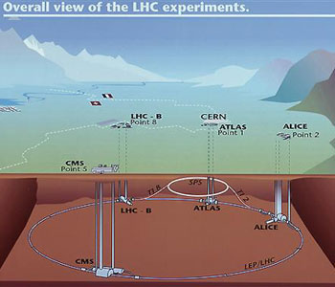
PH/DT MCP & MNO

Slide 4
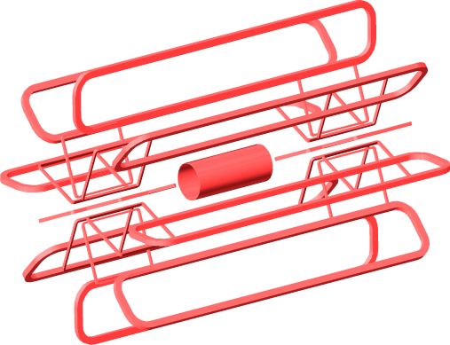
PH/DT MCP & MNO
 | Alice |  | LHCb | Atlas |  |  | CMS
 | Solenoide | Dipole | Dipole | Toroids | End-caps | Solenoide | Solenoide
Technology | Resistive | Resistive | Resistive | Superconducting | Superconducting | Superconducting | Superconducting
Nominal Current | 30 kA | 6 kA | 6 kA | 20.5 kA | 20.5 kA | 7.6 kA | 19.5 kA
Nominal Field | 0.5 T | 0.7 T |  | 3.9 T | 4.1 T | 2.6 T | 4 T
Nominal voltage | 130 V | 639 V | 730 V
Inductance |  | 1 H | 2 H | 5.14 H | 1.09 H | 1.35 H | 14 H
Atlas Magnet Simplified Representation

Slide 5
PH/DT MCP & MNO
MSS
2
PVSS
HLM. ALTERA
PROGR. LOGIC ARRAY
MDS
PLC
ELECTRONIC SIGNAL CONDITIONNIG
ATLAS OVERALL MAGNET CONTROL LAYOUT

Slide 6
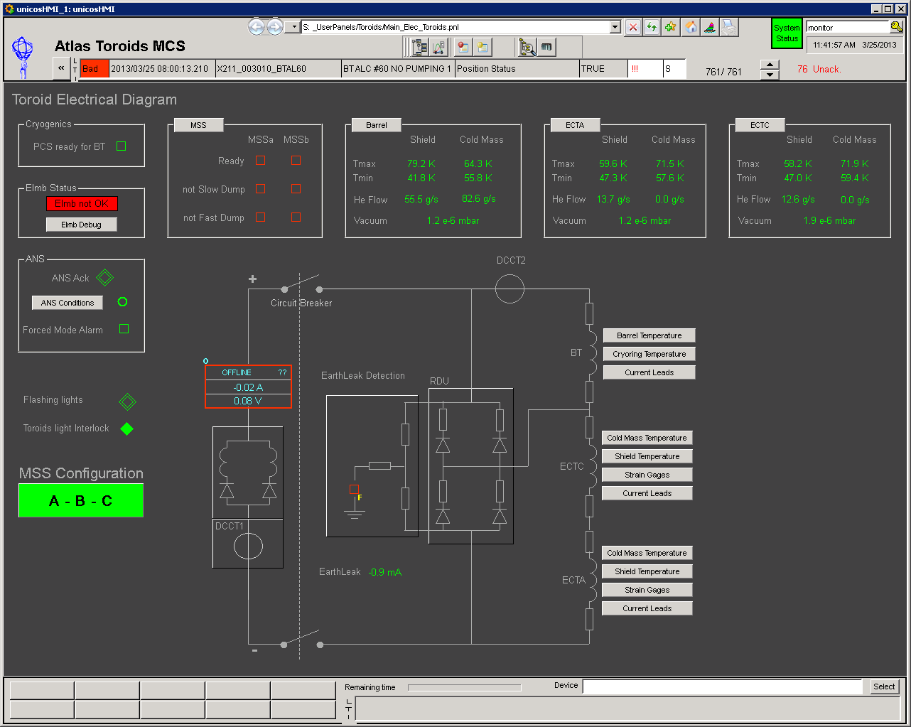
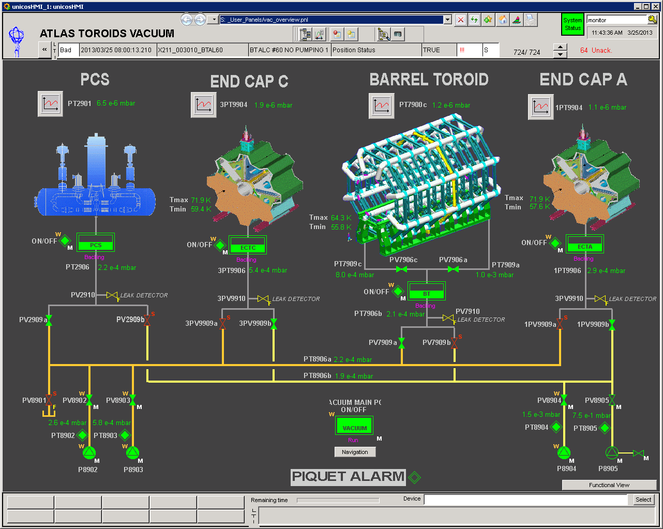
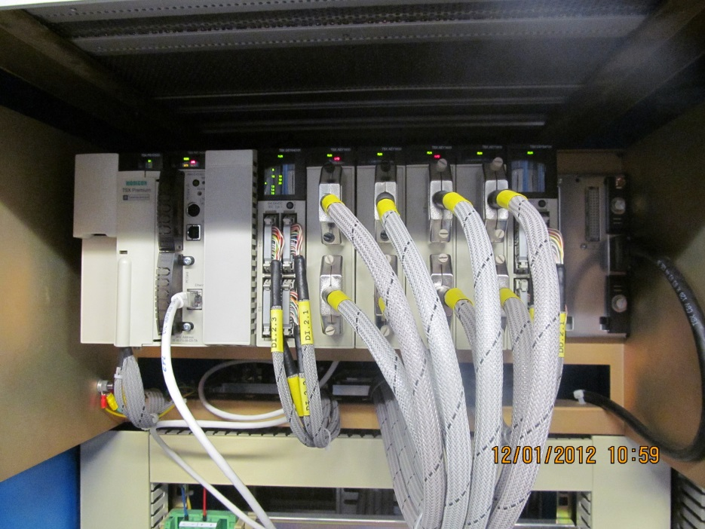
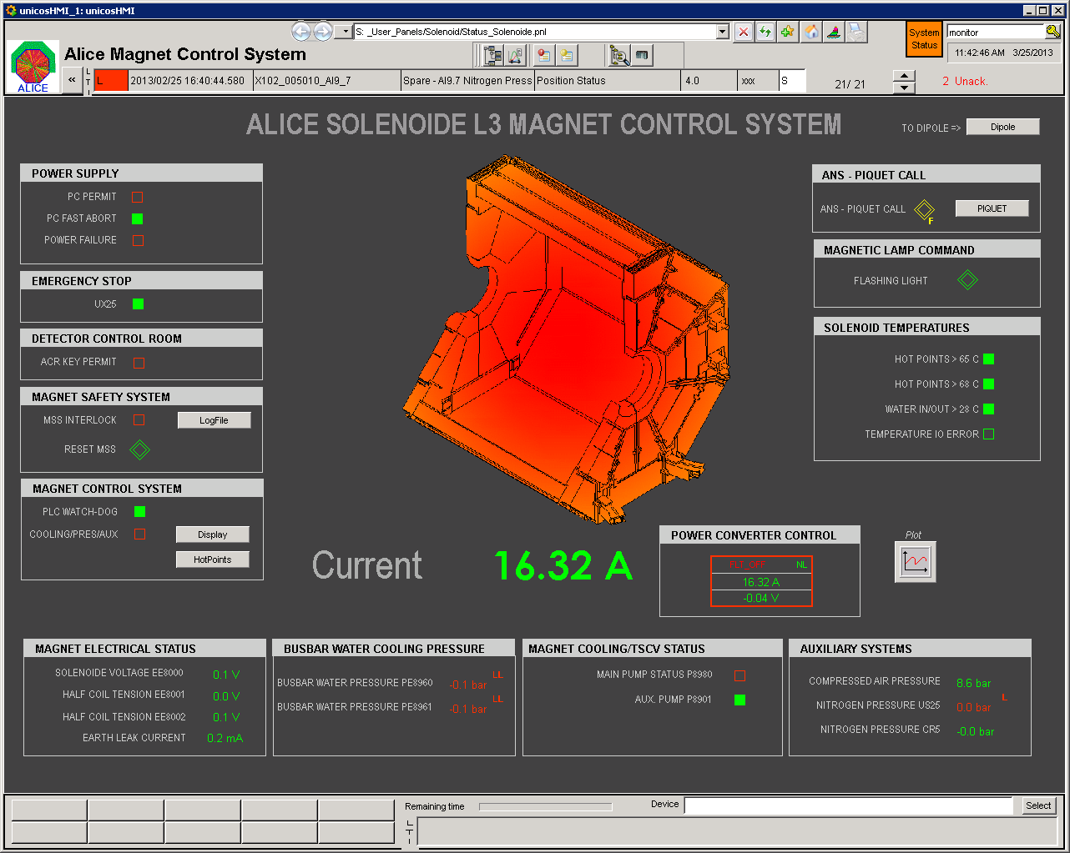
PH/DT MCP & MNO
MCS SLOW CONTROL – PLC +SCADA

Slide 7
PH/DT MCP & MNO
MSS – MAGNET SAFETY SYSTEM
The purpose of the MSS is to detect anomalies endangering the safety of the magnet and to take appropriate action in order to bring the magnet into a safe state.
Maximum availability/reliability
Dedicated sensors
Multiple detection techniques/Overlapping sensors
Redundancy
Galvanic Isolation
Fail-safe operation

Slide 8
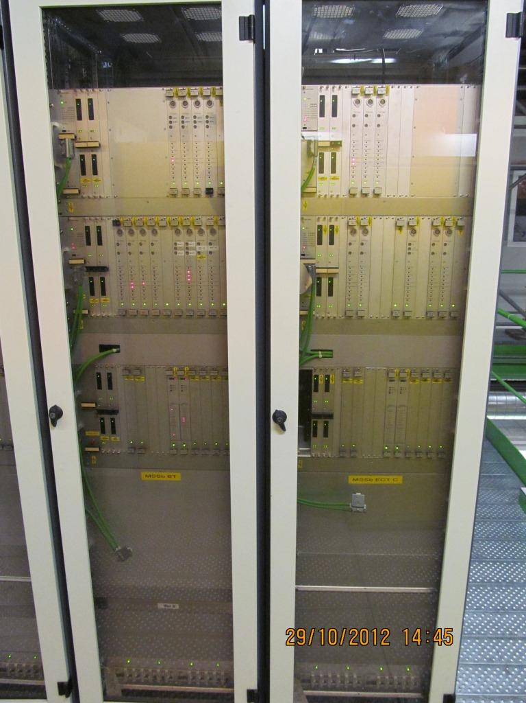
MSS - ATLAS
ATLAS MSS assembly in 19’ rack format.
  Altera Prg. Logic Array
  Digital Input Interface DIM
  Analogue Input Interface
  Digital Ouput Interface APC
FULLY REDUNDANT
  MSSa and MSSb

Slide 9
PH/DT MCP & MNO
MSS - Digital Signal Processing

Slide 10
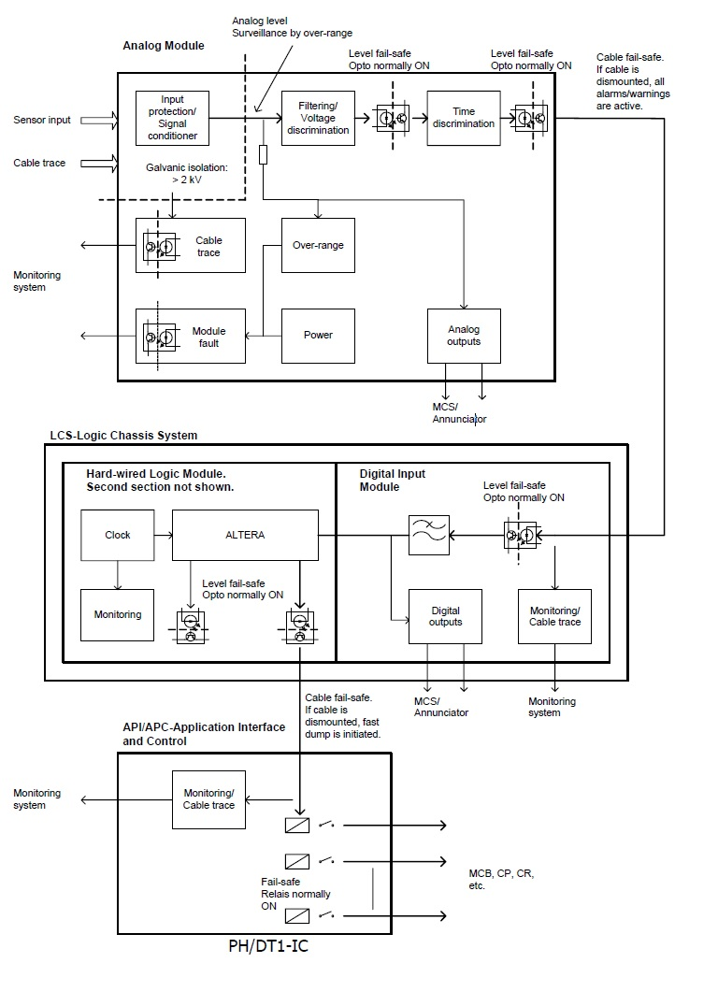
PH/DT MCP & MNO
MSS - Analogue Signal Processing
Analogue Input Types:
Dual Voltage Measurement module –DVM module 2 Voltage measurements – 1 differential measurement Bipolar
Dual Temperature Measurement module – DRM module2 Temperature measurements Configurable for PTC, NTC and SQD measurements
Dual Bridge Measurement module –DBM module2 Bridge measurements Bipolar

Slide 11
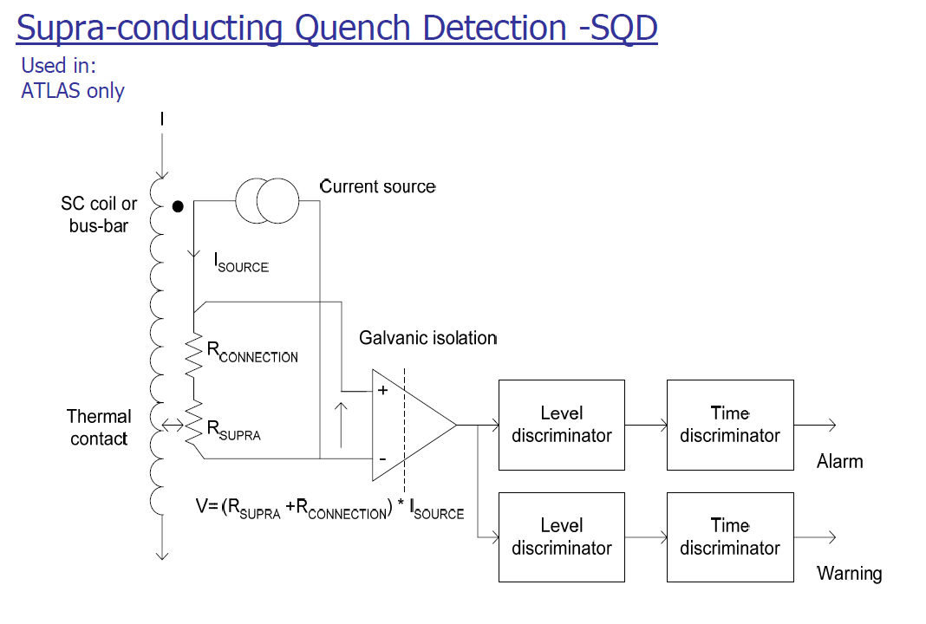
MSS – ANALOGUE INPUT TYPES

Slide 12
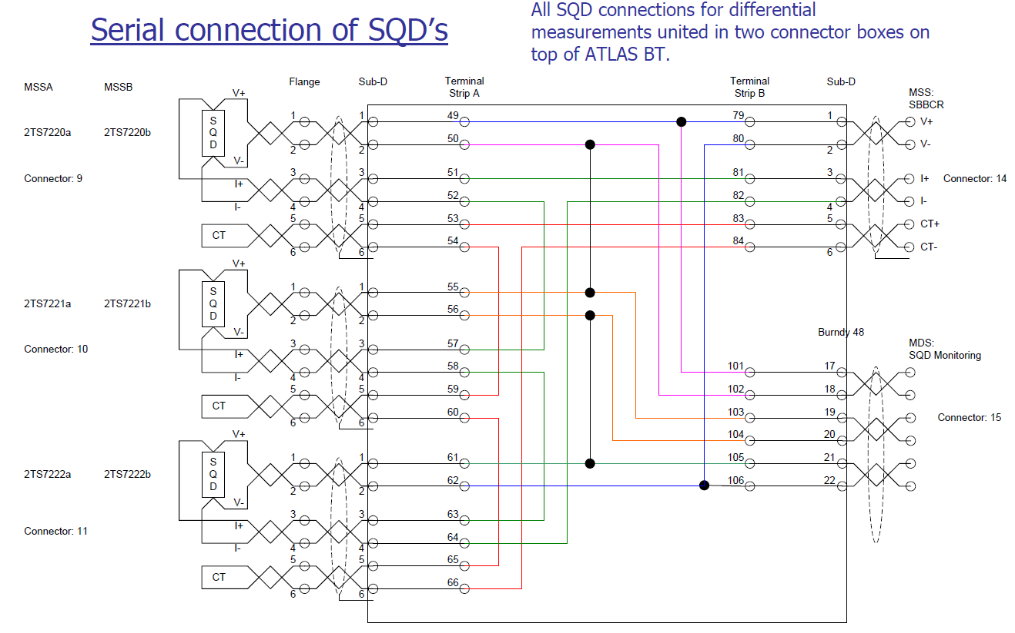
MSS – ANALOGUE INPUT TYPES

Slide 13
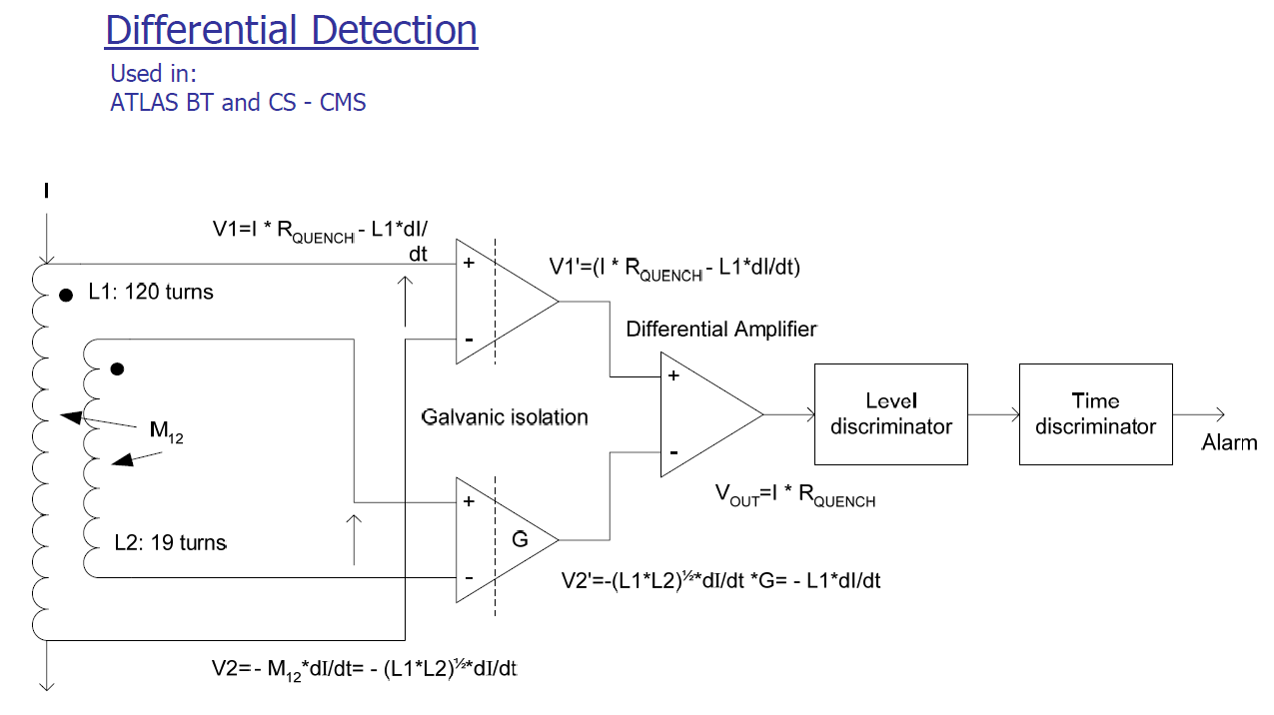
MSS – ANALOGUE INPUT TYPES

Slide 14
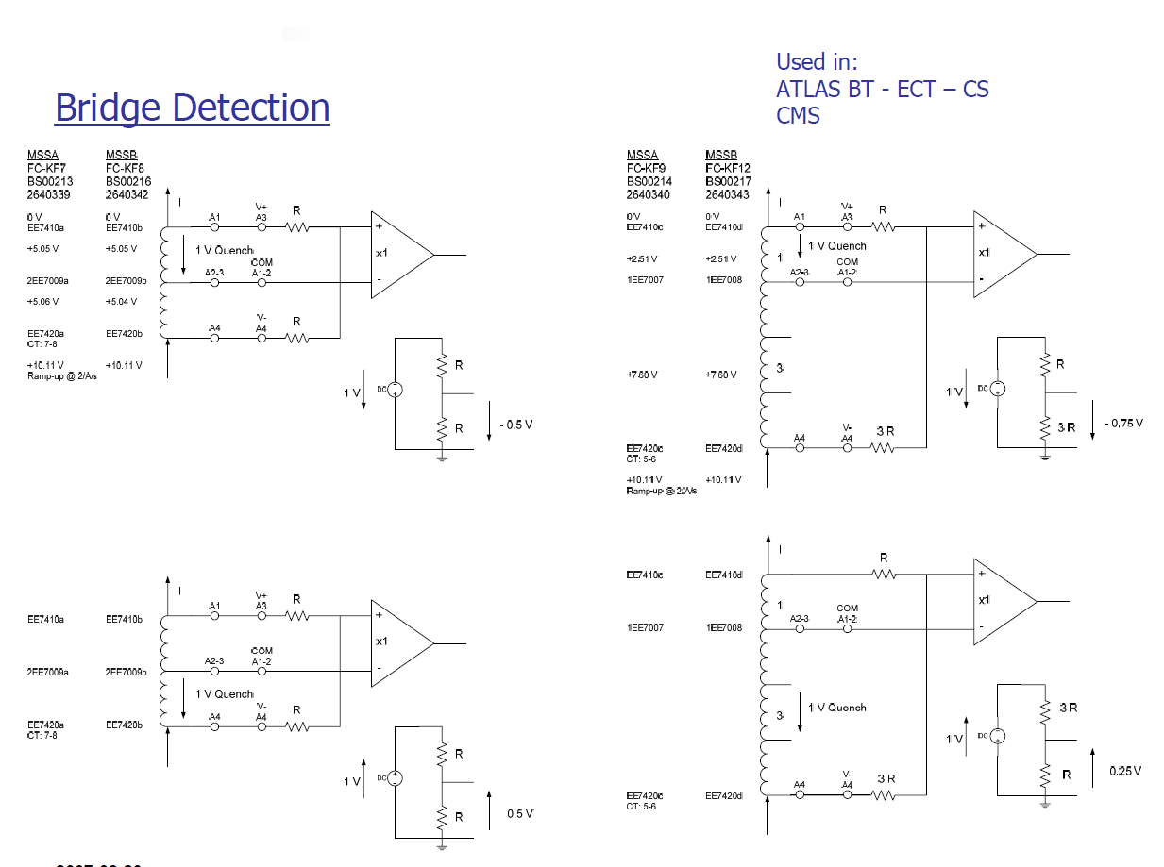
MSS – ANALOGUE INPUT TYPES

Slide 15
PH/DT MCP & MNO
Sensors –ATLAS (BT –ECTA-C –CS)
•5 types for safety:
Voltage measurements –DVM moduleTotal:28/14 Channels/Modules (MSSA+MSSB)
Temperature measurements –DRM moduleTotal:32/16 Channels/Modules (MSSA+MSSB)
Supra-conducting measurements –DRM moduleTotal:36/20 Channels/Modules (MSSA+MSSB)
Differential measurements –DVM moduleTotal:20/10 Channels/Modules (MSSA+MSSB)
Bridge measurements –DBM moduleTotal:24/16 Channels/Modules (MSSA+MSSB)
Grand total:Total:140/76 Channels/Modules (MSSA+MSSB

Slide 16
PH/DT MCP & MNO
CMS -SENSORS
4 types for safety:
Voltage measurements –DVM moduleTotal:21/11 Channels/Modules (MSSA+MSSB)
Temperature measurements –DRM moduleTotal:8/4 Channels/Modules (MSSA+MSSB)
Differential measurements –DVM moduleTotal:10/5 Channels/Modules (MSSA+MSSB)
Bridge measurements –DBM moduleTotal:5/3 Channels/Modules (MSSA+MSSB)
Grand total:Total:44/23 Channels/Modules (MSSA+MSSB)

Slide 17
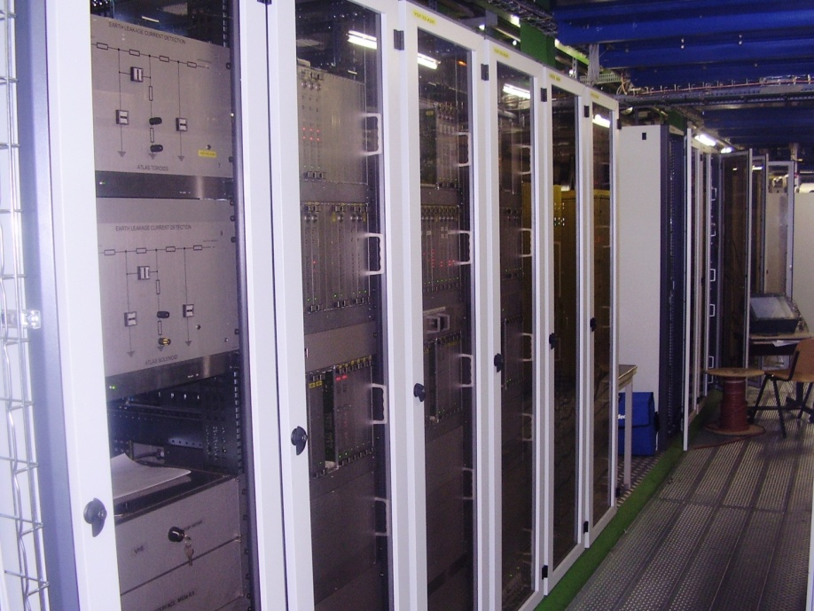
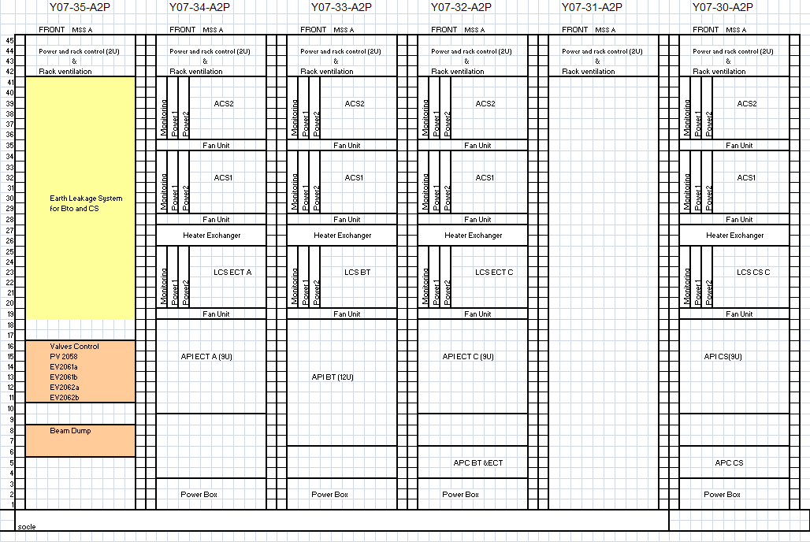
PH/DT MCP & MNO
ATLAS
  8 racks
  12 chassis
  4 control boxes
  8 interface boxes
  8 power boxes
  260 modules
  + Heater cicuits
  A mess of cables...
ATLAS MSS Racks
MSSA only

Slide 18
PH/DT MCP & MNO
Why upgrade? Mean Time Before Failure - Components
  Worst case calculations - Environmental factors
  Many opto-couplers (in series)
  Some components no longer available – Isolation amplifier – FPGA
  MSS started in 1998 – First installation 2002-2003 (CS of ATLAS – Still running)

