Slide 1
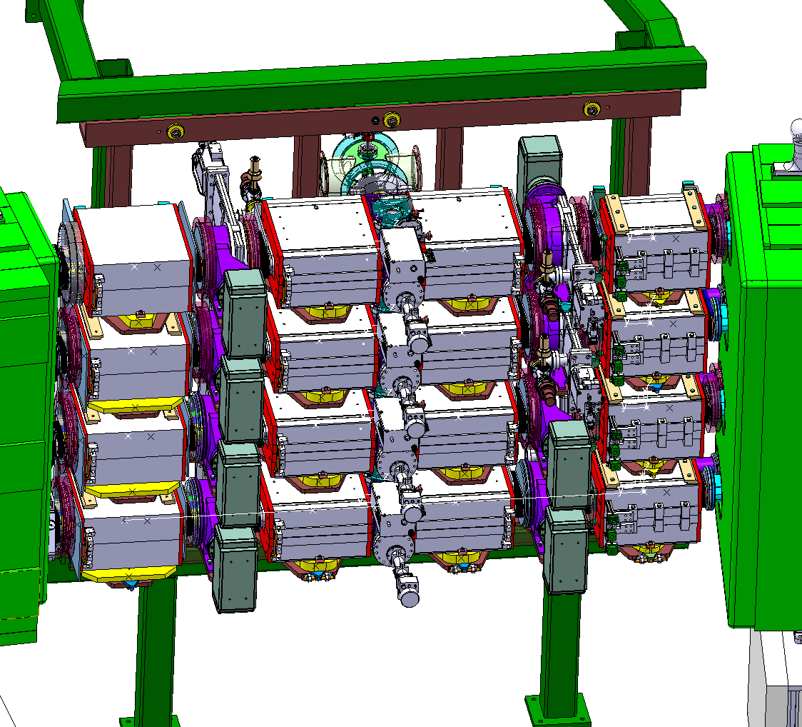
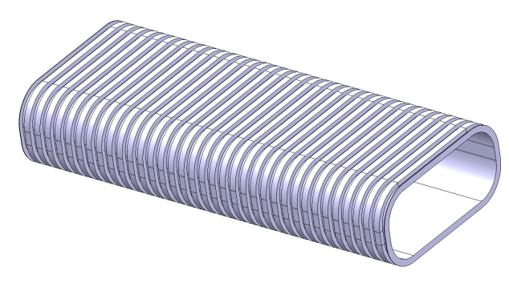
Inconel Chambers & Vacuum System:
Layout Status
LIU-PSB Meeting 103
B. Riffaud
On behalf of
A. Dallocchio, M. Garlaschè, L. Zuccalli

Slide 2
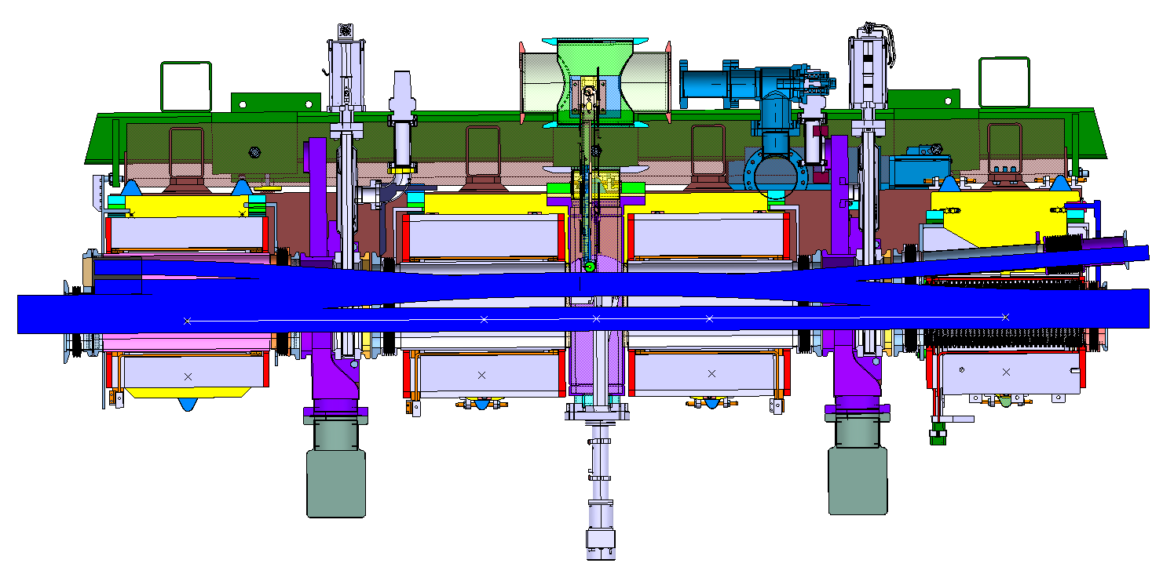
Overview:
Design BASELINE Parameters:
Undulated Vacuum Chambers (Inconel)
Independent sector for BSW2/BI.STR/BSW3
Currently specified beam envelope (TE/ABT)
Magnet parameters (position, aperture, tolerances)(EDMS 1244362)

Slide 3
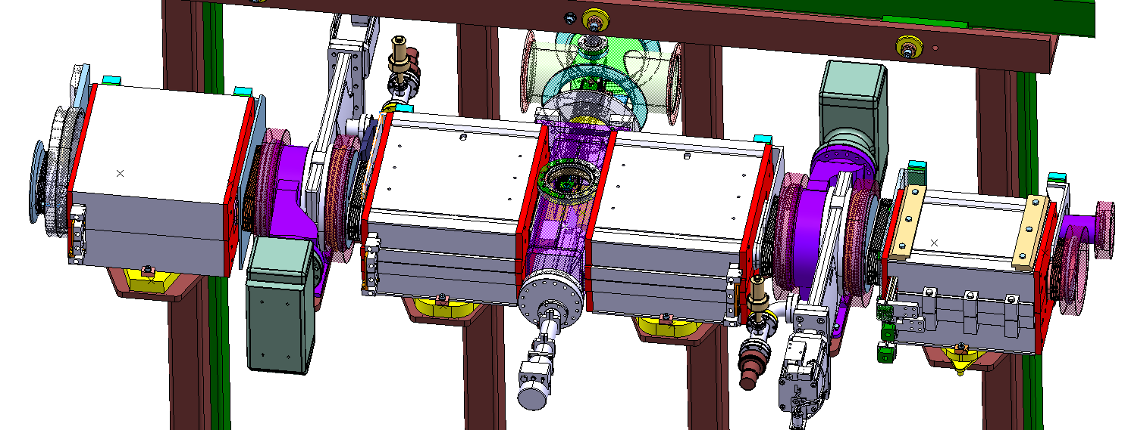
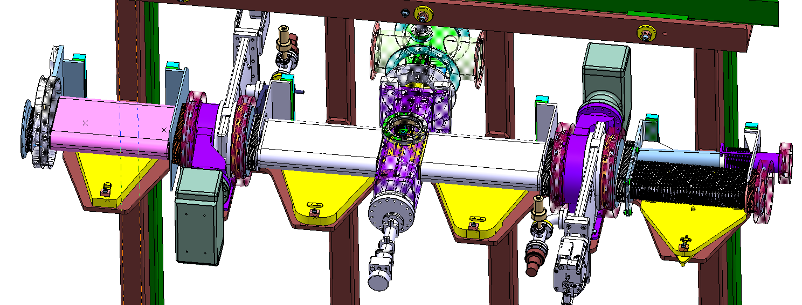
Current Layout:
Chamber:
Undulated, Inconel
0.45mm max. thickness (mandatory)
Draft specification performed (EDMS 1277821)
Market survey launched (TE/ABT)
Interface w. Stripping foil box to be defined (with TE/ABT)
Design status – ONGOING

Slide 4
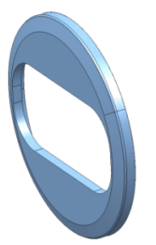
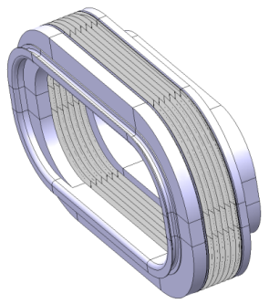
Current Layout:
Flanges:
Bellows:
Edge welded
First proposal from Mewasa
Compatibility check with PSB beam aperture
Final dimensions to be confirmed
Bellow compression tool
Position tolerance of injection-region adjacent flanges (BHZ 11 & 162) needed
Conical by MKT
Insulation: special ceramic coating on surface (spec by TE/VSC)
Design status – ONGOING
Design status – CLOSED

Slide 5
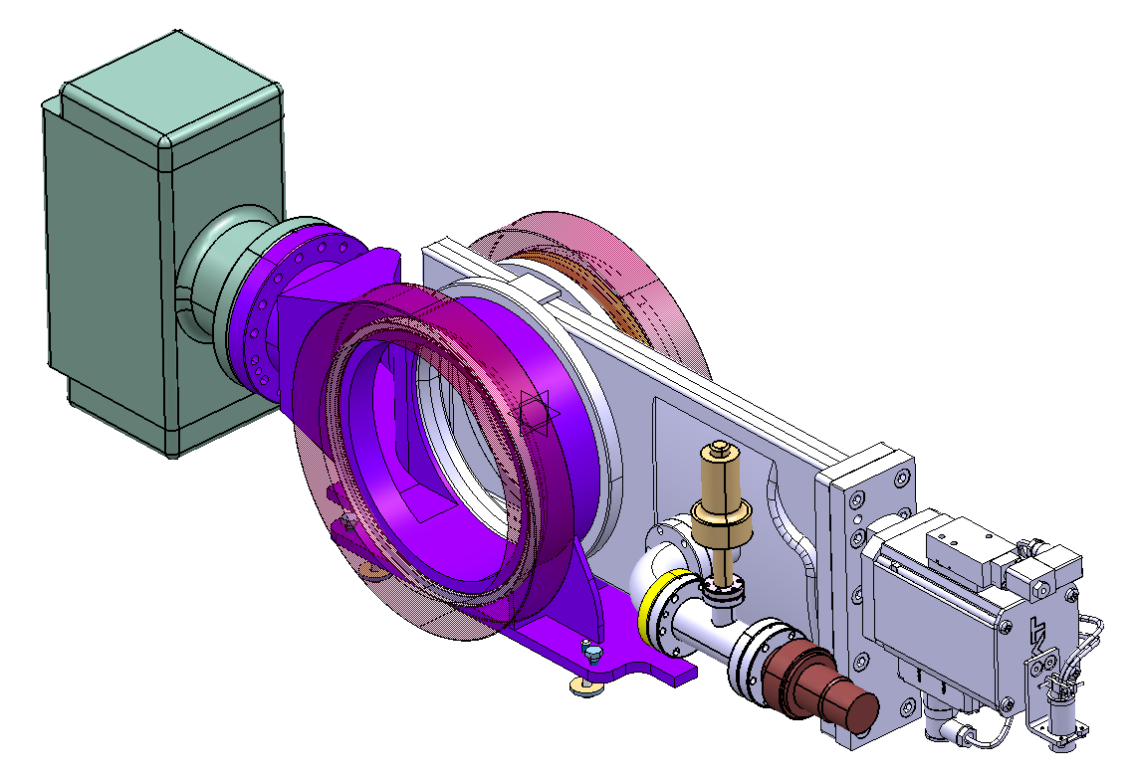
Current Layout:
Sectorizing System:
NOVEL DESIGN: single compact system for sectorization, pumping and instrumentation
Quick independent extraction from the line
Technical feasibility to be confirmed by supplier (VAT)
Design status – ONGOING

Slide 6
Current Layout:
Design status – ONGOING
BSW2/BI.STR/BSW3 Section :
Primary Pumping and venting: fixed pumping system required (TE/VSC)
Study ongoing for quick disconnection of complete section (vacuum + magnets)

Slide 7
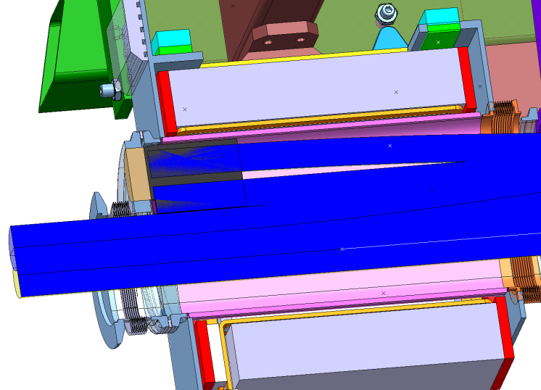
Open Questions:
Dump:
Waiting for outcomes of review
Impact on:
Design and integration
Workdose planning

Slide 8
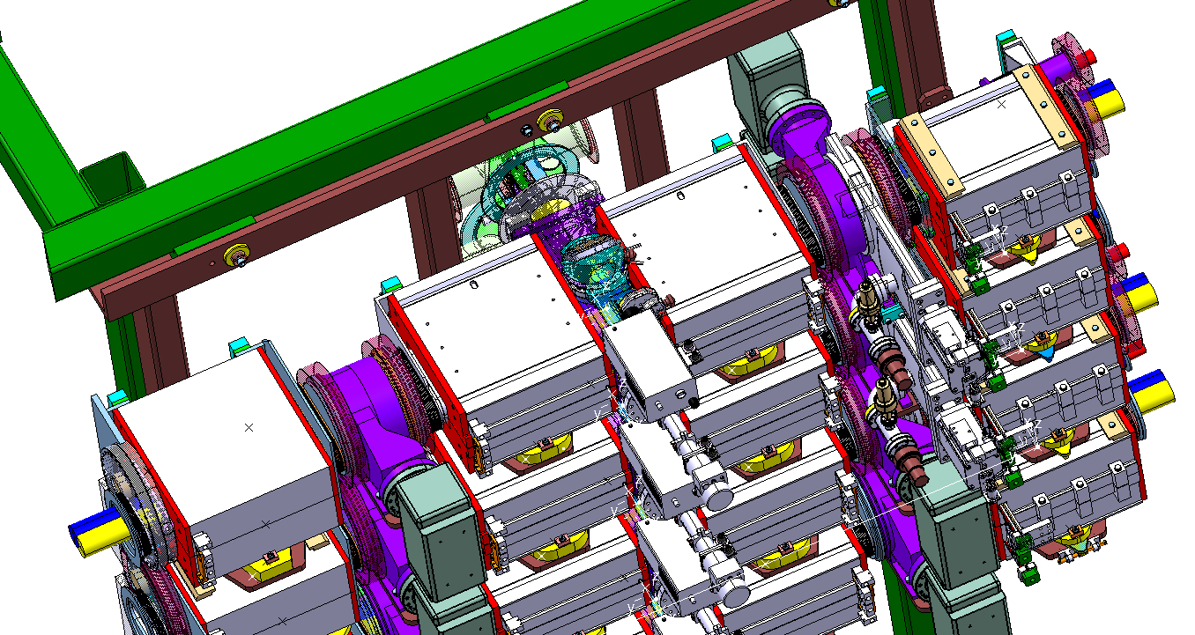
Open Questions:
TE/VSC proposal :
NO single Sector for BI.STR
Valve after BSW1
Ionic pumping after BSW3
Primary pumping & sectorizing @ existing PSB sector after bending magnets
TE/VSC proposal based on current workdose planning (draft)
TE/ABT recommends separate sector for BI.STR (BASELINE) following review (link1, link2)
EN/MME advises:
Final & validated workdose planning (dump choice related)
Evaluation of venting issues and pumping duration

Slide 9
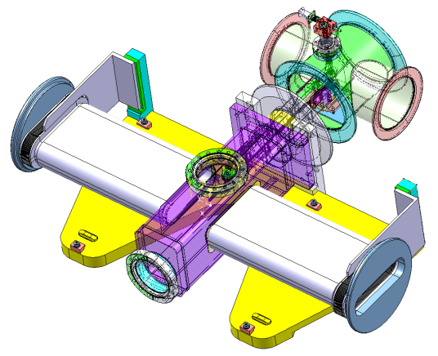
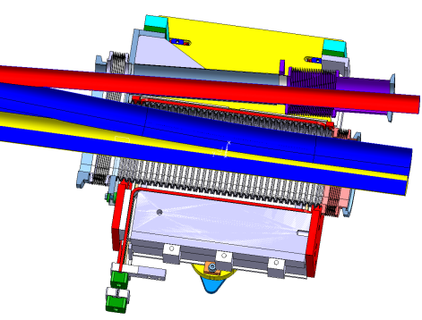
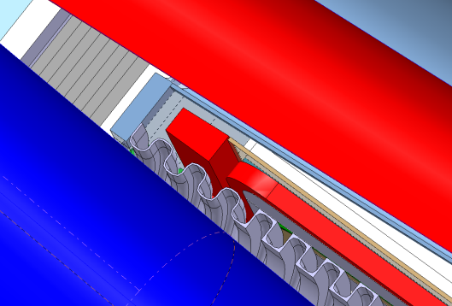
Ceramic Chamber: what if?
Production feasibility of ceramic chambers validated : preliminary market survey done (TE/ABT) , functional spec (EDMS 1277821)
Enough space inside yokes to house ceramic chamber
Support for chambers:
Independent w.r.t. magnet support (BASELINE)
Hyperstatic
Support & alignment strategy (quick plug in) to be reconsidered
Ceramic chambers imply smaller gap available w.r.t to beam envelope and magnet aperture

Slide 10
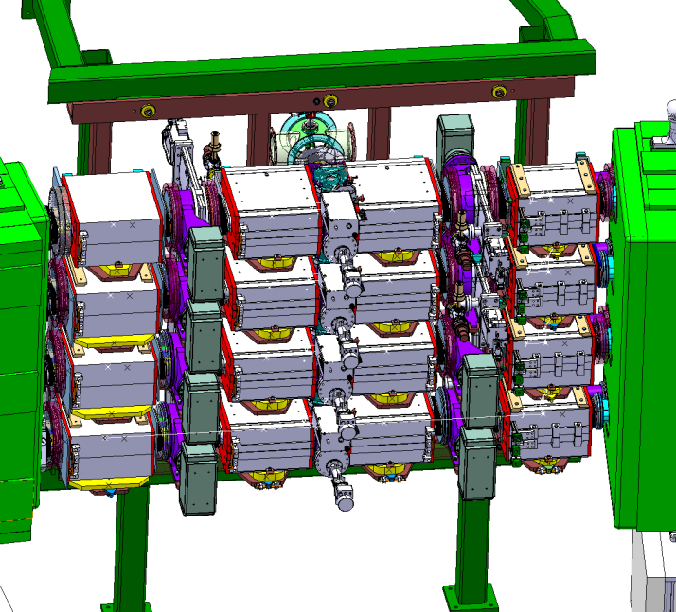
Conclusion:
Critical Information needed for design progress:
Dump review outcome
Workdose planning
Venting and pumping strategy
Sector for stripping area
Position tolerance of BHZ 11 & 162 flanges
Chamber : Inconel vs. Ceramic

