Slide 1
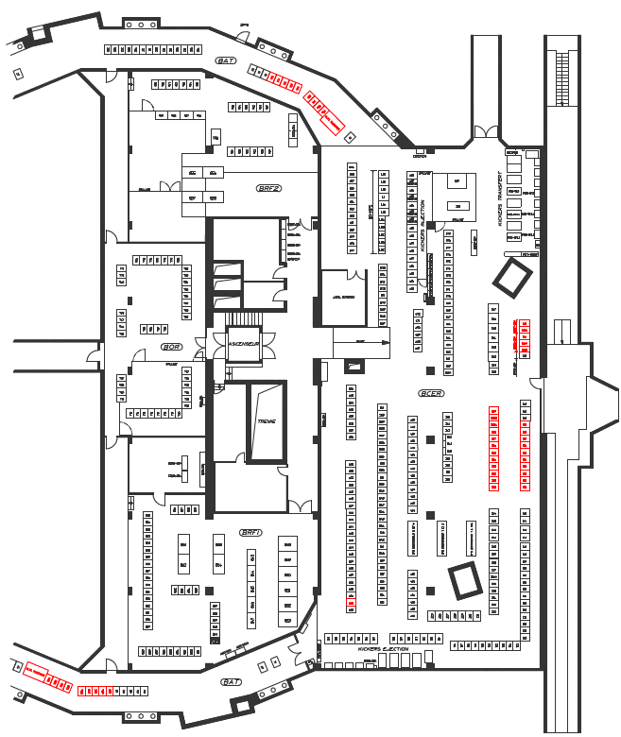
Space in 361
The following is proposed in 361-1-012
Remove SMH and SMV[1,2,4]
Install new SMV[1,2,4]
Remove DIS PB[1,2,3] (4x3 racks)
Install BI[1,2,3,4].BS Chicane (~5x3 racks)
  Alternative
  Install BI[1,2,3,4].BS Chicane (~5x3 racks)
Install PSB Qstrip Trims (2x5 racks)
Obsolete (see next slides)

Slide 2
Power converters for strip foil chicane
16 Power converters integration

Slide 3
Space in 361
The following proposal in 361-1-012 needs further study, but identifies space for 57 EPC racks required for H- operation
From LS1 -> H- operation
  Install new SMV[1,2,4] (megadiscap)(x4 non-standard racks)
  Remove DIS PB[1,2,3] (4x3 racks)
For H- operation
  Remove old SMH and SMV[1,2,4]
  Install BI[1,2,3,4].BSW1 (~5x3 racks)
  Install BI[1,2,3,4].BSW[2,3,4] (~14x2 racks)
  Install PSB Qstrip Trims (2x5 racks)

