Slide 1
CENF
EHN1 Extension Drawings
EHN1 Integration

Slide 2
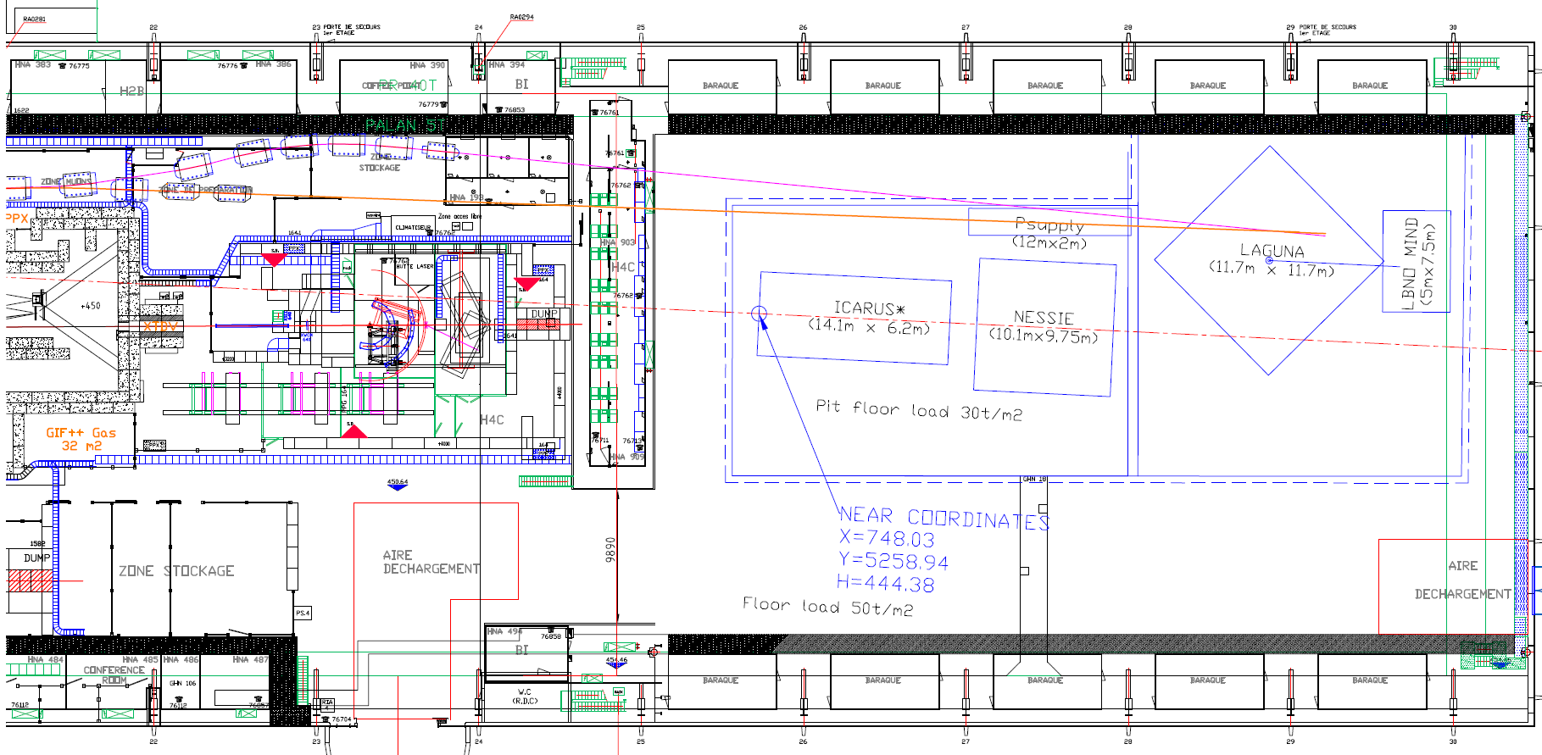
EHN1 extension with beams
H2 beam 10 GeV
H2 beam 30 GeV
Neutrino beam

Slide 3
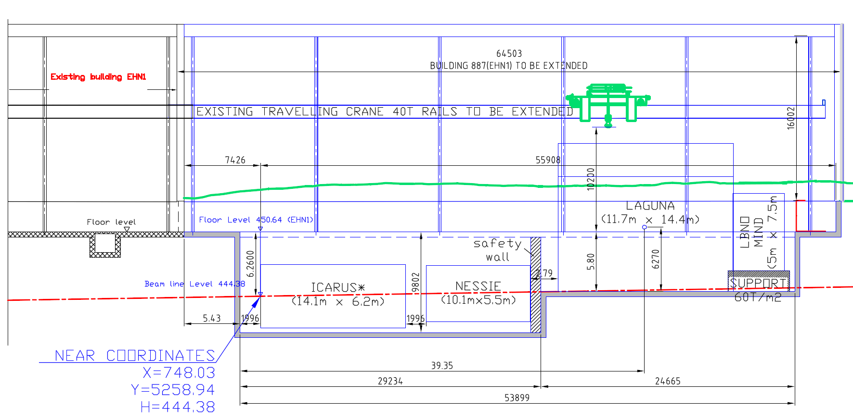
EHN1 side view

Slide 4
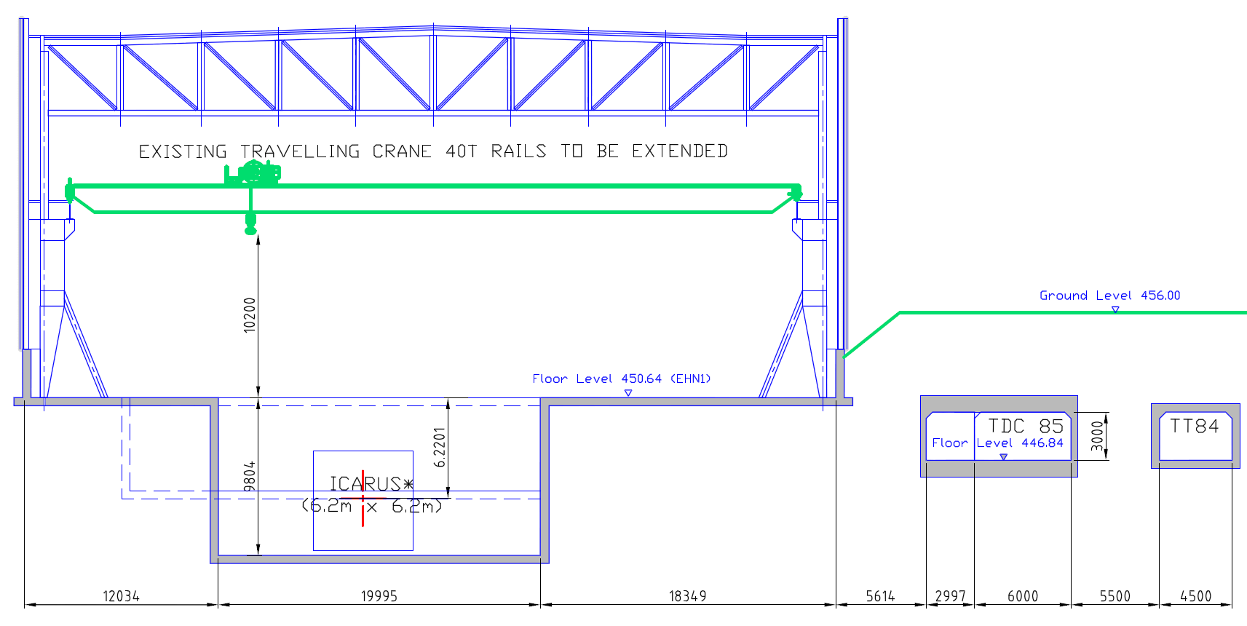
EHN1 section view

Slide 5
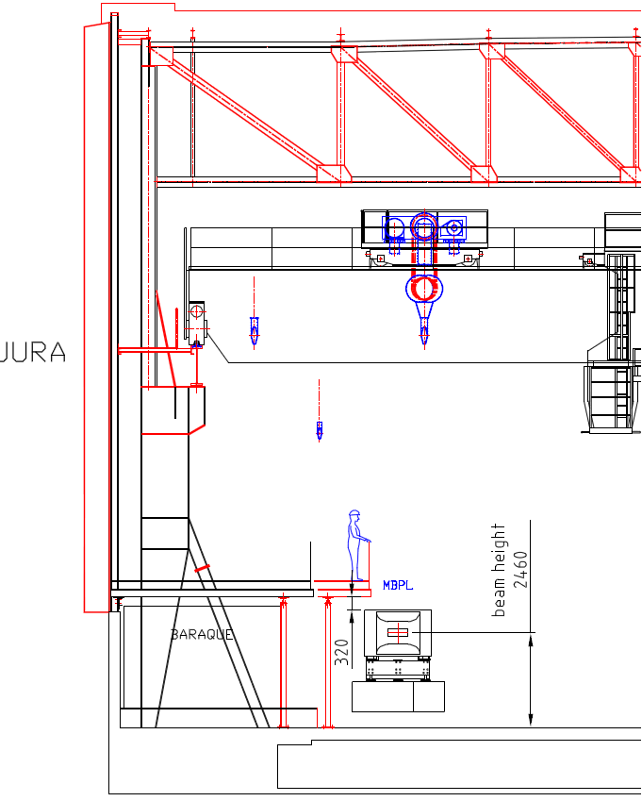
EHN1 section view
15:33
H2 beam
10 GeV

