Slide 1
Beam-beam deflection during Van der Meer scans
T. Pieloni
LHC Luminosity Calibration and Monitoring Working Group 8th April 2013
LHC Luminosity Calibration and Monitoring Working Group 29th April 2013

Slide 2
VdM Scan

Slide 3
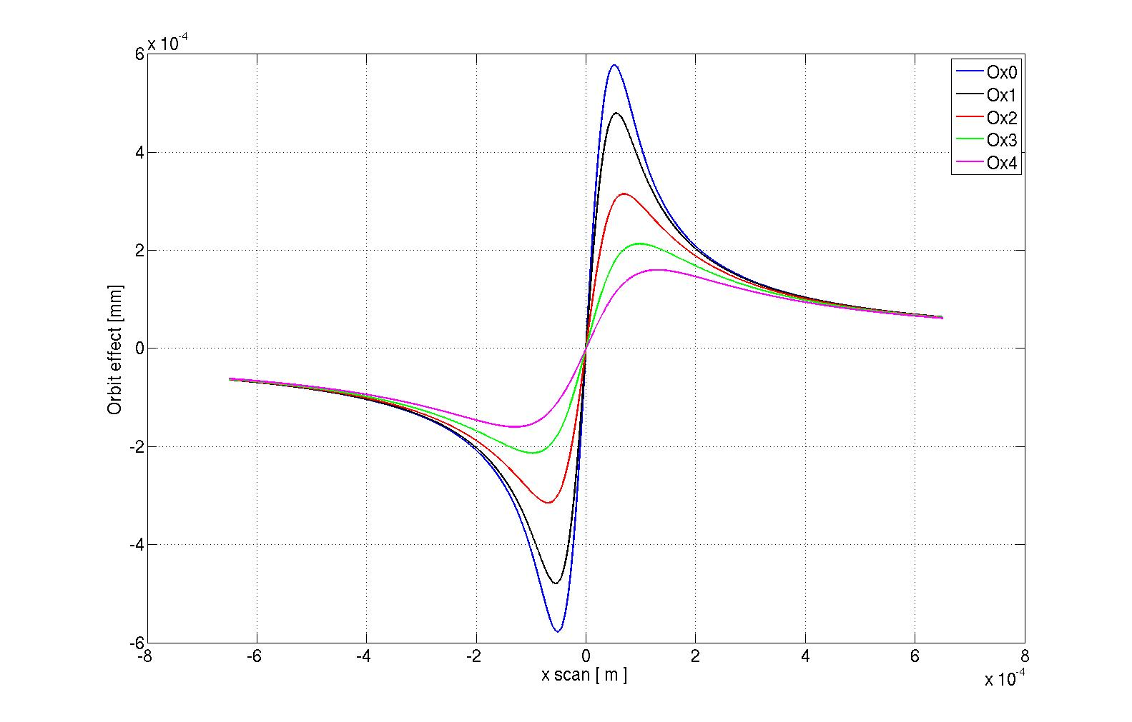
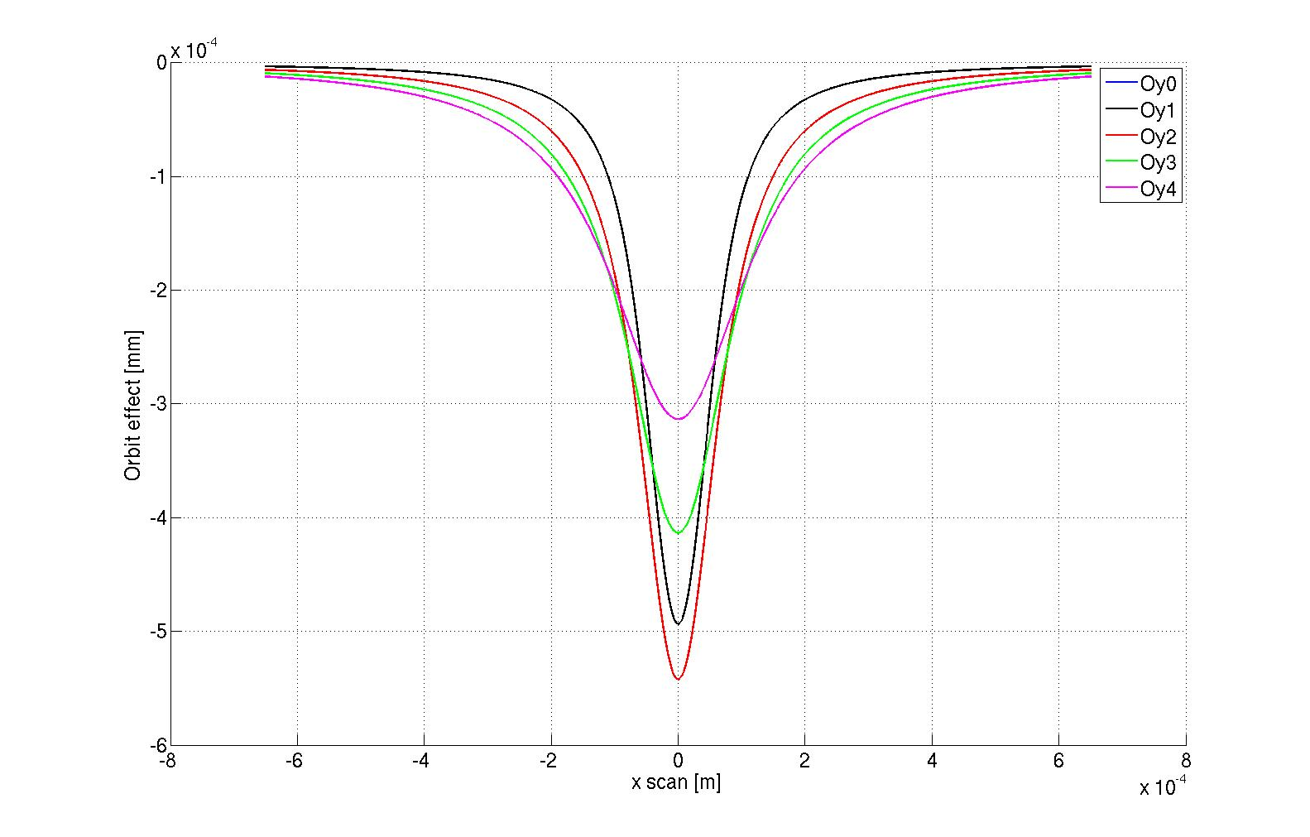
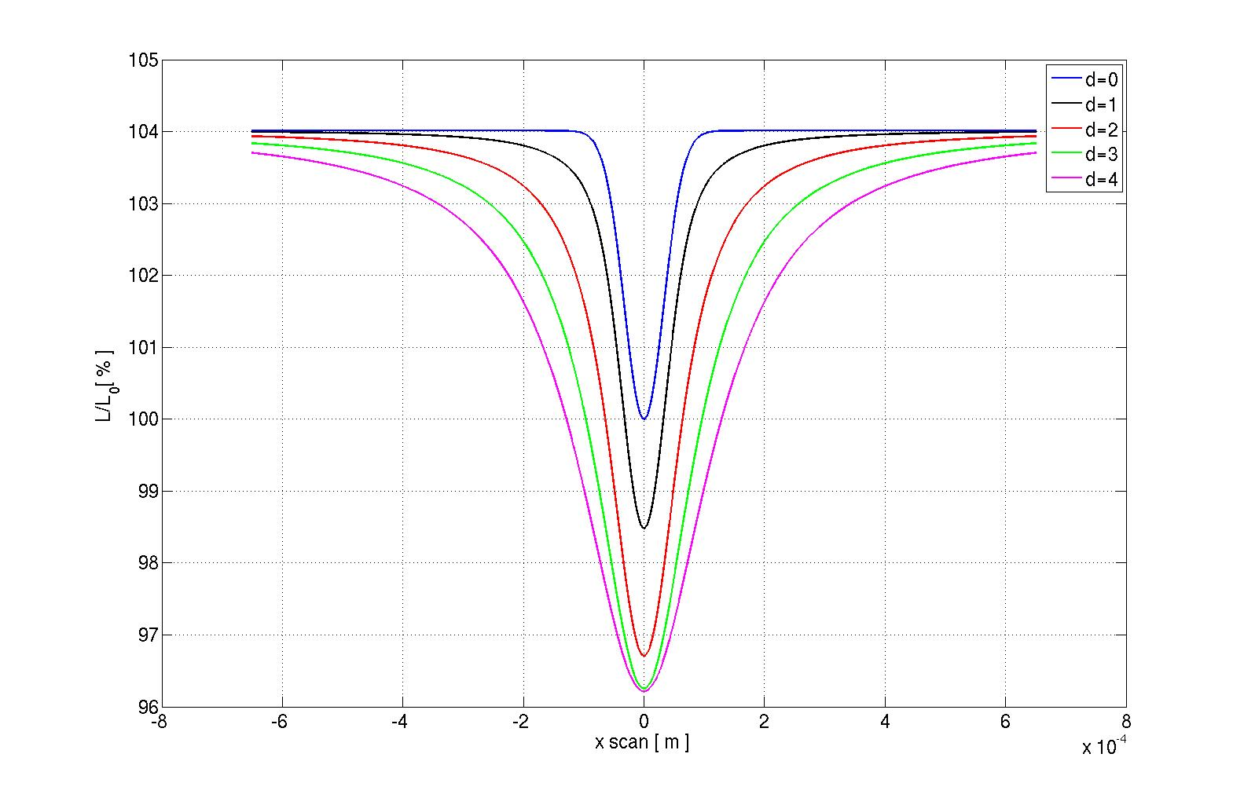
Beam-beam deflection during VdM Scans:
Analytical calculations using round Gaussian beams: effect is IMPORTANT!
X-plane deflection
Y-plane deflection
Calculations extended to non-round beams (Bassetti-Erskine formulas)
Provide a python routine for non-round beams to calculate deflection for defined configuration (29th April)
Lumi effects

Slide 4
Beam-Beam deflection angles and orbit
[Ref. M. Venturini and W. Kozanecki, SLAC-PUB-8700]
Deflections:
Closed Orbit effect:

Slide 5
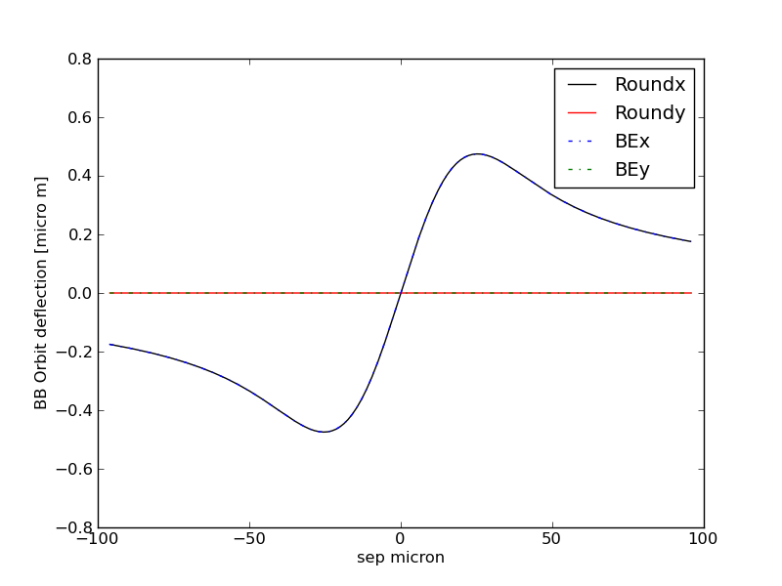
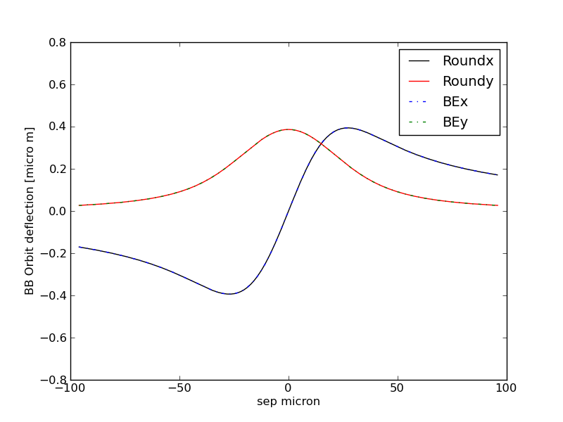
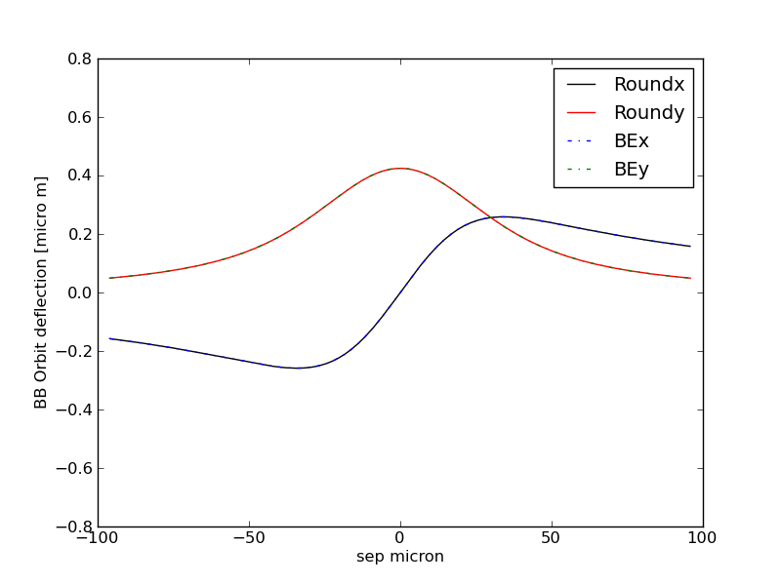
Example 1 round beams
H in-plane scan
H out-plane scan 1σ
H out-plane scan 2σ
BBScan.py: to test the BB routine, available for estimates
BB.py: calculation routine
BassErsk: to calculate the electric fields
Ref. CERN-ISR-TH/80-06.

Slide 6
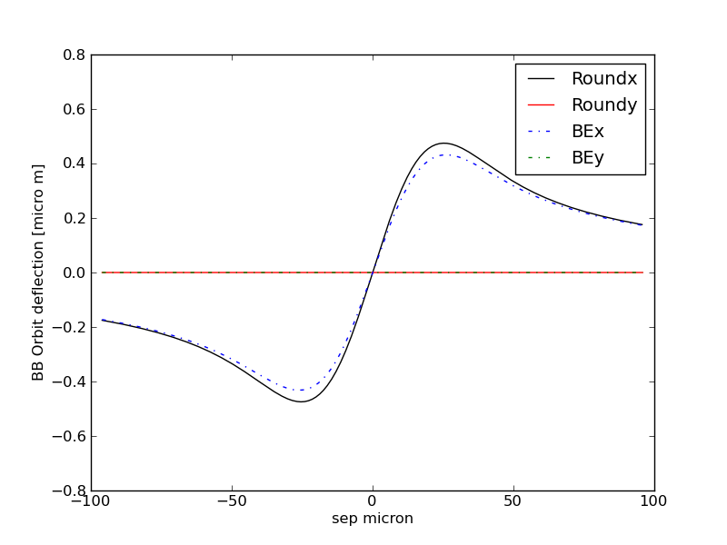
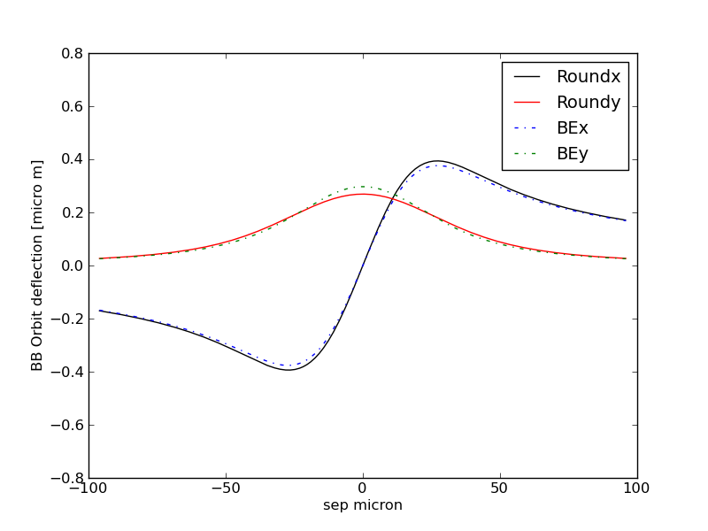
Example 2 non-round beams
H in-plane scan
H out-plane scan 1σ

Slide 7

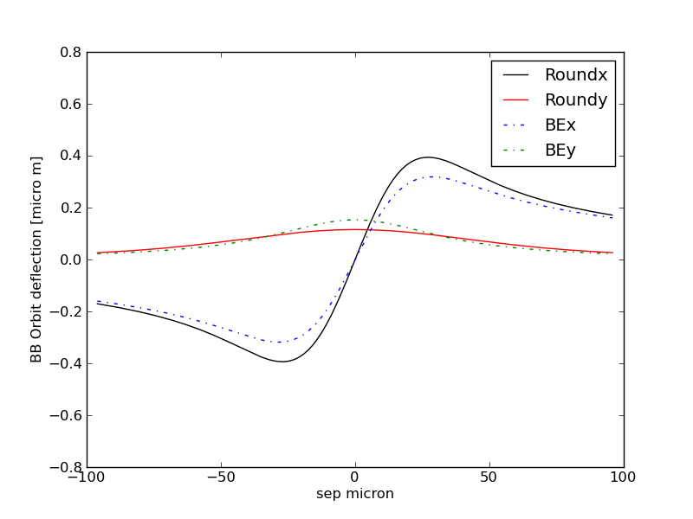
Example 2
non-round beams
H in-plane scan
H out-plane scan 1σ

Slide 8
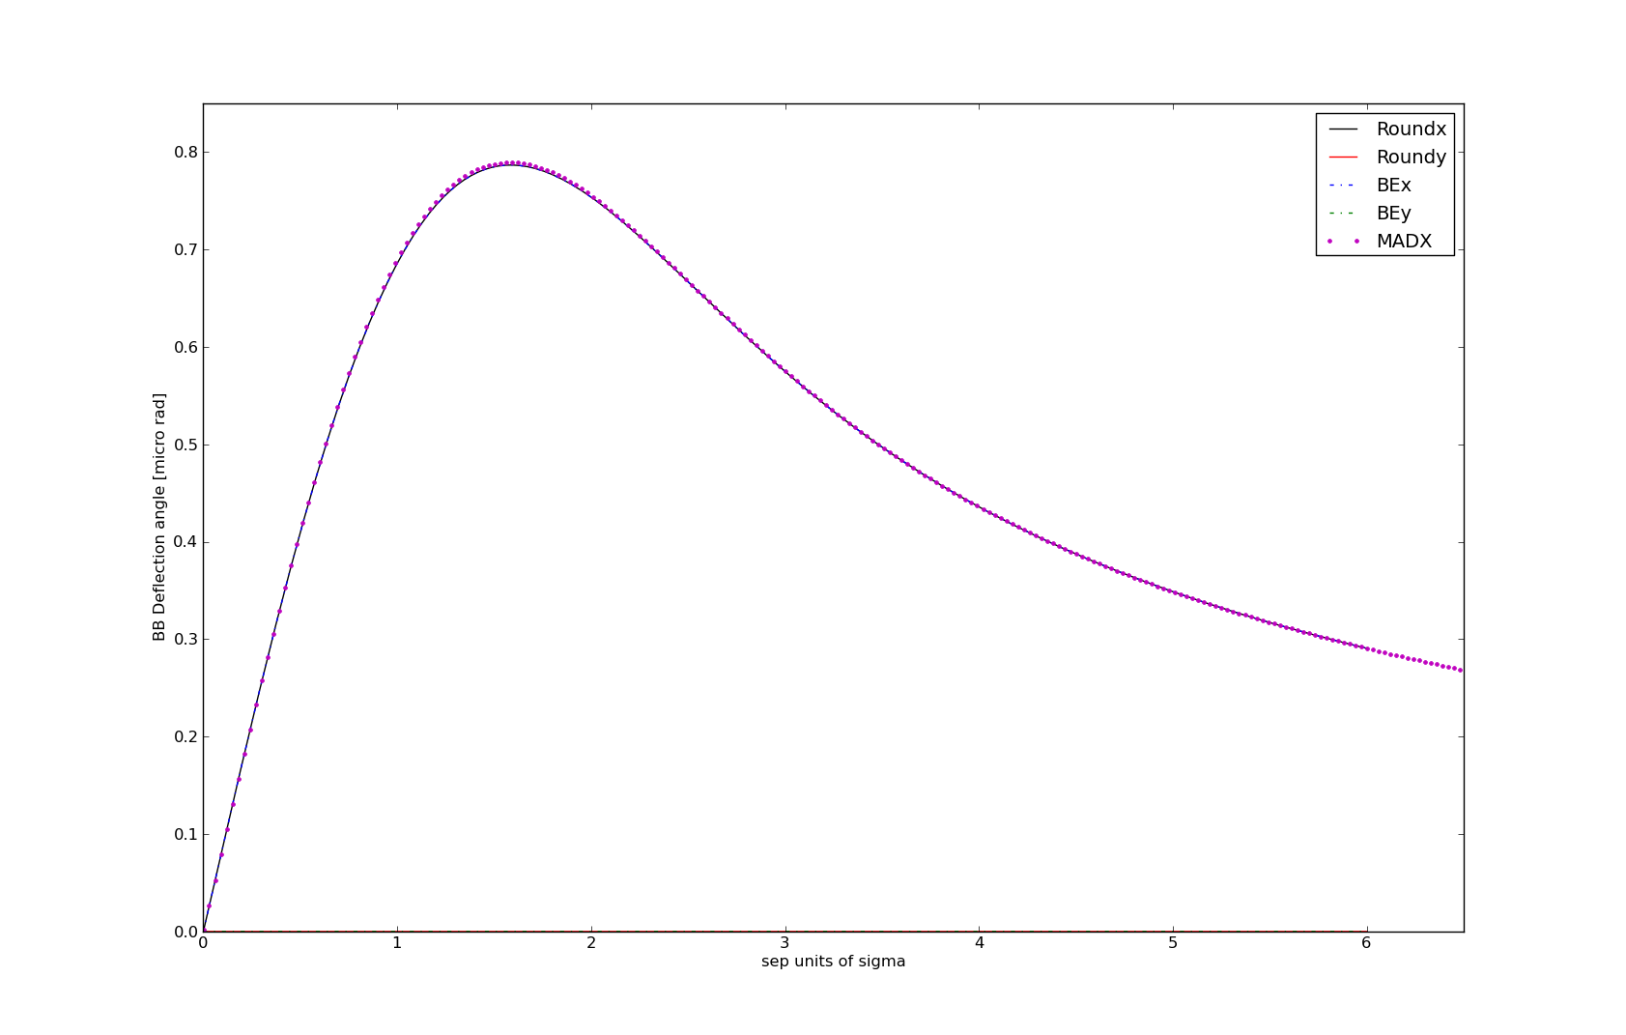
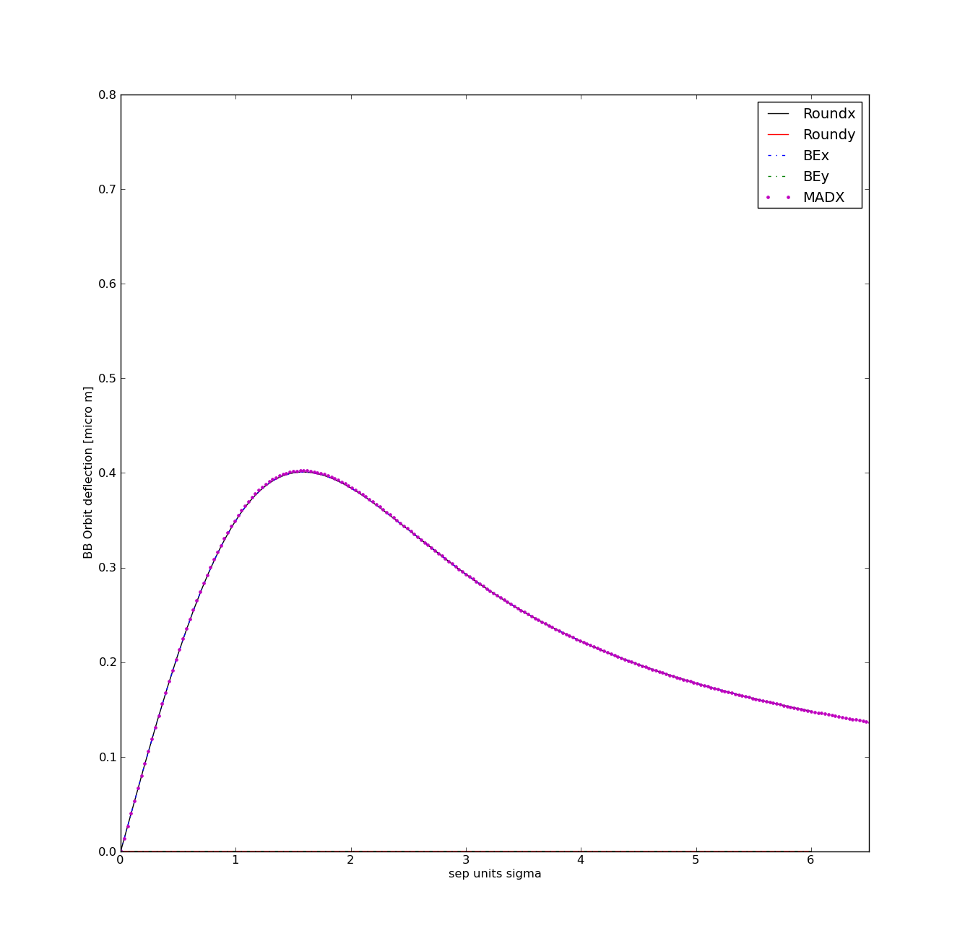
MADX vs analytical model IP1 scan H
VdM scans 2011 May
Emittance 4 μm
Optics:
MADX doesn’t give BB angular kick and closed orbit effect?!
TRACK in MADX gives angular kick and closed orbit effect?!
Verify with experts the implementation and ask for modifications!
With some tricks: Good agreement, differences due to dynamic beta effect

Slide 9
MADX:
CASE 1 (May 2011) 3.5 TeV V6.5.coll_special.3.5TeV_1.5m10m1.5m3m.str
CASE 2 (2012 April) 4 TeV V6.5.inj_special.str with coll tunes
Scan H in ATLAS and V separation in all other Ips
V scan in ATLAS and H separation in all other ips

Slide 10
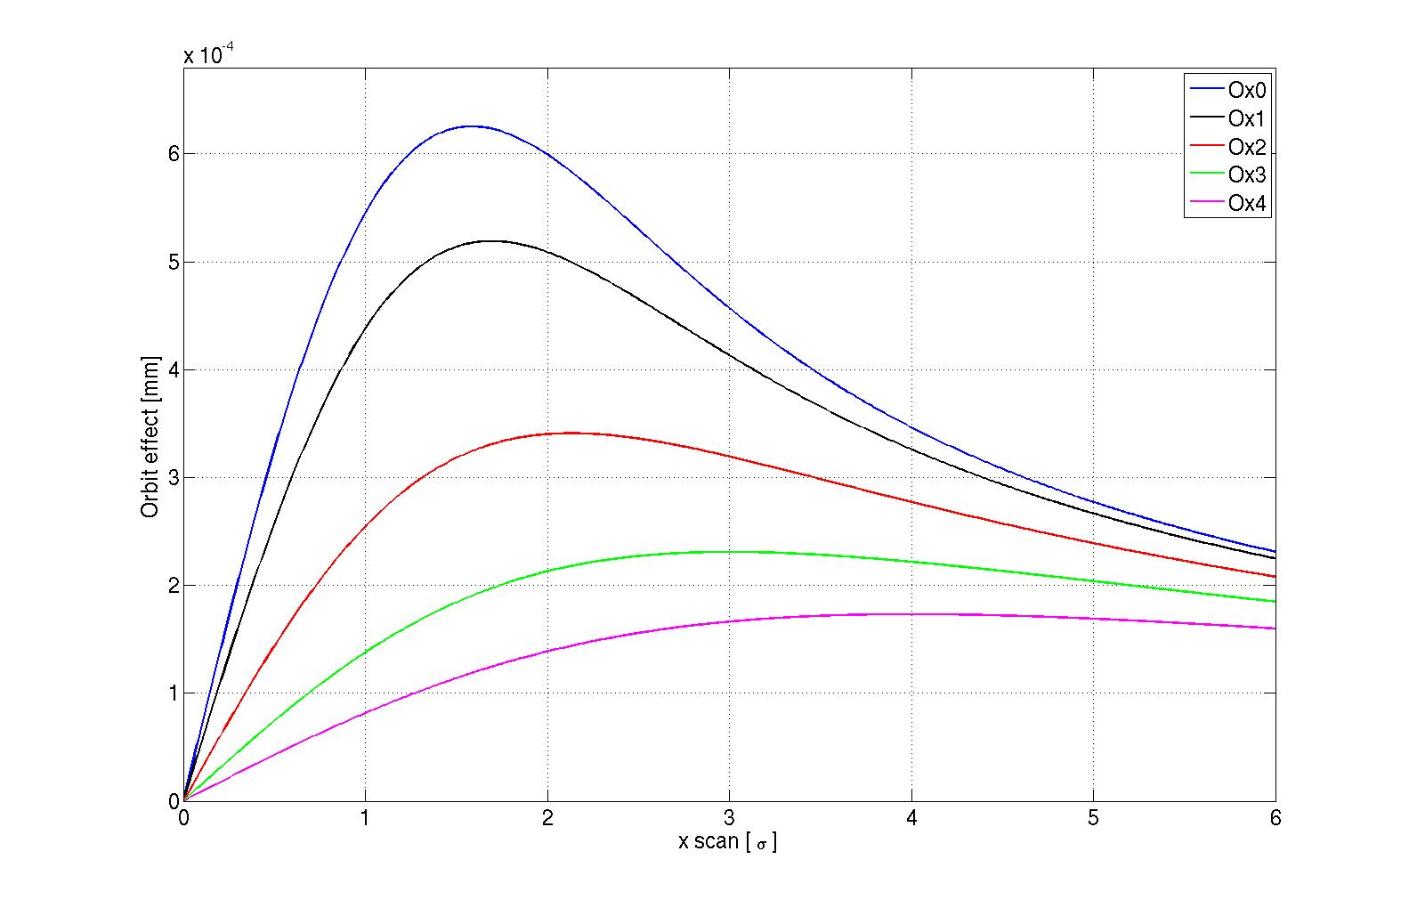
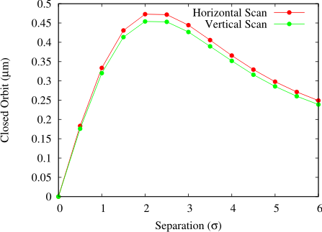
Next step 1
How effects adds up with multiple Ips?Evaluate effects on Van der Meer scans May 2011 and April 2012, to allow experiments to evaluate impact on results.
Analytical calculations do not take into account the self consistent orbits of the two beams: TRAIN code in next weeks
Reproduce VdM scan dynamics (interplay of different IPs), in this study assume 1 IP scan and other separated! Different scenarios should be studied!
Evaluate cases for after LS1 (different optics options: standard optics, ATS tunes)
S. White from Lumi days 2011
Closed orbit effects for ξ = 0.003.
Simulated with TRAIN.
Orbit effects for ξ = 0.003, analytical model

Slide 11
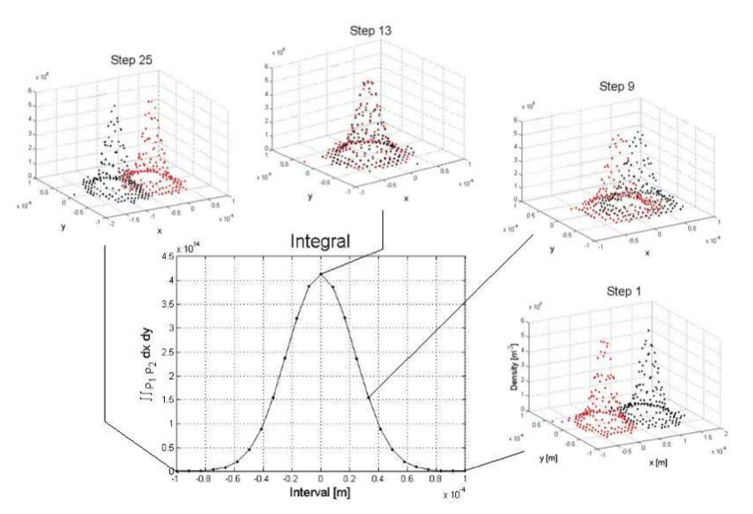
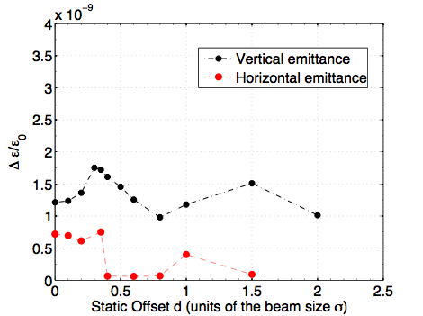
Next step 2
Is there something more during VdM scans?
Are distributions modified?
How different initial distribution will change the results?
Emittance growth?
T. Pieloni, W.Herr and J.Qiang, PAC09
Δσ / σ ₀ (per turn)
Multi-particle simulations
(work started M. Schubiger&T.Pieloni):
Any particle distribution allowed
Leaves particle distribution evolve in time
Time consuming simulations…will need time to conclude!

