Slide 1
STATUS AND PLANS OF ICARUS-NESSIE
(part 2 : plans)
Carlo Rubbia
GSSI, L’Aquila, Italy
SPS-C meeting June 25th, 2013

Slide 2
Pre-history: The P311/I-216 saga
During 1999 the P-311 experiment was proposed to carry on at CERN a highly sensitive search for νμ − νe oscillation in the appearance mode and a decisive test of the LSND claim.
Far position at 885 m
Near position at 127 m
Dual fine iron (2mm)-scintillator calorimeters of 476 t and 104 t
“The SPS-C recognises with interest the proposal of the short-baseline experiment P311 in the region of the LSND result, complementary to the MiniBooNE proposal at FNAL”
“However, P311 would not be able to produce results before MiniBooNE. In view of the above, P311 is not recommended for approval”.
“Maiani dixit”

Slide 3
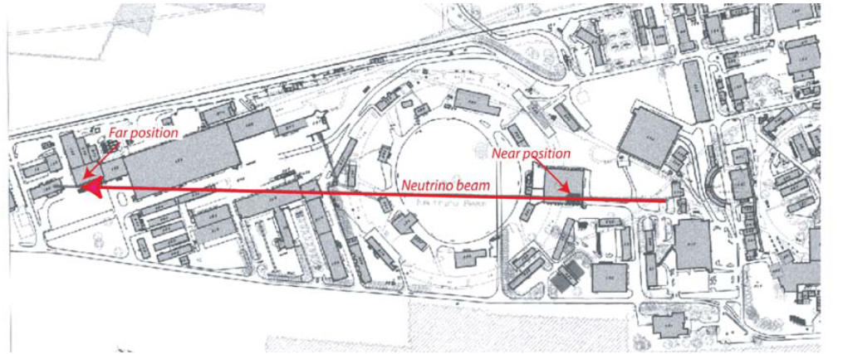
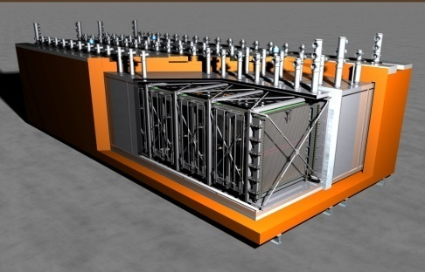
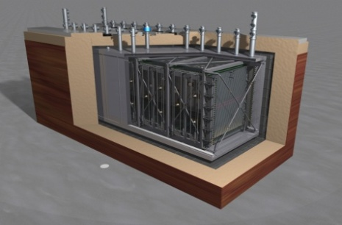
May 2009: the CERN /PS double LAr-TPC
DOUBLE-LAr:
Sterile neutrinos
with the CERN PS
The PS proton beam at 19.2 GeV/c is extracted from the PS via TT2, TT1 and TT7. The magnetic horn is designed to focus particles of momentum around 2 GeV/c.
The decay tunnel is about 50 m long, followed by an iron beam stopper. There are two positions for the detection of the neutrinos.
The far (main) location is at 850 m from the target; a secondary location is foreseen at a distance of 127 m from the target. MiniBooNE was at 550 m from the target.
Carlo Rubbia
CERN Geneva, Switzerland
and
INFN/LNGS, Assergi, Italy
Carlo Rubbia, CERN ,11May 09
ICARUS T600 moved
to CERN after 2012
Additional LAr-TPC
small detector

Slide 4
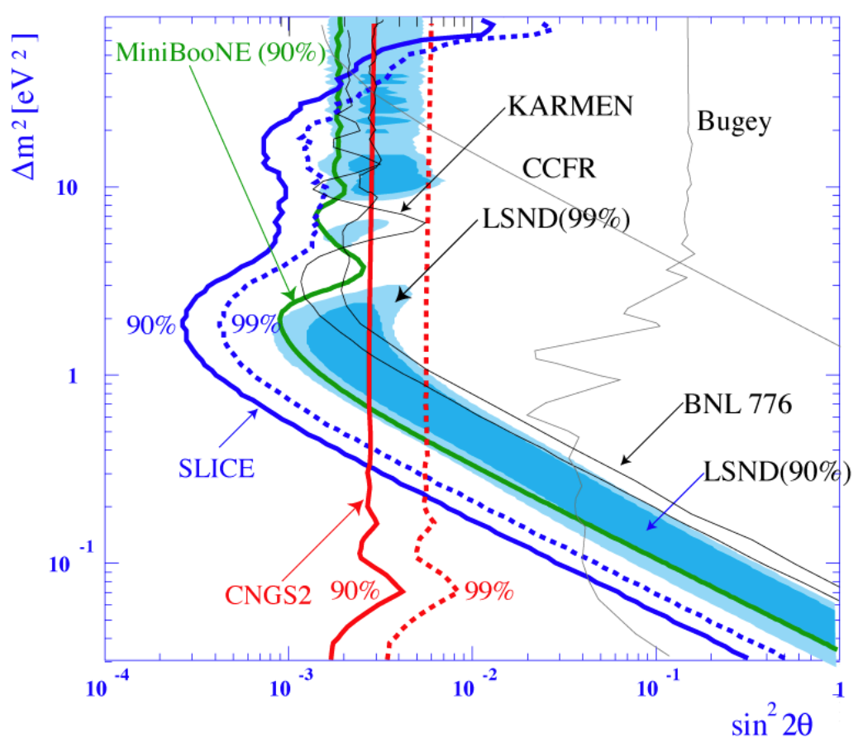
Expectations from the 2009 –CERN /PS double LAr-TPC
This proposal (2009)
2.5 10²⁰ POT
Present CNGS2 experimental results

Slide 5
CERN-16 March 2013
Deliberation Document on the update of the European Strategy for Particle Physics
The European Strategy Group ESG (Prepared by the Scientific Secretariat for the European Strategy Session of the Council)
at point f)
Rapid progress in neutrino oscillation physics, with significant European involvement, has established a strong scientific case for a long-baseline neutrino programme exploring CP violation and the mass hierarchy in the neutrino sector.
CERN should develop a neutrino programme to pave the way for a substantial European role in future long — baseline experiments.
Europe should explore the possibility of major participation in leading long — baseline neutrino projects in the US and Japan.
“CENF and Sterile neutrino not mentioned in the Document”

Slide 6
History of our proposal
May 10th,2009 “New opportunities in the physics landscape at CERN ” ArXiv:0909.0355 Hep-ex. First LOI for a dual LAr experiment at the CERN-PS
Oct 1st,2009 “European strategy for future neutrino physics”
March 9th,2011 Memo to SPS-C “Physics program for ICARUS after 2012”
Oct,14th 2011 “A comprehensive search for “anomalies”…with two LAR-TPC at CERN PS” . Proposal (SPSC-P-345) ICARUS
Oct. 11th, 2011 “Prospect for Charge Current Neutrino Interactions Measurements at the CERN-PS with two magnetic spectrometers for measuring CC neutrino interactions” . Proposal (SPSC-P-343) NESSIE
March 15th, 2012 “Search for “anomalies” from neutrino and anti-neutrino oscillations at Δm² ≈ 1eV² with muon spectrometers and large LAr–TPC imaging detectors” ,Techn. Proposal (SPSC-P 347)

Slide 7
History of the ICARUS experiment (cont)
Summer 2012 SPS-C recommends a joint working group between the ICARUS+NESSIE Collaboration and the CERN beam dept. in order to define and optimize the details of the beam design, associated infrastructure and experimental conditions.
Sept 2012 Krakow meeting: neutrino options presented
Jan, 2013 Erice meeting continues Krakow’s discussions
Jan 15th, 2013 (Positive) recommendations of SPS-C
Feb.7th, 2013 presentation of the “Letter of Intent for the new CERN neutrino facility (CENF)”
May 8th, 2013 Report of the SPC-Neutrino Working group
June 21st, 2013 CERN Council: (excerpts from the Zwirner presentation) “In the approved CERN-MTP 2014-18 no concrete plan for developing and funding neutrino-related activities at CERN, apart from a very modest seed funding for more detailed studies in neutrino physics at CERN”.

Slide 8
Related consequences
There will be no funding for a new neutrino beam in the North Area. This programme is therefore closed ?.
CERN proposes to move the ICARUS-NESSIE programme for a technical overhaul in the Gargamelle Hall. This is not yet for an experiment in a beam, but simply a beneficial occupancy.
An agreement to this effect may be presumably signed with CERN early in July in order insure the necessary member states funding for 2014.
A R&D plan for possible future neutrino physics at CERN will be initiated in the second half of 2013 having in mind:
  Physics case for SB oscillation experiment
  Possible synergies with LB neutrino projects
  Estimate of cost and impact on other CERN projects
  Physics communities intending to participate
“What is the status of SPSC-P-347 ?”

Slide 9
Our new collaboration ICARUS/LBNE :
The Italian ICARUS Collaboration has now joined LBNE, the long baseline Collaboration from FNAL to the Homestake mine.
In the last ICARUS – LBNE Meeting we have co-signed that:
  We agree to collaborate on the Long-Baseline Neutrino Experiment.
  We agree to collaborate and coordinate R&D in the development of large LAr detectors for neutrino physics.
  We agree to collaborate and coordinate on development of software for LAr detectors for neutrino physics.
  We are interested to investigate the potential use of ICARUS T600 as a near detector for LBNE.
  Our intention is to proceed towards the joint realization of a larger underground LAr detector in the LBNE neutrino beamline
Mechanisms of exchange of personnel will be investigated.

Slide 10
A neutrino beam activity prior to the LBNE experiment
In order to comprehensively prepare for the LBNE related programme and in view of the relative novelty of the LAr-TPC technology, a vast “LAr programme” must be continued, in which real neutrino and antineutrino events are studied at lower Eν ’s.
The T600 will then be operated (either at CERN, if a beam will be made available on a reasonable time schedule, or else at FNAL) collecting a large number (≥10⁶) of events on a short baseline and also appropriate for the future LBNE experiment.
In addition to a definitive clarification of sterile neutrino, the programme may pave the way to the realization of the LNBE detector for instance with
  An accurate determination of cross sections in Argon
  The experimental study of all individual CC and NC channels
  The realization of sophisticated algorithms capable of the most effective identification of the events.

Slide 11
The need for a continuing neutrino programme
The ultimate goal of the LBNE experiment is the realization of a vast International programme in the Homestake mine with an adequate detector’s mass in order to detect both neutrino events from FNAL and possibly other underground non–accelerator phenomena
We strongly believe that the exclusive utilization of a charged particle beam as proposed by the LAGUNA collaboration, will be vastly insufficient and unrealistic for a substantial European role — at least at the level of development and complexity of our LAr — TPC programme, and in order to prepare adequately for the long term realization of the LBNE.
The direct and continued access to a neutrino beam is necessary if we were to maintain the appropriate levels in the R&D and the participation in the physics developments with a “learning” process based on real events and cross sections.
“LAr ion space charges will strongly distort charged particle beams”

Slide 12
Conclusions
After years of discussions and in spite of the promise to “pave the way for a substantial European role”, the CERN plan for neutrino physics expressed in the CERN-MTP 2014-18 is not yet clearly defined and it is now without any appreciable funding.
ICARUS has now successfully completed the LNGS experiment
The T600 will be overhauled by the end 2014.(but where ??)
Our vigorously INFN driven programme will be continued, but in a closer collaboration and as members of the LBNE team.
T600 is today the only operational, physical scale LAr detector and it shall be so for several years to come. We intend to:
  contribute to the clarification of the “sterile neutrino” story
  collaborate with LBNE during the preparation phase and with a large amount of neutrino events at the appropriate energy
  our detector as a convenient “near detector” for LBNE
The useful lifetime of the ICARUS detector could then be extended to the two next decades to come !

Slide 13
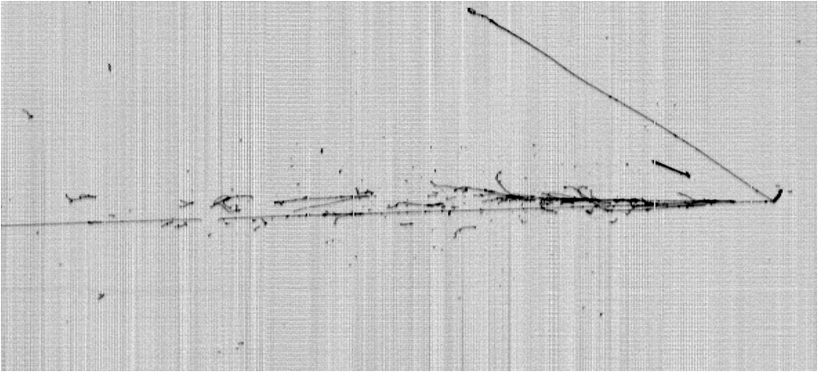
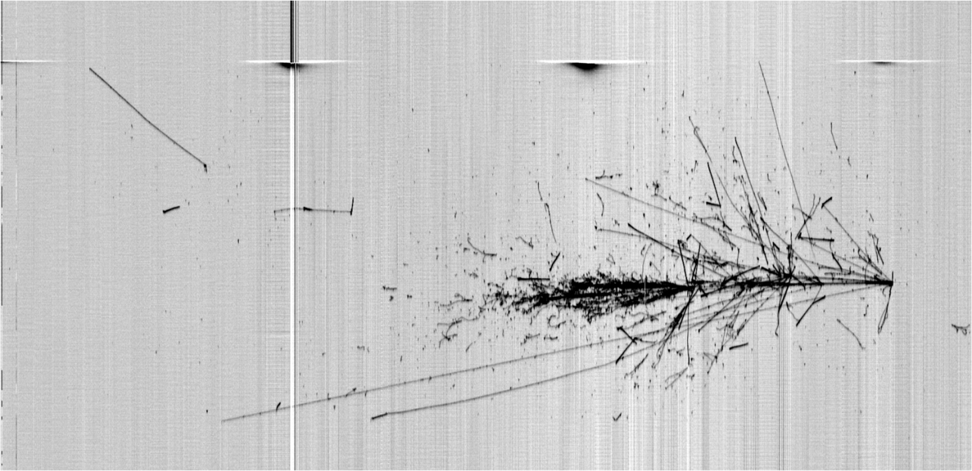
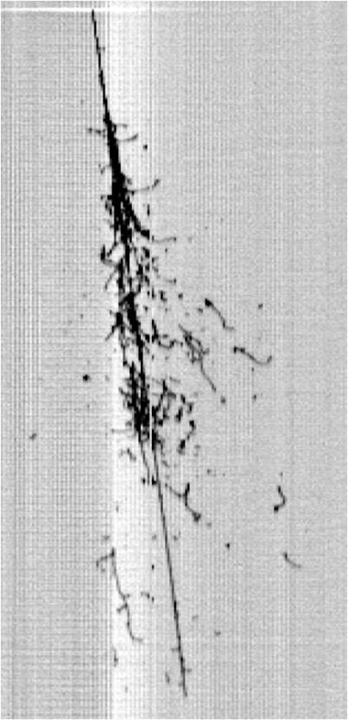
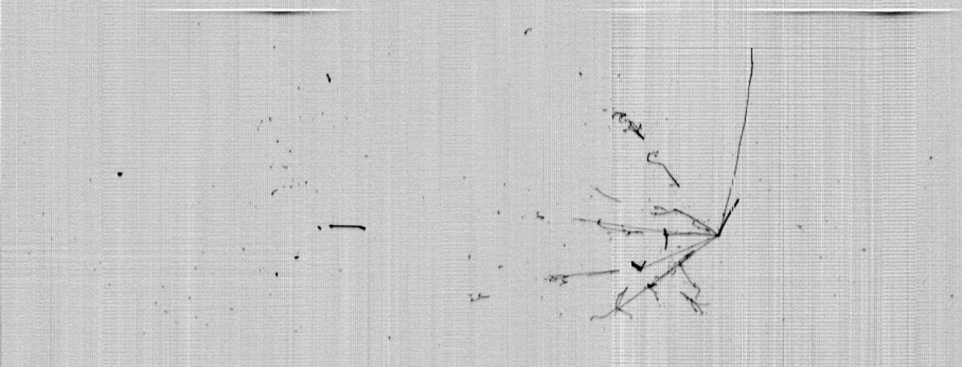
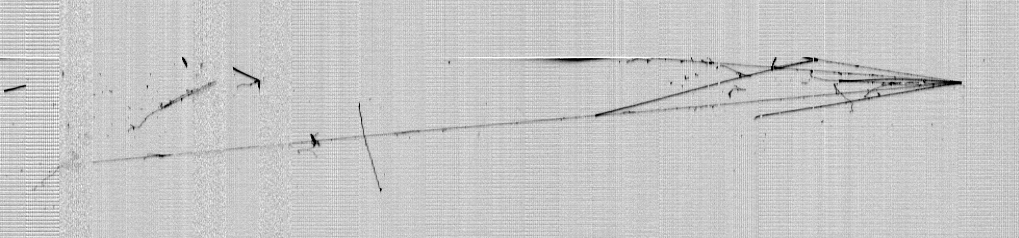
Thank you !
LNGS_May2011
Slide 13

