Slide 1
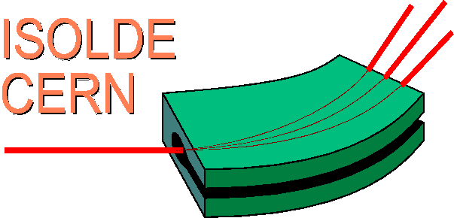

CERN
ISOLDE facility
HIE ISOLDE – Workshop 2013
Targets and Front Ends
“A new modulator system”
Contribution: by T.Fowler, J.Schipper, B.Bleus, T.Gharsa/TE-ABT-EC
prepared by R.A.Barlow (November 2013)

Slide 2
OUTLINE
Why modulate the target ?
Existing HV modulation characteristics
Existing HV modulator
The ISOLDE HT Room
Upgrade of existing modulator
Reasons for modulator upgrade
The Marx generator, the C modulator
HV test cage and current development
Behlke switch and a Behlke test bench
Current studies and conclusion

Slide 3
WHY MODULATE THE TARGET?
Ionisation around the target in air during and immediately after beam impact produces excessive loading on the power supply which reduces the target voltage level
To ensure extraction of short life-time isotopes this voltage is required to recover to its stable value within 10ms
Because of the limited power output of the high precision power supply the recovery time cannot always be respected
A modulation system is used in which the charge on the effective target capacitance is resonantly transferred to a buffer capacitor during the heaviest ionisation period ( few tens of us after beam impact) and re-established ~200us later on the target capacitance
Circuit losses requires the power supply to provide current for a further 6ms before full stable target voltage is obtained (±0.6V)

Slide 4
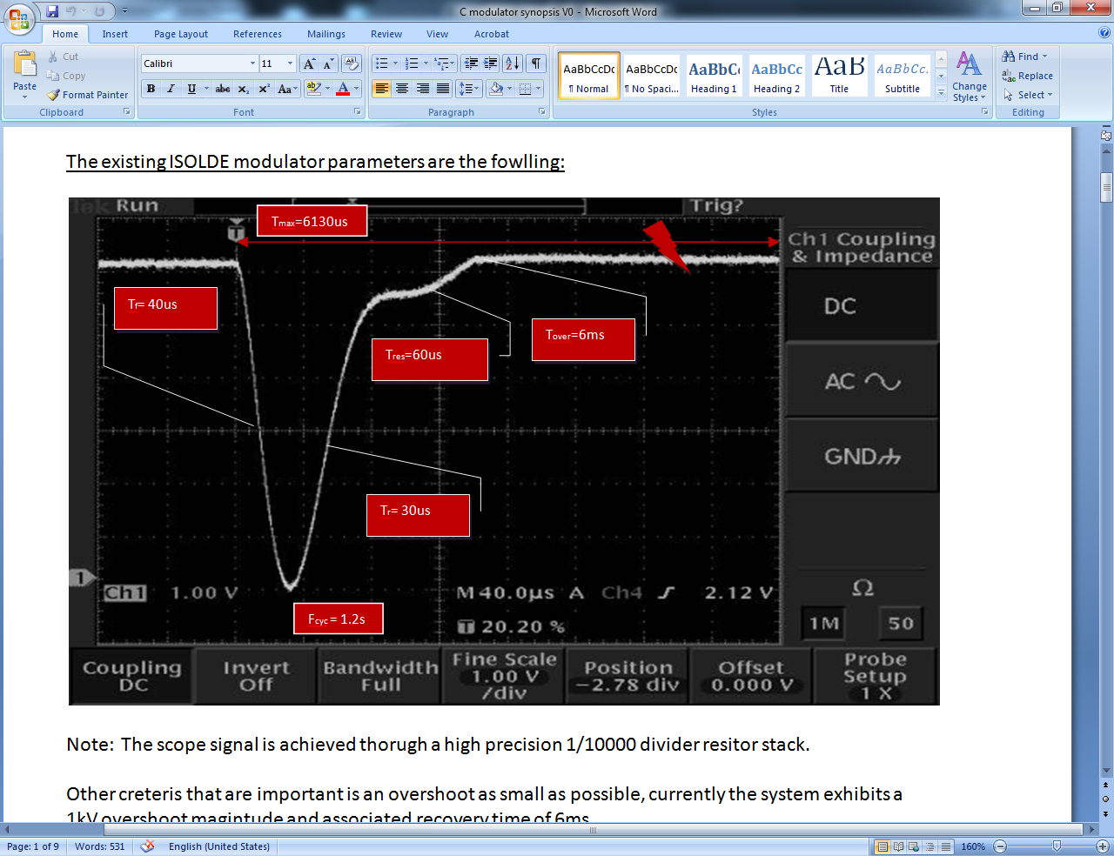
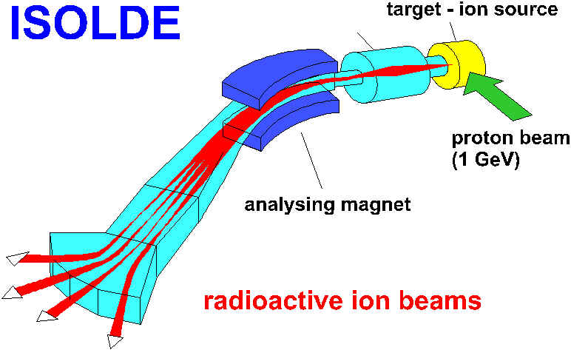
EXISTING HV MODULATION CHARACTERISTICS
Specifications:
Fast recovery from modulation
10⁻⁵ DC voltage stability for isotope mass selectivity
H/W requirements:
High precision HV power supply
Advantages of modulation:
Prevent HV breakdown
HV recovery time shortened
Beam impact

Slide 5
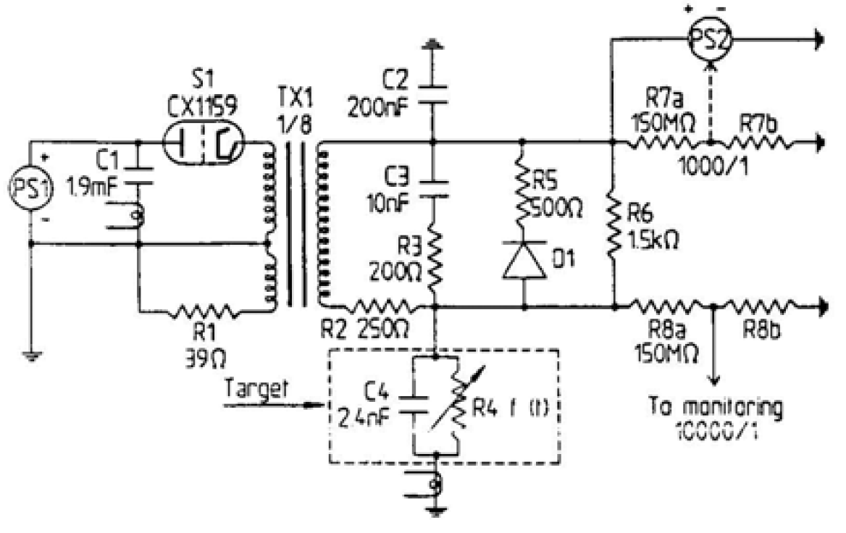
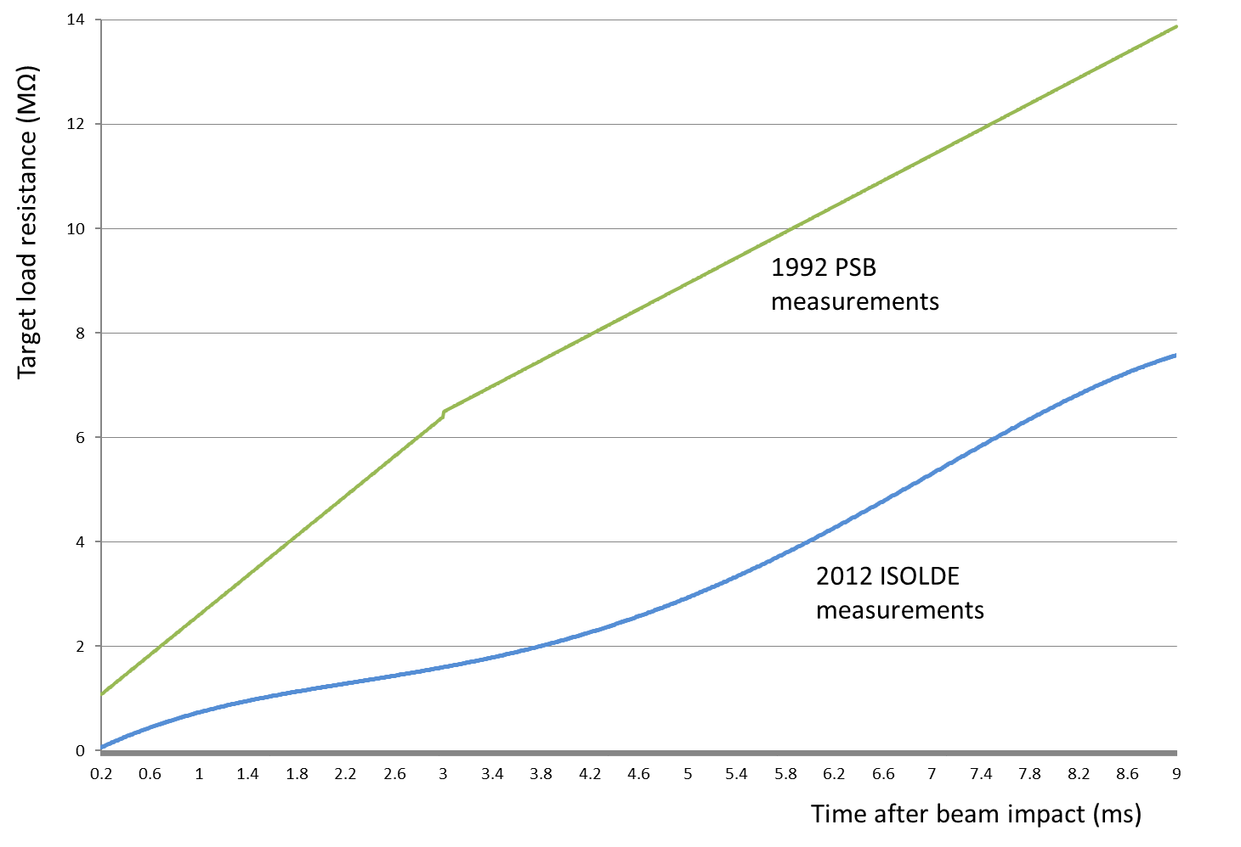
EXISTING HV MODULATOR
Commutating thyratron
200nF buffer capacitor
Precision power supply
+/- 0.6V on 60kV (custom-design, ASTEC)
Modulation power supply
(FuG)
Target model

Slide 6
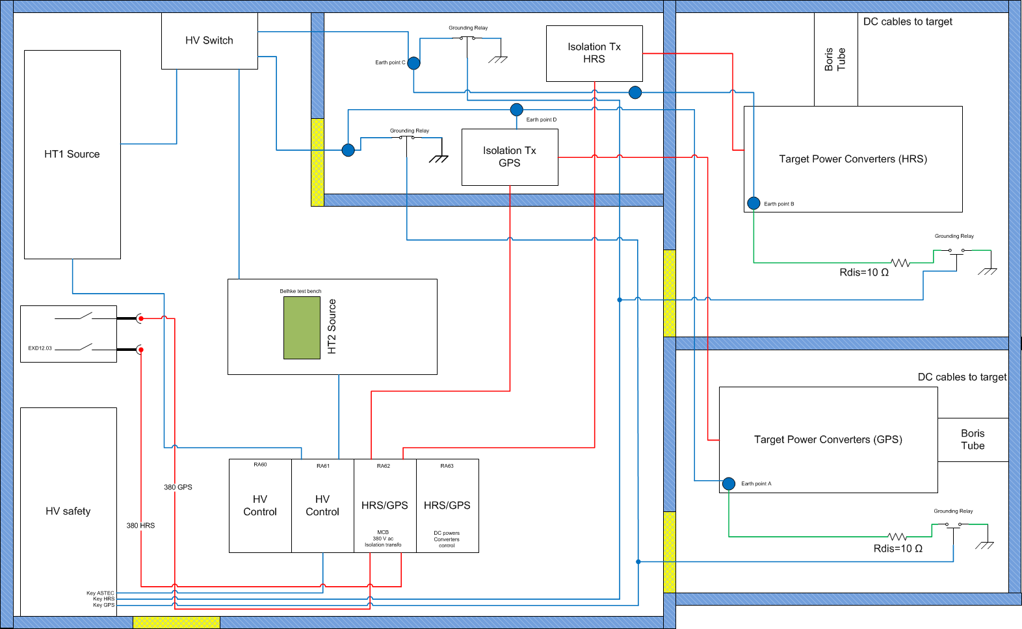
ISOLDE HT ROOM

Slide 7
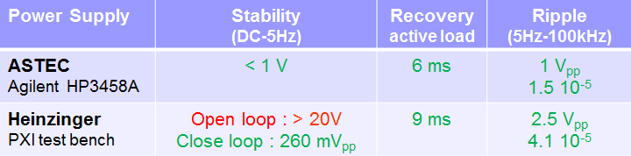
TENTATIVE UPGRADE OF THE EXISTING MODULATOR
Performance tests were carried out on a 60kV/40mA bi-polar power supply from Heinzinger as possible replacement solution of the custom-built ASTEC power supply
On most targets the recovery time specification was achieved however some targets result in 40-50ms recovery
The Heinzinger suffers from a thermal drift of tens of volts over the first few operating hours- implementation of an external feedback loop has been made to compensate for this

Slide 8
REASONS FOR MODULATOR UPGRADE
Increasing ionisation due to new target materials and neutron converters has stretched the limits on the voltage recovery time, >10ms
ASTEC power supplies more difficult to maintain and repair, these are no longer manufactured
Other modulator components are aging
HIE-ISOLDE intensities will add further stress onto ionisation impact

Slide 9
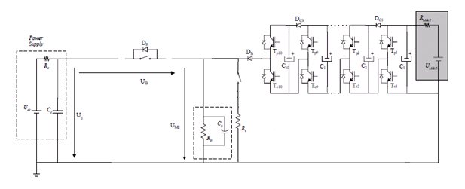
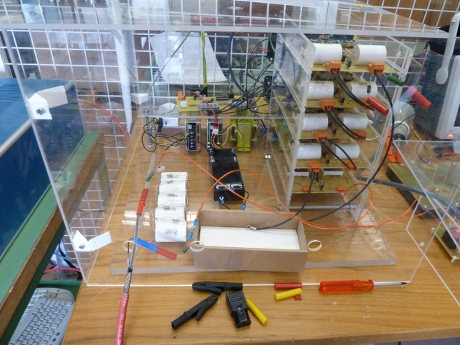

Proposed modulator variants:
THE MARX GENERATOR MODULATOR
Marx generator prototype circuit developed in collaboration with Lisbon University, 10kV system. Tested at 3kV only.
Reduced voltages across individual devices
A good recovery time with a standard R-C load. Dynamic ionization effects are ignored
Control of fall and rise times possible to reduce risk of HV breakdown
Many devices, troubleshooting difficult
PS high current
Reliability
Trigger system complex
Expensive system

Slide 10
Proposed modulator variants:
THE C MODULATOR
HV semiconductor switch
Simpler circuit
Monolithic HV semiconductor-based switch commercially available
Rapid recovery time
Flexible modulation time
Compact
Re-uses many passive components of present modulator tank
Semiconductor switch is not a proven, mature technology
Fast rise time may increase probability of HV breakdown

Slide 11
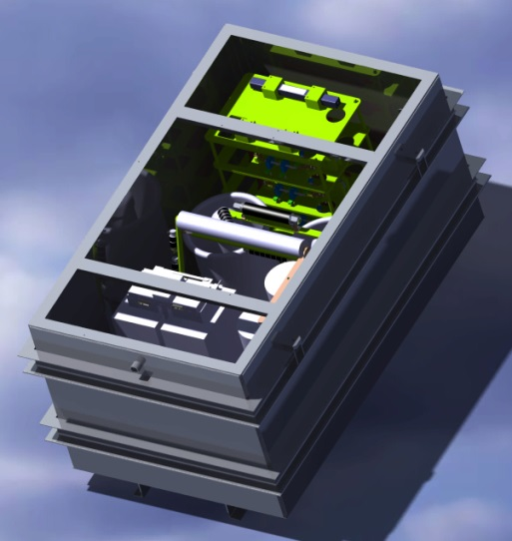
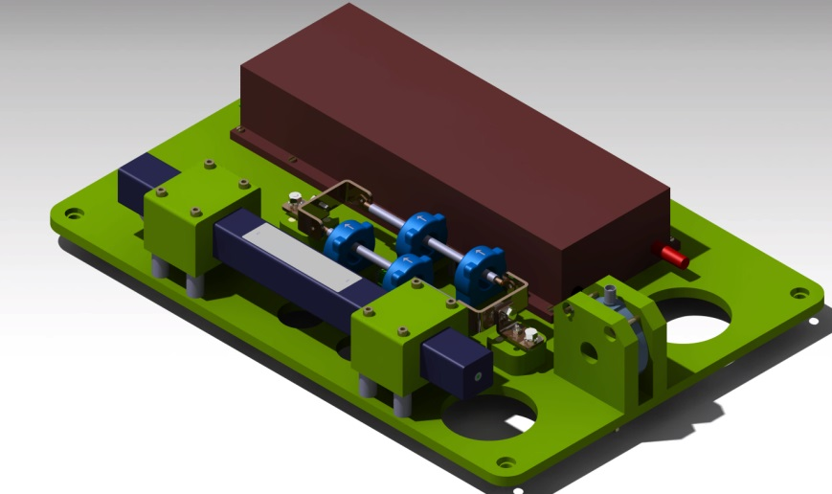
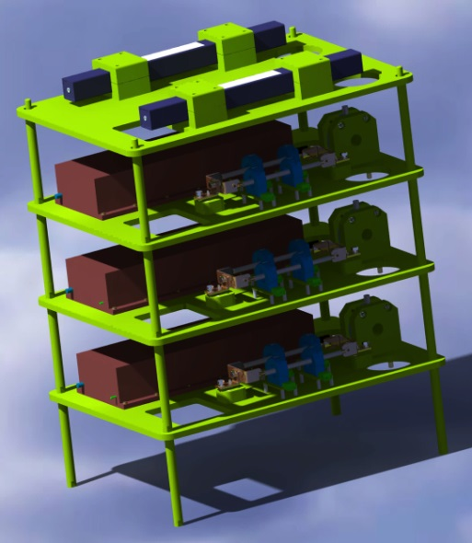
THE C MODULATOR – MECHANICAL OUTLINE
Three tier modular system
Easy maintenance
Basic external diagnostics
Sits in existing housing

Slide 12
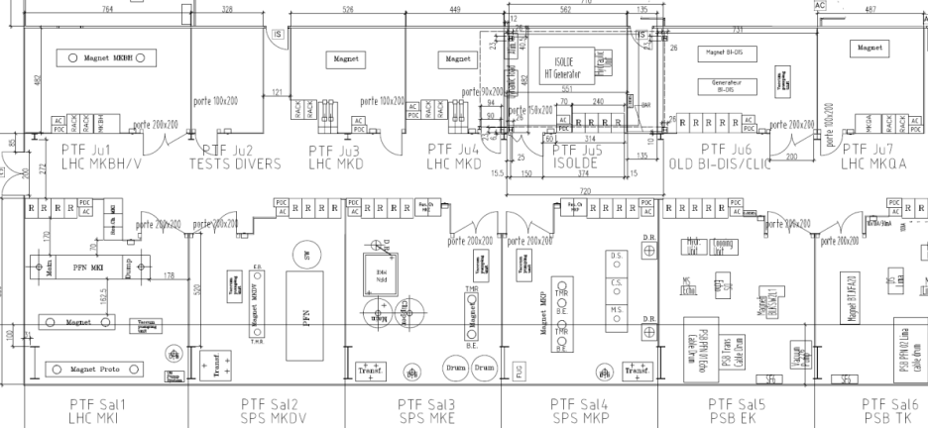
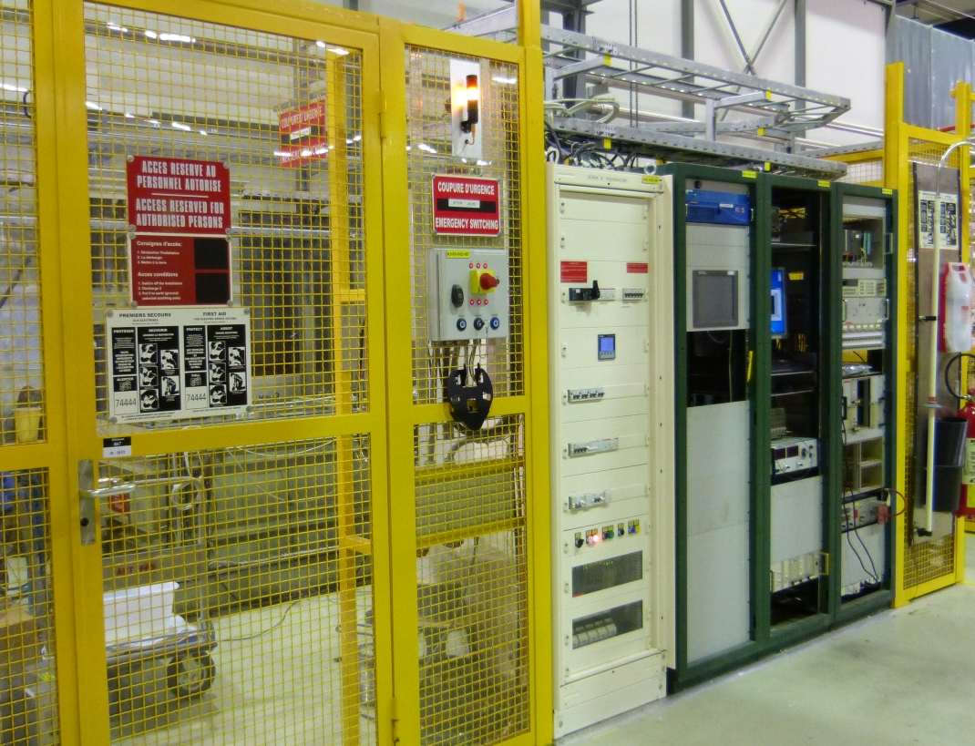
DEDICATED HV TEST CAGE FOR ISOLDE MODULATOR
BUILDING 867, Prevessin, CERN
Technical characteristics
Modern HV test facility
Safety access system
Spacious (important for 60kV test)
Overhead crane
Static and dynamic load capability

Slide 13

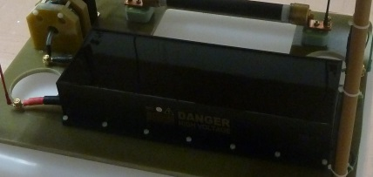
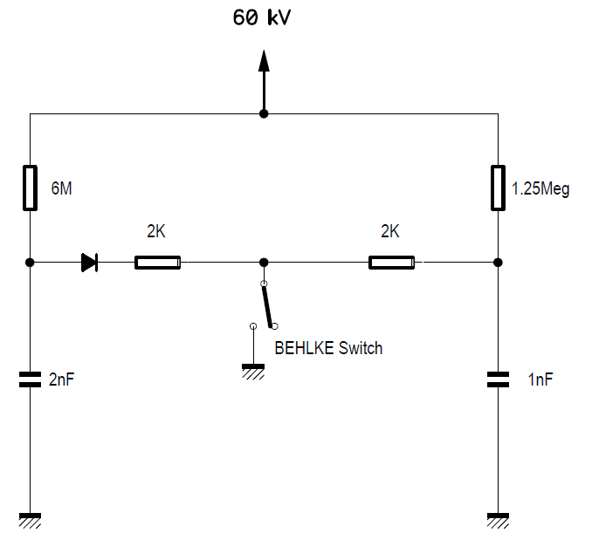
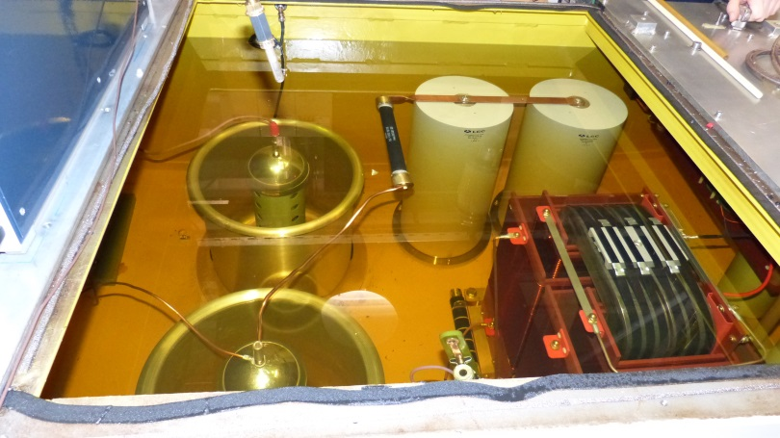

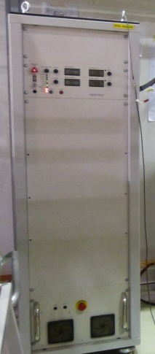
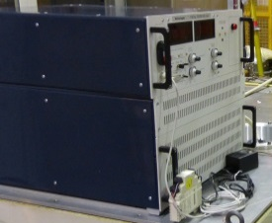

CURRENT DEVELOPMENT: C-MODULATOR
90kV Behlke switch + Behlke diode (FDA 800-75)
Dummy load
Static + dynamic
60kV 300 mA
65 kV 40mA
Inside the generator tank, 200nF Capacitor Bank

Slide 14
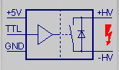
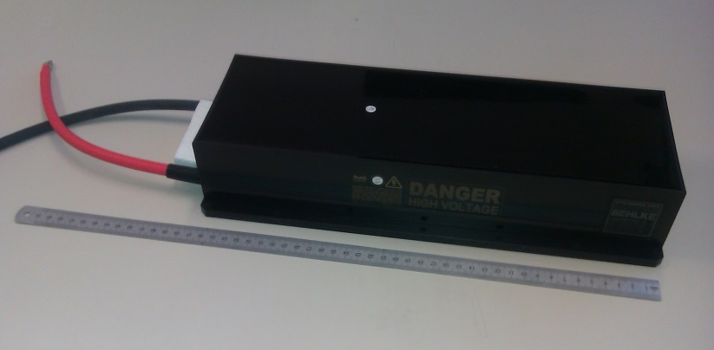
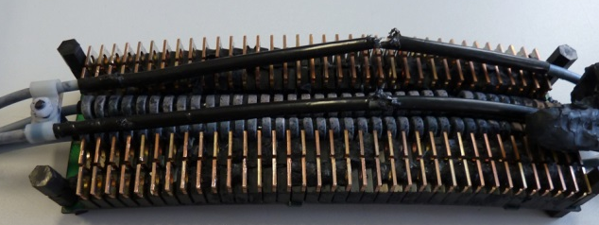
THE BEHLKE SWITCH
Technical characteristics
Series-parallel MOSFET architecture
Control Unit
TTL level triggering
90kV Behlke Switch
(MODEL HTS 901-10-LCS)
Ip(max) =100ADC (tp<200us,1%duty cycle)
On Res=32Ω.typ
Tr(on)=15ns

Slide 15
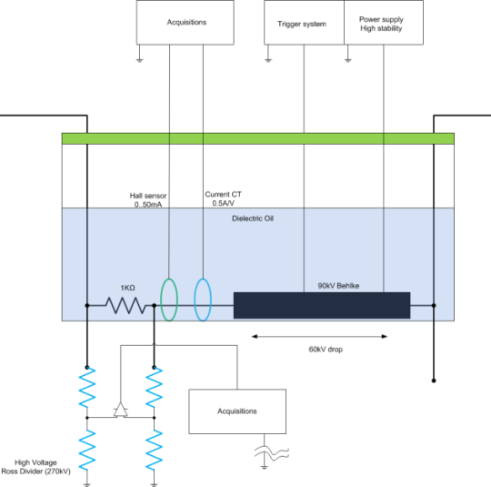
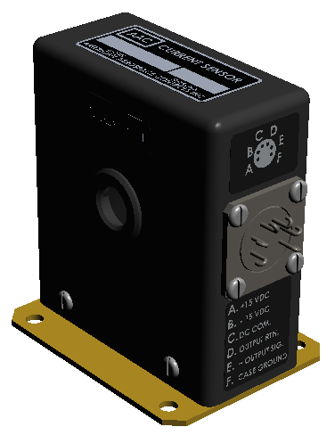

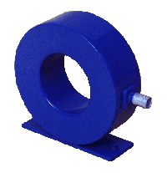
TEST BENCH FOR A BELHKE SWITCH
High current measurement
Low current measurement
Switch voltage drop
Series resistor voltage drop
High precision voltage measurement
Hall effect transducer AAC,
905B-50 (0..50mA of dynamic range)
Ross VD-270 matched
pair HV dividers
CT Stangeness,
model 0.5V/A

Slide 16
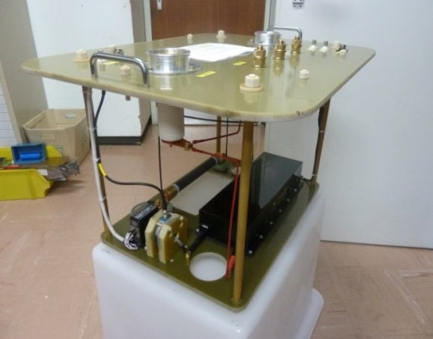
TEST BENCH IMPLEMENTATION
Voltage holding capabilities of the system
Voltage and current measurements linearity test
R ‘ON’ studies
Studies with dynamic load
Switch behavior when triggered
Di/Dt’s & Dv/Dt’s
Snubber circuits investigation

Slide 17
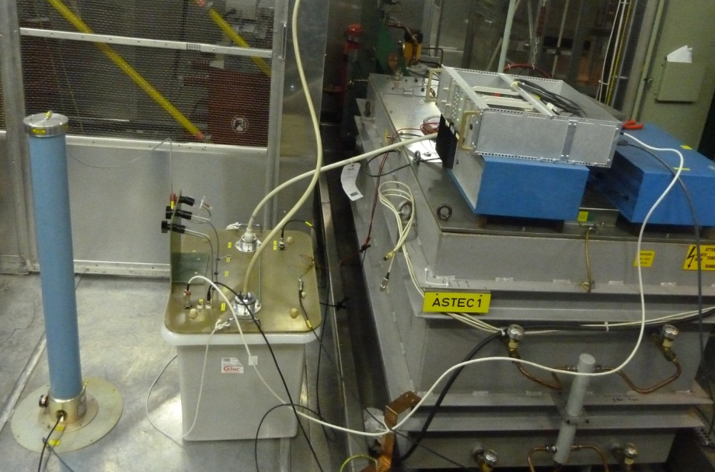
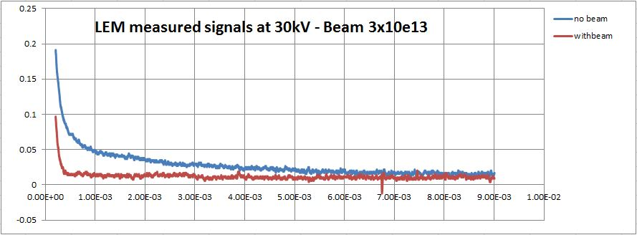
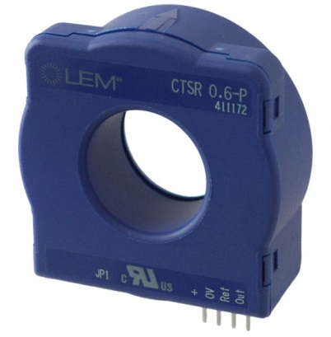
TEST BENCH MD AT ISOLDE
Aim to measure real target current and test robustness of Behlke switch.
Tested at 2 intensities levels (1x10^{e13}p+ & 3x10^{e13}p+)
‘Cold’ and ‘Hot’ target measurements
Extraction Electrodes in/out position
Dynamic electrical load studies (with beam/no beam)
Target charging voltage
Dynamic load impedance of target
Mainly 30kV studies due to the hall effect current transducer saturating
Behlke test bench setup at ISOLDE on the HRS target on HT1 slot,
Use of worst case target, Uranium Carbide Target + Neutron converter (Tungsten)
no beam
With beam
Measured current
LEM CTSR-0.6P

Slide 18
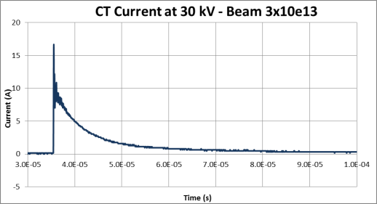
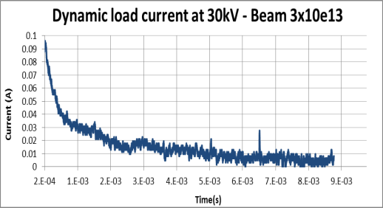
MD RESULTS
The MD measurements showed that a ‘cold’ target or ‘heated’ target shows no difference in the dynamic loading of the modulator.
The extraction electrodes position, completely ‘out’ or ‘in’ gives no change in the dynamic loading i.e. the ion beam seems to have no effect on the loading of the HT sources.
Measured impact current
Measured recovery current
The peak current of 17A during beam impact was measured with the CT pick-up. The current decreases rapidly after 100us.
Target leakage current 200us after beam impact

Slide 19
CURRENT DEVELOPMENT
C-Modulator:
  Overcome the 30kV limitations of the Hall effect system, design of a saturation protection circuitry
  Test all possible configurations of switch topology (1,2 or 3) with power supplies and elements
  Characterisation of Heinzinger and Genvolt power supplies
  Investigation of series-protection diodes (inc. Behlke FDA 800-75) for future modulator design
Other topologies and ideas:
  Investigation of single switch operation,
  Feed forward voltage loops,
  Charge pumping mechanism
Controls for modulator on going elaboration

Slide 20
CONCLUSIONS
The Behlke test bench has proven to be an invaluable asset in determining the next generation of ISOLDE/HIE-ISOLDE modulator design.
The Behlke technology has demonstrated its ease of use, simple mechanical implementation and robustness. It has shown to be very capable of good linear performance, very satisfactory R_{on} measurements and excellent repeatability on all measurements carried out.
Target ‘discharge’ time can be tailored to suit target types, a real ‘bonus’ compared to last type of modulator
Serviceability and repair should be simpler with the new modulator technology.
Prototype configuration and functionality still to be determined through R&D program!

