Slide 1




CATHI
Marie Curie Initial Training Network
Cryogenics, Accelerators and Targets at HIE-ISOLDE
Target Unit Design Study
SERENA CIMMINO(EN-STI/RBS)*

Slide 2
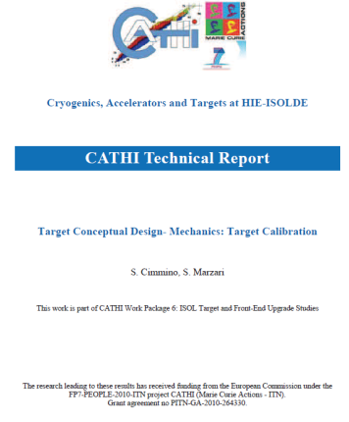

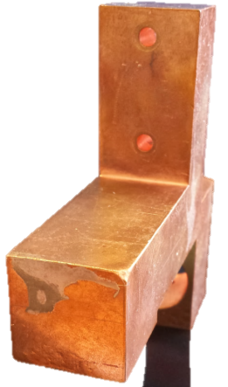
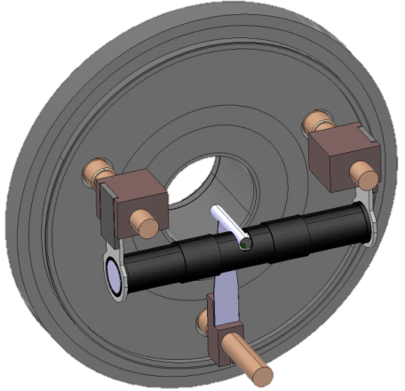
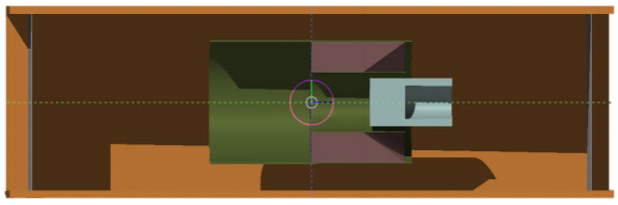
Outline
Standard Temperature Calibration
Outlook
Target Container Optimization
Neutron Converter
Design Study
Cold Line – Alternative Cooling Solution Study

Slide 3
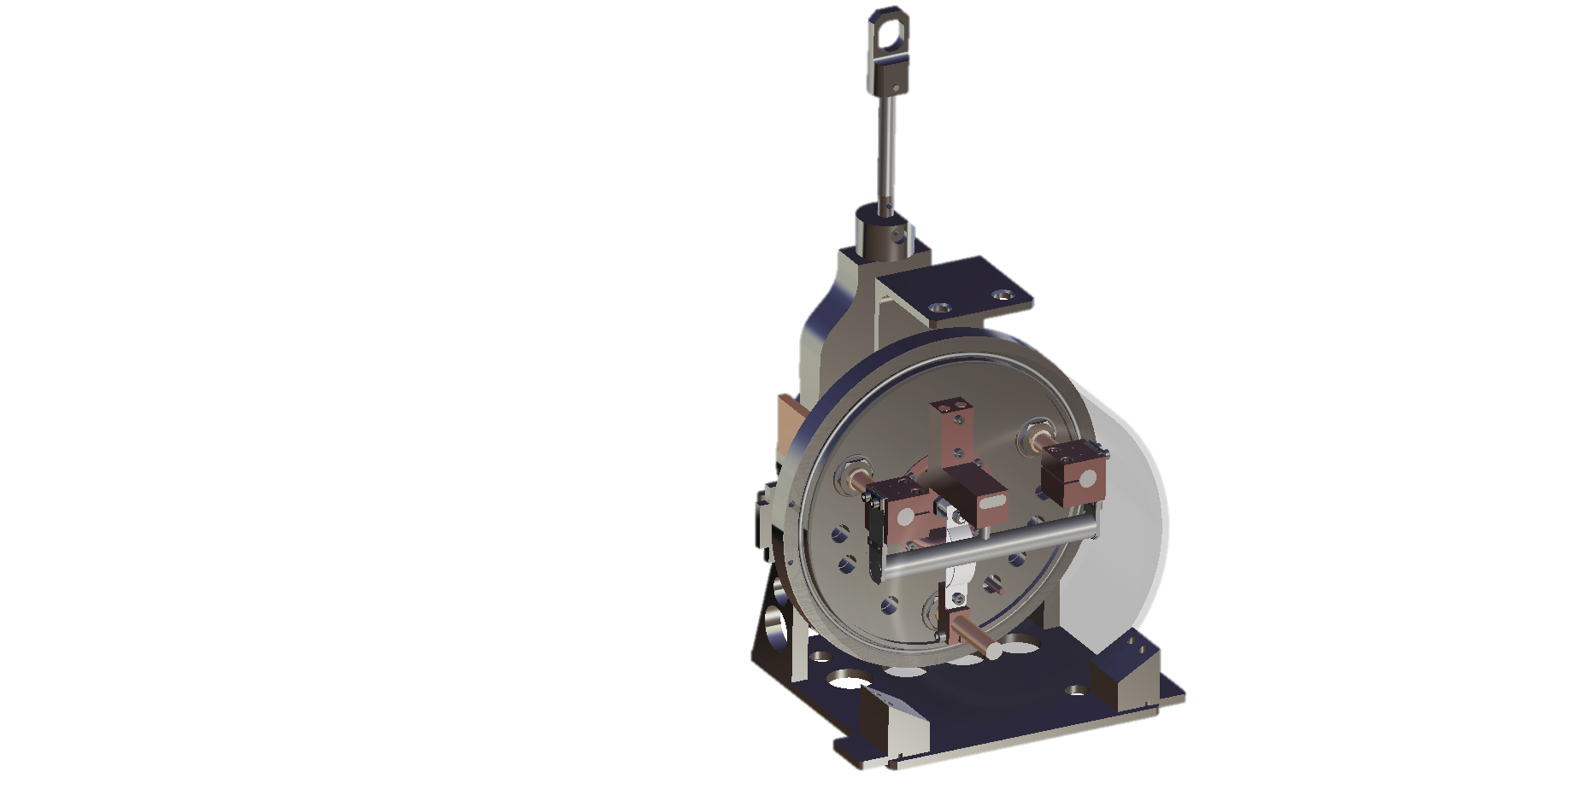

ISOLDE Target Unit
Ohmic Heat (2000 °C)
Systems
Vacuum (10 -7 mbar)
Active Cooling
Flow rate: 180 L/h
Inlet Temperature: 15°C
Outlet Temperature: 24-25°C
Pressure: Approx. 5 bars
Safety
Cold Line
Feed-Through
Target Life
Optimization
Production
Ion Source
Radioactive Waste
Target Container

Slide 4
Standard Temperature Calibration

Slide 5
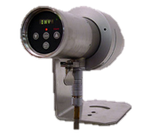
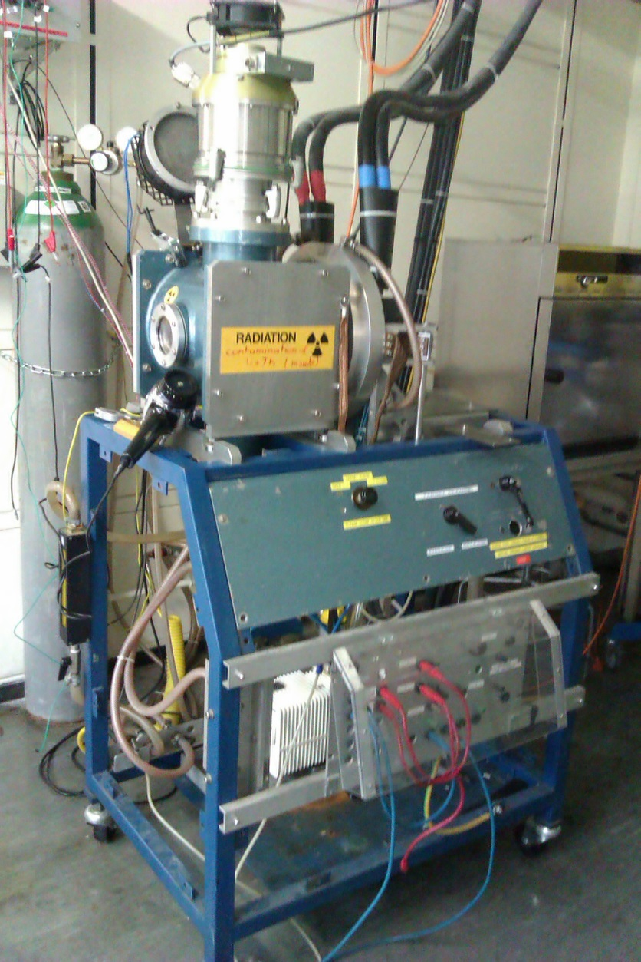
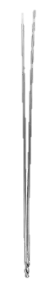
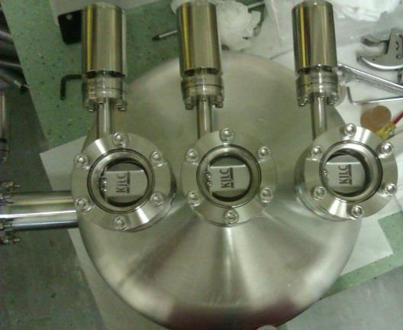
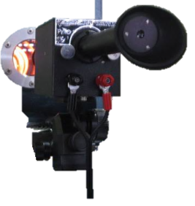
Calibration Chart
Preserve the target during operation
Calibration Chart
Avoid excessive stress
I_{cont} [A] | V_{cont} [A] | I_{source} [A] | T_{cont} [°C] | T_{source} [°C]
450 | 3.01 | 270 | 1717 | 1294
500 | 3.38 | 270 | 1740 | 1294
550 | 3.68 | 270 | 1850 | 1294

Slide 6
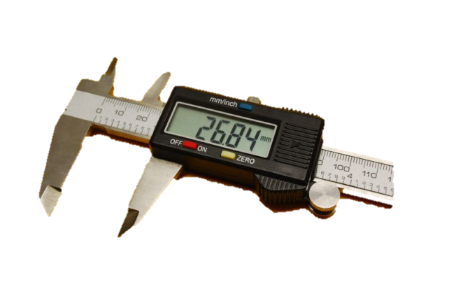


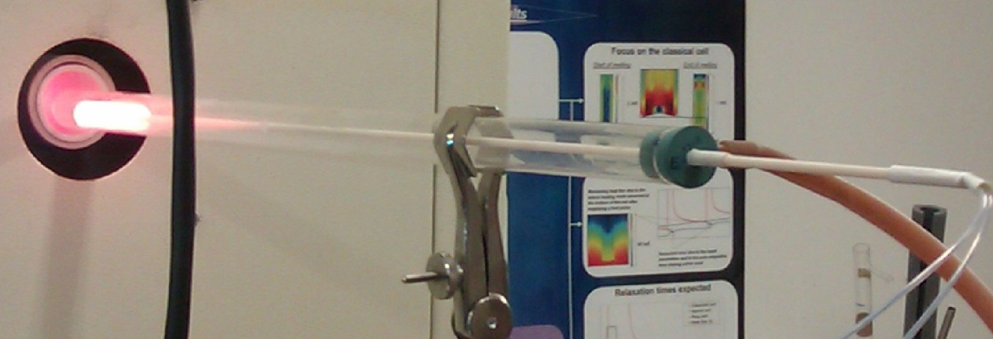
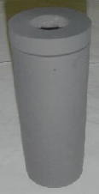

Thermal Measures Optimization
Precision
Reproducibility
Intensive Test Campaign
Diagnostic Instrumentation Study
Laboratoire national de métrologie et d’essais
Calibration Cell

Slide 7
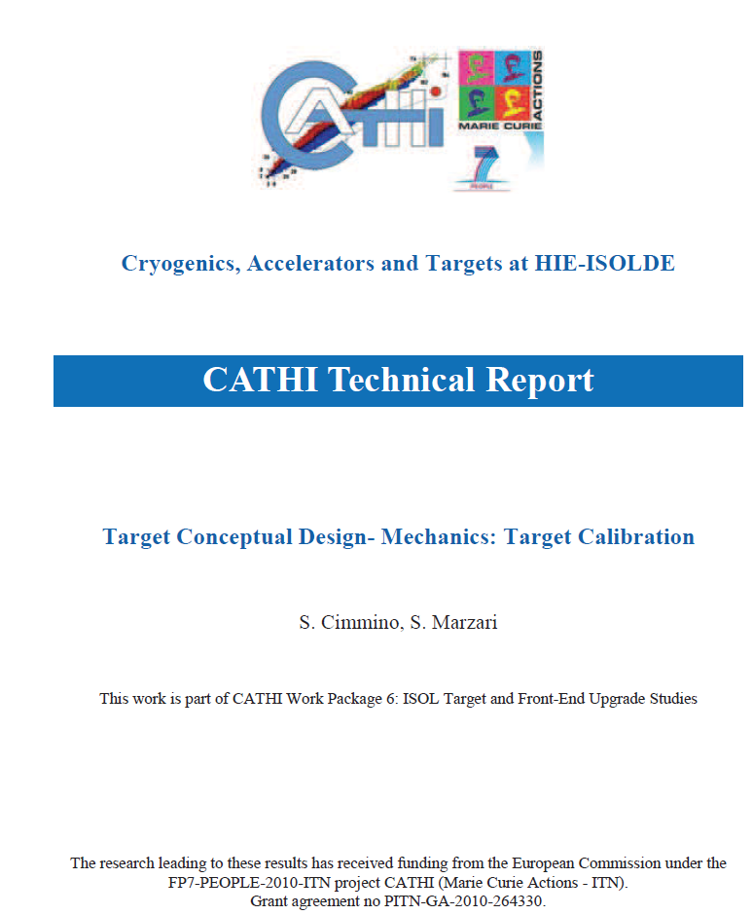
Standard Thermal Calibration
Pyrometer to use
Thermocouple Installation
Measurement Conditions

Slide 8
Target Container Optimization

Slide 9
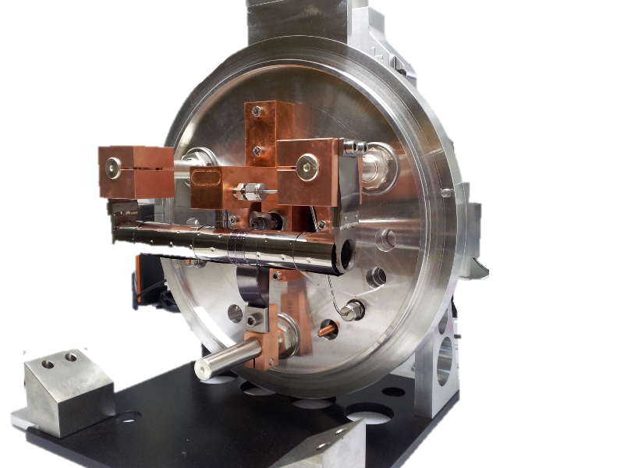
Conventional ISOLDE Container
Uniform Thermal Field
Release Efficiency Increase
Target Container Optimization

Slide 10
New Graphite Heater Prototype

Slide 11
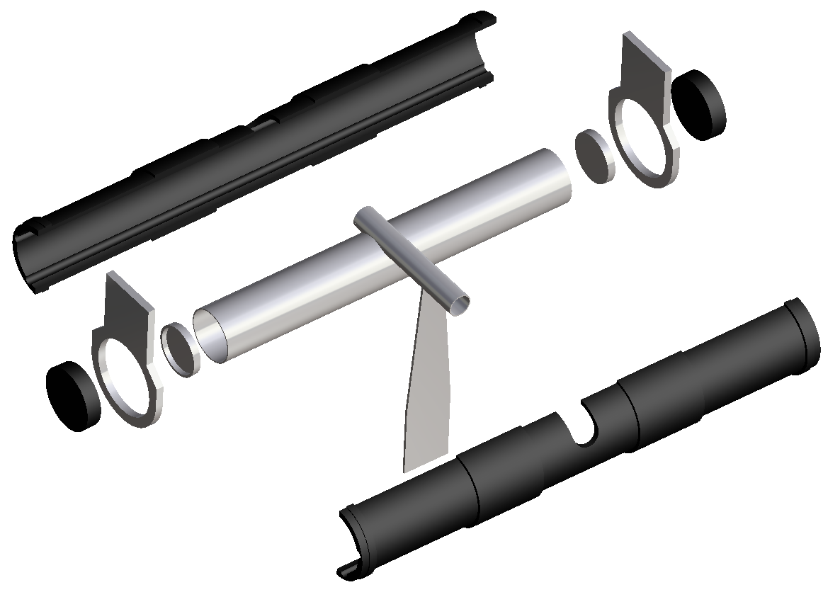
New Graphite Heater Prototype
Ohmic Heat / Containement
Thermocouple

Slide 12
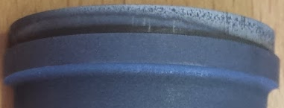
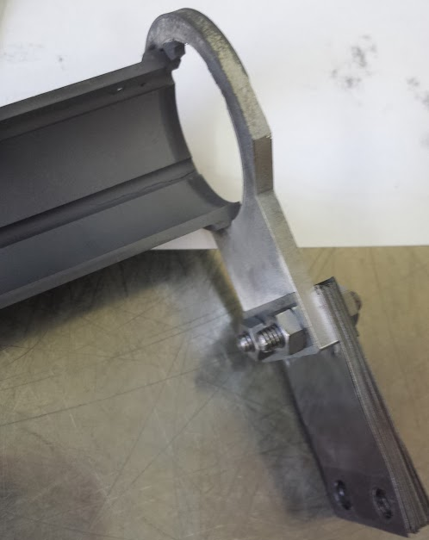
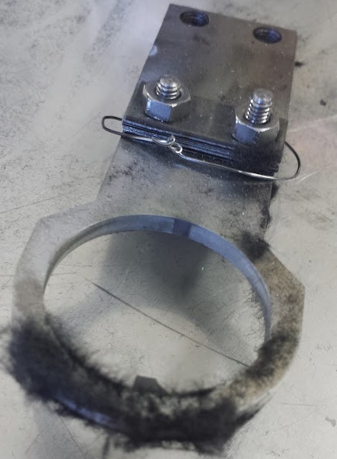
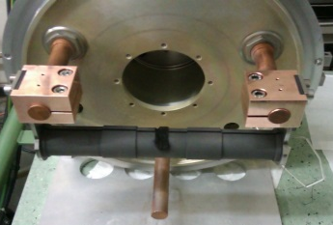
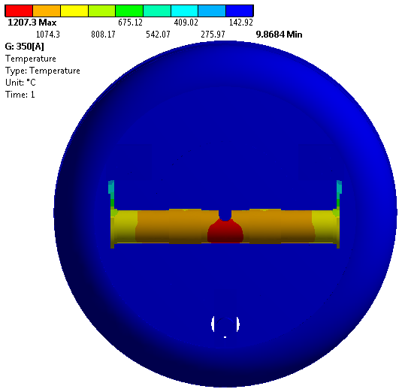
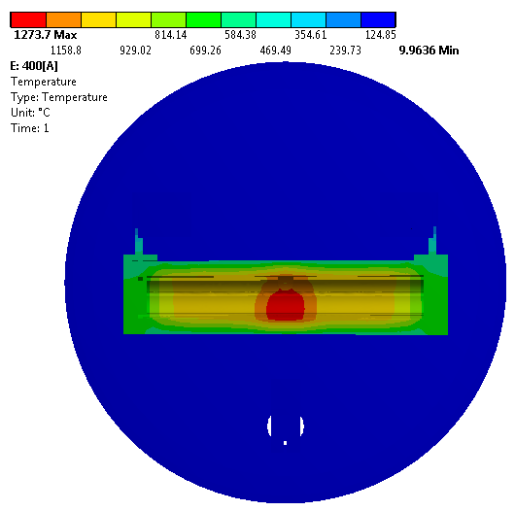
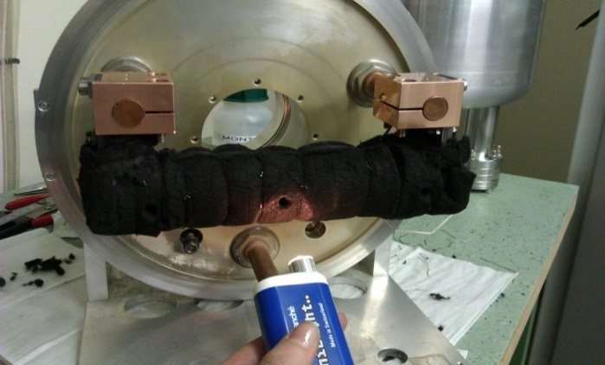
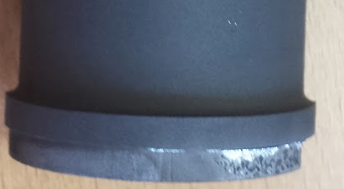
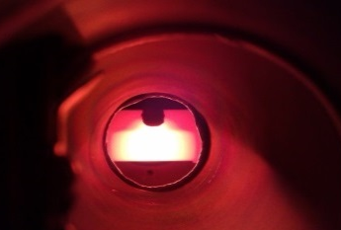
Graphite Prototype Study
Graphite Heater Tests and Simulations
Graphite Heater – Sigratherm Shielding : Tests and Simulations
Total Graphite
Graphite Heater
Tests
Graphite Heater Simulations
Sigratherm screen Simulations
Sigratherm Screen Tests

Slide 13
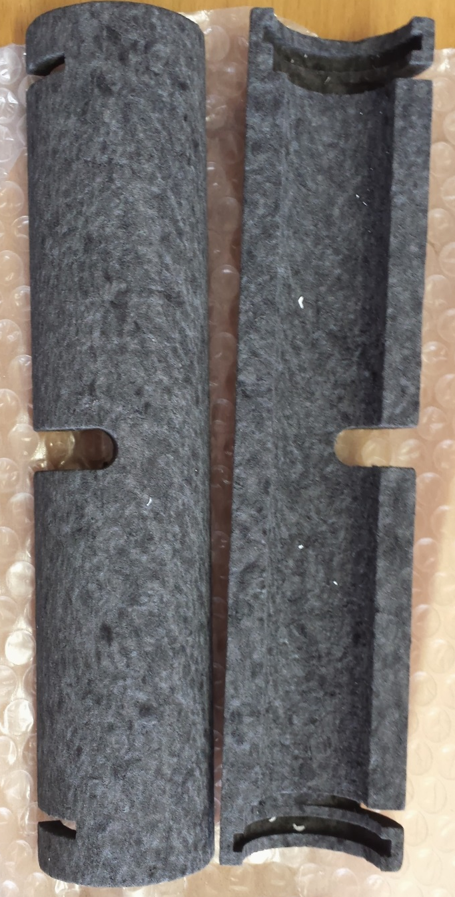
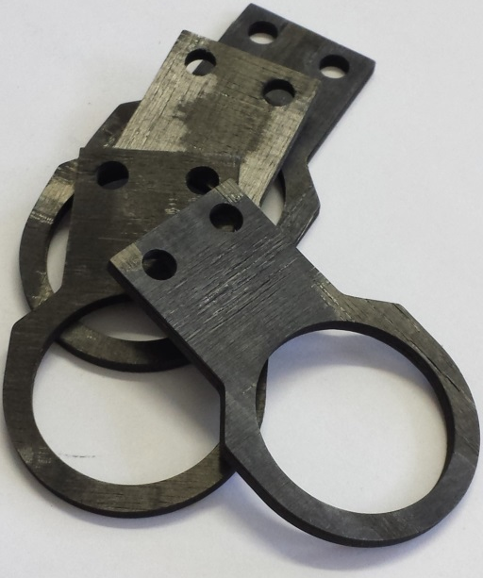
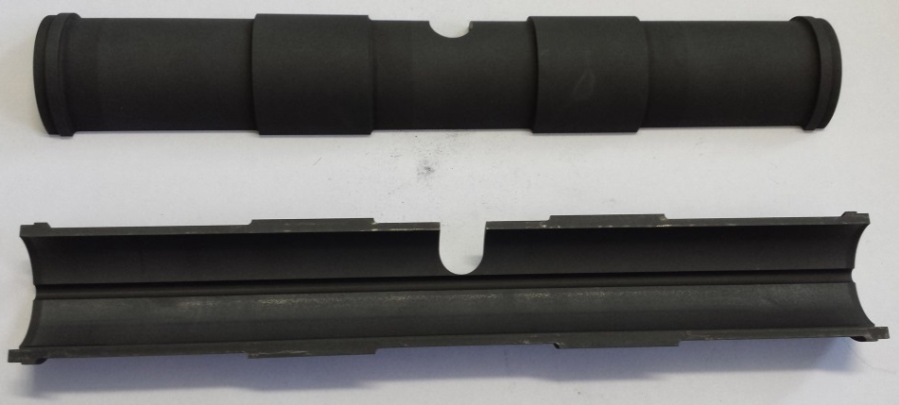
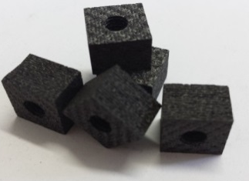
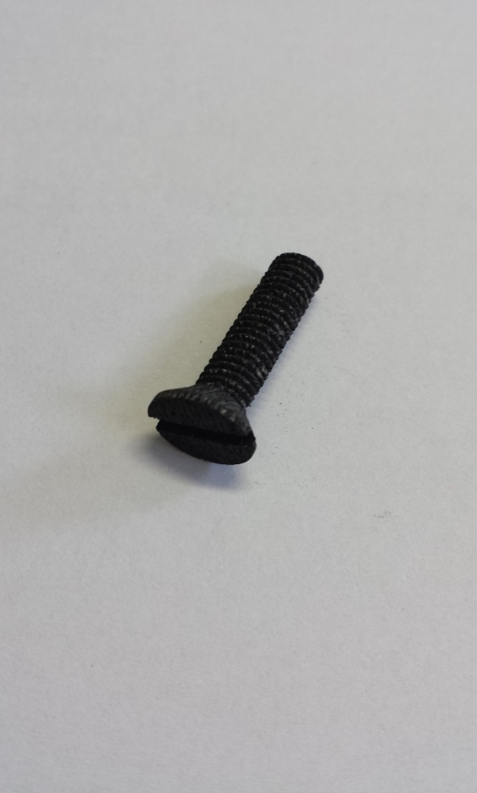
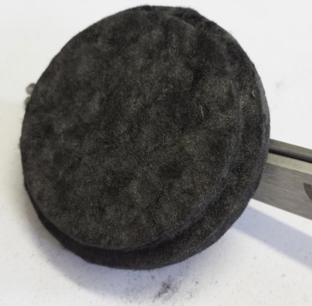
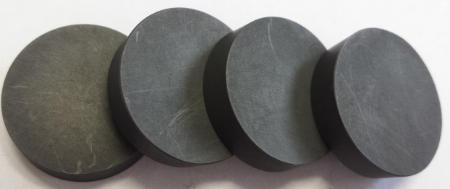
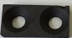
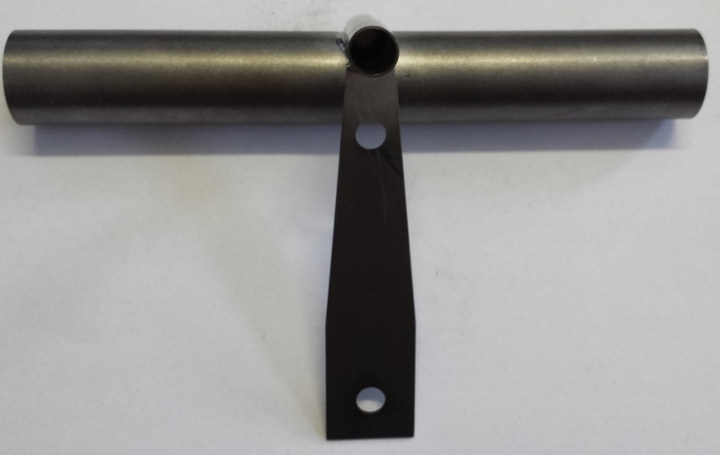
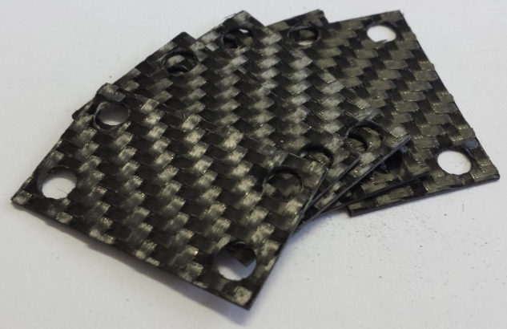
Parts Collection

Slide 14
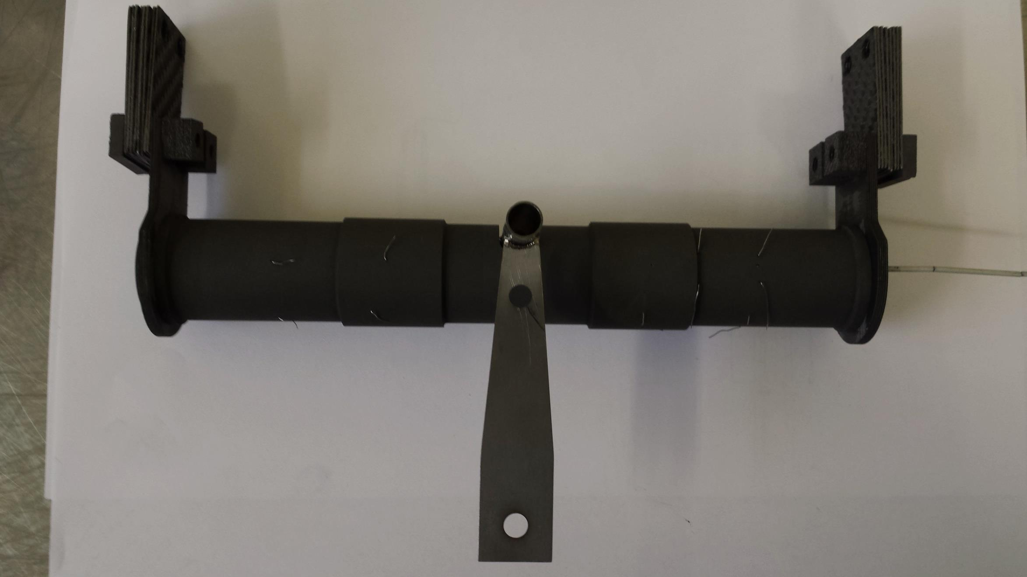
Prototype

Slide 15
Cold Line – Alternative Cooling Solution Study

Slide 16

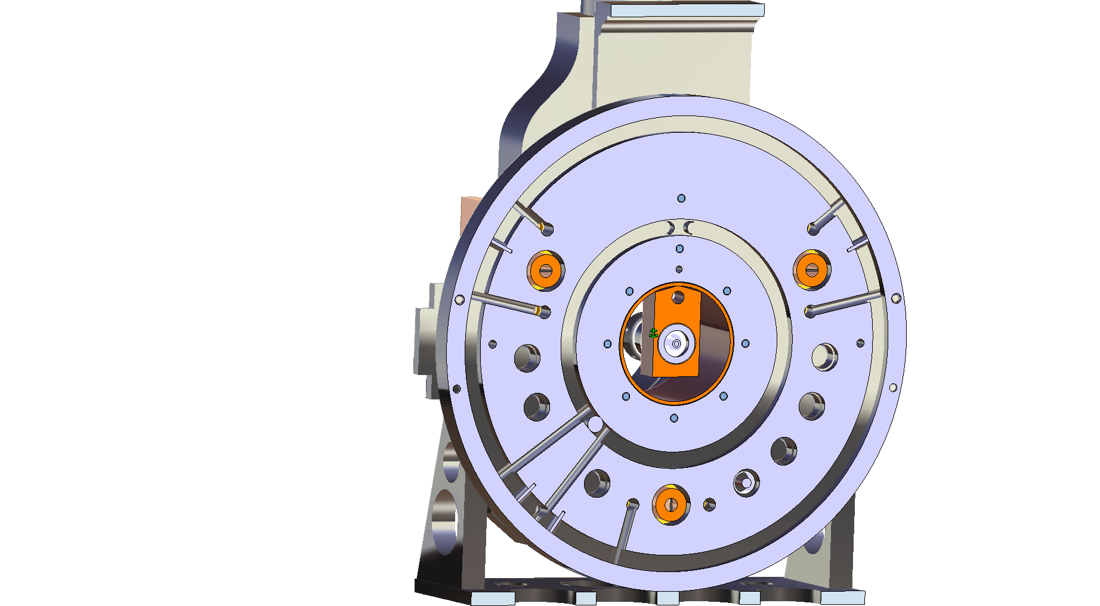

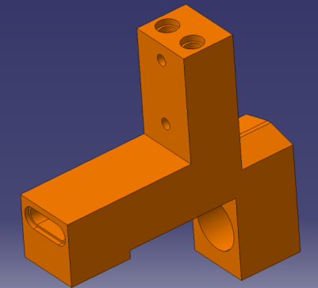
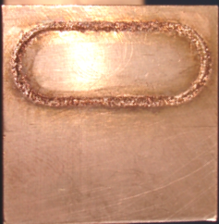
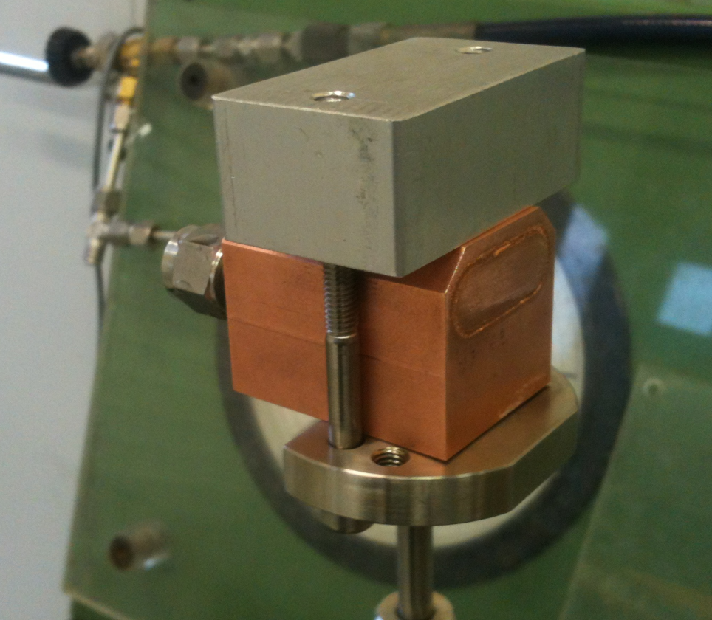
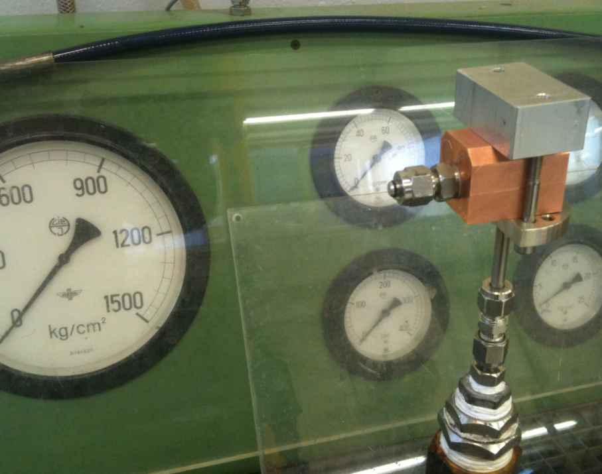

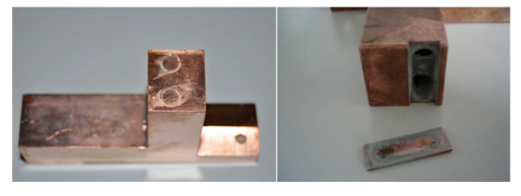
Water Leaks Investigation
Electron Bombardment welding
Brazing
It resists up to 500 bar

Slide 17

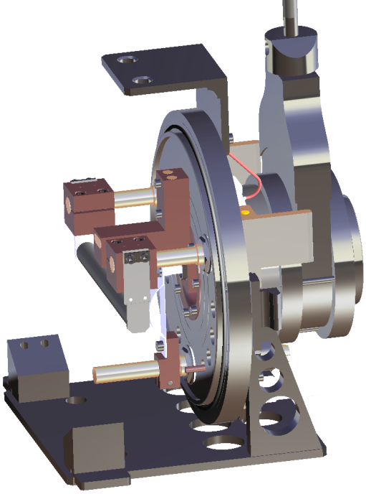
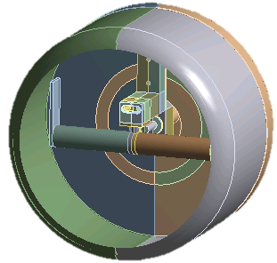
Alternative Cooling Solutions
No cooling Water
750W to dissipate
Thermal Contact Flange
Heat Flux Optimization
Load
Container heat | 1370 [W]
Source heat | 1250 [W]
Radiation | 1 enclosure
Film Coefficient Convection | 3500 W/m²
Heat Pipes Integration

Slide 18
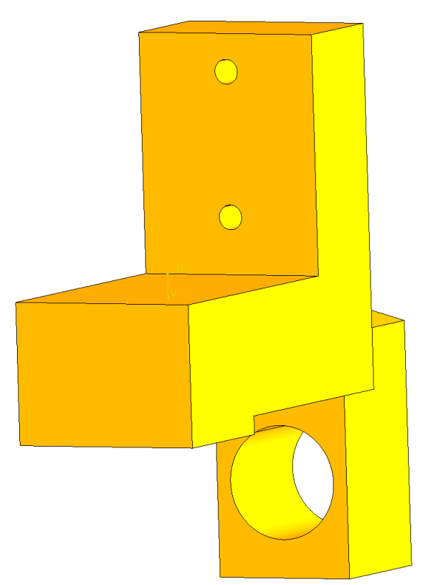
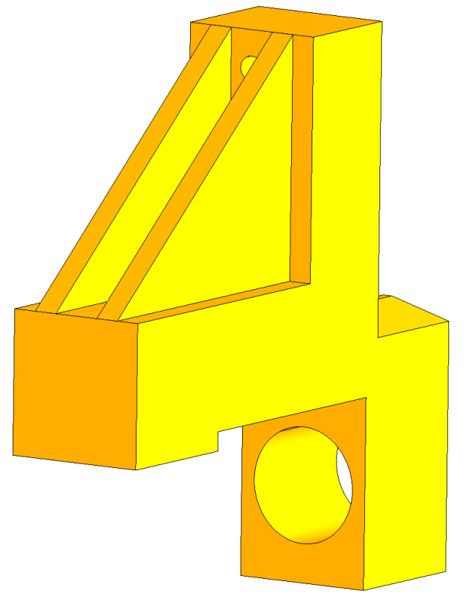
Heat Flux Optimization
Thickness Increase
Connection Hot-Cold

Slide 19
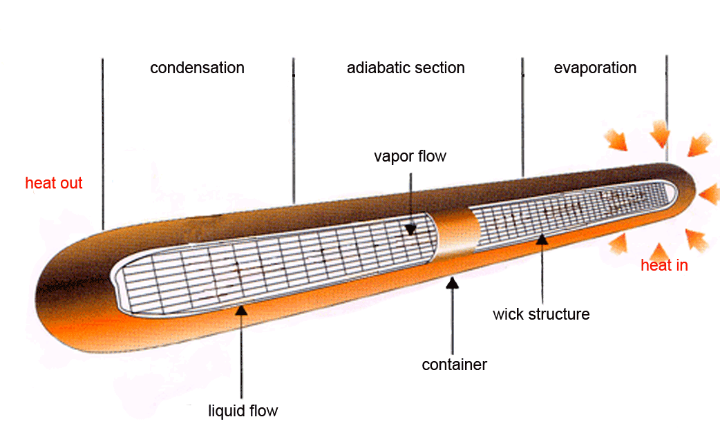
Heat Pipes

Slide 20
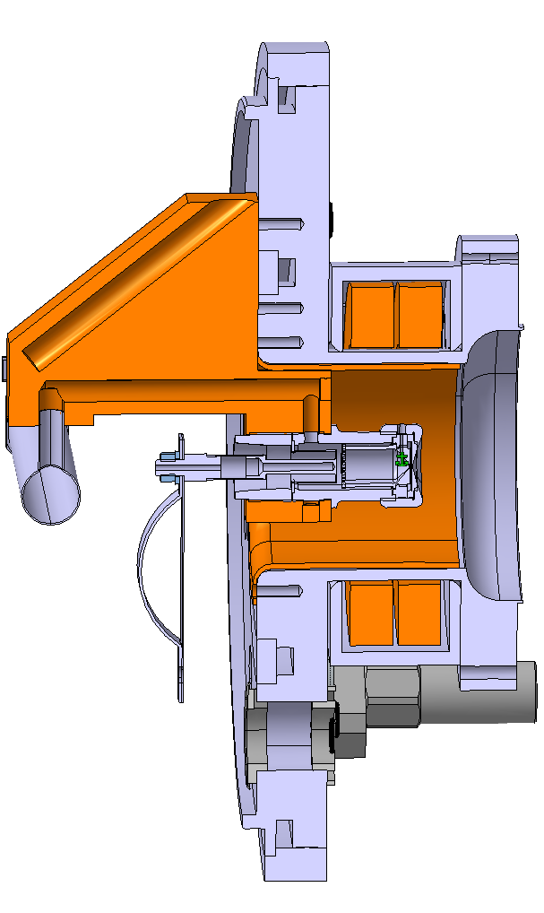
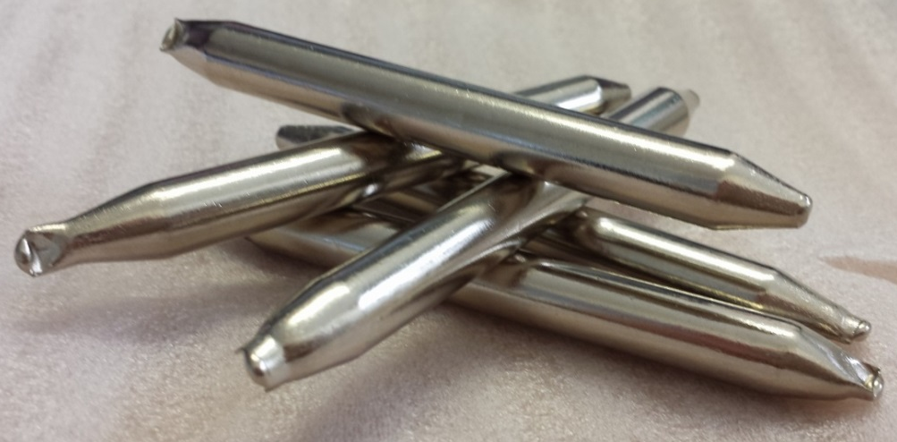
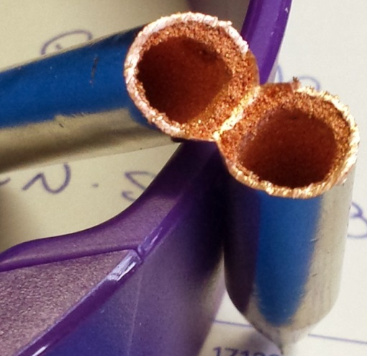
Heat Pipes Integration
Material: Copper nickel plated;
Wick Type: Sintered;
Fluid: water;
Active Length: 100mm;
Total Length: 130mm;
Diameter: 10mm;
Heat Transport 65 W;
Thermal Resistance: 0.015 ~ 0.0769.

Slide 21


Feed Through Solution

Slide 22
Neutron Converter
Design Study

Slide 23



Neutron Spallation Source
Energy Deposition
Neutron Converter
Isobaric Contaminant
Z=50, N = 82 double nuclear shell closure (132Sn)
Z=28, N = 50 double nuclear shell closure (78Ni)

Slide 24



ISOLDE Conventional Converter
Proton Distribution(p/cm²/μC)
Neutron Distribution(n/cm²/μC)
R. Catherall et al., NIMB, 204 (2003) 235.
R. Luis et al., European Physics Journal A, 48 (2012) 90

Slide 25
Simulation Validation
A. Gottberg et al., to be submitted to NIM B

Slide 26
Production Comparison

Slide 27
Production Comparison

Slide 28



Design Study
Beam Energy: 500 MeV;
Beam Intensity: 100μA;
FWHM: 3mm;
Particles per second: 6.242 E14;
UCx density: 3.63g/cm3

Slide 29
Production Comparison

Slide 30
Production Comparison

Slide 31

Preliminary Thermal Analysis

Slide 32



Outlook
Neutron Converter Design Finalization
Calibration Cellule Development
Converter Online Tests
Graphyte Protoptype
Experimental Tests
Design Optimization Test and Simulations

Slide 33


THANK YOU FOR THE ATTENTION

