Slide 1
ISOLDE DUMPS THERMO-MECHANICAL STUDY
Valentina Venturi EN-STI-TCD
Notes:
Method:
individual interviews with group leaders based on the April schedule -> to gather bottom-up data,
EN retreat on 1st July -> the aim was to bring the MTP in line with the last schedule & saving requests from the Council in June
ENMB on 26th July -> validate with group leaders the top-down arbitration

Slide 2
INTRODUCTION
OBJECTIVES
Understand the present state of HRS and GPS dumps from the thermo-mechanical point of view (FEA)
→Dumps were designed for a beam of 800 MeV
Check the future situation in case of beam upgrade
→Dumps are under-dimensioned
Present the proposed solution

Slide 3
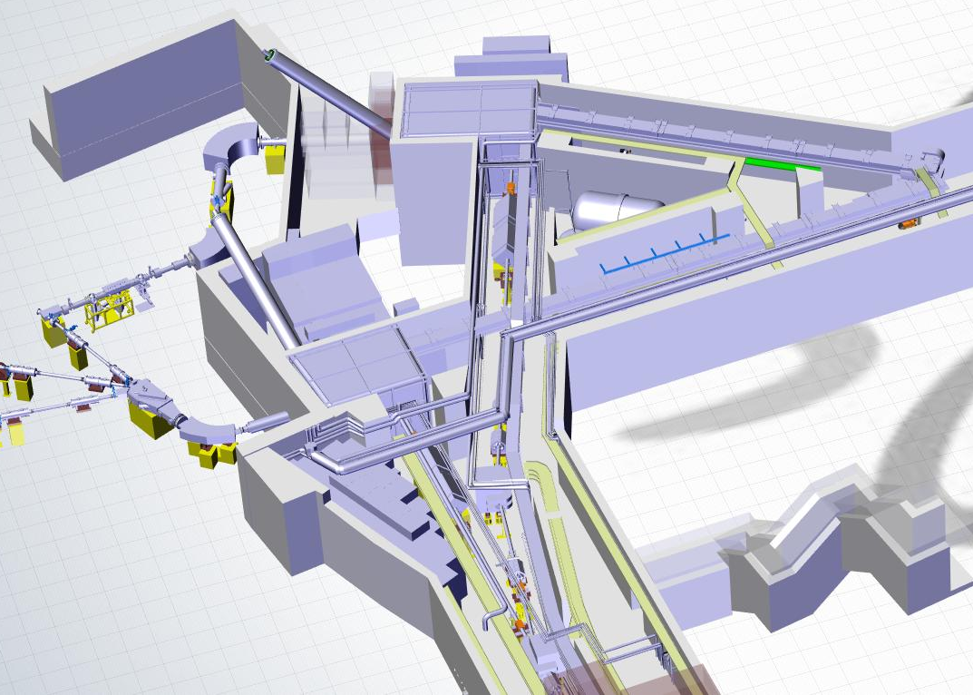
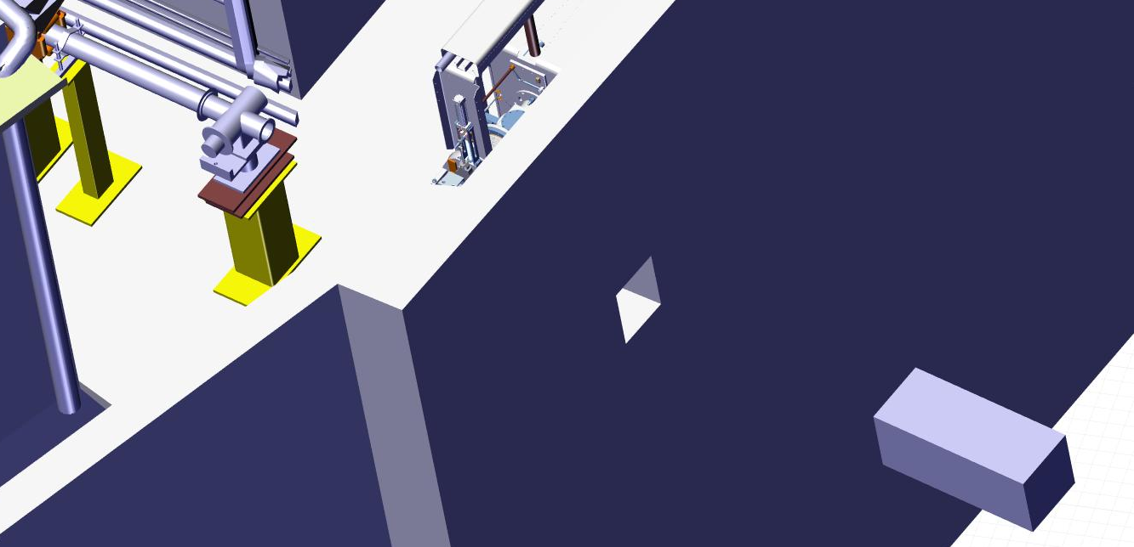
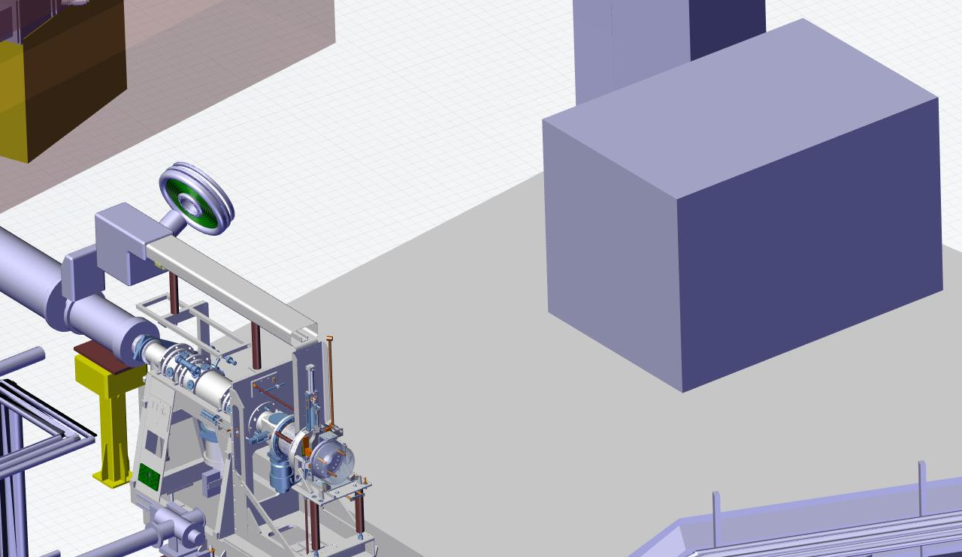
ISOLDE DUMPS LOCATION
GPS DUMP
HRS
DUMP
HRS core
GPS core

Slide 4
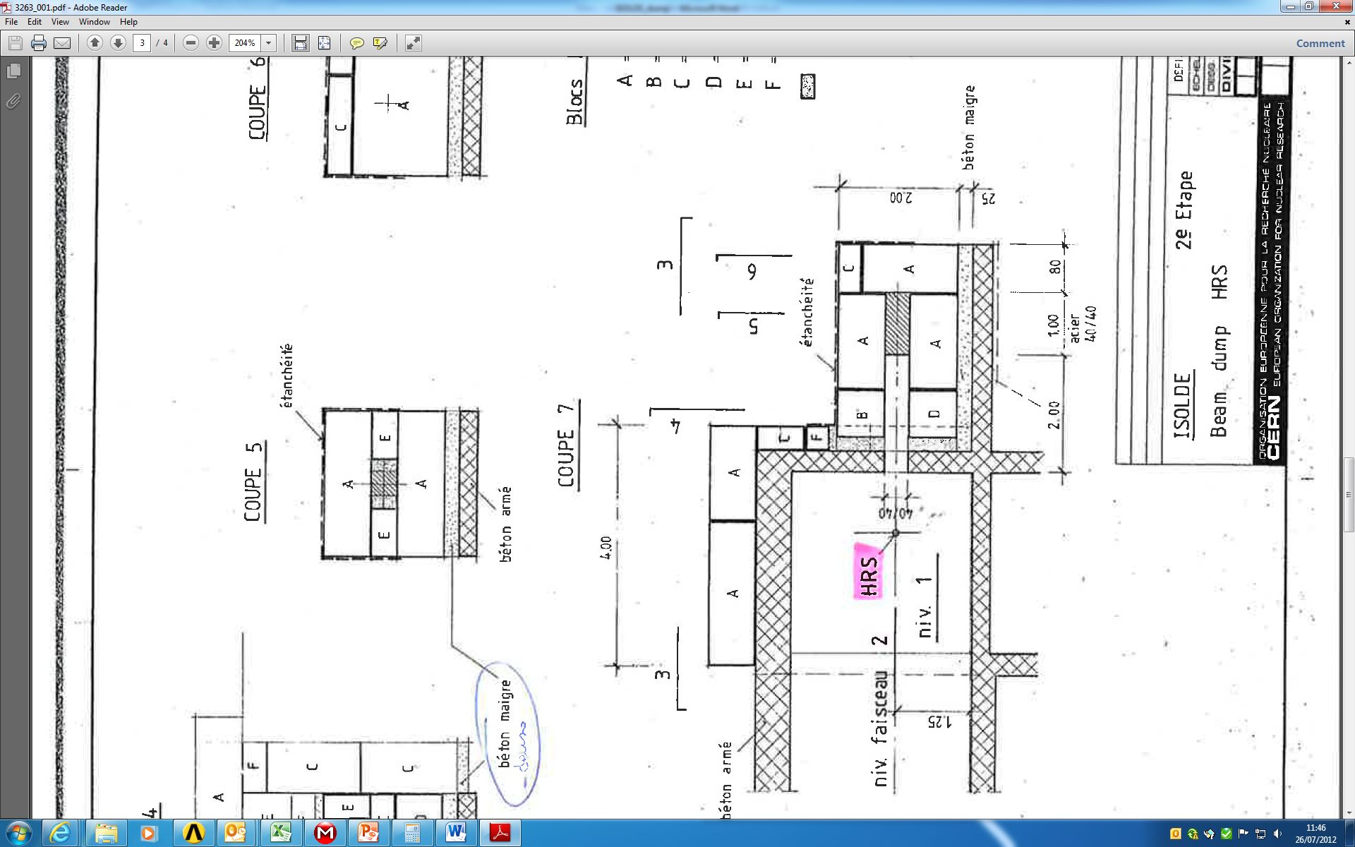
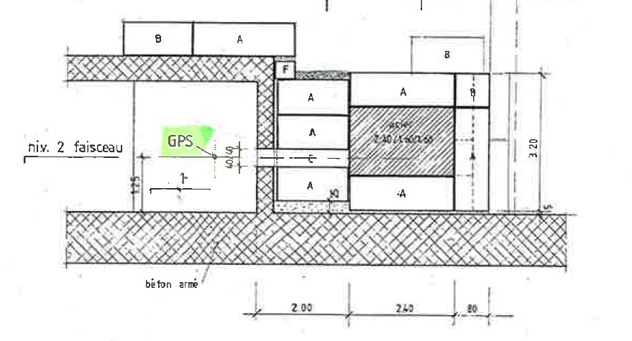
DUMPS CHARACTERISTICS
Dump material: not fully defined
→ carbon steel A36 (S275)
Dimensions (WxHxL) [m]:
-HRS: 0.4x0.4x1
-GPS: 1.6x1.6x2.4
Shielding: concrete blocks
State of contact shielding/dump: unknown
April 1991

Slide 5
ASSUMPTIONS
Assumptions are necessary:
very bad/no contact → very good contact
Constant temperature around the dumps (22 °C)
Dynamic analysis not considered for pulses
Thermal properties data are available up to 800 °C
core
core
simplifications
for
calculations

Slide 6
ASSUMPTIONS
A36 thermal properties:
Thermal conductivity
W/(m.K)
Thermal expansion
1/ºC
Specific heat
J/(kg.K)

Slide 7
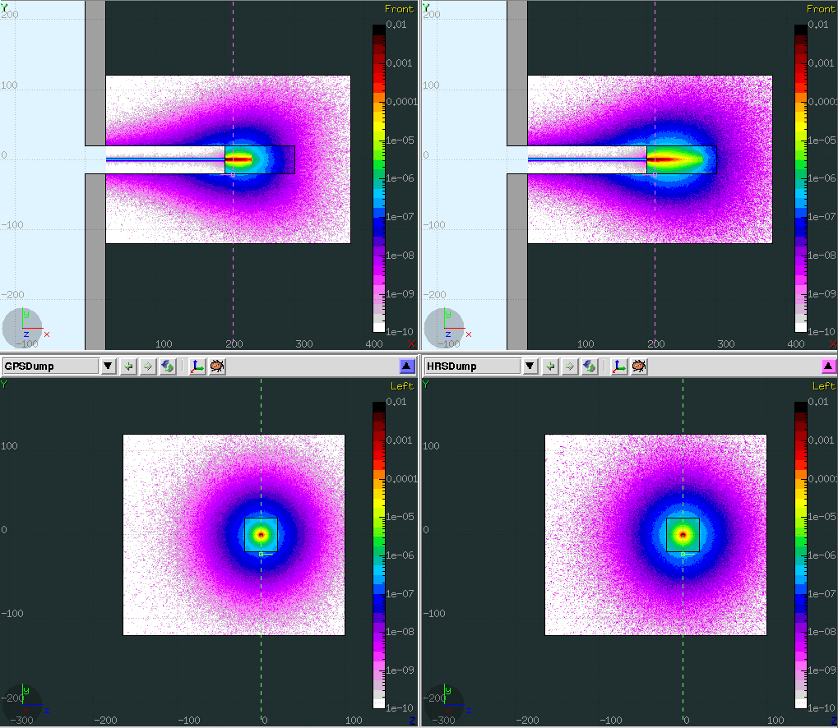
CASES STUDIED
From FLUKA simulations
Beam parameters:
“PS BOOSTER DUMP UPGRADE,
EDMS 1229493”
Case | Intensity [particles/pulse] | Energy/proton [GeV] | Pulse period [s] | Pulse time [µs] | Beam power [kW] | Heat generated in core [kW]
1 Present situation | 3.30E+13 | 1.4 | 2.4 | 0.94 | 3.08 | 2.25 (HRS) 2.32 (GPS)
2 Higher intensity | 8.00E+13 | 1.4 | 2.4 | 1.96 | 7.46 | 5.45 (HRS) 5.62 (GPS)
3 Higher intensity and energy | 8.00E+13 | 2.0 | 2.4 | 0.94 | 10.68 | 7.57 (HRS) 7.85 (GPS)

Slide 8
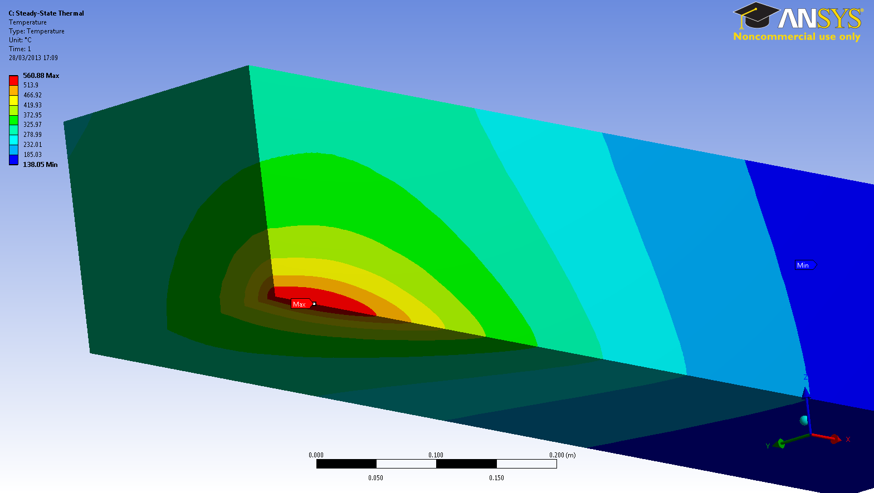
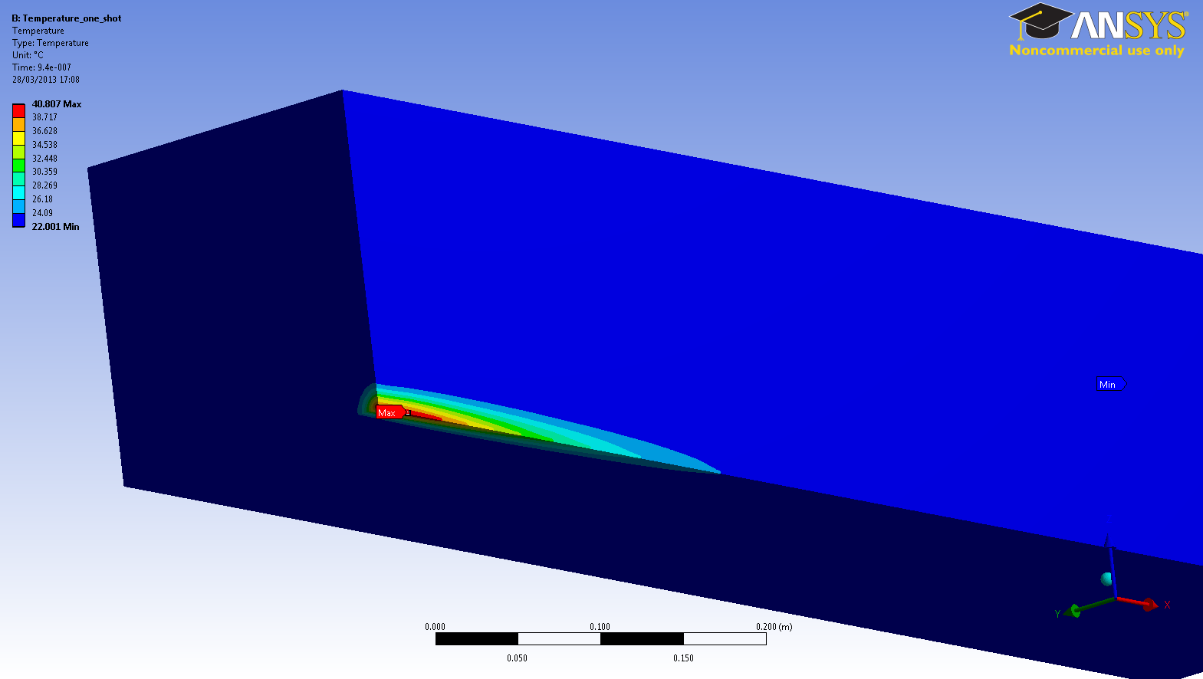
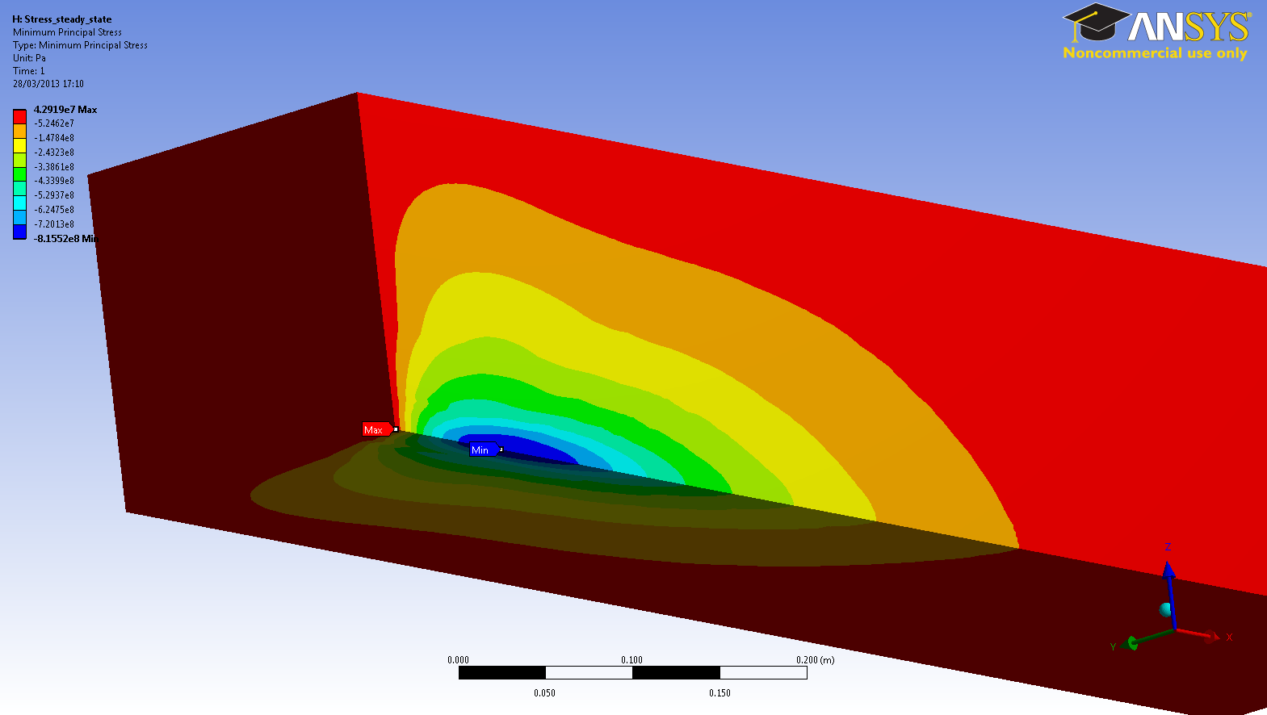
CALCULATIONS
Results of temperatures and stresses
for different boundary conditions:
HRS at 1.4 GeV present state
h (Heat transfer coefficient) [W/m²K] | Min Temp [ºC] | Max Temp [ºC] | Max Comp. Stress [MPa] | Tensile Strength [MPa]*
3 (bad contact) | 356 | 607 | 336 | 159
5 | 218 | 377 | 116 | 391
10 | 111 | 230 | 157 | 440
20 | 60 | 153 | 120 | 441
30 | 43 | 139 | 110 | 441
40 (good contact) | 36 | 113 | 105 | 441
Steady-state temperature
Single pulse temperature
*Values corresponding to maximum temperature of the dump for each analysis
Maximum temperature increase for a single pulse: 7 ºC
Maximum stress for a single pulse: 19 MPa
Thermal stresses

Slide 9
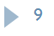
CALCULATIONS
Steel properties
RESULTS

Slide 10
CALCULATIONS
Steel properties
RESULTS
Yield stress

Slide 11
CALCULATIONS
Steel properties
RESULTS
Tensile strength
Yield stress

Slide 12
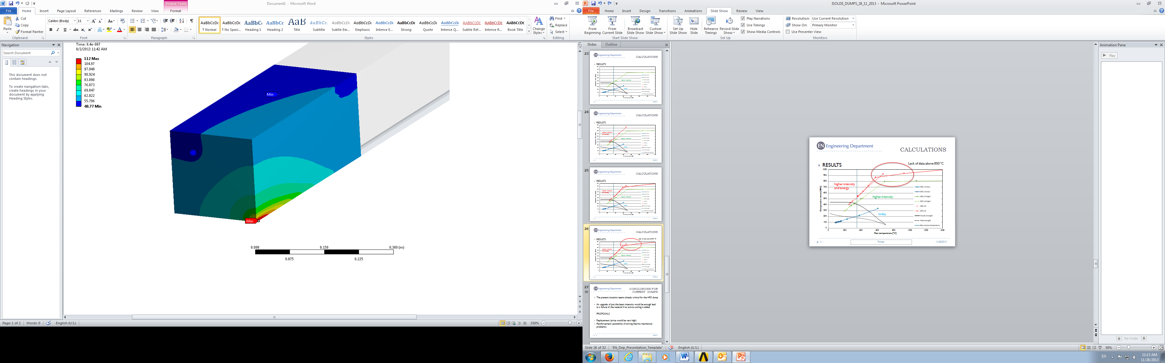
CALCULATIONS
Steel properties
RESULTS
Maximum
service
temperature
Tensile strength
Yield stress

Slide 13
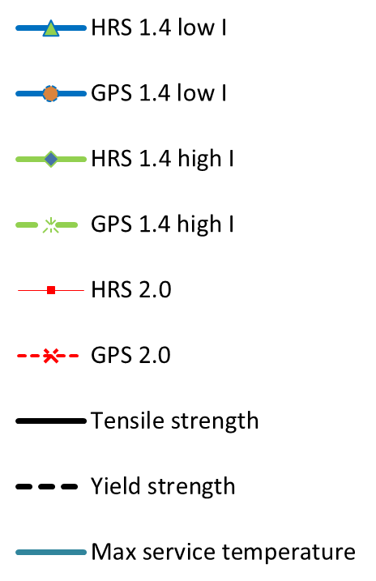
CALCULATIONS
Steel properties
RESULTS
Maximum
service
temperature
Tensile strength
Yield stress

Slide 14
CALCULATIONS
RESULTS
Safe region

Slide 15
CALCULATIONS
RESULTS
Safe region

Slide 16
CALCULATIONS
RESULTS
Safe region

Slide 17
CALCULATIONS
RESULTS

Slide 18
CALCULATIONS
RESULTS

Slide 19
CALCULATIONS
HRS at 1.4 GeV present state
h (Heat transfer coefficient) [W/m²K] | Min Temp [ºC] | Max Temp [ºC] | Max Comp. Stress [MPa] | Tensile Strength [MPa]*
3 | 356 | 607 | 336 | 159
5 | 218 | 377 | 116 | 391
10 | 111 | 230 | 157 | 440
20 | 60 | 153 | 120 | 441
30 | 43 | 139 | 110 | 441
40 | 36 | 113 | 105 | 441
RESULTS

Slide 20
CALCULATIONS
RESULTS
h=3 (bad contact)

Slide 21
CALCULATIONS
RESULTS
today

Slide 22
CALCULATIONS
RESULTS
today

Slide 23
CALCULATIONS
RESULTS
today

Slide 24
CALCULATIONS
RESULTS
today

Slide 25
CALCULATIONS
RESULTS
today

Slide 26
CALCULATIONS
RESULTS
today

Slide 27
CONCLUSIONS FOR CURRENT DUMPS
The present situation seems already critical for the HRS dump
An upgrade of just the beam intensity would be enough lead to a failure of the material if no active cooling is added
PROPOSALS
Replacement (price would be very high)
Reinforcement (possibility of solving thermo-mechanical problems)

Slide 28
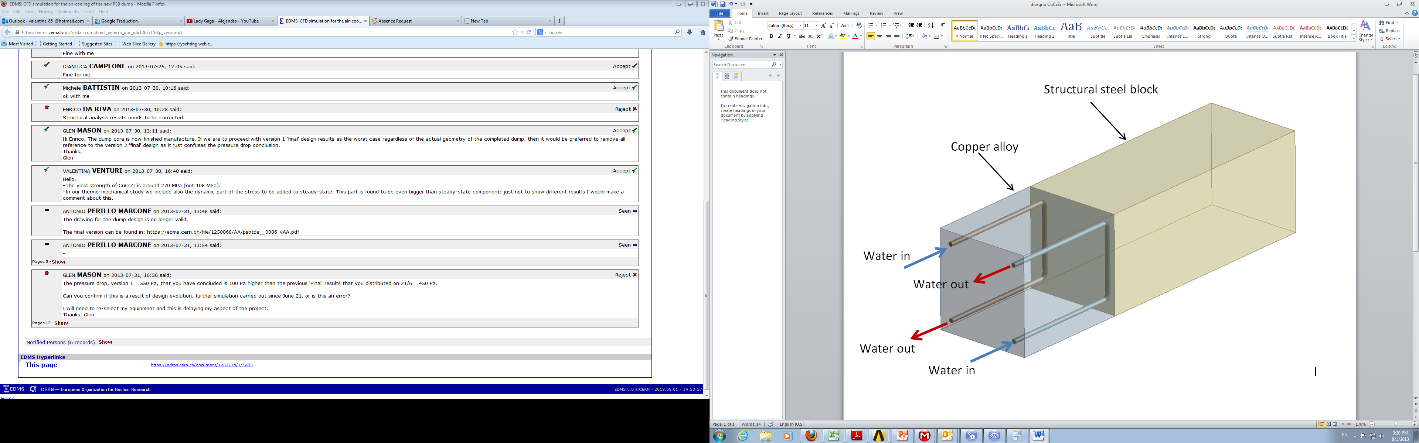
NEW DESIGN
HRS dump is studied
water cooled copper block (CuCrZr) could be placed in front of the existing dumps (length = 0.5 m)
CuCrZr → new PSB dump
Beam parameters:
-high intensity (8 E13 ppp)
-high energy (2.0GeV)
HRS dump

Slide 29
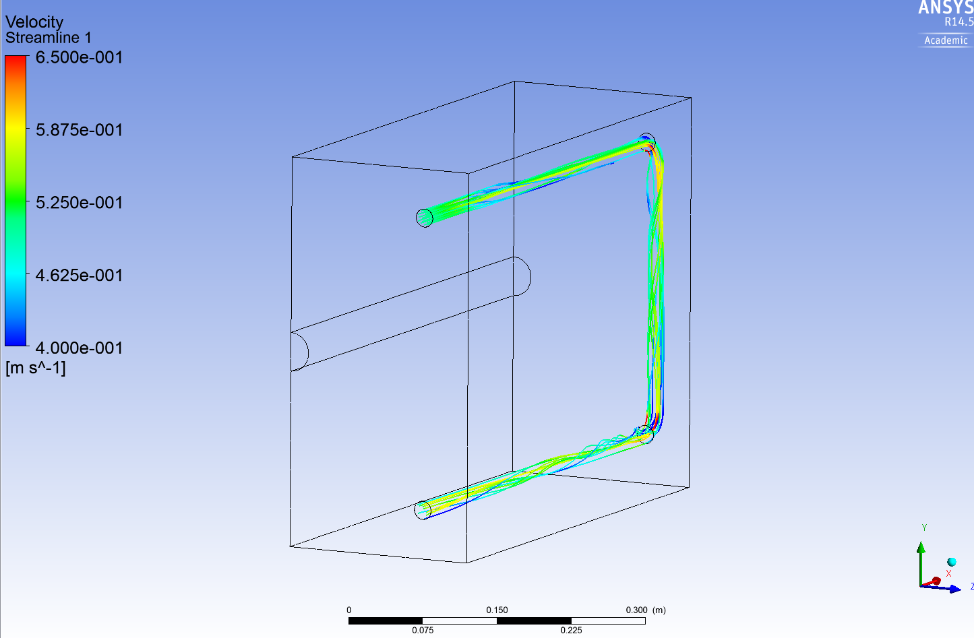
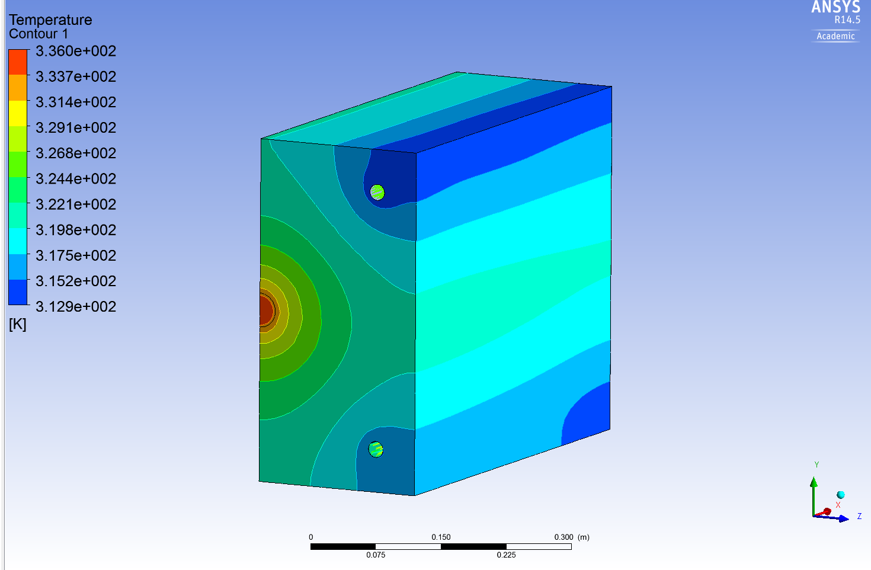
CFD SIMULATION
85 % of the total power is deposited on the Copper block (6.5 kW)
water flow: 1 m^3/h , 20 ºC
water temperature increase: 5 ºC
CFD: water cooling
CFD: steady-state temperatures

Slide 30
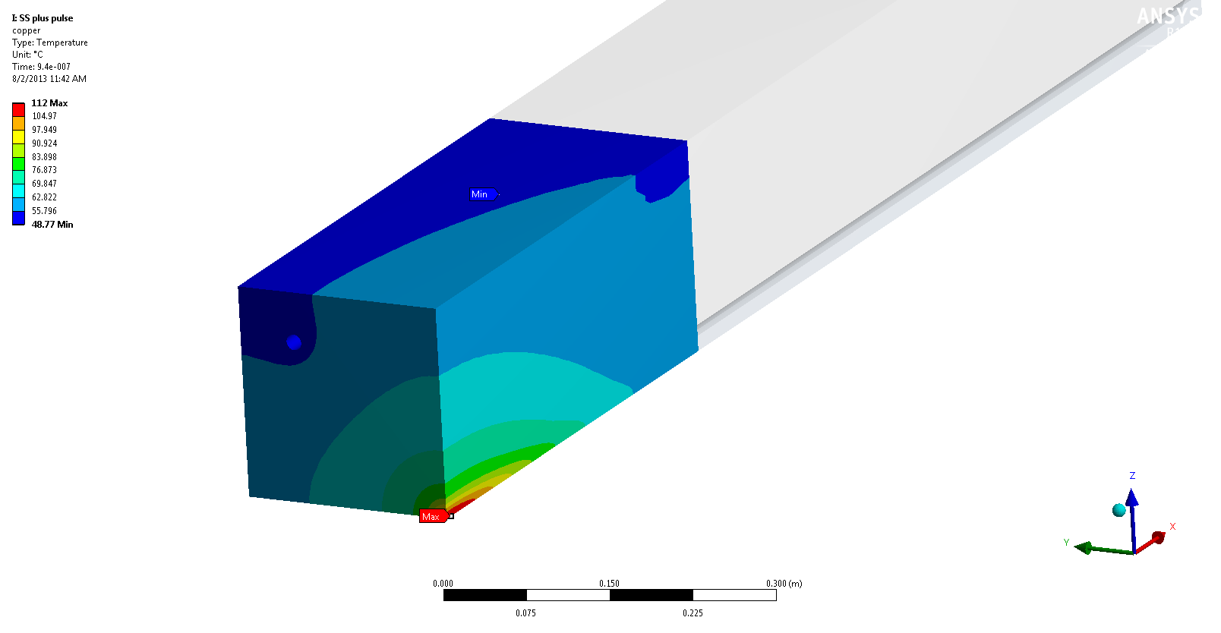
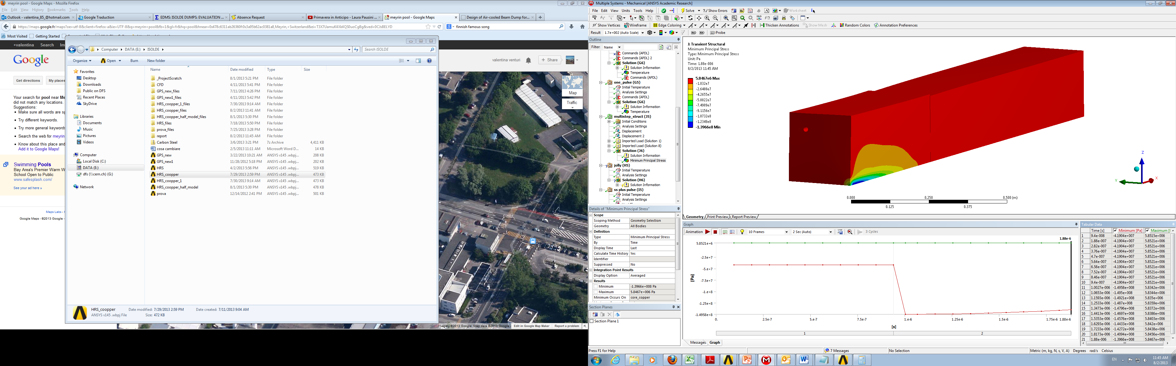
CFD SIMULATION
Thermo mechanical study
Part | Max temperature increase per pulse [ºC] | Max temperature steady- state [ºC] | Steady-state stresses compressive [MPa] | Dynamic compressive stresses [MPa] | Fatigue: stress amplitude [MPa]
CuCrZr | 27 | 90 | 41 | 149 | 53.8
Steel | 0.2 | 62 | 6.5 | 7 | 0.25
Steady-state + pulse temperatures on the CuCrZr block
Dynamic stresses analysis

Slide 31
CONCLUSIONS
All results are based on the beam parameters described on the document:
“PBU-T-ES-0002-00-20, EDMS 1229493”
The placement of a water cooled copper block in front of the dumps seems to be a good option to avoid the replacement of the dumps from the thermo-mechanical point of view
The results of the analysis show that temperatures and stresses remain below the material’s limits in both blocks during commissioning
For further information:
“ISOLDE DUMPS: EVALUATION OF PRESENT AND FUTURE OPERATION , EDMS 1277863 “
“ISOLDE DUMPS DESIGN PROPOSAL: EVALUATION OF FUTURE OPERATION, EDMS 1308217”

Slide 32
Thank you!

