Slide 1
HIE-ISOLDE Project
Status Report
Y. Kadi for the HIE-ISOLDE Project Team
HIE-ISOLDE Workshop: The Technical Aspects
CERN, 28-29 November 2013

Slide 2
OUTLINE
Scope of HIE-ISOLDE
Upgrade of ISOLDE Facility: HIE-ISOLDE
Status
Summary

Slide 3
Motivation
The High Intensity and Energy (HIE) ISOLDE project builds on the success of the REX-ISOLDE post-accelerator and will focus on the upgrade of the REX facility but also aims to improve the target and front-end part of ISOLDE to fully profit from upgrades of the existing CERN proton injectors (LINAC4 and PSB Upgrade):
    Higher energy for the post-accelerated radioactive beam
    More beams (Intensity wise and different species)
    Better beams (High purity beams, low emittances, more flexibility in the beam parameters)

Slide 4
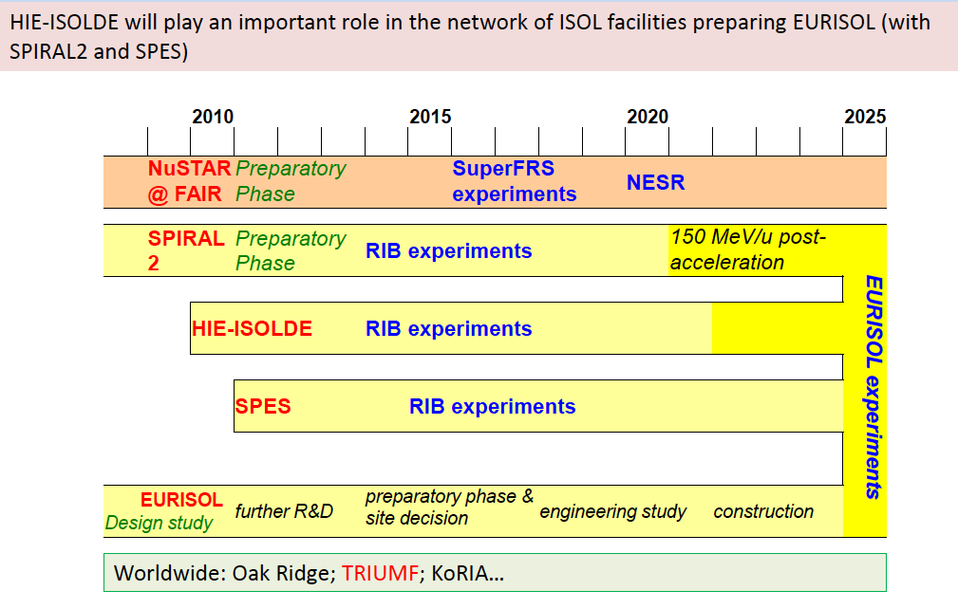
NuPECC Long Range Plan 2010 Timeline for RIB Facilities

Slide 5
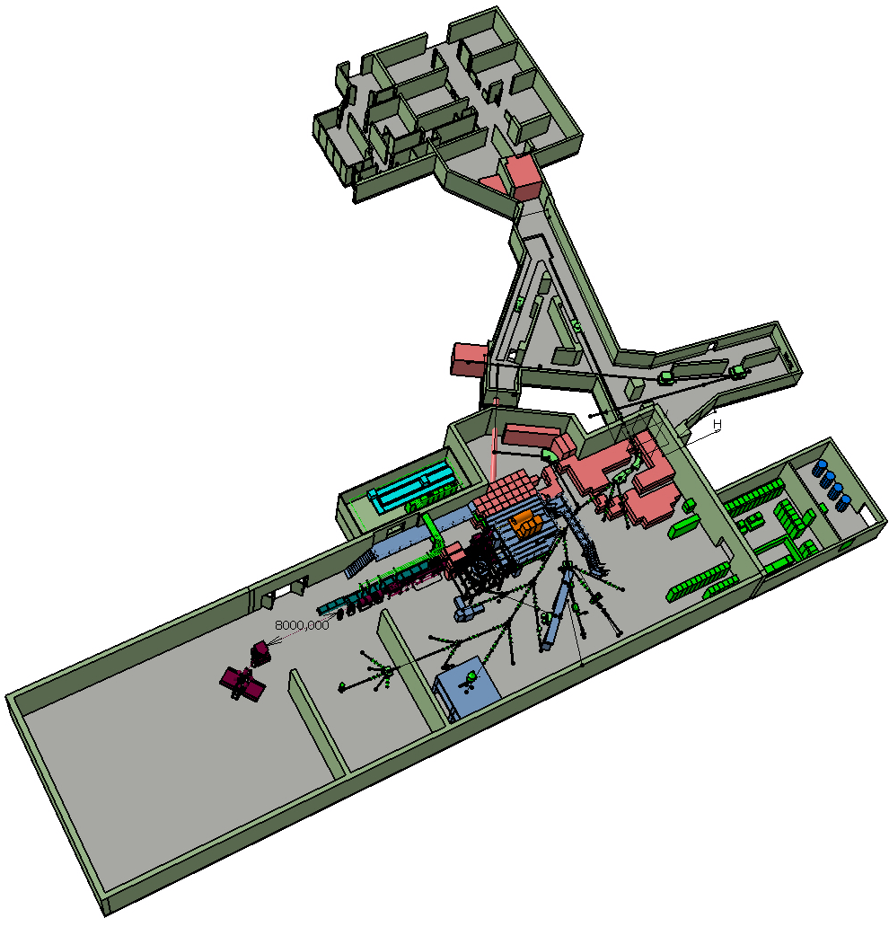
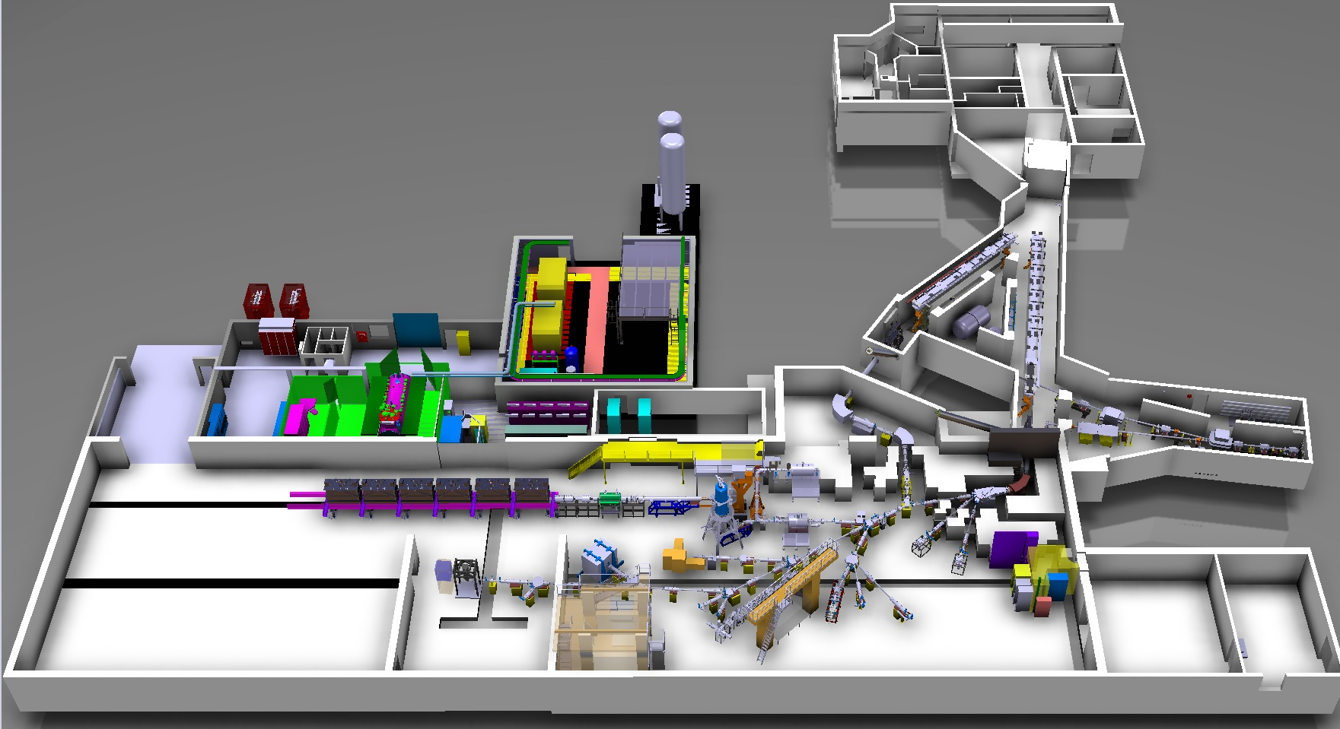
HIE-ISOLDE aims at increasing the energy of these RIB up to 10A MeV and their intensity by a factor 10
Energy Upgrade:
The HIE-ISOLDE project concentrates on the construction of the SC LINAC and associated infrastructure in order to upgrade the energy of the post-accelerated radioactive ion beams to 5.5 MeV/u in 2015 and 10 MeV/u in 2017
Intensity Upgrade:
The design study for the intensity upgrade, also part of HIE-ISOLDE, started in 2012, and addresses the technical feasibility and cost estimate for operating the facility at 15 kW once LINAC4 and PS Booster are online.
Notes:
The objectives of the Design Study
address the issues arising from an increase in primary beam power and to provide acceptable scenarios for the modification of the ISOLDE facility.
Provide a design for the improvement of radioactive isotope production rates and beam characteristics.

Slide 6
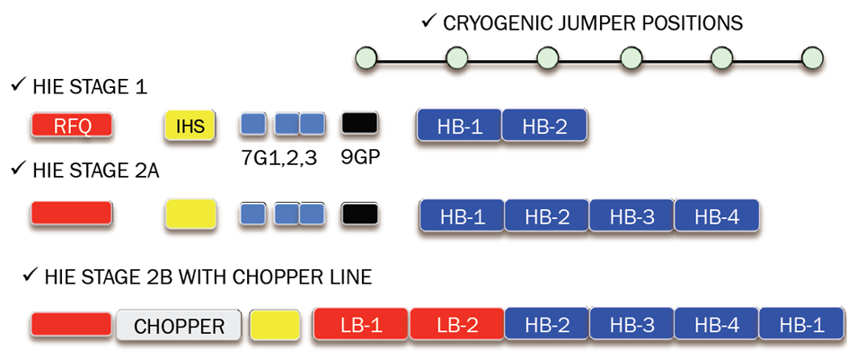
Superconducting LINAC installed in Three Phases
Fall 2015 5.5 MeV/A
2017
10 MeV/A
Not defined yet
Period 100ns
Resolution 1-2 ns
Background < 1%

Slide 7
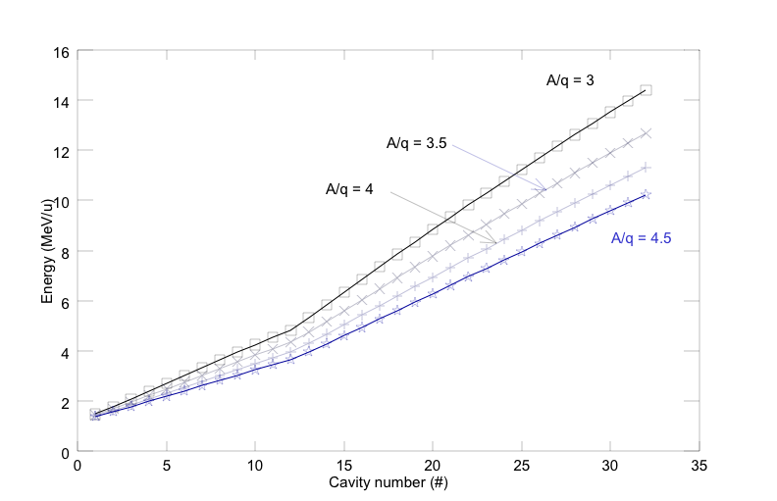

Final Beam Energies

Slide 8
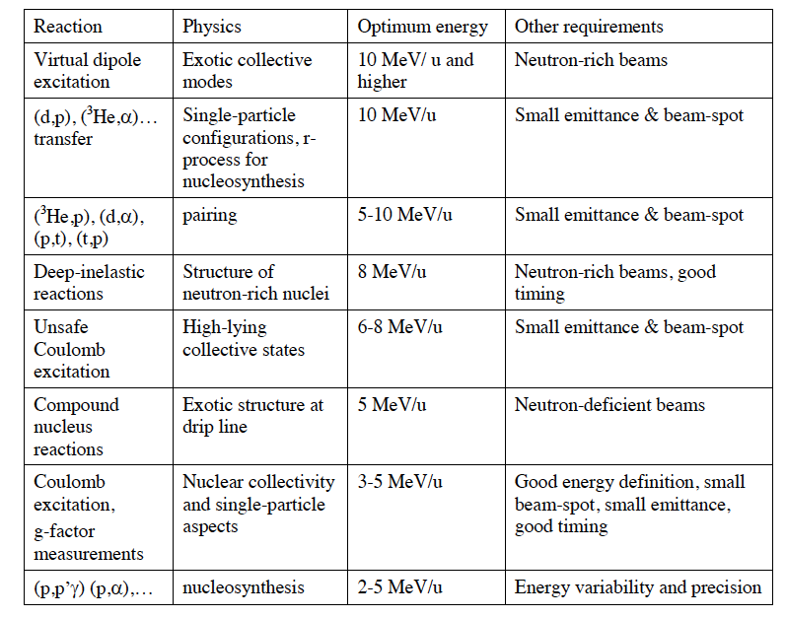
Different reactions and Physics reach with the upgraded facility

Slide 9
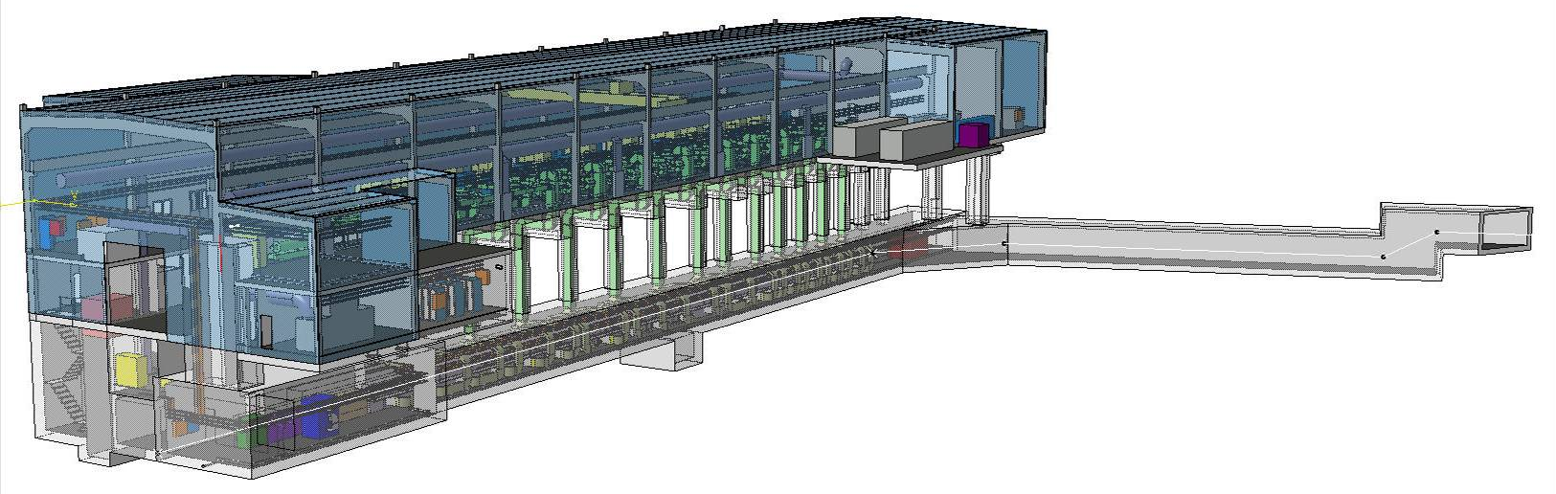
High Intensity Upgrade
Protons/pulse | Intensity (µA) | Energy (GeV) | Cycle (s) | Power (kW)
3.3x10¹³ | 2.2 | 1.4 | 1.2 | 3.1
1x10¹⁴ | 6.7 | 1.4 | 1.2 | 9.3
1x10¹⁴ | 6.7 | 2.0 | 1.2 | 13.3
Projected beam parameters considered within the HIE- ISOLDE Design study.
Based on ISOLDE receiving 50% of available proton pulses from the PS-Booster.

Slide 10
Accelerated ¹³²Sn yields (per second) (fission factories only)
HRIBF 10⁵ 4.5 MeV/u (now)
REX-ISOLDE 10⁶ 3 MeV /u (now)
CARIBU 5.10⁴ 10 MeV/u (2010)
TRIUMF p-driver 10⁷ 5 MeV/u (2010)
CARIBU phase 2 10⁶ 14 MeV/u (2013)
HRIBF HDU 10⁸ 4.5 MeV/u (2013)
HIE-ISOLDE 5.10⁷ 10 MeV/u (2017)
TRIUMF e-driver 5.10⁸ 5 MeV/u (2015)
SPES 5.10⁸ 9 MeV/u (2015)
SPIRAL-2 10⁹ 8 MeV/u (2015)
EURISOL 10¹² 150 MeV/u (2025)

Slide 11
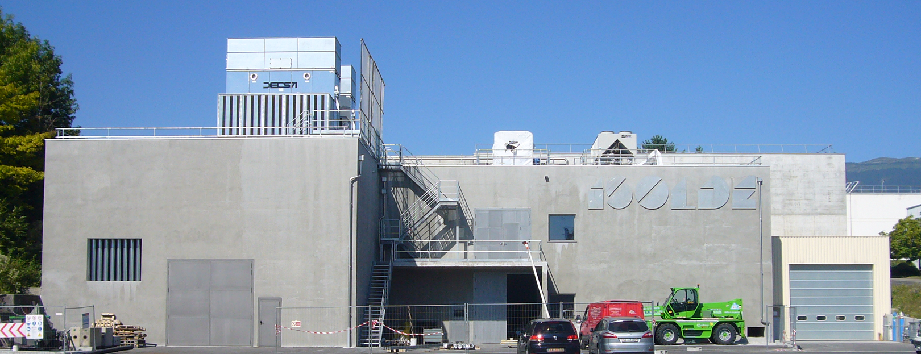
HIE ISOLDE installation progress

Slide 12
Technical Advances
SC Linac
      Cavity series production started
      RF coupler and tuner systems are being validated
      LLRF prototype successfully tested => series production underway
      SC solenoid design approved=> fabrication starting
      Cryomodule design finalized => procurement underway for long-lead items
High-Energy Beam Transfer lines
      Layout frozen => tracing on the floor
      Dipole and quadrupole Magnets + supports ordered
      H/V corrector magnets by end of November
      vacuum chambers design to be finalized soon
      Diagnostic boxes under procurement
Installation works @ ISOLDE
Design Study for the Intensity Upgrade well underway
      Target + Front-end (FE8 and 9)
      Offline separator test bench
      HVAC + Cooling => nuclearization
      Charge Breeder => assembly of electron gun, test at BNL (US)

Slide 13
HIE Simplified Planning
Start Isolde shutdown
17 dec 2012
We are here:
Nov 2013
End LS1:Start Low E physics
July 2014
HIE physics at 5.5MeV/u
October 2015
2011
2012
2013
2014
2015
2016
Q1
Q2
Q3
Q4
Q1
Q2
Q3
Q4
Q1
Q2
Q3
Q4
Q1
Q2
Q3
Q4
Q1
Q2
Q3
Q4
Q1
Q2
Q3
Q4
Civil
HEBT
Civil hall
Cryo
Main services
RF
Ventilation
Demi water
5.5MeV/u
Electrical syst.s
CM 1&2
Timeline:
Cabling
sd
sd
LS1
sd
sd
17 Dec 2012 - Q3 2014
Beam commissioning
3 months
shutdown
Isolde Ops
HIE installations and tests (Isolde normal operations)
Machine Check-Out
(Isolde normal operations)
Beam Commissioning
(Isolde normal operations)

Slide 14

Conclusions (1/2)
Technical Activities: progress is tangible on most of the machine parts => however one has to carefully monitor the following items:
      Series cavity production
      Tuning system procurement
      Procurement of CM parts and instrumentation
      Tooling for clean room assembly
      Cryogenics for SM18 test
      Transport solutions
      Reliability issues
      Safety
  Installation Works: High activity in the hall and service buildings; Despite delays we are still in line with the overall schedule which aims for low energy physics during 2014 and HIE physics as of Oct 2015. Critical paths for some activities are being addressed (cryogenics & cryomodule assembly)

Slide 15
Conclusions (2/2)
Safety:
      Shielding study finished – Report under preparation
      Beam losses and dump study to be finished
      CFD simulations of He leaks done by EN/CV have helped to discuss the access to the tunnel during steady state
      Safety folder => Demonstrative part to be finished
      Safety review carried out on November 6th 2013
Budget & Planning: consolidation ongoing

Slide 16

Acknowledgements
The presence of the CATHI fellows is paramount for the HIE-ISOLDE project:
      Replace missing staff deployed on other high-priority projects (LS1, LHC Upgrade, L4, LIU, etc…)
      Represent 1/4 of the total manpower of the project and almost 2/3rd in the case of the Design Study !
      Help establish or re-inforce existing collaborations
Keep up with the pace – maintain this good spirit and teamwork

Slide 17
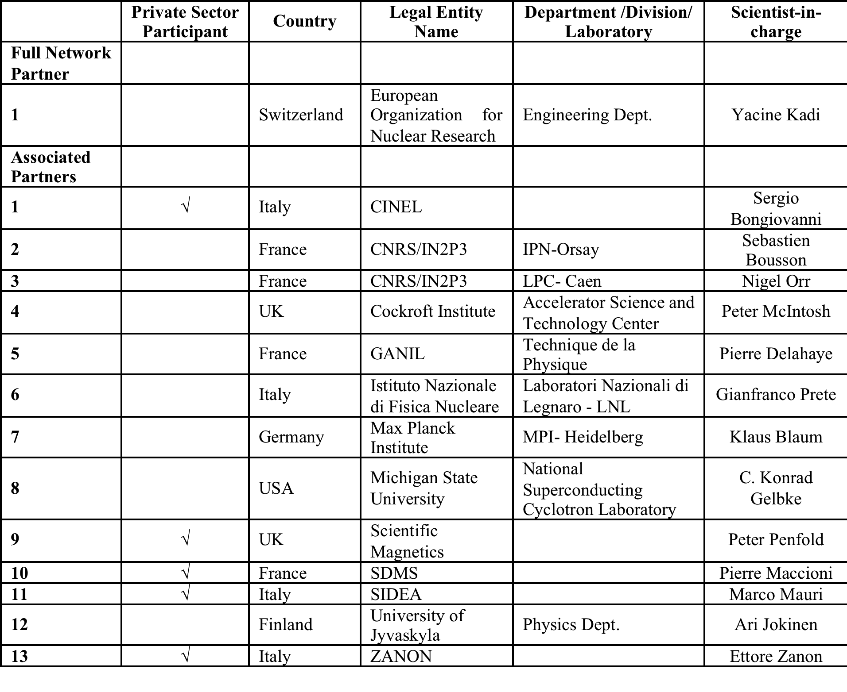
Associated Partners

Slide 18
New Partners

Slide 19

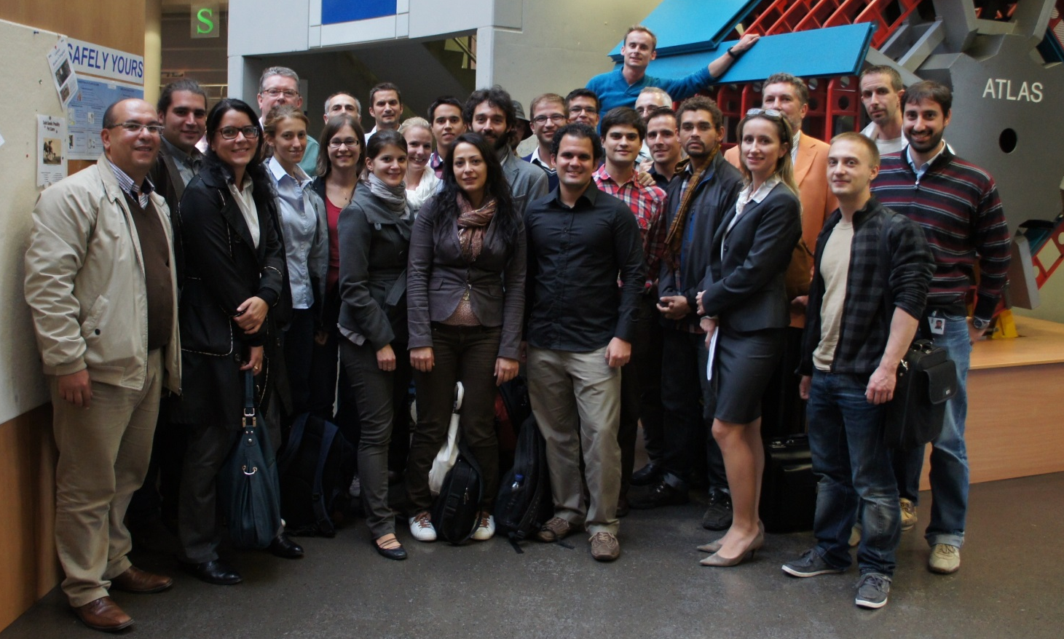
The research leading to these results has received funding from the European Commission under the FP7-PEOPLE-2010-ITN project CATHI (Marie Curie Actions - ITN). Grant agreement no PITN-GA-2010-264330.

Slide 20
Thank you

