Slide 1
HIE-ISOLDE Workshop : The Technical Aspects
November, 28th 2013
Latest developments of the
HIE-ISOLDE Alignment and Monitoring System
G. Kautzmann, J-C. Gayde, Y. Kadi, F. Klumb, S. Rokopanos, CERN, Geneva, Switzerland
J. Bensinger, K. Hashemi, Brandeis University, Waltham, USA
M. Šulc, Technical University of Liberec, Liberec, Czech Republic

Slide 2
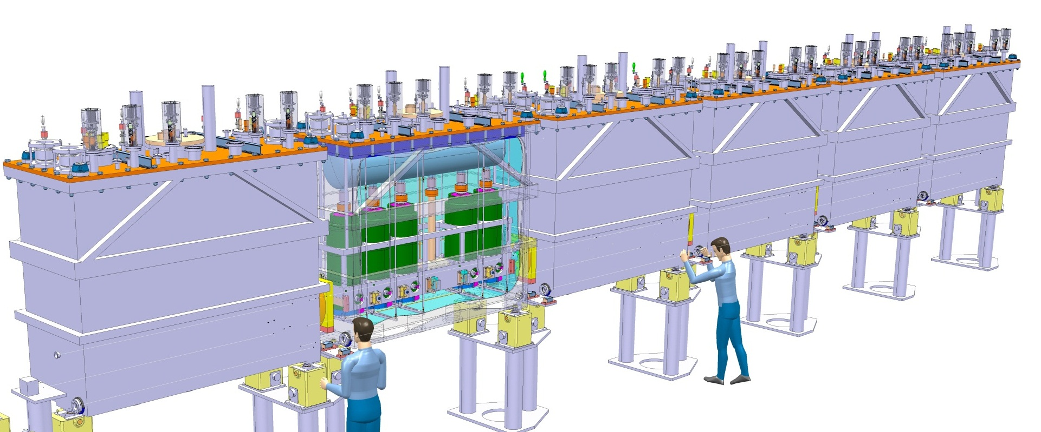
Alignment specifications
General
HIE-ISOLDE : Upgrade of the existing REX-ISOLDE
Alignment and monitoring of the Cavities and Solenoids in the Cryomodules w.r.to a common nominal beam line (NBL) along the Linac
Permanent and Modular system
Precision asked along radial and height axis at 1 sigma level :
  300 microns for the Cavities
  150 microns for the Solenoids
~16 m
NBL
+/-150 micr
+/-300 micr

Slide 3
Alignment specifications
Alignment System
CONCEPT
Creation of a closed geometrical network continuously measured
Observation and position reconstruction of Cavities and Solenoid in this Network
SYSTEM
RF cavities and solenoid equipped with targets
Interface Atmosphere / High Vacuum → Precise viewports
BCAM cameras fixed to inter-module metrological tables
External Lines => Position and orientation of metrological tables and BCAMs
Internal Lines => Position of the targets inside the tank
RF Cavity
Solenoid
BCAM
External Line
Pillars
Pillars
Cryo-module
Metrologic Table
Internal Line
BCAM observations

Slide 4
Alignment specifications
Alignment System
Top view
Overlapping zone of BCAM obs. on external lines
Double sided targets observations on internal lines
=> Redundancy
Side view
Ext. line
Overlapping
Pillar
Pillar
BCAM
BCAM to BCAM observations
Metrological Table
BCAM to Pillar observations

Slide 5
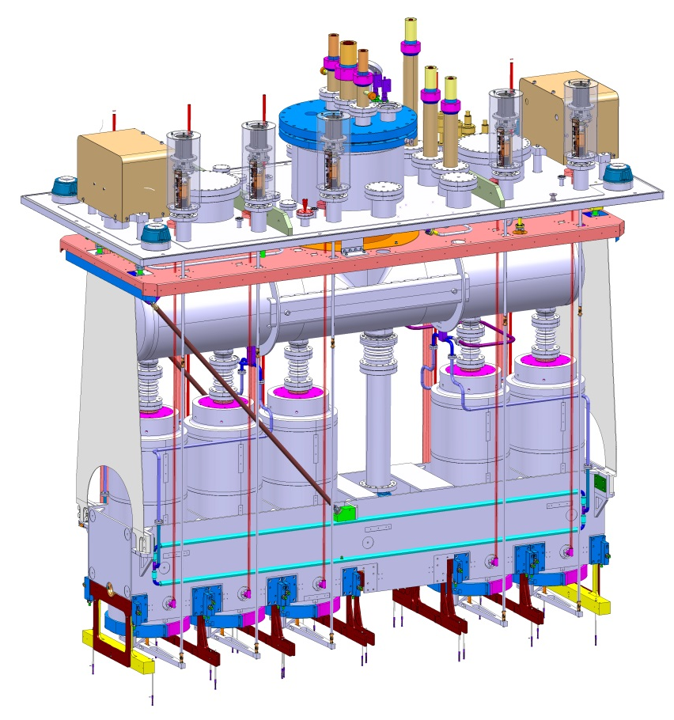
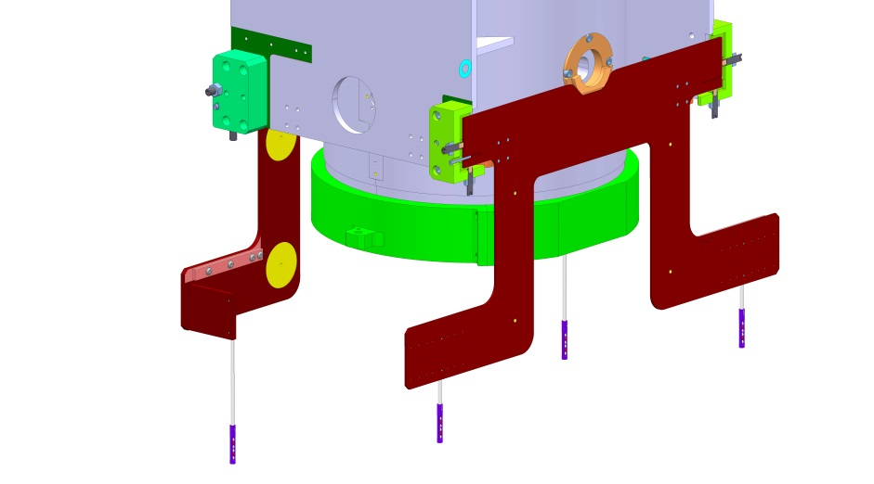
Supporting and adjustment
Cryomodule assembly in ISO Class 5 clean room
Survey sockets → Assembly / CM pre-alignment
Frame suspension and adjustment
Cavity and solenoid isostatic support: Sphere – V-shape
Precise adjustment
Solenoid adjustment allowed in operational conditions
Used as Target support

Slide 6
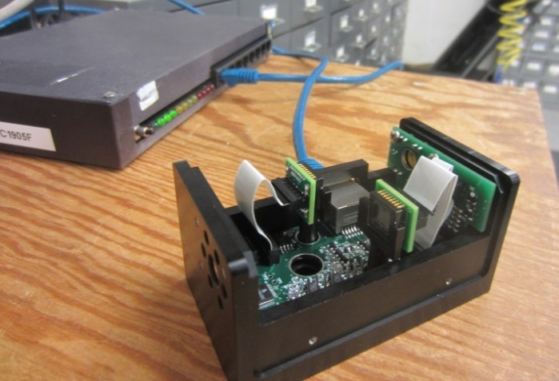
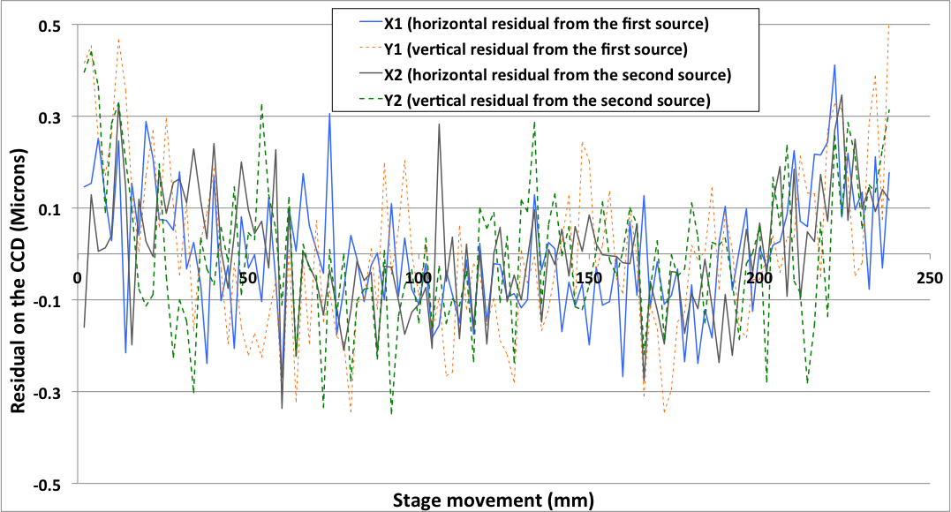
BCAMs
Developed on 1999 by Brandeis University for ATLAS Muon alignment
OSI (Open Source Instruments)
Original BCAM → HBCAM
Camera focal length: 72 mm → 49 mm – 50 mm
Sensor: 336 x 243 pixels 10 micr → 659p × 494p, 7.4 microns
Field of view: 40 mrad x 30 mrad → ~ 100 x 70 mrad
Sources: Laser Diodes 650 nm + Calibration of their power
+ Additional synchronized illumination system
http://alignment.hep.brandeis.edu/
http://www.opensourceinstruments.com/
Mounting: "Plug-in" isostatic system under the chassis
Double sided model → Chain of BCAMs
Resolution: 5 micro radians constructor (OSI)
→ Same range
Accuracy of 50 micro radians to absolute
→ Same range
Cable length BCAM/Driver > 60 m
+ Connection on the side
Delivered calibrated (focal length, position diodes, geometric relationship with plate support)
1 micron on CCD
6

Slide 7
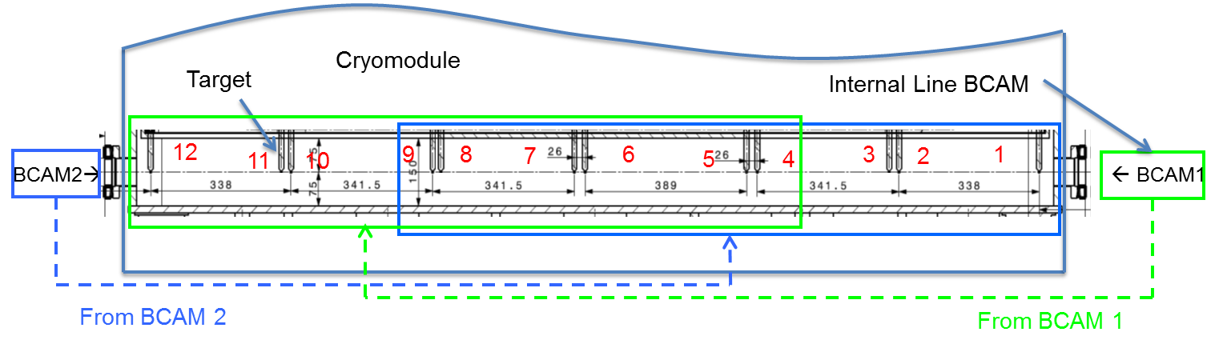
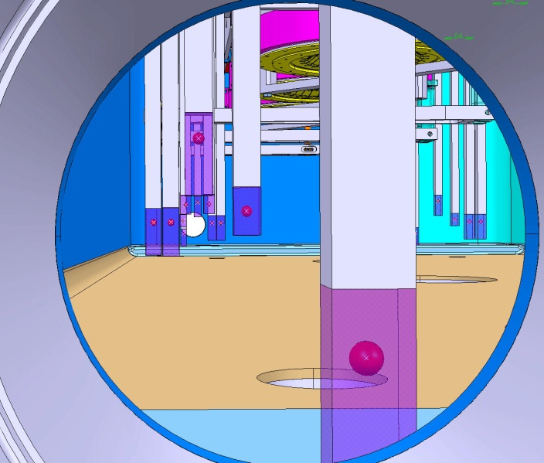
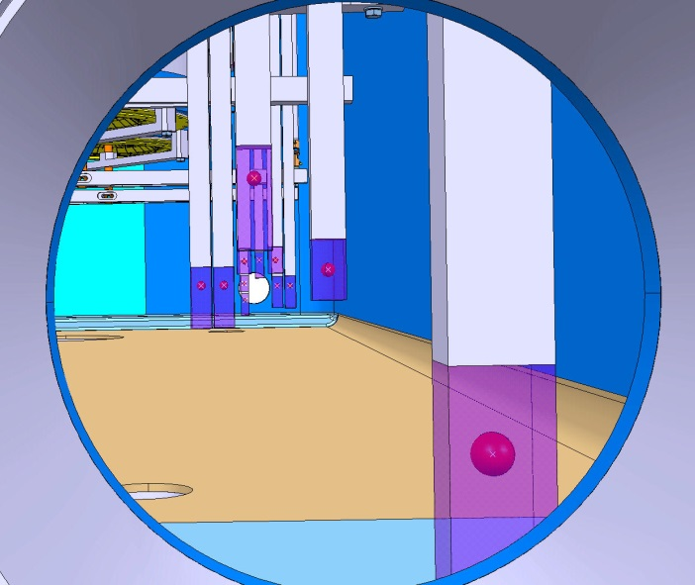

Targets
Integration
From HBCAM2
From HBCAM1
HBCAM vs BCAM Field of view

Slide 8
Targets
Overview
Constraints → HIGH VACUUM - CRYO CONDITIONS - SIZE
Studied Target Types
  Silica Silica optical fiber end
      - feed-through needed, one-sided target
      + easy light level control, OK with cold and vacuum (tested)
  Silica Silica optical fiber ended by a ceramic ball
      - feed-through needed, connection fiber/ball
      + visible from all positions, good diffuser
  Retro-reflective targets
      - illumination needed, all targets in one shot
      + double-sided, passive target, no feed-through

Slide 9

Targets
High Index Glass Balls
High index glass ball:
Developed by OHARA Inc., Kanagawa, Japan
Material : S-LAH79
Off the shelf
Available from diameter 1mm to 10mm
Diameter Tolerance (μm) : 0/-3
Sphericity (μm): 2
Refracting index of 1.993 for HBCAM Lasers (650nm)

Slide 10
HIE-ISOLDE
Glass ball theory
Study carried out by M. Šulc, Technical University of Liberec

Slide 11
HIE-ISOLDE
Glass ball theory

Slide 12
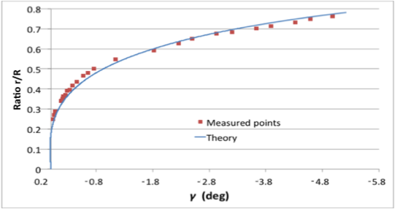
HIE-ISOLDE
Test results
Fit well to the theory

Slide 13
Targets
Outgassing
Test done by Mario Hermann (TE/VSC)
Outgassing at background level. Test done with an equivalent of 20 Ø4mm balls or 80 Ø2 mm balls.

Slide 14
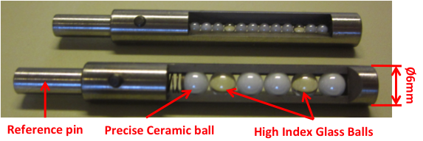
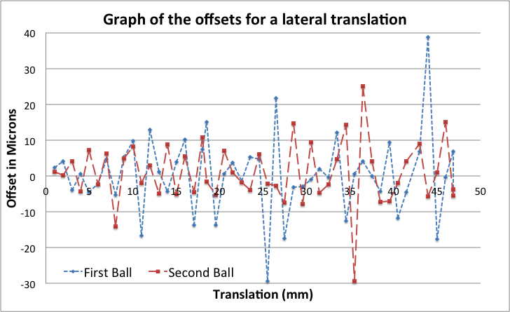
Targets
High-Index Glass
High Index glass balls based TARGETS:
Based on high index glass balls (Ø2 or 4mm)→ Retro reflective effect
Double Sided
Flashed by HBCAM Lasers
Possibility of multi-balls targets
Glass balls: Vacuum compatible
Good geometrical results
Distance to target:
1.2 m
Scan over 40% of the field of view
Precision of the reconstructed movement: ~10 microns at one sigma level
Expectation: around 10 urad
20 microns

Slide 15
Conclusion
ALIGNMENT SYSTEM MAINLY BASED ON WELL KNOWN ELEMENTS
BCAMs
  Proved and used devices
  New HBCAM inside the specifications
TARGETS
  All alternatives seem to work well (Fibers – Ceramic balls – Retro targets)
  Passive high index glass ball target looks promising → “Final” validation test on-going
VIEWPORTS
  Studied and fitting well to the theory → Easy BCAM observation corrections
  Be careful in the choice of the viewport → High optical quality needed
SOFTWARE:
  Under development
  Simulation of metrol. table position reconstruction → ~20 microns at 1 sigma level
GOAL: BE READY FOR THE VACUUM AND CRYOGENIC TESTS OF 1st CRYOMODULE

Slide 16

HIE-ISOLDE
Alignment and Monitoring System
Acknowledgement:
This research project has been supported by a Marie Curie Early Training Network Fellowship of the European Community’s Seventh Framework Programme under contract number (PITN-GA-2010-264330-CATHI).
Thanks for your attention

Slide 17
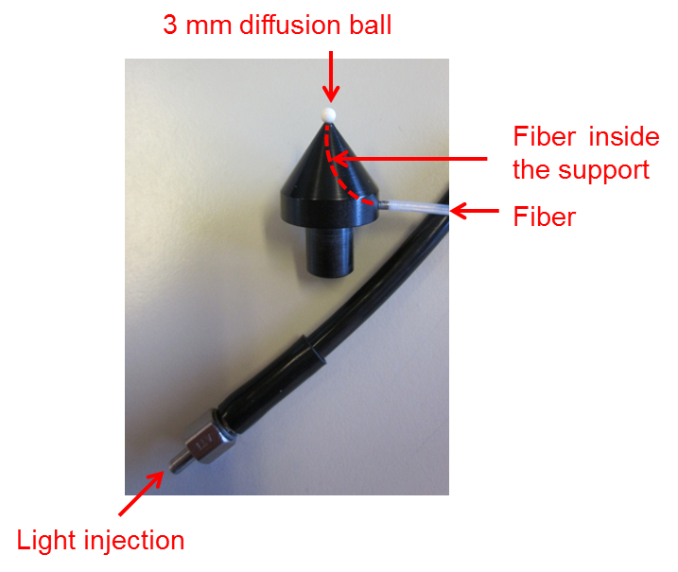
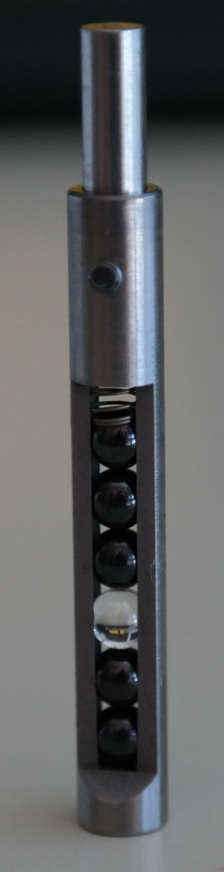
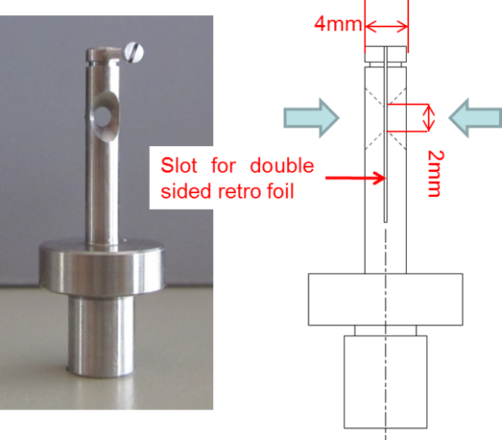
Targets
Double-sided
Three types of “double sided” targets considered
Laser illuminated ceramic balls
Retro-reflective bi-directional target
Retro-reflective high-Index Glass ball target
Test prototype for an illuminated ceramic ball synchronized to the acquisition system
But Active targets
Double sided retro-reflective target Prototype
But Not High-Vacuum compatible

Slide 18
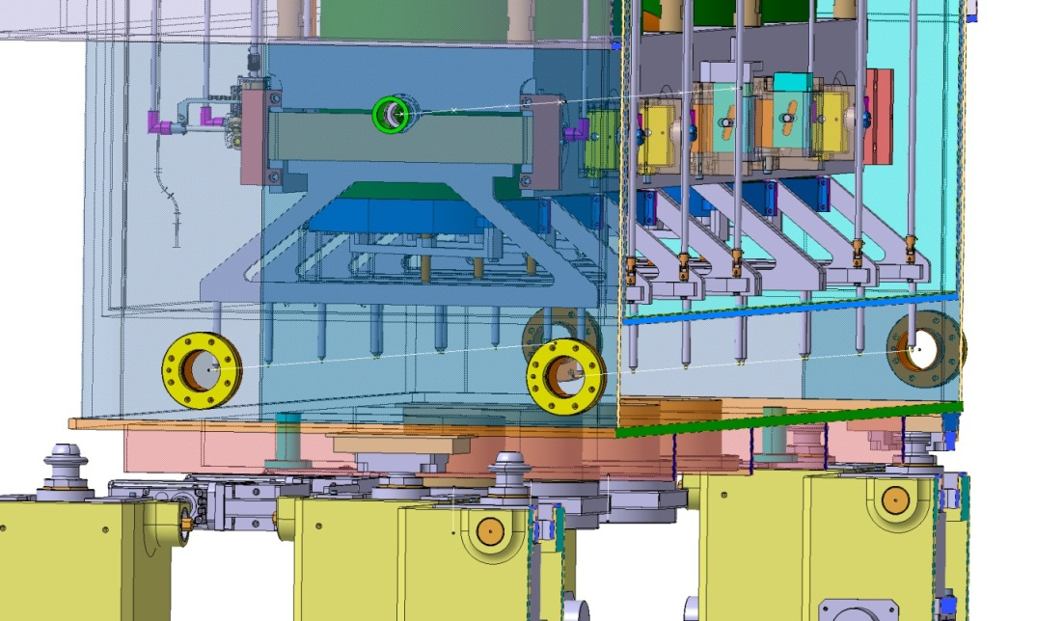
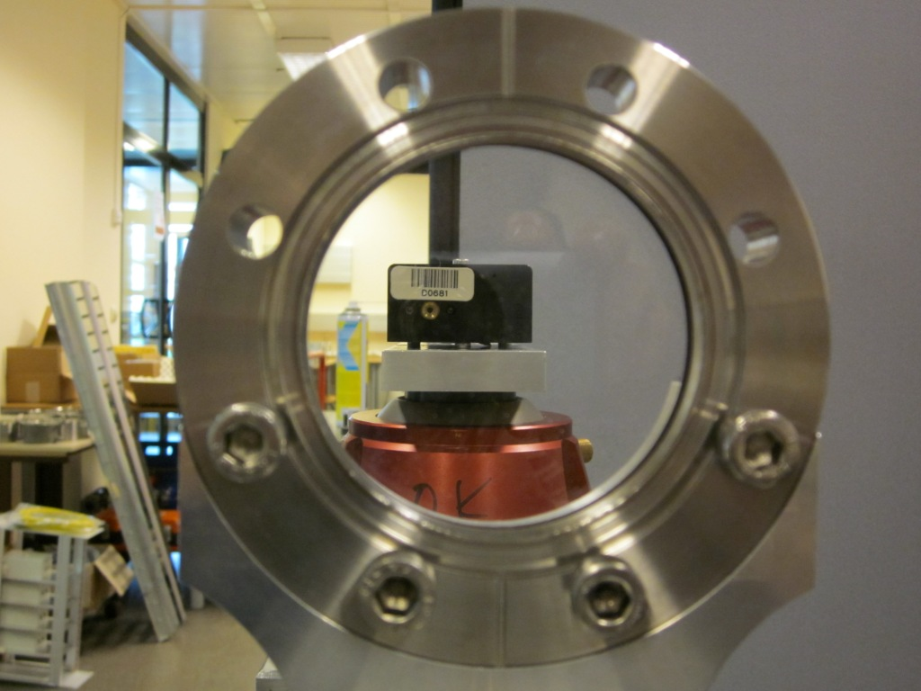
Viewports
Atmosphere / Vacuum interface
Parallel plates window
Viewports at CM ends (off the shelf)
Study of viewport effects on BCAM observations
Viewport 6.55 mm thick
3 opt. quality classes tested
Wedge angle
    10 micro-rad
Parallel plate effect
  1 Deg → 40 microns
  Match the theory → correction by software
Deformation due to vacuum
  Less than 0.015 deg of angular deviation

Slide 19
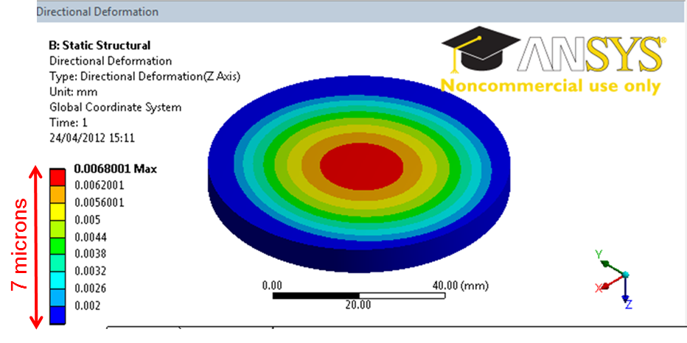
Viewports
Wedge angle
    10 microrad wedge angle acceptable
    Parallel Plate Effect
    Incident angle change of 1gon (0.9deg) → 37 microns radial object “displacement”
    Match the theory by a few microns → Easy observation correction by software
    Adjustment of the Window within less than 1 degree → Ease the correction
Window | Given wedge angle (microrad) from window’s technical data | Wedge angle observed (microrad) | Influence on target at 1m (micr) | Influence on target at 2m (micr)
A | 25 | 5 | 2.5 | 5
B | 50 | 10 | 5 | 10
C | 500 | 300 | 150 | 300
    Vacuum deformation
    Less than 7 microns deformation at the center
    Less than 0.015 degree of angular deviation
    Deformation measurements Liberec University (CZ):
      Results match the calculated deformations by a few microns
      Same deformation on both side → Parallelism kept

Slide 20
Software
Coordinate Systems
Each element has a specific coordinate system atached
Hierarchical scheme of coordinates systems :
  Topmost: HIE system → Link to the NBL
  For each table: Table system → Link between the BCAMs
  For each BCAM: Mount system → Calibration parameters
  CDD System → Observations

Slide 21
Software
Adjusted Parameters
Translations and rotations for each table need to be estimated: 6 parameters per table in the setup
Relations between mount systems on the same table are fixed → Tables considered as a floating rigid body

Slide 22
Software
Adjustment
Temperature Observations
Calibration parameters
External Observations
HBCAM Observations
Configuration
Least square adjustment
Adjusted parameters between the systems
→ reconstructed coordinates

Slide 23
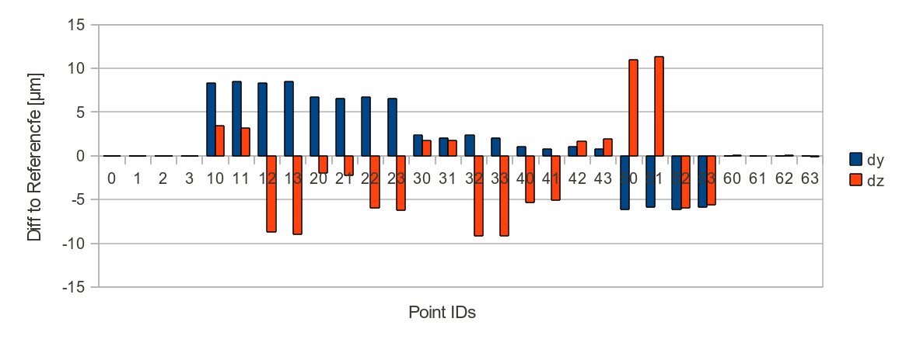
Software
Simulation results
20 microns
Σ₀²=0.0117 | σty [μm] | σtz [μm] | σrx [μrad] | σry [μrad] | σrz [μrad]
0 | 0.49 | 0.53 | 1.54 | 3.51 | 1.2
1 | 9.19 | 10.72 | 34.5 | 4.16 | 3.78
2 | 12.72 | 15.38 | 38.2 | 3.59 | 3.39
3 | 13.67 | 16.87 | 38.02 | 2.82 | 2.69
4 | 12.73 | 15.6 | 38.27 | 3.56 | 3.39
5 | 9.21 | 11.01 | 34.54 | 4.18 | 3.78
6 | 0.9 | 1.07 | 3.18 | 3.93 | 1.23
Overlapping improves the results by a factor 2
Still some error budget for the reconstruction of the targets

Slide 24
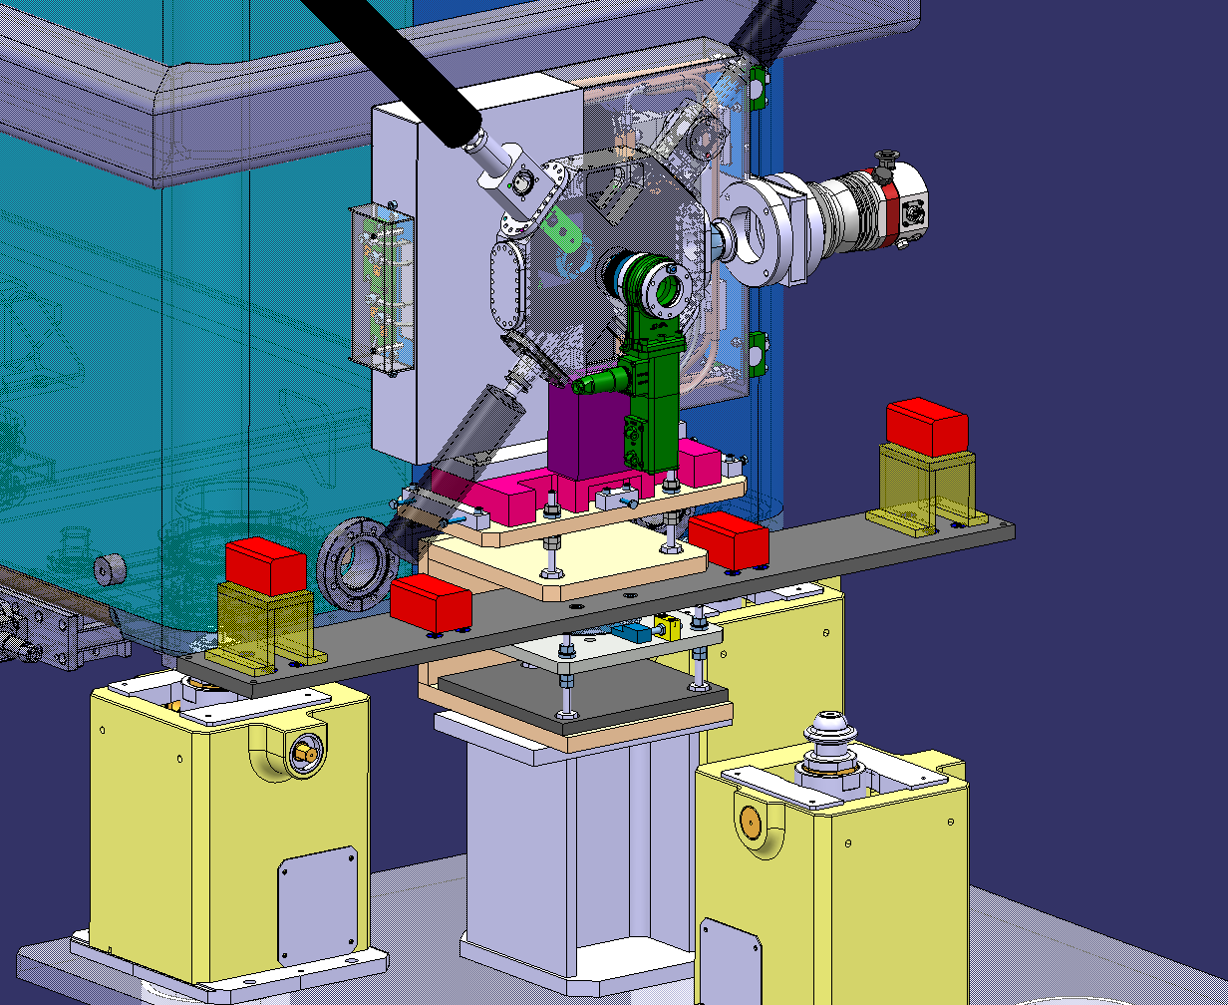
HIE-ISOLDE
Alignment and Monitoring System

