Slide 1
Kicker Electronic and Slow Control
Etienne CARLIER AB/BT/EC

Slide 2
Outline
Control Architecture
State Control and Surveillance System
Trigger Synchronisation & Distribution System
Beam Energy Tracking System
Operational Check

Slide 3
Architecture General
State
Kick Time
Kick Strength
State Control & Surveillance System SCSS
Trigger Synchronisation & Distribution System TSDS
Beam Energy Tracking System BETS
Operational Check Static & Pulse modes
Alarm
Logging
Trending
Fast Analog Acquisition System

Slide 4
Architecture Functional
Beam Energy Tracking System
Trigger Synchronisation and Distribution System
Power Supplies
1
15
Power Triggers
1
15
Pulse Generators & Kicker Magnets
1
15
Re-Trigger
1
15
State Control and Surveillance System

Slide 5
Performance of LHC Extraction Kickers Typical Possible Failures
Generator failure in static mode → SCSS
Less than 15 pulse kickers are able to respond to a dump request
Energy tracking failure → BETS
→ Kick strength outside tolerance window
Kick is too large
Kick is too small
Synchronisation failure → TSDS
→ A spontaneously triggering of a kicker
A drift or shift of the synchronisation pulse train w.r.t. the beam abort gap
Generator failure in pulse mode → POC
→ One missing branch

Slide 6
State Control & Surveillance
State
Kick Time
Kick Strength
State Control & Surveillance System
Trigger Synchronisation & Distribution System
Beam Energy Tracking System
State management
Interlock
Switches
Power supplies (over-voltage, over-current, short-circuit
Electrical circuit closure…
Monitoring
Power supply (current, voltage)
HV dividers…
Personal Safety
Electrical distribution

Slide 7
State Control & Surveillance Architecture
Ethernet
Simatic S7-400
CP416F-2DP
PROFIBUS-DP PROFIsafe
DP / DP Coupler
Generator 1
Generator 15
CP315F-2DP
Simatic S7-300
PROFIBUS-DP PROFIsafe
PROFIBUS-DP PROFIsafe
ET200M
ET200M
S7-300 modules used in standard mode
S7-300 fail-safe modules used in safety mode

Slide 8
State Control & Surveillance Implementation
Based on fail-safe SIEMENS SIMATIC S7-F Programmable Logic Controllers and on fail-safe communications between PLC via PROFIBUS-DP fieldbuses using PROFIsafe protocol.
Surveillance based on a hierarchical design based on failure severity
Analogue inputs based on redundant 4-20mA current loop sensors, digital inputs based on non-equivalent sensors and redundant digital outputs used for actuators control.
“Passivation” of inputs and outputs (i.e. dump request) in case of sensor failure or discrepancy between sensors (redundant, non-equivalent)
Manual “Re-integration” after a failure involving a safety elements
Reaction time is typ. 20ms (max 50ms)

Slide 9
Trigger Synchronisation & Distribution
State
Kick Time
Kick Strength
State Control & Surveillance System
Trigger Synchronisation & Distribution System
Beam Energy Tracking System
State management
Interlock
Switches
Power supplies (over-voltage, over-current, short-circuit
Electrical circuit closure…
Monitoring
Power supply (current, voltage)
HV dividers…
Personal Safety
Electrical distribution
Synchronisation of dump requests with beam abort gap
Distribution of dump requests up to HV generator
Protection of the machine against spontaneous firing

Slide 10
Trigger Synchronisation & Distribution Architecture
Trigger Synchronisation Unit
Trigger Fan-out
Power Trigger Unit
Re-trigger Box
Generator 1
TSU
TFO
PTU
Branch A
RTB
PTU
Branch B
RTB
F_{rev}
Generator 15
Client Interface
TSU
TFO
PTU
Branch A
RTB
PTU
Branch B
RTB
RTD
Re-trigger Delay
Fail-safe
Fault-tolerant
Re-trigger lines

Slide 11
Trigger Synchronisation & Distribution Dump Request Distribution
Dump request uses the “domino effect” for trigger distribution
Energy required to distribute the dump request up to the kicker HV generator is
Pre-stored within capacitor at each stage of the triggering chain,
Used to trigger the next stage, and
Checked before a beam permit signal is issued,
But, somebody has to trigger the chain… to push the first domino stone!
→ Interface to the LBDS Clients
Propagation of the trigger pulse through the different stages of the triggering chain relies either on an active fail safe logic up to the synchronisation with the abort gap and on a passive redundant fault tolerant logic up to the HV generator in order to avoid asynchronous beam dumps.

Slide 12
Trigger Synchronisation & Distribution LBDS Clients
Client
Signal Redundancy
Signal Type
Signal Media
Response Time
BIS
Yes
8.315 MHz & 9.315 MHz Frequencies
Fibre Optic
< 250 ns
BLM
No
Current Loop
Opto-coupled copper cable
< 1 us
BETS
Yes
10 MHz Frequency
50 Ω galvanic signal
< 250 ns
LBDS MKD Ready MKB Ready TSU Ready BETS Ready IPOC Ready LASS Ready
Yes
Non-Ambivalent Redundant Contact
(SCSS)
Floating Relay
~ 20 ms
Injection Prepulse
No
1us logic pulse
50 Ω galvanic signal
< 150 ns

Slide 13
Trigger Synchronisation & Distribution Implementation
1oo2 ‘Trigger Synchronisation Unit’ systems can synchronise the dump request.
Both systems are independent.
The mission time for tests is 89 µs.
1oo4 independent trigger channels can issue the dump trigger.
Each branch has 5 re-trigger sources which feed 2 re-trigger distribution lines.
Twice 1oo5.
Each source can deliver sufficient energy to trigger all power triggers of all magnets MKD/MKB.
Continuity of the re-trigger lines is continuously checked (pulse train).

Slide 14
Beam Energy Tracking
State
Kick Time
Kick Strength
State Control & Surveillance System
Trigger Synchronisation & Distribution System
Beam Energy Tracking System
State management
Interlock
Switches
Power supplies (over-voltage, over-current, short-circuit
Electrical circuit closure…
Monitoring
Power supply (current, voltage)
HV dividers…
Personal Safety
Electrical distribution
Synchronisation of dump requests with beam abort gap
Distribution of dump requests up to HV generator
Protection of the machine against spontaneous firing
Acquisition and distribution of the beam energy
Generation of kick strength reference signals
Surveillance of the charging voltages w.r.t. the beam energy

Slide 15
Beam Energy Tracking System Functions
Acquisition of the machine “beam energy”,
Generation of the kick strength reference signals for LBDS extraction and dilution kicker high voltage generators w.r.t. the beam energy,
Continuous surveillance that the charging voltages of the different capacitors within the kicker high voltage generators follow their references within predefined tolerance windows (extraction trajectory aperture),
Continuous surveillance that the LBDS extraction septa and ring quadrupole Q4 currents are within predefined tolerance windows (extraction trajectory aperture),
Generation of a dump request after detection of an upcoming tracking fault if the measured values are not within predefined tolerance windows relative to the beam energy,
Distribution of the beam energy to external clients.

Slide 16
Beam Energy Tracking System Relations
Power Converter Right 4
Dipole Magnet 4-5
Other users
Beam
dump
Power Converter Left 8
Dipole Magnet 7-8
DCCT
DCCT
Beam Energy Tracking System
(BETS)
Power Converter Left 6
Dipole Magnet 5-6
Power Converter Right 6
Dipole Magnet 6-7
DCCT
DCCT
HVD
DCCT
DCCT
HVD
Kicker HV Gen. Ext. Beam 1
Power Converter Q4 Beam 1
Quadrupole Q4 Beam 1
Power Converter Septum Beam 1
Septum Magnet Beam 1
Kicker HV Gen. Dilution Beam 1
Kicker Magnet Ext. Beam 1
Kicker Magnet Dilution Beam 1

Slide 17
Beam Energy Tracking System Architecture
Acquisition
Settings
Main
Bends
I_{meas}A
Beam Energy Meter
E_{beam}A
Kicker HV
Generators
Reference
U_{ref}K_{i}
Main
Bends
I_{meas} B
Beam Energy Meter
E_{beam}B
Tracking Interlock Logic
|E_{beam}B – E_{beam}K_{i}| > 0.5% * E_{beam}B
Dump Trigger Request
Interlock
Kicker HV
Generators
Beam Energy Meter
U_{meas}K_{i}
E_{beam}K_{i}
Acquisition
Tracking

Slide 18
Beam Energy Tracking System Implementation
Based on four redundant and independent measurements of the main bends magnet current to get the beam energy.
Generation of the kick strength reference signals is integrated within the SCSS.
Tracking interlock logic is based on two redundant systems built on the basis of two different technologies
One on fail-safe SIEMENS SIMATIC S7-F Programmable Logic Controllers → Feedback Tracking
The other one on dedicated hardware → Real-time Tracking
Both systems have to be continuously in agreement. In case of discrepancy between the two systems, a dump request will be issued immediately.

Slide 19
Beam Energy Tracking System Real-Time Vs Feedback
Real Time Tracking
Dedicated VME hardware
Surveillance of
MKD
Principal circuit
Compensation circuit
MKB
Q4
MSD
1 ms surveillance cycle
10 µs response time
Dump request through redundant 10 MHz connections to the TSU
Integrated within SCSS
Surveillance of
MKD
Principal circuit
Compensation circuit
Triggering circuits
MKB
20 ms surveillance cycle
10 ms response time
Dump request through the general “LBDS ready” signal
Feedback Tracking

Slide 20
Post-Operational Check
Post-Operationnal analysis is the only way to verify the correct execution of the last dump action.
Despite a perfectly dumped beam, it remains possible that damage has been caused to one or more components of the dump system during the previous dump action (e.g. the solid state switches).
The beam dump system will be declared ready for the next mission if, and only if, it can be expected that all the hardware, including all the redundant components, will respond correctly to the next dump request.

Slide 21
Post-Operational Check Data Acquisition
Trending
Continuous sequential data logging at a fixed acquisition frequency
Alarm
Acquisition and archiving of unforeseen process events detected by equipment surveillance programs
Transient Recording
Pre & Post trigger data acquisition after reception of an external asynchronous trigger
Logbook
Record of actions performed on equipment hardware and software by CCC and equipment specialists

Slide 22
Post-Operational Check Transient Signals
Free wheel Diodes
Currents
Principal Switches
Currents
Compensation Switches
Currents
Magnet Current

Slide 23
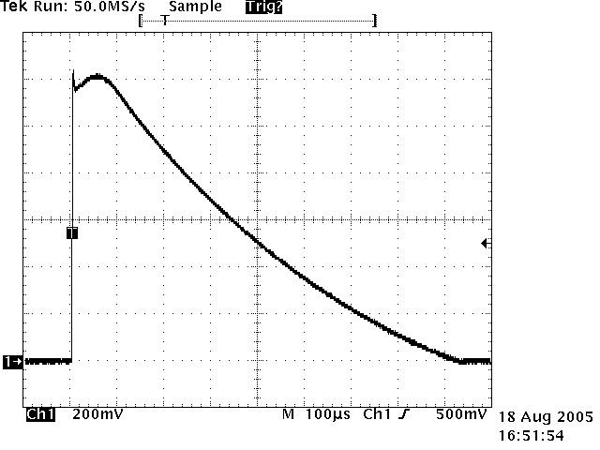
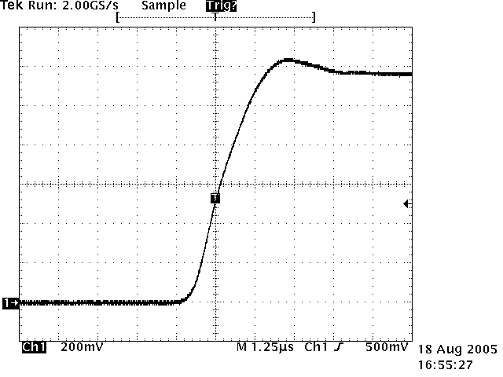
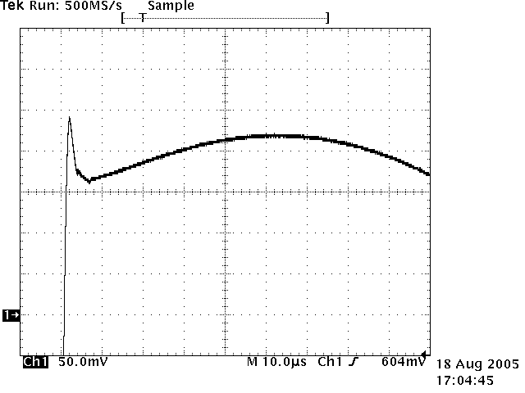
Post-Operational Check Transient Recording Analysis
Two different levels of Analysis
XPOC – External Post Operation Check
What happened during the dumping process with the beam?
What is the evolution of the performance of the system
IPOC – Internal Post Operation Check
How performed the different sub-systems during the dumping process?
IPOC analysis for LBDS extraction kicker
Kick Synchronisation Analysis
Kick rise-time, kick length,
Kick synchronisation with beam.
Kick Amplitude Analysis
Kick normalization with beam energy
100 % kick measurement,
Kick first overshoot, second overshoot.

Slide 24
Post-Operational Check Implementation
High precision acquisition and analysis of the 15 magnet current pulse shapes will be performed after each dump action.
2 different types of acquisition sensors: Pearson PU (passive) and Rogowski PU (active)
The acquisition system is based on two CompactPCI crates running SCL4 and housing:
NI-PXI 5122 digitizers with 14 bit resolution and 100 MS/s sampling rate for the kick strength & kick synchronisation surveillance and monitoring
Acquisition and verification of the current in the different branches of the generator in order to identify the faulty circuit will be available in a second phase (prototype available)
Principal circuit
Compensation circuit
Freewheel circuit

