Slide 1
Direct CP: Charmed and not
Amarjit Soni
HET, BNL
LHCb, CERN Oct 15, 2013

Slide 2

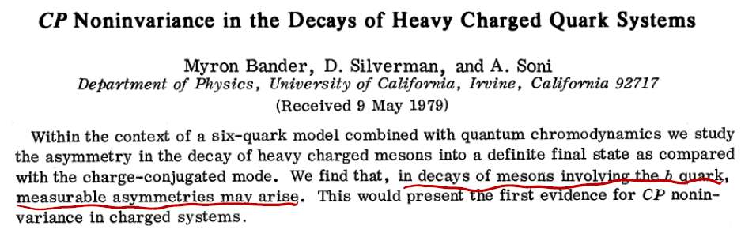
Dedicated to the memory of Myron Bander , who decades ago started
me off in the interesting and important path of Direct CP

Slide 3
Scope of talk
Outstanding challenge for decades
important measure for flavor alignment………..demands continual attack despite non-trivial QCD challenges
Useful tool to search BSM CP phase(s):
Multitude of observables
However, unfortunately size of effects in interesting model(s) are now expected to be on the small side demanding greater precision from Expt. & Th.
Therefore, SM null tests gain more prominence
Examples: DCP many modes B: SCP(γ); Δγ; ε’,
K_{L}=>π⁰ νν; nedm; colliders: all t-CP

Slide 4
Charm CP

Slide 6
Experimental status
CDF, BELLE, BaBar joined soon thereafter
HFAG: ΔA_{CP} = -0.678 +- 0.147%
In particular Belle gave separate #s for KK and ππ though for now only about 1.5σ significance.
But SuperKEK B should be able to provide much better (separate) numbers a few years from now.

Slide 7
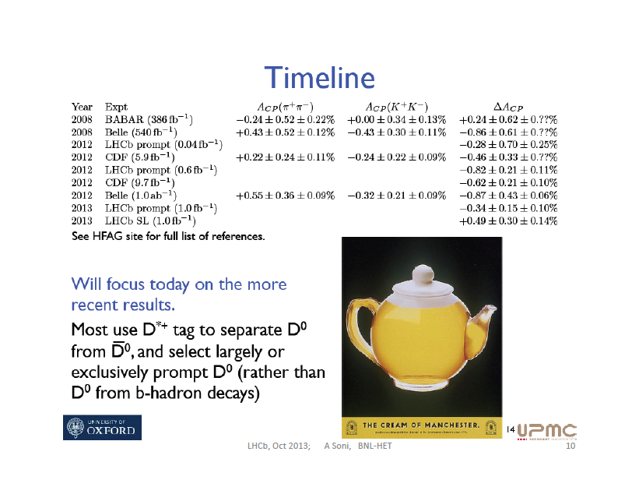
Stolen from Mat Charles
[Charm 2013]

Slide 8
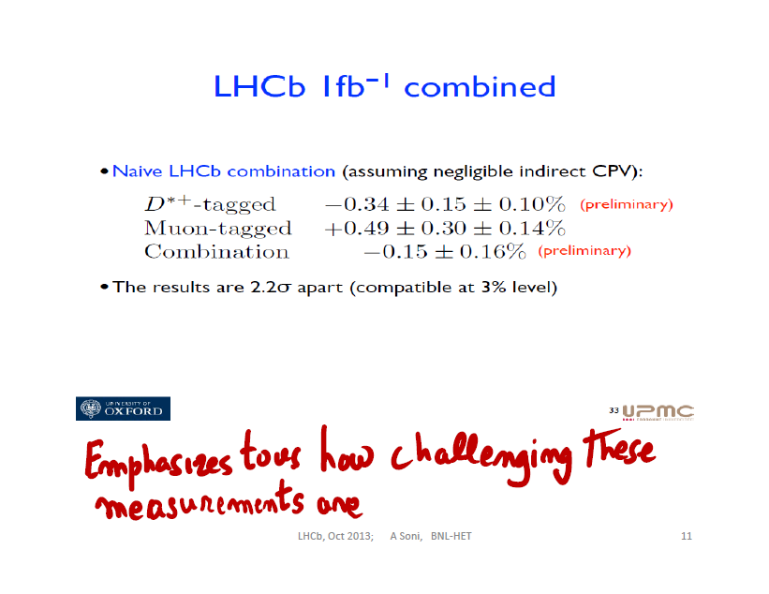
Stolen from Mat Charles
[Charm 2013]

Slide 9
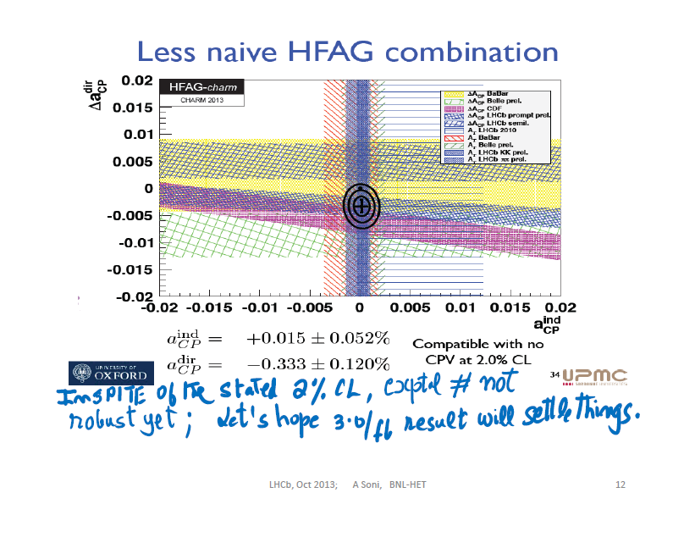
Stolen from Mat Charles
[Charm 2013]

Slide 11
SM estimate for ΔA_{CP}

Slide 12
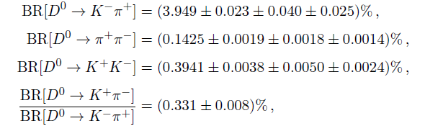
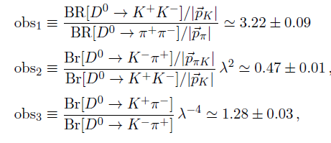
Peek @ PDG: old results

Slide 13
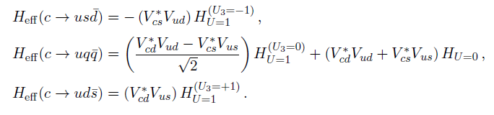
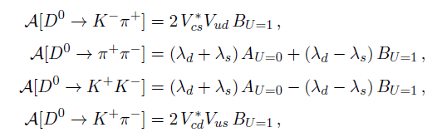
EXACT U-SPIN LIMIT

Slide 14
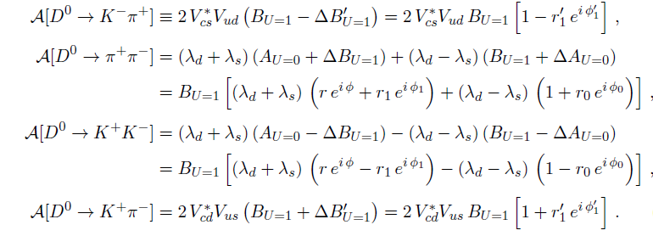
Taking U-spin breaking into a/c

Slide 15
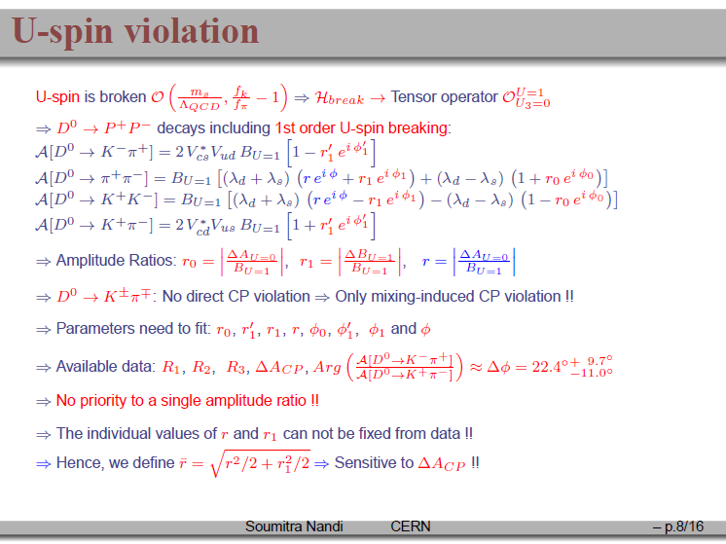

Slide 16
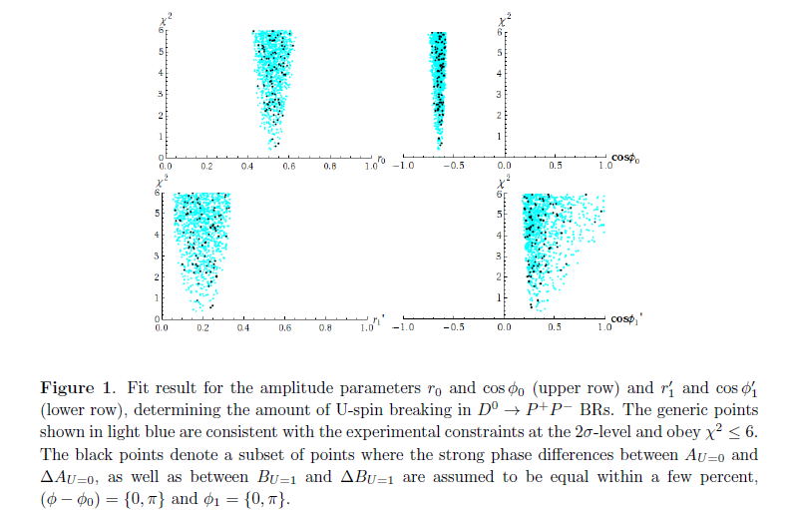

Slide 17
Summary (so far) on D-CP results
SM explanation cannot be ruled out and is quite plausible if expt finds ~few X 10⁻³. However, a compelling case for SM explanation can also not be made. Theory is very foggy.
In fact SM # may well be very close to quark level…Highly unlikely that charm penguin ME are enhanced =➔
OTOH unless true result is, for sure, 1% or more, not a compelling sign of new physics at this time.
theory estimates (esp. for 2 Ps modes) plagued by large hadronic (non-perturbative) uncertainties; NO RIGOUROUS METHOD IN SIGHT; LONG-TERM WORRY => Ghost of ε ‘/ε. However, unlike K-> ππ , lattice methods appear exceedingly difficult
More exptal input (many other modes) crucial & could change interpretation…
Searches in modes where SM predicts close to 0 esp. important

Slide 18
Quenched and unquenched p/t for K=> pi pi & possible implications for D->KK,pi pi

Slide 19
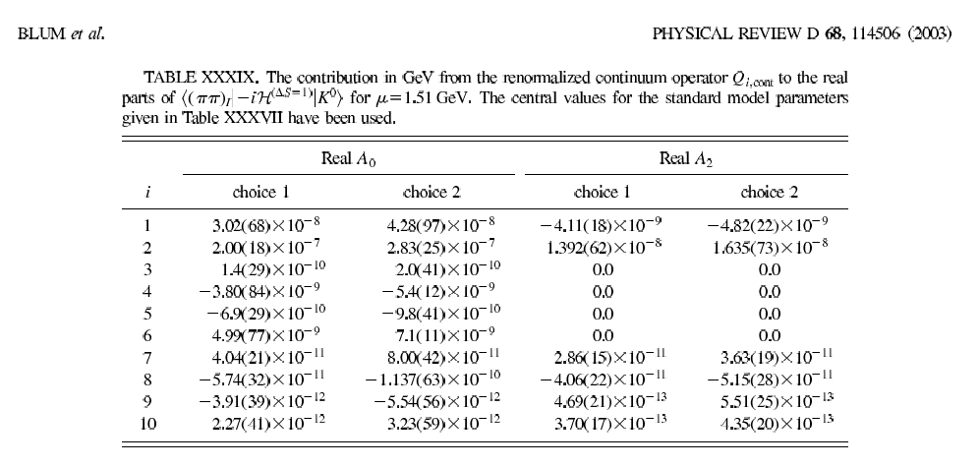

Slide 20
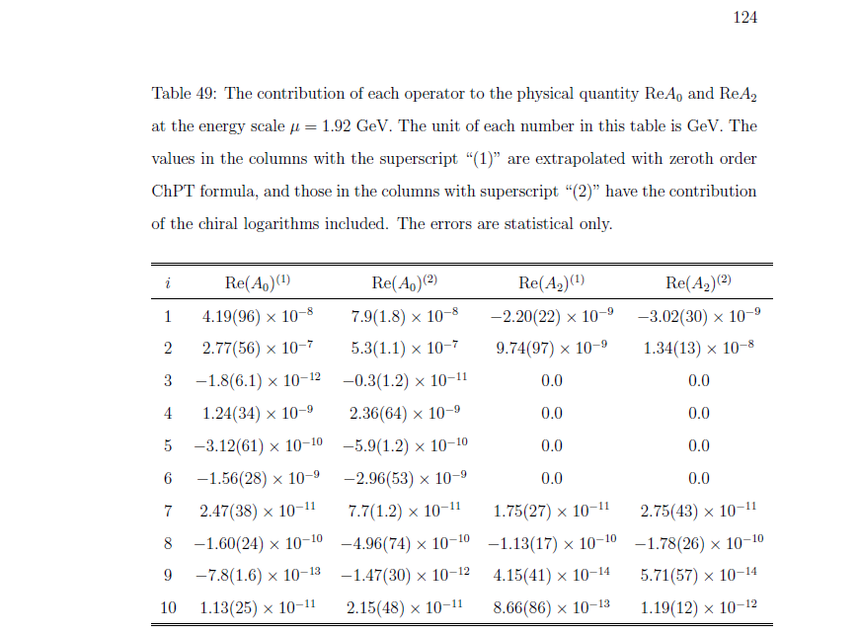

Slide 21
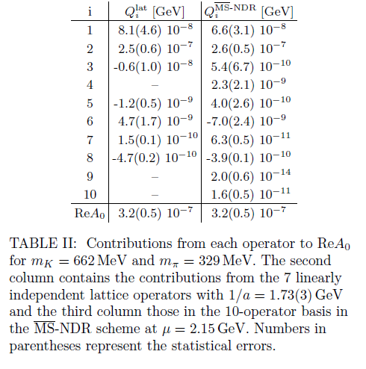

Slide 22
P/T in K decays vs D decays
.

Slide 23
EXCEEDINGLY Important to ascertain if D-CP is receiving contribution from BSM
Suggestions:
Atwood & AS, arXiv:1211.1026;PTEP2013

Slide 24
Implications of CPT
Final States with enhanced CP; esp important to pursue as KK, pi pi channel
results now appear rather small.
SM or not : A possibly useful test
Final states (best) suited for BSM searches

Slide 25
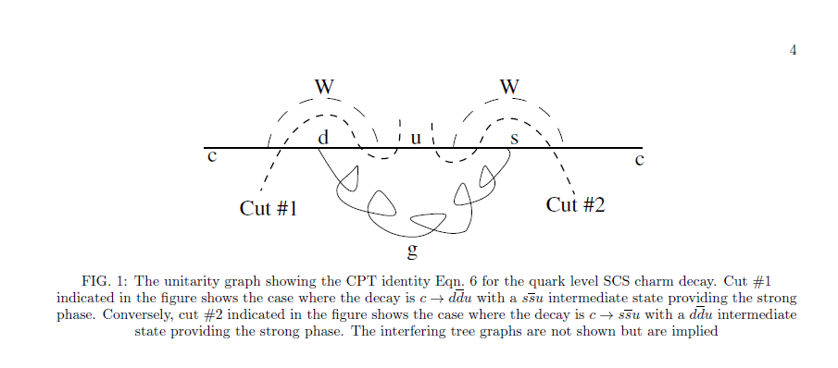


Slide 26
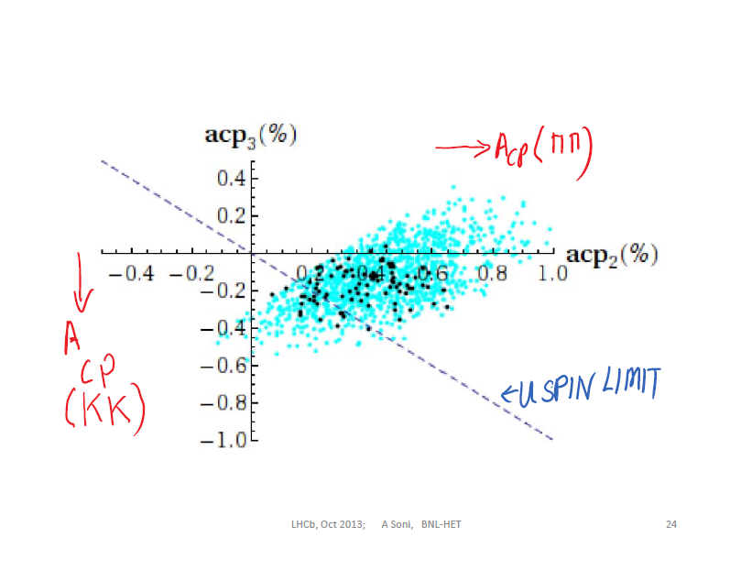

Slide 27
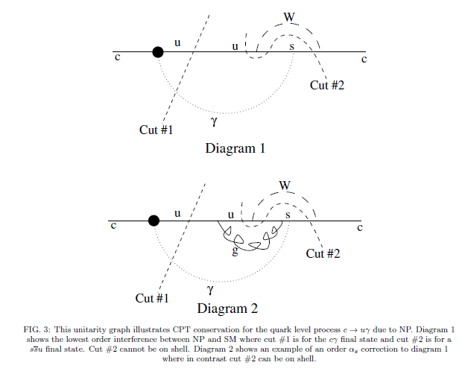
Radiative D-decays
See also : Isidori & Kamenik ‘12;
Lyon & Zwicky ‘12
In radiative D-decays, CP-conserving phase likely small

Slide 28
Candidates for enhanced CP asymmetry
[because of CPT] (1)
Since asymmetry arises from T and P interference and as a rule P<<T, need final states where T is suppressed => color suppressed modes: compare D⁰ => ρ⁺ + ρ⁻ versus ρ0 ρ0
ρ0 ρ0 also gives 4 charged pi’s and possibility of triple correlation asymmetry
Other examples:
For KEKB D=> π⁰ π⁰ (η, η’)
also imp but may not be CS

Slide 29
Candidates for Enhanced CP Asy
[due CPT] (2)
In the SM, dir CP from interference of P X T
As a rule for D, P/T << 1
To optimize SM CP choose FS such that
1) Tree is CLS; therefore (for interference with P) need SCS + CLS
2) choose enhanced penguin (i.e.color allowed)
EXAMPLES: D⁰=> φ (η’)ρ⁰ ; D⁺=>φ(η’)π⁺……
From the standpoint of SM these may be most promising and some even allow triple correlations

Slide 30
Possibly useful test for new physics
Key idea: Hadronic matrix elements enhancement (factor O( few) ) only operational for EXCLUSIVE (in particular 2 body pseudoscalar) MODES
Inclusive (multibody) modes[esp. when summed] should exhibit quark level asymmetry[quark-hadron duality] ~6X10⁻⁴ if SM is the source, if these also show appreciably larger asymmetry compared to quark level SM expectations, then BSM-CP is the origin
Hope for implementation at LHCb and BF but especially SUPER-KEKB should be able to use this.

Slide 31
How to look for inclusive final states?
Simple suggestion
Look for D => K K X
Operationally KKX is any final state containing a K K with total energy in the 2 kaons less than the energy of the parent D
LHCb may try use multibody FS perhaps with a soft pi trigger
Charm mass may not be high is a concern so specific multibody FS (rather than sum) may be used and test still likely to work

Slide 32
Multibody FS can also be very useful
Main point is esp avoid 2-body pseudos as they tend to have significant non-perturbative effects.
[Of course tests need be done so that systematics respect CP]
examples: D0=> KK + n(pi) with n = 2,3…
Ds=> phi + K+ + npi

Slide 33
For Direct CP charged modes may be specially useful
D+ => K+ (*) K0(*) + n pi
Ds => K+(*) + K+(*)+K-(*) ……

Slide 34
Modes w/o penguins esp. significant
SM-CP should be exceedingly small at best
Good for searching phases from extended Higgs sector, RPV-SUSY….
Some EXAMPLES
D⁰ => K⁻(*) π⁺ …..
D⁺ => K⁰ (*) π⁺….
D_{S} => φ π⁺; η’ π⁺ …

Slide 35
Unfortunately BSM-CPV effects now appear small

Slide 36
Fits like a glove!
[or does it?]

Slide 37
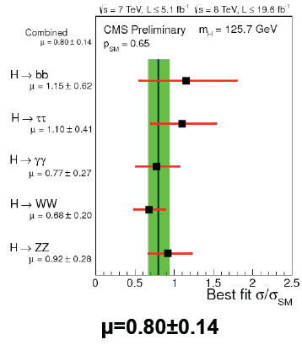
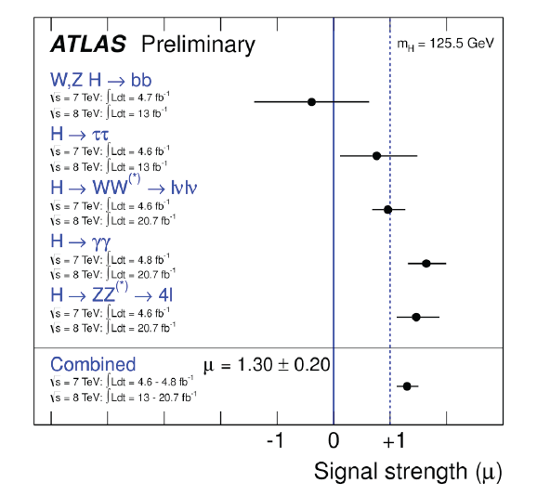

Slide 38
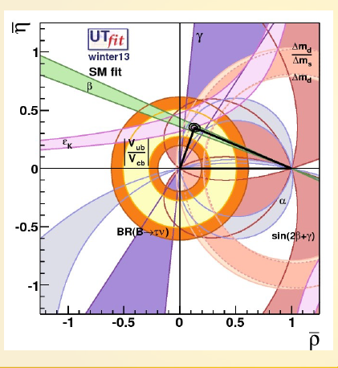
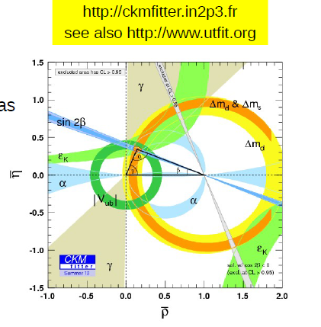

Slide 39
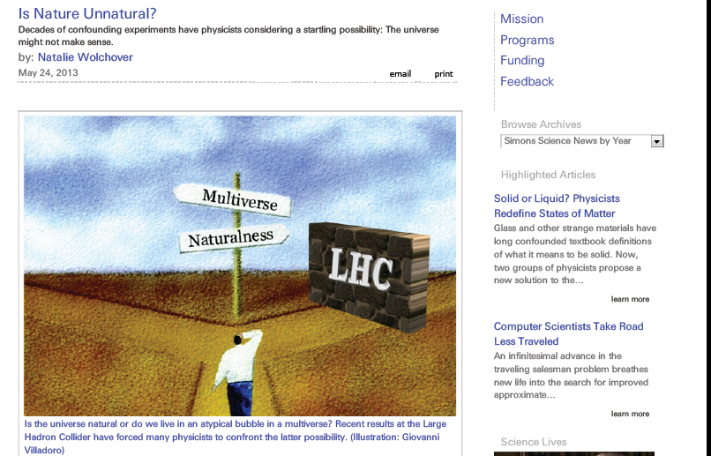

Slide 41
A lesson from history (I)
---------------------------------------------------------------------------------------------------------------
"A special search at Dubna was carried out by E. Okonov and his group. They did not find a single K_{L} → π⁺ π⁻ event among
600 decays into charged particles [12] (Anikira et al., JETP 1962). At that stage the search was terminated by the administration of the Lab. The group was unlucky."
-Lev Okun, "The Vacuum as Seen from Moscow"
------------------------------------------------------------------------------------------------------
1964: BF= 2 x 10⁻³
A failure of imagination ? Lack of patience ?

Slide 42
Should we be shocked to find that the scale of new physics is not ~ 1 TeV & appears to be higher?

Slide 43
Insights from a CANDIDATE (geometric) theory of flavor

Slide 44
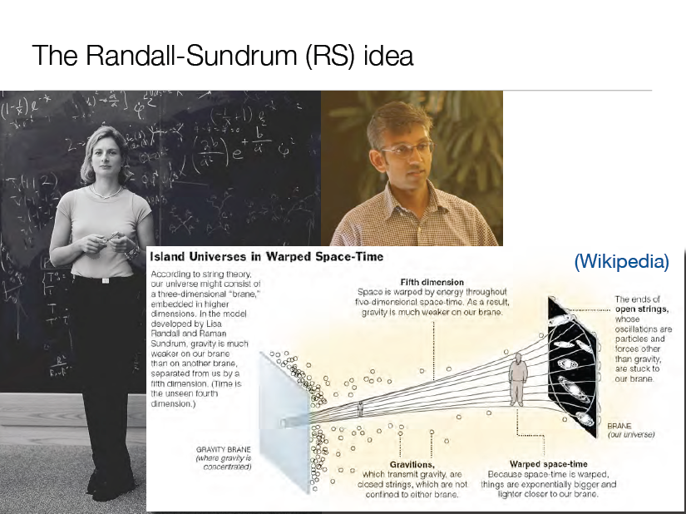

Slide 45
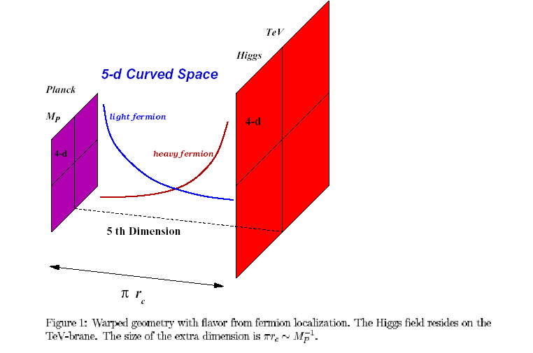
Simultaneous resolution to hierarchy and flavor puzzles

Slide 46
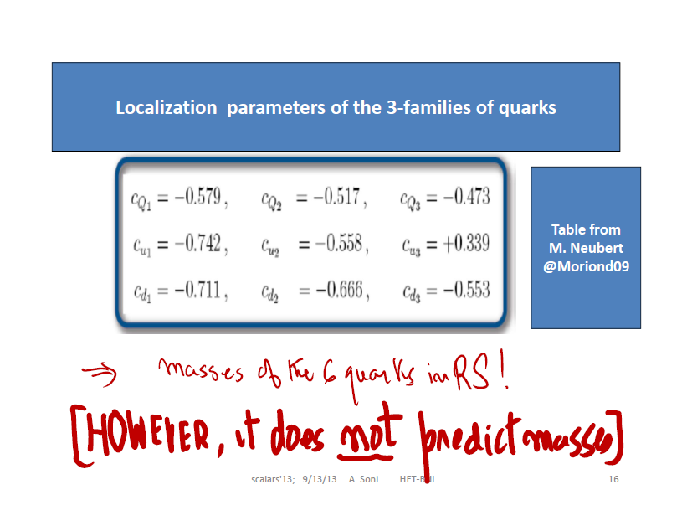

Slide 47
Fermion “geography” (localization) naturally explains:
Grossman&Neubert; Gherghetta&Pomarol; Davoudiasl, Hewett & Rizzo
Why they are light (or heavy)
FCNC for light quarks are severely suppressed automatically
RS-GIM MECHANISM (Agashe, Perez,AS’04) flavor changing transitions though at the tree level (resulting from rotation from interaction to mass basis)are suppressed roughly to the same level as the loop in SM=> CKM hierarchy
O(1) CP ubiquitous;…..in fact for neutron a (mild) CP problem
Most flavor violations are driven by the top
-> ENHANCED t-> cZ, (alsoD⁰ mixing w & w/o CP)….A VERY IMPORTANT “GENERIC” PREDICTION..Agashe, Perez, AS’06
EXTENSIVE RECENT STUDIES by BURAS et al and NEUBERT et al

Slide 48
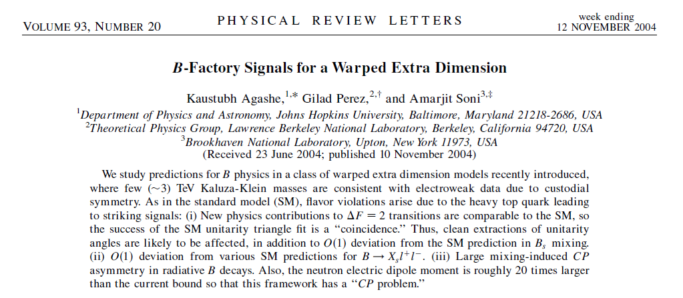
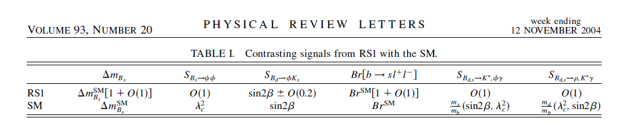

Slide 49
In our ‘04 papers 3 TeV scale was an unfortunate oversight
FC KK-glu exchanges give rise to LR currents
LR currents cause enhanced Kaon mixings…..
[Beall, Bander, AS, PRL ‘82]….
C also M.Bona et al [UTFit] arXiv:0707.0636; Lunghi + A S arXiv:0903.5059
Gedalia, Isidori and Perez, arXiv: 0905.3264

Slide 50

EWPC/Little Hierarchy
Unless KK-masses are not heavy enough, T-parameter tends to come out large
Since tuning goes as ~ [<v>/m_KK]^2 this tends to make the set up more unnatural
Agashe, Delgado, May & Sundrum, JHEP’03 proposed an interesting way out. Impose “Custodial Symmetry” => extend the gauge group to SU(2)XSU(2)XU(1) which requires introducing additional fermions
Thereby EWPC and Z=> bb allow m_KK to be ~ 3 TeV =Tuning
is around ~10^{-2.}

Slide 51
To Tune or not
Imposing custodial symmetry, by enlarging
SU2 => SU2 X SU2 and by adding additional fermions, m_{KK} > ~ 3 TeV [see Agashe,Delgado,May & Sundrum’03]
A key attraction of RS is that it provides interesting theory (perhaps the only one) for flavor but then kaons demand m_KK > ~ 10 TeV
Once RS_{Fl} > 10 TeV is imposed, EWPC likely
automatically satisfied i,e w/o making the RS set up more complicated by CS …; so the “Little Hierarchy” is somewhat worse .e. tuning O(10⁻³) is somewhat worse but the setup is more economical & simpler; perhaps the experimental indications to date are that nature prefers this simplicity ….
Admittedly, this is not the last word yet; experiment as always is the decider and LHC(~14) will provide an important clue

Slide 52
Bottom line is that even 10⁻³ it is a far far cry from 10⁻³⁴!
=> Naturalness is not at stake; at least not now

Slide 53
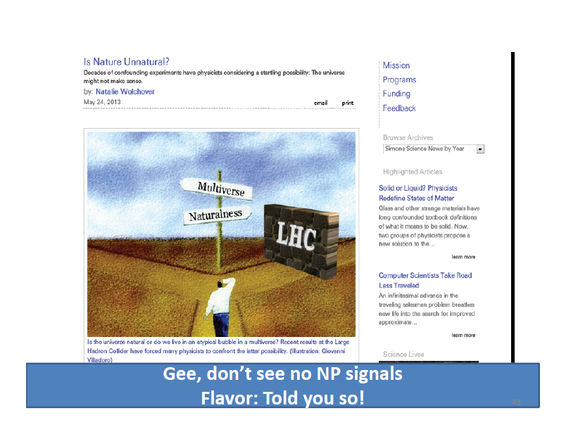

Slide 54
So far we got from perspective of flavor [and EWPC]
Next we look at it from the perspective of SMS (126 GeV)

Slide 55
Higgs is SM-like =>
Light SM-like Higgs (126) strengthens case for
mKK > 3 TeV in warped framework
1. With mKK ~ 10 TeV resulting set up is simpler and economical as then may NOT need to enforce custodial symmetry
(which requires introducing more dofs….see Agashe et al…)
2. With mKK ~ 10 TeV, tuning is somewhat worse but has the advantage of a more economical theoretical framework and may well be preferable.
M. Carena et al, 1204.0008; Neubert et al; Azatov et al;
Davoudiasl, McElmurry, A. S. 1206.4062

Slide 56
Important observables & some expectations
For The Intensity Frontier
nedm within factors of O(few) close to Expt bound < 6 X 10⁻²⁶ e-cm
Null tests extremely important ; Gershon & A. S. ’07
Time dependent CP Bd=> K(π)π γ …
Important to measure γ (AP)² ; fortunately data driven methods exist. Good news theory Δγ ~ O(2X10⁻³) [May be a lot less..Brod & Zupan’13] 2nd order WI theory uncertainties

Slide 57
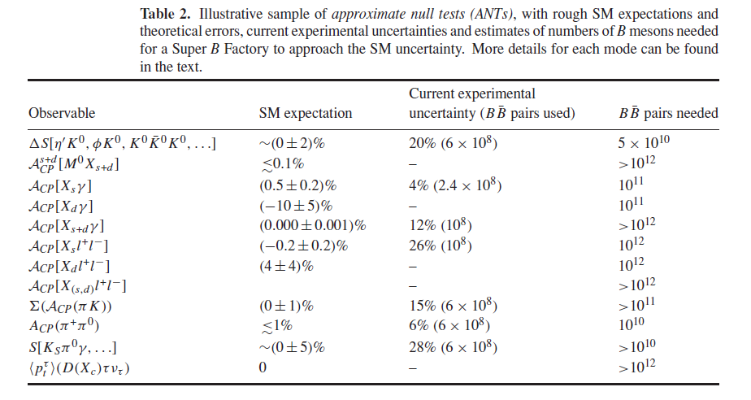

Slide 58
(More) For The Intensity Frontier
Charm CP esp. modes where SM predicts 0…e,g D=> φπ⁺ , π⁺π⁰…..Modes w/o Penguins
D=>K(*) π⁺ exceedingly important.
ε’/ε : Hadronic matrix elements still a huge challenge …. BSM ops. Also
K=> π⁺ ν ν ;
KL->π ⁰ νν, a superb yardstick!
Desperate search for deviations from SM

Slide 59
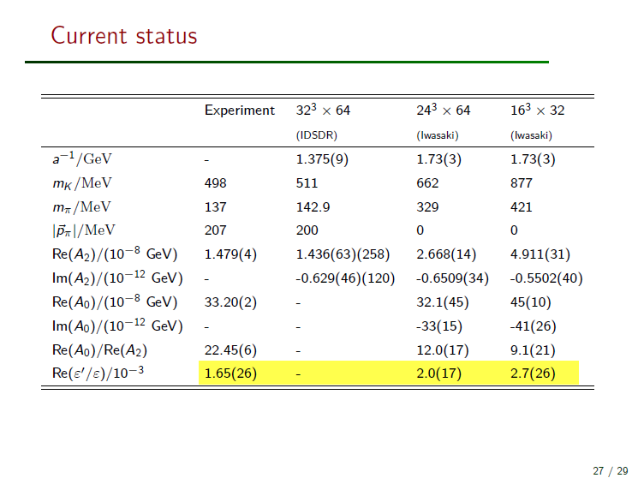
Stolen from Christoph Lehner

Slide 60
For the Energy Frontier
t=> c Z, ch Br O(10 ⁻⁷ ); many orders of magnitude bigger than SM
pp => t c h another nice
example
ee=> tc; R_{tc} ~ 10⁻⁶ - 10⁻⁵
tedm ~ O(10⁻²⁰ e-cm)
Triple correlation in ee=> tth ;

Slide 61
Expected deviations tend to be very small, strongly suggesting we need to strengthen both our computational AND measurement infrastructure

Slide 62
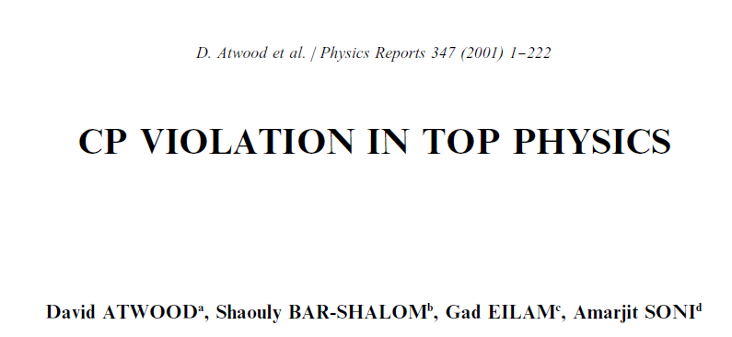

Slide 63
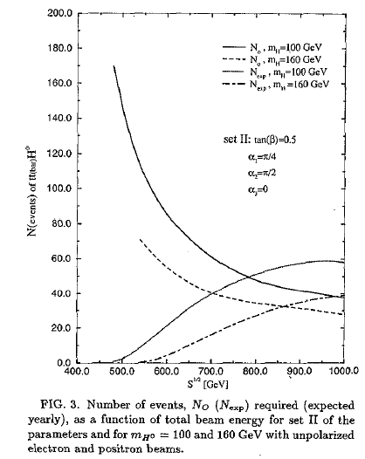

Slide 64
Y BORDERS?

Slide 65
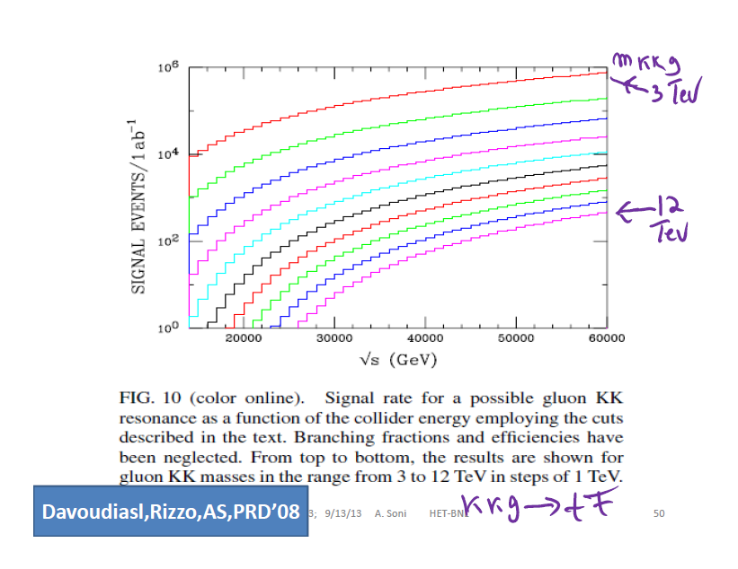
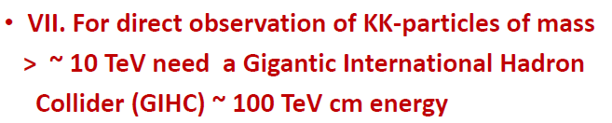

Slide 66
Summary & Outlook (1 of 2)
Reg. ΔA_{CP}(D), SM is not inconsistent with
~fewX10⁻³, but at the same time we cannot be confident that that SM is the sole source. Suggestions:
1) (Semi) inclusive asy ---likely to give asy closer to quark level: KK X….
2)Enhanced(SM) CP channels=> Tree is suppressed i.e. SC + CLS, BUT PENGUIN IS ENHANCED! :
D⁰=> φ (η’)ρ⁰ ; D⁺=>φ(η’)π⁺ …..
3) BSM CP => penguin is absent: D=>K π⁺ ;D_{S} => φ(η’)π⁺

Slide 67
Summary & Outlook (2)
Flavor + Collider info now suggest scale of NP
is higher than ~ 1TeV ….Taking cue from an interesting geometric theory of flavor, scale my be ~10TeV
Beat them to death: e.g. nedm, ε’/ε, γ; Null Tests: [for D and B; (D)B=>π⁺ π⁰ ); S[B=>K π(π) γ]; τ pol in B->D(*) τ ν
t-dm; top FV via e.g. t=>c Z; t=> c h; pp => t c h; e⁺ e⁻ => t c
Precise measurements & precise computations deserve a very high priority
It is essential to have high sensitivity flavor experiments AND we should be seriously thinking of a GIHC as the next step in our adventure.

Slide 68
EXTRA

Slide 69
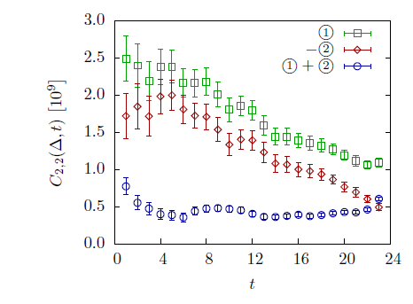
Dissecting 3/2 Amp on the lattice
RBC-UKQCD
arXiv:1212.1474

Slide 70
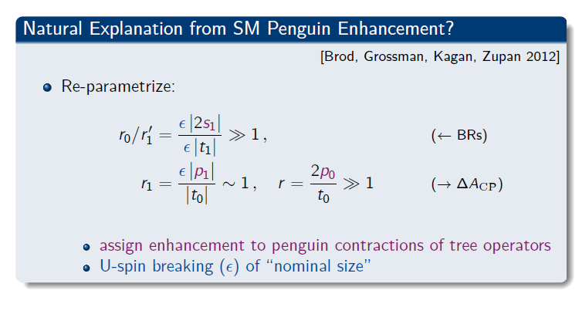

Slide 71
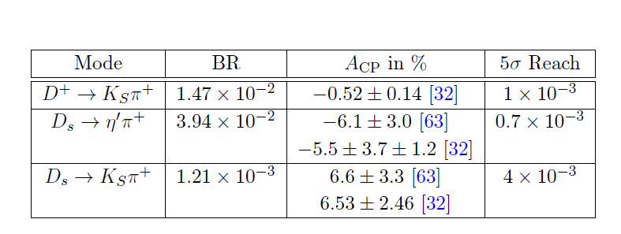

Slide 72


Recent results from LHCb, CDF

Slide 73
U –spin (d ⬄ s)

Slide 74
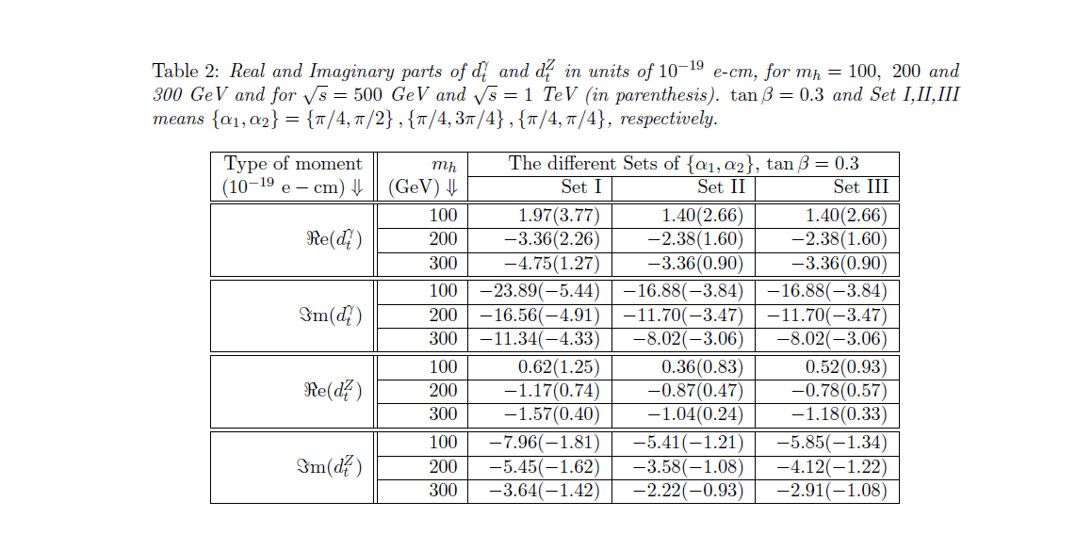

Slide 75
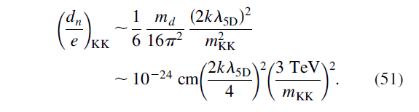
Nedm estimate in RS
APS PRD’05

Slide 76
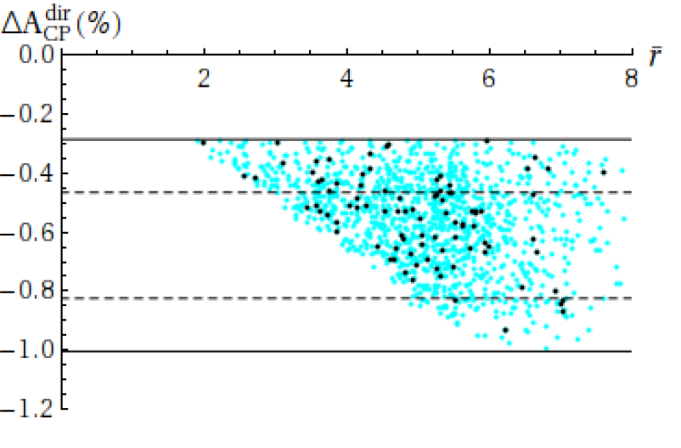

Slide 77
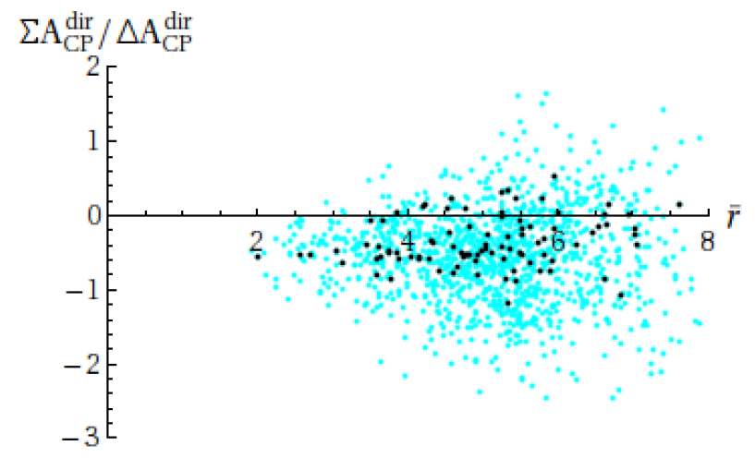

Slide 78
