Slide 1
Latest Results of DA Tracking Study with IR Magnet Field Errors for HL-LHC Layout SLHCV3.01 at Collision Energy
Yuri Nosochkov (SLAC)
Y. Cai, M.-H. Wang (SLAC)
S. Fartoukh, M. Giovannozzi, R. de Maria, E. McIntosh (CERN)
HL-LHC WP2 Task2.3 General Meeting, CERN, 7 June 2013

Slide 2
Outline
Latest results of field quality optimization for the IT quadrupoles Q1, Q2, Q3.
First evaluation of dynamic aperture with non-linear field in the D1, D2 separation dipoles and Q4, Q5 matching quadrupoles and its preliminary optimization.
Lattice layout SLHCV3.01, β*=15/15 cm at IP1 and IP5, SC IT quadrupoles with 150 mm coil diameter and 123 T/m gradient, 7 TeV beam energy.
Tracking code SixTrack.
These results are published in two papers at IPAC 2013: TUPFI016 and TUPFI017.

Slide 3
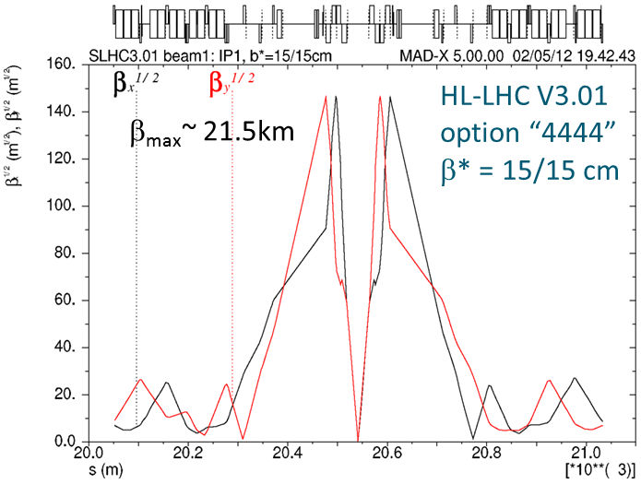
Interaction region
Q1
Q3
Q4
Q2
D1
D2
Q5

Slide 4
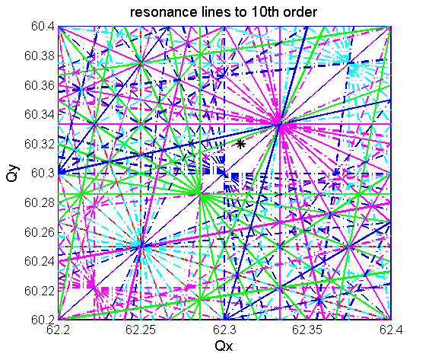
Non-linear field
where n=1 is for a dipole, etc.
B_{N} is the main magnet field at r₀
The bn, an represent the n-th order “normal” and “skew” field components normalized to the main magnet field at a reference radius r₀ (in 10⁻⁴ units).
In LHC, each an and bn is composed of 3 components: “mean”, “uncertainty” and “random”.
The non-linear field excites high-order resonance effects limiting DA.
The DA is sensitive to the IR magnet errors because of the very high beta functions.
The IT includes local correctors to compensate the IT and D1 low order non-linear field.

Slide 5
Expected to achieve field quality in IT quadrupoles with 150 mm aperture at r₀ = 50 mm
Presented by E. Todesco at the 2nd Joint HiLumi LHC-LARP Meeting, November 2012, Frascati ``Field Quality in the Inner Triplet and in the Separation Dipole’’.
This table will be further referred to as error table “target6”. The goal is to obtain sufficient DA with IT field errors close to this table values (or larger).
skew | uncertainty | random |  | normal | mean | uncertainty | random
a3 | 0.800 | 0.800 |  | b3 | 0 | 0.820 | 0.820
a4 | 0.650 | 0.650 |  | b4 | 0 | 0.570 | 0.570
a5 | 0.430 | 0.430 |  | b5 | 0 | 0.420 | 0.420
a6 | 0.310 | 0.310 |  | b6 | 0.800 | 1.100 | 1.100
a7 | 0.190 | 0.190 |  | b7 | 0 | 0.190 | 0.190
a8 | 0.110 | 0.110 |  | b8 | 0 | 0.130 | 0.130
a9 | 0.080 | 0.080 |  | b9 | 0 | 0.070 | 0.070
a10 | 0.040 | 0.040 |  | b10 | 0.150 | 0.200 | 0.200
a11 | 0.026 | 0.026 |  | b11 | 0 | 0.026 | 0.026
a12 | 0.014 | 0.014 |  | b12 | 0 | 0.018 | 0.018
a13 | 0.010 | 0.010 |  | b13 | 0 | 0.009 | 0.009
a14 | 0.005 | 0.005 |  | b14 | -0.040 | 0.023 | 0.023

Slide 6
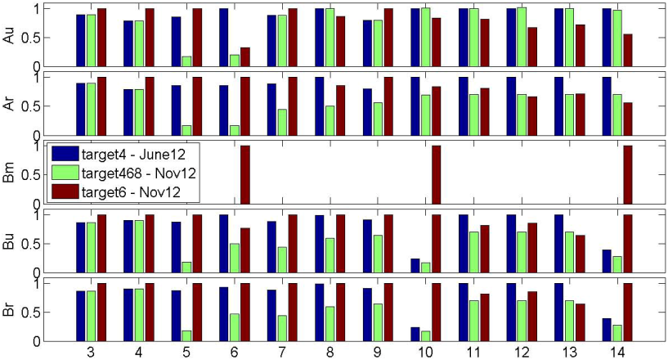
Comparison with IT error tables from previous studies
“target4” – previous version of expected to achieve field error table (June’12).
“target468” – previous optimized field error tolerance table satisfying DA (before Nov’12).
Main features of the “target6” table: 1) non-zero b6m, b10m, b14m (mean values); 2) significantly increased b10, b14 (“allowed” multipoles); 3) mostly higher low order terms (for which IT correction exists); 4) mostly lower high order terms (uncorrected).

Slide 7
IT field optimization strategy and tracking set-up
Maximize field coefficients towards the values in the error table “target6” while providing sufficient DA.
To avoid too tight tolerances, set the minimum allowed an, bn to 50% of the “target6” values.
Set acceptable minimum DA to 10.5σ for the design 3.75 μm-rad emittance.
Redo some of the DA sensitivity scans, especially for the new larger coefficients, using the table “target6” as the new basis.
Use results of the previous study as a guidance.
SixTrack tracking set-up:
10⁵ turns, 60 random error seeds, 30 particle pairs per amplitude step (2σ), 11 angles, 7 TeV beam energy, initial Δp/p = 2.7e-4, tune = 62.31, 60.32, normalized emittance = 3.75 μm-rad.
Arc errors and correction are included.
IT correctors for a3, b3, a4, b4, b6 field errors are included.
IT correctors for a5, b5, a6 errors are not included in this lattice SLHCV3.01. Note: these correctors have been studied in detail for lattice layout SLHCV3.1b (M. Giovannozzi, et al).
No field errors in the D1, D2 separation dipoles and Q4, Q5 quadrupoles.

Slide 8
DA with IT errors at full and half values of “target6”
”target6”, DA_{min}=6.35σ
Half “target6”, DA_{min}=8.33σ
The plots show minimum DA for 60 seeds as a function of x-y angle.
The DA is well below the desired 10.5σ even at half values of “target6”.
To improve the DA, we first study IT correction of a5, b5, a6 terms. These correctors are not included in this lattice SLHCV3.01. To simulate the correction, we allow smaller a5, b5, a6 terms assuming they are residual values after correction. Their optimal values are determined in the scan.

Slide 9
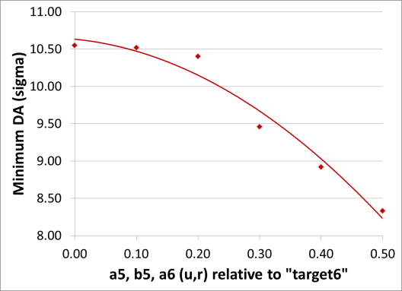
Combined scan of a5, b5, a6
All other an, bn are set to half-values of “target6” table.
Conclusion: the effective residual a5, b5, a6 values (after correction) should be near 0.2 level relative to “target6” values. The actual a5, b5, a6 values in the magnets (before correction) will be higher.
In all other scans the a5, b5, a6 will be set to 0.2 relative to “target6” and the other an, bn terms to 0.5.

Slide 10
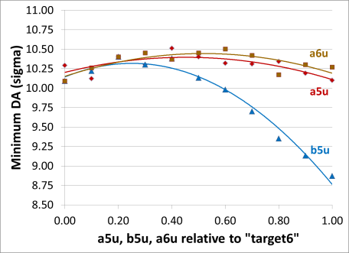
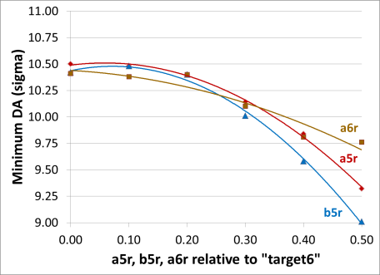
Scan of uncertainty and random terms of a5, b5, a6
DA is sensitive to the random components and b5u.
Conclusion: the residual b5u, a5r, b5r, a6r should be at 0.2 level (relative to “target6”), and a5u, a6u may be relaxed.

Slide 11
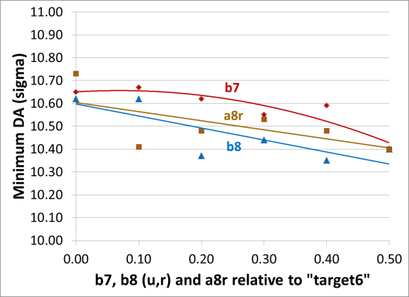
Scan of b7, b8 (u,r) and a8r
These are the lowest order uncorrected IT field error terms.
Conclusion: DA is sensitive to the b7, b8 (u,r) and a8r, hence they should stay at the minimum level of 0.5.

Slide 12
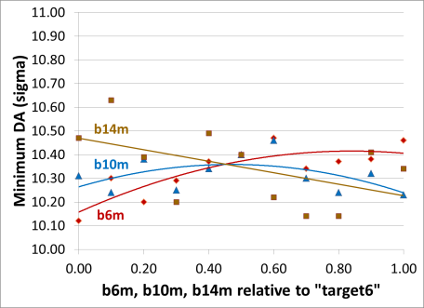
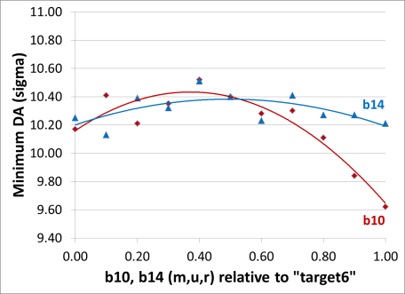
Sensitivity to b6m and b10, b14 (m,u,r)
These are allowed multipole coefficients with large expected values.
Conclusion: b10 and b14 should be at 0.5 level relative to “target6”, and b6m may be relaxed to 1.0.

Slide 13
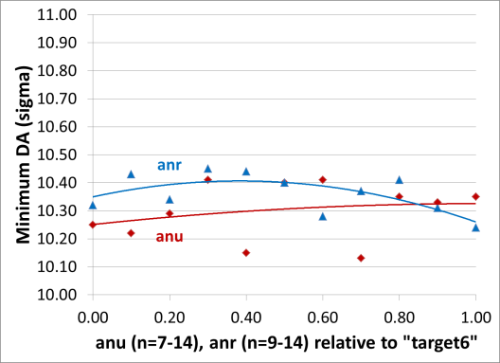
Sensitivity to high order uncertainty and random an terms
The DA is not very sensitive to high order an terms in agreement with the earlier study.
Conclusion: high order an may be set to near the level of table “target6” values.

Slide 14
Latest optimized IT field error table “target65” (normalized to “target6” values) with DA_{min}=10.45σ
skew | uncertainty | random |  | normal | mean | uncertainty | random
a3 | 1.0 | 1.0 |  | b3 | -- | 1.0 | 1.0
a4 | 1.0 | 1.0 |  | b4 | -- | 1.0 | 1.0
a5* | 0.2 | 0.2 |  | b5* | -- | 0.2 | 0.2
a6* | 0.5 | 0.2 |  | b6 | 1.0 | 0.5 | 0.5
a7 | 0.8 | 0.5 |  | b7 | -- | 0.5 | 0.5
a8 | 0.8 | 0.5 |  | b8 | -- | 0.5 | 0.5
a9 | 0.8 | 0.5 |  | b9 | -- | 0.5 | 0.5
a10 | 1.0 | 0.8 |  | b10 | 0.5 | 0.5 | 0.5
a11 | 1.0 | 0.8 |  | b11 | -- | 0.8 | 0.8
a12 | 1.0 | 1.0 |  | b12 | -- | 0.8 | 0.8
a13 | 1.0 | 1.0 |  | b13 | -- | 0.8 | 0.8
a14 | 1.0 | 1.0 |  | b14 | 0.5 | 0.5 | 0.5
* a5, b5, a6 values in the table are effective residual values after correction. The actual a5, b5, a6 in the IT quadrupoles (before correction) will be higher.

Slide 15
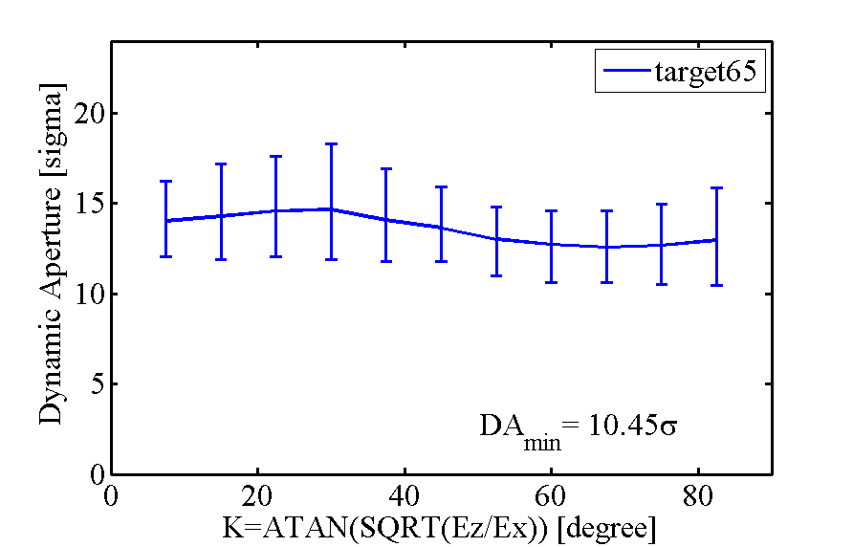
Dynamic aperture for the IT error table “target65”
The line shows an average DA as a function of x-y angle.
Vertical bars show range of DA for 60 seeds at each angle.

Slide 16
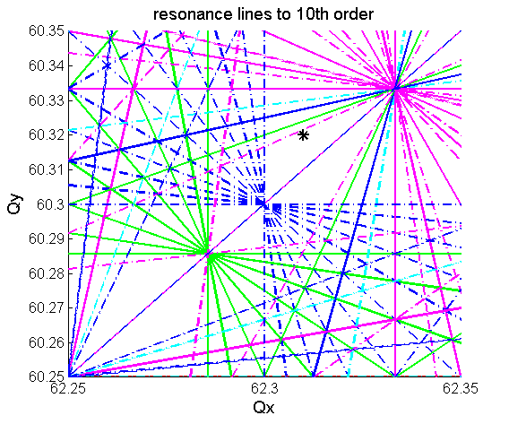
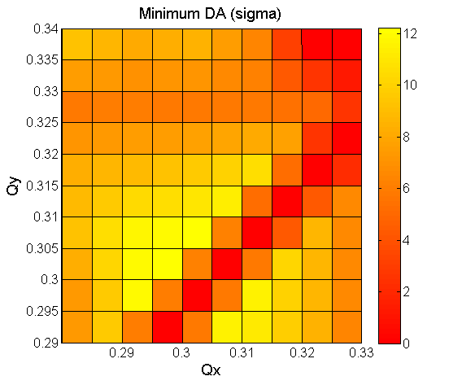
DA sensitivity to tune with IT field errors (w/o beam-beam effects)
The DA with IT field errors is increased by >1σ by moving the tune farther away from the 3rd order resonance crossing point. This demonstrates an operational flexibility for improving the DA by optimizing the tune.
To verify this conclusion, beam-beam effects need to be included in the simulation.

Slide 17
First evaluation of DA with non-linear field in the D1, D2 separation dipoles and Q4, Q5 matching quadrupoles
The HL-LHC will include the new large aperture magnets in the IP1 and IP5 regions:
Nb-Ti SC separation dipoles D1, D2 with 160 mm and 105 mm aperture, respectively,
SC Q4 matching quadrupoles with 90 mm aperture,
SC Q5 matching quadrupoles with 70 mm aperture.
The impact of non-linear field errors in these new magnets on DA needs to be evaluated and their field quality may need to be optimized in order to provide an acceptable DA.
The present lattice model does not include the off-center trajectory in the D1, D2 dipoles, thus missing the feed-down effects. Therefore, the resulting DA should be considered optimistic.
The IT field is set to the error table “target65” in this study.

Slide 18
Expected to achieve field quality in the D1, D2 dipoles
D1 field coefficients are obtained in magnetic field calculations (E. Todesco, error table “D1_errortable_v1”).
D2 field coefficients are based on scaling from the measured field of the existing dipole MBRB with 80 mm aperture (error table “D2_errortable_v1”).

Slide 19
Expected to achieve field quality in Q4, Q5 quadrupoles
Q4 field coefficients are based on scaling from the measured field of the existing quadrupole MQY with 70 mm aperture (error table “Q4_errortable_v1”).
Q5 will be the MQY-type quadrupole, hence its field is exactly the measured field of the MQY (error table “Q5_errortable_v0”).

Slide 20
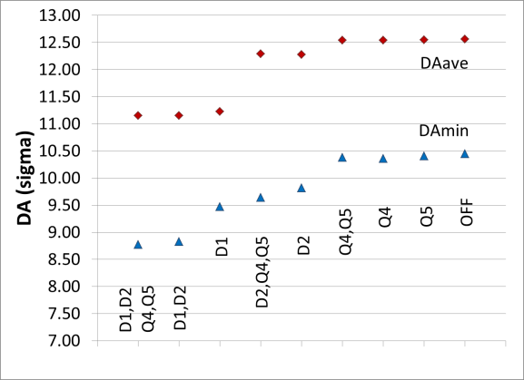
DA with the D1, D2, Q4, Q5 expected field errors
IT errors are set to error table “target65”.
60 seeds.
Conclusion:
D1 and D2 errors reduce DA by ~1.5σ, hence require adjustment.
Q4, Q5 errors have weak impact on the DA, therefore are acceptable.

Slide 21
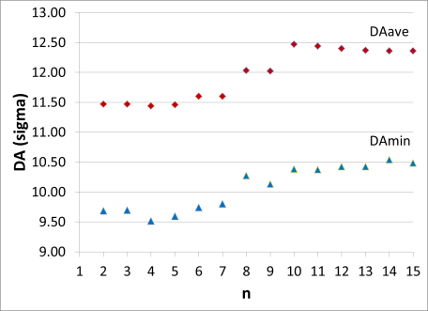
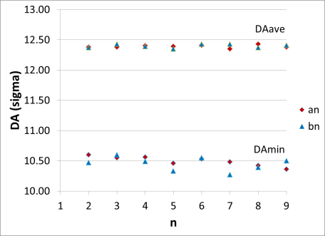
DA with the D1 errors
Accumulated effect: For a given “n” the an, bn are turned on for orders from n to 15
Individual effects: Only an, bn for a given “n” are turned on
IT errors are set to error table “target65”.
D2, Q4, Q5 errors are off.
30 seeds.
Conclusion:
Strongest DA reduction is from b5, b7, b9 (allowed field coefficients).

Slide 22
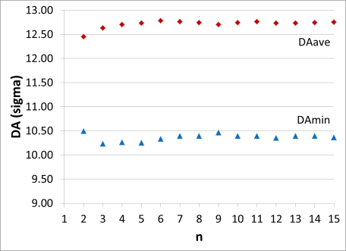
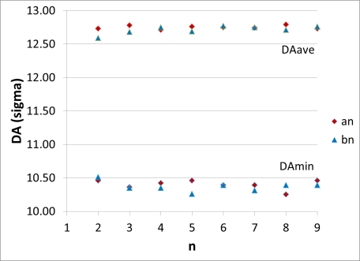
DA with the D2 errors
Accumulated effect: For a given “n” the an, bn are turned on for orders from n to 15
Individual effects: Only an, bn for a given “n” are turned on
IT errors are set to error table “target65”.
D1, Q4, Q5 errors are off.
30 seeds.
Conclusion:
Most DA reduction is due to low order terms at n = 2-5.

Slide 23
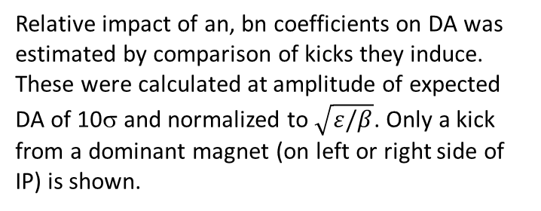
Analytic estimate of D1, D2 error effects and preliminary adjustment of the error table
Relative impact of an, bn coefficients on DA was estimated by comparison of kicks they induce. These were calculated at amplitude of expected DA of 10σ and normalized to $\sqrt{ε/β}$. Only a kick from a dominant magnet (on left or right side of IP) is shown.
Preliminary conclusion and adjustment:
Kicks induced by D1 terms n=2-9 and D2 terms n=2-5 are comparable to some of the IT kicks, hence may need to be reduced.
D1 n=3,4 and b6 are corrected with the IT local correctors, and n=2 and b3 are corrected with global tune, coupling and chromaticity systems.
As a first optimization step, the following terms are reduced to 50%:
D1: a5, b5, a6, b7, b9m; D2: n=2,3, a4, b5.
The D1 a5, b5, a6 terms may be later relaxed if the IT a5, b5, a6 correctors are included.

Slide 24
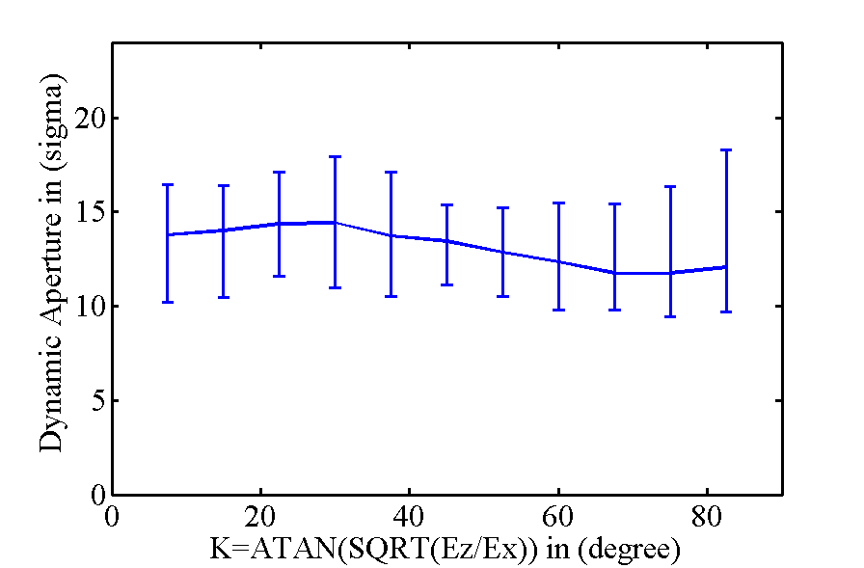
DA with the IT error table “target65”, adjusted D1 and D2 errors, and original expected Q4 and Q5 errors
DA_{min} = 9.43σ is influenced by one bad seed out of 60 seeds. The next worst seed gives DA = 9.81σ. Hence the combined impact of the D1, D2, Q4, Q5 errors on DA is in the range of 0.5-1σ.

Slide 25
Summary
Field error tolerances for 150 mm aperture IT quadrupoles in the SLHCV3.01 lattice have been re-optimized with respect to the latest “expected to achieve” error table “target6”.
The resultant optimized error table “target65” provides minimum DA of ≈10.45σ at 3.75 μm-rad normalized emittance when D1, D2, Q4, Q5 errors are not included.
The required level of a5, b5, a6 correction was determined. These correctors have been recently studied in detail for a different lattice layout SLHCV3.1b.
A preliminary tune scan without beam-beam effects indicates that DA may be improved by optimizing the working point. However, to make a final conclusion, the beam-beam effects must be included in the simulation.
DA with the expected non-linear field in the large aperture D1, D2 separation dipoles and Q4, Q5 matching quadrupoles have been evaluated.
The impact of Q4, Q5 field errors is small.
After preliminary adjustment of the D1, D2 errors the impact on DA is in the range of 0.5-1σ.
More detailed study of D1, D2 errors is needed for final conclusion. For better accuracy, the simulation should include the missing feed-down effects from the offset beam trajectory in the D1, D2 and the planned IT correctors for a5, b5, a6 terms.

Slide 27
Back-up slides

Slide 28
IT field error table “target65” at r₀ = 50 mm
skew | uncertainty | random |  | normal | mean | uncertainty | random
a3 | 0.800 | 0.800 |  | b3 | 0 | 0.820 | 0.820
a4 | 0.650 | 0.650 |  | b4 | 0 | 0.570 | 0.570
a5* | 0.086 | 0.086 |  | b5* | 0 | 0.084 | 0.084
a6* | 0.155 | 0.062 |  | b6 | 0.800 | 0.550 | 0.550
a7 | 0.152 | 0.095 |  | b7 | 0 | 0.095 | 0.095
a8 | 0.088 | 0.055 |  | b8 | 0 | 0.065 | 0.065
a9 | 0.064 | 0.040 |  | b9 | 0 | 0.035 | 0.035
a10 | 0.040 | 0.032 |  | b10 | 0.075 | 0.100 | 0.100
a11 | 0.026 | 0.0208 |  | b11 | 0 | 0.0208 | 0.0208
a12 | 0.014 | 0.014 |  | b12 | 0 | 0.0144 | 0.0144
a13 | 0.010 | 0.010 |  | b13 | 0 | 0.0072 | 0.0072
a14 | 0.005 | 0.005 |  | b14 | -0.020 | 0.0115 | 0.0115
* a5, b5, a6 values in the table are effective residual values after correction. The actual a5, b5, a6 in the IT quadrupoles (before correction) will be higher.

