Slide 1
CENF BUILDINGS
AND GALERIES

Slide 2
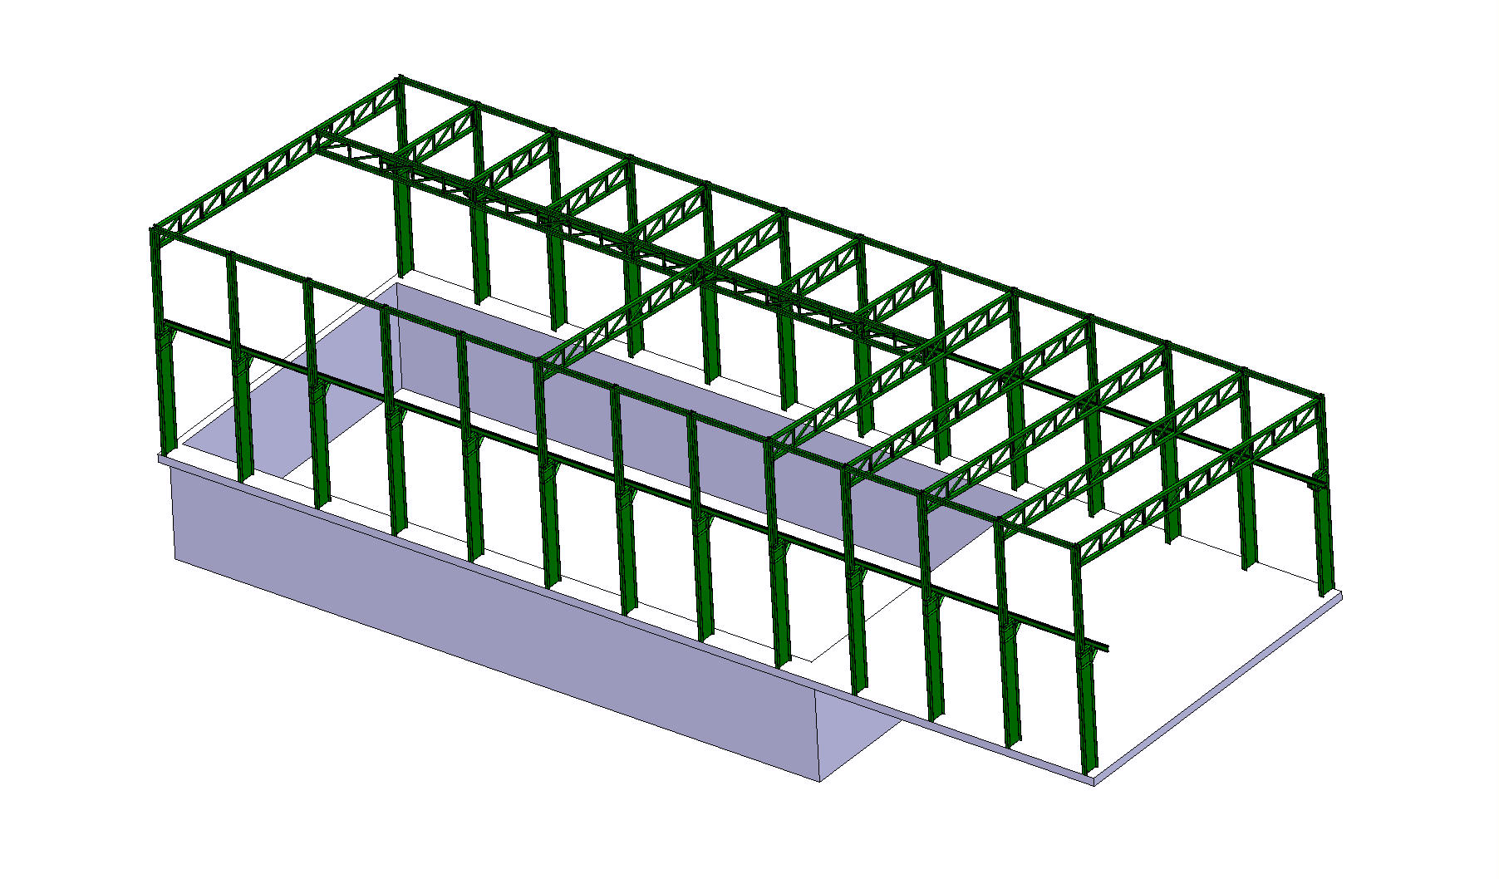
CENF FAR DETECTOR BLD759 (EHN3)
CATIA MODEL ST0515196_01

Slide 3
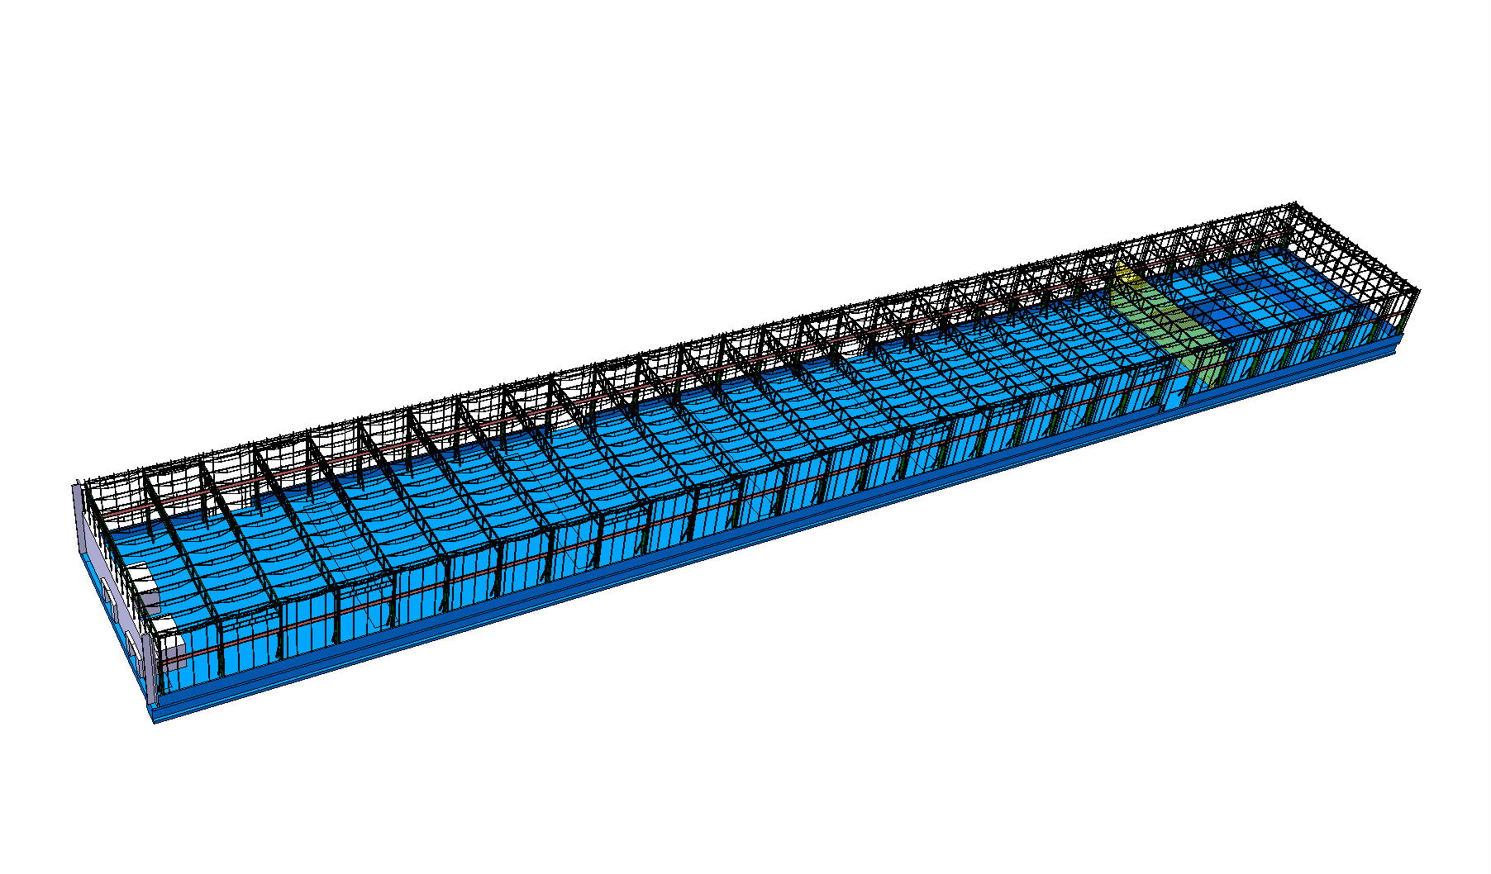
CENF EXTENTION OF BLD887 (EHN1)
CATIA MODEL ST0512457_01

Slide 4
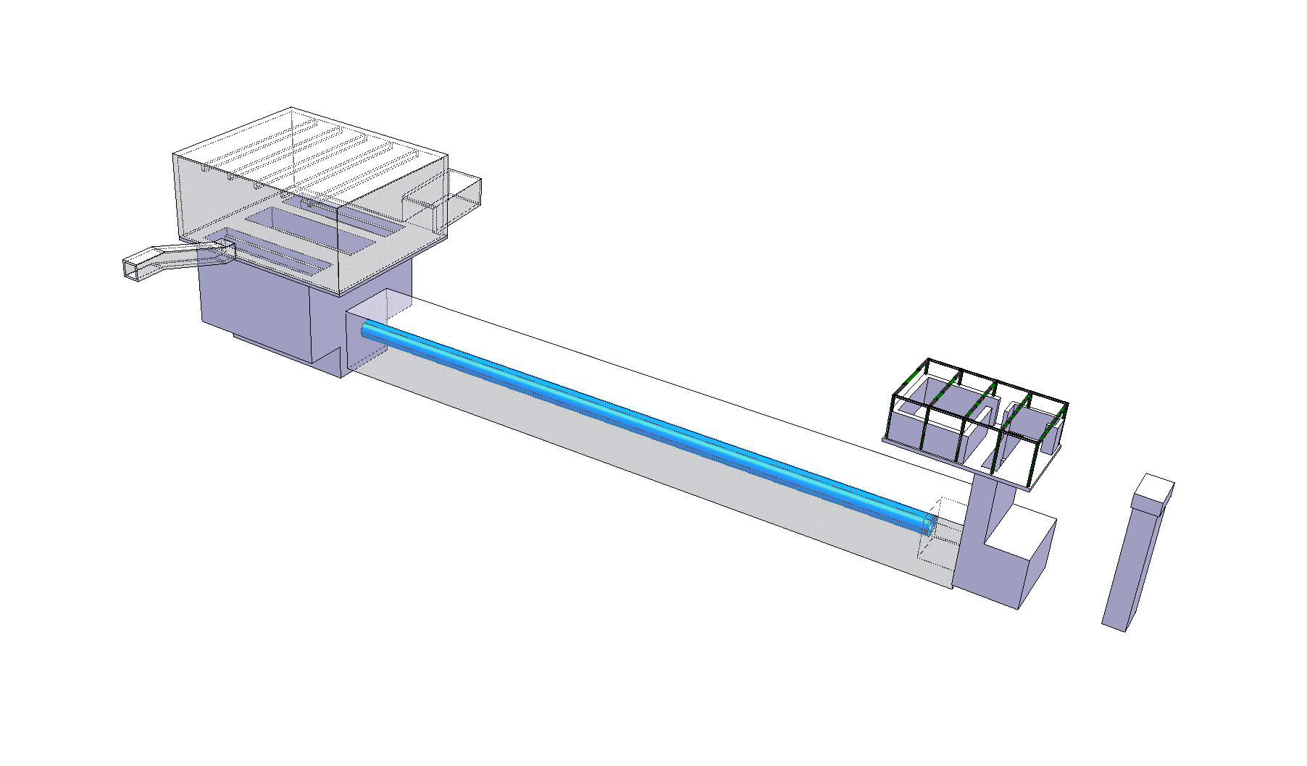
CENF TARGET AREA BLD755(BHS26)
MUON PLT BLD757(BAV26)
CATIA MODEL ST0517376_01
TARGET CAVERN TCC26
BEAM DUMP CAVERN TNB26
PLT ACCES 727 PGC261

