Slide 2
MPP Workshop Summary
11-13 March 2013
Acknowledgements: B.Dehning, S.Redaelli, R.Schmidt, J. Uythoven, J.Wenninger, D.Wollmann, M.Zerlauth in the name of all Workshop participants, especially all speakers!

Slide 3

Mandate
Discuss mid-and longer-term improvements of the MP systems for the LHC + injector complex:
  review of the current operational experience with MP systems during the first running period (2009-2013).
  understanding the planned changes of MP equipment during LS1 and the consequences/potential limitations for operation after LS1.
  identify areas where improvements are required.
  ensuring coherence between the different MP systems.
  identify misses.

Slide 4
Program
Indico Page
6 sessions, 2 ½ days, ~ 85 participants (11-13 March)
  MPS experience (2008-2012) and outlook (D.Wollmann)
  Injection and LHC beam dumping system (J.Uythoven)
  Beam Diagnostics (B.Dehning)
  Collimation and movable devices (S.Redaelli)
  Electrical circuit related protection (M.Zerlauth)
  Operation after LS1 (J.Wenninger)
  Summary and discussion (R.Schmidt)
Executive summary in LMC (24.April)
More detailed session summaries in ATS Seminar (today)
Proceedings (ongoing)

Slide 5
Content
Session 1 - MPS operational experience (2008 – 2012) and outlook
  Performance and availability of MPS 2008-2012 (B.Todd)
  MPS issues and MP approach concerning operation and MDs (M.Zerlauth)
  OP view on handling of MP issues (G.Papotti)
  Global vision of MPS after LS1 and beyond (R.Schmidt)
Session 5 - Electrical circuit related protection
  Powering issues (S.Rowan)
  Changes in QPS (R.Denz)
  Changes in powering interlocks (I.Romera)
  Electrical distribution: How to ensure dependable and redundant powering of systems? (V.Chareyre)

Slide 6
Content
Session 1 - MPS operational experience (2008 – 2012) and outlook
  Performance and availability of MPS 2008-2012 (B.Todd)
  MPS issues and MP approach concerning operation and MDs (M.Zerlauth)
  OP view on handling of MP issues (G.Papotti)
  Global vision of MPS after LS1 and beyond (R.Schmidt)
Session 5 - Electrical circuit related protection
  Powering issues (S.Rowan)
  Changes in QPS (R.Denz)
  Changes in powering interlocks (I.Romera)
  Electrical distribution: How to ensure dependable and redundant powering of systems? (V.Chareyre)

Slide 7
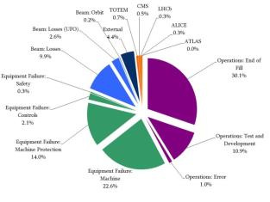
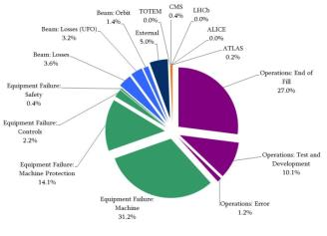
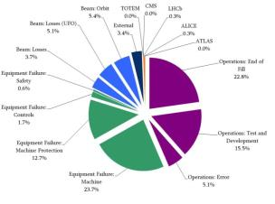
3 years of LHC Machine Protection
Some 3499 clean beam dumps performed since Oct 2009:
  1582 beam dumps above 450GeV.
  In 2012 a majority of dumps with beam energies > 100MJ (reaching max 146MJ).
No beam induced magnet quenches @3.5/4.0TeV.
No serious equipment damaged due to beam (excl. heating, corrector coils of RQX.3L2, ALICE detector).
Reasons and MPS response reasonably well documented, analyzed and validated for all beam dumps > 450GeV. ➔ More details see talk from B. Todd
2012
2011
2010

Slide 8
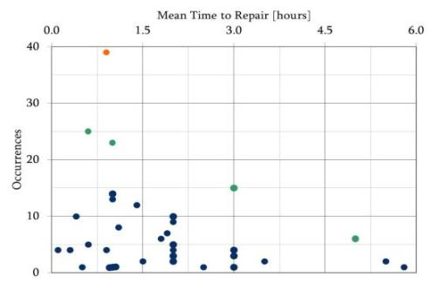
Dependability of LHC Machine Protection
Reliability of the MPS: 12-14% of physics fills aborted due to internal failures (>450GeV).
7 top systems, >250 false positives, 36 failure modes, >400h repairs.
>50% of beam aborts come from 12 BIS inputs (of total 275 inputs), 48% (136) inputs never triggered.
BLM triggered 215 out of 1090 beam aborts in 2012. Can we dump more directly on root causes? (Defense chain).
QPS
BLM
In all failure cases it takes expert help to diagnose the problem.
Impact on physics is not clear from this…
Access time and call-out-time not consistently registered between systems
Improved fault tracking required.

Slide 9
Observed MP issues – near misses
LBDS 12V
Quench detection issues on IPQ, 600A EE
HTS instrumentation cable on RB.A45
TL collimators
Injecting H9
False collimator settings (2 x TCTV IR2, 2x IR3)
Roman Pot Controls
BLM High Voltage Cable
OFSU reference problems
BSRT Mirror
MKI flashovers
QFB not usable in squeeze due to poor signal
Instrumentation problem in triplet L8 after TS2
Loss of redundant protection (60A power permits, LHCb dipole , CMS solenoid,…)
Collimators not moving in squeeze.
….
From an OP point of view these issues can be classified:
  Failures only detectable by experts.
  Failures detectable by shift crew (after dump / with beam in the machine).

Slide 10
Outlook to MP organization post LS1
What can help the shift crew (trade-off between MP and efficiency):
  Automatic tools to help detecting abnormal situations.
  Procedures (accessible, useful, up-to-date, more needed?).
  Clear responsibilities (e.g. MDs).
Commissioning & changes during production:
  more dependable + automatic sequencing, dependency tracking + follow-up (ACCTEST framework).
  define and enforce minimum (non-negotiable) validation costs of changes.
MDs: improve efficiency and safety by
  MD - 4 weeks: Up-to-date MD request for ALL MDs.
  MD - 2 weeks: EDMS doc for more critical MDs + approval circuit.
rMPP after LS1 with updated membership and improved follow up
Interplay of MPP and MP3 for performance of magnet powering system to be defined/improved for post LS1
MP piquet for LHC restart in 2015 (Contact for operation crews, documentation, follow-up of operational issues, …)

Slide 11
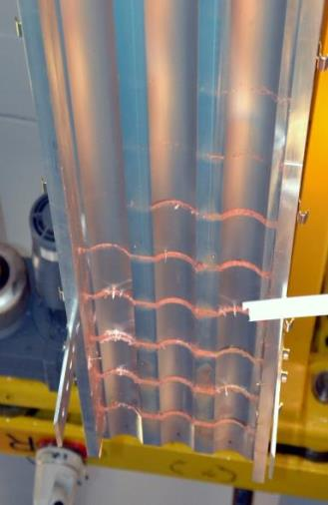
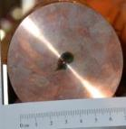
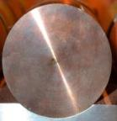
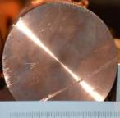
Damage studies
Critical failure scenarios for LHC (360MJ per beam):
  Beam dumping system deflects beam with non nominal strength.
  Beam dumping kickers are not triggered.
Studies of beam impact on matter:
  Hydrodynamic tunneling of beam through matter.
  Experiment for Code validation and extrapolation to LHC beams
Cover target 1
Cover target 2
Cover target 3
Block 8
Block 8
Target 1
144 bunches ~1.9E11@50ns, 2.0mm σ -> no tunnelling expected
108 bunches ~1.9E11@50ns, 0.2mm σ -> tunnelling expected
144 bunches ~1.9E11@50ns, 0.2mm σ -> tunnelling expected
Target 2
Target 3
Copper Target length of about 2 m
11

Slide 12
Critical failure scenarios today and tomorrow
The full LHC beam is expected to tunnel more than 30 m into a solid target, leading to massive damage of the equipment if the machine protection systems fail
Raises questions concerning most critical failure scenarios today and in the future:
Does it make sense to further investigate the consequences of “catastrophic” failures?
Does it make sense to investigate mitigation methods?
Absorber blocks?
Redundant kicker + absorber blocks?
Are crab cavities introducing a new type of very fast failures?
Can we protect the LHC efficiently if such failures occur?
Should we continue using only robust collimators, or re-consider the materials if possible damage is understood and limited … if we gain in overall integrated luminosity?
Do we have to reconsider our protection strategy in case of missing beam halo?

Slide 13
Content
Session 1 - MPS operational experience (2008 – 2012) and outlook
  Performance and availability of MPS 2008-2012 (B.Todd)
  MPS issues and MP approach concerning operation and MDs (M.Zerlauth)
  OP view on handling of MP issues (G.Papotti)
  Global vision of MPS after LS1 and beyond (R.Schmidt)
Session 5 - Electrical circuit related protection
  Powering issues (S.Rowan)
  Changes in QPS (R.Denz)
  Changes in powering interlocks (I.Romera)
  Electrical distribution: How to ensure dependable and redundant powering of systems? (V.Chareyre)

Slide 14
Electrical circuit related protection
Interlock conditions
24
~ 20000
~ 1800
~ 3500
~ few 100
~ few 100
~ few 100
HTS temperature interlock
~ few 100
Access vs Powering
Total of 1600 electrical circuits (1800 converters, ~10000 sc + nc magnets, 3290 (HTS) current leads, 234 EE systems, several 1000 QPS cards + QHPS, Cryogenics, 56 interlock controllers, Electrical distribution, UPS, AUG, Access)
6 years of experience since initial HWC
Preventive beam dumps in case of powering failures, accounting to almost 50% of premature beam dumps in LHC

Slide 15
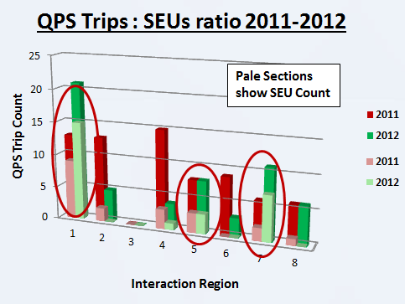
Powering Issues
Up to 50% of premature beam dumps from LHC magnet powering system(s)
  Few but big systems (QPS, Cryogenics, Power converters,..)
  Merits continuous attention for reliability + potential of increased availability, just one example….
Revisit dependability studies in light of experience + criticality
Powering tests to be organized and followed up (CSCM, EOY, TS,…)!
  Potential problem: Very efficient test execution tools but analysis not up to same speed?

Slide 16
Non-conformities in protection
Protection function maintained, still a few near misses need detailed follow-up
RB.A34 2011 - QPS failed to respond/open EE on discharge request
  Mitigated by introduction of new commissioning phase to check specifically for this issue
RQX.A23 2011 - Continuous firing of heaters without request
  Mitigated by Firmware update
RCD.A12 Jan/Feb 2013- EE did not open on request signal
  Mitigated by Firmware update
RQ5.R1 Feb 2013 - QPS did not detect quench
  One off event, can only advise training of personnel be improved to minimise chance of such events
Common cause: Human mistake or system not fully up to date

Slide 17
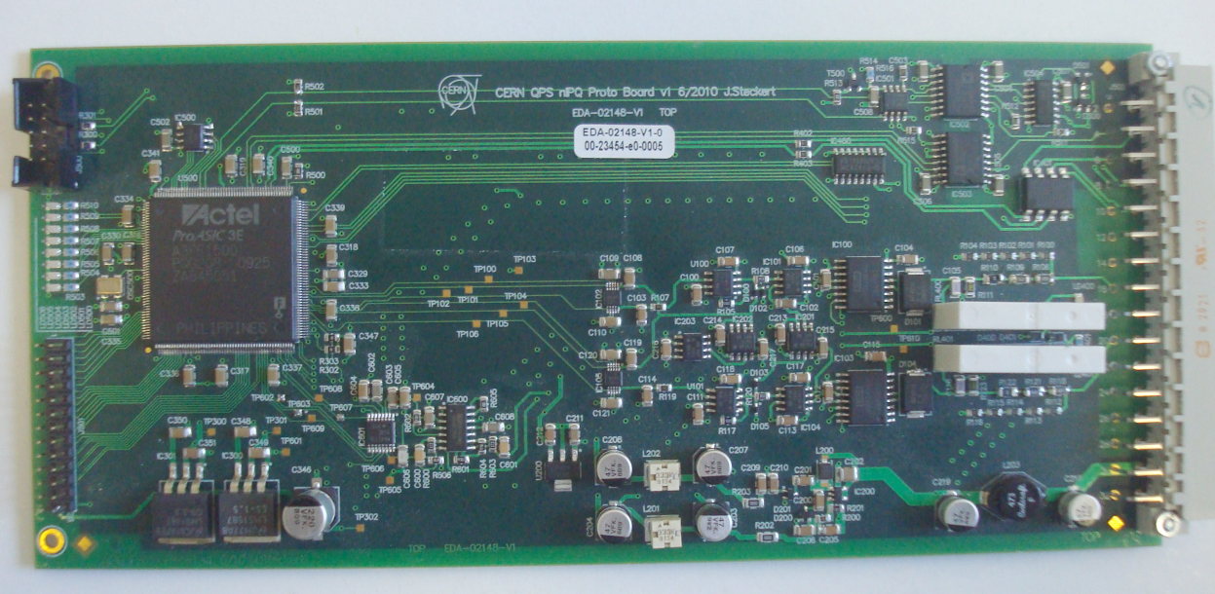
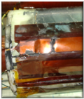
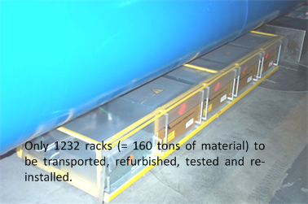
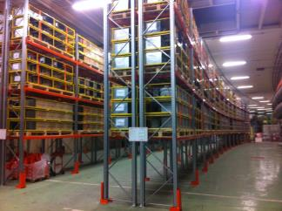
Changes in QPS
R2E consolidations (relocation, radiation tolerant HW for IPQ/Ds and 600A circuits in RRs, enhanced power cycle options)
Enhanced quench heater supervision (detect precursors of potential failures of heater strips)
‘Yellow racks’ (refurbishment for new features, redundant powering,..)

Slide 18
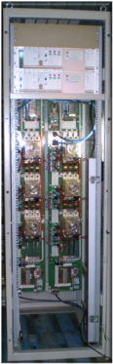
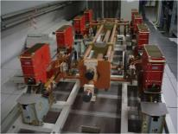
Changes in QPS
Earth voltage feelers to monitor electrical insulation of LHC main circuits
Energy Extraction Systems (new arc chambers, snubber capacitors, preventive maintenance on 252 extraction switches)
Revisions of most detection firmware's
Upgrade of QPS low-level supervision
Duplication of WorldFip fieldbus (full PM and Logging data)
Threshold revisions (mainly 600A and IPQ)
Enhanced high level supervisory tools to decrease dependency on human interactions (configuration management in LSA, signal integrity checks,..)

Slide 19
Changes in QPS in short
Huge amount of extensions/changes foreseen to increase system dependability and to enhance diagnostic capabilities
Major upgrades can only be smoothly implemented during long shutdowns ?!
  Some incidents due to known issues not put into machine due to resource constraints…
Still (too) big dependency on human interaction/procedures
  -> Tools, tools, tools,….
Sufficient time for testing and re-commissioning including some contingency required

Slide 20
Network Perturbations affecting the LHC (very similar for SPS/PS)
Recommendation for
good insensitive equipment
(EDMS 113154)

Slide 21
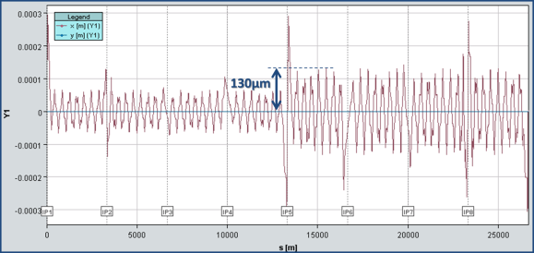
Sensitivity to electrical perturbations
High power thyristor converters (used to power nc separation dipoles, quadrupoles and extraction septa in the LHC) very sensitive to AC perturbations
High sensitivity (<3x10⁻⁴ of output current change) by dedicated protection system (FMCMs) is required to avoid fast failures in the LHC
  Limit of relaxing thresholds is reached (6.5TeV!)
Effect of 100mA current change on orbit in the arc
Courtesy of T.Baer

Slide 22
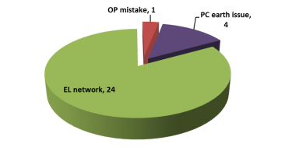
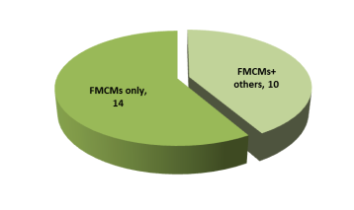
Sensitivity to electrical perturbations
24 FMCM triggers last year due to glitches in the electrical network distribution
A large fraction do not result in equipment trips and only seen by FMCMs!
Being RD1 and RD34 most sensitive circuits which tripped in most of the cases
RD1.LR5 is about 40% more sensitive than RD1.LR1 despite similar input amplitude
EPC to initiate collaboration with EPFL to better understand effects of such glitches and to provide better rejection of perturbations by changing the regulation characteristics of the RD1 and RD34 power converters
2012
Systems affected by EL perturbation
FMCM dump cause
Likelihood to trip

Slide 23
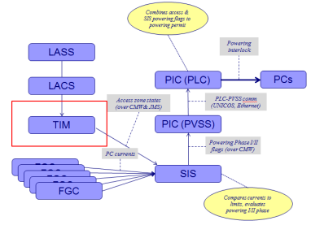
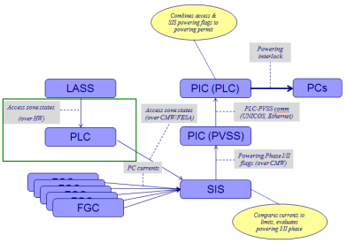
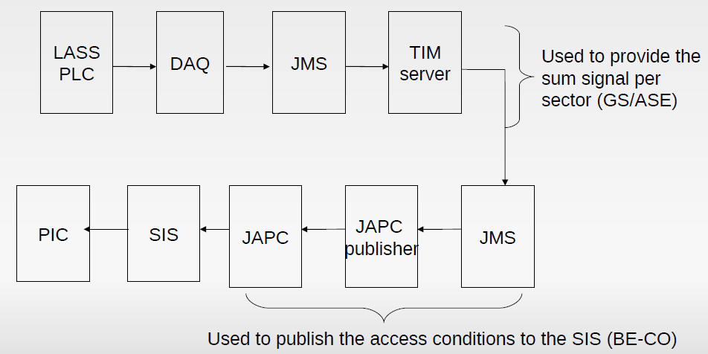
Powering Interlocking
In general redundant protection assured, few incidents (Magnet Safety System of EXP, nested config in inner triplets, SW interlocks,…) to be followed up to restore protection redundancy
More dependable solution to replace SW based implementation of Access vs Magnet powering
Full renovation of SPS magnet interlock system
Courtesy of J.Wenninger
Courtesy of L.Ponce – see Chamonix 2010

Slide 24
Redundant Powering for MPS
After the incident in September 2008: request for truly redundant QPS system powering
How to ensure safe powering for these MP systems?
Only 1 solution: 2 independent and redundant power paths
(protected by UPS systems)
Impact on the availability of UPS network and for the users
Single point of failure
with or without redundant systems

Slide 25
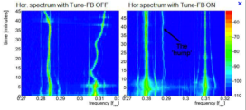
Redundant Powering for MPS
  Complete replacement of 64 (machine) UPS by new double conversion types to restore true redundancy and increase availability
  Will we finally find the hump?!
  (switching frequency 8kHz → 4 and 7 kHz
Organize full-scale tests for redundant powering during HWC 2014
Quality of network will not improve, need to continue identifying and improving weak elements

Slide 26
Conclusions
Very fruitful and open discussions throughout the 2 ½ days
Considerable list of actions and work tbd during LS1
Follow up of issues already started and will be coordinated in different WGs and teams
Vital to profit from LS1 to improve overall dependability of MPS in view of (beyond) nominal machine parameters
Extend of changes is impressive, and sufficient time for testing and re-commissioning including some contingency required
26

Slide 27
End

Slide 28
Machine Developments
Machine Developments per definition explore new machine and machine protection territory and hence risks!
MP documents did allow to address and mitigate risks – did preparation phase increase as well the efficiency of the MDs?
Un-intentional losses of beams as (one possible) indicator for ‘efficiency’, e.g. hidden interlocks during change of SBF, (not counting machine unavailability, equipment failures,…)
With detailed MP MD doc ~ 0.38 unintentional dumps/MD
Without doc ~ 0.67 unintentional dumps/MD
Courtesy of D.Wollmann

