Slide 1
ECFA
Physics Goals and Performance Reach Preparatory Group report
P. Braun-Munzinger, A. Dainese, C. Hill, T. Gershon, M. Klute, I. Melzer-Pellmann, B. Murray, A.Nisati, G. Salam, A. Weiler, P. Wells, G. Wilkinson
Plenary meeting, June 10th

Slide 2
Proposed Agenda & “Theory & Physics Goals…” session
Introduction – 5’
Theory overview - physics case for HL-LHC 25’
Higgs boson precision measurements and VBS 35’
New Physics searches: SUSY, ExtraDimensions, etc; 35’
Requirements for Trigger, Detector and Physics objects performance 25’
Heavy Flavour [LHCb speaker] 25’
Heavy Ion [ALICE speaker] 25’
Theory considerations relevant for HL-LHC are presented in each talk (except 5)
The Introduction is a talk that presents the structure of the session

Slide 3
Theory Overview
Intro
  E.g. parton lumis & gain in reach from 300 → 3000 fb⁻¹
Higgs measurements:
  Indirect probe of new physics most relevant for the hierarchy problem: energy reach at HL?
  ttH production processes and H→Zγ final states: lift BSM degeneracies; H→μμ: test 2nd gen'
  p p → HH: self-coupling, composite Higgs
  Does the Higgs fully unitarize W_{L}W_{L} scattering?
BSM:
  Reach for EW cross-sections, 3rd gen’ NP (also non-susy)
  tt-Resonances, VV resonances, Dark Matter searches
SM
  SM measurements needed in order to get max benefit from HL (both in Higgs precision studies & BSM)
  Prospects for improved precision in theory calculations (included PDF improvements with LHC data)

Slide 4
Higgs & VBS
Higgs couplings
  Study different SM Higgs boson processes to investigate production mechanisms (ggF, VBF, VH, ttH, bbH, etc) and decay final states (γγ,ZZ*,WW*,ττ,bb,…)
  Study signal strengths
  Study couplings in two scenarii: a) coupling ratio: this allows model independent analyses; b) assuming no BSM contribution to loops and Higgs boson natural width
  Reinterpretation of these results with BSM models?
Should include SM measurements to reduce theory uncertainty on Higgs boson predictions, e.g. constrain PDFs using LHC data
includes rare decays: H→μμ, H→Zγ

Slide 5
Higgs & VBS
Higgs selfcoupling
  Revisit HH→bbγγ
  Explore new channels: HH→bbττ
  HH is probably the challenge at HL-LHC: will need to explore many channels, each individually with weak sensitivity, that combined together should provide the ultimate HL-LHC performance on this study; too early for October 2013, develop this in detail for the mid term future
    All combinations can add – need to prioritize
  Establishing link on this activity with the LHC Higgs XS WG

Slide 6
Higgs & VBS
Higgs CP violation studies
  Probe the presence of CP-odd components in Higgs boson decays
VBS: sensitivity studies to detect non-SM contribution from VV invariant mass analysis
  Replies to the question: is the recently discovered Higgs boson the only mechanism that regularizes the VV scattering cross-section? ➔ Study the VV mass (transverse mass) spectrum, and look for deviations from SM
  This process could be seen as part of BSM studies (in discussion)
  Example: VBS WW → lnln qq , lnqq; ZZ qq;

Slide 7
BSM searches
Some ideas based on ES studies:
Third generation squark searches
Electroweak gaugino searches
(Squark and gluino searches)
Study how well we can measure model parameters in HL-LHC if SUSY will be discovered at LHC (300 fb⁻¹)
  “normal” susy particle spectrum
  “compressed” spectrum
Difficult susy benchmarks (degeneracies)
Heavy resonance decays to ttbar, VV, leptons, …
Top partners (Q = 5/3, 2/3, 1/3)
Monojet + MET (dark matter)
Vector Boson Scattering (see comments in previous slide)

Slide 8
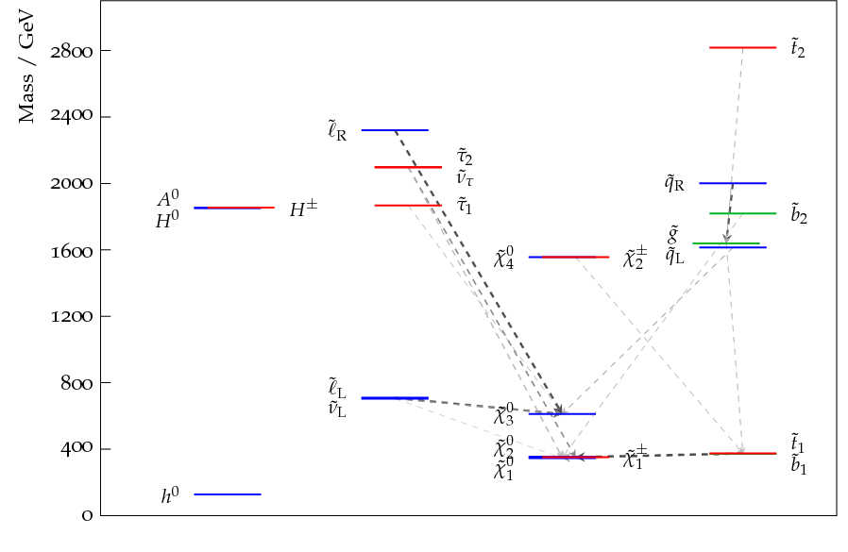
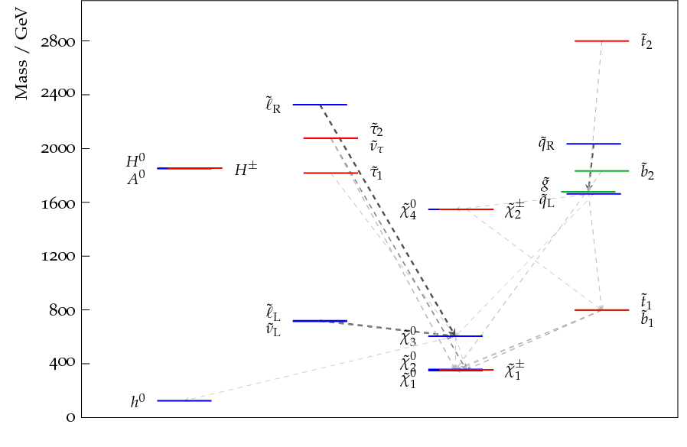
SUSY benchmark models for ECFA
Main idea:
  How well can we study with 3000fb⁻¹ SUSY discovered with 300fb⁻¹?
  Propose 3 full pMSSM models – similar spectra, but different behaviour
  Main features:
    Degenerate Higgsinos Light stops/sbottoms Light gluinos
    3rd model with higher 1st and 2nd generation squark masses to come…
SLHA files available already

Slide 9
Requirements for Trigger, Detector and Physics objects performance
This talk should collect and present in a comprehensive manner the main requests to trigger and detector systems based on the physics analyses that will be presented in the session
Items that we would like to see:
  Eta coverage for the tracking system
  p_{T}/E_{T} thresholds for lepton triggers, jet and MET triggers; eta coverage
  topological/multi-object triggers

Slide 10
Heavy Flavour (1)
Propose a talk on HF physics
  Suggest an LHCb speaker for this contribution
  Cover b-, c- and τ-physics, as well as top FCNC decays and lepton flavour violation (e.g. τ→μμμ)
  Emphasize synergies between LHC and ATLAS/CMS
  Focus on HL-LHC era (post LS3), but recall LHCb upgrade physics starts post-LS2
Not useful to discuss in terms of L
  Consider LHC run period, with certain assumptions

Slide 11
Heavy Flavour (2)
Consider performance vs time, for example:
  B(B⁰→μ+μ-)/B(B⁰_{s}→μ+μ-) LHCb, ATLAS?, CMS?
    Precision SM and MFV test
  Φ_{s}(B⁰_{s}→ΦΦ) LHCb
    Search for New Physics causing CP violation in loops
  CKM angle γ LHCb (Belle2)
    Crucial input for CKM fits
  A_{Γ}(D0→K+K-, π+π-) LHCb (Belle2)
    Search for CP violation in charm mixing – SM null test
  τ→μμμ LHCb (Belle2) - CMS?
    Not much new expected before October, perhaps another illustrative channel would be better
    Lepton flavour violation
  t→cX(X=γ, μμ, ee, …) ATLAS, CMS?
    FCNC top decays – SM null test

Slide 12
Heavy Ion physics - 1
Propose a talk on HI physics goals for RUN3+4 (after LS3)
  Suggest an ALICE speaker for such a report
  Encourage synergy between ALICE and ATLAS+CMS
  Contact already established, will continue in prep for October
LHC: ion runs with increased luminosity
  ALICE target: integrate 10 nb⁻¹ after LS2; pp reference at the same energy as Pb-Pb; at least one p-Pb run

Slide 13
Heavy Ion physics - 2
Main physics items in the proposed report:
  Low-p_{T} heavy flavour and charmonium production + flow (mainly ALICE)
    Heavy quark diffusion in in QGP ( -> equation of state); heavy quark thermalization and in-medium hadronization
    Important to measure precisely (few % level) the J/ψ and ψ’ production down to zero pT, and to perform this as a function of η
  Precise multi-differential Upsilon family measurements (ATLAS, CMS and ALICE)
  Low-mass and low-p_{T} dileptons, ρ, ω, continuum (ALICE)
    photons from QGP, γ to e⁺e⁻, map temperature during system evolution
    Modification of ρ spectral function (ρ to e⁺e⁻) -> chiral symmetry restoration
  Jet physics
    flavour dependent in-medium fragmentation functions (ALICE ATLAS and CMS), differential jet, b-jet, di-jet, γ/Z-jet measurements at high-pT (mainly ATLAS and CMS)

Slide 14
Strategy to meet the ECFA Workshop deadline (1)
The following discussion concerns the physics programme of Higgs boson(s) and BSM physics by ATLAS and CMS
Perform physics studies by means of fast and full simulation of events at √s=14 TeV, L=5×10³⁴ cm⁻² s⁻¹, ➔ μ ~ 140 events/bunchX
  Discuss and agree on: a) value of mu for simulation studies and b) interaction length along the z-coordinate
Fast simulation: simulate all (or the most important ones) physics processes of interest for ECFA HL-LHC using fast simulation procedures
  ATLAS: approach based on MC particle-level simulations, smeared by efficiency/rejection/resolution functions of the type used for European Strategy revised by physics performance studies based on full simulation
  CMS: MC events processed through both parametric simulations like ATLAS and fast simulation of the CMS detector

Slide 15
Strategy to meet the ECFA Workshop deadline (2)
Full event simulation and reconstruction: this is challenging, but also very important to show in a few channels simulated in detail in the ATLAS/CMS upgraded detectors, and reconstructed with dedicated algorithms
  We’re discussing to choose a few channels among those listed in the next slide
Compare channels studied in fast and full simulation, to further “validate” the outcome from fast simulation

Slide 16
Possible channel(s) for full simulation
Due to practical & physics considerations, top priority is
  Higgs self-coupling: HH→ bb γγ
Other high priorities, consider as time/resources allow:
  Rare Higgs boson decays: H→μ⁺μ⁻; H→Zγ
  Higgs processes: VBF H→ ττ
  Vector Boson Scattering; examples:
  pp→WW→lnln qq;
  pp→ZZ→4l qq
  A few channels from BSM
Studies not done in full sim should be done with parametric MC and/or fast sim covering as many as possible of those enumerated in this talk
  By at least one of CMS/ATLAS (if not both)

Slide 17
Status and availability of the required material
The European Strategy documents submitted by ATLAS and CMS
  The MC samples and the ES smearing functions used by ATLAS
    Similar parametric MC currently being produced by CMS
  The “backup” public documents on ES studies
  The procedure used by CMS for projecting current data/MC results to HL-LHC
The HI & HF studies submitted for European Strategy
ALICE/ATLAS/CMS/LHCb Upgrade documents
  ATLAS:
  Useful info on trigger rates @ 7x10³⁴
  Very useful information on ITK performance
    Transverse momentum resolution as a function of (p_{T},η)
    Efficiencies as a function of fucntion of (p_{T}, η) with pile-up. For muons pions and electrons
    B-tagging with pile-up.
  CMS: Technical Proposal for the Upgrade through 2020
  LHCb: arXiv: Implications of LHCb measurements and future prospects
Recent effort (ongoing) for Snowmass

Slide 18
Next steps
Review ES smearing functions with available new results from Upgrade and Snowmass efforts
Review ES strategy findings with the more info available after Cracow
Follow closely ongoing activity on Snowmass preparation
Follow closely ATLAS and CMS progresses on full simulation work at HL-LHC
Plan meetings of the PG for next months

Slide 19
appendix

Slide 20
ALICE Goals after LS2
Three main physics topics that are unique of the upgraded ALICE detector:
Heavy-flavour transport parameters in the QGP
  Heavy-quark diffusion coefficient (→ QGP equation of state, viscosity of the QGP fluid)
  Heavy-quark thermalization and hadronization in the QGP
  Mass dependence of parton energy loss in QGP medium
Low-mass dielectrons: thermal photons and vector mesons from the QGP
  Photons from the QGP (γ→e⁺e⁻) → map temperature during system evolution
  Modification of ρ spectral function (ρ→e⁺e⁻) → chiral symmetry restoration
Charmonia (J/ψ and ψ’) down to zero p_{T}
  Only the comparison of the two states can shed light on the suppression/regeneration mechanism
  Study QGP-density dependence with measurements at central and forward rapidity

Slide 21


ATLAS and CMS HI Goals after LS2
Precision and multi-differential Y measurements
  Onset and dependences of quarkonium suppression
Multi-differential studies of b quark energy loss
  b-tagged di-jets, γ/Z-b jet
  Z ➝ bbar
Precision measurement of multi-differential medium-modified fragmentation functions
  Δφ-dependent γ-jet, Z-jet
  γ-jet, Z-jet fragmentation @ high z
  γ/Z- multijet
  fragmentation photons
B. Cole, G. Roland, HI Town Meeting, June 2012

Slide 22
HI - Available Documents
ALICE Upgrade LOI: CERN-LHCC-2012-012
  Addendum in preparation (Muon Forward Tracker)
ALICE Inner Tracking System Upgrade CDR: CERN-LHCC-2012-013
  TDR in preparation
Presentations at the Heavy Ion Town Meeting (June 2012):
  http://indico.cern.ch/event/HItownmeeting
Inputs by ALICE, ATLAS, CMS to the ESPG meeting Cracow (Sep 2012)
  http://indico.cern.ch/confId=182232
  HI community presentation (H. Appelshaeueser)http://indico.cern.ch/getFile.py/access?contribId=16&sessionId=2&resId=0&materialId=slides&confId=182232

Slide 23
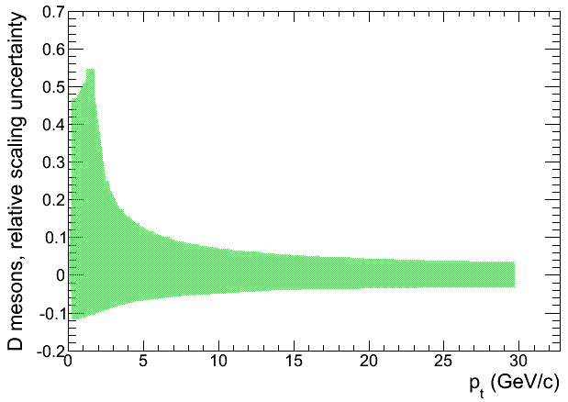
pp reference: L_{int} and √s
ALICE LOI: assessment of pp reference for low-p_{T}, low S/B measurements: charm mesons and baryons, charmonium
Statistical error on pp reference should be negligible wrt Pb-Pb (e.g. √2 times smaller) → N_{pp}=2 N_{PbPb} [(Signif/ev)_{PbPb}/(Signif/ev)_{pp}]²
For L_{int}^{PbPb}=10/nb:
  D⁰ → L_{int}^{pp} ~ 6/pb (4x10¹¹ events)
    Valid also for D-from-B measurement
  J/ψ, Λ_{c} → L_{int}^{pp} ~ 0.6/pb
Reference scaling from 14 to 5.5 TeV with pQCD introduces a large systematic error for low-p_{T} charm
~1 month
at ~100 kHz
50% unc.
below 2 GeV/c
Need ~1-month
pp run at √s=5.5 TeV
FONLL

Slide 24
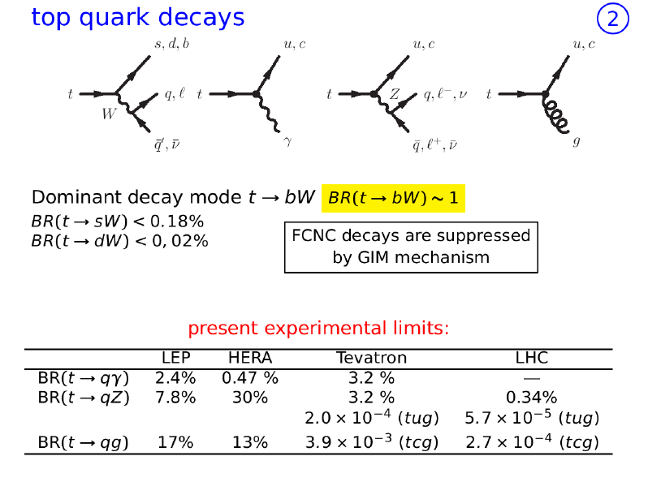

Slide 25
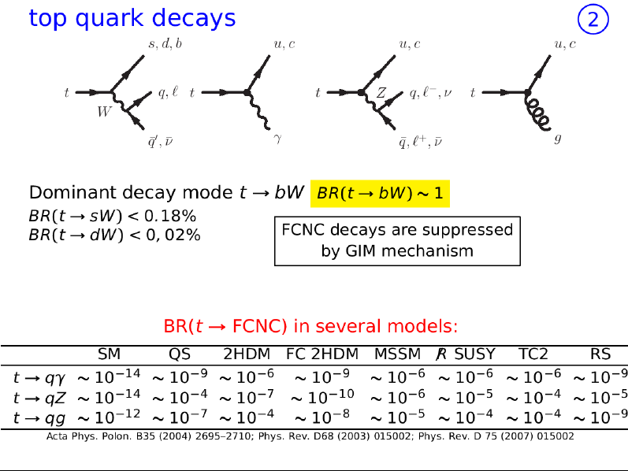

Slide 26
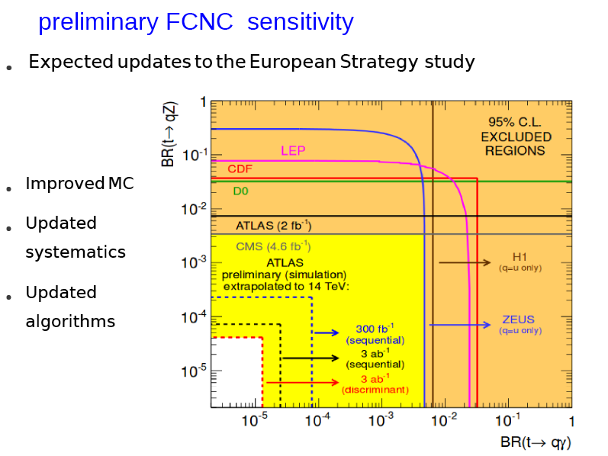

Slide 27
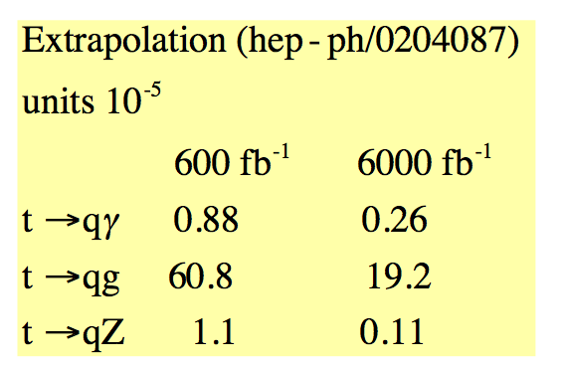
Top FCNC (CMS)

Slide 28
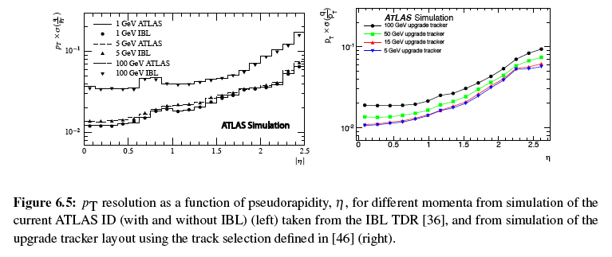
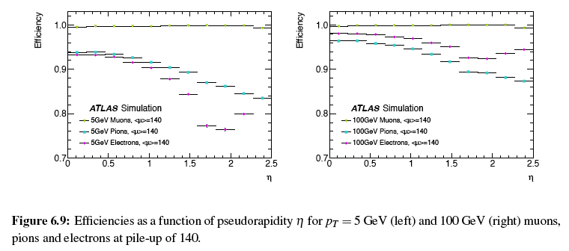

Slide 29
