Slide 1
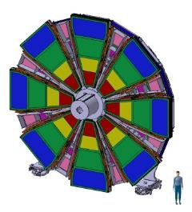
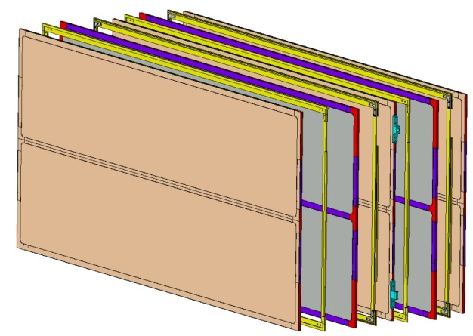


ATLAS - NSW
(new small wheel)
News from Saclay
Mechanical prototype M4
Patrick PONSOT for the CEA-Saclay-Irfu group:
F.Bauer, P.Daniel-Thomas, E.Ferrer-Ribas, J.Galan, W.Gamache, A.Giganon, P-F.Giraud, P.Graffin, S.Hassani, S.Herlant, S.Hervé, F.Jeanneau, H.LeProvost, O.Meunier, A.Peyaud, Ph.Schune
ROMA MMM workshop – 15-16th of July 2013

Slide 2
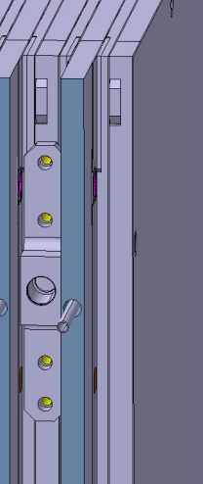
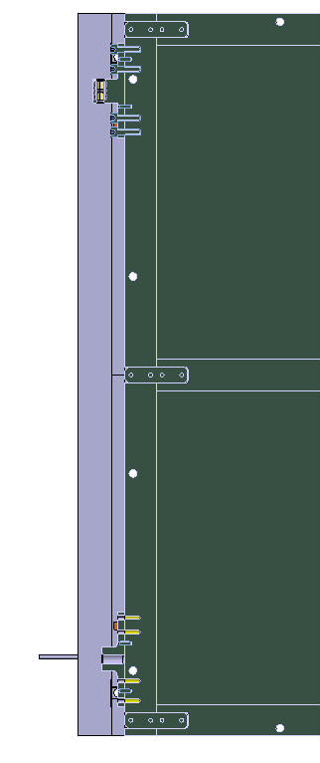
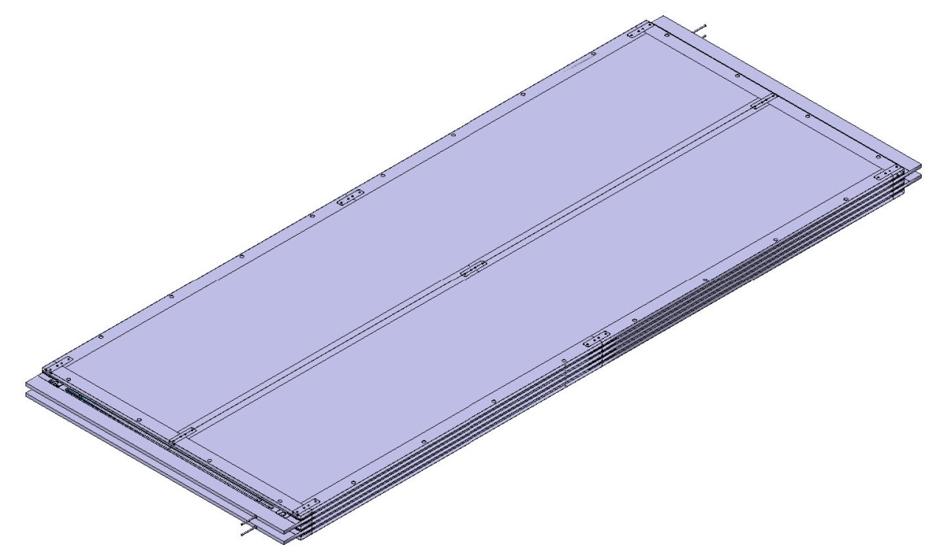
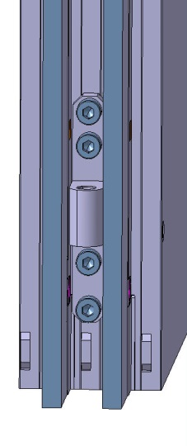
Modification of the design
The frames have been modified to test also the screwing of the M4 on a spacer
  The 2 systems have been kept, the 3 interfaces for kinematic mount are still in place
The drawings have been updated and finalized
The M4 is under tendering, we expect to have all components and tooling on mid-September
Holes for screwing on a spacer
Kinematic mounts

Slide 3
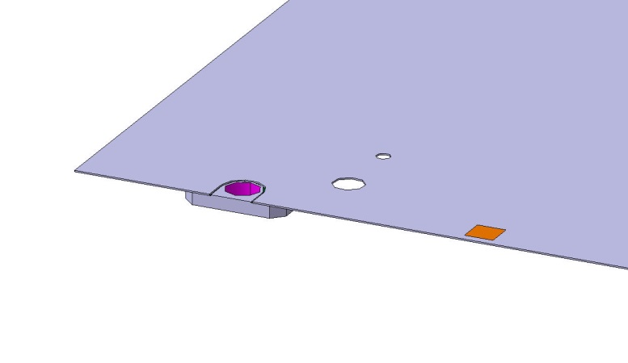
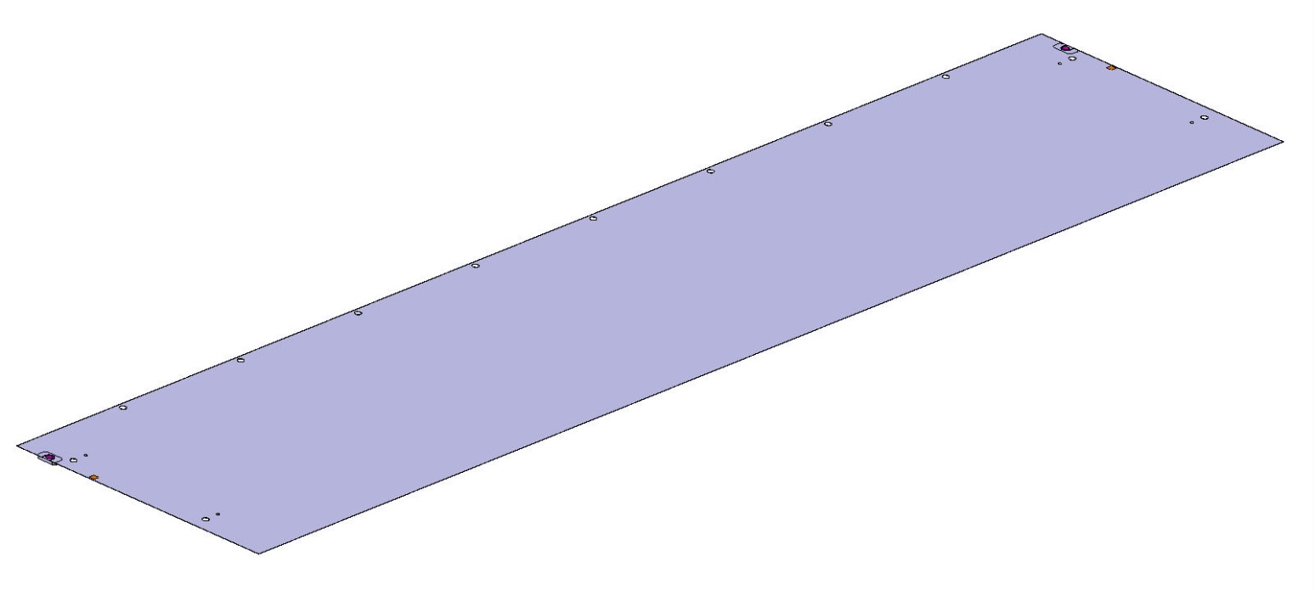
Preparation of the dummy PCB
Gluing of 2 inserts to create a mechanical reference
2 masks 10mmx10mm to test the alignment procedure
Metallic insert glued on the dummy PCB
Alignment mask to test the positioning procedure

Slide 4
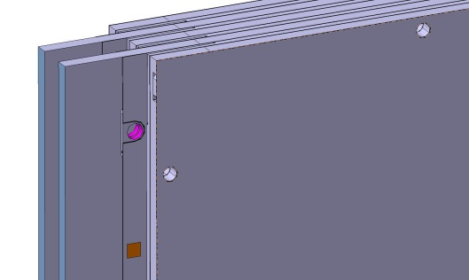
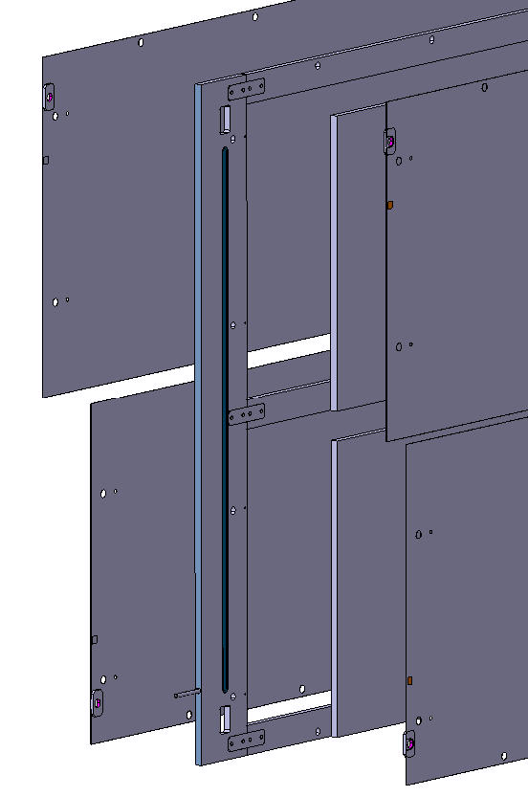
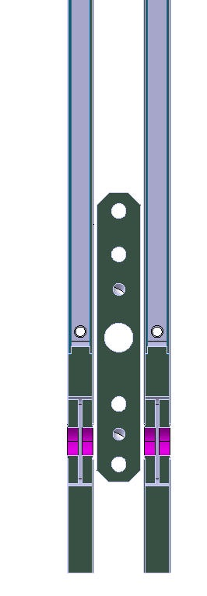
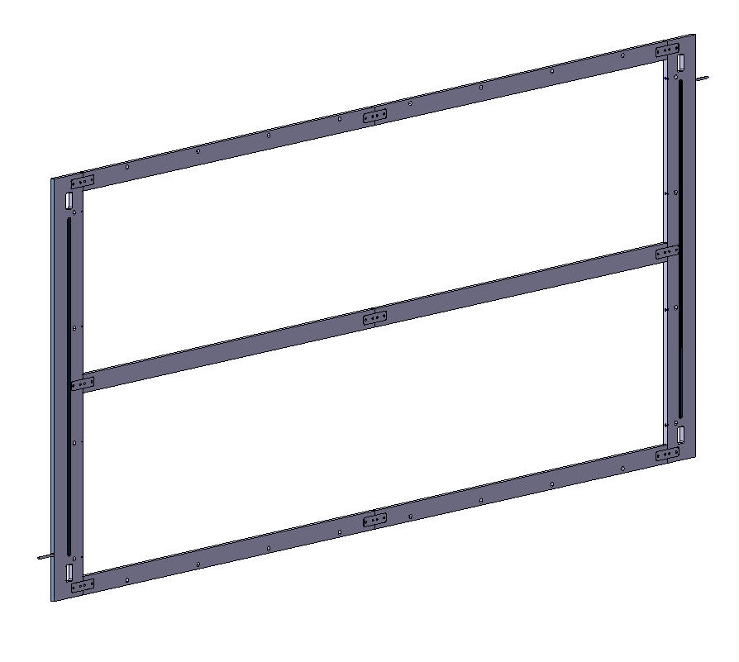
RO panels
2x2 dummy PCBs
Frame: Aluminum bars have been extended in strip direction to simulate the space for cooling system (100mm for electronics and frames)
Metallic inserts inside the 2 RO panels

Slide 5
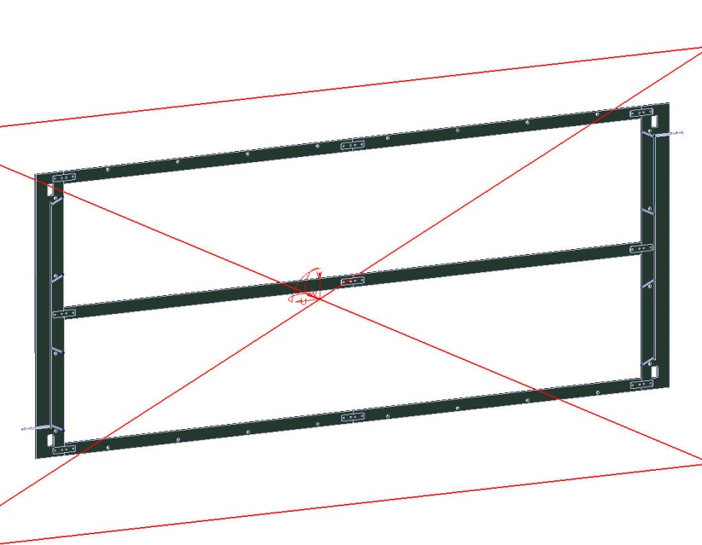

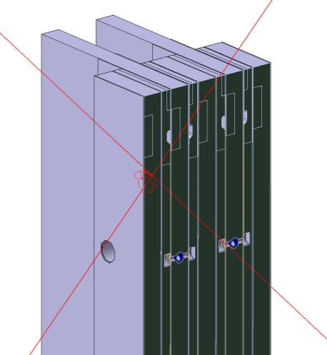
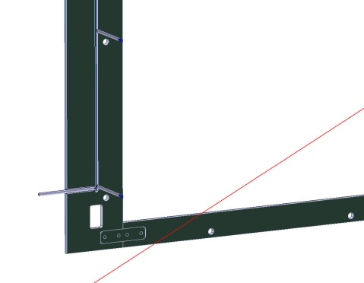
gas distribution
The inlets and outlets are machined directly in the RO frames
One inlet, a groove to distribute the gas, 4 holes which inject the gas behind and below the mesh (same configuration for extraction)

Slide 6
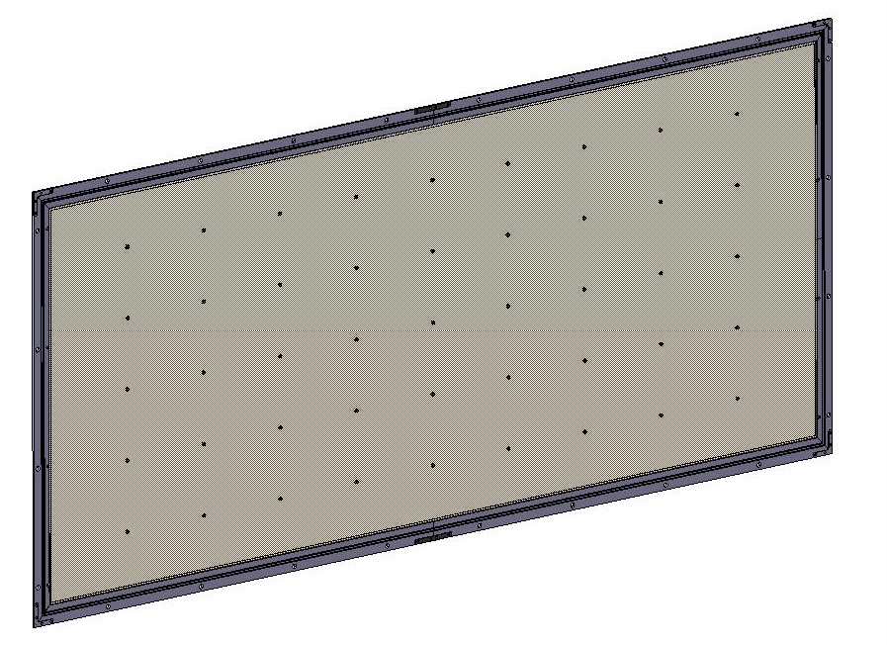
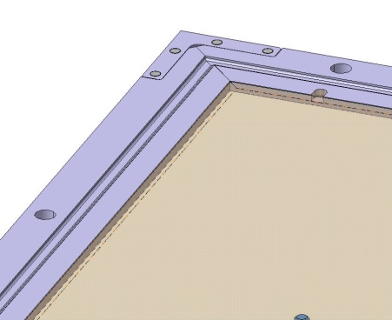
GLUING of the mesh ?
New design for the mesh-frame to be able to apply the tension
In spite of the more complex procedure for the production (using of a transfer frame to dismount it), we decided to fix the mesh-frame on the RO panel
During the production we can test the full RO panels and glue the quadruplet at the end of the assembly without opening of the mesh after testing

Slide 7
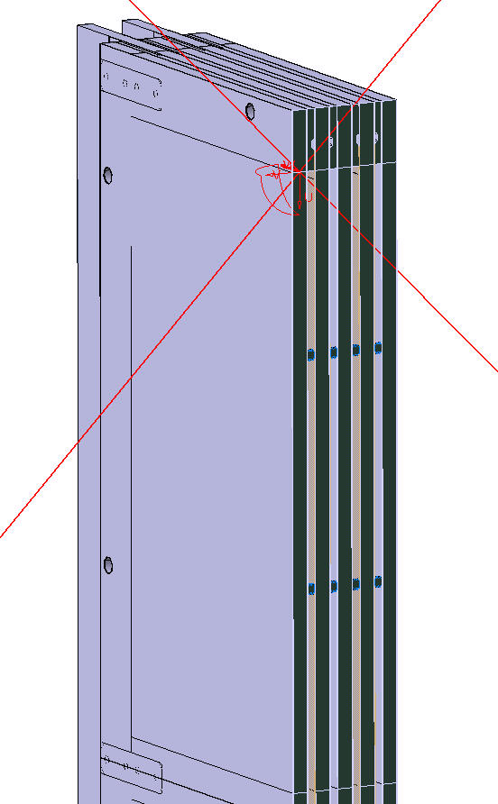
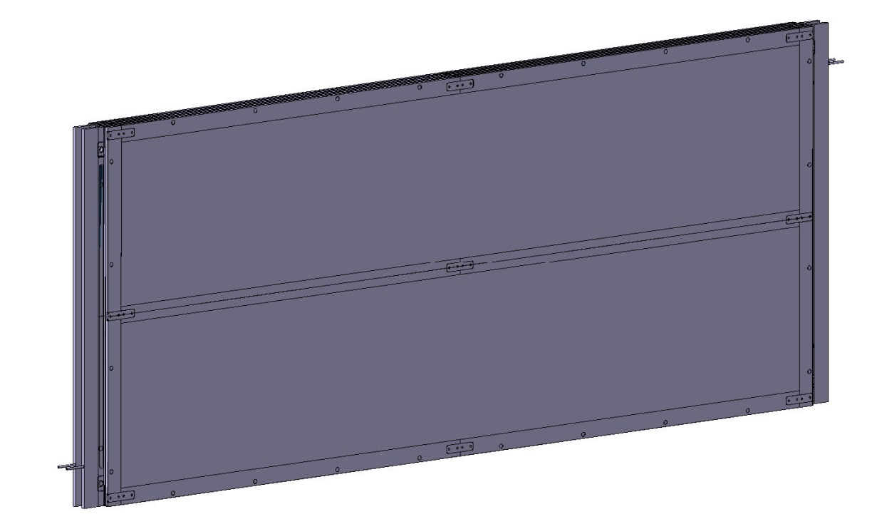
Assembly of the quadruplet
All the components are glued at the end of the assembly (according the thermo-mechanical simulation, all should be glued with spacers inside the drift gap)
All the frames are glued
Pillars are glued on both sides (RO and Drift panels)

Slide 8
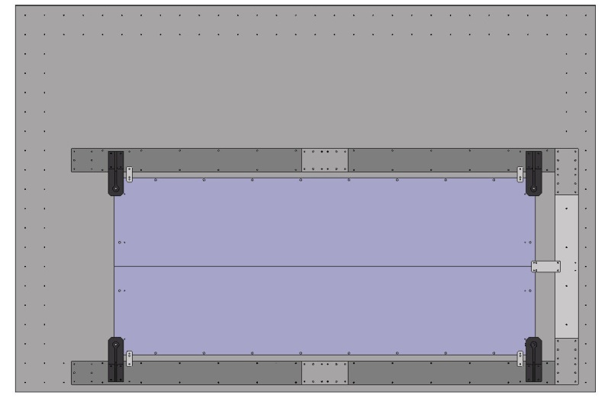
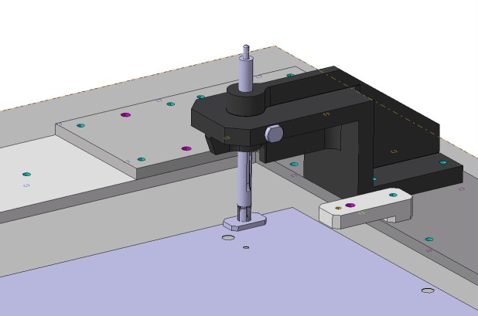
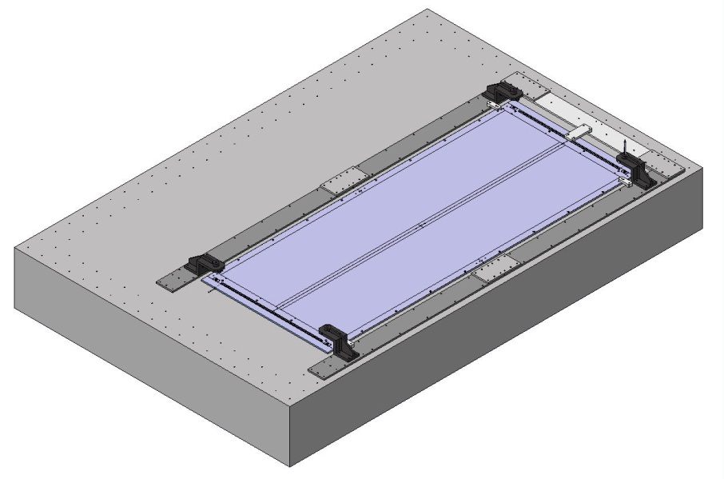
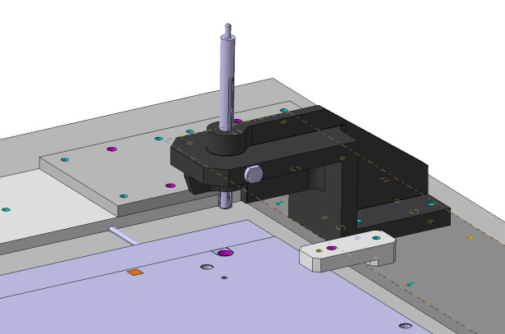
Tooling for construction of M4
Principle: Preliminary tooling to be able to test the alignment of the 2 dummy PCBs
Positioning towers with expansible pins
Should be compatible with the using of a stiffback (under study)
Positioning tower will be equipped with an alignment cameras
Expansible pin

Slide 9
Tooling for construction of M4
Using of a stiffback coupled with a vacuum bag
Some tests are in progress
See next talk from Fabien

Slide 10
DSM
Irfu
SIS/LCAP (PC N°12, Bt 123)
Patrick PONSOT
Thank you for your attention !
Commissariat à l’énergie atomique et aux énergies alternatives
Centre de Saclay | 91191 Gif-sur-Yvette Cedex
T. +33 (0)1 69 08 79 30 | F. +33 (0)1 69 08 89 47
  Etablissement public à caractère industriel et commercial | RCS Paris B 775 685 019

