Slide 1

News from Saclay
F. Bauer, M. Boyer, D. Desforges, E. Ferrer-Ribas, W. Gamache, A. Giganon, P.F. Giraud, P. Graffin, S. Herlant, S. Hervé, F. Jeanneau, H. Le Provost, O. Meunier, A. Peyaud, P. Ponsot, Ph. Schune
Atlas MMM – rome 15/16 july 2013

Slide 2
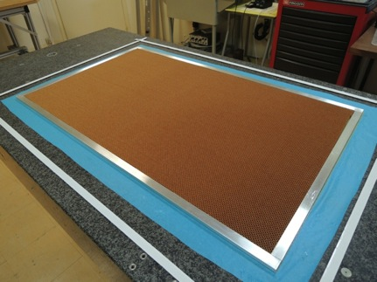
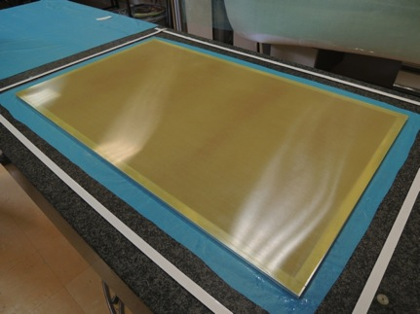
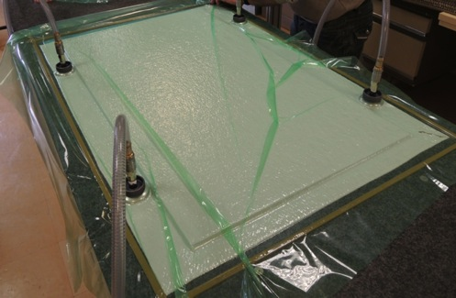
Glueing tests: vacuum bag
# | Steps | Frame | Honeycomb | Skin
1 | 1 | Al bars | Nomex, 5 mm | FR4
2 | 2 | Al bars | Nomex, 5 mm | FR4
3 | 1 | G10, good precision | Nomex, 5 mm | FR4+Cu
4 | 1 | Al, extruded | Al, 5 mm, µ-holes | FR4
5 | 1 | Al, extruded, drilled | Al, 5 mm, µ-holes | FR4+Cu
6 | 1 | No | Al, 5 mm, µ-holes | FR4+Cu
Skins: 1000 x 600 x 0.6 mm³
Al frame: no particular mech precision
Glue: Araldite 2011, applied by hand
Pressure: -900/1000 mbar
Curing: ~24hrs

Slide 3
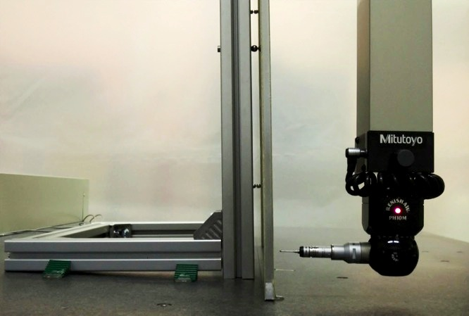
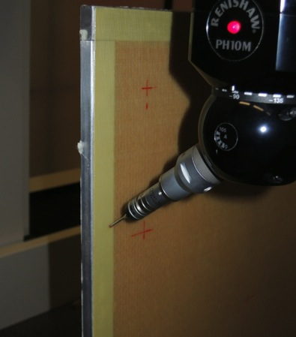
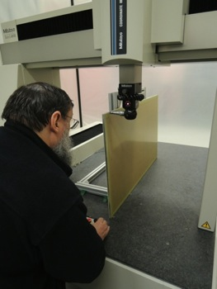
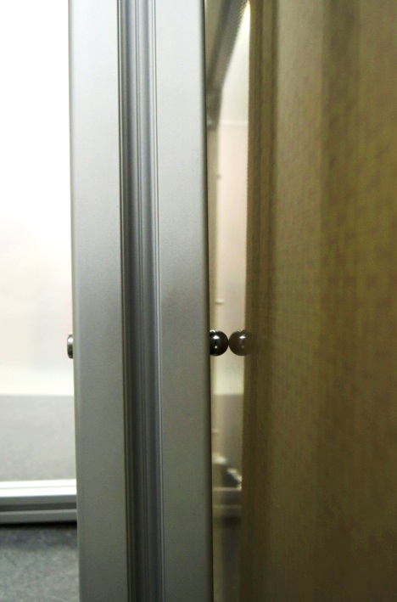
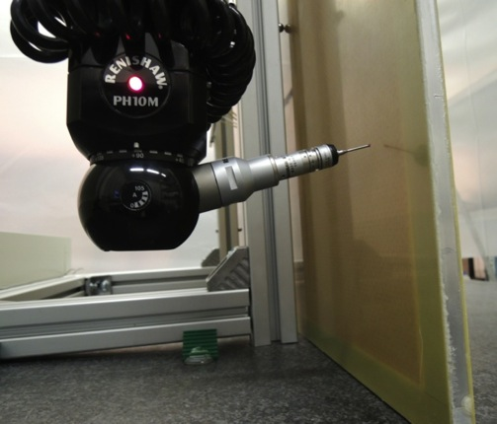
Planarity measurements
Horizontal and vertical measurements
Planarity
72 points (with and w.o. frame)

Slide 4
Planarity: horizontal profiles
0.132 [
0.056
-0.076
0.103 [
0.039
-0.064
Face 1 including frame
Face 1 – no frame
0.419 [
0.245
-0.175
0.095 [
0.053
-0.042
Face 2 including frame
Face 2 – no frame
G10, good precision | Nomex, 5 mm | FR4+Cu
Face 1 on the table

Slide 5
Planarity: vertical profiles
Face 1
Face 1
0.095 [
0.043
-0.053
0.218 [
0.143
-0.075
Compared to ~70µm on table
Face 2
0.091 [
0.049
-0.042
Face 2
0.238 [
0.148
-0.091
Frame | Honeycomb | Skin
G10 good precision | Nomex, 5 mm | FR4+Cu
Frame | Honeycomb | Skin
Al | Al | FR4+Cu

Slide 6
Planarity: results
Material (frame, stiffener) | F1 – frame (mm) | F1 – no frame (mm) | F2 – frame (mm) | F2 – no frame (mm)
Al, Nomex | 0.545 | 0.136 | 0.155 | 0.1
Al, Nomex | 0.237 | 0.206 | 0.608 | 0.110
G10, Nomex | 0.132 | 0.103 | 0.419 | 0.095
Al, Al | 0.193 | 0.161 | 0.622 | 0.221
Al, Al | 0.113 | - | 0.457 | 0.109
No frame, Al | - | 0.047 | - | 0.101
Horizontal measurements
Material (frame, stiffener) | F1 – no frame (mm) | F2 – no frame (mm)
Al, Nomex | 0.332 | 0.259
Al, Nomex | 0.256 | 0.206
G10, Nomex | 0.95 | 0.91
Al, Al | 0.357 | 0.329
Al, Al | 0.164 | 0.188
No frame, Al | 0.151 | 0.165
Vertical measurements

Slide 7
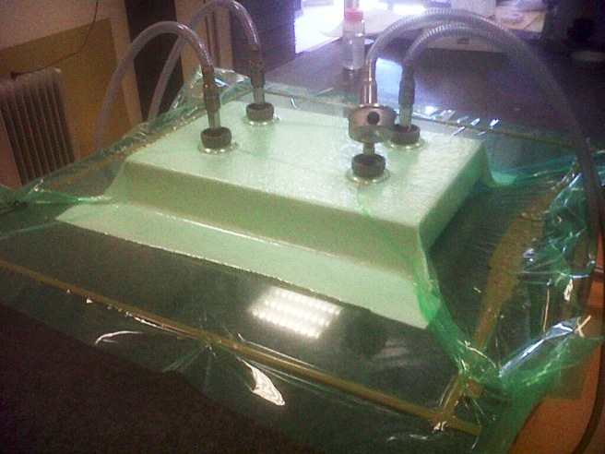

New trys
Vacuum bag + reduce pressure (500 mbars): FR4+Cu / Al frame / Al honeycomb / 1200 X 600 mm²
 | F1 – frame (mm) | F1 – no frame (mm) | F2 – frame (mm) | F2 – no frame (mm)
Horizontal | 0.080 | 0.072 | 0.479 | 0.074
Vertical | - | 0.218 | - | 0.238
Twisted frame (see glueing #3 with G10 rectified frame)
Vacuum bag + Stiffback: FR4 / no frame / Al honeycomb / 450 X 250 mm²
 | F1 – no frame (mm) | F2 – no frame (mm)
Horizontal | 0.071 | 0.046

Slide 8
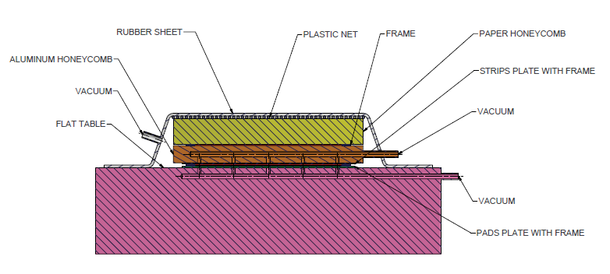
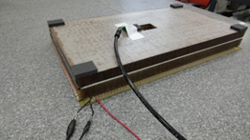
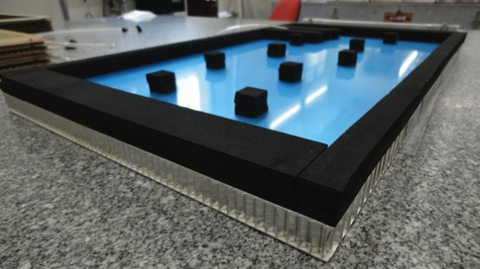
Vacuum bag + stiffback method
Proposed by Georges Mikenberg for the sTGC glueing
2 steps glueing process:
3 h of curing on face 1 before the 2nd step
Less time consuming
Curing of the 2 glue layers at the same time

Slide 9
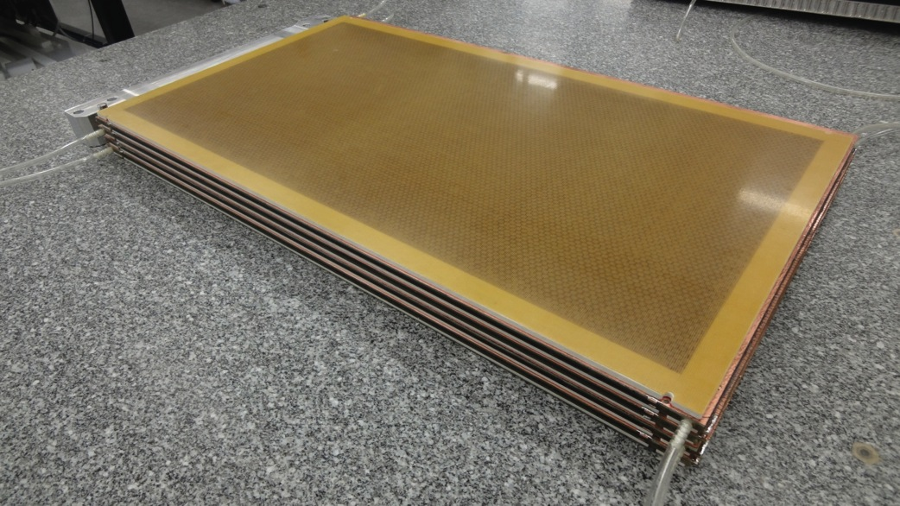
Flatness achieved to within 50μm and uniformity of thickness around the edges with σ=48μm with larges deviation <100μm.

Slide 10
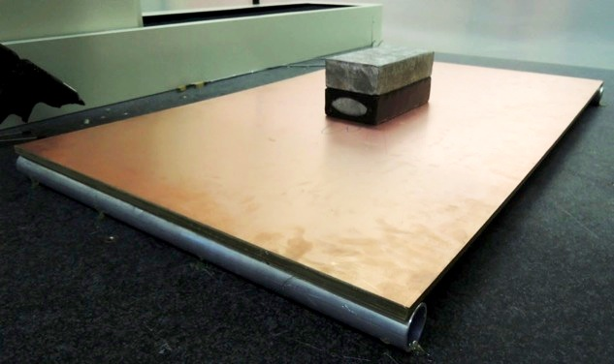
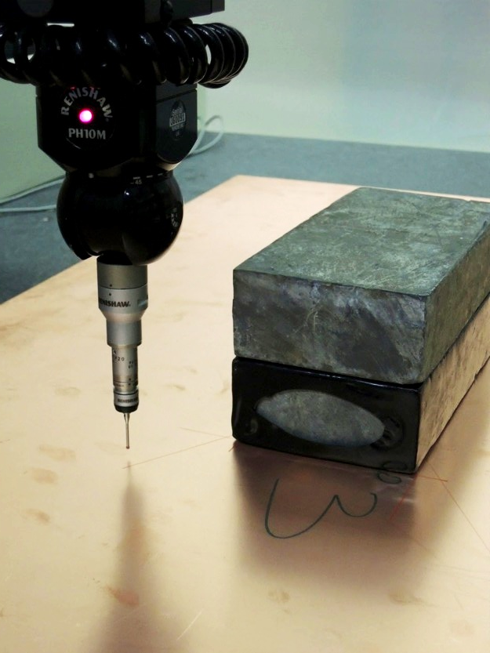
Stiffness measurements
Geometry
Dimensions: 1000 x 600 x 11.2 mm³
2 FR4 plates (e= 0.6 mm)
Frame: rectangular section (20 x 10 x 1 mm³)
Honeycomb (e=10 mm)
Boundary conditions
Support: cylindrical tubes (960 mm spacing)
Load: 220 N (Lead bricks, area: 200 x 100 mm²)
Load in the center

Slide 11
Stiffness: results
The structure is 30% stiffer than in the model

Slide 12
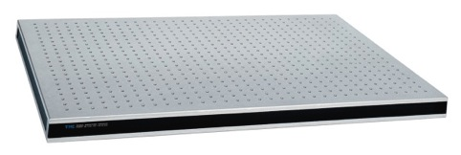
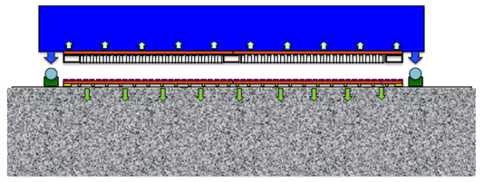
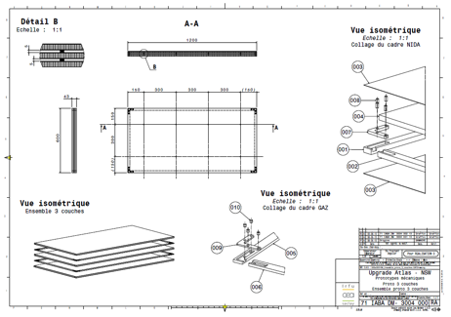
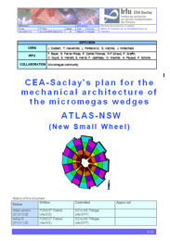
Other actions
Glueing process: stiffback
The intermediate mechanical prototype (doublet) is in progress (manufacturing of the mechanical components)
Goal: measurement of the bending transmission with and w.o. spacers in the drift gap (ceramic pillars) to define the in-plane alignment system
Glueing process: intermediate mechanical prototype
Assembly in progress
M4 mechanical prototype
Drawings are finished: see Patrick’s talk

Slide 13
Conclusion
Basic material and tools: laminar air-flow ordered
Vacuum bag glueing tests:
  High precision manufacturing needed for the frame
  Difference between the 2 faces
  Vertical measurements show a twist effect (reduced pressure test)
First test with stiffback method (better than 70 µm for a small surface)
Stiffback + vacuum bag method: plan to buy or built a Stiffback
Stiffness 30% larger than in the model
Operational multi-layer: PCB ordered
Deformation prototype: assembly in progress
M4: drawings are finished
Bulk workshop at Saclay: mesh stretching up to ~1m²

Slide 14
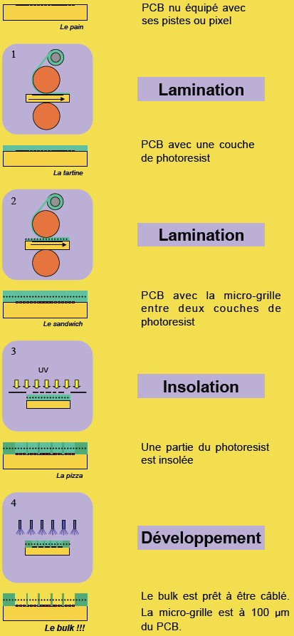
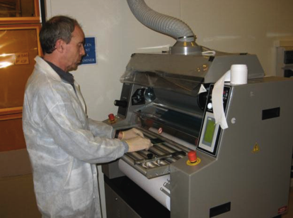
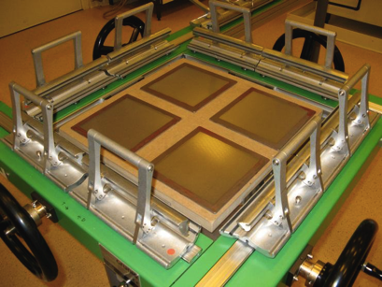
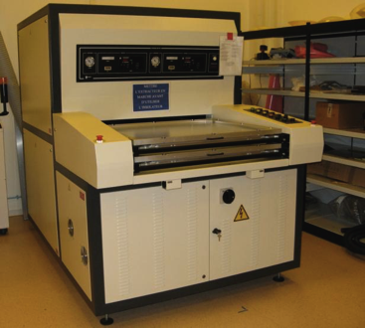
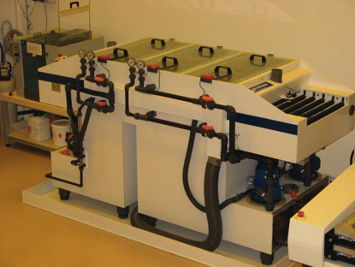
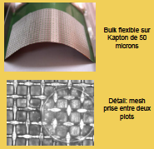
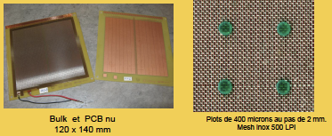

Bulk workshop at saclay
Lamination
Mesh stretching
Insolation
Development

