Slide 1
Dubna report

Slide 2
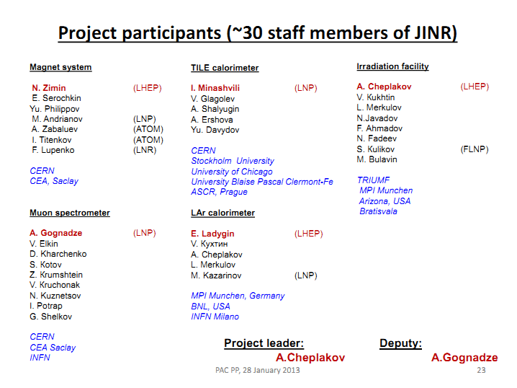
January 28 - Programme Advisory Committee approved JINR participation plan in the ATLAS upgrade , which was presented by A.Cheplakov

Slide 3
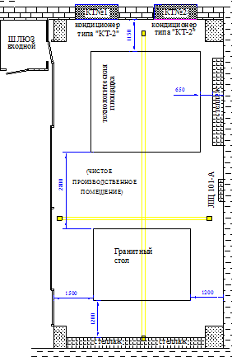
Clean room for MDT/MicroMegas assembly
A tender was announced
3 water cooled air conditioners produced in the early 80s
Decision: renew the system. Tender was announced.

Slide 4


Granite table extension
3550
280
100
2600
2000
500
The extension bar will be supported on 3 points
Designs are complete, preparation in progress

Slide 5
At the end (October-November):
Clean room according to U.S. standard 209B-class 100000, temperature 21±1 ⁰С, humidity 45±10 % (reminder: initial requirement for MDT was 10000 class for MDT tube and 100000 for MDT chamber production which then changed to 100000 and dust free respectively )
- Granite table for small sector full wedge producing

Slide 6
What JINR can/wish do:
Small sector full wedge RO&Drift planes, quadruplets or any sizes in case of 2-3 modules/wedge
Tests: mechanical (planarity, parallelism, distance between the surfaces, …), gas leak, HV (leakage current), …

