Slide 1
Mechanical analysis of Foam and plastic honeycomb panels
Simon Gonzalez

Slide 2
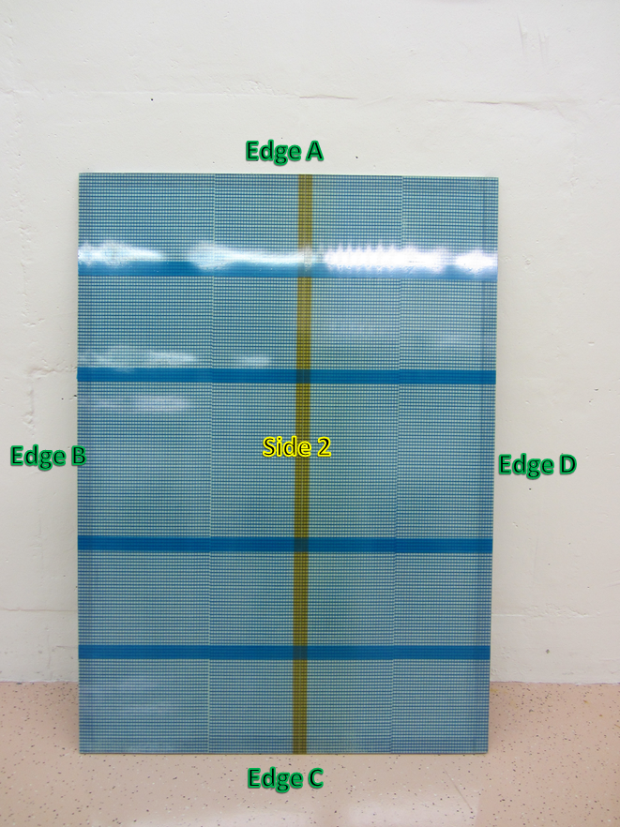
Foam Panel
Composition of Foam Panel
  FR4 skins
  Blue plastic mesh
  Glued with Araldite 2011 (side 1) and Araldite AY-103 (side 2)
  Aluminum frame
Scans of the panel were done on both sides along the length and width of the panel.

Slide 3
Results From Side 1
Standard deviation from measurements (in mm)
  0.16411 for Z(136)
  0.11056 for Z(288)
  0.06977 for Z(527)
  0.05125 for Z(688)
Standard deviation from measurements (in mm)
  0.05451 for Z(200)
  0.07511 for Z(400)
  0.05545 for Z(715)
  0.05803 for Z(900)

Slide 4
Results From Side 2
Standard deviation from measurements (in mm)
  0.0387 for Z(108)
  0.0439 for Z(511)
Standard deviation from measurements (in mm)
  0.03568 for Z(400)
  0.03909 for Z(715)
  0.03947 for Z(900)
  0.02269 for Z(200)
The graphs is generated by subtracting the panel form the marble reference.

Slide 5
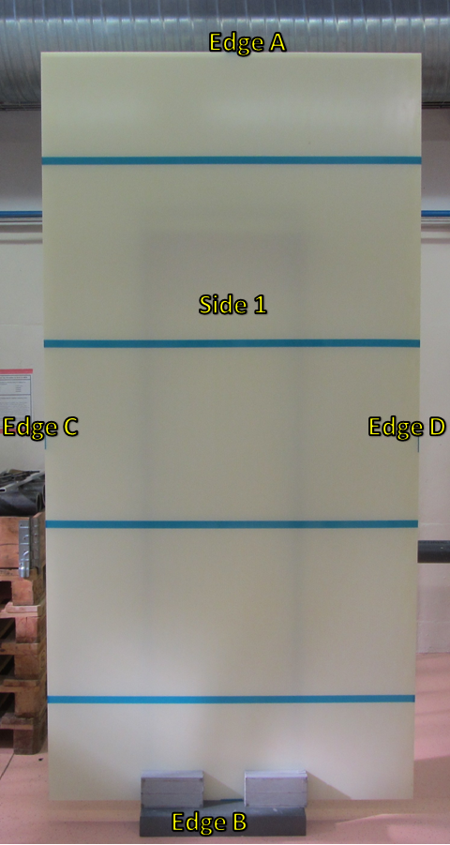
Large Honeycomb Panel
Consist of a plastic honeycomb.
Scans of the panel were done on both sides along the length and width of the panel.

Slide 6
Results From Side 1 Edge and Side 2 Edge A to B
Standard deviation from measurements (in mm)
  0.05247 for Z(117)
  0.0846 for Z(441)
  0.08411 for Z(791)
  0.09544 for Z(1163)
Standard deviation from measurements (in mm)
  0.0999 for Z(52.64)
  0.07321 for Z(771.36)

Slide 7
Results From Side 1(edges C to D and D to C), Side 2 (edges C to D and D to C)
Standard deviation from measurements (in mm)
  0.1965 for Z(401.82)
  0.14259 for Z(986.5)
  0.25678 for Z(400.72)
  0.22024 for Z(987.4)
Standard deviation from measurements (in mm)
  0.2421 for Z(403.57)
  0.19152 for Z(984.18)
  0.17784 for Z(402)
  0.11398 for Z(983)

Slide 8
Results From Curve Side 1(edges C to D and D to C), Side 2 (edges C to D and D to C)
Standard deviation from measurements (in mm)
  0.0348 for Z(401.82)
  0.0513 for Z(400.72)
  0.0439 for Z(986.5)
  0.0317 for Z(987.4)
Standard deviation from measurements (in mm)
  0.0379 for Z(403.57)
  0.0255 for Z(402.00)
  0.0340 for Z(984.18)
  0.0379 for Z(983)

