Slide 1
MM mechanical prototype
Work progress at CERN

Slide 2
Purpose
Demonstrate feasibility
Setup of basic infrastructure
Gain experience with
  Materials
  Construction/assembly ideas/schemes
  Procedures
  Precision (panel planarity, parallelism of skins, …)
Produce objects that can be measured
Establish an Assembly Manual

Slide 3
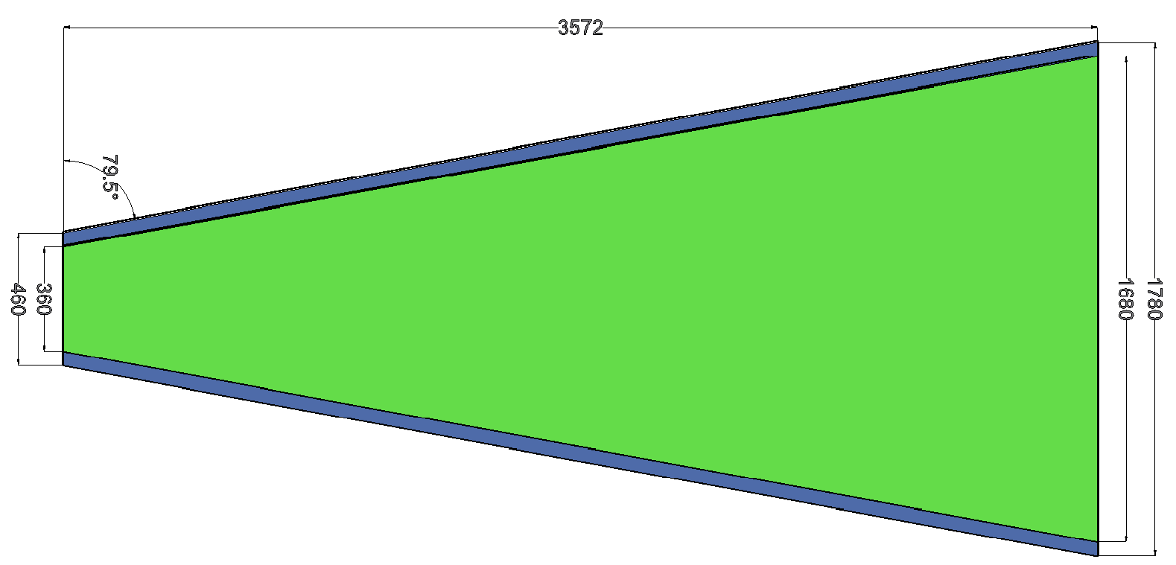
CERN mechanical prototype (1)
Full-wedge small sector quadruplet
  Eta and stereo doublet
Drift gap spacers: 5 mm
Total thickness: ~80 mm
Gas distribution
Mesh?

Slide 4
CERN mechanical prototype (2)
All panels of equal thickness – 12 mm
  Frame of standard t=10 mm Al profiles
  0.4 mm plastic mesh
  9.5 mm foam panels
  Skins – 0.5 mm FR4
  Glue – Araldite 2011
  – Araldite AY 103-1 + HY 991
  – Araldite AY 103-1 + HY 951

Slide 5
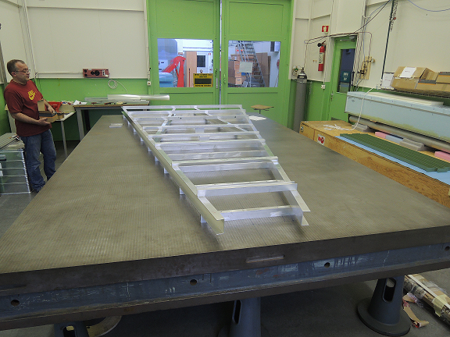
The table
Size: 4 x 2.5 m
Flatness: ≤ 20 µm
Location: Bld. 153

Slide 6



Stiff-back (1)
Using Skin suction Tool
Clarinet gas
Vacuum
Vacuum
Vacuum
Vacuum
Rohacell honeycomb
Skin (G10)
Precision insert
Expansive glue
Precision shim

Slide 7
Stiff-back (2)
Simple stiff-back structure with suction heads (following small test structure) used for 2 x 1 m² prototype
CERN-DT group is working on a final system using a perforated honeycomb structure with a perforated lower skin
Work in progress
  Small 50 x 50 cm² prototype ready for the test
  Large, full wedge size, if prototype successful
60 mm

Slide 8
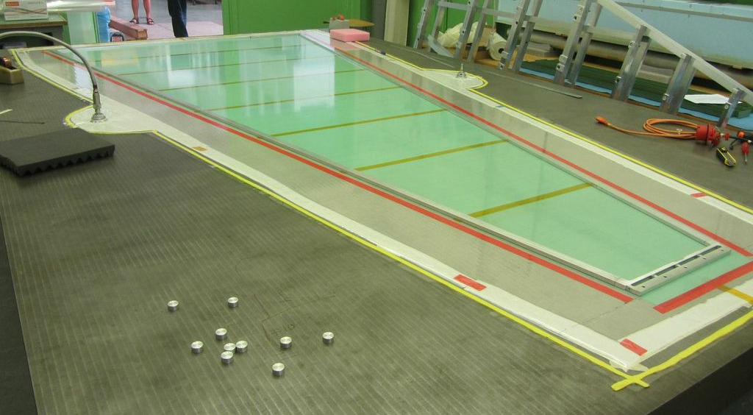
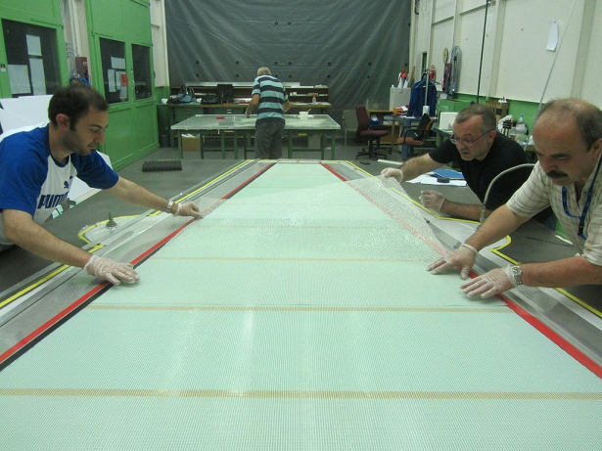
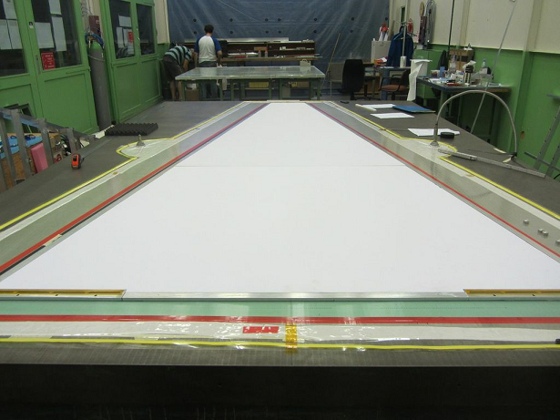
Gluing (1)
Step 1 – FR4 skins were placed and sucked
on the table
Step 2 – Plastic mesh was wetted with
the glue and placed on the FR4
Step 3 – Frame foam panel were placed on the mesh

Slide 9
Gluing (2)
Second skin was placed and sucked on the table
Glue was distributed on the surface
Plastic mesh was wetted by glue and placed on the skin
Prepared “half panel” picked up with the stiff-back structure and placed on the mesh
Calibrated shims were placed under the stiff-back

Slide 10
First experience (1)
Two full-wedge size drift panels were glued
The planarity of the panels seems good
– to be measured on the laser interferometer
  Araldite AY103 + HY991 seems the optimal
Some problems with the gluing
  Some regions where mesh is not glued to the skin
  Use other type of glue?
  Change the gluing procedure?
  Increase the glue gap?

Slide 11
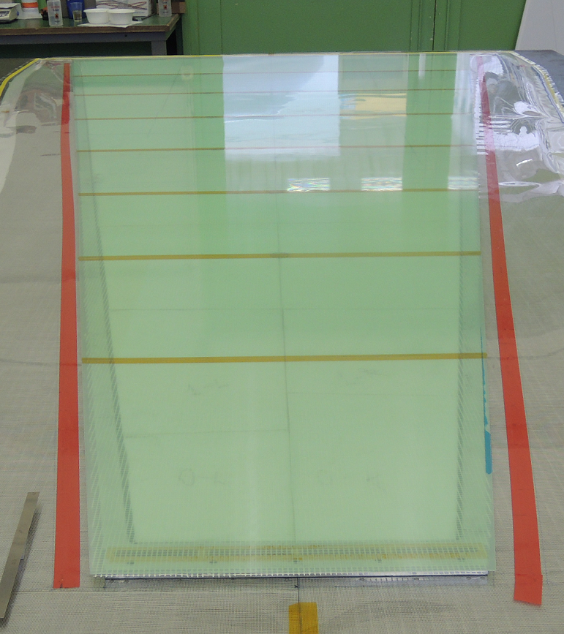
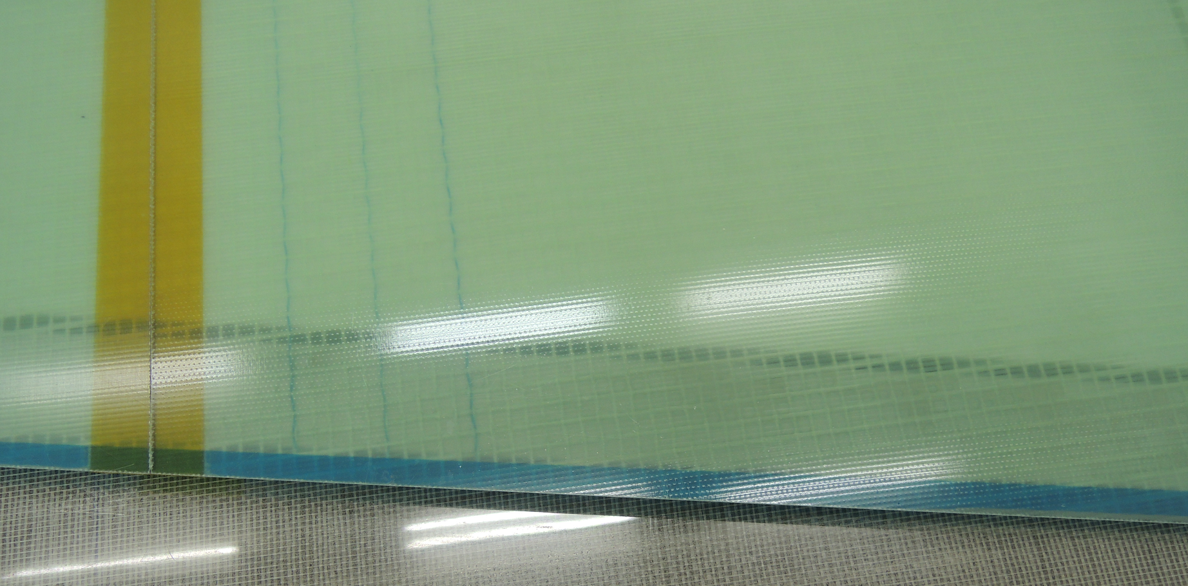
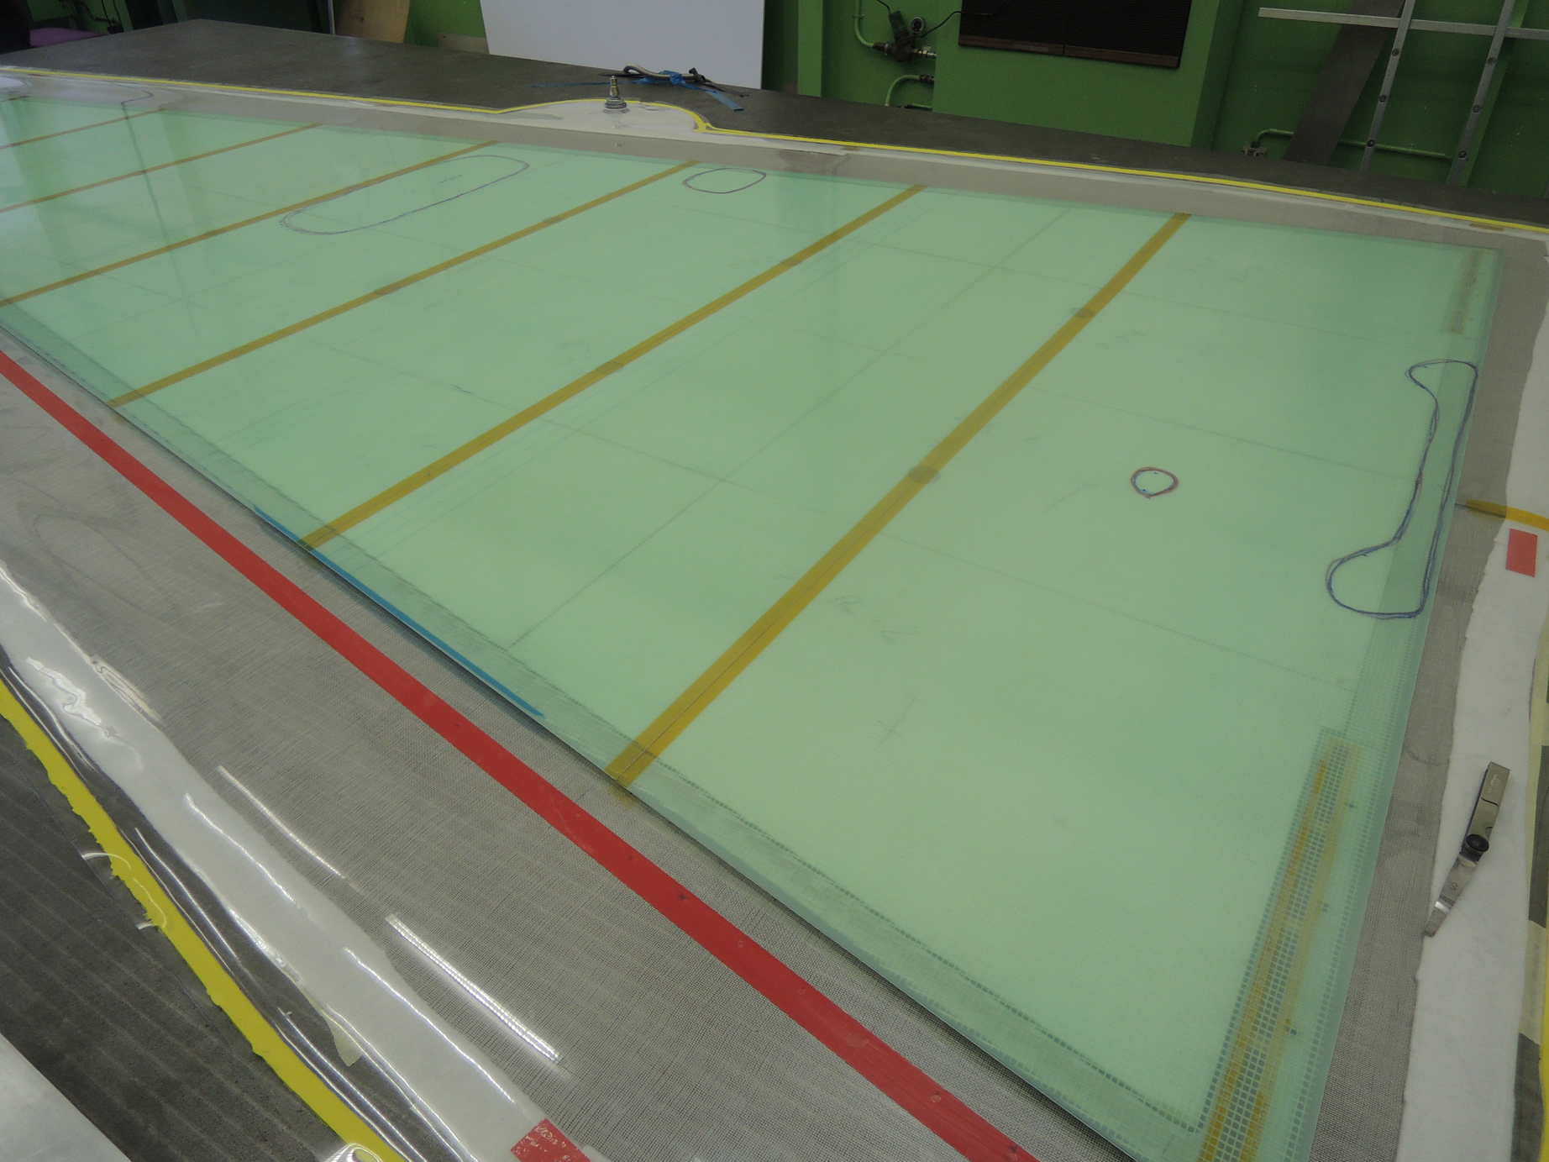
First experience (2)
Inner structure
Full panel view
Problematic regions

Slide 12
Collaborative effort
CERN, Dubna, Lecce …
Drawings and calculations: Lecce and CERN
Infrastructure and tooling: CERN
Technical work: CERN, Dubna, Lecce
+ 3 summer students (2 physicist + 1 engineer)

