Slide 1
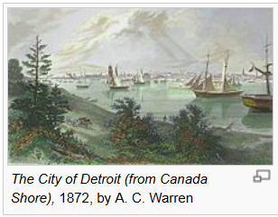





Near- and Medium-Term Future of E_{loss} Measurements at RHIC
Justin Frantz
Ohio University
2nd Annual Wayne State Jet Workshop

Slide 2
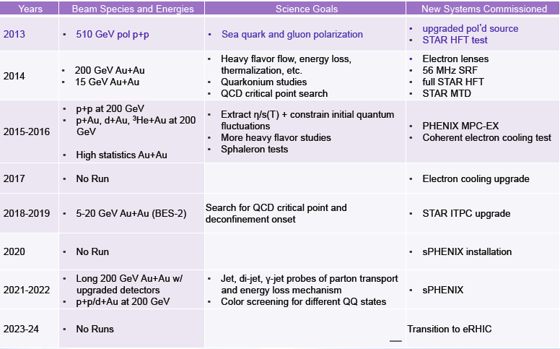
Plans at RHIC
From RHIC ALD Berndt Muller talk in June:
This talk will focus on the next decade of Heavy Ion (A+A) E_{loss} physics - special focus on sPHENIX
Won’t talk ~much about Initial State and Forward Physics

Slide 3
RHIC in Next 10 years
Exploit RHIC’s Flexibility to study different systems, small and large
Geometry: Exotics CuCu, CuAu, UU, dAu, tAu, He³Au
(Cool stuff: p + A !)
Energy: (2 Roles)
  For E_{loss}
  factor of 20-40 lower sqrt(s) → 0.1 TeV ?
    Heavy Flavor
    Jets → sPHENIX
  Another factor of 20 lower (with fixed target statistics!) e.g. The BES : Phase Transition Physics

Slide 4
Complementarity of RHIC/LHC
We have seen demonstrated in many ways why RHIC remains crucial in understanding sQGP physics (list a few big ones)
v_{n}
  Idea put forth for RHIC data (n = 3?)
  Confirmed and Widely Expanded by LHC (n >= 6…)
  Hydro models extract small η/s , quantitatively from RHIC and LHC establishing universality of perfect fluid
Jets: Enhancement at Low z in Fragmentation Function
  Discovered at RHIC first (at first in spite of LHC null effects)
  Confirmed and made precise by measurement at LHC
  Uniformly defined measurement key tool in constraining E_{loss} models
Hydro-like signals in small systems?
  Flow-like signals discovered in small systems at LHC
  Looks like they exist at RHIC: constraining CGC contributions? Subnucleonic glauber?
  PID behavior at LHC also hydro-like
Heavy Flavor?

Slide 5
Near Term RHIC Outlook
Heavy Flavor
Small system stuff
Jets/Jet Reco

Slide 6
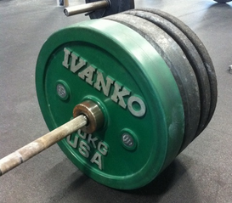
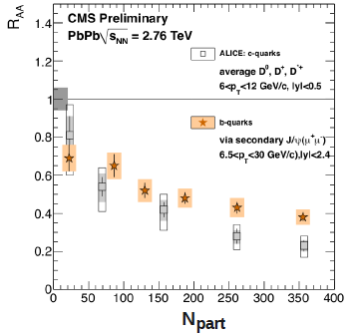
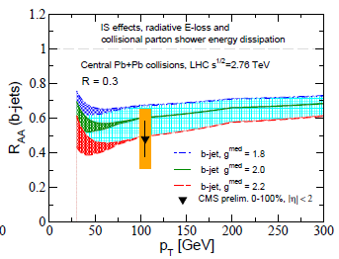
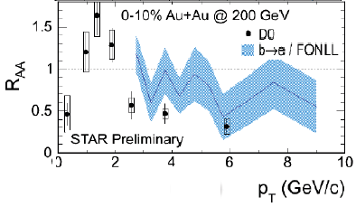
Near-Term HF At RHIC
The near future at RHIC has a decidedly Heavy flavor! Especially 2014: 2 STAR/2 PHENIX HF upgrades
Perfect timing: LHC b-quark suppression

Slide 7
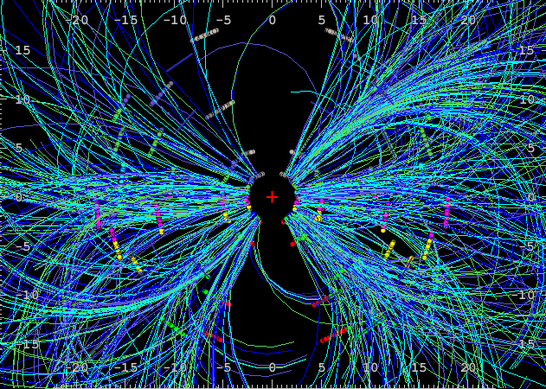
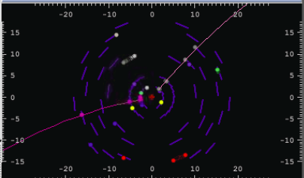
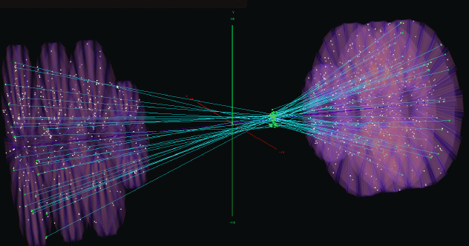
!
PHENIX Silicon Vertexing
VTX dataset in Au+Au 2011 and 2012 p+p
FVTX Commisioning 2012 , Data taking 2013
R_{AA} v₂ of c, b separately
Data: Au+Au@200 GeV, 2011
2012 p+p @ 200 dataset!
Detector commissioning /p+p reference went well
-
FVTX

Slide 8
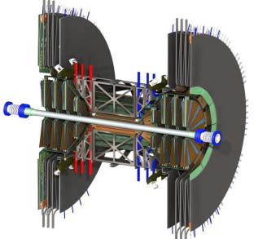
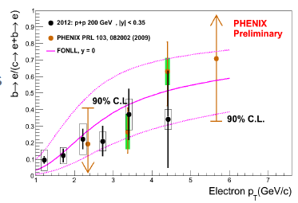
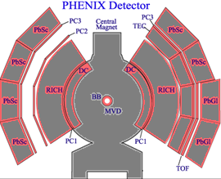
PHENIX VTX Upgrade
c→ / b→ e separation
Run11 Commissioning successful
Run 12 p+p preliminary results below
FVTX
VTX

Slide 9
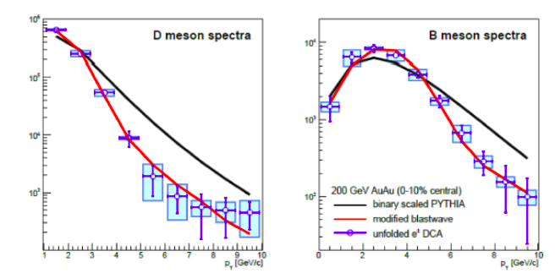
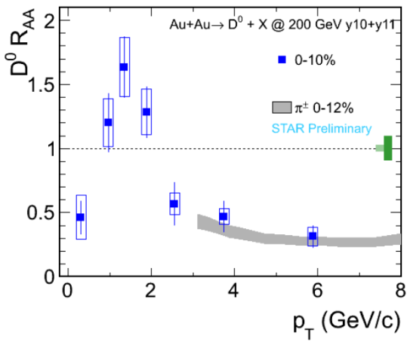
PHENIX VTX
Run 11/12 data indicated repairs necessary, much of detector offline for 2013 run
QM12 A+A results did not include full b/c parent spectra unfolding systematics
  Re-analysis underway QM 12 analysis to be updated
Run14: Full Repairs completed, ready! functionality updated, unfolding techniques ready for first A+A production run! Projections with full unfolding systematics below:

Slide 10
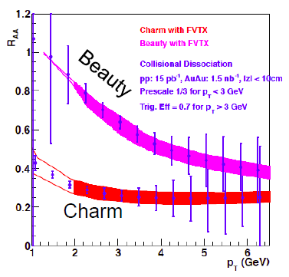
PHENIX FVTX
FVTX provides c/b separation for forward/bkwd Muon arms
HF Single and Di-muons / Drell-Yan
FVTX commissioning run in Run-12 > 96% live active area
Displaced vertex results for open heavy flavor from Run-12 Cu+Au expected soon

Slide 11
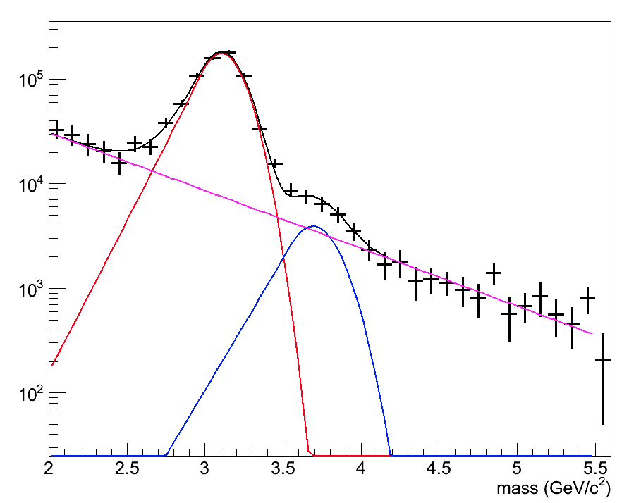
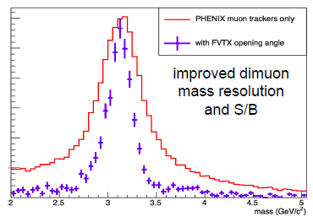
FVTX Di-muons Run-13
Dimuons matched to FVTX
  use FVTX opening angle
  require tight matching between FVTX/MuTr tracks
Di-Muon Invariant Mass
Di-Muon Invariant Mass
FVTX working great!
Awaiting external improvements (global alignments, multi-collision vertex finding, VTX repairs) to realize ultimate performance

Slide 12
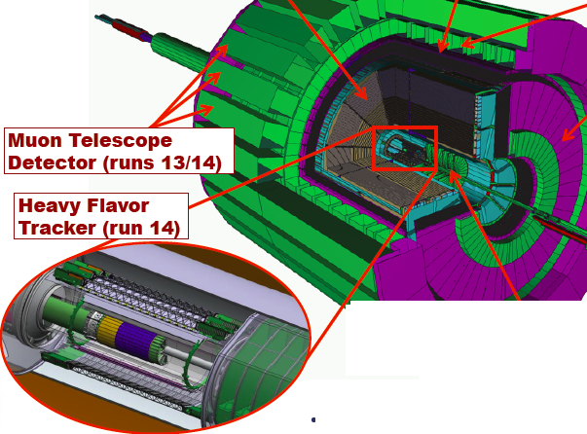
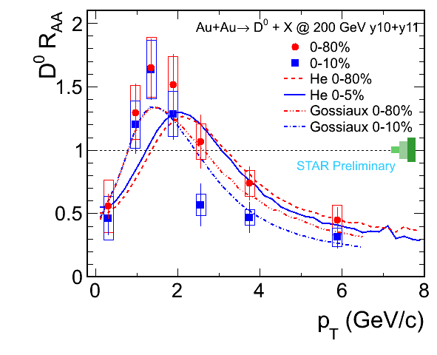
STAR HF Upgrades
MTD and HFT Upgrades are two large acceptance central rapidity PID detectors complementing the STAR barrel
Add c/b quark separation complementing current nice e.g. D meson, D→e / expanding w/ μ capabilities

Slide 13
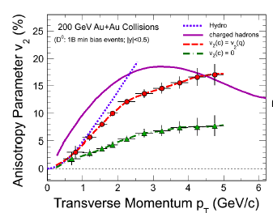
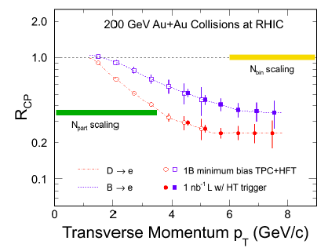
STAR Heavy Flavor Tracker
Matches TPC acceptance
3 types of layers, SSD, IST, PXL innermost
Precise Charm v2, c/b Rcp, RAA, J/Psi from B, Charm Baryons (test recombination for HF)

Slide 14
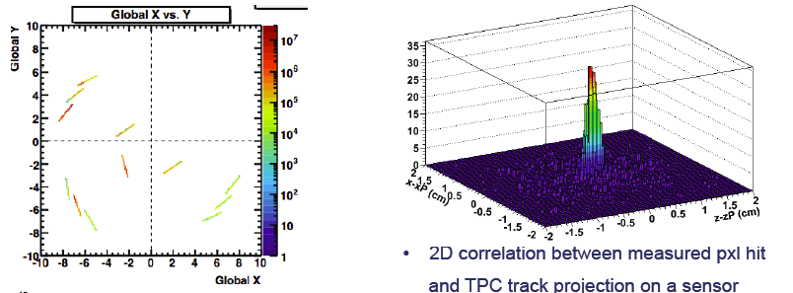
STAR Heavy Flavor Tracker
Engineering Partial Installation for PXL during Run13
Full commissioning and physics for long AuAu run

Slide 15
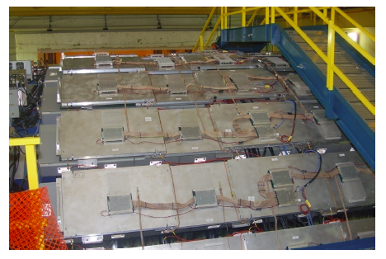
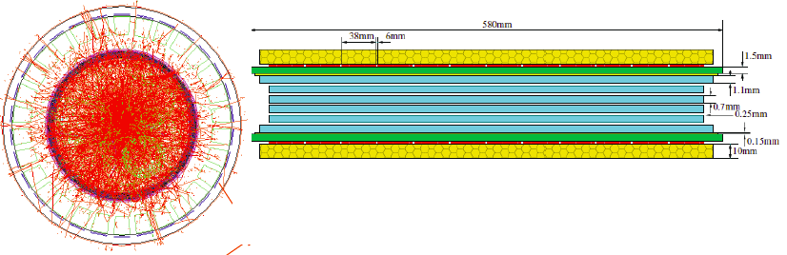
STAR Muon Telescope Detector
Multi-gap Resistive Plate Chamber (MRPC) technology
Onia states resolution, e-μ correlations (for di-lepton contributions), muonic atoms?

Slide 16
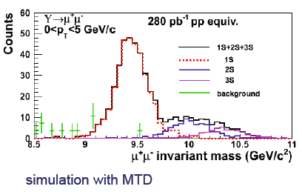
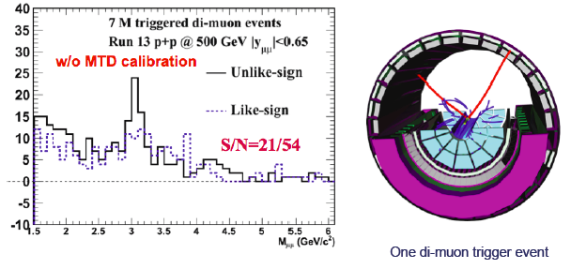
STAR MTD
63% installed in Run13 Working well! Ahead of schedule→ Ready for Run14 Au+Au

Slide 17
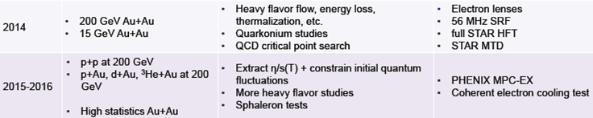
Small System Flow
STAR/PHENIX BUP small systems Run15-16

Slide 18
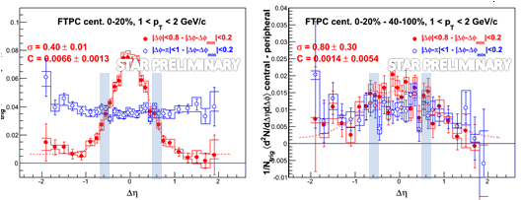
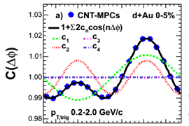
d+Au Flow: STAR vs. PHENIX
After digesting Fuqiang’s last week presentation Helen mentioned:
With increased Δη, STAR sees (weak?) very long range ridge: agreement with PHENIX Central-Backward
Although broader than normal jet, contribution measured by PHENIX at mid-rapidity may be larger than the very long range component
PHENIX Prelim

Slide 19
Near Term Jet Results
Jet Reco of Light Jets
Gamma-Hadron

Slide 20
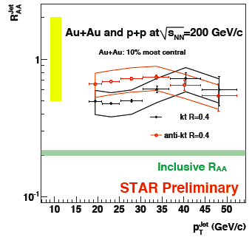
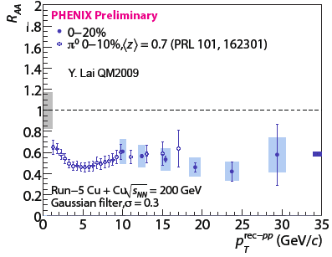
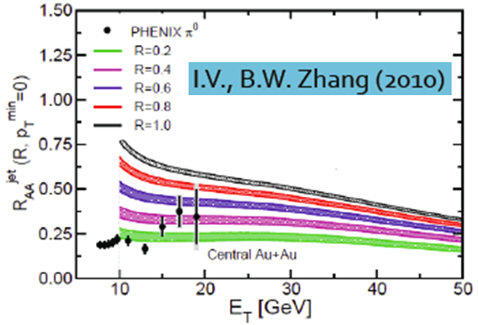
Jet Reco @ RHIC
So far warm ups: preliminary results only in A+A
First STAR Preliminary Results 2009
PHENIX Cu+Cu ~’09 Jet RAA Results:
Need Updated Experimental RHIC Jet Reco RAA result (STAR and PHENIX)!
PHENIX: sPHENIX work → A+A expertise increasing
  Cu+Au: Jet Reco Analysis Underway: First Asymmetric System
Jet
R_{AA}
GLV

Slide 21
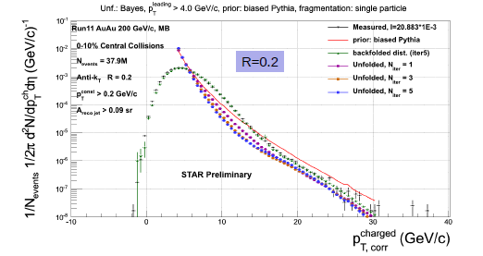
New STAR Jet Reco Coming Soon
Full Bkg Subtraction/Unfolding Technique Completely Updated (Shared ALICE/STAR method)
Seems to be working well
STAR Run 11 Au+Au Large Jet Dataset
Abstract Submitted for Nov. Hard Probes

Slide 22

A Different Complementarity
Both 2-p correlations AND Jet Reco need to be explored!
My Opinion: (Seems to be theme of this meeting too)
Jet Reconstruction is crucial for final understandings of Jet Quenching → Modifications to Showering Process
  sPHENIX!
In the short term : DANGER : Don’t let jet quenching studies (RHIC/LHC) become too Jet Reco- biased!
We first need to learn what quenched jets look like!
  May need completely new jet finding techniques to study quenched jets
Complementarity: Jet Finding + Angular Correlation (Jet-h and γ-h) Measurements
  We can study when modification is mostly NOT there with jet finding: e.g. Energy Asymm
  Don’t ignore modification just because it not seen w/ jet finding observables

Slide 23
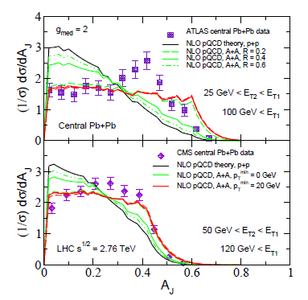
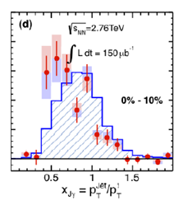
Example: “Jet” Finding + Correlations
Event by Event CHOOSE Jets with quenching A_{J}/x_{γJ}
The Ultimate Tool? Identify perturbative quenching regions, vary the quenching fraction?
Look for shape of quenched jets in regions of di-jet asymmetry Direct γ-jet/di-jet different systematics
  Di-jet A_{J} Gamma-jet x_{jγ} cut
Need to do it with and without quench jet reco axis!
Di-jet Asymmetry
Distribution
γ-jet Asymmetry
Distribution
Vitev J.Phys. G38 (2011) 124087 ATLAS
CMS PLB 718 (2013) 773

Slide 24
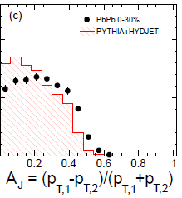
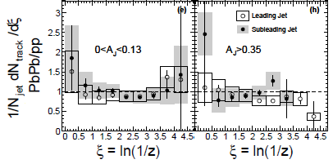
“Jet” Finding + Correlations
This has been tried at LHC
LHC FF Modification Correlates with Large A_{J}? No?
Bias of found jets
  → Look outside jet cone!
  → Look below jet finding cutoff
Technical Difficulties due to UE event subtraction: Don’t use awayside jet energy
dN/dA_{J}
Ratio FF Pb+Pb / p+p = 1 → No mod?

Slide 25
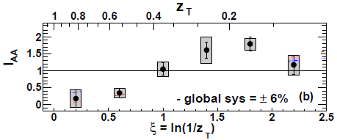
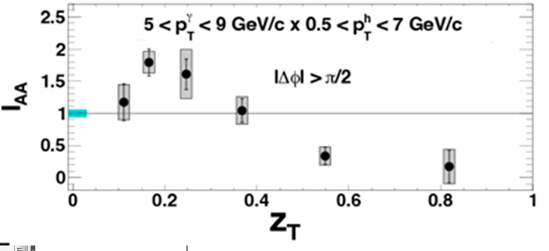
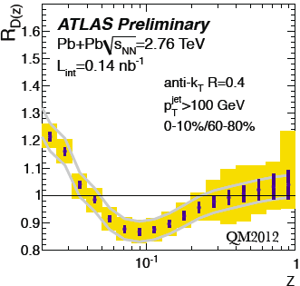
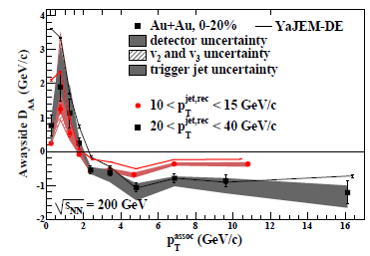
PHENIX Direct γ-Hadron
PHENIX
1212.3323
PRL Accepted !
Photon Hadron FragFn Modification!
Low z Enhancement
Very Similar to LHC Jet-reco
  LHC FF=1 ~= Jet RAA
~Consistent with STAR Jet-hadron
  RHIC-RHIC Consistency!
These analyses are important!
Reco jets != All Jet Suppression (?)
STAR 1302.6184

Slide 26
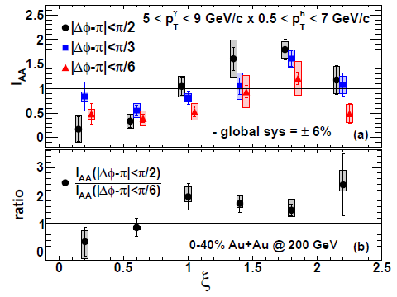
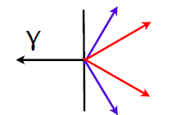
There’s more information
Modified FF isn’t the whole story (don’t stop there!)
Correlations: angular shape
PHENIX
1212.3323
PRL Accepted

Slide 27
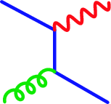
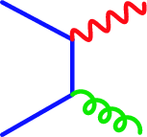
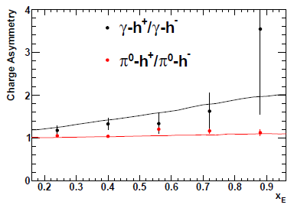
Example 2: Correlations + “Jet”(γ)
Quark Tagging
q
γ
q
γ
In γ-h Compton scattering means quark jet tag
Charge asymmetry of cross section and valence u vs d quark should be reflect in final state charged hadrons
g
q
q
g
Compton
Annihilation
PHENIX PRD 82, 072001 (2010) ,
SEEN IN p+p 2-p @ PHENIX
Allow q vs g Eloss study in AuAu
MENTIONNED IN STAR BUP!
p+p 200 GeV Awayside

Slide 28
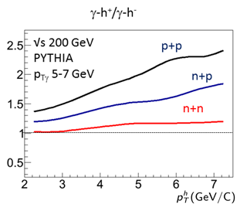
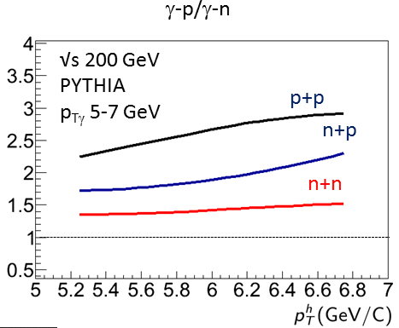
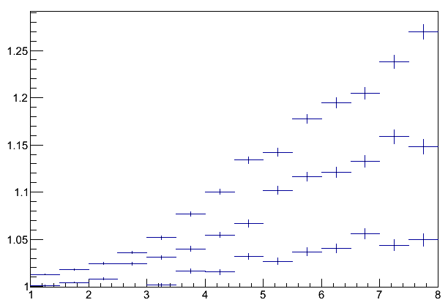
Charge Asymmetry
Applying Iso Cut allows selection of Compton-- u, d quark counting should govern expected scale of asymmetry
  : dσ ~ Z_{q}² u:d → 8:1 p+p, A+A, d+Au : 4.7-6.2
Assoc p vs n similar - independent
How do these go together (d+A → p+A)?
√s 5 TeV
PYTHIA
p_{T}γ 20 GeV
p+p
n+p
n+n
p_{T}^{h} (GeV/c)

Slide 29
Near-term PHENIX jet/ γ-jet
Run 11/14 VTX installed : 10 x stats (track acceptance) for γ-jet associated hadron acceptance
And ~2-3 x Integrated Lumi Run 7/10 Current Result
Isolation cut in Au+Au analysis well underway
  Should improve precision in peripheral collisions→ towards centrality dependence of enhancement
Cu+Au Jet Reconstruction analysis underway
STAR interest for γ-jet again for Run11
VTX

Slide 30
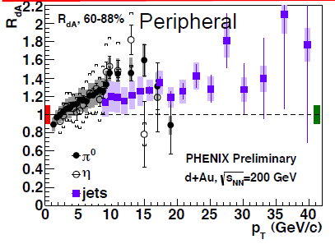

D+Au Jet Reco
Status: Helen described situation well yesterday
Enhancement at pretty high p_{T} (HF e comparison?)
Some possibility of cross talk between Jet reco and Pi0 (2-ana’s weren’t blinded, EM calibration, etc…)
PHENIX HF Electrons
D+Au 200 GeV
Phys. Rev. Lett. 109, 242301 (2012) ,

Slide 31


Recent Re-check of Auto Correlations
Recent Recheck of Bias Factors in HIJING study
C_{bias}→ (partly) increased BBC mult w/ Jet Trigger: (Underlying Event, Rapidity Shifts etc. ) → Shifts <Ncoll> for triggered centrality samples
HIJING: Small effect for RHIC consistent with previous published C_{bias} factors ! (bigger for LHC ?)
Ratio BBC multiplicity with particle p_{T} > x / Untriggered BBC multiplicity
HIJING
Good matching to real p+p
PHENIX Run3 dAu Phys. Rev. C77, 014905

Slide 32
Mid-term Outlook
The ~5 yrs after the new few

Slide 33
Beyond the next few years
Tension between sPHENIX /Jet vs BES goals?
  There is ample time for both

Slide 34

Hard Physics during BES-2 ?
There could be some interesting things to learn e.g. about the onset of initial state effects
H.Caines : Tues Talk

Slide 35


Initial vs Final State Scan
Significant critical mass of theorists interested in CNM developing? April Workshop very successful!
RHIC should continue to lead this effort!
Short term “Scan” ?: Get p+p and p+A ~one point above and below ~ 30 GeV ?
Longer term sPHENIX can contribute with full Jet studies → a key observable?
Cronin Dominated
Suppression Dominated
think color tranparency effects
R_{AA} or R_{CP} at p_{T} =
3-4 GeV/c
STAR R_{CP}
PHENIX R_{AA} (Cu)
ALICE
Phase transition

Slide 36


sPHENIX
Upgrade optimized around jet/di-jet/photon measurements
Compact, High rate, large uniform acceptance over |η| < 1
Submitted by BNL to DOE for MIE CD-0 review last Feb
  Review will start soon…
Fe-Scint Hcal Unique Design
Prototyping underway
(Previous Design Beam Tested Dec 12 )
W-Sc EMCal – Accordion Design

Slide 37
sPHENIX Motivation
The goal of sPHENIX is determine the basic nature of the perfect fluid, the strongly coupled QGP, via jet “x-rays”
  its unique coupling and effective constituents (or lack thereof)
  its formation vs. temperature/time
Jets and their E_{loss} are the most obvious and natural external probe for doing this

Slide 38

sPHENIX Motivation
Another restatement of the above (mine):
The novel sQGP coupling that results in such fast anisotropization/thermalization needs externally probed
  (by something other than viscosity)
Jets/hard scattering must be sensitive to the nature of this coupling!

Slide 39


Can even d+Au/p+Pb produce a perfect fluid?
ALICE plot
These developments in the past year underscore the need for measurements to address
why and how perfect fluidity arises

Slide 40



At what scale does bulk coupling relate to probe coupling?
-Although qhat (ehat) might not be the only way to quantify E_{loss} and realize goals of sPHENIX, it is one example of a framework for doing so
-How best to demonstrate its robustness (going into strong coupling?) and impedance match for theory community?

Slide 41


Slide 42


BaBar solenoid
A major positive update to the MIE considerations :
BaBar Magnet from SLAC recently made available!
Major parameters:
  1.5 T solenoid
  Inner radius: 140 cm (x 2 compared to MIE)
  Outer radius: 173 cm
  Length: 385 cm

Slide 43

Notes:
MIE sPHENIX

Slide 44

Notes:
sPHENIX with BaBar magnet

Slide 45
Impacts
The sPHENIX cost estimate in the MIE proposal was
  $29.1M of new equipment (including $7.9M for the magnet)
  $6.3M of redirected labor
We are still evaluating the costs with the BaBar solenoid; the detector is larger, costs increase
  Increase in radius of HCal 112 cm to 173 cm
the possibility of improved performance (EMCAL resolution, for example)
removing a very risky $7.9M cost is a huge win
Should only positively impact schedule

Slide 46


sPHENIX MIE Proposal
CD-0 DOE MIE Proposal: 60/120 pages:
Generic RHIC Jet Physics Discussion!
  (A good read! link to mie pdf)
The crucial physics offered by an LHC-like detector at RHIC using LHC-like Jet Reconstruction Methods
Unfolding
Bkg Subtraction

Slide 47

Possible “in Principle”?
(No published results so far…)
Too many Fake Jets? NOPE!
-vs LHC:
Lower underlying event wins over steeper production spectra for E > 18 GeV

Slide 48

Fake vs Real Jets
No FAKE Rejection applied yet either!
(Studies Underway:
e.g. track jet/cal jet matching cuts)

Slide 49

Fake vs Real Jets

Slide 50

sPHENIX @ √s 100 GeV?
fake-jet dominance subsides at ~same E
Lower UE wins again!
Stats > 20 GeV ~1/50 compared to 200
Still 10⁵-10⁶ Jets > 20
Even Lower E limited by stats not fake jets?
How would this addt’l factor of 2 in √s leverage for theory ?
J

Slide 51



Larger Cone Sizes?
Yes: baseline for 0.4: E_{min from bkg} = 35 –> fake rejection should lower this
LHC: Interesting at these cones, sPHENIX energies
CMS QM12
r

Slide 52


Event By Event Opportunities
Dijet A_{J} : 0-10 % HIJING Embedding—Unfolding procedure works well
Good separation in raw distributions
Raw Distribution
Unfolded vs Truth

Slide 53

RHIC: Key Discrimination
Between models

Slide 54



γ-Jet in SPHENIX
Access high stats…
Clear Modification signal, comparable to current LHC Results
Separation in raw distributions at large x_{γj}

Slide 55


sPHENIX: u & d-jet “tagger”

Slide 56

Ψ_{n} Dependence of E_{loss}
One of the key questions addressed by the sPHENIX proposal is the length scale of the jet medium interaction
  Presumably can tells us about the nature (size) of the medium constituents
Correlations w/ volume geometry (e.g. pathlength) have already been important
Higher order moments could play an even more important role (event by event)
φ^{Jet} , φ^{Trig.}
φ^{Jet} , φ^{Trig.}
8
7
8
6
7
5
6
5
4
4
3
3
2
2
1
1
Ψ₂
Ψ₃

Slide 57
sPHENIX v_{n} ?
Jet vn: statistics in the right region? Looking into
Supposition that bulk v_{n} will be pretty much done by sPHENIX
However, some fronts (high n >= 5 and high p_{T} n > 2! @ RHIC) are converging slowly.
Can sPHENIX make any contributions?

Slide 58


sPHENIX Heavy Flavor
Electron ID with additional tracking/pre-shower (modest addition to base MIE, hopeful for Day 1)
b-tagging from displaced vertices may be possible with base sPHENIX?– currently being investigated

Slide 59
Other Plans/Upgrades
Many other upgrades : hopefully these were discussed a bit by Stefan Bathe in his talk on dAu
These are focused on understanding initial state/cold nuclear effects obviously very important to understanding E_{loss} at RHIC
PHENIX:
PHENIX MPC-EX 2015 Forward Tracking/PreShower for MPC
  Direct g/p separation for eta 3.1-3.8: contraining spin pdf’s, npdf’s
fsPHENIX : Forward sPHENIX (Strong Interest Coming on Shell) ideally as close timewise to sPHENIX as possible
ePHENIX : farther future suite of upgrades for eRHIC
STAR:
-Forward Gem Tracker
-VFGT
- TOF
-eSTAR

Slide 60
Conclusions
Jet Quenching Studies at RHIC are and should exploit RHIC’s Flexibility
Coming Soon: RHIC c/b Heavy Flavor! (Upgrades)
Jet Reco , Spectra, Jet/ γ/ h Correlations
  Both STAR and PHENIX have nice comprehensive spectral data that can be a nice starting point for finally understanding Cronin Effect
    With sufficient theoretical interest!
  RHIC spans the key energy range to do this uniquely!
  Di-hadrons at intermediate p_{T} are focused on understanding medium/jet medium systematics, not so much quenching itself
  Could this be largely resolved within a few years?
  Direct γ-hadron and Jet-h and ARE important to quenching considerations NOW and shouldn’t be disregarded because of bias in field towards pure jet reconstruction
sPHENIX!
  A powerful new detector to understand robust physics of jet quenching across 2 orders of magnitude in √s at RHIC and the LHC

Slide 61

η~1
R (cm)
R (cm)
η~-1
HCal
HCal
AreoGel
EMCal
-1.2
DIRC
EMCal & Preshower
RICH
μ-TPC
η~4
EMCal
p/A
e⁻
GEMs
GEMs
Station1
GEM
Station2
GEM
Station3
GEM
Station4
z (cm)

Slide 62


Slide 63


Angular distributions
PHENIX
1212.3323
PRL Accepted
γ-h
0.
Jet –h
STAR 1302.6184
So much broadening too “weird”?
-There’s a lot of interesting stuff at R > 0.8!

