Slide 1
Swedish Teachers Programme Status
19 June 2013 – L.Jirdén

Slide 2
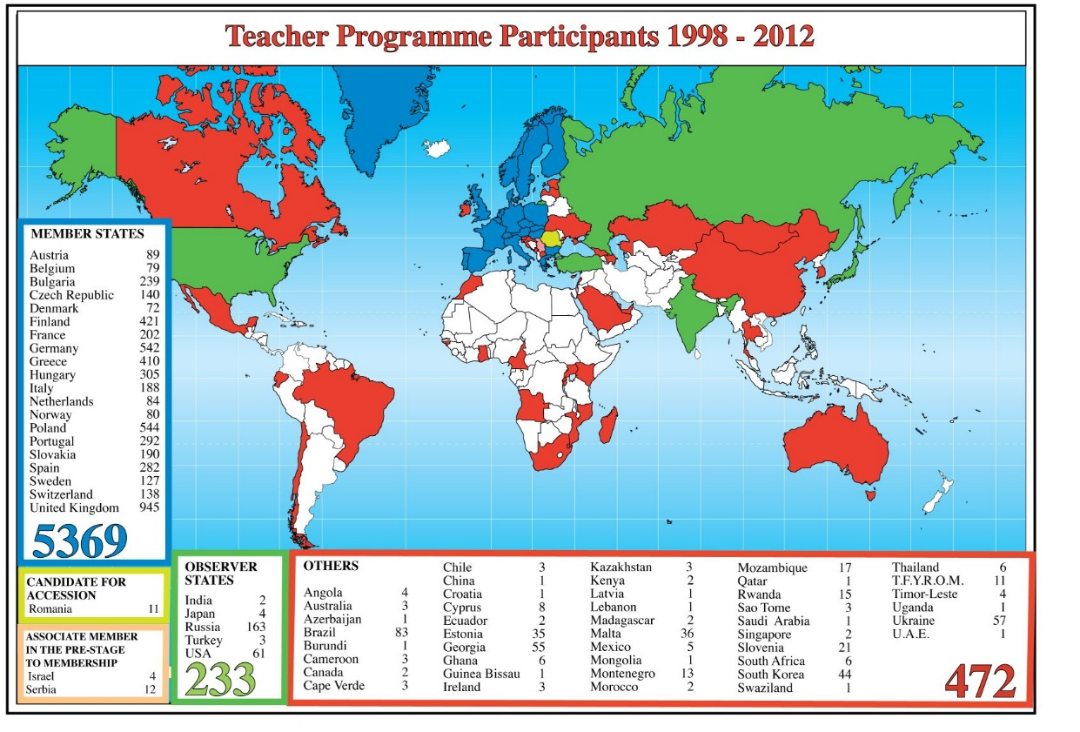
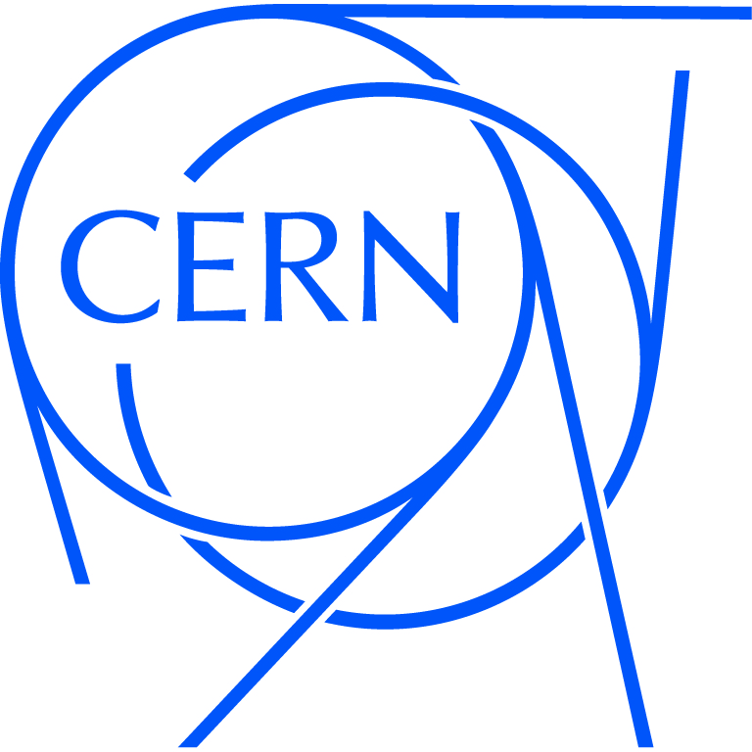
Pratique de la CO
Denmark 72
Norway 80
Sweden 127
Finland 421
Germany 542
UK 945

Slide 3
Swedish courses
IEDC courses
  1992 June R.Jacobsson
  2013 June R.Jacobsson
  20 courses ~ 350 participants
    Teachers “gymnasiet ? %
    Teachers “högstadiet” ? %
    Students ? %
PH EDU group courses
  2006 Oct H-Å. Gustavsson
  2008 Oct H-Å. Gustavsson
  2011 Oct L.Jirden
  2012 June L.Jirden
  2012 Oct L.Jirden
  2013 Oct L.Jirden (planned)
  5 courses 127 participants
    Teachers “gymnasiet 70%
    Teachers “högstadiet” 20%
    Students 10%
TOTAL: 25 courses ~ 480 participants

Slide 4
Organisation
Course registration
    Teachers contacts CERN EDU group or
    contacts L.Jirden directly
Duration
    5 days Sunday → Friday evening
Housing
    CERN Hotel if booked early enough
Costs
    Travel, Housing, Meals paid by teachers/schools
    Courses free of charge

Slide 5
Programme
Lectures Visits Exercises
        Introduction to CERN
        Introduction to Accelerators
        Introduction to Particle Physics
        Why do we do PP research?
        Cosmology
        Antimatter
        Higgs + new Physics
        Medical applications, spin offs
        Data Challenge
        Introduction to Master Classes
    Accelerator
      Magnet test facility
      Proton source, linac…
      LHC control centre
    Experiments
      ATLAS, CMS, ALICE
      AD experiments
    Other
      AMS control centre
      IT computer centre
      Globe
        Build Cloud Chamber
        Cosmic Ray detection
        Exploring particles

Slide 6

Programme
      Reviews
        Review of the day
        Q & A sessions
        Course evaluation
Lecturers & guides
    Richard Jacobsson
    Hans Danielsson
    Tord Ekelöf
    Thomas Pettersson
    David Milstead
    Peter Sollander
    Roderic Bruce
    Roger Ruber
    Christian Hansen
    Olov Barring
    Kerstin Jon-And
    Elena Wildner
    Tommy Ericsson
    Olof Ahlen
    Michael Doser
    Dave Watts
    Maria Pradillo
    Giacinto De Cataldo
    Despina Hatzifotiado
    Mick Storr
    Antonino Sergi
    Markus Joos
    Hartmut Hillemanns
    ALICE DCS members
    CERN guides
    …
      Social events
        Discover Geneva Treasure Hunt
        Programme dinner
        Aperitif with Swedish scientists
        Improvised evening activities

