Slide 1
Physics in Disguise

Slide 2
Compare to
Experiment
Compute the Consequences
Guess
Observation
Nature
Observation

Slide 3
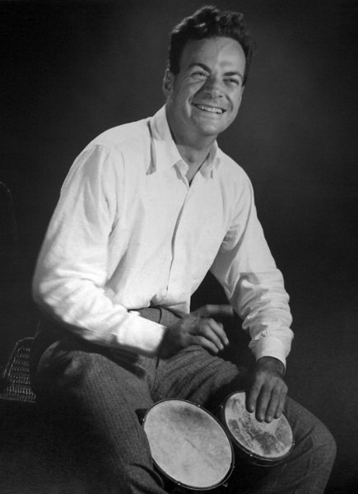
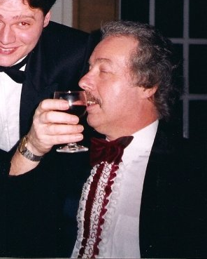

Slide 4
WRONG!

Slide 6
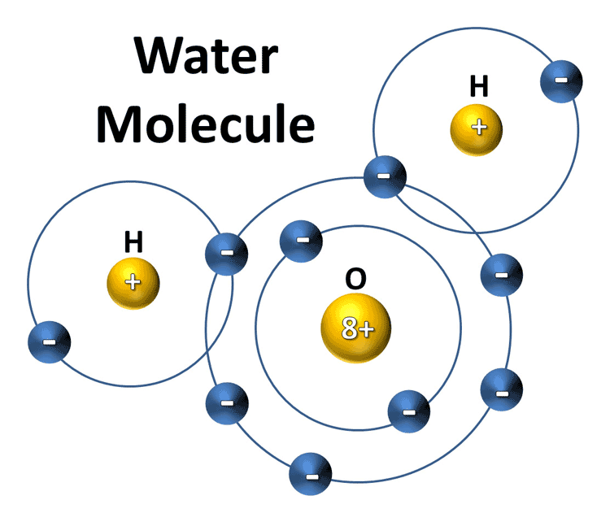
Water
Polar molecule
non-symmetric charge distribution

Slide 7
Guess!

Slide 8
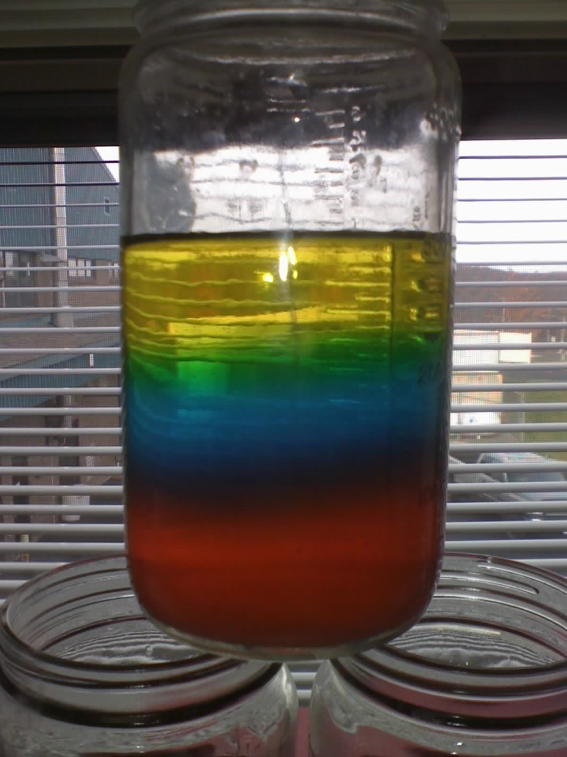

Slide 9
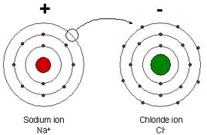
Sodium Chloride
Ionic lattice
Sodium donates electron
Chlorine receives electron

Slide 10
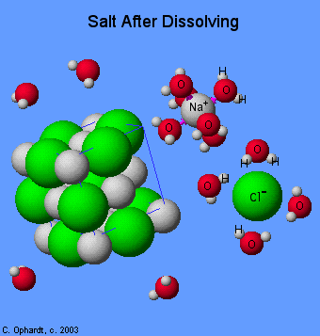
Salty Water

Slide 12
Magnetic Viewing Film

Slide 13
1 Magnet vs.
2 Magnets vs.
3 Magnets

Slide 14
Guess!

Slide 15
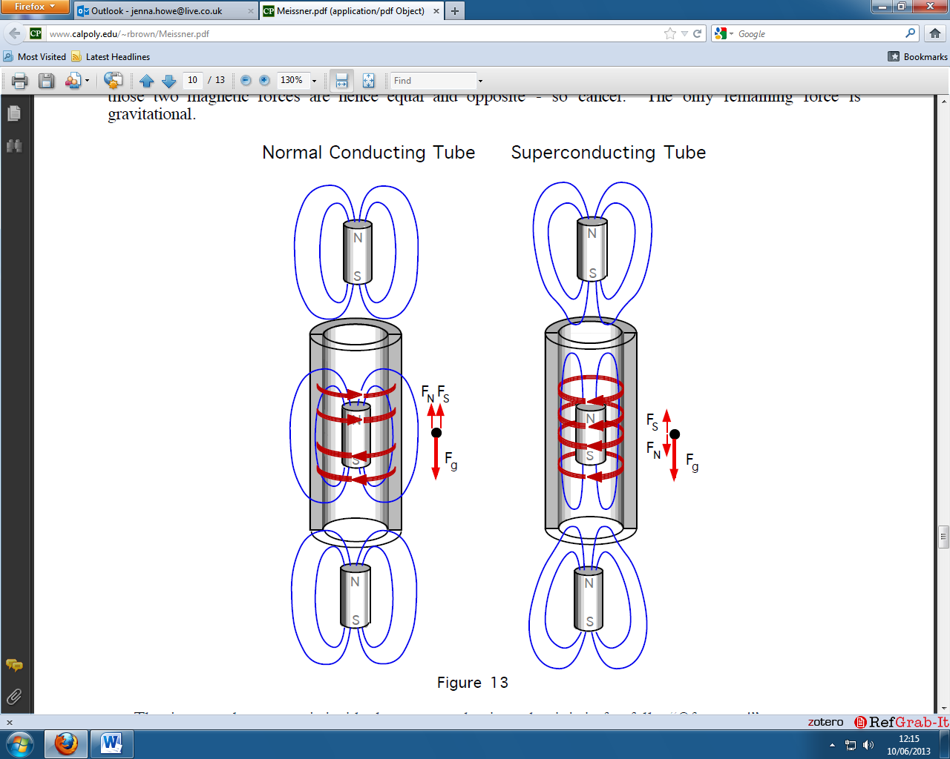

Slide 16
V_{t} ∝ R

Slide 17
Broken Magnet vs.
Normal Magnet

Slide 18
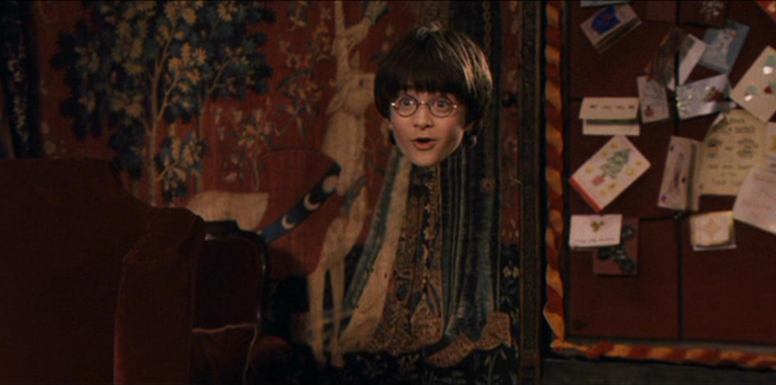

Slide 19
Guess!

Slide 20
Matching indices
Smaller difference in refractive indices
Results in: Smaller refraction

Slide 21
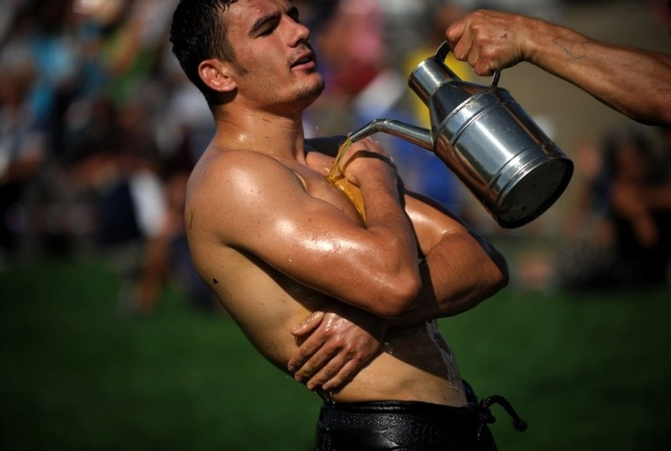

Slide 22
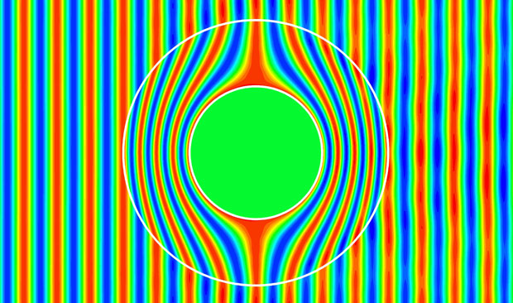
Metamaterial Cloaking

Slide 23
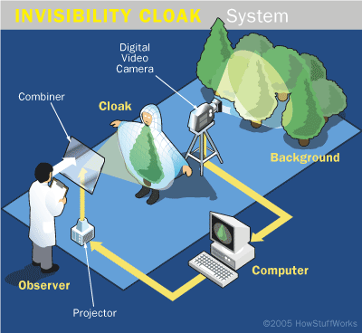
Adaptive Camouflage

Slide 24
Special Thanks to Ian and Michele!

