Slide 2
Present baseline of HL-LHC integration
C. Adorisio, R. Bruce, M. Brugger, R. Calaga, O. Capatina, F. Cerutti, S. Chemly, C. Collazos Gonzales, J.P. Corso, R. De Maria, D. Duarte Ramos, L. S. Esposito, P. Fessia, H. Mainaud Durand, Y. Muttoni,
H. Prin, S. Redaelli T. Renaglia, E. Todesco
S. Roesler, S. Weisz
Presented by
P. Fessia

Slide 3
Outline:
Magnet system, LHC vs. HL-LHC
Crab cavity
Alignment
SC links
Collimation
Conclusions and next steps
Remark:
the integration effort has just started and it is putting in evidence challenges.
Due to time and rapid evolution of reference baseline we do not have yet solutions for all of them

Slide 4
Interaction region magnet system
IP1 and IP5

Slide 5

IR where ?
Point 7
Point 1
Point 5

Slide 6
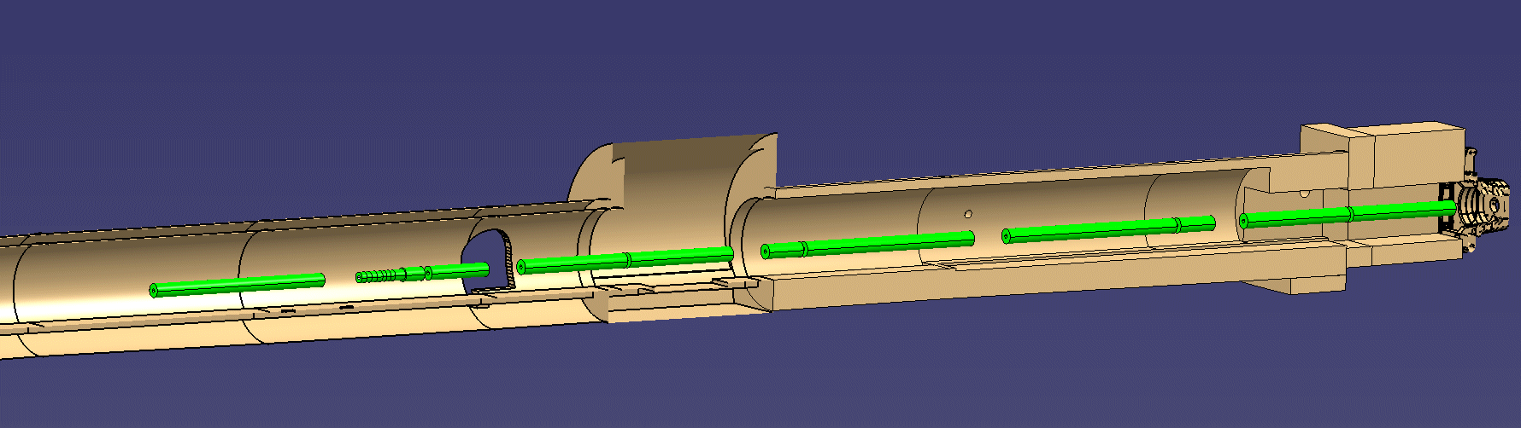
From concept to virtual reality
Q1
MCBX
Q2a
Q2b
MCBX
Q3
MCBX
CP
D1
SM
4.0
4.0
1.2
6.8
6.8
1.2
4.0
4.0
2.2
6.7
20
30
40
50
60
70
80
E. Todesco
distance to IP (m)

Slide 7
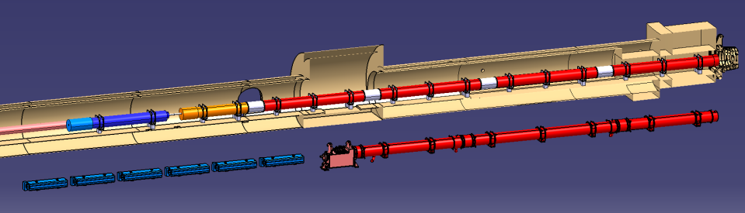
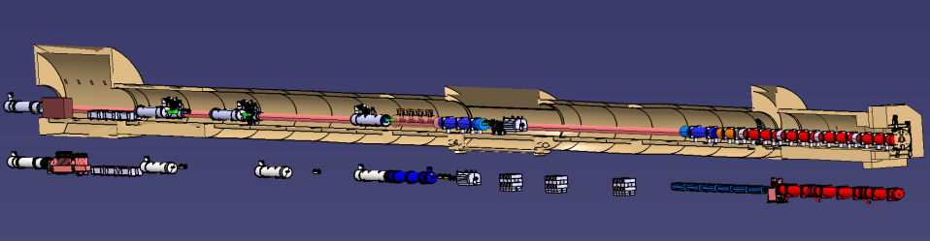
The LHC vs. HL-LHC

Slide 8
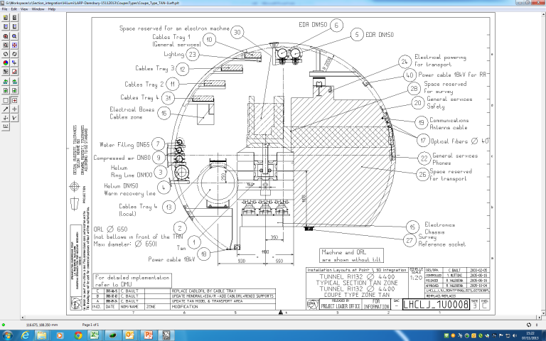
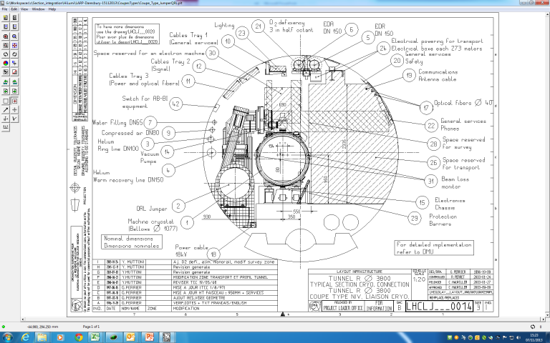
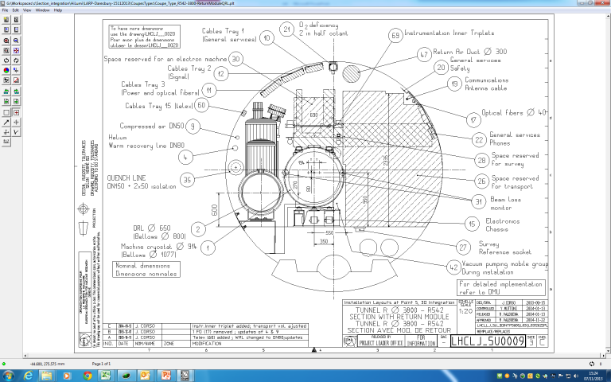
3D models are, at this stage, a simplification of reality…

Slide 9
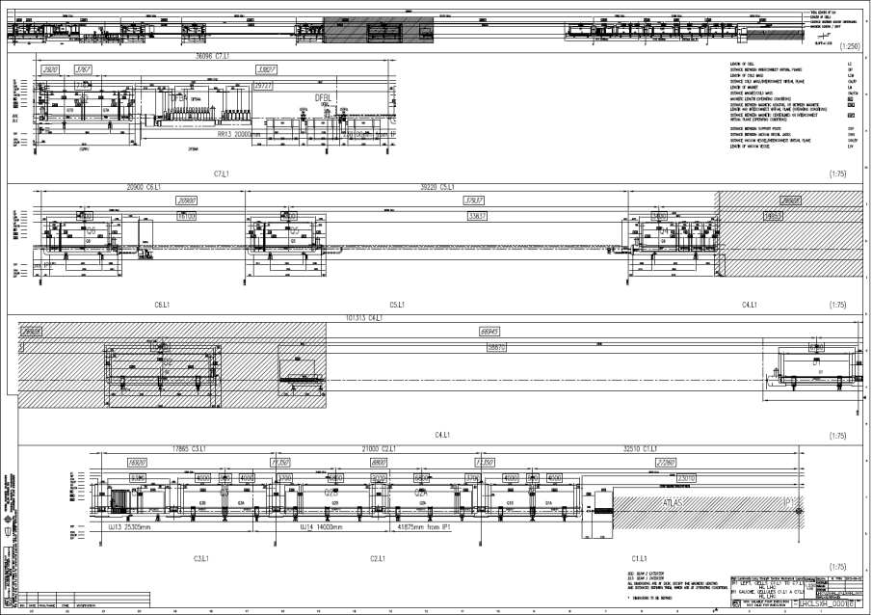
The contractual document

Slide 10
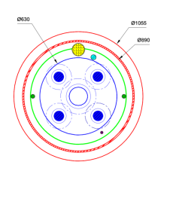
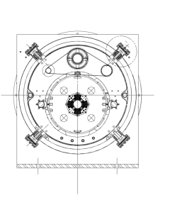
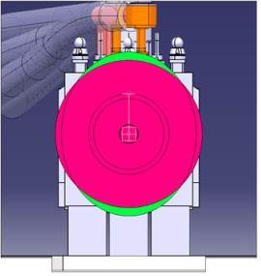
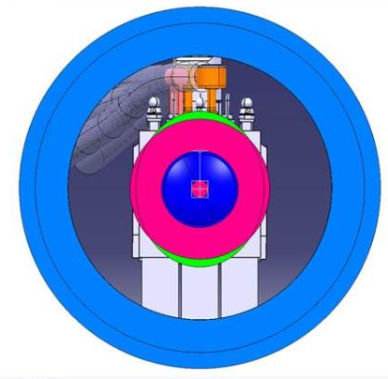
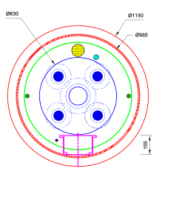
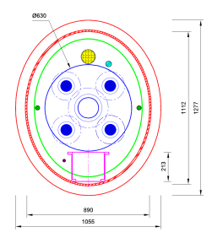
Cryostat system
Heat exchanger
Quench line
Pumping line
OD 1055
Thermal shield cooling
“Spider” support
Cold mass
Standard cryostat diameter no solution to accommodate all manifolds
D. Duarte Ramos
Larger diameter cryostat, but compatible with transport space, feasible but issues (heat loads)
Elliptical cryostat. Very good accommodation but technological challenges

Slide 11
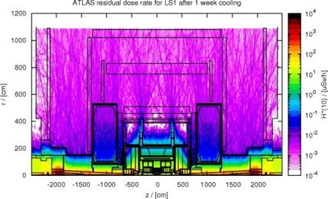
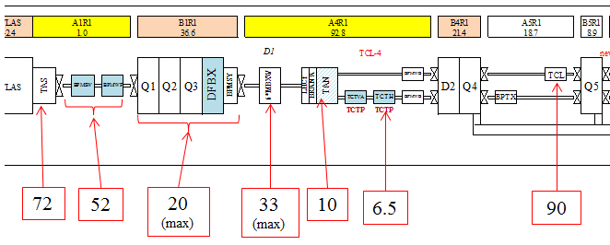
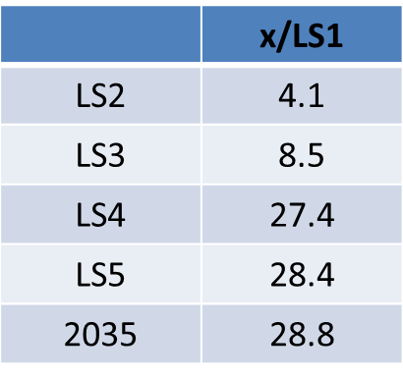
Residual radiation dose
FLUKA calculations for LS1 (1 week cooling)
Courtesy: C.Urscheler et al.
Ambient dose equivalent rates in µSv/h at 40cm
measured on Dec 17, 2012
(last “good” fill on Dec 5, i.e. cooling time >1week)
4 months cooling
S. Roesler
LS3
t_{cool} | Scaling factor
1 week | 1.6
1 month | 1.0
4 months | 0.47
6 months | 0.35
1 year | 0.2
205
148
57
95
29
19
257
LS4
660
480
180
300
90
60
830
2035
700
500
190
320
100
65
870
“LSS1 and LSS5 will become Limited Stay Areas until LS3 with residual dose rates (few months cooling) in the aisle of about 100 µSv/h, reaching several mSv/h close to most radioactive objects.” S. Roesler remote handling workshop

Slide 12
Crab cavity
4+4 baseline service Space requirement under revision by crab cavity team
IP1 and IP5

Slide 13
Ancillary equipment needs
On the beam
8× 270 mm diam. coax
8× 270 mm diam. coax
In the tunnel
Circulator
Load
Tetrode
Amplifier
100 m²
100 m²
Circulator
Load
Tetrode
Amplifier
Rad hard, no EM shielding
Rad hard, no EM shielding
CP1
Shielded area
8× 50 mm diam. coax
8× 50 mm diam. coax
LLRF racks
Main power drivers
12 m²
48 m²
12 m²
48 m²
LLRF racks
Main power drivers
CP2
Probably not rad hard, EM shielding, temperature control
Probably not rad hard, EM shielding, temperature control
Centre betw.
cavities
LLRF central racks
Slow control
9 m²
8 m²
Probably not rad hard, EM shielding, temperature control

Slide 14
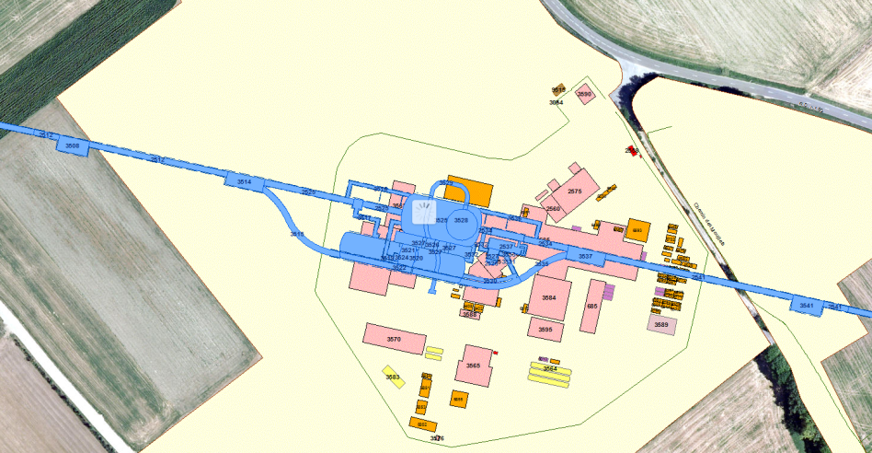
The 1st obvious option for CP1: RR
RR53
UJ53
UJ57
RR57

Slide 15
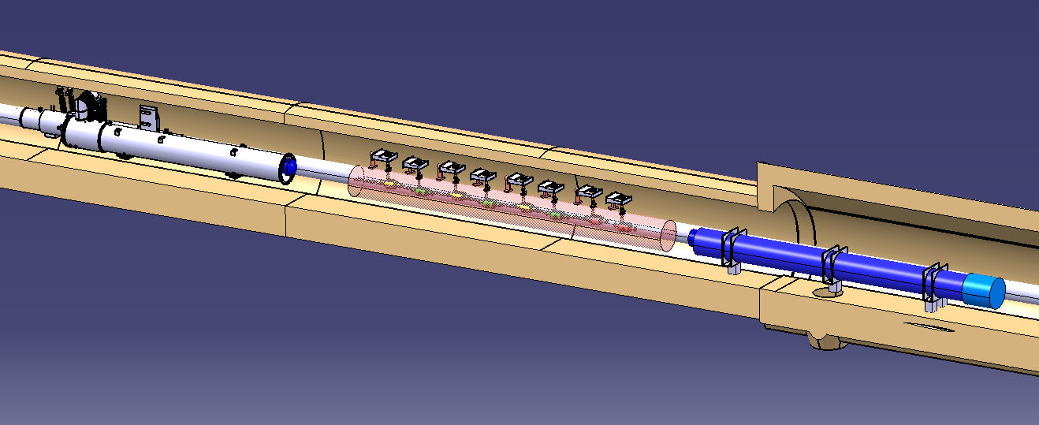
From crab to RR
8× 270 mm diam. coax
min 1100 mm × 550 mm

Slide 16
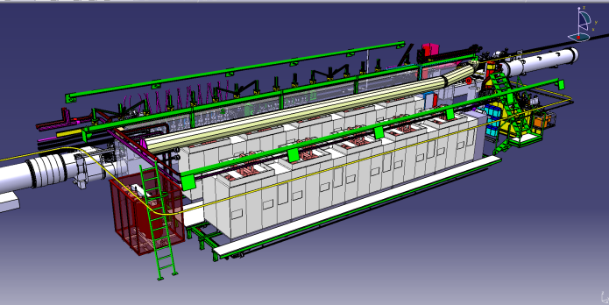
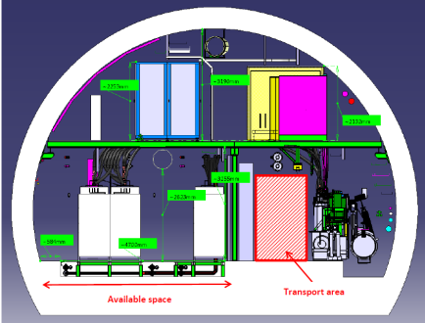
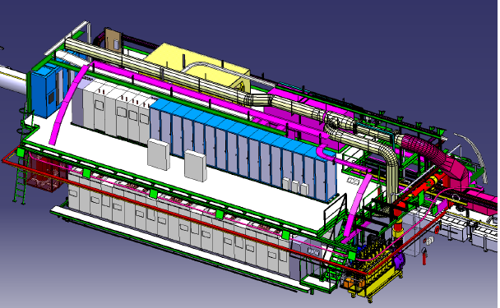
RR present occupancy
RR ground floor
RR upper floor

Slide 17
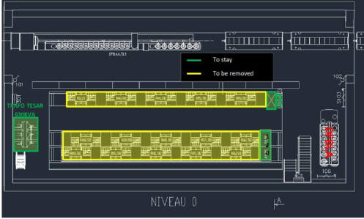
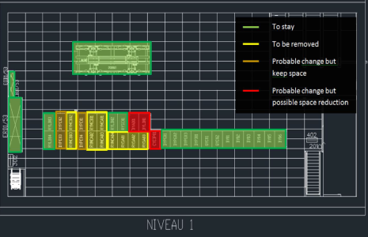
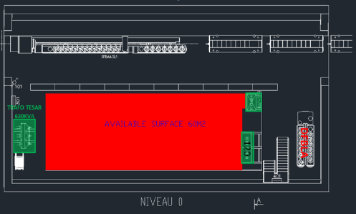
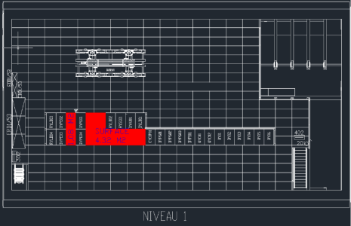
RR future occupancy with full SC link option

Slide 18
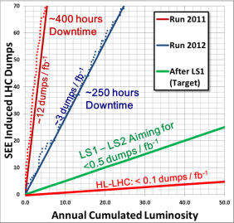
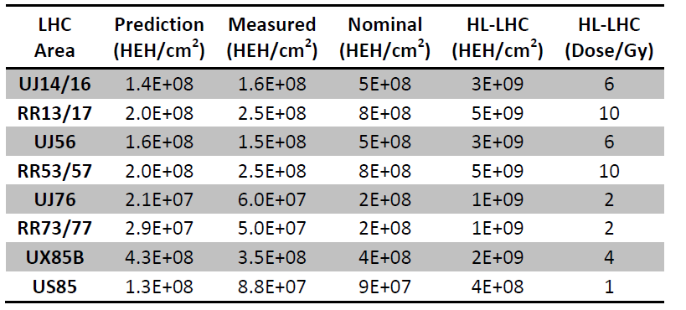
RR radiation wise in HL-LHC perspective
 | N_{b coll} [10¹¹] | L_{peak} [10³⁴ cm⁻²s⁻¹] | L_{lev} [10³⁴ cm⁻²s⁻¹] | Lev. time [h] | Opt. Fill length [h] | η_{6h} [%] | η_{opt} [%]
HL-Flat | 2.2 | 18.6 | 5.06 | 7.0 | 8.4 | 57.8 | 53.5
HL-Round | 2.2 | 20.1 | 5.06 | 7.3 | 8.6 | 57.8 | 53.1
  Figure of merit (performance efficiency η): fraction of physics time to reach goal with a sequence of successful fills with 3h turnaround time using both optimal fill length and 6h fill length (2012 run would figures with 53.5%).
M. Brugger
During last year of operation
we had a number of radiation induced failures
at 10⁸ -10⁹ cm⁻² y⁻¹
According to R2E experience and analysis
10⁷ cm⁻² y⁻¹ acceptable

Slide 19
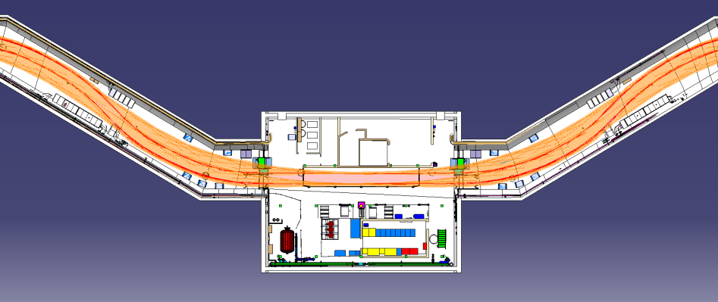
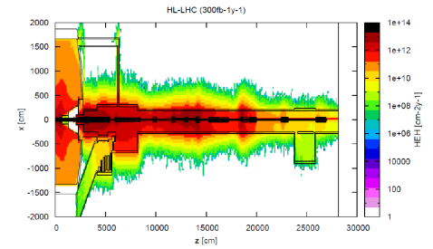
CP2 IP 1
UL14
US15
UL16
Available place LS3
Available place LS3
[M. Brugger]
HL-LHC 10⁹ HEH
Equipment requires faraday cage and +/- 1º C control.
Necessary to find very compact solution. Challenging but to be studied
HL-LHC 2×10⁸

Slide 20
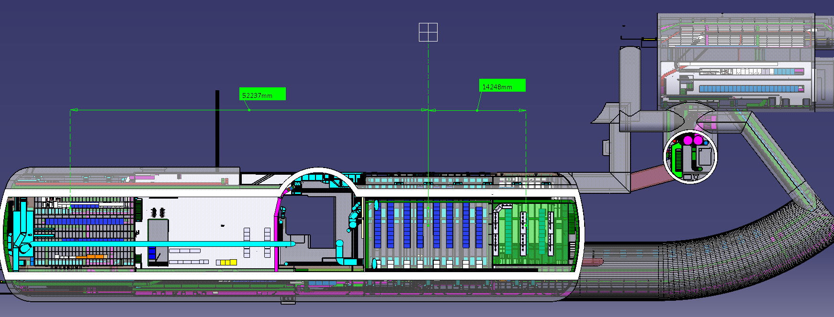
CP2 IP 5
RR53
IP 5
UJ53
UJ57
USC55
RR57
Available place
Available place
Option to be discussed with CMS if ,after more in-depth,analysis, it would still be interesting

Slide 21
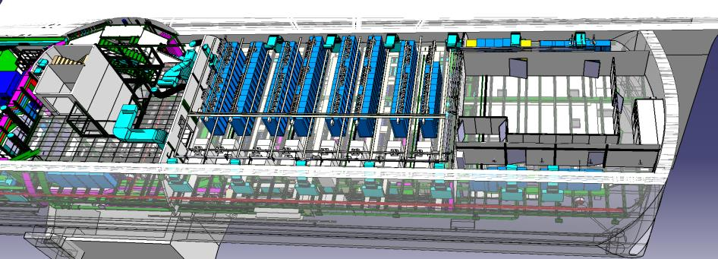
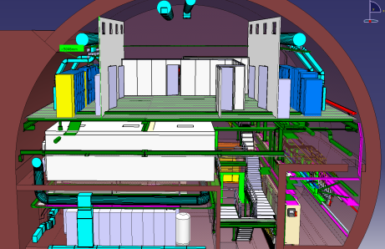
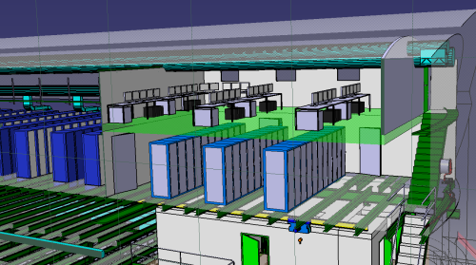
PC2 IP 5
Control Room (68m²)
RR53
RR57
False floor
option
Option to be discussed with CMS if ,after more in-depth,analysis, it would still be interesting

Slide 22
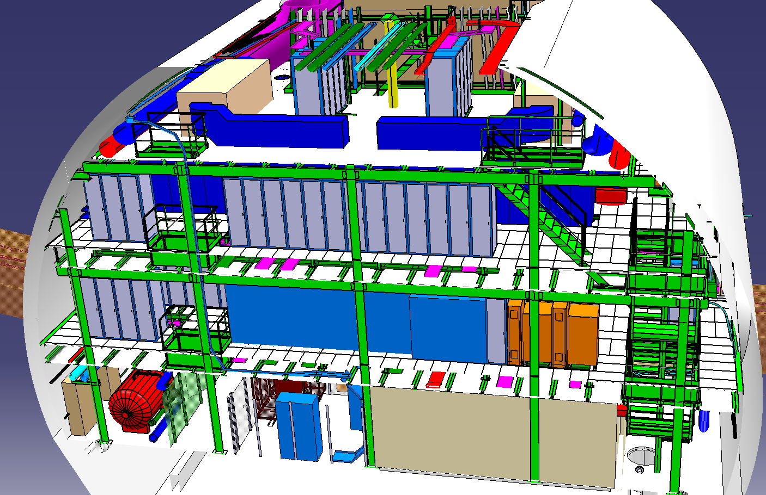
US15 – 3 reserve racks on 3rd level…by now
Option to be discussed with CMS if ,after more in-depth,analysis, it would still be interesting

Slide 23
Alignment
1st approach to identify major problems, requiring restudy taking into account accessibility
IP1 and IP5

Slide 24
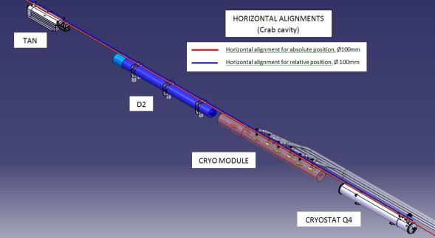
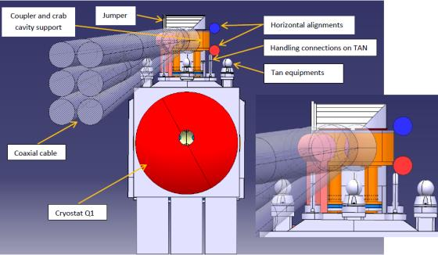
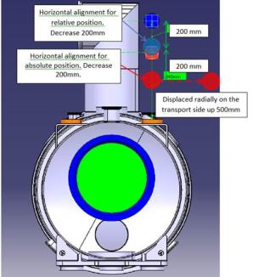
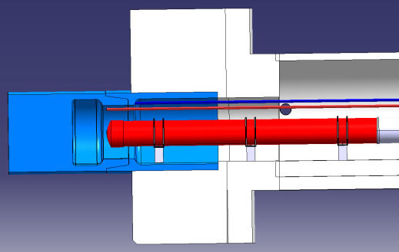
Horizontal alignment
Horizontal alignment
Two systems
Reference for absolute position from Q1 till Q5
Reference for relative position from Q1 till Q4

Slide 25
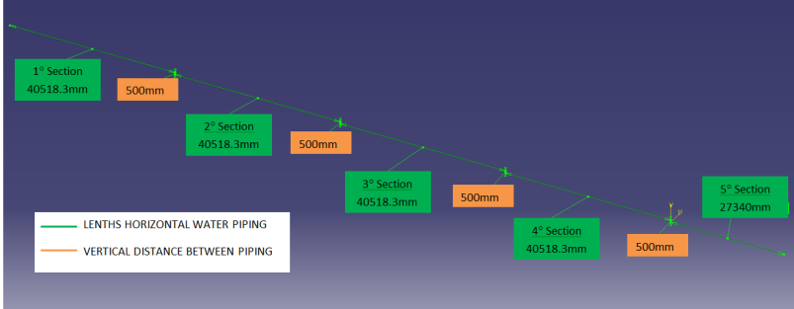
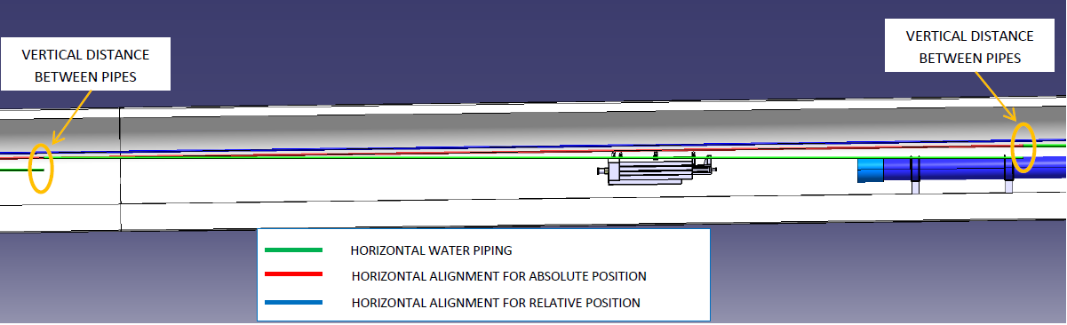
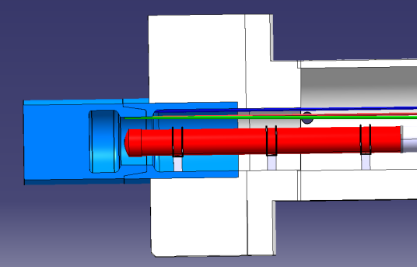
Vertical alignment from Q1 to Q5
Maximum segment lengths
Vertical distance at compensation points

Slide 26
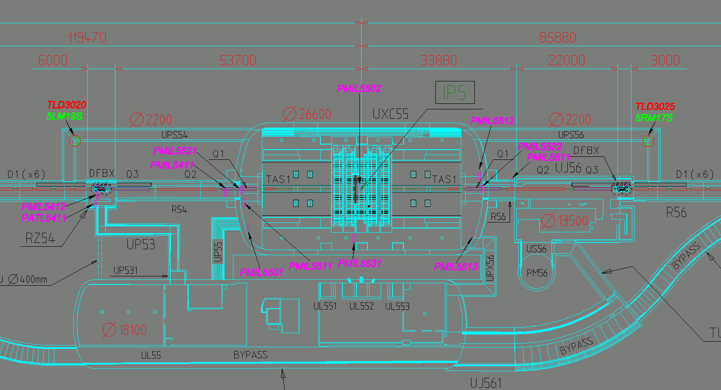
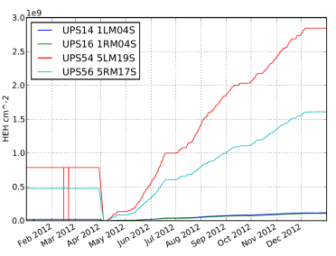
Alignment Service Cavern UPS
Measured value in 2102 run
3 10¹⁰ HEH
Electronics tested life duration 500 Gy.
Very probable isse with TID, better location in UPS to be identified
1.8 10¹⁰ HEH
 | Scaling factor approx. with luminosity
HL-LHC | 12
1 10⁹ HEH

Slide 27
Horizontal Sc links see presentation J. P. Corso-S. Weisz WP 6 Wednesday afternoon
IP 7

Slide 28
IR where
Point 7
Point 1
Point 5

Slide 29
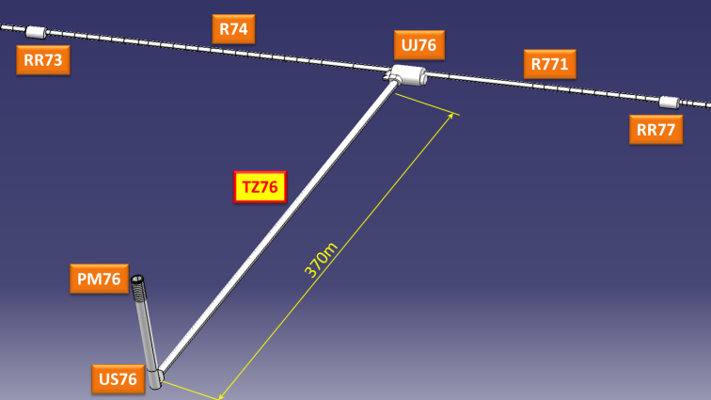
Overview of the Point 7
DFBA actual position
DFBA actual position
IP7
SC links
DFB HL-LHC positions

Slide 30
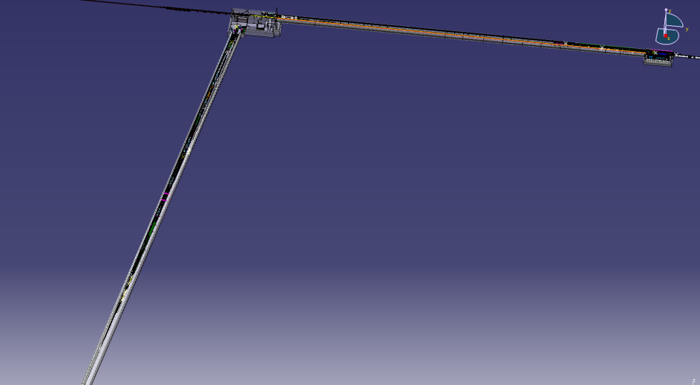
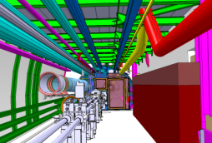
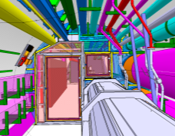
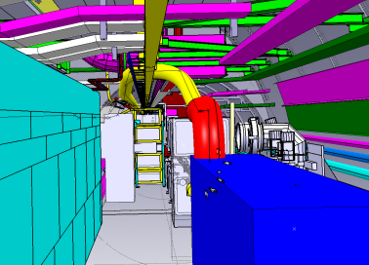
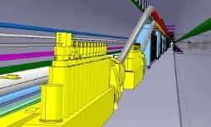
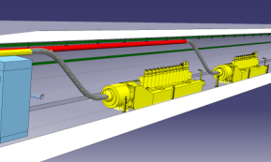
Overview of the Point 7
R771
RR77
UJ76
TZ76

Slide 31


Routing Options – UJ76
Option 1
2 ducts 3m
Quite complex path
SC Links
2 ducts 3m
UJ76
Option 2
2 ducts 20m;
2 ducts 3m,
less bends in the cryostat

Slide 32
Collimation
1st view of the collimation system reinforced by the new masks, no optimization performed yet

Slide 33





1st view of the collimation system reinforced with masks (under analysis)

Slide 34
Next steps and Conclusions

Slide 35
HL-LHC Layout and integration I
An HL-LHC dedicated integration team is taking shape and available resources will increase from March 2014
1st integration studies have been carried out for the magnet system, crab cavities, alignment and SC link
Next steps I
  Magnet system
    Upgrade the 3D model to the baseline cryostat diameter / shape
    Following steps depends on the cryogenic routing, bus bar routing
    We need to have 1st estimation of the cryogenic underground installation
  Crab cavity:
    Complete with the crab cavity team the revision of the space requirements, presently due the space constraints, and the R2E issue the installation of the RR electronics in the RR look to be challenge
  Alignment
    Needs identified, but problems in term of access. Need to look at options in order to improve accessibility-maintenability and limit radiation dose to personnel

Slide 36
HL-LHC Layout and integration II
  Next Steps II
  SC link:
    Progress with the detail design in correlation with the cryostat installation procedures
  Collimation
    Analyse in details requirement vs. practical feasibility and space available taking into account space for insulation vacuum and beam vacuum sectorization
  Point 4: complete the revision of the available space for e-lenses, 800 MHz, 200 MHz, …
Mandatory to start working with approved system/equipment functional specification
Release 1st series of 2D lay out drawings to have a reference baseline setting up all the requirement links with the database
We need to start working extremely urgently on the cryogenics system at point 1,4 and 5 that could have major impact on the underground space
“Given the importance of radiation levels in several locations, a follow-up during 2015/2016 operation should be envisaged for the radiation monitoring (putting more monitors in critical areas, performing a respective analysis, scaling evaluation, etc.)” (M. Brugger)

Slide 37
Back up slides

Slide 38


D2 to Q4. Point 5L

Slide 39


Q1 to Q4 (General view). Point5L

Slide 40


Q1 to Q4 (Magnetics Length). Point 5L

Slide 41


Q1 to D1 (Magnetics Length) Point5L

Slide 42


Q1 to D1 (Cold Mass. Point5L)

Slide 43


Q1 to D1 (General View). Point5L

Slide 44


Q1 to Q2 (General view). Point 5L

Slide 45


Q1 to Q2 (General view). Point 1L

Slide 46
Crab Cavities Integration
Point 1 & 5 – LS3
UL14-US15-UL16
USC55

Slide 47

Global View Point 1
UL14
US15
UL16
Available place LS3
Available place LS3

Slide 48

Zoom on UL16
Radiation exception area limit
UL16
Radiation exception area
US15
Available place LS3

Slide 49


Asymmetry Issue
IP 1
~ 30m !

Slide 50
US15 – 3 reserve racks on 3rd level…by now

Slide 51

UL14 – 2014/03 – Relocalisation Racks & Convertisseurs
Zone transport
Châssis débitmètres
DFBX
RYSC01
Convertisseurs
RYMCB 01-04
CYCIP01 + DYPG02
DYPG01
Convertisseurs
RYLB01
RYLC01
RYMCC01
Convertisseurs
RTQX2.L1
Convertisseurs
RTQX.L1
RYCA01
RYCA02
QYC02
QYC01
TYCFL01

Slide 52

UL16 – 2014/03 – Relocalisation Racks & Convertisseurs
Zone transport
RYSC01
Convertisseurs
RYMCB 01-04
CYCIP01 + DYPG02
DYPG01
Convertisseurs
RYLB01
RYLC01
Convertisseurs
RQX.R1
RTQX2.R1
RYMCC01
RYCA01
RYCA02
QYC01
QYC02
TYCFL01

Slide 53
Global View Point 5 around IP
IP 5
USC55
Available place
Available place

Slide 54

USC55 – 3524-U2-001 - control room
Lift and PM54
Control Room (68m²)
RR53
RR57
USC55

Slide 55

USC55 – 3524-U2-001 - control room
Lift and PM54
Control Room (68m²)
RR53
RR57

Slide 56

USC55 – 3524-U2-001 - control room
Available height
Control Room (68m²)
Existing duct between USC55 and by-pass
By-pass

Slide 57

Very last option – “mezzanine”
Control Room (100m²)
HL Crab Cav racks

