Slide 1


Crab Cavity Summary:
Can we make a choice in 2014?
Erk Jensen
CERN, BE-RF
& Man United, Vice Captain
3rd Joint HiLumi LHC-LARP Annual Meeting, 14-Nov-2013, Daresbury Lab.

Slide 2
Good progress on all fronts, but identified some critical items
I will not go through the presentations, but I’d like to thank all for their work and for their presentations – this was a very fruitful workshop!
1 technical detail that I have learned:

Slide 3
Phase modulation & crabbing
Ideal crabbing
Bunch phase error (late arrival)
CC1
IP
CC2
Good news: No loss of luminosity,
but some offset of luminous region!
But: Crab Cavities must be phase synchronized!

Slide 4
… and now the discussion part
We clearly identified as highest priority:
Get ready for SPS test on time!
  To get there, we will have to advance the engineering on the SPS CM!
  plan:
    Dec 9-11, 2013: LHC-CC13 – things to progress for that
    Feb 6th, 2014: CM Status update meeting
    March 2014: Freeze design
    April 2014: Advisory committee for endorsement, release
    Then: start procurement, cut metal

Slide 5
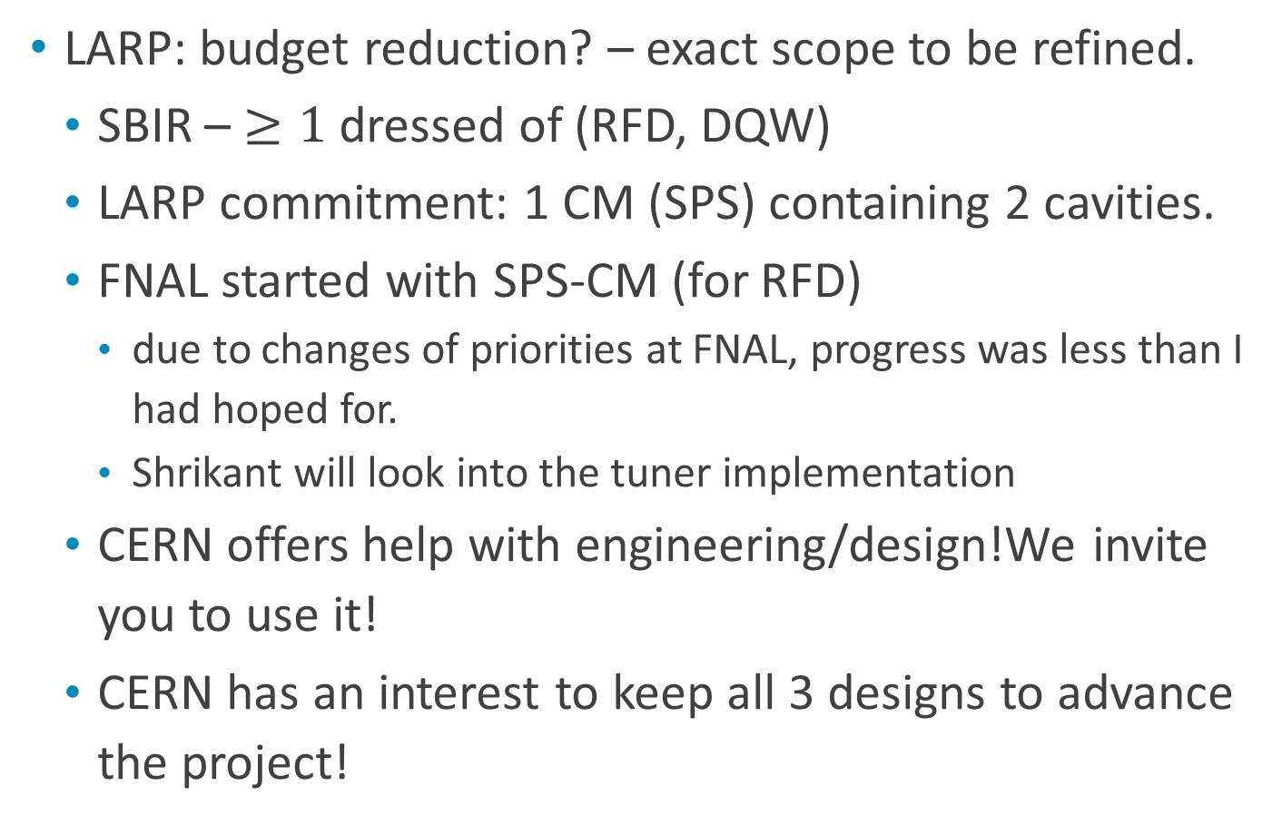
Situation with LARP
LARP: budget reduction? – exact scope to be refined.
  SBIR – $≥1$dressed of (RFD, DQW)
  LARP commitment: 1 CM (SPS) containing 2 cavities.
  FNAL started with SPS-CM (for RFD)
    due to changes of priorities at FNAL, progress was less than I had hoped for.
    Shrikant will look into the tuner implementation
  CERN offers help with engineering/design!We invite you to use it!
  CERN has an interest to keep all 3 designs to advance the project!

Slide 6
LARP internal review (June 2013) pushed for a “down -selection” asap,
we think what they really need is to contain the cost.

Slide 7
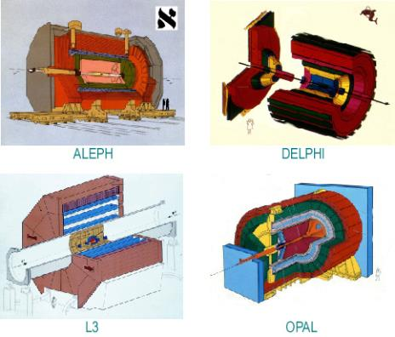
The advantage of diversity
Friendly competition – mutual push
Complementarity
Comparing methods – comparing results
Consolidation of tools
We learn from trying

Slide 8
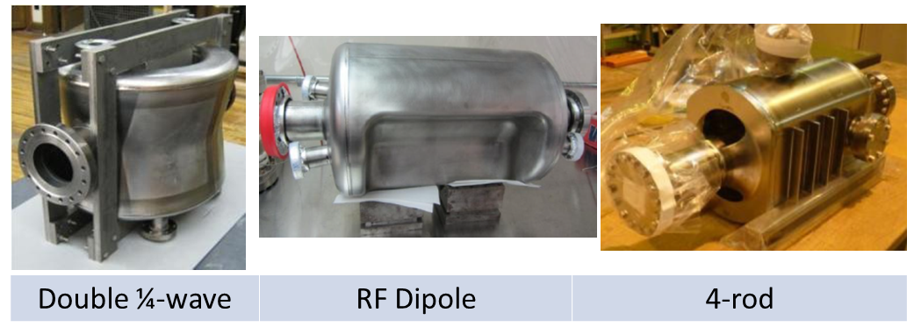
What are the choices?
No – the choices are:
Can we afford to keep these 3 designs?
Can we afford to discontinue one?
Can we afford to keep only one?

Slide 9
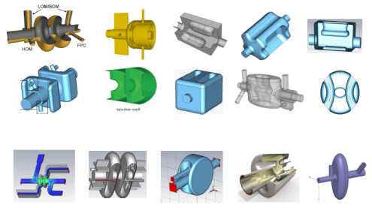
What about our defined milestone?
We formulated: “Initial Compact Crab Cavity down-selection, leaving at least two CC options for technical design and prototyping”
This was not meant to eliminate valid contenders!
We have done this
down-selection:

Slide 10
Can we make a choice in 2014?
Yes: The choice is “increase our chances for success!”, i.e.
  continue with the 3 different, complementary designs until we can decide which cavity (cavities) can go in the LHC.
  We will propose criteria for this latter selection and agree on them with all involved (+ advisory committee?)
  We will decide what will go in the LHC after we have done relevant tests.

Slide 11
Tests
Vertical tests
Tests of dressed cavity
Low power RF tests of cavity in CM
RF tests of fully equipped cavity (HOM damping, power coupler)
Test with beam in SPS
relevant

Slide 12
Conclusions
We must concentrate on preparing for the SPS Tests first!
This requires the freeze of the CM design soon!
CERN wishes to keep the 3 cavity proposals alive and supports them while they are valid.
We count on LARP for continued support – may have to refine the exact scope. (for SPS, no change!)
The decision which cavity can go into the LHC will have to be based on results of relevant tests – criteria to be established.
This was a very fruitful workshop! Thanks to all!

