Slide 1
Heat load from impedance on existing and new hardware in the LHC era
Gianluigi Arduini, Mike Barnes, Philippe Baudrenghien, Rama Calaga, Fritz Caspers, Serge Claudet, Hugo Day,
Juan Esteban Mueller, Themis Mastoridis, Elias Métral, Nicolas Mounet, Giovanni Rumolo,
Benoit Salvant, Elena Shaposhnikova, Laurent Tavian, Rainer Wanzenberg (DESY), Carlo Zannini,
Olga Zagorodnova (DESY), M. Zobov (INFN), and the impedance team.
Many thanks to
David Belohrad, Christian Boccard, Riccardo de Maria, Stephane Fartoukh, Giovanni Iadarola, Rhodri Jones, Thibaut Lefevre, Andrea Mostacci (La Sapienza), Uwe Niedermayer (GSI), Ralph Steinhagen, Simon White,
the equipment groups, the operation, integration and Timber teams.
.

Slide 2
Main messages
Already many heating issues related to beam impedance in 2011 and 2012.
Need to optimize LHC hardware as the conditions will be much tougher in HL-LHC era (~factor 5 more )
Some hardware already at the limit will need modifications:
  Injection kickers → upgrade underway
  Injection dump collimators → consolidation of current TDI + new design is planned (WP14)
  Synchrotron Light Monitor → new design underway
Beware of non-conformities
  Check carefully all devices and cooling that are supposed to be put in the LHC
  Need of efficient temperature monitoring during intensity ramp up to detect problems early
Strategies for mitigation:
  Optimize designs to reduce heat load
  If cavities are necessary, detune and localize the heat loss in ferrites.
  Working now on extracting the heat from the system (longer term)
  Higher harmonic system will give flexibility to tune the bunch distribution in case of problem

Slide 3
Agenda
Main messages
Current issues in LHC
Beam induced heating?
Reaching HL-LHC parameters
Possible mitigations
Perspectives

Slide 4
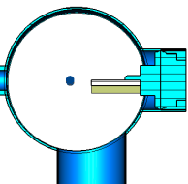
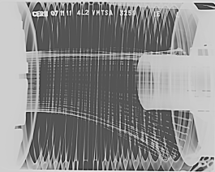
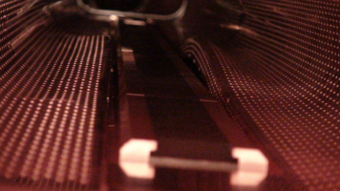
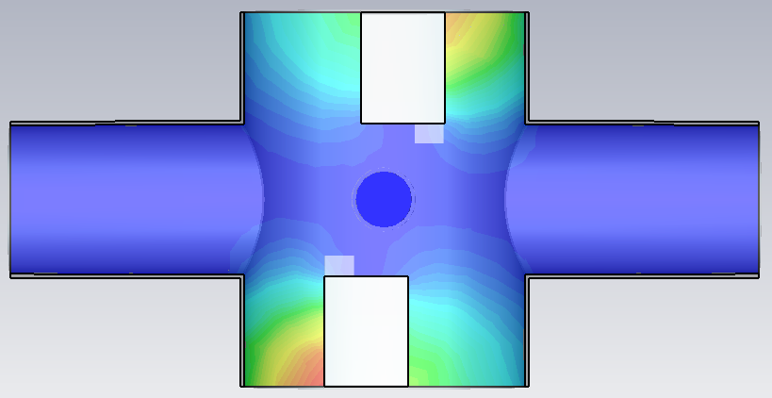

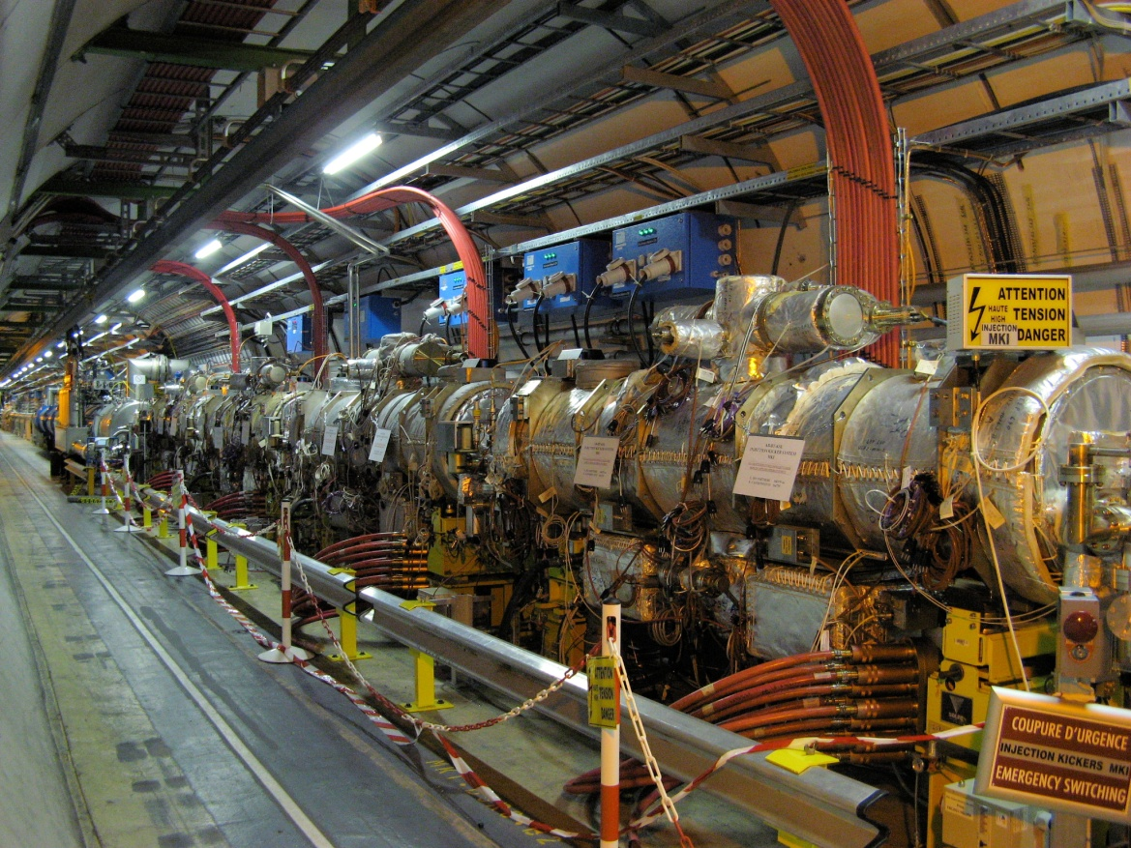
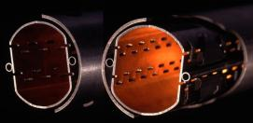
Heating issues in LHC
Damaged synchrotron light monitor
Temporary replacement
New design
Damaged vacuum module in 2011
→ Repaired and reinforced
Damaged injection collimator
will be reinforced
New design underway
ALFA detector could be damaged
Cooling will be added
Injection kicker delays injection
Bakeout jackets removed
screen conductors optimized
Primary collimator is heating (1/6)
Cooling will be fully checked
one single cryogenic module (Q6R5) has no margin for cooling.

Slide 5
Agenda
Main messages
Current issues in LHC
Beam induced heating?
Reaching HL-LHC parameters
Possible mitigations
Perspectives

Slide 6
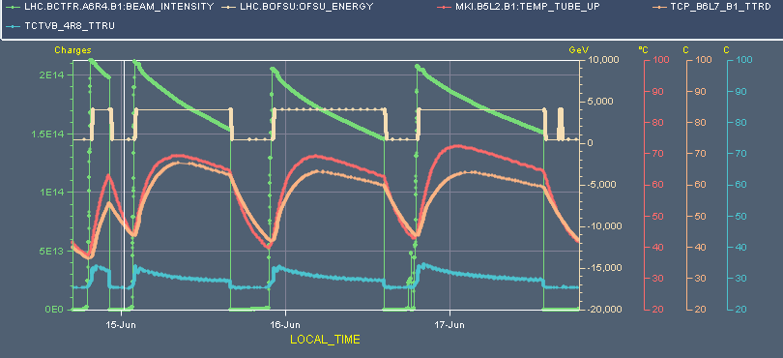
Beam induced heating?
100 °C
Intensity
Energy
Temp MKI
Temp TCP
Temp TCTVB
20 °C
Example of temperature of certain LHC devices during physics fills
  MKI: injection kicker (interlock for injection at ~61 degrees C)
  TCP: primary collimator
  TCTVB: 2-beam tertiary collimator
Temperature increase due to the interaction of beam induced wake fields with the surrounding
→ Has strongly affected operation since intensity ramp up started in mid-2011

Slide 7
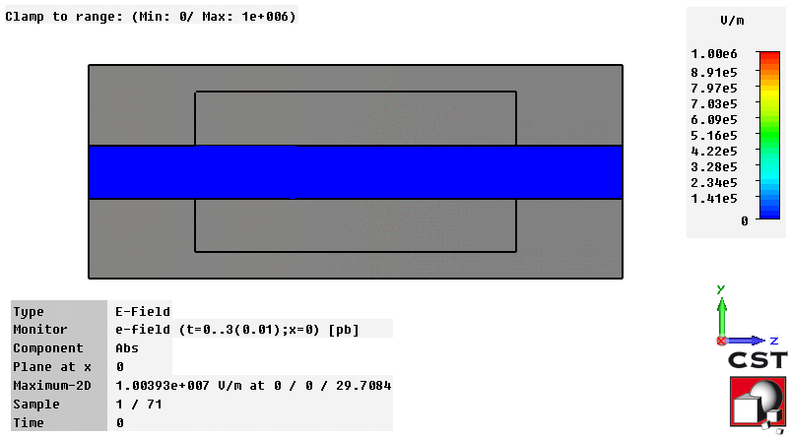
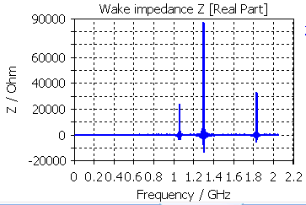
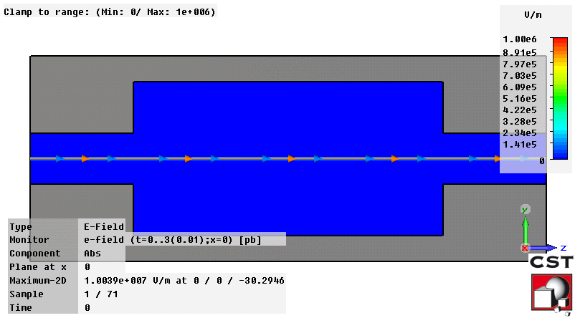
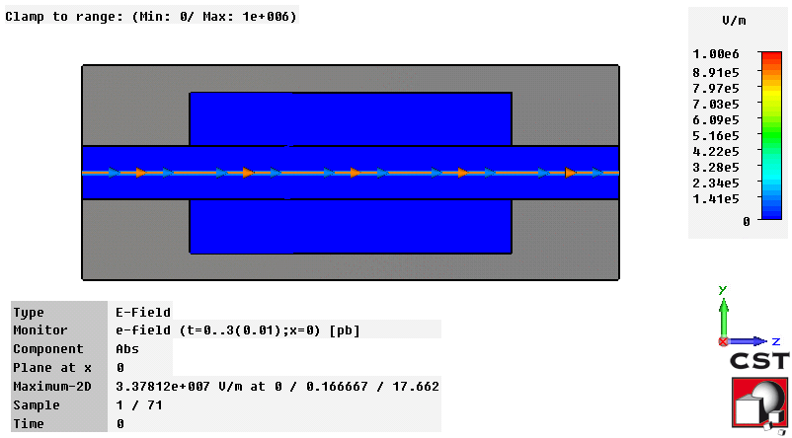
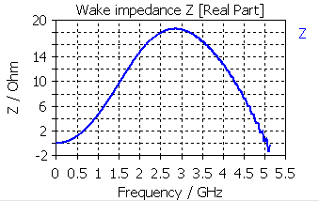
Perturbation of surrounding geometry to the electromagnetic fields of the beam
No additional perturbation
due to the device
Smooth perfect
conducting pipe
Perturbation at discrete frequencies
→ narrow band resonances
Cavity
Perturbation over a wide range of frequencies→ Broadband resonances
Lossy material
Energy lost by the bunch will heat the surrounding

Slide 8
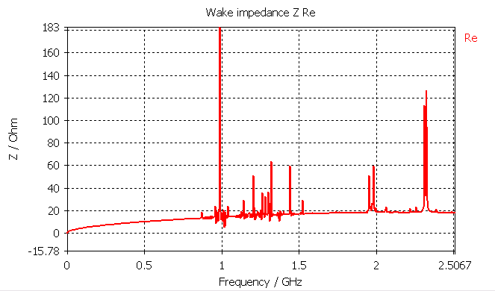
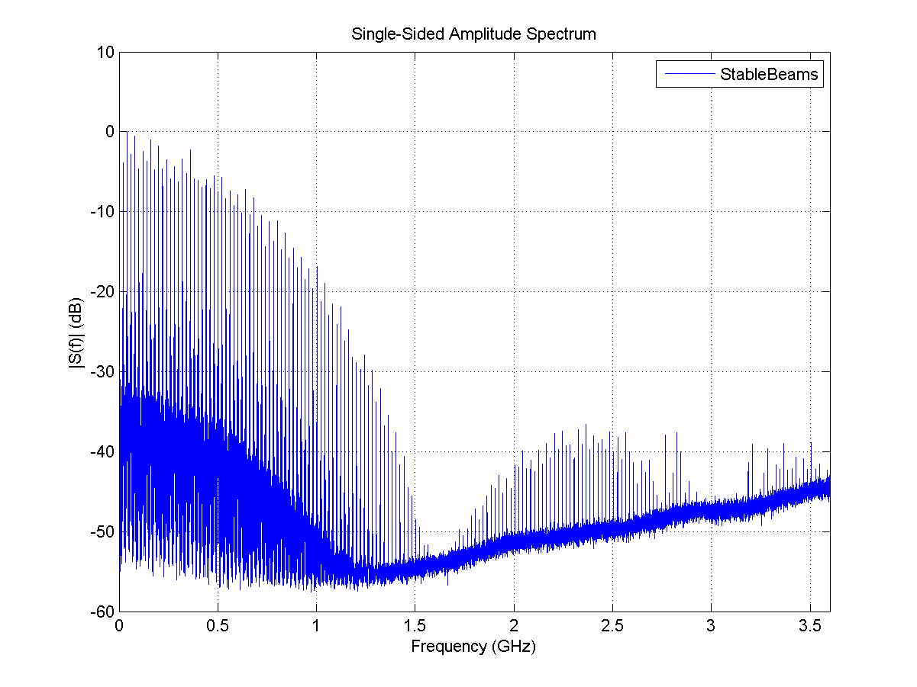
Computing power loss
Power lost by the beam in a device of impedance Z_{long} (see E. Métral at Chamonix 2012):
M= number of bunches
N_{b}=intensity per bunch
Impedance Re(Z_{long}) of simulated primary collimator
Power spectrum measured on 50 ns beam
by P. Baudrenghien and T. Mastoridis
Narrow band at f_{res}
broadband
Broadband contribution: sum can be replaced by an integral
Narrow band contribution: sum can be replaced by a single term

Slide 9
Agenda
Main messages
Current issues in LHC
Beam induced heating?
Reaching HL-LHC parameters
  Scaling heat load
  Status of current issues
  Other devices to monitor
  What we do not know
Possible mitigations
Perspectives

Slide 10
Increase in heat load only from intensity increase
Factor from situation before LS1 | Nominal (25 ns) | ultimate (25 ns) | Before LS1 (50 ns) | US2 (25 ns) | HL-LHC (25 ns) | HL-LHC (50 ns)
M | 2808 | 2808 | 1374 | 2748 | 2808 | 1404
Nb | 1.15 | 1.8 | 1.6 | 2.2 | 2.2 | 3.5
Broadband (M*N_{b}²) | 1.06 | 2.59 | 1 | 3.78 | 3.86 | 4.89
Narrow band (M*N_{b})² | 2.16 | 5.29 | 1 | 7.56 | 7.9 | 5
*Narrow band is a worst case scenario assuming that the resonance stands exactly at a multiple of 40 MHz
Significant increase in heat load from impedance with HL-LHC intensity (factor 4 to 7)

Slide 11
Increase in heat load from intensity increase and bunch length decrease to 1 ns
Factor from situation before LS1 | Nominal (25 ns) | ultimate (25 ns) | Before LS1 (50 ns) | US2 (25 ns) | HL-LHC (25 ns) | HL-LHC (50 ns)
M | 2808 | 2808 | 1374 | 2748 | 2808 | 1404
Nb | 1.15 | 1.8 | 1.6 | 2.2 | 2.2 | 3.5
Broadband (M*N_{b}²) | 1.48 | 3.62 | 1 | 5.29 | 5.41 | 6.85
Narrow band (M*N_{b})² | 3.02 | 7.40 | 1 | 10.59 | 11.05 | 6.99
*Narrow band is a worst case scenario assuming that the resonance stands exactly at a multiple of 40 MHz
Significant increase in heat load from impedance with HL-LHC parameters (factor 5 to 10)
→ Hardware that are limiting now or marginal need to be upgraded for HL-LHC
Note: a further reduction of bunch length to 4 cm leads to an additional factor of at least 3 in power loss

Slide 12
Agenda
Main messages
Current issues in LHC
Beam induced heating?
Reaching HL-LHC parameters
  Scaling heat load
  Status of current issues
  Other devices to monitor
  What we do not know
Possible mitigations
Perspectives

Slide 13
Summary table of LHC issues
equipment | Problem | 2011 | 2012 | Hopes after LS1 | OK for HL-LHC?
VMTSA | Damage |  |  | removed | removed
TDI | Damage |  |  | Beam screen reinforced, copper coating on the jaw | New design underway
MKI | Delay |  |  | Beam screen and tank emissivity upgrade | Current upgrade may not be enough
TCP_B6L7_B1 | Few dumps |  |  | Cooling system checked | 400 W expected for 7 kW cooling
TCTVB | Few dumps |  |  | removed | removed
Beam screen Q6R5 | Regulation at the limit |  |  | Upgrade of the valves + TOTEM check | Upgrade should be sufficient
ALFA | Risk of damage |  |  | New design + cooling | No forward physics after LS3?
BSRT | Deformation suspected |  |  | New design + cooling | New design underway
Damage
→ Most problems are efficiently addressed
→ Other devices may show up in the list
Limits operation
Worry that can limit operation
Should be fine

Slide 14
Summary table of LHC issues
equipment | Problem | 2011 | 2012 | Hopes after LS1 | OK for HL-LHC?
VMTSA | Damage |  |  | removed | removed
TDI | Damage |  |  | Beam screen reinforced, copper coating on the jaw | New design underway
MKI | Delay |  |  | Beam screen and tank emissivity upgrade | Current upgrade may not be enough
TCP_B6L7_B1 | Few dumps |  |  | Cooling system checked | 400 W expected for 7 kW cooling
TCTVB | Few dumps |  |  | removed | removed
Beam screen Q6R5 | Regulation at the limit |  |  | Upgrade of the valves + TOTEM check | Upgrade should be sufficient
ALFA | Risk of damage |  |  | New design + cooling | No forward physics after LS3?
BSRT | Deformation suspected |  |  | New design + cooling | New design underway
Damage
→ Most problems are efficiently addressed
→ Other devices may show up in the list
Limits operation
Worry that can limit operation
Should be fine

Slide 15
Devices to monitor for HL-LHC: beam screens
Expected from theory, accounting for the weld on the side (+44%, see PhD of Andrea Mostacci and Carlo Zannini) and magnetoresistance (for instance in PhD of Nicolas Mounet, pessimistic for quadrupoles), accounting for factor 2 in addition (worst case for 2 beams in same aperture, pessimistic). Note: LHC design report aperture chosen instead of mechanical aperture (more pessimistic).
See talk of N. Mounet for more details
Power loss for 2 beams in mW/m | Nominal (25 ns) | ultimate (25 ns) | Before LS1 (50 ns) | US2 (25 ns) | HL-LHC (25 ns) | HL-LHC (50 ns)
M | 2808 | 2808 | 1374 | 2748 | 2808 | 1404
Nb | 1.15 | 1.8 | 1.6 | 2.2 | 2.2 | 3.5
Arc beam screens (18.4 mm) | 290 | 509 | 165 | 1040 | 1060 | 1350
Inner triplets Q2 and Q3 (24 mm → 59 mm) | 445 | 781 | 253 | 678 (1590) | 693 (1630) | 877 (2060)
inner triplets Q1 (17.3 mm → 49 mm) | 618 | 1082 | 351 | 563 (2212) | 575 (2261) | 728 (2861)
→ Beneficial effect of new triplet
For the arcs, cooling power is 200 W per half cell (i.e. 3800 mW/m).
Is that enough margin for synchrotron radiation and electron cloud?
Could also be limiting for standalones and triplets (if cooling power is 250 W → 8300 mW/m).

Slide 16
Devices to monitor for HL-LHC: Injection kickers
Data from Mike Barnes and Hugo Day et al obtained by measurements on upgraded MKIs, to be installed during LS1
Power loss in W | Nominal 25 ns (2808*1.15, 1 ns, 7 TeV) | Before LS1 50 ns (1380*1.6e11@1.2 ns, 4 TeV) | US2 25 ns (2748*2.2e11) | HL-LHC 25 ns (2808*2.2e11) | HL-LHC 50 ns (1404*3.5e11)
Non conform MKI8D (limiting for LHC) | - | 161 W/m |  | - | -
Upgraded MKI | 34-52 W/m | 20-34 W/m | 106-180 W/m | 124-191 W/m | 151-240 W/m
The HL-LHC parameters will bring the power loss back to limiting values.
However, the heat distribution should be quite different (less power in ferrite), and heavy effort of the kicker team to evacuate the heat by improving tank emissivity
need to wait for run 2 to assess if the upgraded MKI can withstand HL-LHC parameters

Slide 17
Other devices to monitor for HL-LHC
Experimental beam pipes (CMS and ATLAS data from R. Wanzenberg and O. Zagorodnova - DESY)
  CMS chamber (e.g. mode 750 MHz, R=1.5 kOhm): from 50 W before LS1 to potentially more than 350 W
  ATLAS chamber: no significant mode expected
  ALICE chamber (e.g. mode 530 MHz, R=1.5 kOhm): from 150 W before LS1 to potentially more than 1 kW
  LHCb chamber (e.g. mode 620 MHz, R=0.6 kOhm): from 30 W before LS1 to potentially more than 250 W
Instrumentation
  Upgraded BSRT
  striplines, button BPMs, wall current monitor → some electronics may need to be changed to accept more power
RF cavities
  R. Calaga: very small power extracted from the RF couplers before LS1 (a few Watts)
Stochastic cooling
  possibility to shield completely during proton operation?
Dump MKD kicker is shielded behind a thin metallic coating
→preliminary computations: from 6 W before LS1 to 25 W for HL-LHC (in fact small temperature increase was measured → J. Uythoven)
Collimators, recombination chambers, electron lens, beam-beam compensation (strong impact expected if outside of collimator)
Other ideas?

Slide 18
Agenda
Main messages
Current issues in LHC
Beam induced heating?
Reaching HL-LHC parameters
  Scaling heat load
  Status of current issues
  Other devices to monitor
  What we do not know
Possible mitigations
Perspectives

Slide 19
What we don’t know
Many devices are not yet designed
Energy loss in regions with two beams
  Work by A. Grudiev and more recently by G. Rumolo and C. Zannini.
Non conformities
  Need more systematic temperature monitoring on near beam hardware
  Need to check cooling system before/during installation
  Need to check longitudinal impedance of new equipment before installation to detect problems
Longitudinal bunch distribution along the fill (could be controlled)
Fruitful work with thermal simulation experts to predict temperature distribution, but still a difficult process

Slide 20
Agenda
Main messages
Current issues in LHC
Beam induced heating?
Reaching HL-LHC parameters
  Scaling heat load
  Status of current issues
  Other devices to monitor
  What we do not know
Possible mitigations
Perspectives

Slide 21
Possible mitigations in case of issues
Reduce longitudinal impedance
  Avoid unnecessary cavities (contact RF fingers, elliptical bellows for elliptical chambers, tapered transitions)
  If the heating is due to resistive wall, increase material conductivity
  If the heating is due to trapped modes, reduce material conductivity
Reduce impedance overlap with beam spectrum
  For resistive wall or broad resonance, increase bunch length.
  For narrow resonance, detune the resonant mode (with ferrite or coupler)
  Possibility to tune the beam spectrum with the longitudinal distribution (higher harmonic cavity)
  For narrow resonances, switch to smaller bunch spacing
Reduce bunch or beam intensity
Extract the heat from critical locations (ferrite, RF fingers, springs)

Slide 22
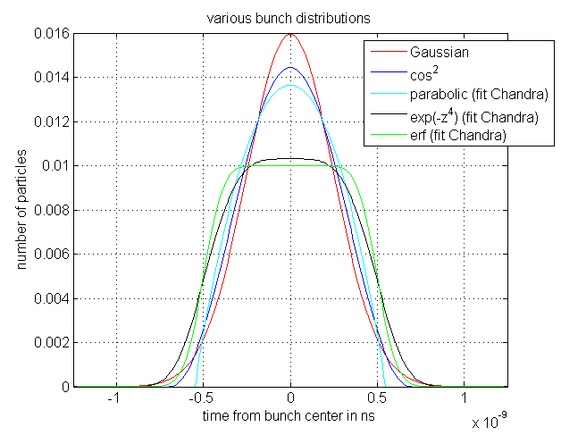
Possible mitigations:
Effect of flat bunches?
Power loss for a constant impedance
(with reference to measured 2012 spectrum)
Flat bunches
Cos^2 bunches with same rms
Flat bunches not far from single RF situation in terms of heating for very broadband impedances
(constant over frequency). Effect will depend on the spectrum of each device.

Slide 23
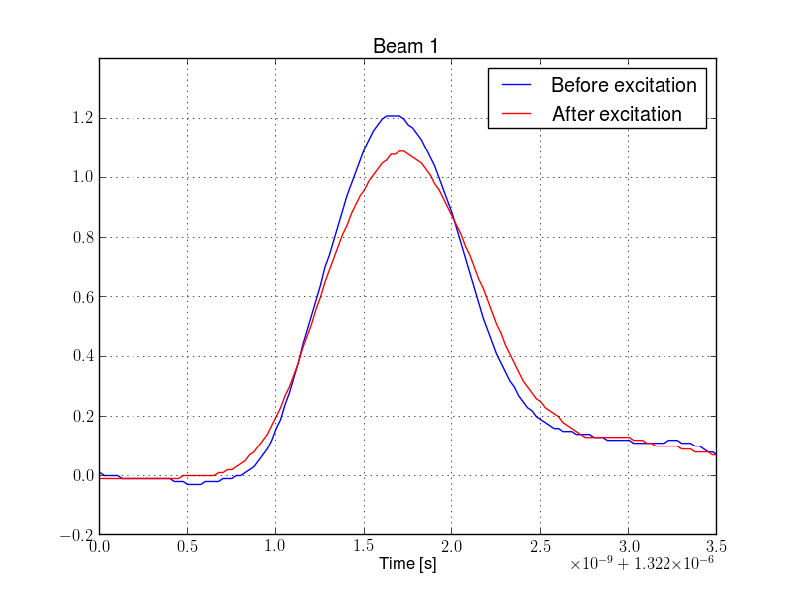
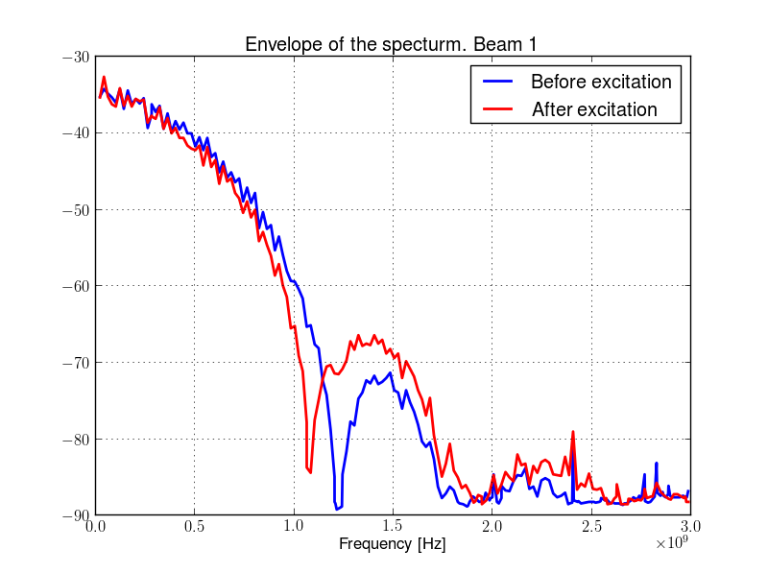
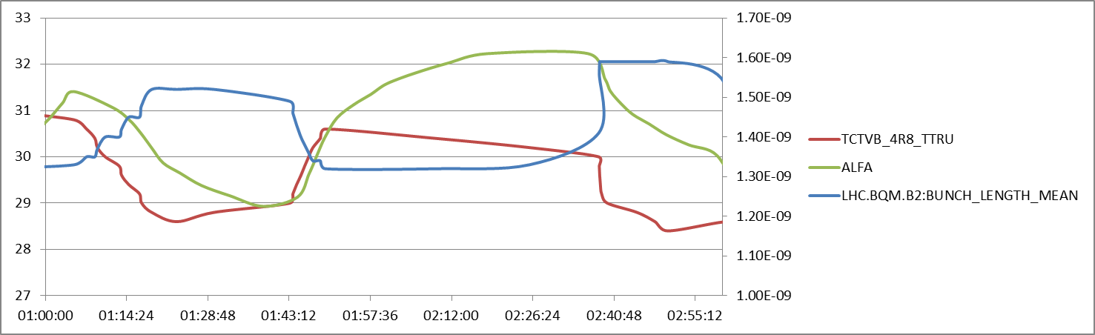
Flat bunches: another degree of freedom in case of abnormal heating
Juan Esteban Mueller, Elena Shaposhnikova et al
ALFA
TCTVB
Temperature [ºC]
Bunch lengths
Voltage
variation
RF phase
modulation
UTC Time
→ LHC MD in 2012: excitation to flatten bunches reduced temperature on TCTVB and ALFA

Slide 24
Agenda
Main messages
Current issues in LHC
Beam induced heating?
Reaching HL-LHC parameters
  Scaling heat load
  Status of current issues
  Other devices to monitor
  What we do not know
Possible mitigations
Perspectives

Slide 25
Perspectives
No brick wall showstopper found so far to reach HL-LHC parameters, but many worries, in particular non-conformities.
Proposed actions for early detection of heating issues:
  Careful simulation/measurement validation of all new and potentially critical devices
  Appropriate dimensioning and validation of cooling system
  Need temperature monitoring in suspected regions
  Near beam temperature probes are not installed everywhere: vacuum and cryo data are our only eyes in the major part of the machine
  → Need a tool to extract vacuum patterns that indicate potential heating
  Need to define alarms (in collaboration with equipment groups and machine protection
  Be ready to implement mitigation to reduce impedance, beam spectrum or extract heat.
Need to compute the power loss, but also the distribution of the temperature increase to assess the damage potential: 100 W on a 2 mm thick cooled beam pipe may not be an issue while a fraction of W on a 0.3 mm RF finger can be dramatic.
Significant effort should continue to be put on:
  Understanding underlying mechanisms (impact of filling schemes, 2 beams)
  Robustness and sensitivity of impedance simulations and measurements
  Impedance/thermal co-simulations
  Can we use couplers to extract the heat instead of ferrites

