Slide 1
Cryogenics for cold-powering at LHC P1 and P5
U. Wagner
CERN

Slide 2
Topics
Given boundary conditions
  Mechanical
  Lay-out
  Process,
Overview of considered cooling solutions for the cryogenic circuit
Influence on the energy consumption.
List of open questions.

Slide 3
Boundary conditions
Considered DFB’s
  DFBA: Current feed box for the arc; connected to existing refrigerator.
  DFBL: Current feed box for the matching section; connected to new refrigerator
  DFBX: current feed box for the inner triplet; connected to new refrigerator.

Slide 4
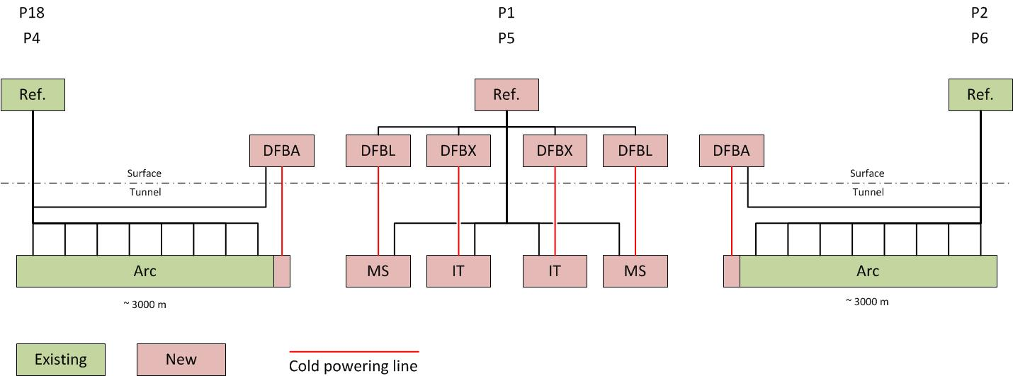
Boundary conditions
Defined only by tunnel geometry
Defined by existing equipment

Slide 5
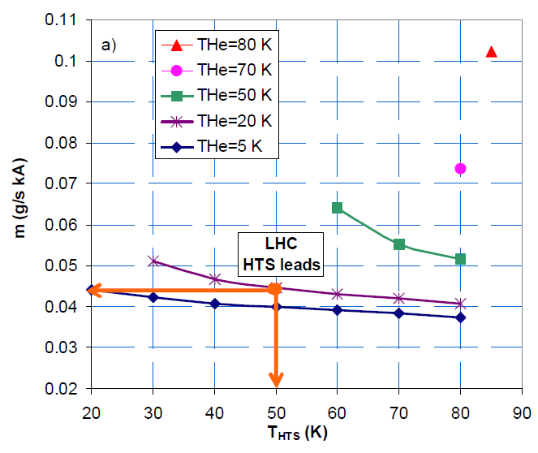
Assumptions (as in previous presentation)
The following assumptions were first formulated in 2010.
  They are still the baseline today
Link SC is MgB₂
Splice LTS to MgB₂ (magnet to link) requires liquid helium bath.
Max MgB₂ temperature 20K
  Max. helium temperature 17 K
He consumption for current lead cooling:
  As published by A. Ballarino in CERN/AT 2007-5

Slide 6
The DFBA and the existing refrigerators
The following slides only concern the DFBA integrated in the existing cryogenic system.
The total DFBA current is considered to be 220 kA.

Slide 7
Helium conditions at interface DFBA
 | Average actual values
 | Sector 4-5 |  | Sector 5-6 |  | Sector 8-1 |  | Sector 1-2
Line | T [K] | P [kPa] | T [K] | P [kPa] | T [K] | P [kPa] | T [K] | P [kPa]
C | 5.0 | 450 | 5.0 | 360 | 4.9 | 360 | 4.7 | 400
D | 16.5 | 126 | 11 | 130 | 10 | 130 | 11 | 130
E | 59 | 1400 | 72 | 1490 | 60 | 1520 | 50 | 1520
F | 61 | 1330 | 75 | 1470 | 61 | 1500 | 51 | 1500
Worst case considered for study of all points
Not relevant for cooling

Slide 8
Transfer line options
See previous presentation
  Flexible “Nexans” line
  Custom line

Slide 9
Conclusions from 2011 presentation
High current case P1 and P5
  The cooling for the current lead defines the helium flow.
  Heat load on transfer lines of second order.
  Invest design effort to obtain a current lead with low coolant consumption.

Slide 10
Cost of cooling comparison
Two reference cases
  Actual cooling with DFB in the tunnel.
    Lower limit.
    Reference for comparison as this case does not solve our problem.
  LTSC link, as already realised in LHC P3
    Upper limit
    Used only as reference!
      Unlike for P7 the link in P3 is not sufficient as a demonstrator. Additional R&D might be necessary.

Slide 11
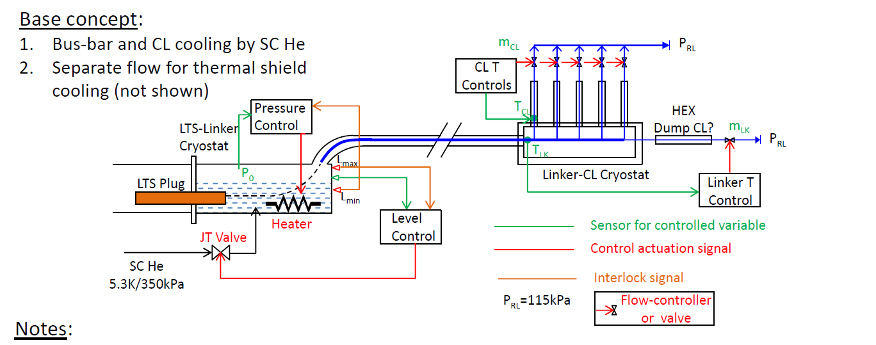
Current Base concept (all sites)
Helium at max. 17 K
Helium from line C
  As in previous presentation!

Slide 12
Studied cooling options DFBA
Several different cooling options were studied
The only relevant solution is:
  Shield cooling with 20 K gas, mixing of gas for the cooling of the copper part.
Two options:
  “Nexans like” line
  Custom line

Slide 13
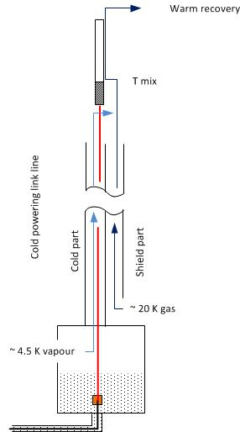
Cooling methods sketch DFBA
The current lead consumption is such that the mixing temperature of the two flows is sufficiently low to cool the copper part.
Difference due to heat load of the two TL options.

Slide 14
Comparison of cooling methods DFBA
Values without uncertainty / overcapacity margin
 |  |  |  | Additional capacity
 | T at Lead [K] | T at HTS top [K] | Relative Cost [-] | 4.6 - 20 K [W] | 20 - 280 K [g/s]
Actual LHC | 4.5 | 20.0 | 1.00 | 0 | 0.0
Custom line | 17.0 | 25.4 | 1.38 | 22 | 2.2
Nexans line | 17.0 | 30.6 | 1.68 | 175 | 3.3
LTS solution* | 5.3 | 4.5 | 2.13 | 933 | -1.1
Capacity margin | (only if add. Refrigerators) |  |  | ~ 10000 | ~ 10.0
* 50 – 70 K shield load not shown for LTS
Reference
Kept in mind if integration of Nexans line impossible

Slide 15
Conclusion DFBA cooling
The additional capacity for the link cooling can be easily covered by the existing refrigerator
  Provided we have new refrigerators in P4, P1 and P5.
Challenge:
  The total pressure difference for the 20 K gas between supply and return is only about 150 mbar
    The pressure loss budget at the moment is:
      50 mbar in the link line, 50 mbar in the Current lead, 50 mbar in the return line.

Slide 16
The DFBX, DFBL and the new refrigerator
The following slides concern the DFBX, the DFBL integrated with the new cryogenic system.
The total currents are considered to be:
  150kA for DFBX
  80 kA for DFBL
As the refrigerator is still to be defined:
  No limits on cooling capacity
  No limits on existing lines, pressure or temperatures.
    We still consider the nominal LHC values for temperature and pressure as boundary condition in the tunnel.

Slide 17
Cost of cooling comparison
Two reference cases (as before)
  Actual cooling with DFB in the tunnel.
  LTSC link, as already realised in LHC P3
Considered cooling options
  Again the two transfer line options, “Nexans” and custom.
  For the DFBX:
    like DFBA, i.e. shield cooling with 20 K gas, mixing of gas for the cooling of the copper part.
  For the DFBL:
    like above, but as additional option for the “Nexans” solution add flow from the 20 K level in order to limit the mixing temperature to 50K.

Slide 18
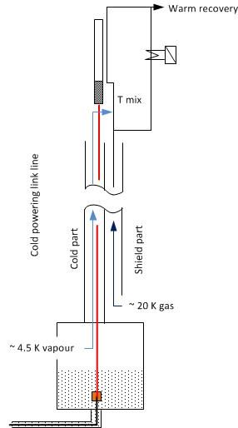
Cooling methods sketch
Shield with 20 K gas and mixing.
Calculated for all cases.
Shield with 20 K gas and mixing
plus additional flow through heater.
Nexans line for DFBL only

Slide 19
Comparison of cooling methods DFBX
 |  |  |  | Required capacity
 | T at Lead [K] | T at HTS top [K] | Relative Cost [-] | 4.6 - 280 K [g/s] | 20 - 280 K [g/s]
Actual LHC | 4.5 | 19.7 | 1.00 | 0.12 | 6.6
Custom | 17.0 | 33.1 | 1.29 | 0.22 | 8.5
Nexans | 17.0 | 40.7 | 1.61 | 1.66 | 7.3
LTS solution* | 4.5 | 4.5 | 2.13 | 6.00 | 0.0
* 50 – 70 K shield load not shown for LTS
Reference
Kept in mind if integration of Nexans line impossible

Slide 20
Comparison of cooling methods DFBL
 |  |  |  | Required capacity
 | T at Lead [K] | T at HTS top [K] | Relative Cost [-] | 4.6 - 280 K [g/s] | 20 - 280 K [g/s]
Actual LHC | 4.5 | 19.7 | 1.00 | 0.06 | 3.5
Custom | 17.0 | 43.8 | 1.37 | 0.22 | 4.6
Nexans | 17.0 | 53.3 | 2.11 | 1.66 | 3.9
Nexans add flow | 17.0 | 49.7 | 2.23 | 1.66 | 4.4
LTS solution* | 4.5 | 4.5 | 2.22 | 3.20 | 0.0
Discussion: see next slide

Slide 21
Cooling of the link for DFBL P1 / P5
The cost of cooling for the Nexans solution is nearly identical as for a LTS solution.
From the view point of saving primary energy there is little interest.
  The MgB₂ basically only allows for a transfer line with high heat load.
To be verified:
  The highest temperature necessary for the lead cooling.
  Possibility to integrate the MgB₂ cable for DFBX and DFBL in the same cryostat (transfer line).
    This would lead to a cost of cooling as for the DFBA.
Even if of little interest for the cost of cooling, the Nexans line might still be a valid option as discussed before.

Slide 22
Uncertainties and recommendations
  How to link the different power supply lines in the tunnel for the matching section?
  At least a concept should be fixed.
(courtesy L. Tavian)
Separate cryostats, how to link together?
LTS or MgB2?

Slide 23
Conclusions DFBA and existing refrigerator
From the aspect of “cost of cooling” the reference solution with a flexible transfer line can be easily covered by the existing refrigerators.
Uncertainties remain as for the lead performance and concerning the low available pressure difference for the cooling.

Slide 24
Conclusions DFBX, DFBL and new refrigerator
We can establish a budget for the cost of cooling to contribute to the refrigerator specification.
The concept of how to link the stand alone magnets of the matching section (DFBL) to the link should be addressed.

