Slide 1


Accelerating Science and Innovation
CERN Vision
for Physics at higher luminosity
and higher energy
R.-D. Heuer, CERN Daresbury, Nov 11, 2013
Notes:
1

Slide 2
LHC run 1
at 7 and 8 TeV
a great success

Slide 3
Four main results from LHC Run-1
1) We have consolidated the Standard Model
(wealth of measurements at 7-8 TeV, including the rare, and very sensitive
to New Physics, B_{s} → μμ decay)
→ it works BEAUTIFULLY …
2) We have completed the Standard Model: Discovery of the messenger
of the BEH-field, the Higgs boson discovery
(over 50 years of theoretical and experimental efforts !)
3) We found interesting properties of the hot dense matter
4) We have NO evidence of new physics
Note: the last point implies that, if New Physics exists at the TeV scale and is discovered
at √s ~ 14 TeV in 2015++, its spectrum is quite heavy → it will require a lot of luminosity
(→ HL-LHC 3000 fb⁻¹) and energy to study it in detail → implications for future machines

Slide 4

This is VERY puzzling ….
On one hand, the LHC results imply that the SM technically works up to scales
much higher than the TeV scale, and limits on new physics seriously challenge
the simplest attempts (e.g. minimal SUSY) to fix its weaknesses
On the other hand: there is strong evidence that the SM must be modified
with the introduction of new particles and/or interactions at some energy scale
to address fundamental outstanding questions, including the following
Why is the Higgs boson so light (so-called “naturalness” or “hierarchy” problem) ?
What is the nature of the matter-antimatter asymmetry in the Universe ?
Why is Gravity so weak ?
And perhaps the most disturbing one …

Slide 5

The DARK Universe (96%):
73% Dark Energy
23% Dark Matter
Only 4% is ordinary (visible) matter
DARK …. MATTERS !

Slide 6
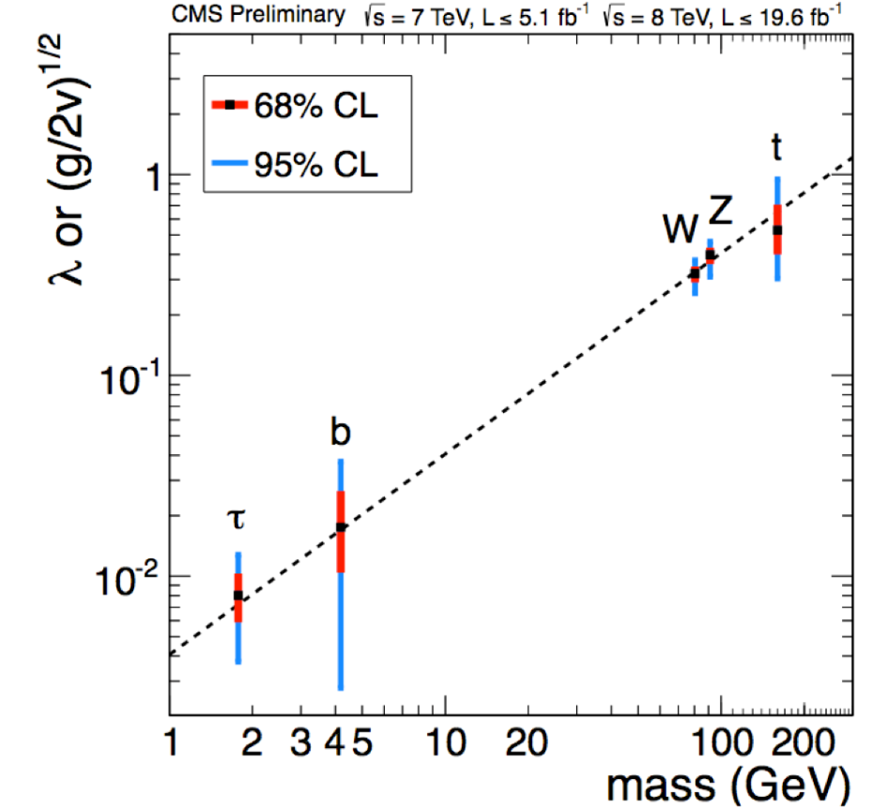
The new particle is a Higgs boson
ATLAS and CMS have verified the two “fingerprints”
1) To accomplish its job (providing mass)
it interacts with other particles (in particular W, Z) with strength proportional to their masses
It completes the Standard Model,
thus describing ~5% of the Universe
What about the “Dark Universe” ?
The detailed study of the properties of this Higgs Boson could give
… information on Dark Matter
… first hints on Dark Energy
2) It has spin 0, it is representing a scalar field

Slide 7
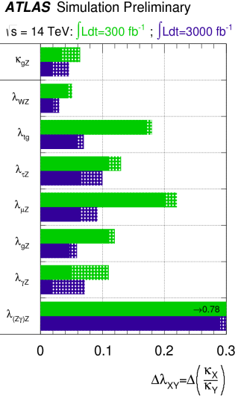
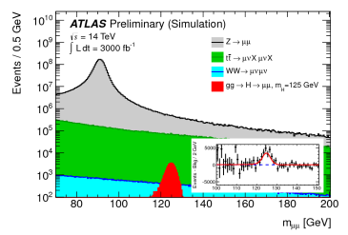
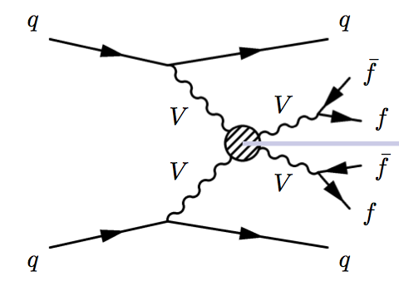
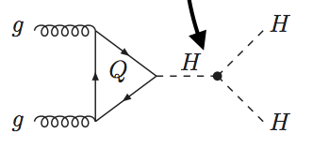
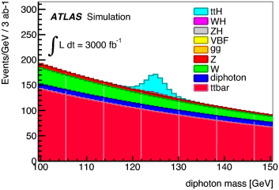
LHC --> HL-LHC: THE Higgs factory
Fabiola:
today : ATLAS+CMS have 1400 Higgs events
HL-LHC: (3000fb-1) > 3M/170M useful for precise measurement
Measure as many Higgs couplings to fermions and bosons as precisely as possible
Measure Higgs self-couplings (give access to λ)
Verify that the Higgs boson fixes the SM problems with W and Z scattering at high E
Couplings
Vector boson fusion
Self-coupling
ttH
γγ
g_{HHH}~ λv
H −−> μμ
Difficult measurement
precision 30%(?) for 3000fb-1
Check if Higgs does the
(whole) job of
cancelling divergences
x 1.5 to 2 for
300 --> 3000fb-1
Access to rare
processes
+

Slide 8
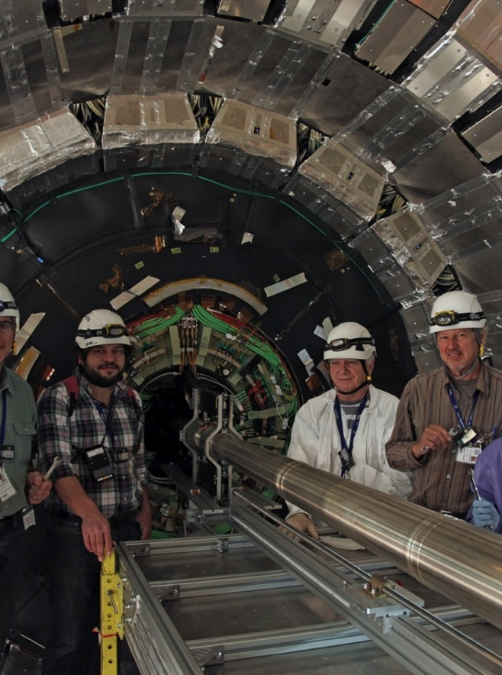
post- H(126)-discovery
Good reasons to expect more
  We have really just begun the searches
  Much space has yet to be accessed
  And there are important new physics models yet-to-be invented
Precision and rare physics
  Beyond our direct production reach
      LHC is a superb intensity frontier machine
Investment is critical
  Powerful detectors, triggers, computing
    A sustained period of important results
    And practical applications
The LHC is the only Higgs, (top, Z, W…) factory on the planet for many years to come!
8

Slide 9
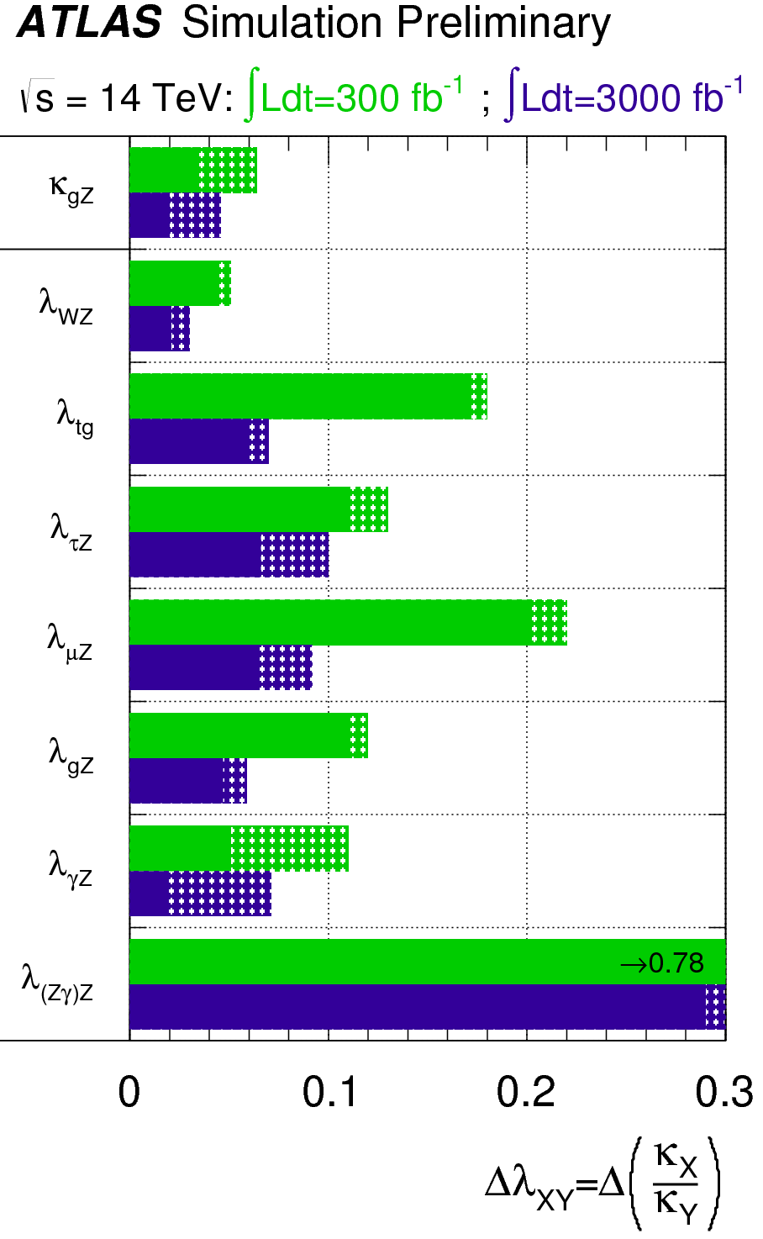
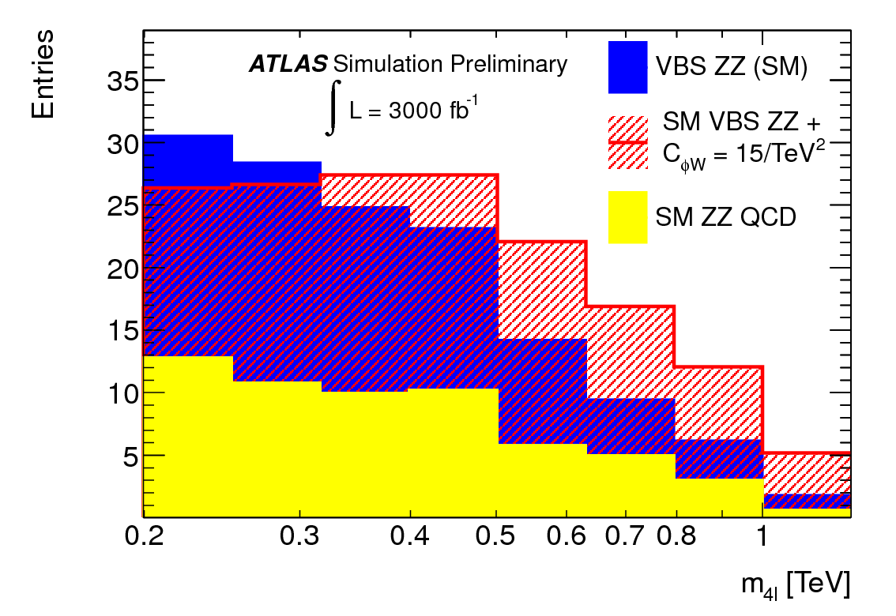
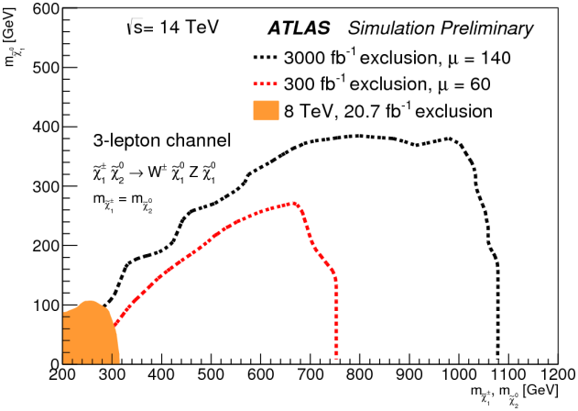
HL-LHC Physics
The HL-LHC data sample of 3000 fb⁻¹ at 14 TeV centre-of-mass energy will provide unprecedented and unparalleled physics opportunities at the energy frontier:
  to measure the H(125) in many production and decay modes, and to measure HH production in order to probe the HHH coupling
  to extend the mass reach for new particle searches by ~1 TeV
  to probe for new physics in longitudinal vector-boson scattering
  to study in depth further new physics which may be discovered at the LHC in the next decade
Higgs coupling precisions for 300 and 3000 fb⁻¹, with different systematic error assumptions
ATLAS-PHYS-PUB-2013-014
Invariant mass distribution for vector-boson scattering , in SM and with anomalous coupling
ATLAS-PHYS-PUB-2013-007
Example search sensitivity (95%CL ) for sample SUSY model with EW-ino production and decays including 3 prompt leptons
ATLAS-PHYS-PUB-2013-011

Slide 10
European Strategy for Particle Physics
High-priority large-scale scientific activities
After careful analysis of many possible large-scale scientific activities requiring significant resources, sizeable collaborations and sustained commitment, the following four activities have been identified as carrying the highest priority.
c) The discovery of the Higgs boson is the start of a major programme of work to measure this particle’s properties with the highest possible precision for testing the validity of the Standard Model and to search for further new physics at the energy frontier. The LHC is in a unique position to pursue this programme.
Europe’s top priority should be the exploitation of the full potential of the LHC, including the high-luminosity upgrade of the machine and detectors with a view to collecting ten times more data than in the initial design, by around 2030. This upgrade programme will also provide further exciting opportunities for the study of flavour physics and the quark-gluon plasma.

Slide 11

Key message
LHC
Upgrades to accelerator complex,
detectors, and computing Grid are
vital to fully exploit the physics potential of LHC
There is a program at the energy frontier with the LHC beyond 2030:
7 and 8 TeV
14 TeV design luminosity
14 TeV high luminosity (HL-LHC)

Slide 12
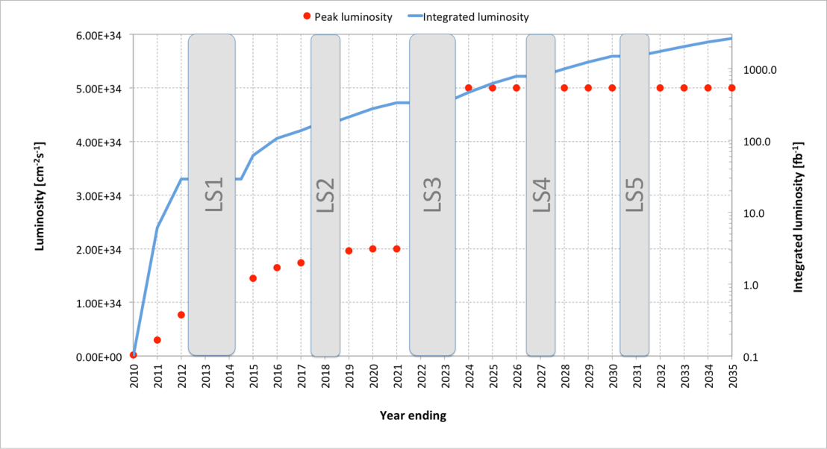
Possible plan of HL-LHC (baseline)
Very preliminary and very likely to change
Levelling at 5 10³⁴ cm⁻² s⁻¹: 140 events/crossing in average, at 25 ns; several scenarios under study to limit to 1.0 → 1.3 event/mm
Total integrated luminosity of 3000 fb⁻¹ for p-p by 2035, with LSs taken into account and 1 month for ion physics per year.

Slide 13
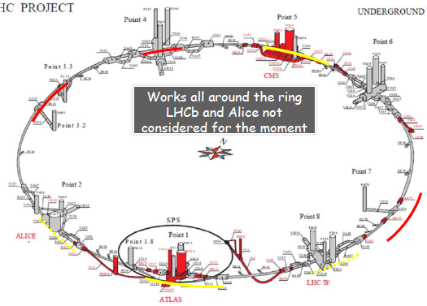
The HL-LHC Project
New IR-quads Nb₃Sn (inner triplets)
  New 11 T Nb₃Sn (short) dipoles
  Collimation upgrade
  Cryogenics upgrade
  Crab Cavities
  Cold powering
  Machine protection
  …
Major intervention on more than 1.2 km of the LHC

Slide 14

Setting up International collaboration
with national laboratories but also involving industrial firms
Q4
Baseline layout of HL-LHC IR region

Slide 15
Experiments from LHC to HL-LHC
An extensive and rich physics program
Maintain full sensitivity for discovery
  And precision measurements at low p_{T}
Pileup
  <PU> ≈ 50 events per crossing by LS2
  <PU> ≈ 60 events per crossing by LS3
  <PU> ≈ 140 events per crossing by HL-LHC
    Lumi-leveling at 5x10³⁴cm⁻²s⁻¹
Radiation damage
  Requires work to maintain calibration
  Limits performance-lifetime of the detectors
    Light loss (calorimeters)
    Increased leakage current (silicon detectors)

Slide 16
R&D
R&D is key to cost-effective solutions to high radiation, PU
  R&D has been ongoing for many years in some cases
    Tracker, Track Processor, Trigger, Calorimeters, etc.
  Final design choices needed in 3-4 years for current baseline schedule
  Key areas of development include
      Radiation tolerant silicon sensors (pixels and strips)
      Radiation tolerant ASIC development (including 65 nm processing)
      High bandwidth and radiation tolerant optical data transmission
      Radiation tolerant powering scheme
      Light structures, detector assemblies, high density interconnections
      Fast processors for track-triggers
      Rad-tolerant crystals, tiles, fibres, photo-detectors for calorimeters
      High rate gas chambers with improved spatial and timing resolution
      Demonstration of high precision timing in calorimeter pre-sampling
      Software for new technologies (multicore processing, GPU, etc…)
Many of these areas are common between experiments

Slide 17
Computing: Software
Moore’s law only helps us if we can make use of the new multi-core CPUs with specialised accelerators etc. (Vectorisation, GPUs, …)
  No longer benefit from simple increases in clock speed
Ultimately this requires HEP software to be re-engineered to make use of parallelism at all levels
  Vectors, instruction pipelining, instruction level pipelining, hardware threading, multi-core, multi-socket.
Need to focus on commonalities:
  GEANT, ROOT, build up common libraries
This requires significant effort and investment in the HEP community
  Concurrency forum already initiated
  Ideas to strengthen this as a collaboration to provide roadmap and incorporate & credit additional effort

Slide 18
Key message
HL-LHC
We need a strong engagement by all partners to make HL-LHC a success and to fully exploit its unique physics capabilities

Slide 19
European Strategy for Particle Physics
High-priority large-scale scientific activities
After careful analysis of many possible large-scale scientific activities requiring significant resources, sizeable collaborations and sustained commitment, the following four activities have been identified as carrying the highest priority.
d) To stay at the forefront of particle physics, Europe needs to be in a position to propose an ambitious post-LHC accelerator project at CERN by the time of the next Strategy update, when physics results from the LHC running at 14 TeV will be available. CERN should undertake design studies for accelerator projects in a global context, with emphasis on proton-proton and electron-positron high energy frontier machines. These design studies should be coupled to a vigorous accelerator R&D programme, including high-field magnets and high-gradient accelerating structures, in collaboration with national institutes, laboratories and universities worldwide.

Slide 20
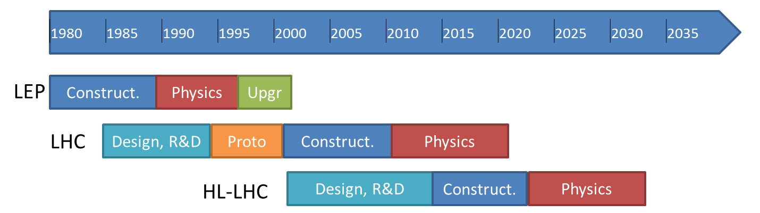

“CERN should undertake design studies for accelerator projects in a global context, with emphasis on proton-proton and electron- positron high-energy frontier machines.”
today
Project
Kick-off meeting: 11th Nov. 2013 (Daresbury)
FCC Study : p-p towards 100 TeV
Kick-off meeting: mid-February 2014
FCC: Future Circular Colliders

Slide 21
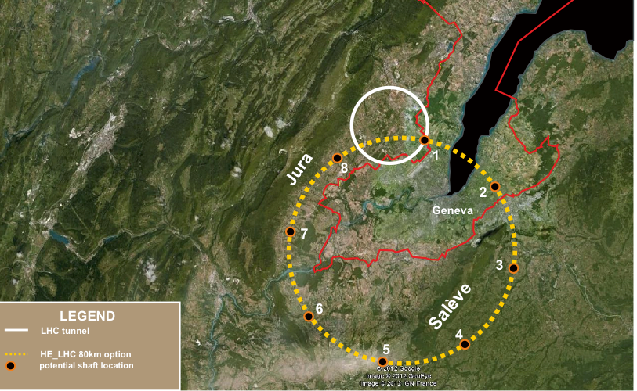
80-100 km tunnel infrastructure in Geneva area – design driven by pp-collider requirements
with possibility of e+-e- (TLEP) and p-e (VLHeC)
Conceptual Design Report and
cost review for the next ESU (≥2018)
FCC Design Study
Kick-off Meeting:
12-14. February 2014 in Geneva area
Establishing international collaborations
Set-up study groups and committees
15 T ⇒ 100 TeV in 100 km
20 T ⇒ 100 TeV in 80 km

Slide 22
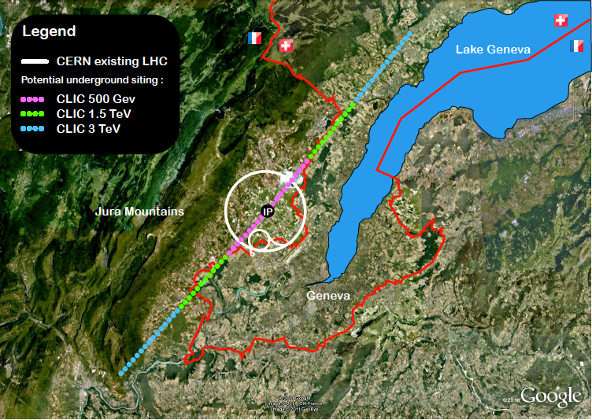
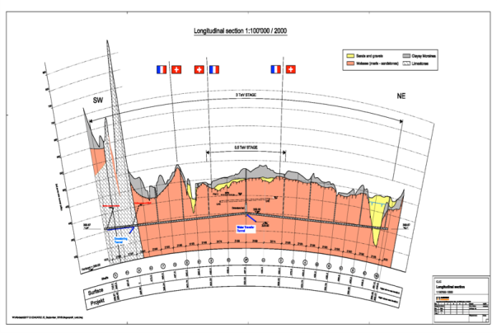
CLIC near CERN
Conceptual Design Report published
R&D continues (accelerator and detector)
in the framework of the LC effort and the
CLIC collaboration
(e.g. high gradient accelerating structures)
Tunnel implementations (laser straight)
Central MDI & Interaction Region

Slide 23
European Strategy for Particle Physics
High-priority large-scale scientific activities
After careful analysis of many possible large-scale scientific activities requiring significant resources, sizeable collaborations and sustained commitment, the following four activities have been identified as carrying the highest priority.
e) There is a strong scientific case for an electron-positron collider, complementary to the LHC, that can study the properties of the Higgs boson and other particles with unprecedented precision and whose energy can be upgraded. The Technical Design Report of the International Linear Collider (ILC) has been completed, with large European participation. The initiative from the Japanese particle physics community to host the ILC in Japan is most welcome, and European groups are eager to participate. Europe looks forward to a proposal from Japan to discuss a possible participation.
At CERN ILC efforts continue
in the framework of the LC efforts.
Hosting LCC Directorate at CERN

Slide 24
European Strategy for Particle Physics
High-priority large-scale scientific activities
After careful analysis of many possible large-scale scientific activities requiring significant resources, sizeable collaborations and sustained commitment, the following four activities have been identified as carrying the highest priority.
f) Rapid progress in neutrino oscillation physics, with significant European involvement, has established a strong scientific case for a long-baseline neutrino programme exploring CP violation and the mass hierarchy in the neutrino sector.
CERN should develop a neutrino programme to pave the way for a substantial European role in future long-baseline experiments. Europe should explore the possibility of major participation in leading long-baseline neutrino projects in the US and Japan.

Slide 25
CERN Neutrino “Platform”
- enable large scale detector development and tests for
neutrino detectors:
WA104 refurbish ICARUS T600
R&D on new Large LAr detector (“ICARUS++”)
R&D for air core muon detector
WA105 R&D on 2-phase LAr prototype
study for a neutrino (test)beam in the North Area started
Discussion with US (Fermilab) started concerning LBNE
common efforts on detector AND accelerator topics
Needs global collaboration and long-term sustained efforts and support

Slide 26
Global Collaboration
To realise our ambitious accelerator based large scale facilities and to fully exploit their excellent physics capabilities we need
coherent and strong efforts in all regions;
long term stability and support in all regions;
careful adjustment of schedules for these facilities
Global collaboration
≡
Global Partnership
with
long-term support

