Slide 2
LIU for HL-LHC
- Presentation on the LIU project with a summary of their RunI performance and projections for RunII (BCMS) with an outline of outstanding tests and improvements -
S. Gilardoni for the LIU project
Input from: H. Bartosik, G. Iadarola, Y. Papaphilippou, G. Rumolo,
E. Shaposhnikova, G. Arduini, T. Argyropoulos, J. Bauche,
T. Bohl, K. Cornelis, P. Costa Pinto, H. Damerau, R. de Maria, D. Manglunki,
J. Esteban Müller, R. Garoby, B. Goddard, S. Hancock,
W. Höfle, M. Meddahi, B. Mikulec, M. Taborelli, H. Timko, R. Wasef

Slide 3
Luminosity and injectors performances
Maximum number of bunches
depends on RF gymnastics
(aka production scheme) chosen in PS
plus number of PS injections in SPS*
Maximum Intensity per bunch limited by
longitudinal beam stability in PS and SPS
and maximum RF power available in SPS
LIU goal:
maximise number of protons
circulating in the LHC while
delivering sufficiently small emittances
both @ LHC injection
Minimum possible emittance deliverable is given by the Linac (L2 or L4)
Emittance conservation limited by Space-charge in PS and SPS
* Once fixed the gaps for kicker rise times (PS, SPS, abort gap)

Slide 4
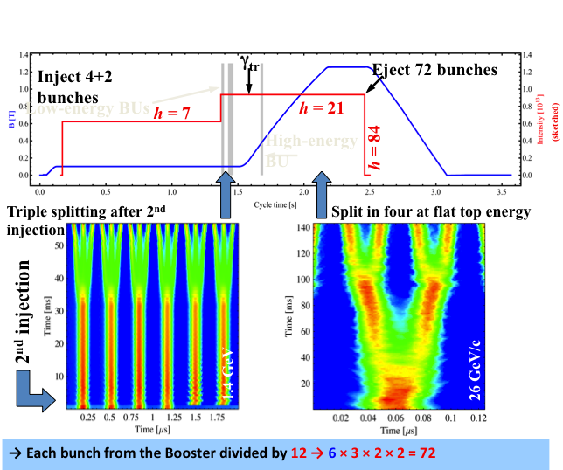
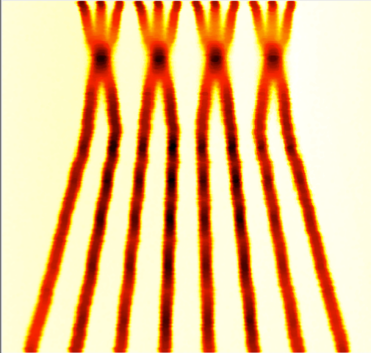
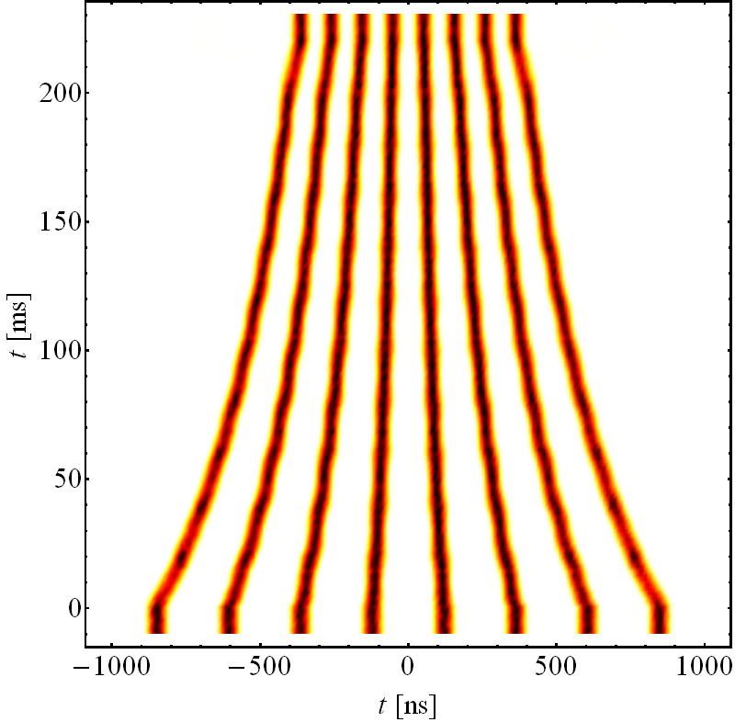
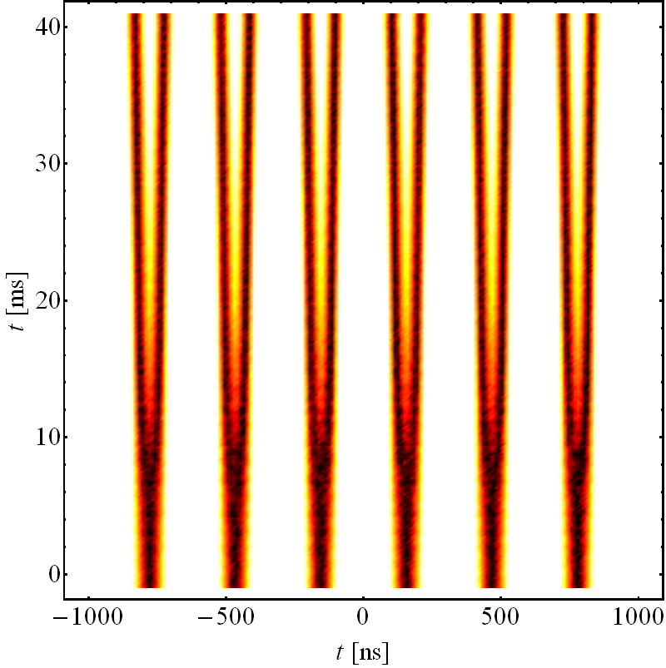
Catalogue of Possible production schemes - 25 ns
Schemes 25 ns | PSB – PS bunches | RF gym. in PS | RF gym. at injection | RF gym. at extraction | b/Train to SPS | SPS injections
3-spitting (standard scheme) | 4 + 2 | /3 ↗ /2 /2 |  |  | 72 | 4
BCMS | 4 + 4 | +2C/3↗/2 /2
 |  |  |  |  | 48 | 5
BCS | 4 + 4 | C ↗ /2 /2
 |  |  |  |  | 32 | 5
8b+4e | 4 + 2 | /2 ↗ /2 /2
 |  |  |  |  | 48 | 5
/ Splitting C Batch Compression + Merging ↗Acceleration to 26 GeV/c

Slide 5
How LIU performances are presented
RF limit* : PS or SPS
Space charge limits* in
PSB/PS/SPS
Present situation
Achieved performance
HL - LHC
Non accessible
beam parameters
*limits = preserve
same beam quality
as today

Slide 6
Standard scheme (72 bunches / PS batch)
LIU upgrades
on top of L4 connection
  SPS 200 MHz upgrade
  SPS e-cloud mitigation
  PSB-PS transfer at 2 GeV
Limitations standard scheme
  SPS: longitudinal instabilities + beam loading
  PSB: brightness
Performance reach
  2.0x10¹¹p/b in 1.88μm
  (@ 450GeV)
  1.9x10¹¹p/b in 2.26μm
  (in collision)
after connection
of Linac4

Slide 7
BCMS scheme (48 bunches / PS batch)
LIU upgrades on top of the
Linac4 connection
  SPS 200 MHz upgrade
  SPS e-cloud mitigation
  PSB-PS transfer at 2 GeV
Limitations BCMS scheme
  SPS: longitudinal instabilities + beam loading
  PS: space charge
  SPS: space charge
Performance reach
  2.0x10¹¹p/b in 1.37μm (@450GeV)
  1.9x10¹¹p/b in 1.65μm
  (in collision)

Slide 8
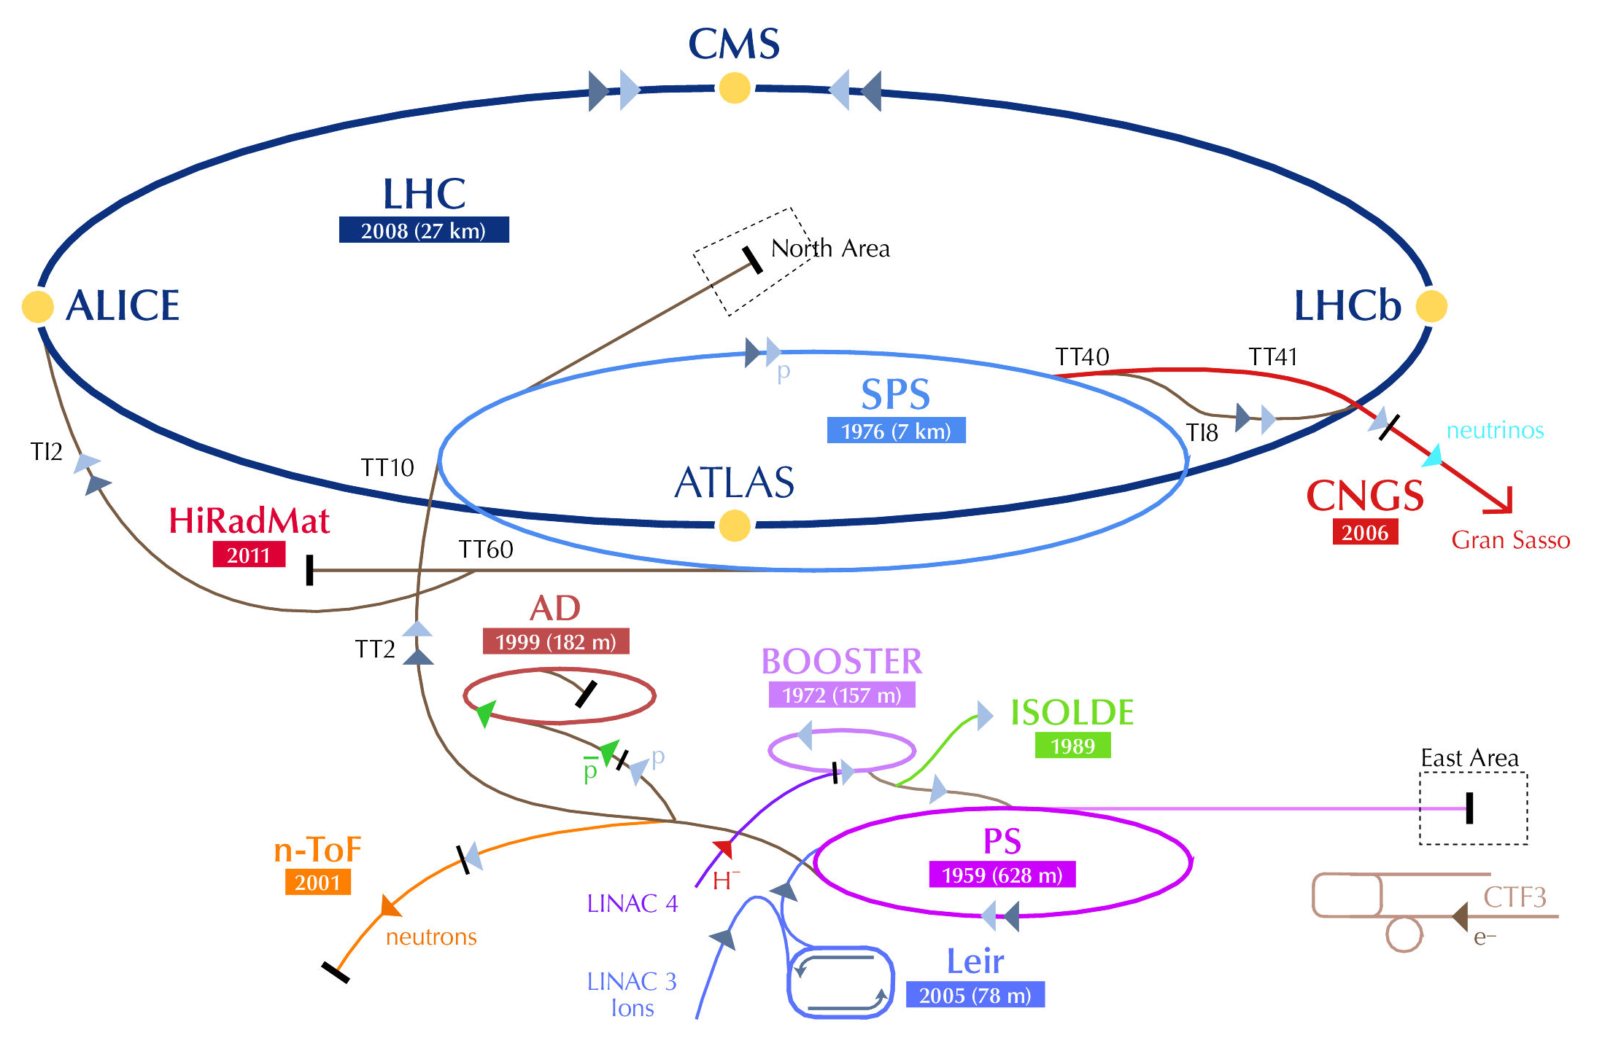
LHC injectors upgrade Goals
Present
LIU (2019)
Proton flux / Beam power
50 MeV
Linac2
Linac4
160 MeV
1.4 GeV
PSB
2.0 GeV
PSB
26 GeV
Output energy
PS
PS
450 GeV
SPS
LHC /
HL-LHC
7 TeV
“The LHC Injectors Upgrade should plan for delivering reliably to the LHC
the beams required for reaching the goals of the HL-LHC. This includes LINAC4, the PS booster, the PS, the SPS, as well as the heavy ion chain…” (This is the mandate … Upgrade of Brightness)
+ determine possible improvements for high intensity beams.

Slide 9
Upgrade Timeline*
Priority to Injectors
Duration ~ 20 Months
Linac 4 ready
PSB H⁻ injection could be available
PSB-PS transfer 1.4 GeV → 2 GeV
Chamonix 2012
Priority to LHC
LS1 for injectors
LS2 for injectors
2012
2013
2014
2015
2016
2017
2018
2019
Analysis
of different
limitations and
parameters definition
LIU Project Baseline definition
Linac 4 connection
SPS aC coating, 200 MHz power upgrade completed
Injectors commissioned to be ready for after LS3
LS = Long Shutdown - No beam
* Pending RLIUP outcomes

Slide 10
Project Organization Breakdown Structure
Director of Accelerators and technology - Steve Myers
LIU Project team
Roland Garoby (Project Leader) - Malika Meddahi (Deputy) - Brennan Goddard (LIU-SPS machine coordinator) - Simone Gilardoni (LIU-PS machine coordinator) - Klaus Hanke (LIU-PSB machine coordinator) - Maurizio Vretenar (Linac4 Project Leader)- Anne Funken (Project Safety Officer)-Django Manglunki (LIU-Ion chain coordinator)
LIU-PSB coordination team
K.Hanke - MC
B.Mikulec – DMC
V.Raginel – SS
LIU- PS coordination team
S.Gilardoni – MC
H. Damerau– DMC
C. Y. Vallgren - SS
LIU-SPS
coordination team
B.Goddard - MC
E.Shaposhnikova – DMC
G.Rumulo – SS
LIU-Project Safety coordination
A. Funken
Linac4 Project
M.Vretenar - PL
A.Lombardi -DPL
LIU- Ion coordination team
D. Manglunki – MC
B. Holzer – DMC
M. Bodendorfer - SS
LIU Administrative Support: Cécile Noels, Nadine Audrey. Project Support: Pierre Bonnal, Sylvain Weisz, Tadeusz Kurtyka - EVM coordinators: De Jonghe, Benoît Daudin

Slide 11
2012 performance (@SPS extraction)
25 ns
Trains of 72 bunches to SPS
Used for the LHC scrubbing run in 2012
Trains of 48 bunches to SPS
Used for the LHC pilot physics run in 2012
Measurement points
Emittances deduced from combined wire-scans at end of SPS flat bottom
(values cross-checked with LHC)
Error bars include spread from several measurements as well as systematic uncertainty (10%)
Intensity measured at SPS flat top after scraping

Slide 12
2012 performance (@SPS extraction)
25 ns
25 ns
 | Δε_{x,y}/ε_{x0,y0} | ΔN/N₀
PS | 5% | 5%
SPS | 10% | 10%
Projected lines derived from the measured brightness curve of the PSB translated into SPS flat top applying budgets (see table)
The traditional 25 ns beam suffers about 15% extra losses and/or emittance growth (slow losses at the SPS FB, PS space charge, electron cloud)

Slide 13
Beams expected @ SPS extraction in 2014-15
 |  | Bunch intensity [10¹¹ p/b] | Transv. Emittance** [1 σ norm, mm.mrad] | Bunches per batch (@ SPS inj.) | PSB rings | Harm. @PS inj.
Baseline for physics | 25 ns**** | 1.15 | 2.8 | 72 | 6 | 7
 | 25 ns BCMS | 1.15 | 1.4 | 48*** | 8 | 9
Eventually for startup | 50 ns | 1.65 | 1.7 | 36 | 6 | 7
 | 50 ns BCMS | 1.6 | 1.2 | 24 | 8 | 9
** Transverse Emittance= (ε_{h}+ε_{v})/2
Beam are produced approx. round: linear coupling in PS used to avoid Head-tail instability
After LS1 it would be possible to have less round beams if needed.
*** Filling scheme with batches of 48 bunches exists giving a reduction of 8%
in Luminosity compared to the same scheme with 72 bunches
**** Better performances measured during scrubbing run: 1.15 10¹¹ p/b, 2.4-2.5 mm.mrad
1.4 10¹¹ p/b produced but no emittance measurements available@SPS

Slide 14
Possible performance improvements after LS1 ?
25 ns beam (both standard production and BCMS) already very close to the limits in injectors
  Intensity per bunch → 10% from the limit due to the SPS constraints
  Brightness → At the limit for space charge in the PS
Higher intensity
  In 2012 SPS MD in which 1.35 x 10¹¹ ppb were accelerated, but with degraded beam quality at 450 GeV/c (longitudinal instabilities, e-cloud ?)
  In any case, max 1.3 x 10¹¹ ppb can be presently extracted from the SPS compatibly with RF power and longitudinal instabilities limitations
Higher brightness
  RF manipulations in the PS @2.5 GeV (instead of 1.4 GeV)
    Larger longitudinal emittance from the PSB
    Space charge alleviated by both longer bunches and larger momentum spread
  PSB control of longitudinal parameters along the cycle

Slide 15
Potential improvement after LS1
(standard scheme – longer bunches PS-PSB transfer)
Present situation
With new longitudinal parameters
Achieved performance

Slide 16
Potential improvement after LS1
(BCMS – longer bunches PS-PSB transfer)
Present situation
With new longitudinal parameters
Achieved performance

Slide 17
Pure batch compression (BC) scheme
Alternative production scheme for 25 ns beams
Pure batch compression at 2.5 GeV (from h=9 to h=21)
Twice double splitting at FT
Trains of 32 bunches to the SPS
Extra-bright 25 ns beam
Trains of 32 bunches can relax the electron cloud issues in the LHC
About 13% lower # of bunches in the LHC
Production and transport of beams with sub-μm transverse emittance not yet demonstrated

Slide 18
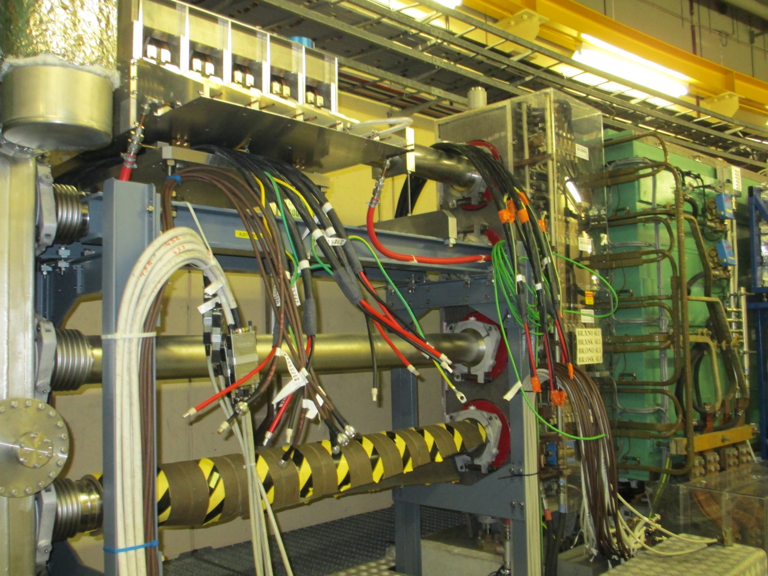
PSB @ 2 GeV : space-charge reduction at PS injection
PSB extraction energy upgrade needed
to reduce space-charge effects at PS injection
2 GeV upgrade requires
(only main elements cited) :
New main power supply (POPS-like)
Main Magnet cooling
New External dump
Main Magnet power distribution
New extraction elements
New transfer line elements
New external beam dump
New RF system
New 2 GeV PS injection elements
Finemet @ R4

Slide 19
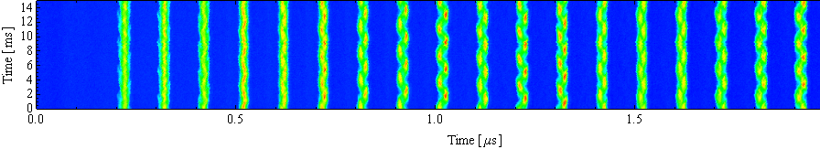
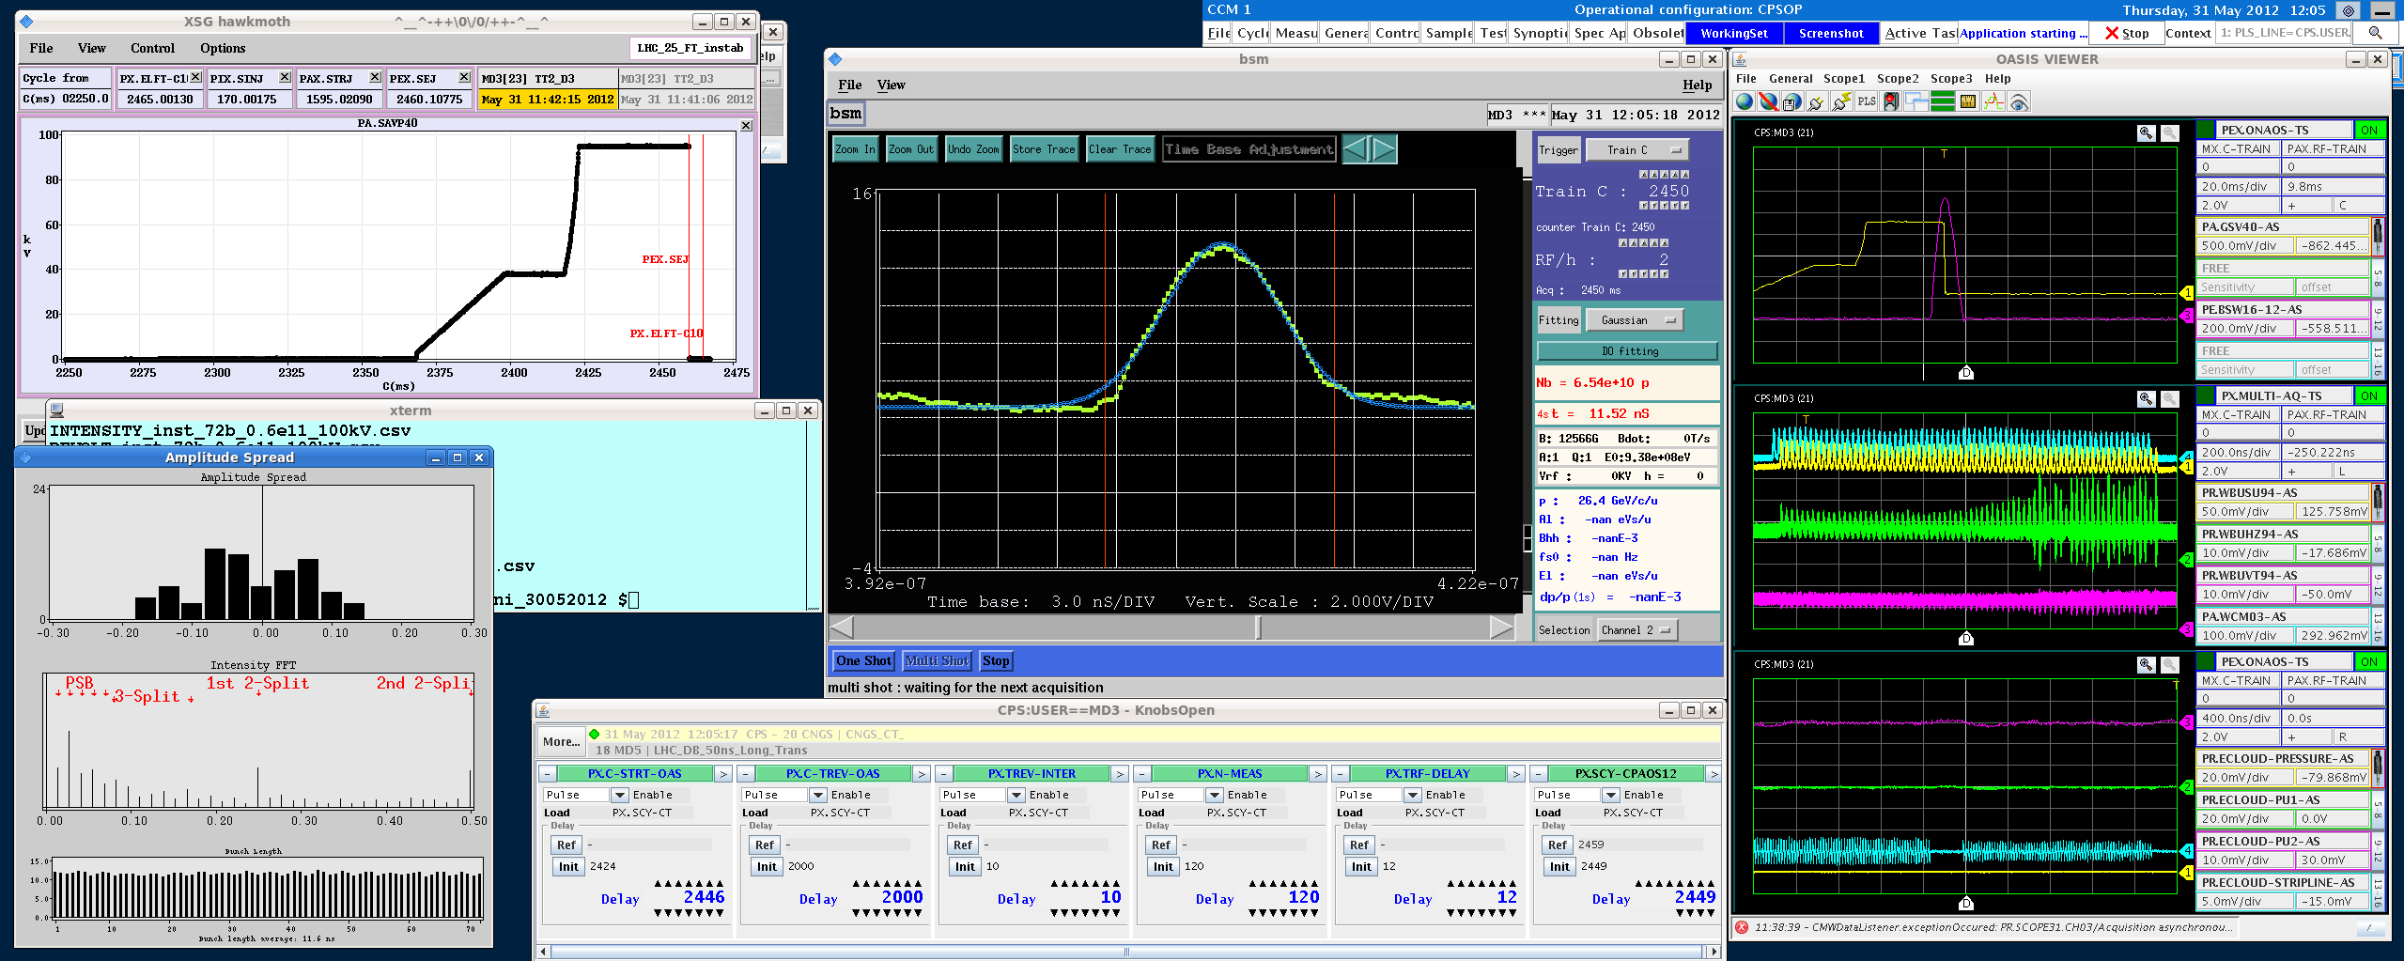
Challenges in the PS
Acceleration/Bunch splittings
Longitudinal CBI → new damper
Transient beam loading → 1 turn delay FB
Transition crossing → no limitation expected
Flat top:
Longitudinal CBI → new damper
Electron cloud → transverse FB
Transverse instabilities → transverse FB
Injection flat bottom:
Space charge → 2 GeV injection upgrade
Headtail instability → transverse FB
Injection flat bottom:
Space charge → higher brightness with 2 GeV
Headtail instability → transverse FB

Slide 20
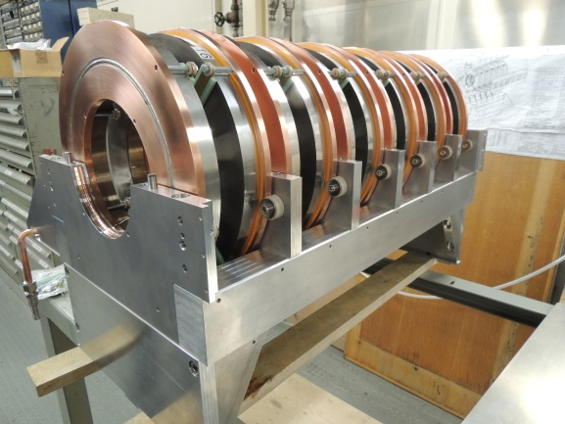
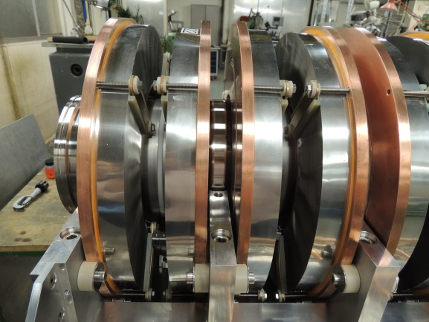
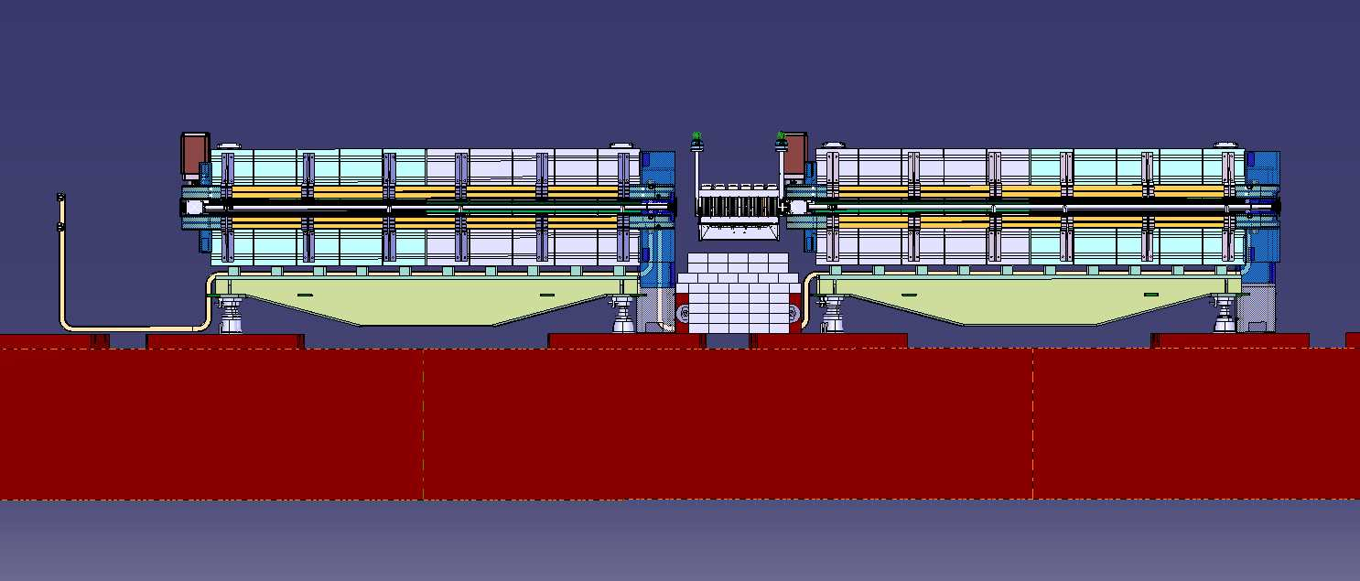
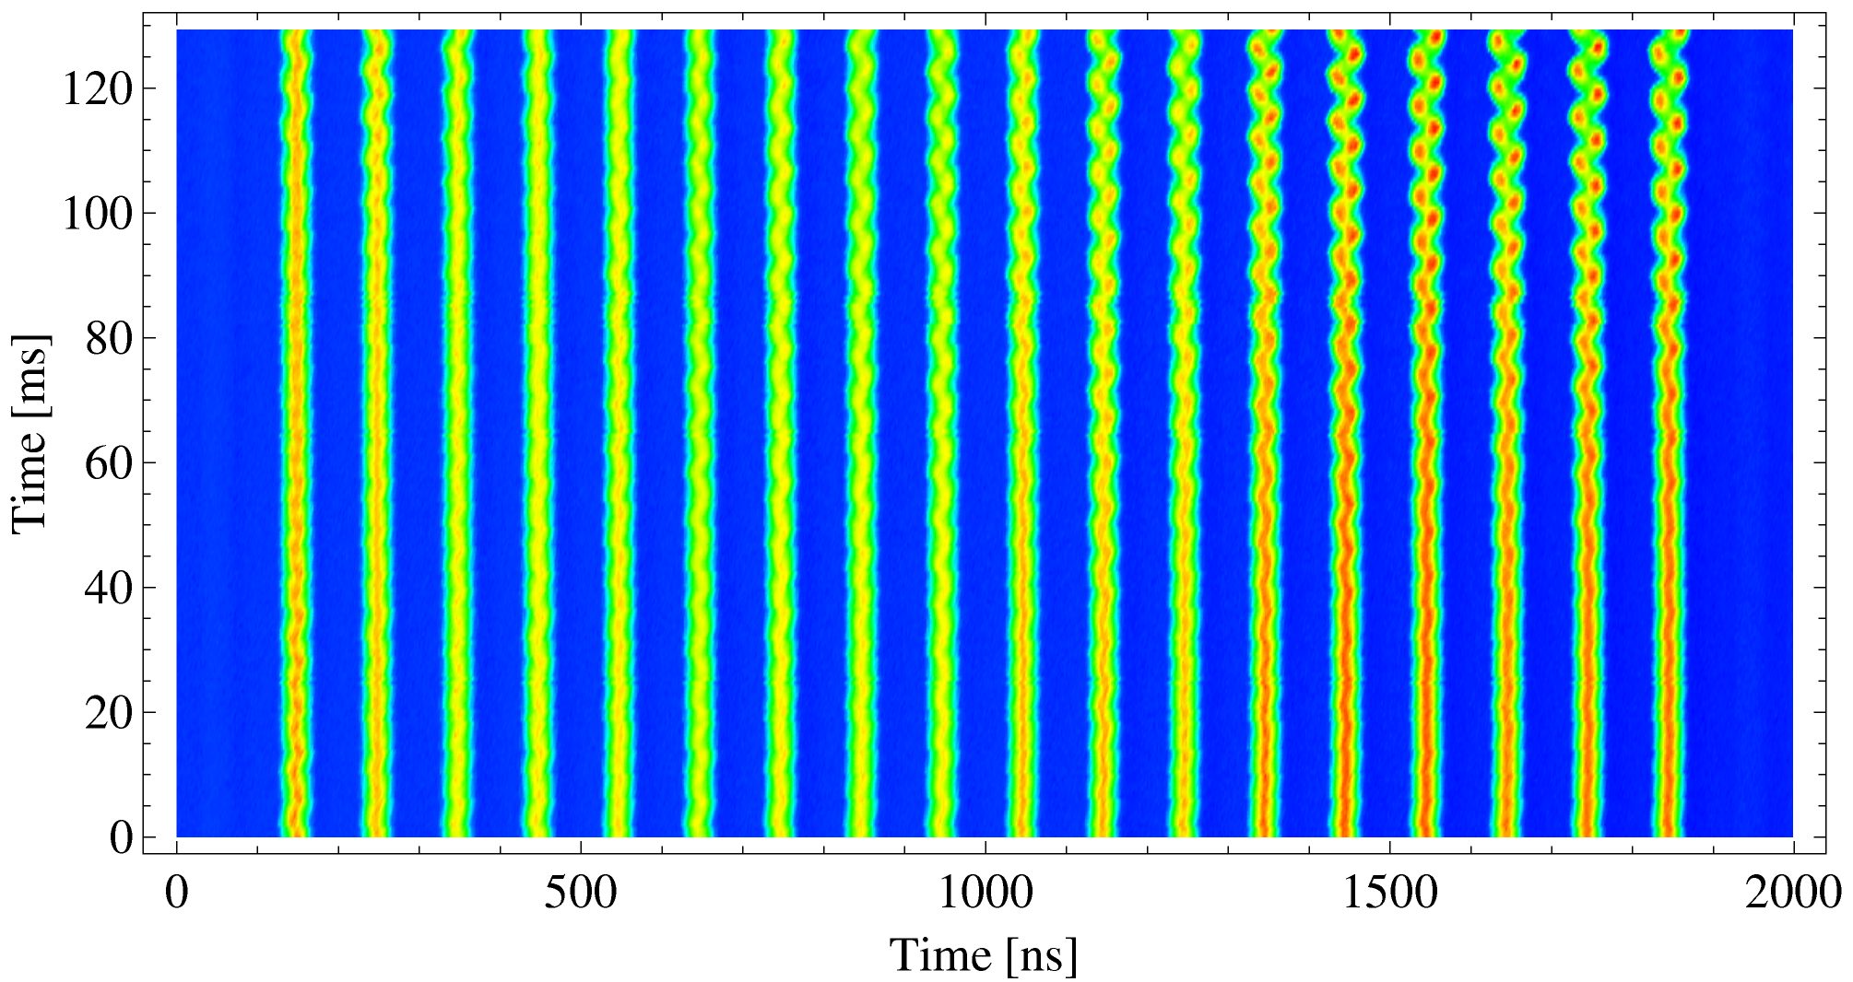
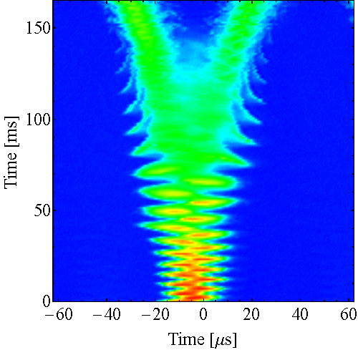
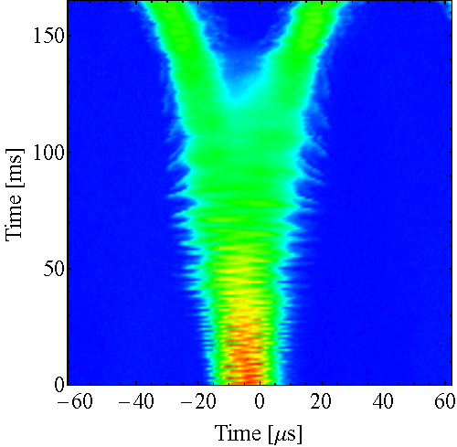
Longitudinal Coupled bunch instabilities
PS cavities assembled
Longitudinal CB instabilities
appear after transition
With new dedicated longitudinal
damper possible to reach
more than 2.5e11 p/b at extraction.
Finemet cavity installed during LS1
Frequency : 0.5-5.5 MHz.
Peak voltage : up to 5 kV.
6-cells cavities.
Each cell with one gap and 2 Finemet® cores.
Each cell driven by two 2.5 kW solid-state amplifier.
Water cooled cavities and amplifiers.
FB OFF
FB ON

Slide 21
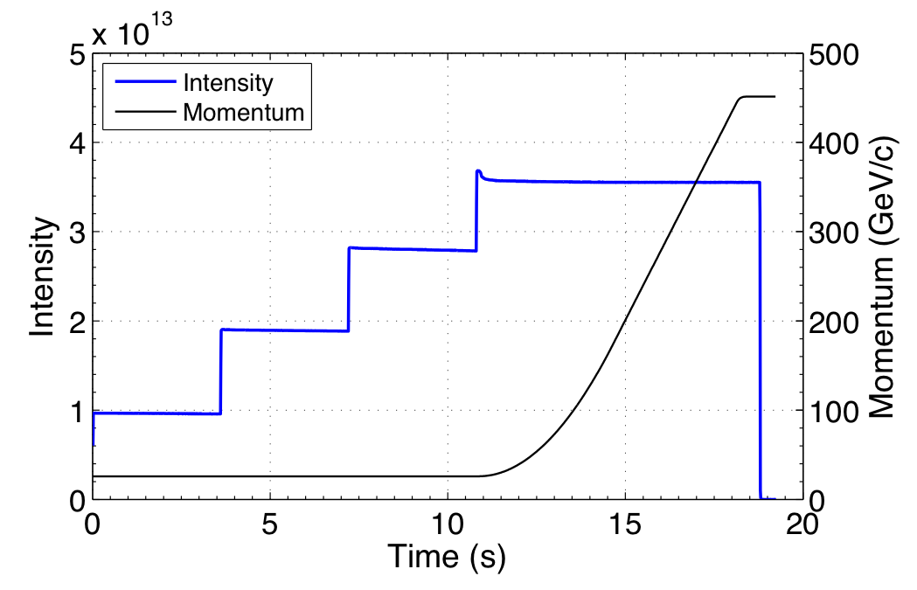
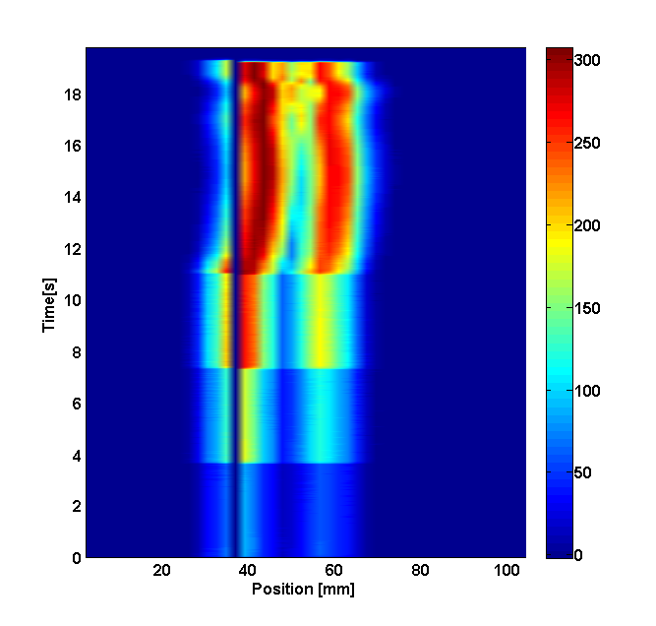
SPS limitations overview
Ramp and flat top:
Longitudinal instability
Beam loading
RF power
Along the whole cycle:
Electron cloud for 25 ns
Injection flat bottom:
Capture losses, incoherent losses
Space charge
TMCI

Slide 22
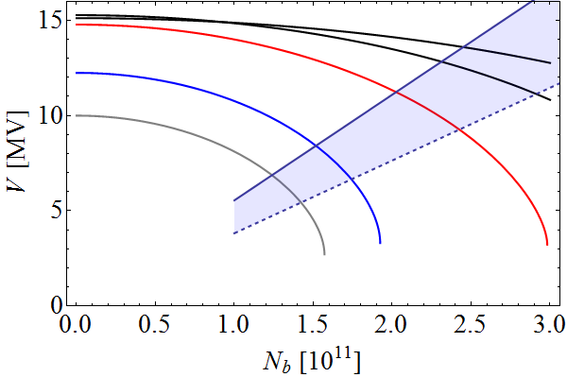
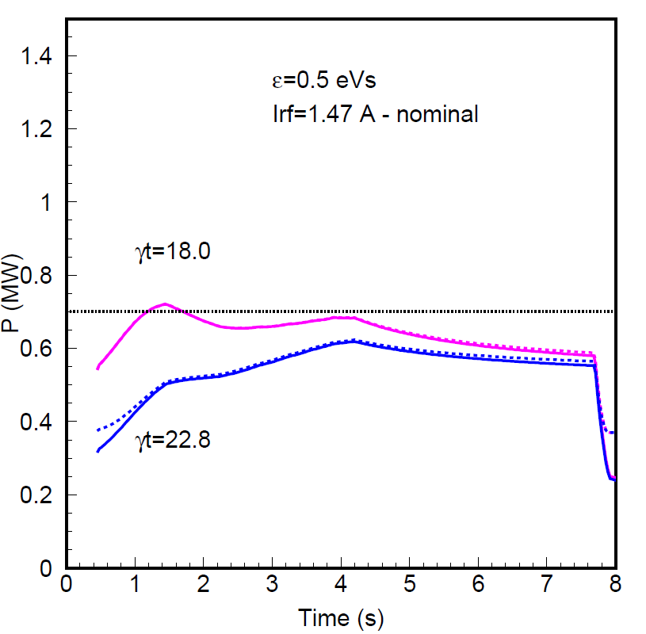
SPS 200 MHz travelling wave RF cavities
RF voltage at transfer to LHC
4×3+2×4
10×2
Total 200 MHz Power/cavity limit:
  Presently 0.7 MW (continuous mode)
  Around 1.05 MW for ½ ring in pulsed
  mode with new LLRF
  Limit reached already during acceleration
Beam loading: less voltage available
for higher intensity!
Bunch length at extraction fixed by LHC acceptance
Upgrade:
  Rearrange 4 existing cavities into 6
    2x4+4x3 = 20 sections, with 2 spare sections
    gives also 20% less impedance
  2 additional new power
  plants with 1.6 MW each
2×4+2×5
4×3+4×2
P_{old} = 1.05 MW
P_{new} = 1.6 MW
Z/n today
Q20 optics
τ = const, LD+PWD
LD: Loss of Landau damp.
PWD: Potential well dist.
Power/cavity (nominal intensity)
Q20
present power limit
Q26

Slide 23
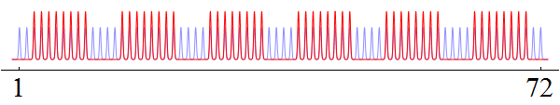
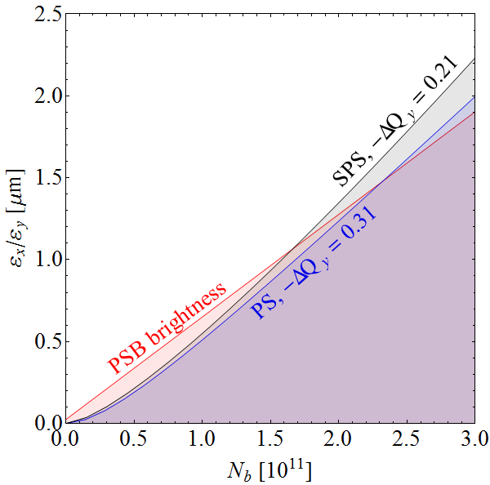
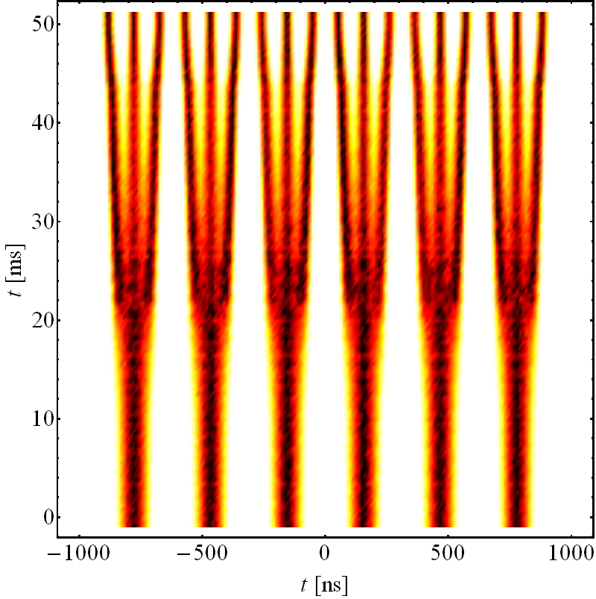
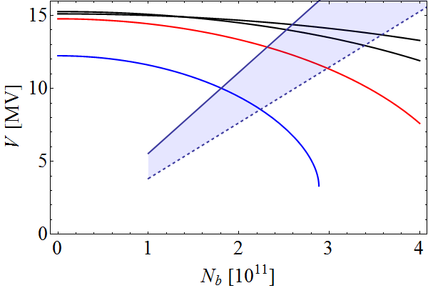
8b+4e scheme in the SPS
Line density averaged over 0.3 ms (≈t_{fill}/2) reduced by 2/3 at constant N_{b}
  50% more intensity per bunch for the same beam loading
No benefit for single-bunch instability effects
4×3+2×4
10×2
E_{kin} = 2.5 GeV
4×3+4×2
2×4+2×5
  Simulation
t = const, LD+PWD
LD: Loss of Landau damp.
PWD: Potential well dist.
N_{b} ≈ 3 · 10¹¹ ppb reachable assuming SPS impedance reduction by 50%
First beam tests after LS1 possible
4 bunches missing every 8 bunches → improvement for e-cloud
50% less bunches in LHC, but with significantly higher intensity

Slide 24
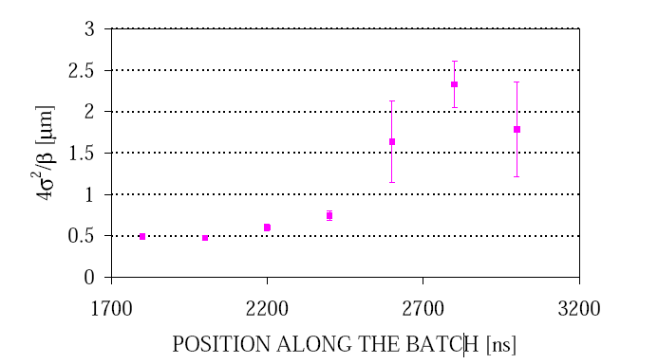
e-cloud and scrubbing in the SPS
2000 (48 b. - 0.8x10¹¹ p/b @inj.)
Strong limitation due to e-cloud in the past
  Instabilities at injection + incoherent effects
  Emittance blow-up along the batch
  High chromaticity needed for beam stability
  Pressure rise around the machine
Situation improved gradually due to scrubbing
  Secondary Electron Yield reduction by e-cloud itself
Scrubbing runs since 2002 → 2012 no beam degradation
  Performed at injection (~40 s cycle length)
  Typically limited by heating and/or outgassing
  ~1-2 weeks periods
SPS scrubbing history
400%
3.5 μm
2012 4x72 bunches (1.15x10¹¹ p/b @inj.)
2002
(14d)
2003
(8d)
2004
(10d)
2006
(5d)
2007
(7d)
2008
(2.5d)
2009
(1.5d)
2012
(5d)
Shutdown

Slide 25
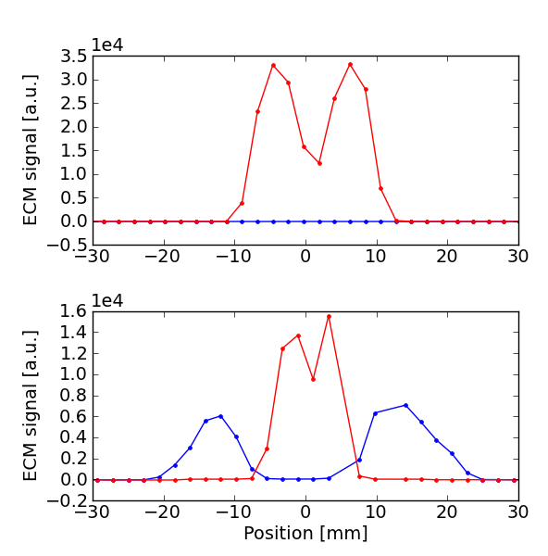
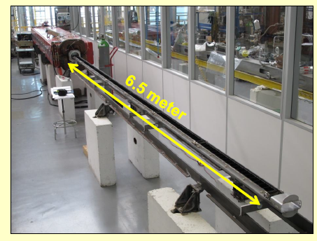
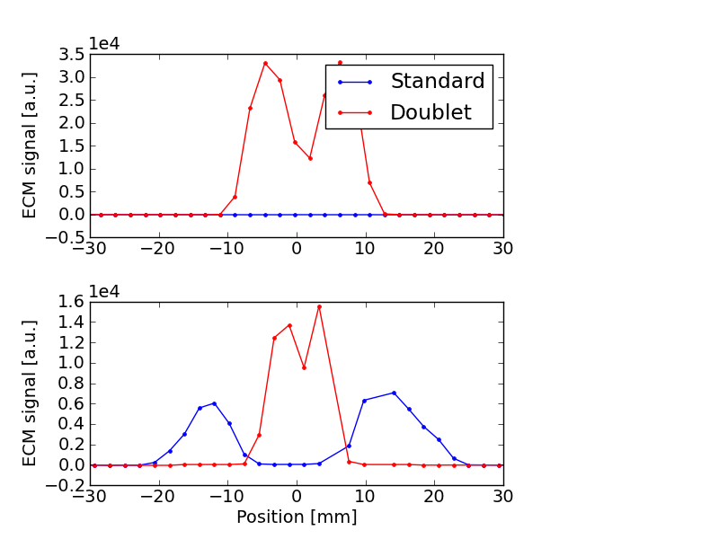
Future: scrubbing or coating ?
Thin a-C film a-C provides low SEY
Suppression of e-cloud in prototype chambers demonstrated with beam in SPS
4 SPS half cells (including quadrupoles) with a-C coating ready for the startup in 2014
→ further tests with beam after LS1
New Scrubbing technique:
Injection of long bunches into SPS (with 25 ns spacing)
Capturing each bunch in 2 neighboring 200 MHz buckets
Successfully tested in MDs at the end of 2012/13 run
with 1.6x10¹¹ p/doublet. New tests after LS2
Clear enhancement on e-cloud detectors compared to
standard 25 ns beam measured
1.6x10¹¹ p/doublet
MBA
1.6x10¹¹ p/b
25 ns
5 ns
1.6x10¹¹ p/doublet
MBB
1.6x10¹¹ p/b
by mid 2015: decide if coating should be applied or scrubbing is sufficient

Slide 26
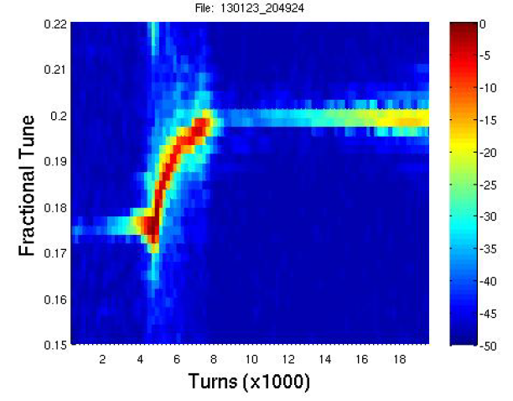
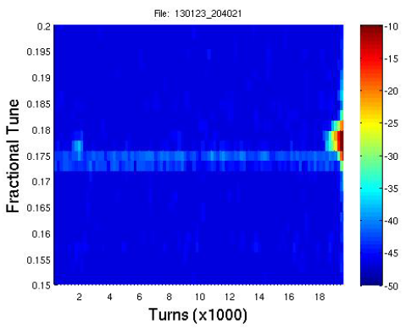
High bandwidth transverse feedback (CERN/LARP)
High bandwidth (intra-bunch) feedback could help
  fight electron cloud instabilities
  improve beam quality during scrubbing → faster and more efficient machine scrubbing
  avoid running with high chromaticity settings → better beam lifetime and emittances
  stabilize the scrubbing beam (present damper cannot cope with “pi-mode” oscillations of doublets)
MD studies in 2012/2013 using a 200 MHz stripline pickup as kicker
  Feedback stabilizes the bunch → clearly works for dipole mode
Chromaticity ramped down
(below zero)
single bunch (1x10¹¹ p/b)
Chromaticity ramped down
(below zero)
Q26
Q26
Instability
Fractional Tune
Tune shift due to Beam loss
Fractional Tune
Feedback switched OFF
Instability
Feedback off
Feedback active
Turns (x1000)
Turns (x1000)

Slide 27
Ions Upgrades and studies
Linac 3: increase intensity
  10 Hz pulsing (included in consolidation - PIC)
  multiple charge acceleration (unsure of benefit for LEIR)
LEIR: Intensity limitation
  ~+40% needed for additional splitting, but cause presently unknown
PS: 50 ns splitting or batch compression near transition
  Tests of 2-bunch batch compression to 50 ns with Ar
  New cavity (Finemet)
  Transition-distortion optics for high energy splittings; imperfections?
SPS
  PFL on MKP + MSI-V septum for 100ns rise time injection / batch spacing
  New beam control allowing RF gymnastics for slip-stacking
  Are resulting imperfections after slip stacking acceptable by the LHC?
  Improvement of beam behaviour on flat bottom (RF noise…)

Slide 28
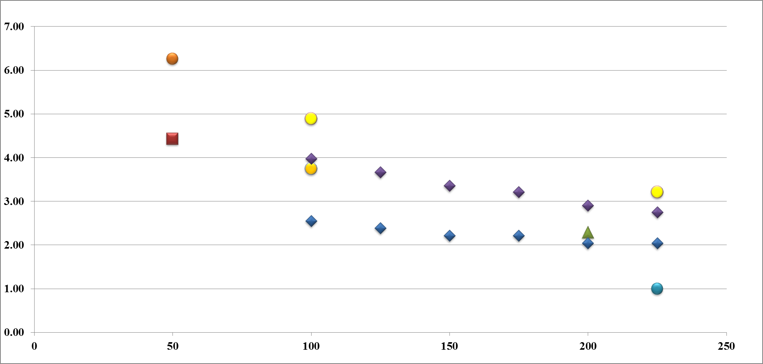
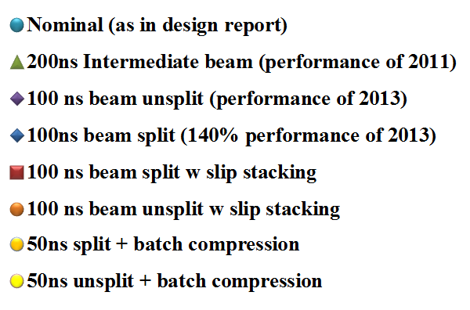
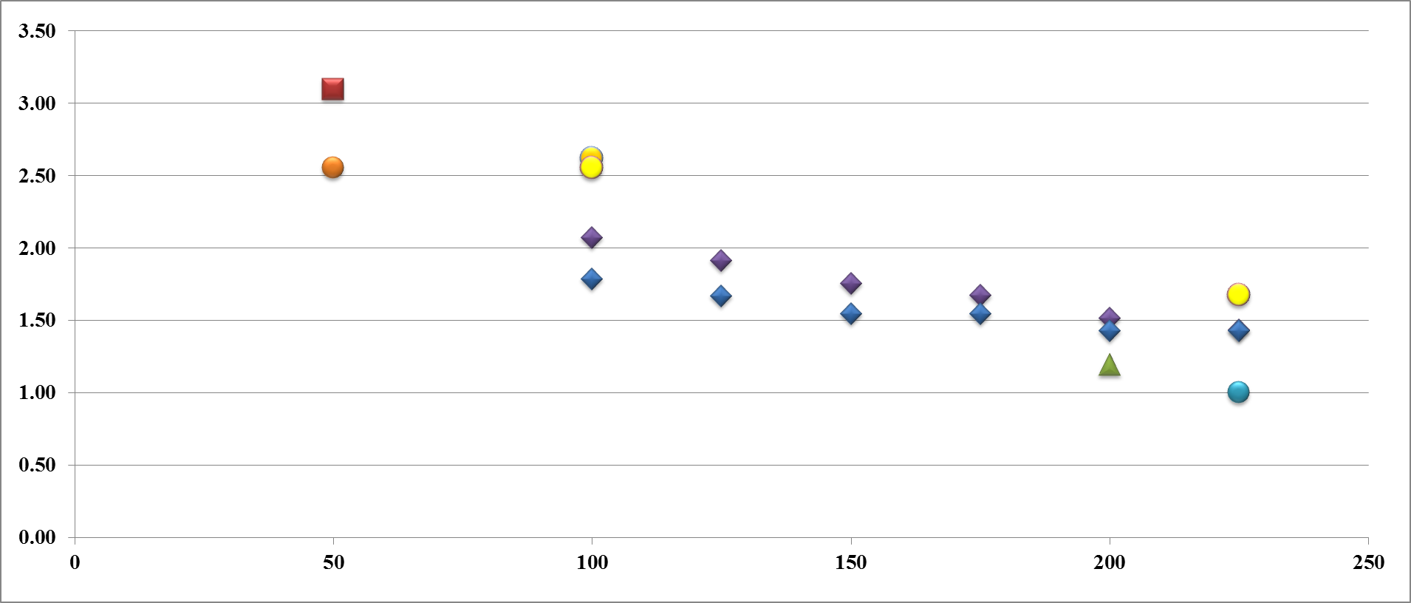
Pb-Pb Summary: Peak luminosity & intensity
(w.r.t. nominal) according to different schemes
Peak luminosity
Slip stacking
50ns batch compression in the PS
Proposed
Baseline (100ns)
2015
2011/2013
Nominal
Batch spacing in the SPS (ns)
Intensity/LHC ring
Batch spacing in the SPS (ns)

Slide 29
Conclusions
The beam characteristics foreseen after implementation of all of LIU
(25 ns, 2E11 p/b, 1.9 μm) are good enough for reaching the HL-LHC goal.
All LIU upgrades will be installed during LS2, including the L4 connection
Intermediate shutdowns will be used to minimize the duration and risks of LS2
Planning is an issue, particularly for the duration of LS2.
It will take ~3 years after the LIU hardware upgrades are installed to reach the promised beam characteristics, i.e., to be ready after LS3 for HL-LHC
The plan for upgrading the ion injectors is adequate for reaching the luminosity requested for ion physics.

Slide 30
Back-up slides

Slide 31
Assumptions for beam parameter estimation
- Scenario foreseen for the injectors:
  Brightness curve of Linac4 projected at PSB extraction
  all upgrade proposed for PSB/PS done (2 GeV + RF) + Linac4
  SPS: 200 MHz power upgrade, assumed e-cloud solved - possibly with aC coating of vacuum chambers
For beam quality preservation:
  Max Laslett tune shift in PS < |0.31|
  Max Laslett tune shift in SPS < |0.21|
  Max intensity in SPS@extraction with 200 MHz upgrade: 2.00 10¹¹ p/b
Losses and emittance blow up:
  LHC: 20% Emittance blow up, 5% losses
  SPS: 10% Emittance blow up and losses
  PSB/PS: 5 % Emittance blow up and losses
  No blow-up or losses in transfer between machines

Slide 32
2012 performance with standard production scheme: summary table

Slide 33
2012 performance with BCMS scheme: summary table

Slide 34
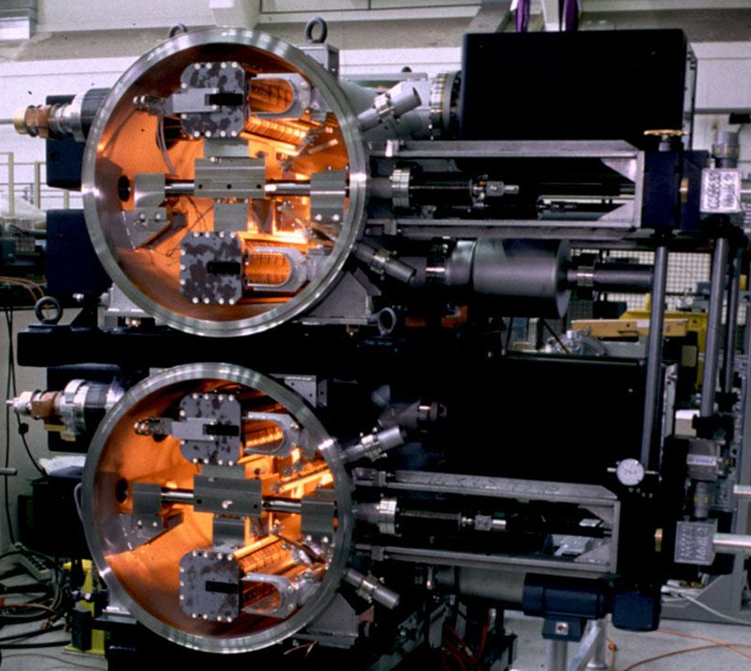
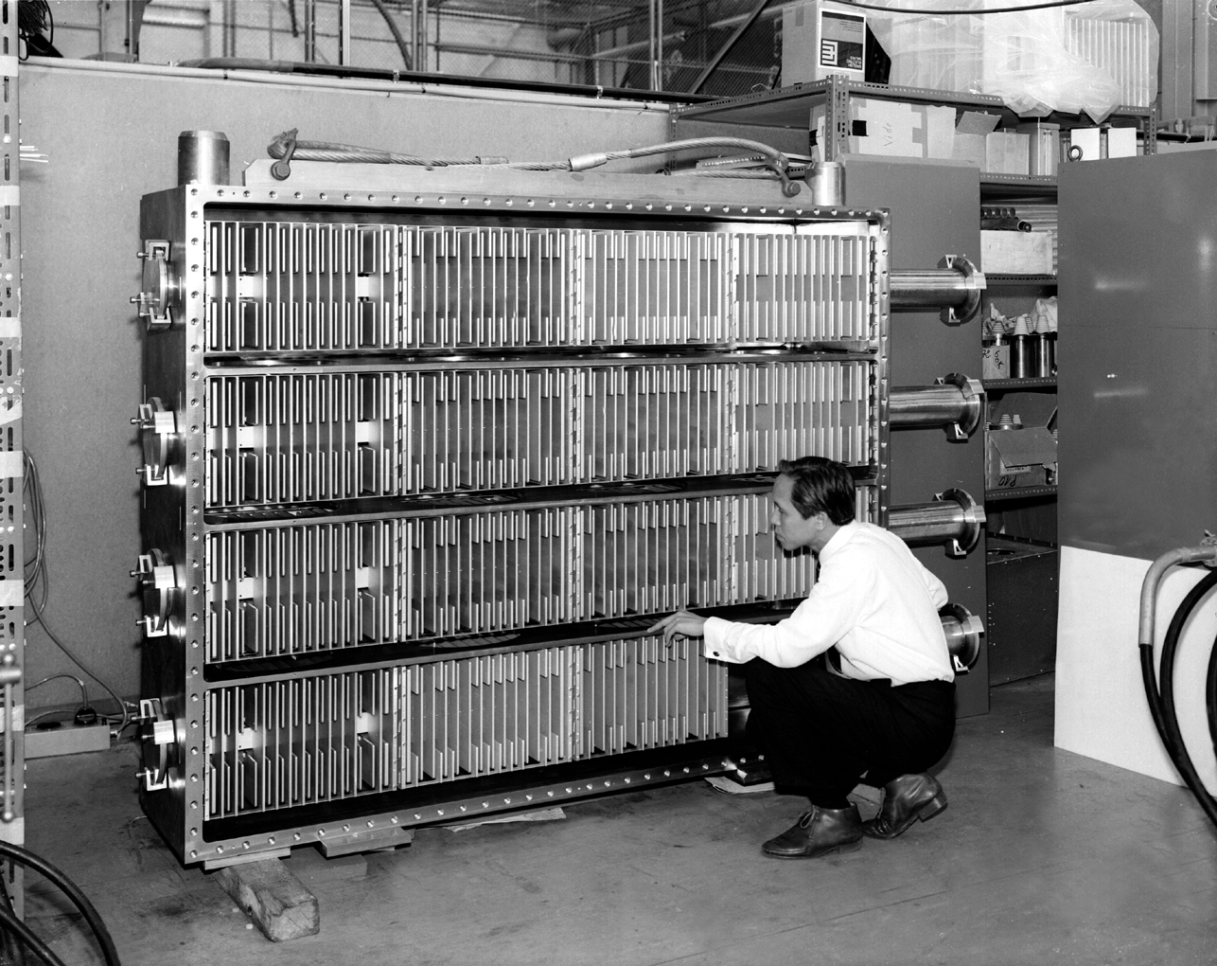
PSB 2 GeV extraction elements
PSB extraction bumpers → OK with present system
PSB extraction kickers → at the limit – to be measured which field can be reached in ferrites
PSB extraction septa: bus bars to be reinforced, magnets to be cooled in parallel to deal with increased RMS current
PSB recombination kickers → to be replaced

Slide 35
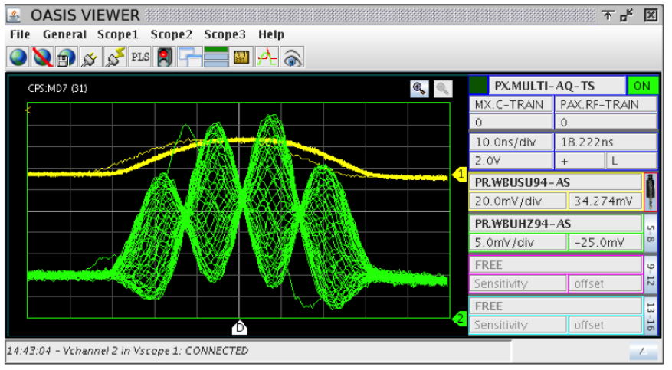
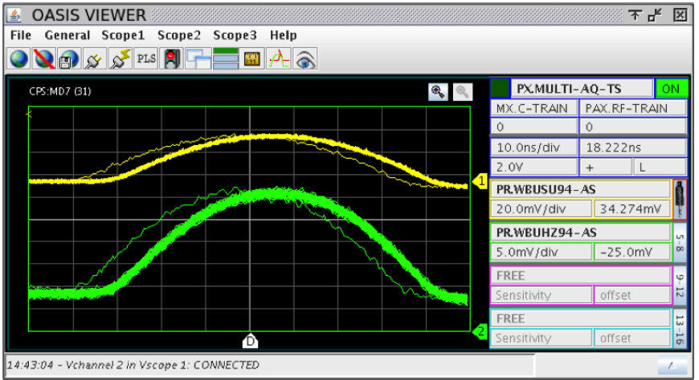
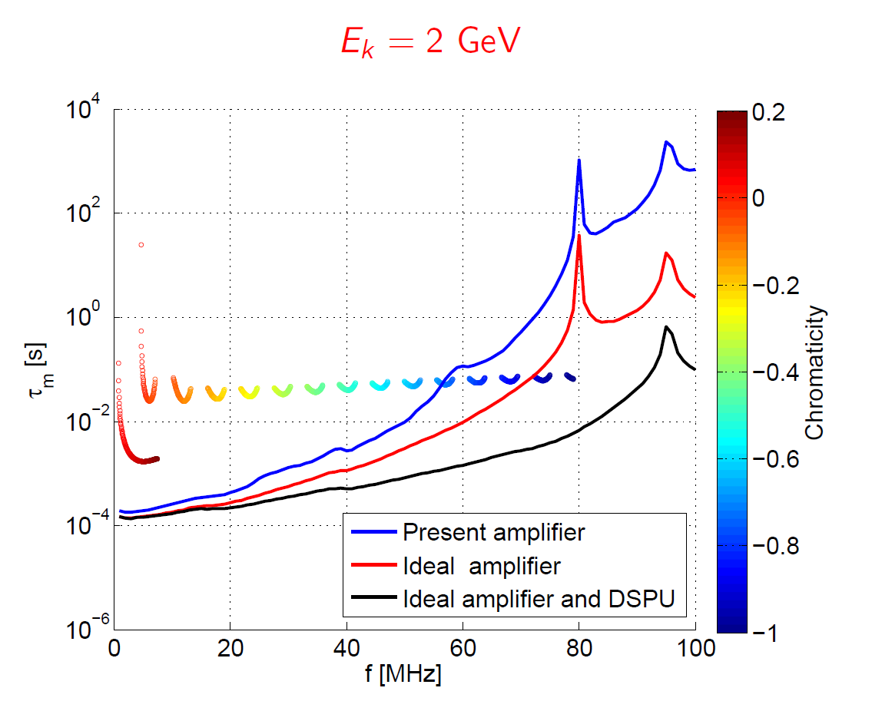
Headtail instabilities
Headtail instab. no T-damper
Headtail instab. with T-damper
Headtail instabilities on injection
flat bottom currently cured
by introducing linear coupling
T-Damper/TFB 2012-2013 studies:
cured headtail at 1.4 GeV
power upgrade for 2 GeV
future chromaticity control needed
to avoid high order modes
HT-Modes

Slide 36
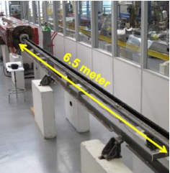
Scrubbing or coating? A possible strategy …
Oct.
SCRUBBING RUN I (2 weeks)
beams: nominal intensity
Goal: recover the 2012 performance
Risk: mixed with machine start-up
a-C coating (during LS2)
Nov.
2014
SCRUBBING RUN II (2 weeks)
beams: 2e11 p/b, scrubbing beam, …
Scrubbing successful for high intensity?
Mar.
2015
YES
NO
Jun.
Scrubbing qualification: No degradation for 2e11 p/b with 4x72 bunches and 6x48 bunches
Results from the 4 coated half cells
Simulations for higher brightness beams (from Linac4)
LIU-SPS Review: coating?
(after data analysis!)
Notes:
Scrubbing run I: operational recovery
Scrubbing run II: for LIU

Slide 37
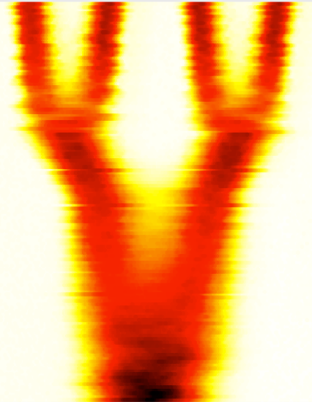
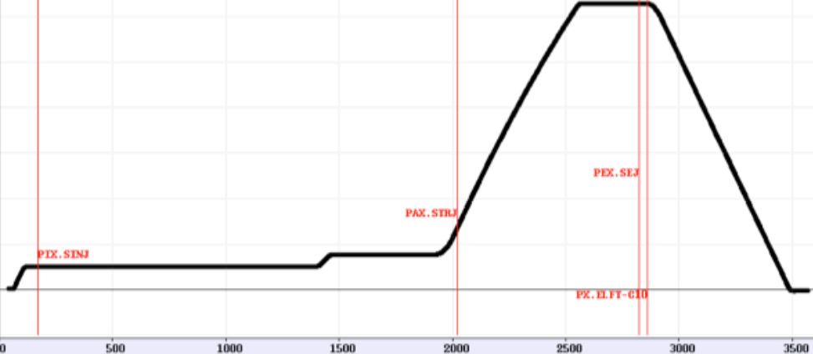
LHC 25(50)ns alternative scheme in PS: BCMS
Production scheme:
a) Double batch injection from PSB (4 + 4 bunches, 8 bunches for PS at h=9)
b) Up to 5 batches of 48 bunches each transferred to the SPS (240 bunches)
Transverse emittance produced in the PSB, longitudinal in the PS
- Multiturn proton injection in PSB with shaving
RF gymnastics in PS@2.5 GeV/c:
  Batch compression
  Bunch merging
  Triple splitting
Acceleration
2 x Double splittings
  (1 Double splitting for 50 ns)
Bunch rotation
BCMS “Batch Compression, Merging and Splitting in PS”
h = 9 →10 → 11→12 → 13 → 14 → 7 → 21
h = 21 → 42 → 84
4 bunches
+4 bunches
h = 9
h = 21

Slide 38
LHC 25ns alternative scheme in PS: BCS
Production scheme:
a) Double batch injection from PSB (4 + 4 bunches, 8 bunches for PS at h=9)
b) Up to 5 batches of 32 bunches each transferred to the SPS (240 bunches)
Transverse emittance produced in the PSB, longitudinal in the PS
- Multiturn proton injection in PSB with shaving
RF gymnastics in PS@2.5 GeV/c:
  Pure Batch compression
Acceleration
2 x Double splittings
  (1 Double splitting for 50 ns)
Bunch rotation
h = 9 → … → 21
h = 9 →10 → 11→12 → 13 → 14 → 7 → 21
BCS “Batch Compression and Splitting in PS”
h = 21 → 42 → 84
4 bunches
+4 bunches
h = 9
h = 21

Slide 39
A simple overview of the main limitation for ε preservation:
Evolution of space charge ΔQ_{y} across the injector chain
1.2 sec long flat bottom (FB) to allow for double batch injection
Limit set to 0.31
PSB cycle
(0.5 s)
PS cycle
(3.6 s)
PS FB
(1.2 s)
SPS FB
(10.8 s)
Large tune spreads
Determine brightness
Handled thanks to efficient resonance compensation, dynamic working point and rapid cycling
10.8 sec long flat bottom (FB) to allow for 4 injections
Limit set to 0.21

Slide 40
Comparison of LIU and HL-LHC parameters

Slide 41
Post-LS1 scenarios: summary

Slide 42
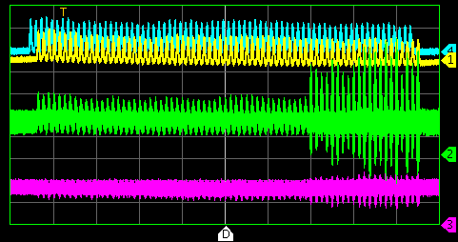
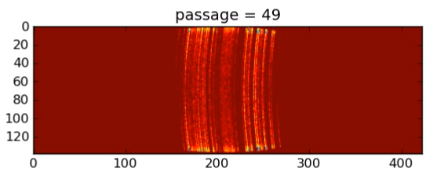
e-cloud instabilities: simulations and T-damper
-- Wall current monitor -- Sum -- Horizontal -- Vertical
e-cloud observed for 25 ns beam production but no influence on beam quality
Transverse instability observed together with
e-cloud if bunches shorter than nominal or kept
in the machine for time longer than needed.
Shorter batches a la BCMS suffering less
Damper/TFB tests proved that
instability can be efficiently delayed
Pycloud simulations for combined function magnets established to predict future operation
10 ms

Slide 43
Issued analysed to preserve beam quality for HL-LHC
L4 160 MeV
(relaxed space charge)
H⁻ injection
Possible production schemes
  3-splitting
  BCMS
Issues common for the two schemes:
  PSB
    Space charge → L4 connection
  PS
    Space charge → PSB@2 GeV
    Headtail instabilities → Transverse damper
    Transition crossing
    Longitudinal instabilities → Finemet cavity
    Electron cloud → Transverse damper
  SPS
    Space Charge → well matched to PS space charge
    Maximum available RF power → 200 MHz LL and HL upgrade
    Electron cloud → Wide-band damper – aC coating

Slide 44
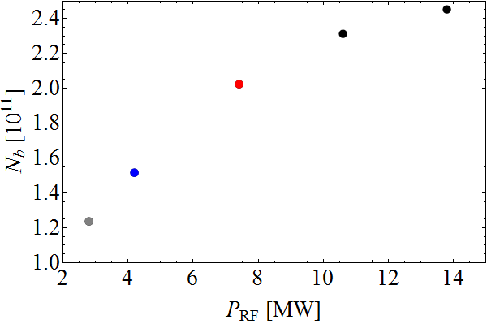
Larger bunch intensity from SPS?
To keep longitudinal stability (Landau damping + potential well dist.)
  Longitudinal emittance increases with intensity: ∝
  RF voltage requirement proportional to I_{RF}
RF voltage at transfer to LHC
RF voltage at transfer to LHC
4×3+2×4
10×2
+0.18 · 10¹¹
2×4+2×5
4×3+4×2
+0.29 · 10¹¹
P_{old} = 1.05 MW
P_{new} = 1.6 MW
+0.51 · 10¹¹
Z/n today
Q20 optics
τ = const, LD+PWD
LD: Loss of Landau damp.
PWD: Potential well dist.
Baseline upgrade: shorter cavities and 2×1.6 MW RF power
N_{b} ≈ 2 · 10¹¹ ppb without degradation, 2.5 · 10¹¹ ppb for 10% longer bunches

